Slide 1



Slide 2


Smart Hostel System
An OOP Project using java

Slide 3

Group Members
258392- Masood Tariq
301995-Adil Bashir
265362- M Abdullah

Slide 4
Motivation/Problem
Hostel Management has become a big issue in today world. Both students and the management teams have to face certain issues regarding hostel management despite of the dominance of computer technology. These problems may be related to applying process, details handling, financial issues or feedback mechanism.

Slide 5
Solution
Smart Hostel System is a java application that has solutions for all the above problems. The main objective of HMS is to ease the hostel management procedure at basic levels using java and android studio.

Slide 6
Benefits
This system is designed in favour of the hostel management which helps them to save the records of the students about their rooms and other things.
It helps them from the manual work from which it is very difficult to find the record of the students and the mess bills of the students, and the information of about those ones who had left the hostel years before.
This system gives an idea about how a student and fee details, room allocation, mess expenditure are maintained in a better way.
The hostel management system will also contain special features like how many students are in a room, student’s id and free rooms or space available. The administration has a unique identity for each member as well as students details.

Slide 7
Modules
Admin login
Student/user ID allotment
Student details
The Fee details & Dues
Feedback Mechanism
Mess Details & Feedback

Slide 8


Tools used

Slide 9
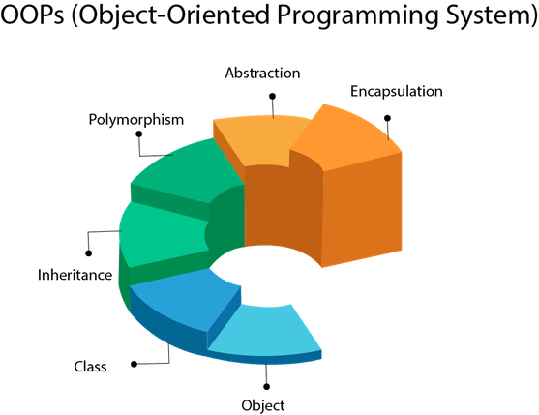
OOP’s Concepts Implemented
Object
Class
Inheritance
Polymorphism
Abstraction
Encapsulation

Slide 10
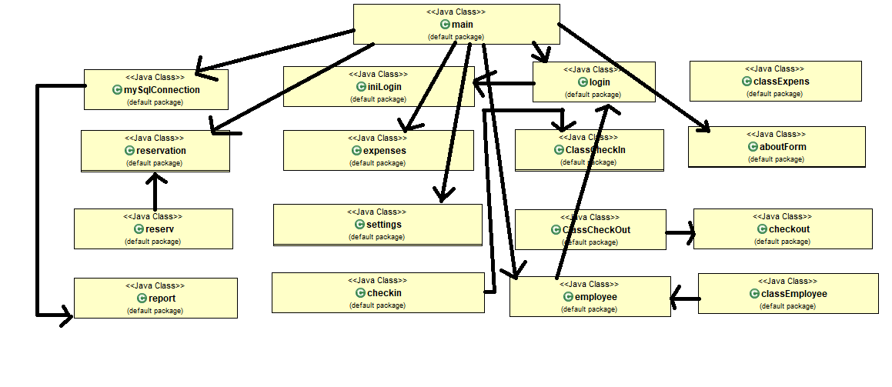
UML Class Diagram

Slide 11
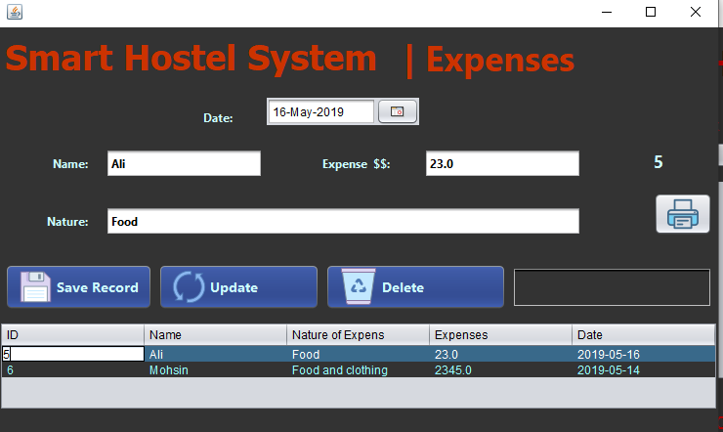
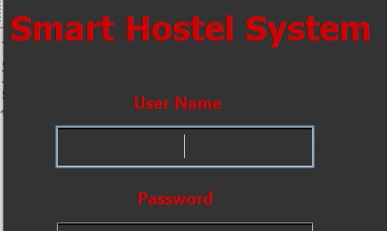
Output Snippets

Slide 12
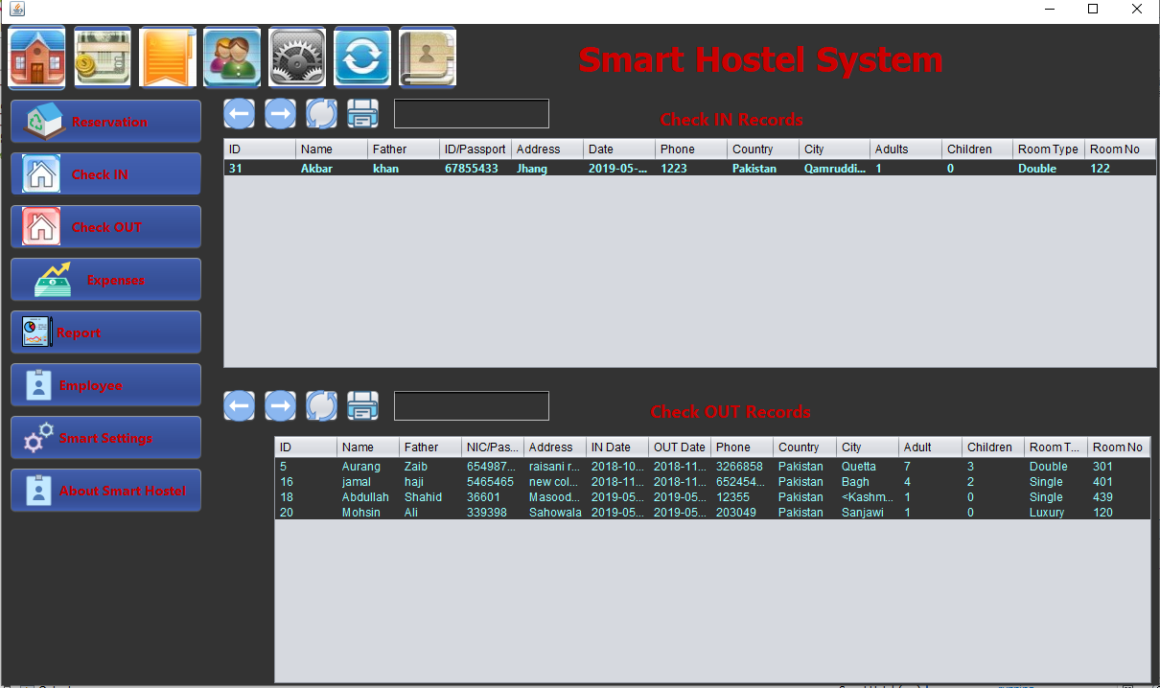
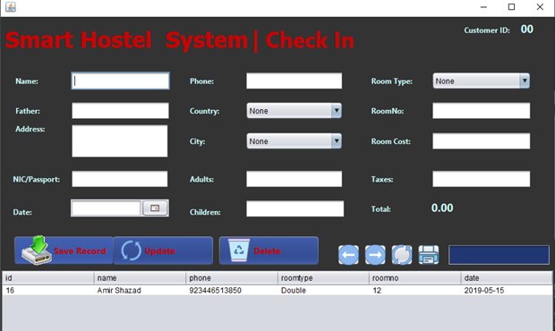
Output Snippets(2)

Slide 13

Conclusion
OOP is great because it encourages thinking in a black box. We used concepts, rather than details. OOP gave us many options how we can implement our solution. With many options come many places where it can go wrong. And so people of FP say OOP adds unnecessary complexity. And that is true, but only for the cases when OOP is done wrong. Proper OOP makes code easier to read, understand and maintain.We learned how to Keep your analysis in the business world, using business words, with encapsulation of related strings and numbers into classes.

