Slide 1
Smart Farming Agent
IBM AICTE PROJECT
Presented By: Masoom Choudhary
Student name : Masoom Choudhary
College Name & Department : IIST (B.Tech CSE)

Slide 2
OUTLINE
Problem Statement
Technology used
Wow factor
End users
Result
Conclusion
Future scope
IBM Certifications
Git-hub Link

Slide 3
Problem Statement
Small and marginal farmers in rural India face difficulties in accessing timely, region-specific, and trustworthy agricultural advice. They often rely on outdated practices or unreliable sources, which leads to poor crop yield, incorrect fertilizer usage, and missed opportunities from government schemes.
Manually seeking this information is challenging due to language barriers and lack of digital literacy.

Slide 4
Technology used
IBM cloud lite services
Natural Language Processing (NLP)
Retrieval Augmented Generation (RAG)
IBM Granite model

Slide 5
IBM cloud services used
IBM Cloud Watsonx AI Studio
IBM Cloud Watsonx AI runtime
IBM Cloud Agent Lab
IBM Granite foundation model
IBM Vector Indexing Service

Slide 6
Wow factors
This project tackles a real-world challenge by providing rural Indian farmers with an AI-powered agent that offers accurate, localized agricultural advice. Using Retrieval-Augmented Generation (RAG), the agent retrieves answers directly from trusted documents like crop calendars, soil guides, and mandi price lists—making responses reliable and grounded. It supports both Hindi and English, improving accessibility for small-scale farmers.
Built on IBM Watsonx.ai, the solution uses enterprise-level cloud tools with a no-code interface, showing practical application of modern AI development. The agent provides season-aware, region-specific recommendations based on real agricultural data. It’s not only technically sound but also socially impactful—empowering farmers with data-driven decisions, supporting sustainable farming, and offering strong potential for future expansion with APIs or sensor data.

Slide 7
End users
Small & marginal farmers across rural india
Agricultural offers and KVSs
Government agriculture department
AgriTech solution providers
Agricultural Universities & Educators

Slide 8
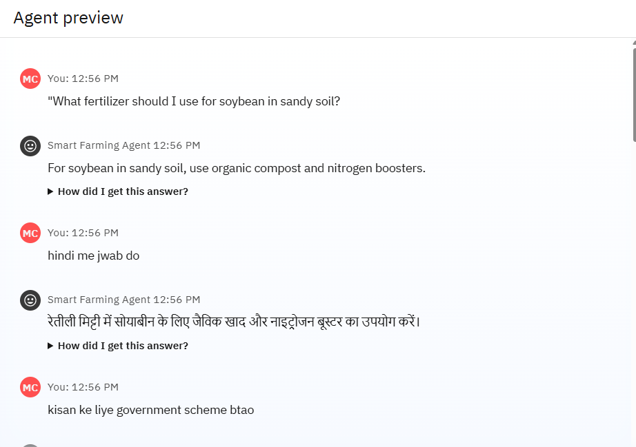
Results

Slide 9
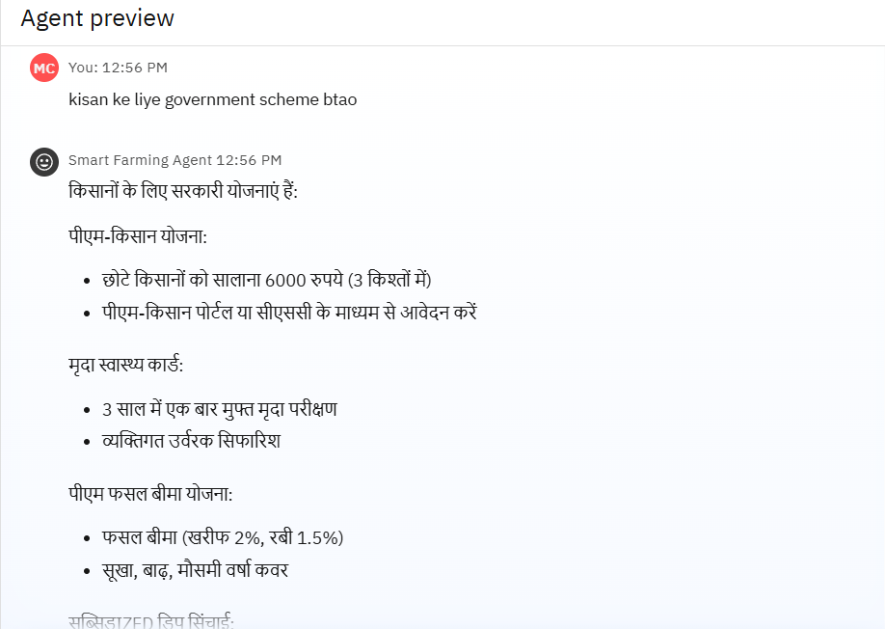
Results

Slide 10
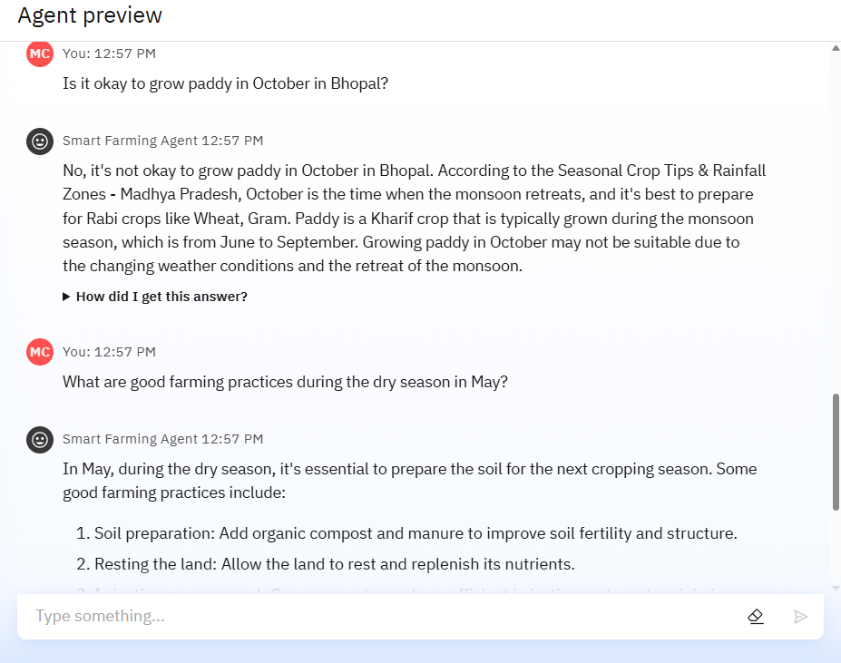
Results

Slide 11
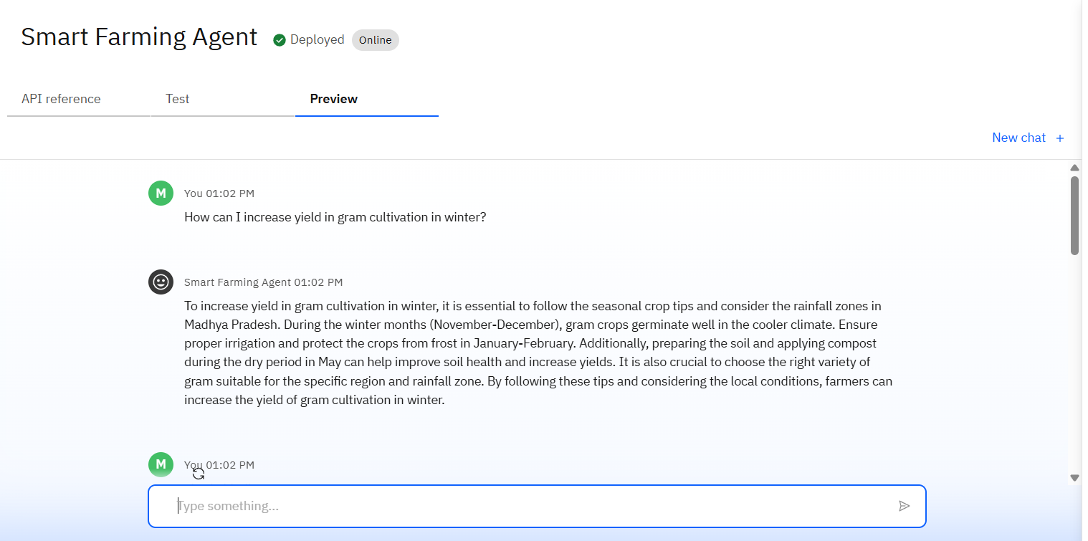
Results
Deployed AI Agent

Slide 12
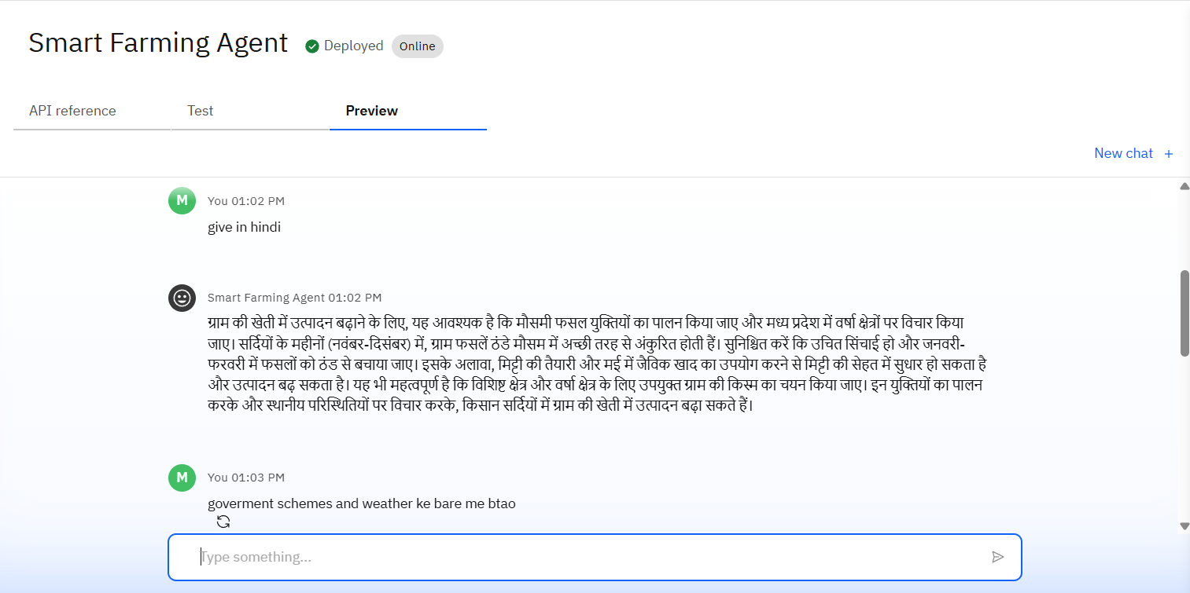
Results
Deployed AI Agent

Slide 13
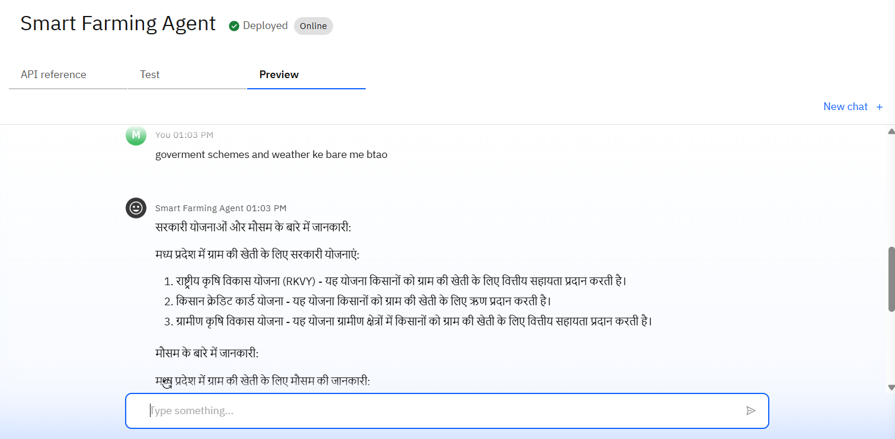
Results
Deployed AI Agent

Slide 14
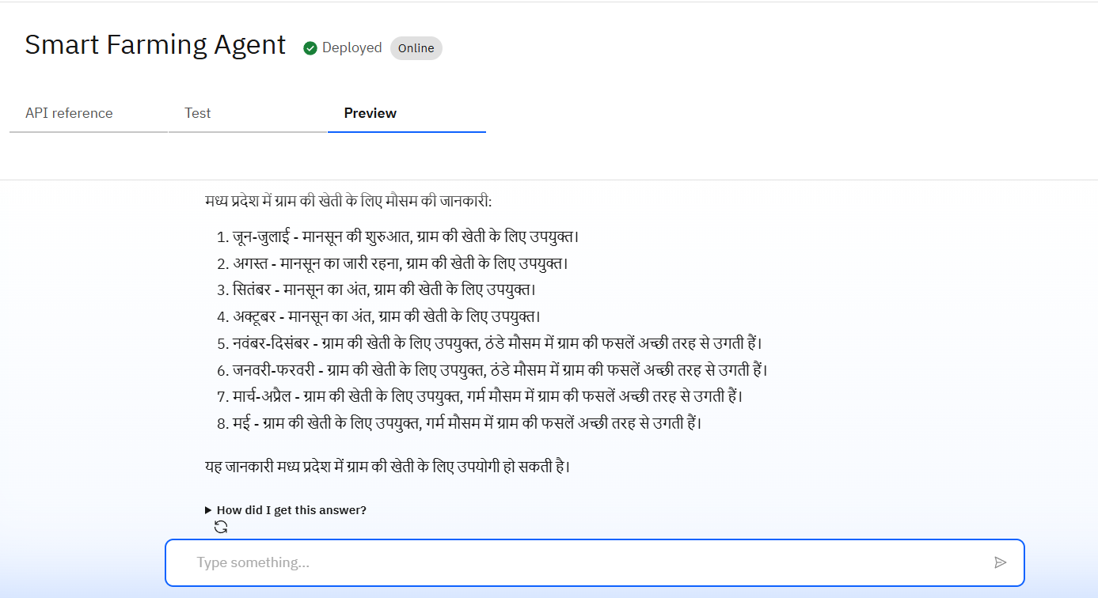
Results
Deployed AI Agent

Slide 15
Conclusion
The project successfully demonstrates how AI and RAG can provide grounded, reliable agricultural advice to small and marginal farmers.
By retrieving answers from real documents, the agent delivers region-specific, season-aware guidance on crops, soil, fertilizers, pest control, and mandi prices.
The solution is farmer-friendly, supporting multilingual interaction (Hindi/English) and removing barriers to information access.
Built using IBM Watsonx.ai, the agent combines modern cloud AI tools with no-code configuration, making it scalable and production-ready.
It enhances decision-making, reduces risks, and promotes sustainable farming practices, addressing real-world agricultural challenges.
The architecture is flexible, allowing future integration with IoT sensors, weather APIs, satellite data, and mobile apps.
Overall, this AI-powered agent bridges the knowledge gap in rural agriculture and empowers farmers with data-driven insights.

Slide 16
Future scope
Integration with Live Weather APIs
Mobile App Deployment
IoT Sensor Connectivity
Personalized Farmer Profiles
Integration with Government Portals
Voice Interaction & IVR System

Slide 17
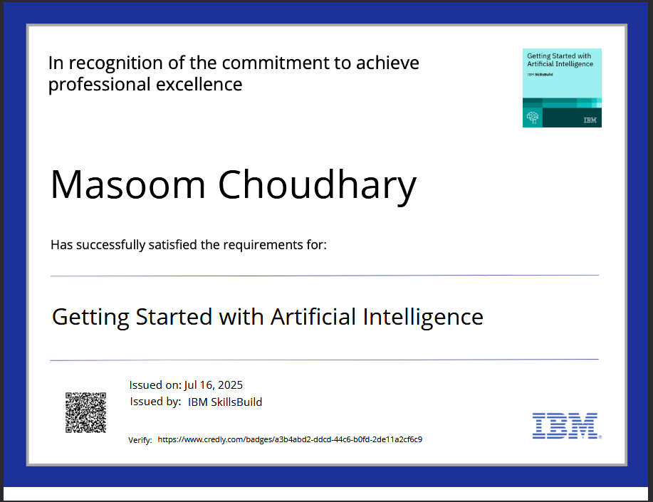
IBM Certifications
Screenshot/ credly certificate( getting started with AI)

Slide 18
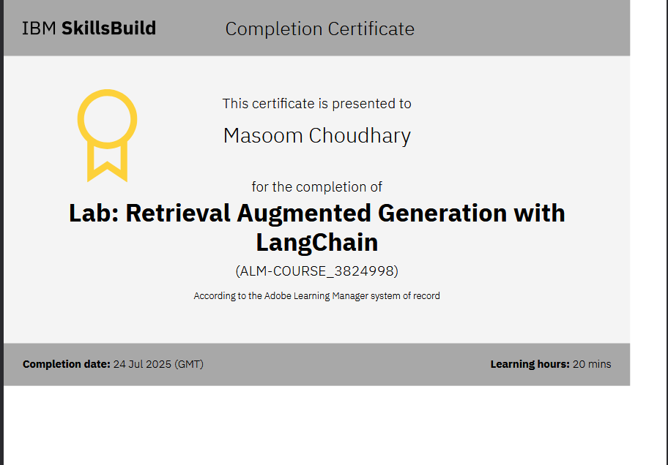
Attach your RAG LAB certificate here

Slide 19
GitHub link
Github Link : https://github.com/masoom58/Smart_Farming_Agent

Slide 20
THANK YOU

