Slide 1


SOLVOKU
The Ultimate Sudoku Solution AI

Slide 2

How much time do you take to solve a SUDOKU puzzle?

Slide 3

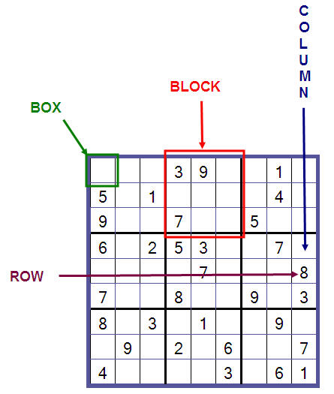
Don’t know SUDOKU?
Rules of SUDOKU:
Each row must contain the numbers 1-9 exactly once each
Each column must contain the numbers 1-9 exactly once each
Each 3×3 box must contain the numbers 1-9 exactly once each

Slide 4
Technologies:
Front-end technologies:
HTML
CSS
Back-end technologies:
Python

Slide 5
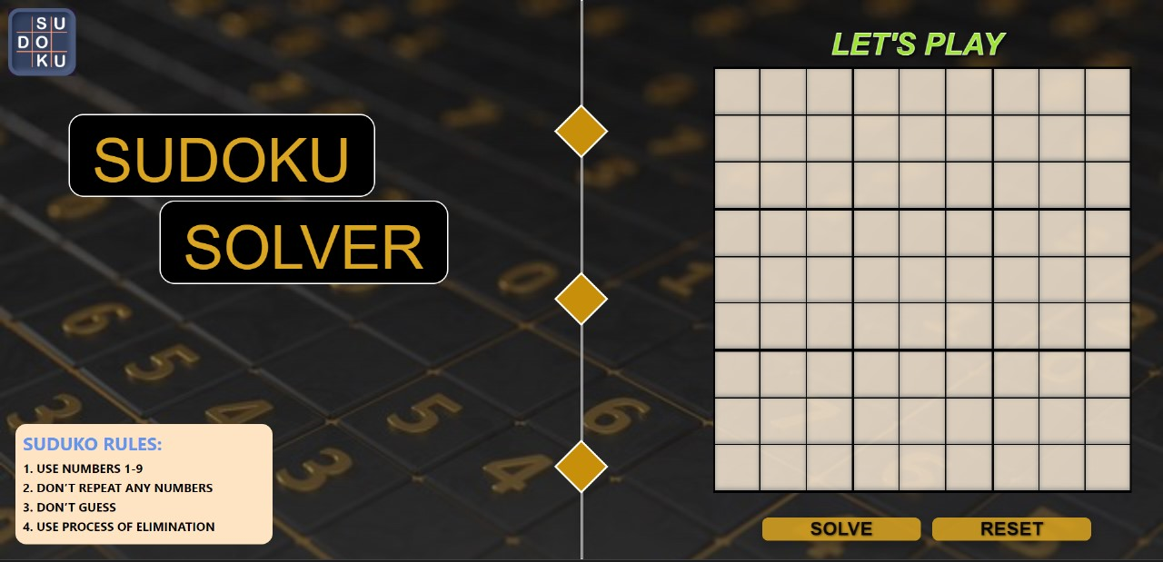
Results:

Slide 6
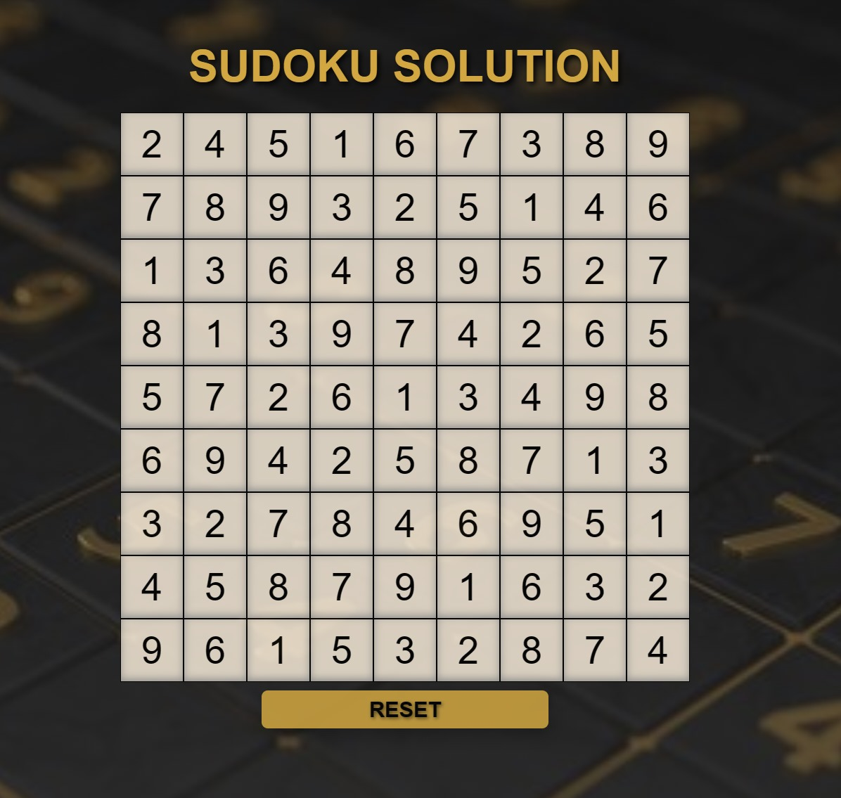

Slide 7

AI Model:

Slide 8
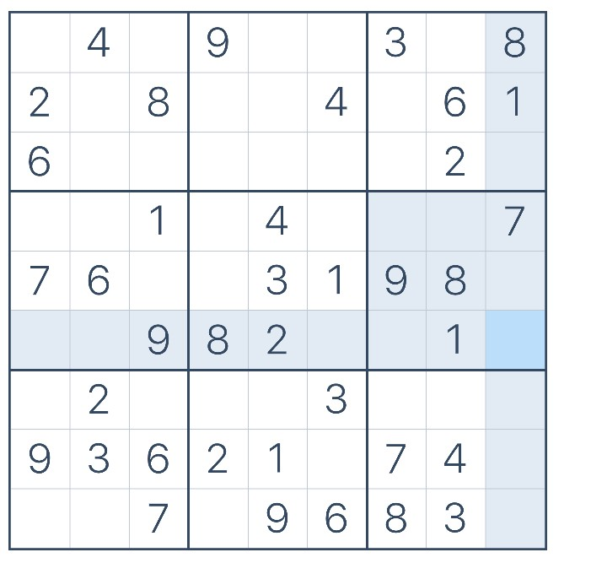

Slide 9
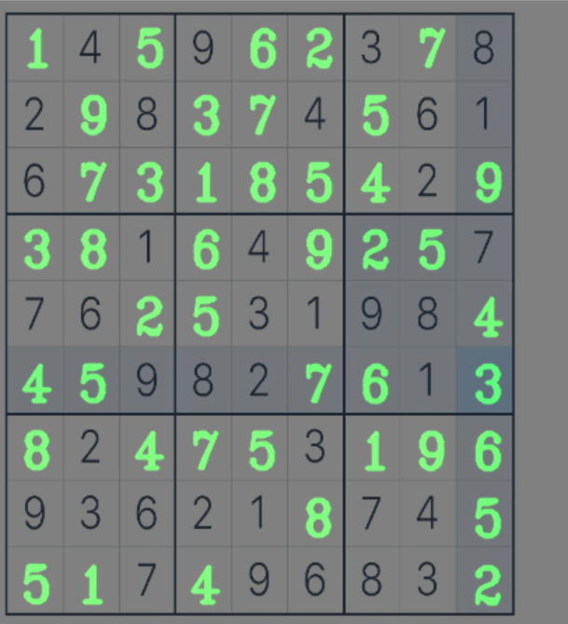

Slide 10
THANK YOU

