Slide 1



G-DUR A Middleware for Assembling, Analyzing, and Improving Transactional Protocols
Masoud Saeida Ardekani*, INRIA & UPMC-Lip6
Pierre Sutra, Université de Neuchâtel
Marc Shapiro, INRIA & UPMC-Lip6
* now @ Purdue University

Slide 2
Motivation
Understanding transactional protocols
Perform apples-to-apples comparison
Study their bottlenecks
Improve them

Slide 3
Insight
Execution Phase
Termination Phase
Read account a
Transfer $100 from account a to b
Commit
Write Changes atomically
Read an object
Read the latest committed version
Take a consistent snapshot
Take the latest consistent snapshot
Certification
No write-write and read-write conflict
No write-write conflict
Atomic Commitment
2PC
Atomic Broadcast
Atomic Multicast + Voting
Commutativity
commute if no read-write nor write-write conflict
commute if no write-write conflict

Slide 4
Insight
Execution Phase
Termination Phase
Read account a
Transfer $100 from account a to b
Commit
Write Changes atomically
Read an object
Read the latest committed version
Take a consistent snapshot
Take the latest consistent snapshot
Certification
No write-write and read-write conflict
No write-write conflict
Atomic Commitment
2PC
Atomic Broadcast
Atomic Multicast + Voting
Commutativity
commute if no read-write nor write-write conflict
commute if no write-write conflict

Slide 5
Insight
Execution Phase
Termination Phase
Read account a
Transfer $100 from account a to b
Commit
Write Changes atomically
Read an object
Read the latest committed version
Take a consistent snapshot
Take the latest consistent snapshot
Certification
No write-write and read-write conflict
No write-write conflict
Atomic Commitment
2PC
Atomic Broadcast
Atomic Multicast + Voting
Commutativity
commute if no read-write nor write-write conflict
commute if no write-write conflict

Slide 6
G-DUR: Generic Deferred Update Replication
Clients
Begin
CRUD Operations
Commit
G-DUR
Instance
…
G-DUR
Instance
CRUD
DS
Execution
Atomic Commitment
Read an object
Termination
Commutativity
Certification
Notes:
So, here is our middleware that we built based on our insight.

Slide 7
Programming Effort
Realization Point | P-Store [SRDS’10] | GMU [ICDCS’12]
Read Object | Read the latest version of objects | Read the latest consistent snapshot
Atomic Com. | Atomic Multicast + Voting | 2PC
Certify | No read-write or write-write conflict | If (write-set is empty) Commit else No read-write or write-write confclit
Commutativity | No read-write or write-write conflict | No read-write or write-write conflict
Notes:
Change Pstore read rule with GMU
=> Around 70% improvement with 90% local reads

Slide 8
Ease of Programming
Protocol |  | Source Lines of Code
 | Consistency | G-DUR | Original
P-Store [SRDS’10] | Serializability | 179 | 6000 [Java]
S-DUR [DSN’12] | Serializability | 397 | N/A
GMU [ICDCS’12] | Update Serializability | 476 | 6000 [Java]
Serrano [PRDC’07] | Snapshot Isolation | 351 | N/A
Walter [SOSP’11] | Parallel Snapshot Isolation | 599 | 30000 [C++]
Jessy [SRDS’13] | Non-monotonic Snapshot Isolation | 352 | 6000 [Java]
Framework SLOC ~ 20’000

Slide 9
Case Study
Apples-to-apples Comparison
Study bottlenecks and limitations of protocol
Improving Protocol
Compare degrees of dependability

Slide 10

Evaluation Setup
4 Sites in Grid’5000
Clients distributed uniformly among sites
Modified YCSB benchmark [SOCC’10]
Disaster Prone
Disaster Tolerant
Y
Y
x
x
U
Z
Z
Z
U
U
Y
X

Slide 11
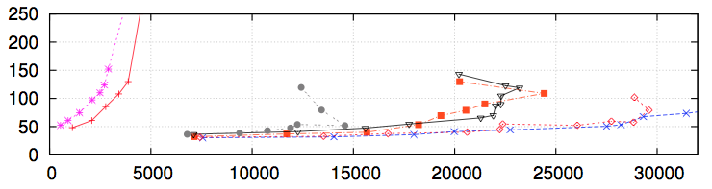
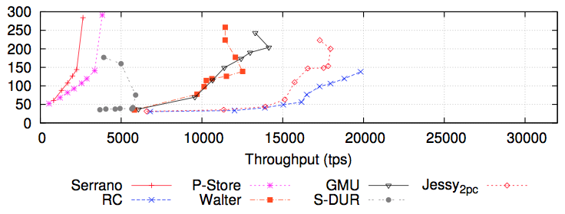
Comparing Protocols in Disaster Prone Rep.
2 Read Operations for R-O txn
1 Read, 1 Update for UP txn
10% Update transactions and 90% Read-only transactions
Termination Latency of Update Transactions (ms)
30% Update transactions and 70% Read-only transactions
Serrano-SI
P-Store-SER
GMU-US
Jessy-NMSI
RC
Walter-PSI
SDUR-SER

Slide 12
Consistency (Isolation level) Hierarchy
Strict Serializability (SSER)
Snapshot Isolation (SI)
Serializability (SER)
Parallel Snapshot Isolation (PSI)
[SOSP’11]
Update Serializability (US)
More Scalability and Performance
Easier Coding and Reasoning for App
Non-monotonic Snapshot Isolation (NMSI)
[SRDS’13]
Read Committed (RC)

Slide 13
Comparing Protocols in Disaster Prone Rep.
2 Read Operations for R-O txn
1 Read, 1 Update for UP txn
GMU-US
Walter-PSI
10% Update transactions and 90% Read-only transactions
Termination Latency of Update Transactions (ms)
30% Update transactions and 70% Read-only transactions
Serrano-SI
P-Store-SER
GMU-US
Jessy-NMSI
RC
Walter-PSI
SDUR-SER

Slide 14
Genuine Partial Replication (GPR) [Schiper’10]
X++
Y--
X
X=X+2
Only replicas of objects read or written inside transaction communicate
Non-conflicting transactions do not interfere ➔ More Parallelism
Disjoint-Access-Parallelism
In the next slide we compare a GPR protocol with a non-GPR protocol
X
Y
Y=Y-3
Y
Z
Z++
Z

Slide 15
Comparing Protocols in Disaster Prone Rep.
2 Read Operations for R-O txn
1 Read, 1 Update for UP txn
Walter-PSI
Non-GPR
Jessy-NMSI
GPR
10% Update transactions and 90% Read-only transactions
Termination Latency of Update Transactions (ms)
30% Update transactions and 70% Read-only transactions
Serrano-SI
P-Store-SER
GMU-US
Jessy-NMSI
RC
Walter-PSI
SDUR-SER

Slide 16
Comparing Protocols in Disaster Prone Rep.
GMU-US
GPR
2 Read Operations for R-O txn
1 Read, 1 Update for UP txn
Walter-PSI
Non-GPR
10% Update transactions and 90% Read-only transactions
Termination Latency of Update Transactions (ms)
30% Update transactions and 70% Read-only transactions
Serrano-SI
P-Store-SER
GMU-US
Jessy-NMSI
RC
Walter-PSI
SDUR-SER

Slide 17
Minimal Commitment Sync. (MCS)
Abort a transaction in case of
a read-write or write-write conflict
write-write conflict
In the next slide we study the effect of MCS

Slide 18
Comparing Protocols in Disaster Prone Rep.
GMU-US
GPR
2 Read Operations for R-O txn
1 Read, 1 Update for UP txn
Walter-PSI
MCS & Non-GPR
10% Update transactions and 90% Read-only transactions
Termination Latency of Update Transactions (ms)
30% Update transactions and 70% Read-only transactions
Serrano-SI
P-Store-SER
GMU-US
Jessy-NMSI
RC
Walter-PSI
SDUR-SER

Slide 19
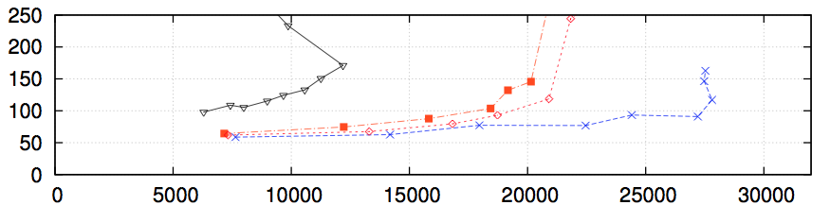
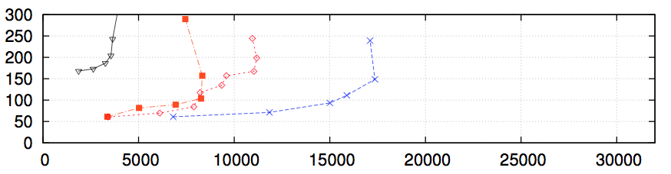
Comparing Protocols in Disaster Tolerant Rep.
Walter-PSI
MCS & non- GPR
GMU-US
GPR
2 Read Operations for R-O txn
1 Read, 1 Update for UP txn
90% Read-only transactions
Termination Latency of Update Transactions (ms)
70% Read-only transactions
Serrano-SI
P-Store-SER
GMU-US
Jessy_{2pc}-NMSI
RC
Walter-PSI
SDUR-SER

Slide 20
Summary / Conclusion
Many transactional protocols follow DUR approach
G-DUR allows fast prototyping of protocols to:
Compare protocols
study limitations & bottlenecks of a protocol
In the paper, compare degrees of dependability
Common specification language

