Slide 1
GAIATHON TEAM 3 GHANA COMMUNICATION TECHNOLOGY UNIVERSITY ACCRA, GHANA EO + IoT FOR SUSTAINABLE DEVELOPMENT TERRAPLAN: SMART LAND-USE INTELLIGENCE PLATFORM FOR AFRICA TEAM ROLES: TEAM LEAD – BERNARD APPIAH TEAM MEMBERS - FAITH AFASI CECIL AGYAPONG AGYEMANG MASOUD SAEED GARIBA

Slide 2
PROBLEM STATEMENT – AFRICA’S LAND-USE CRISIS:
KEY ISSUE: Unsustainable Land-Use Is Fueling Africa’s Ecological & Humanitarian Crises
SOME CORE CHALLENGES:
Climate Displacements (32M since 2008).
Urban sprawl and Informal settlements.
CAUSES:
Population Growth: 2.5B Africans by 2050 (UN).
Data Gaps: <10% of cities have updated land-use maps (World Resources Institute).
Policy Lags: 80% of countries lack enforceable zoning laws (African Development Bank).
“Current planning is reactive, not predictive – costing Africa $10B/year in preventable disasters.”

Slide 3
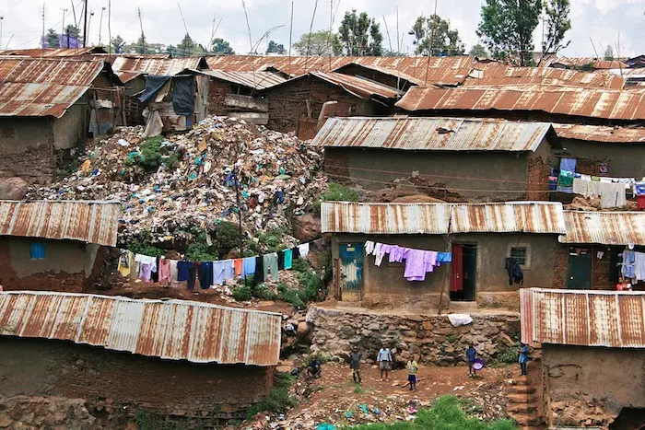
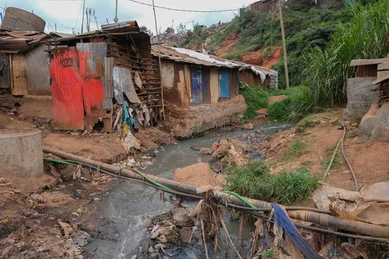
URBAN CHAOS:
NAIROBI CRISIS:
"60% of residents crammed into 6% of city land (informal settlements).“
Consequences:
Service collapse: 70% lack clean water in slums (UN-Habitat).
Disaster risk: 300% increase in flood-related deaths since 2000 (World Bank).

Slide 4
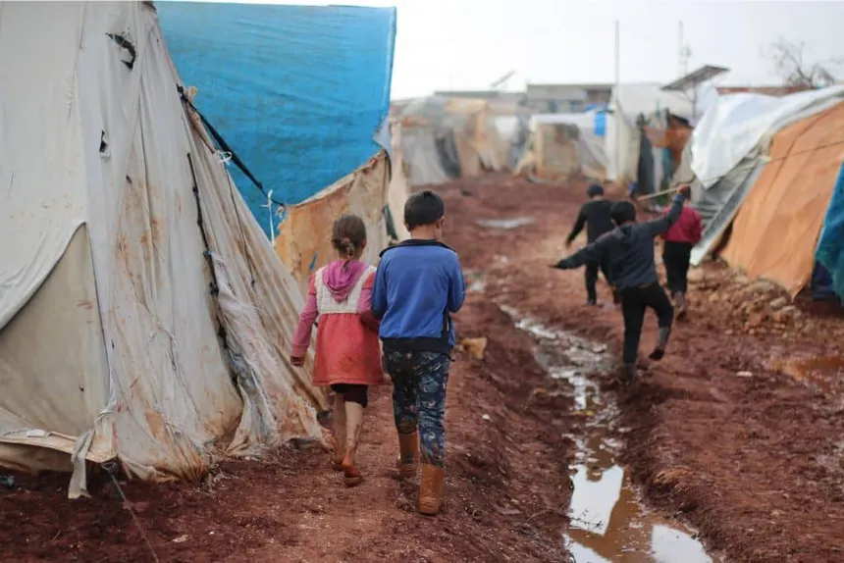
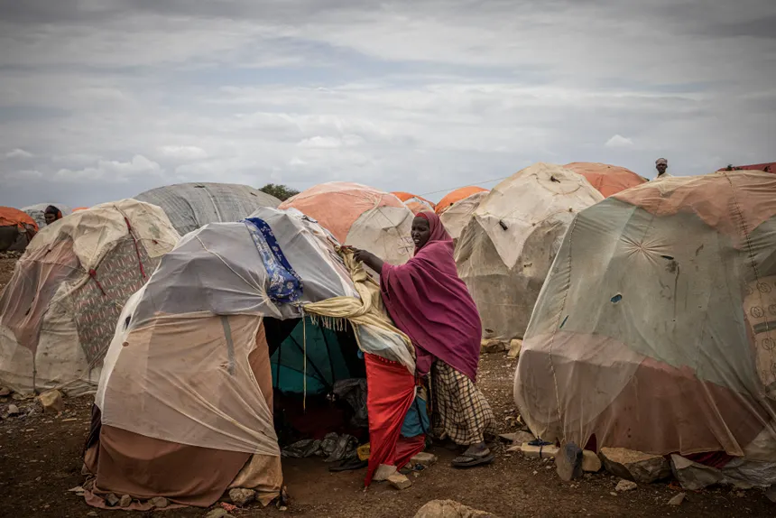
CLIMATE DISPLACEMENT:
HORN OF AFRICA:
1.9 million people displaced annually by droughts/floods – equivalent to 3x Geneva’s population.
CASE STUDY:
Somalia’s 2023 drought displaced 1.4M people in 6 months (UNHCR).

Slide 5
PROPOSED SOLUTION AND VALUE PROPOSITION:
TITLE: "TerraPlan: Africa’s Land-Use Intelligence Platform”
CORE CONCEPT: A ‘Google Maps for land potential’ combining satellite, IoT, and community data to guide sustainable decisions
HOW IT SOLVES THE PROBLEM:
Prevents Sprawl: Identifies optimal urban expansion zones.
Boosts Agriculture: Recommends crops based on soil/weather.
Reduces Disasters: Flags flood/drought risks.

Slide 6
KEY DIFFERENTIATOR: First platform to fuse open EO data (DE Africa), ground sensors, and mobile crowdsourcing for African contexts.
TECHNOLOGY STACK:
DATA LAYER
Satellite: Google Earth Engine (GEE), Digital Earth Africa (DE Africa).
IoT: LoRaWAN networks, Netatmo stations, crowdsourced readings..
Crowdsourcing: Mobile GPS pins.
ANALYTICS LAYER
Google Earth Engine (ML land-classification).
Python (geopandas, TensorFlow for predictions).
DELIVERY LAYER
Flutter app (offline-first for rural areas).
React dashboard (gov’t planners).

Slide 7
KEY USERS AND STAKEHOLDERS
USER | BENEFITS | EXAMPLE USE CASE
CITY PLANNERS | SPRAWL ALERS AND INFRASTRUCTURE PLANNING | REDIRECT GROWTH FROM FLOOD ZONES
FARMERS(40M+) | CROP/LOCATION ADVICE VIA SMS | “WHICH CROPS THRIVE HERE?” – SOIL MAP
AGRIBUSINESS | LAND-ACQUISITION DUE DILIGENCE | FILTER FOR SOIL, WATER AND LABOR ACCESS
UN AGENCIES | SDG PROGRESS TRACKING | MONITOR DEFORESTATION RATES

Slide 8
IMPLEMENTATION ROADMAP
TERRAPLAN 6-WEEK DEVELOPMENT PLAN
WEEK | PHASE | KEY ACTIVITIES | MILESTONES
1-2 | DATA AND BACKEND | Integrate DE Africa/Sentinel-2 APIs Build Firebase/FastAPI backend Standardize IoT datasets | Unified API endpoint online
3-4 | UI PROTOTYPING | Flutter mobile app (offline maps) React web dashboard Connect to backend API | MVP UI functional
5-6 | TESTING AND DEPLOYMENT | GCP Cloud Run deployment Latency/accuracy tests | Tested and deployed prototype.

Slide 9
Week 2 Deliverable
Backend Ready
Earth Observation + IoT data flowing through single API
Documentation for future scaling
Week 4 Deliverable
UI Prototype
Web: Planner hazard maps
Tested on 3 device types
Week 6 Deliverable
Deployed web application
80% accuracy in land recommendations
<2s response time

Slide 10
DATA AND TECHNOLOGY UTILISATION
Earth Observation (EO) Backbone
Sources: Digital Earth Africa (Sentinel-2/Landsat) + Google Earth Engine
Extracts: Crop health (NDVI), water/flood maps, urban sprawl patterns
Process: Automated cloud-free mosaics → GeoJSON vectors
Human Context
WorldPop: Population pressure grids
OpenStreetMap: Infrastructure/roads
AI Layer: Predicts risks (floods, degradation)

Slide 11
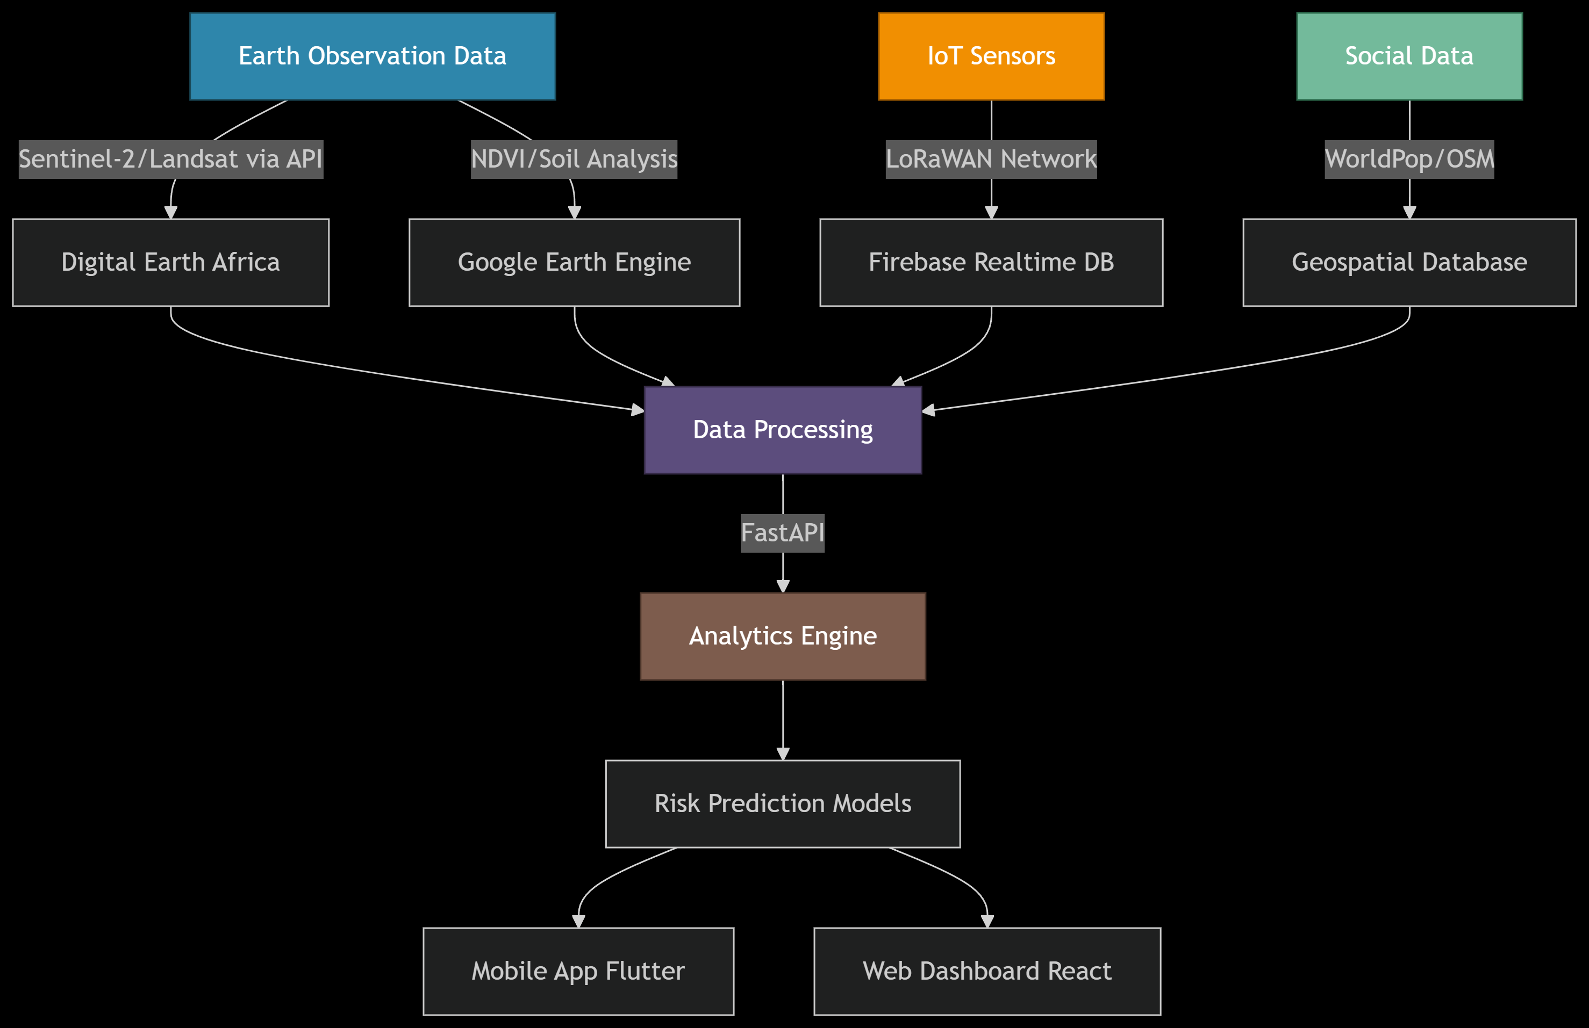
Tech Stack:
FastAPI (backend) + ReactJs with NextJS + GEE (petabyte-scale analysis) + PostgreSQL and Other integrated APIs
Flowchart representation:

Slide 12
FEASIBILITY AND EXPECTED IMPACT
COST EFFICIENCY: Open-source tools and public APIs, hence minimal cost, maximum value
SCALABILITY: Cloud-based (GEE)
TECHNICAL VIABILITY: Proven tech stack (Python, React, PostgreSQL, etc)
SDGs SUPPORTED: 2 (Zero Hunger), 11 (Cities), 13 (Climate).
QUOTE: “Democratize data for youth and smallholders”.

Slide 13
FINAL SUBMISSION ALIGNMENT
TerraPlan directly addresses GAIAthon’s requirements by:
EO and IoT Fusion – Integrates satellite data and IoT data for real-time land insights.
Scalable Impact – Designed for pan-African deployment.
Sustainability Focus – Tackles SDGs 11 (Cities) and 15 (Land) via data-driven planning.
Feasibility – Uses open-source tools (Google Earth Engine, FastAPI) to ensure low-cost replication.
RISK LEVEL | TECHNICAL | MITIGATION | OPERATIONAL | MITIGATION | ADOPTION | MITIGATION
HIGH | IoT Failures | Redundant sensors | Regulatory Barriers | Open-data partnerships | User Resistance | Co design and simple UI
MEDIUM | Data Gaps | Multiple satellite blending | Power Outages | Offline-capable PWA | Training Gaps | Gamified tutorials
LOW | Scalability | Auto-scaling cloud service. | Internet Access | SMS fallbacks | Privacy Concerns | Data anonymization

Slide 14
CONCLUSION
Key Takeaways
Innovation: TerraPlan uniquely fuses satellite AI, IoT sensors, and crowdsourced data—Africa’s first integrated land-use intelligence platform.
Feasibility: Built on open-source tools (Google Earth Engine, FastAPI) with proven results.
Why TerraPlan Wins
Sustainable: Aligns with SDGs 11 (Cities) & 15 (Land)
Inclusive: Offline-first design for rural communities
Scalable: Modular backend ready for continental expansion
Our Commitment
"We pledge to:
Deliver a fully functional platform by the end of incubation.
Secure 2 government partnerships for nationwide rollout.
Train 500+ users in underserved communities.“

