Slide 1


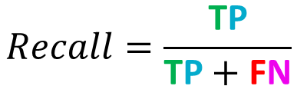

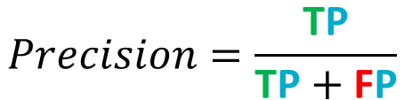

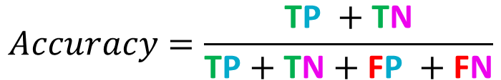
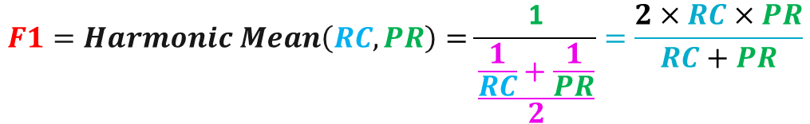

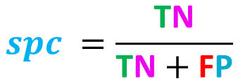

𝑆𝑝𝑒𝑐𝑖𝑓𝑖𝑐𝑖𝑡𝑦(𝑇𝑟𝑢𝑒 𝑛𝑒𝑔𝑎𝑡𝑖𝑣𝑒 𝑟𝑎𝑡𝑒)
$$spc =\frac{\text{T}\text{N}}{\text{T}\text{N}+\text{F}\text{P}}$$
$$spc$$
 |  | Actual
 |  | Positive | Negative
Predicted | Positive | True Positive (TP) | False Positive (FP)
 | Negative | False Negative (FN) | True Negative (TN)
$$Precision=\frac{\text{T}\text{P}}{\text{T}\text{P}+\text{F}\text{P}}$$
$$Pr$$
$$Accuracy=\frac{\text{T}\text{P} +\text{T}\text{N}}{\text{T}\text{P}+\text{T}\text{N}+\text{F}\text{P} +\text{F}\text{N}}$$
$$ACC$$
$$Rc$$
$$F1=Harmonic Mean\left(RC, PR\right)=\frac{\text{1}}{\frac{\frac{1}{RC}+\frac{1}{PR}}{2}}=\frac{2×RC×PR}{RC+PR}$$
$$Recall=\frac{\text{T}\text{P}}{\text{T}\text{P}+\text{F}\text{N}}$$

