Slide 1
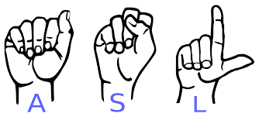
Computer Vision To Translate Letters In American Sign Language
Joey Hussain

Slide 2
Goal of project
500 thousand people who live in the United States in which their native language is that of American Sign Language.
People who do use ASL as there only way to communicate struggle with holding conversations with people who do not possess the understanding of Sign Language.
Create a computer vision model to translate sign language with high accuracy by analyzing three different algorithms.

Slide 3
Dataset
https://www.kaggle.com/datasets/joeyhussain/asl10letters
385 Megabytes
Letters A-J
3000 Images per Letter

Slide 4
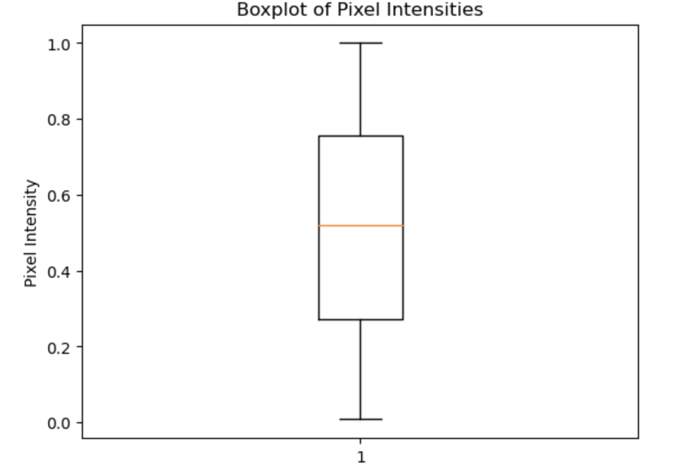
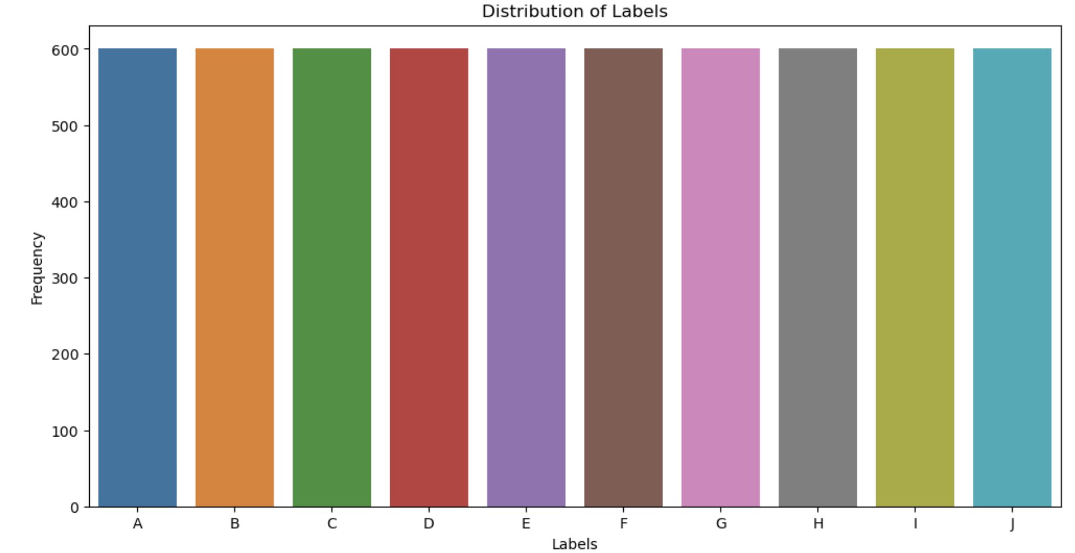
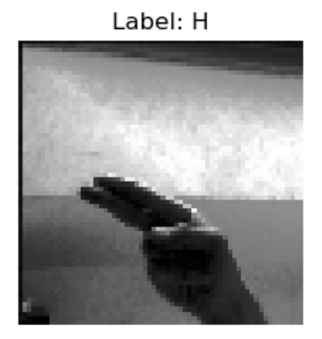
Data Preprocessing
Data Augmentation
Observe Pixel Intensities
Check Distribution of Labels
PCA for Solving Multicollinearity

Slide 5
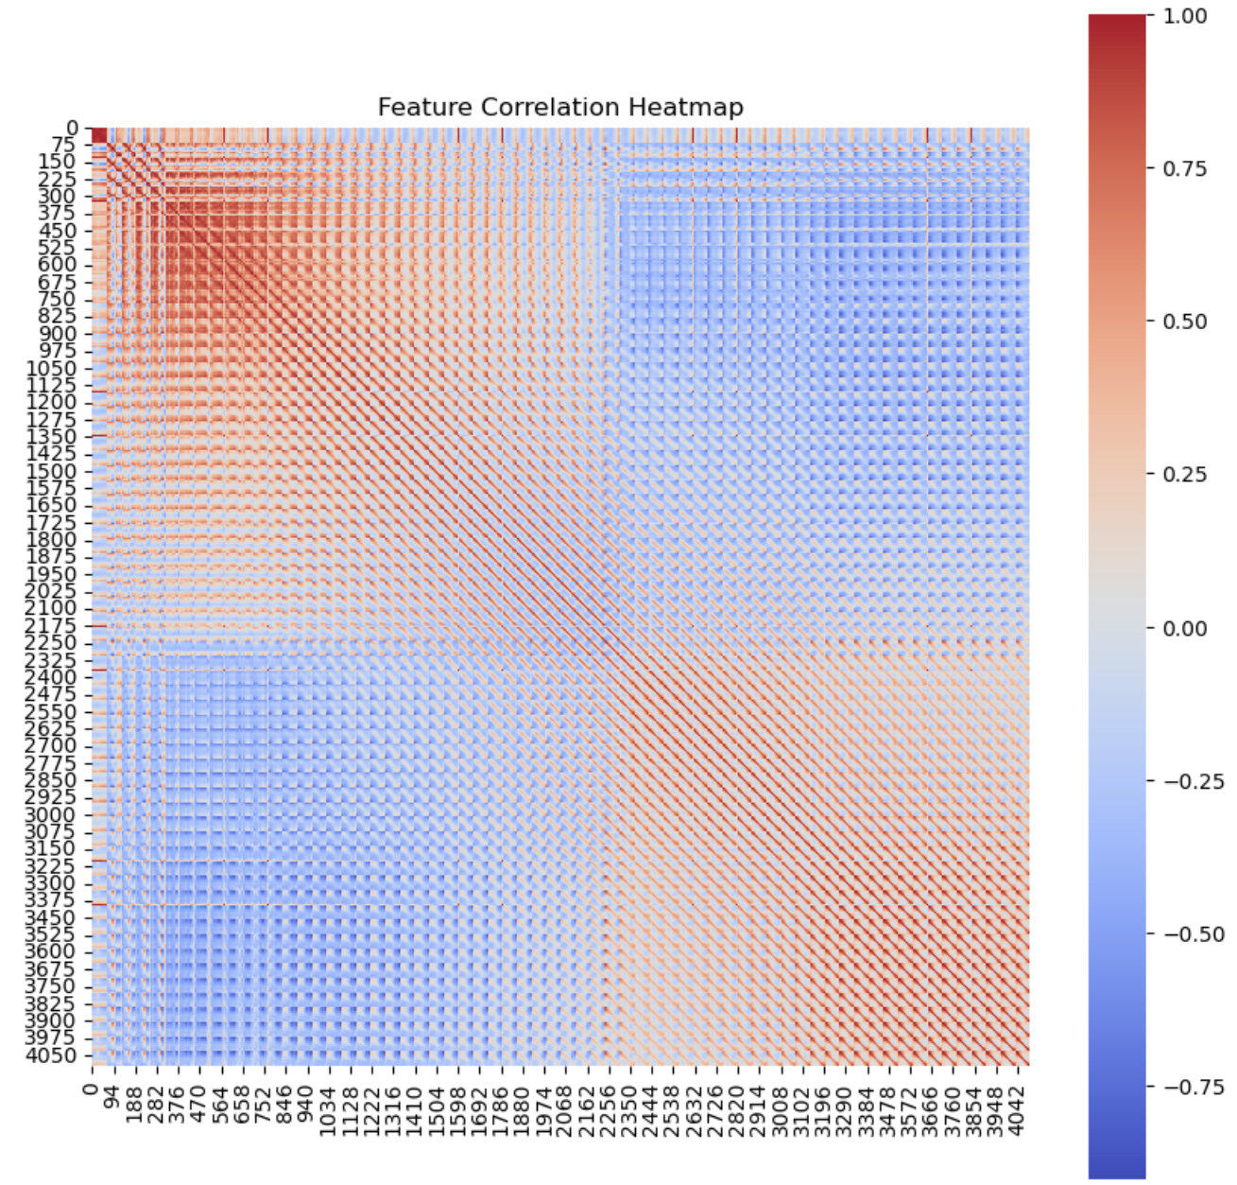
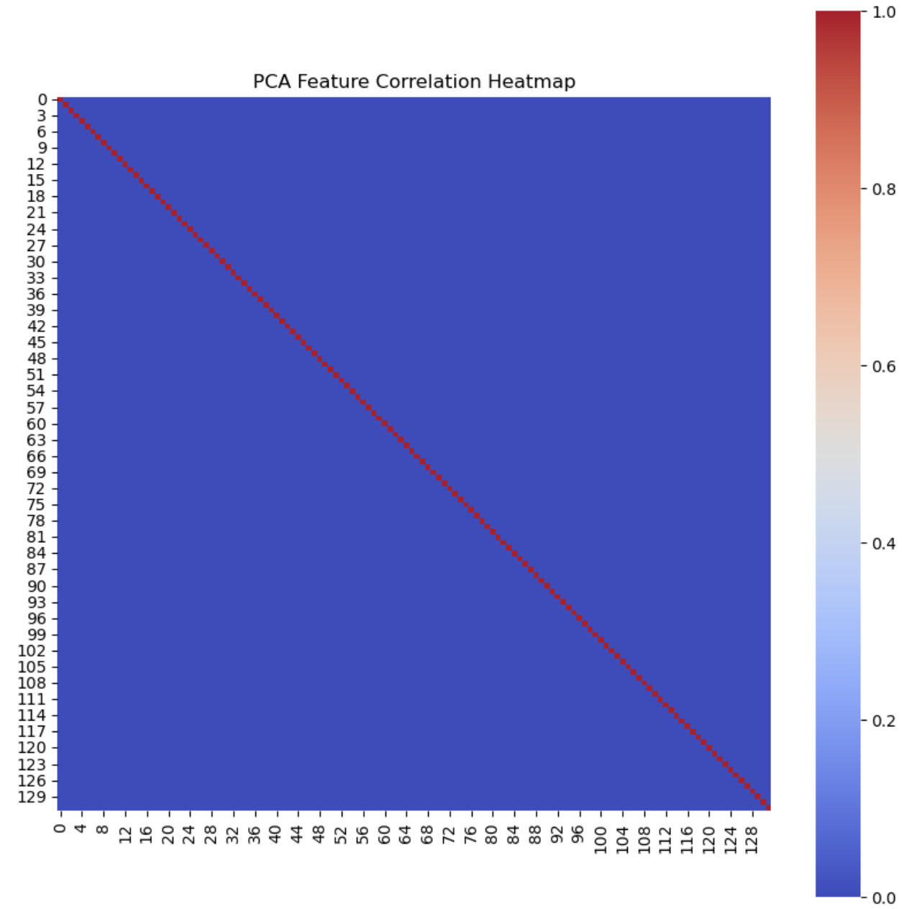

Slide 6
models
Support Vector Machines
K-means Clustering
Random Forest
Convolutional Neural Networks

Slide 7
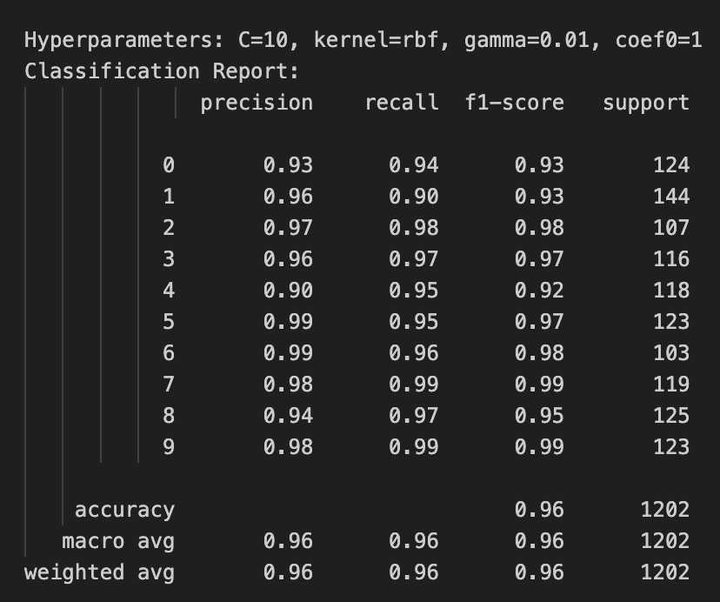
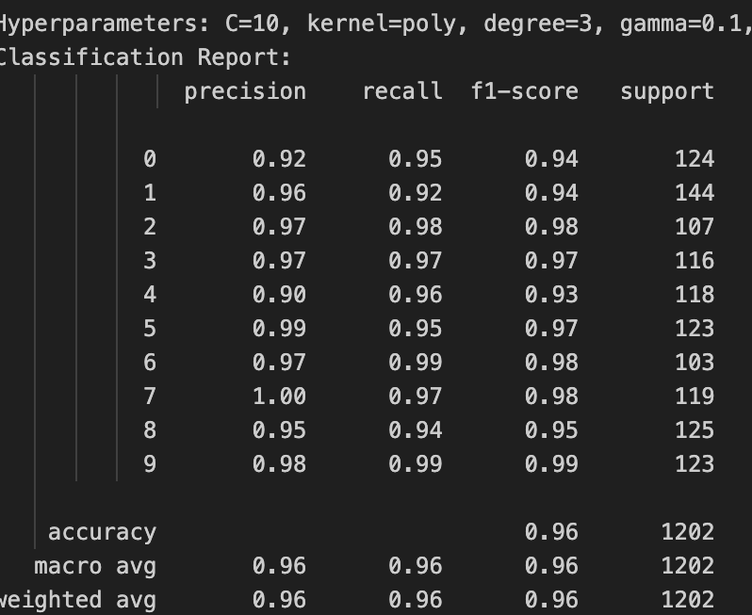
Support Vector Machines (SVM)
Hyperparameters Tuned
Cost - 10
Kernel – rbf/poly
Degree - 3
Gamma – 0.01/.01
Coefficient - 1
PCA Data

Slide 8
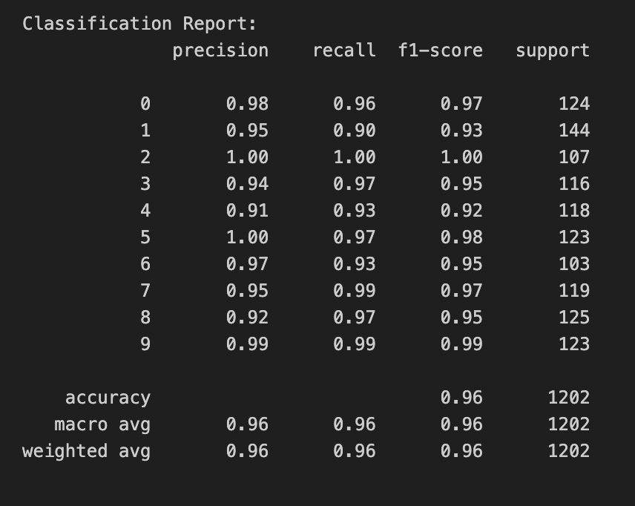
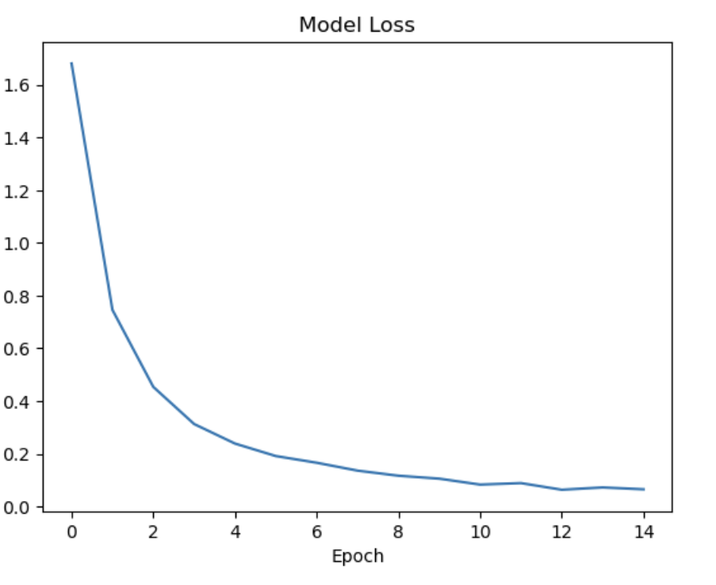
Convolutional Neural Networks (CNN)
Hyperparameters Tuned
Epochs - 15
Dropout – 0.6
Batch Size – 32
Dense Units - 256
Base Data

Slide 9
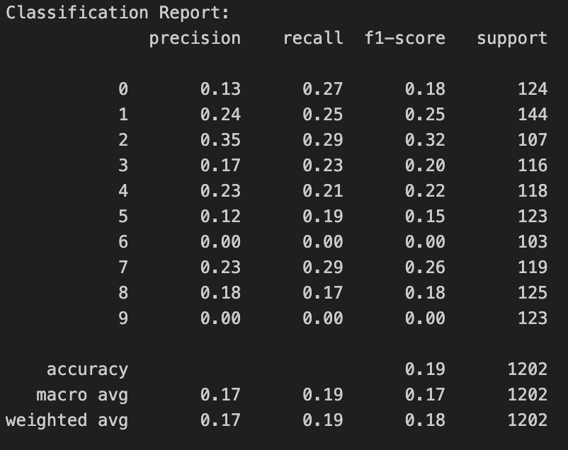
K-Means clustering
Hyperparameters Tuned
Number of Clusters - 8
Random State - 456
Base Data

Slide 10
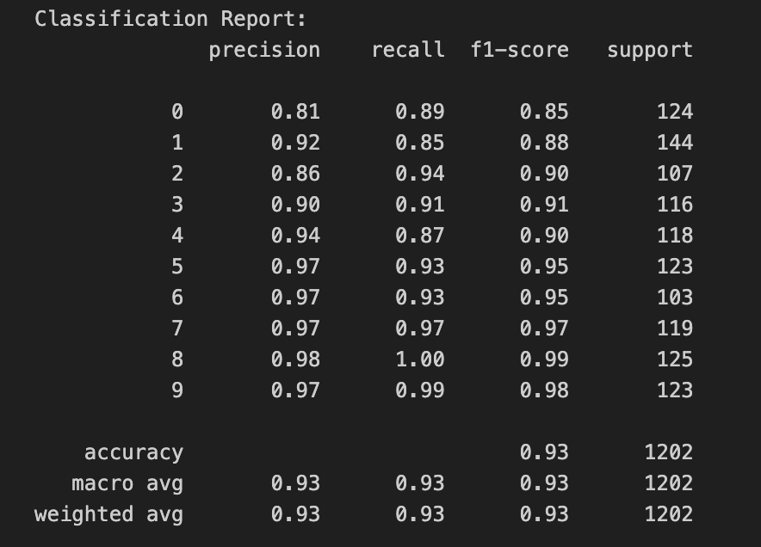
Random Forest
Hyperparameters Tuned
Number of estimators - 500
Max depth – 20
Minimum Sample Split - 2
Minimum Sample Leaf - 1
Max Features – Auto
Base Data

Slide 11
Overall Findings
Best Performing Model were SVM and CNN
CNN took longer of time and used Data without PCA
SVM used Data that went through PCA
Could potentially finetune and build on CNN model more to get better accuracy.

Slide 12
challenges
The main challenged face in this project was over K-Means
K-Means was a model that I spent a lot of time testing and trying out different methods to no avail in term of improving accuracy.
Would not attempt to do this model again for a similar dataset

Slide 13
Future work
Test models built on entire dataset of 26 letters.
Use Object Detection to segment out hand using sign language in image and try to use this as additional training.
Build model to do real time object detection and sign language translation.

Slide 14

PROS AND CONS OF CHATGPT

Slide 15

Advantages
Simplifies mundane tasks
Allows inexperience people a guide to code things for business or personal us
Aids people in learning about topics that they are passionate about.

Slide 16

Disadvantages
Could lead to loss of jobs.
Provides Wrong Information at times.
Out of date on current events.

