Slide 1
Santander Binary Classification & “What is LSTM?”
LeMaur Kydd
DATA 3421 – Final Presentation

Slide 2

Santander Customer Transaction Prediction

Slide 3

Kaggle Problem Description
“Can you identify who will make a transaction?”
Given 199 features of anonymized data on 200,000 customers, including a binary feature outlining whether the customer made the purchase or not…
Use ML/DL to create a model that predicts, with great accuracy, if a given customer will make a purchase.
https://www.kaggle.com/competitions/santander-customer-transaction-prediction/overview

Slide 4
Data Overview

Slide 5
Breakdown
Data Cleaning
Training Dataset
200000 rows × 202 columns
Includes target variable
Testing Dataset
200000 rows × 201 columns
Omits target variable
Both datasets were…
Very clean to begin with
No NaN’s
Float64
Similar duplicates
Balanced

Slide 6
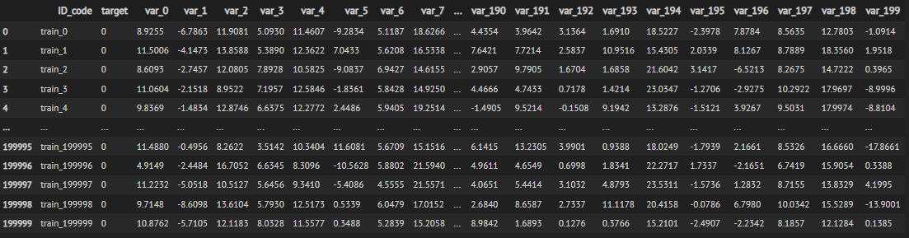
Peek at the Training Dataset

Slide 7
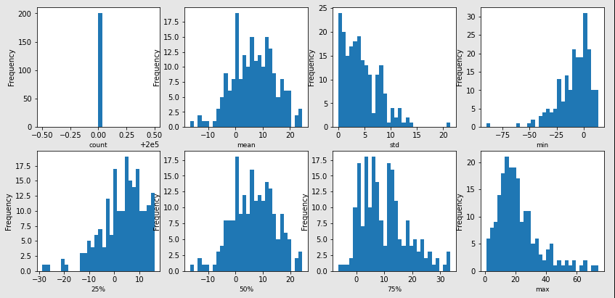
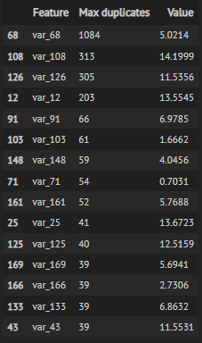
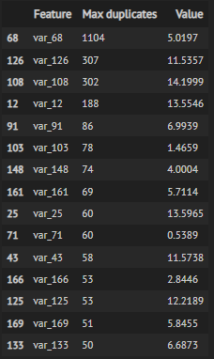
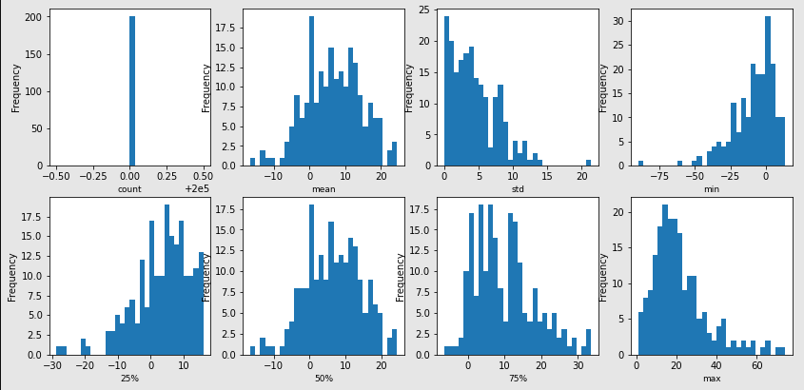
Duplicate values check (Top 15)
Training Testing
Descriptive Statistics
Training
Testing

Slide 8
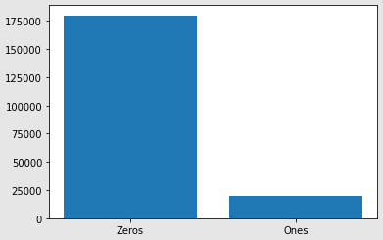
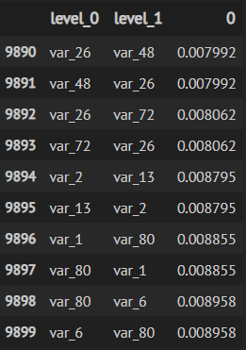
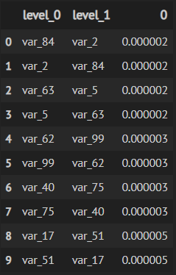
Feature Correlations
Top Ten Bottom Ten
Target Variable Distribution
10.049% Ones
89.951% Zeros

Slide 9
Dimension Reduction

Slide 10
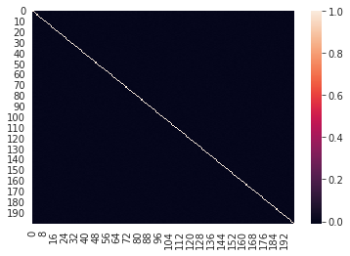
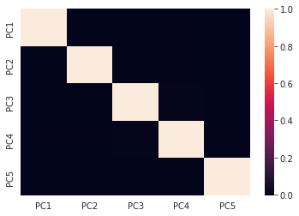
Principal Component Analysis (PCA)
Correlation Heatmap prior to PCA
Correlation Heatmap after PCA

Slide 11
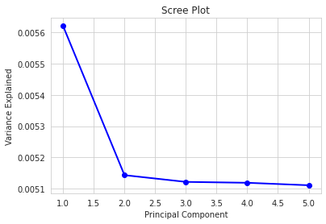
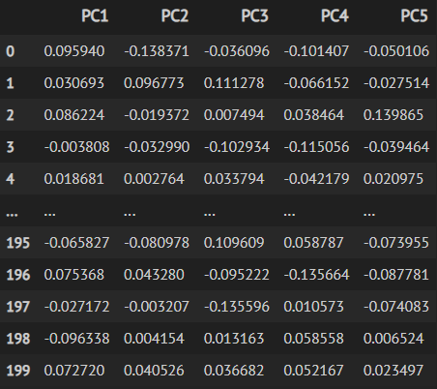
Principal Component Analysis (PCA)
Scree Plot
Principal Components

Slide 12
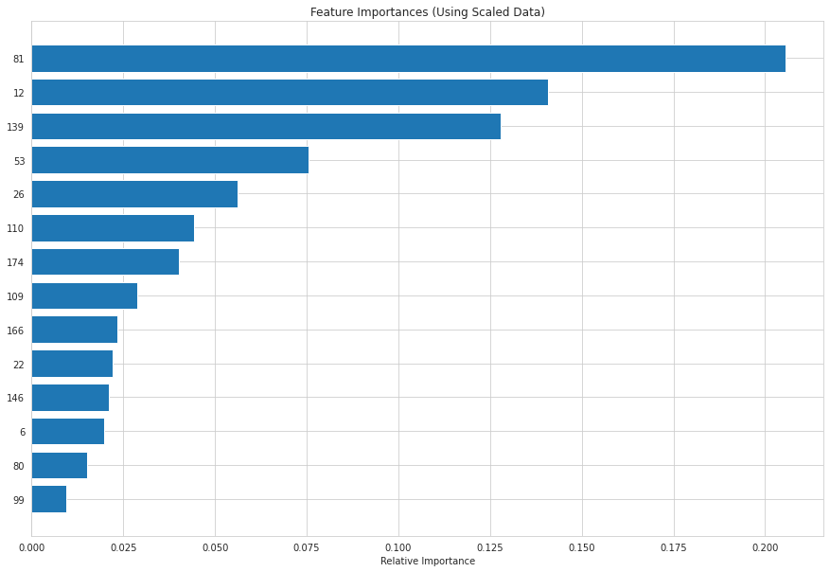
Random Forest
Max depth = 5
Trees = 100
Wall Time = 29min 6s

Slide 13

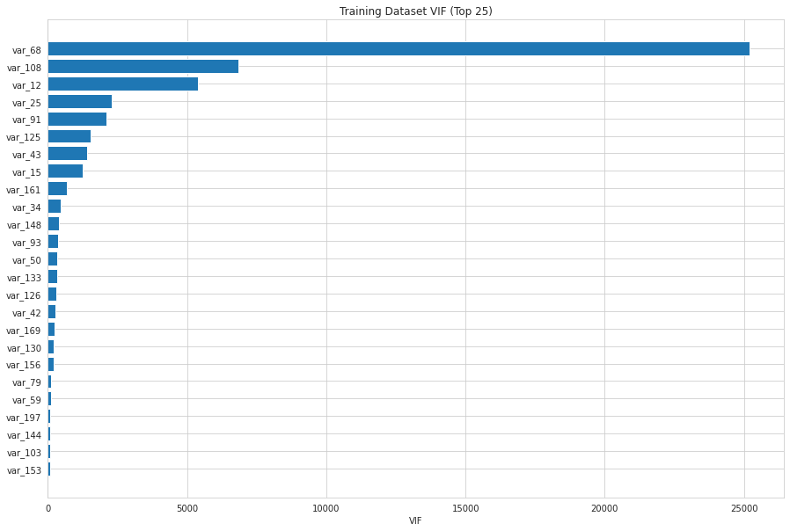
Variance Inflation Factor (VIF)
Wall Time = 55min 20s

Slide 14
Final Dimension Reduction Decision
Stuck with the results provided by VIF
Omitted the top 25 features from training/testing dataset
Left me with…
Training Dataset
200000 rows × 177 columns
Testing Dataset
200000 rows × 176 columns

Slide 15
Binary Classification Algorithm #1
Logistic Regression

Slide 16
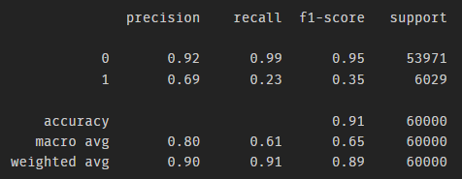
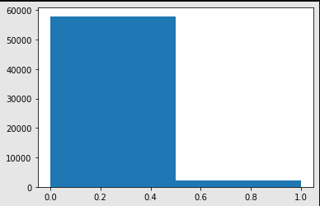
Model Summary Kaggle Score = 0.61049
Setup
Evaluation Metrics
From Training Dataset
Test Size = 0.3
Model Prediction Distribution
96.573% Zeros | 3.4267% Ones
Accuracy = 0.91238
Classification Report

Slide 17
Binary Classification Algorithm #2
Deep Neural Network

Slide 18
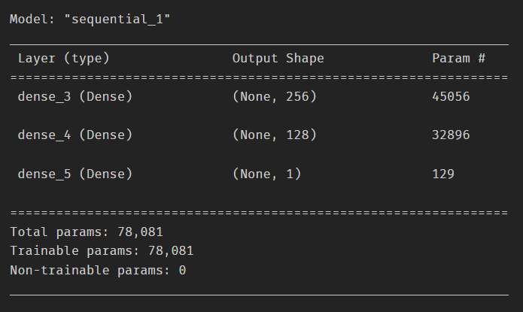
Model 1 Summary (More Robust)
Epochs = 100
Batch Size = 10
Validation Split = 0.1
Wall Time
1h 10min 17s

Slide 19
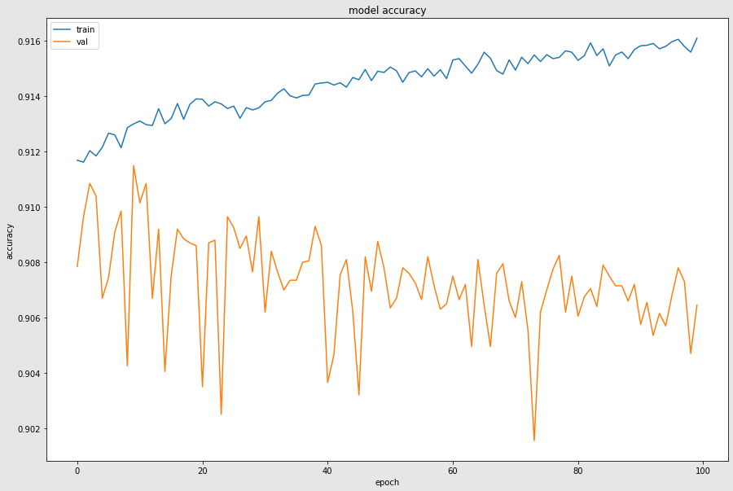
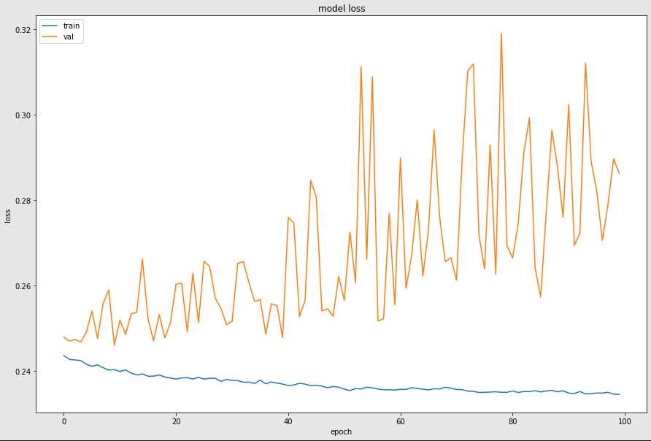
Model 1 Kaggle Score = 0.62945
Model Accuracy
Model Loss

Slide 20
Model 2 Summary (Less Robust)
Epochs = 10
Batch Size = 32
Validation Split = 0.1
Wall Time
2min 22s

Slide 21
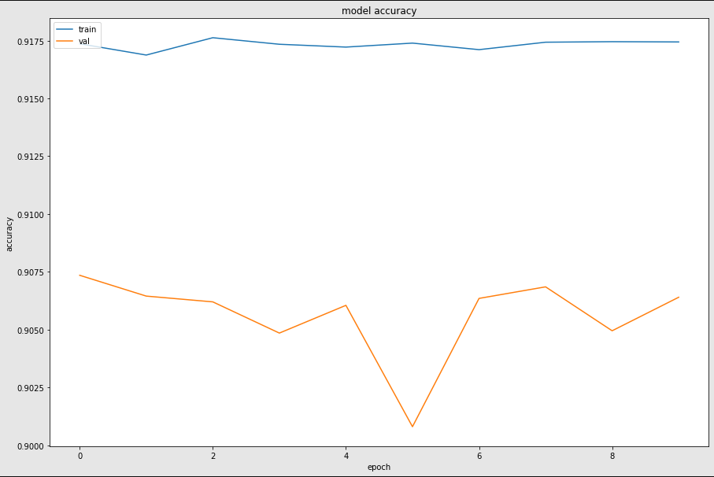
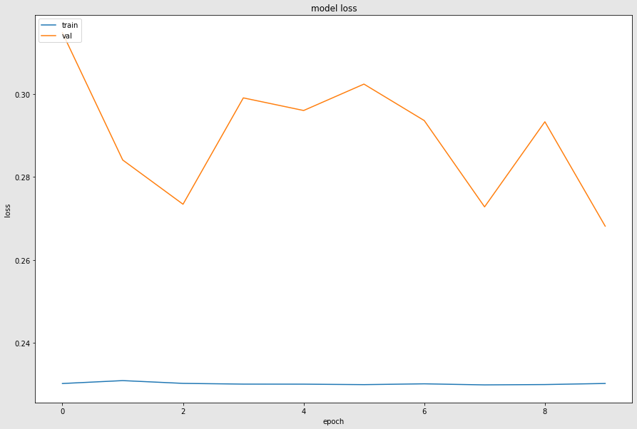
Model 2 Kaggle Score = 0.62382
Model Accuracy
Model Loss

Slide 22
Binary Classification Algorithm #3
K-Nearest Neighbors

Slide 23
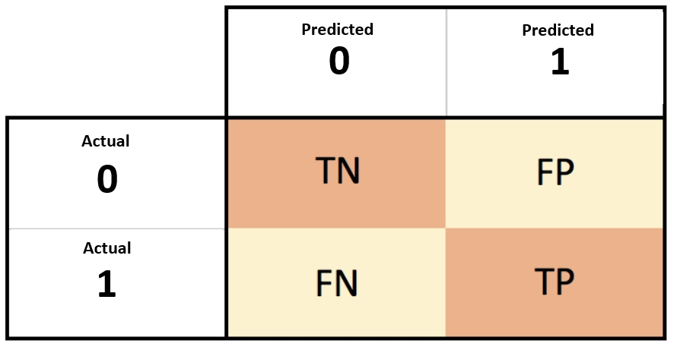

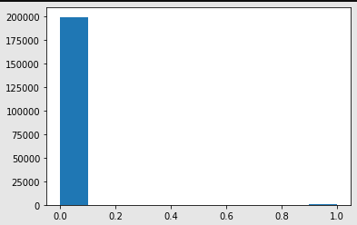
Model Summary Kaggle Score = 0.50165
Setup
Evaluation Metrics
From Training Dataset
K = 2
p = 2 (Euclidian Distance)
Metric = “Minkowski”
Model Prediction Distribution
Confusion Matrix
FN is High
TP is Very Low
Accuracy = 0.89903
99.835% Zeros
0.165% Ones

Slide 24
What is LSTM?

Slide 25
Long Short-Term Memory
Acronym Breakdown

Slide 26
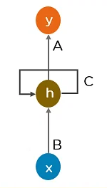
Issue with Recurrent Neural Networks (RNN)
RNN’s are useful because they can “remember” things
Big issue with RNN’s
The more iterations of output data being fed back into the model
The more “Bogged down” and inefficient they can become
“Long term dependency problem”
LSTM’s come in as a solution!
Functions as the way a Neural Network can “remember”
or “forget” things…
Type of Recurrent Neural Network (RNN)
https://www.simplilearn.com/ice9/free_resources_article_thumb/Simple_Recurrent_Neural_Network.png

Slide 27
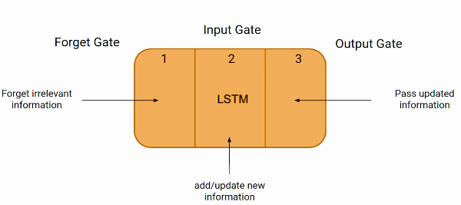
What do LSTM’s bring to the table?
Give each node a “state”
3 gates, holding a value from 0 – 1
0 being fully “closed”
1 being fully “open”
Forget Gate
Tells model what irrelevant information to get rid of before the next step
Input Gate
Tells model what information to include in the calculation for the next step
Output Gate
Tells model what information to include in the output for the next step

Slide 28
Pros
Cons
Effectively rids RNN’s of Long-term dependency problem
Very effective at modeling complex sequential data
High-level representations
Use a different kind of activation function, therefore…
Less issues with vanishing gradient problem
Make RNN’s much more complex
To understand/interpret
Computationally
Require more data to train effectively
Not ideal for…
Non-linear data
Noisy data

Slide 29
LSTM Applications
Language Modeling
Machine Translation
Handwriting Recognition
Image Captioning
Chatbots
Image Generation
Text Generation
Speech Synthesis

Slide 30
Works Cited
RNN Image
https://www.simplilearn.com/ice9/free_resources_article_thumb/Simple_Recurrent_Neural_Network.png
LSTM Applications / Pros & Cons
https://www.knowledgehut.com/blog/web-development/long-short-term-memory
LSTM Explanation
https://youtu.be/b61DPVFX03I

