Slide 1
Diagnosing Autism using Machine Learning
Jason Bard

Slide 2
Using individual brain regions on rs-fMRIs
Section 1
Notes:
This isn’t actually my project for this class, but it’s project-adjacent, and if I’m being honest, I’m just proud of what I’ve done so far and want to show it off. Plus, it uses the same dataset as my project in this class, so I figured I might as well.

Slide 3

Notes:
Here’s a picture of me with the dean and associate dean of the College of Science, holding my fourth-place certificate. I was the only one they had pose like that, and everyone else is looking straight at the camera. Weird.

Slide 4
What and why?
Autism spectrum disorder (ASD) is a neurological disorder
Characterized by lack of social ability or by repetitive behaviors/interests
Usually first detected between 18 and 36 months of age, but not always the case
Early intervention and proper therapies may help
Important for people of any age to be diagnosed
Physical difference in brain structure, especially in the amygdala
Notes:
My dataset is about autism. Given that I have autism, this project has been fascinating to work on, and I feel grateful to be able to work on a project like this that might move the bar in the direction of helping the most amount of individuals with autism.
Now autism spectrum disorder, also known as ASD, can be characterized by an individual’s impairment of their social ability and by having repetitive interests and/or behaviors. It’s typically diagnosed in patients between 18 and 36 months of age, and the severity of symptoms can vary widely. While there is currently no known “cure”, early intervention and treatments, such as behavioral and speech therapy, can help people develop skills and abilities that allow them to be social and to, say, present a poster at a conference, for instance.
Research has shown that there are differences in brain structure and function in individuals with autism, and while the specifics aren’t fully hashed out, we do know some basic parts about how different brain regions affect a potential diagnosis.

Slide 5
Notes:
This is the poster that I presented at the conference. If I have to present on Monday in DATA 4380, I’ll be showing this too.
I utilized the ABIDE dataset, which is a collection of publicly available brain imaging data provided by dozens of universities and medical imaging sites. It consists of over a thousand patients near-evenly split into two groups: those in a healthy control group, and those who have been diagnosed with ASD. The dataset as a whole includes both resting-state and task-based fMRI data in addition to clinical and demographic information about the participants, such as age, gender, IQ, handedness, and diagnostic information relating to treat scores and researchers’ and interviewers’ observations.
In my study, I used Nilearn to transform these rs-fMRIs into time series, using the Harvard-Oxford Cortical Atlas via a masker to determine potential regions of interest, such as the amygdala or the orbitofrontal cortex. Specifically, I only looked at the orbitofrontal cortex, but I may look at the amygdala in the future, given that it is also a region that has been looked at to determine whether or not individuals have autism. As the poster says, I used 80 patients that were scanned at NYU, and here, you can see the brain scan from one of them in the cross-sections. And just below that, that is the change from the mean blood flow for one of the patients’ OFCs.
I ran 1000 simulations of one model of an MLP classifier. And the results I got consistently showed about 50% accuracy, with a maximum accuracy of 81.25%. Precision and recall each showed similar results when it came to the average, except both categories showed a maximum of 100% during many runs. This could show that there’s no reliable way to diagnose based off this region alone, but there’s a more likely explanation. I had an extremely small sample size of 80 because loading the data for any more patients than that made my laptop start screaming at me. In addition, using the subcortical atlas to explore the amygdala would be helpful, given that it’s also connected to research about autism diagnoses. Using patients from more than one center may also help. Doing all these things would make future models much more successful, putting them on par with current cutting-edge research levels. I posited using the mathematics remote server, but I didn’t have enough time to get there before I needed to prepare. Well, there’s always next semester.

Slide 6
DATA 3421 Project: Analyzing Phenotypic Data
Section 2
Notes:
Storage problem isn’t an issue with the project my data is actually on, which is just a CSV of the phenotypic data. So, like, their genders, ages, handedness, IQ, and so on.

Slide 7
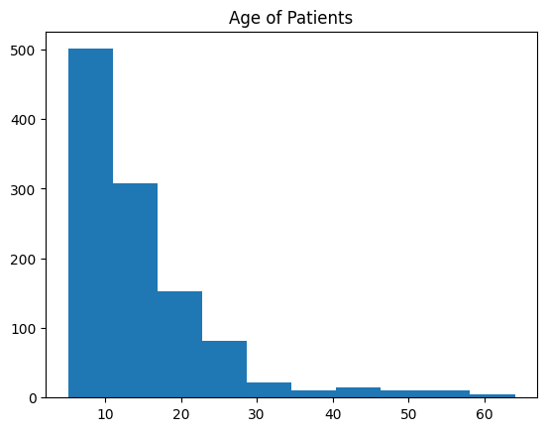
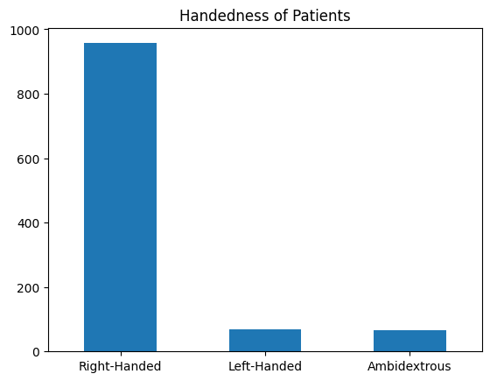
Exploratory Data Analysis
Notes:
Here’s some graphs of some statistics of the patients.
Age, and handedness. There were three different types of IQ tests, and there was also a category about eye status at time of scan, indicating whether the patient was looking at the camera.
For age, those older patients technically count as outliers, but they were left in the final dataset because the age seemed to be the only thing causing them to be an outlier. If I did that for every category, I’d have zero patients. There was one “undefined” in eye status that I had to remove, but other than that, the rest of the patients are here.

Slide 8
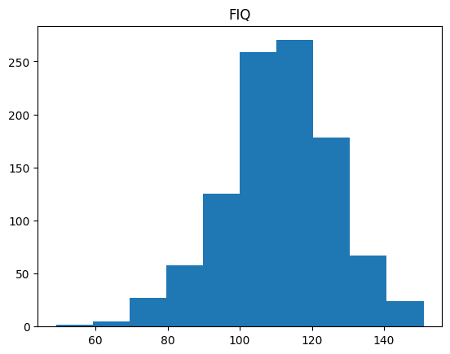
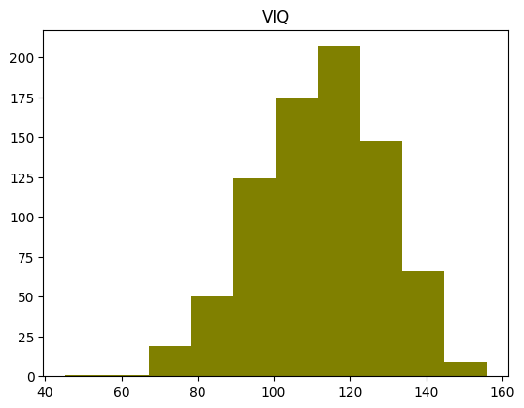
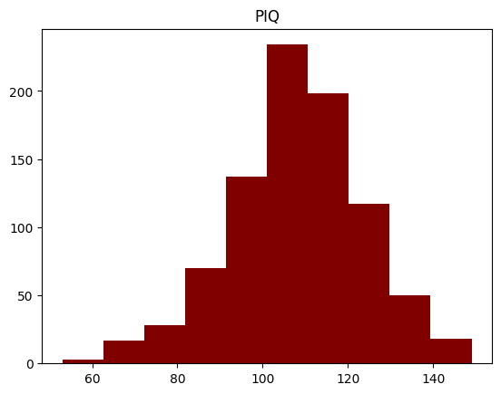
Notes:
Here are the three kinds of IQ tests: Full IQ, Verbal IQ, and Performance IQ. Not every patient did all three. Some did two, some did one, and others did none.

Slide 9
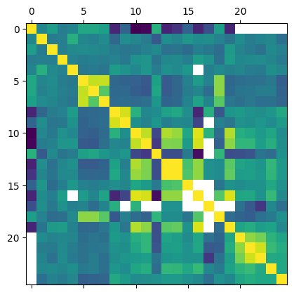
Notes:
This is the matrix after preprocessing, and I’ll explain what that was soon. No PCA was necessary, or at least I chose to proceed without it

Slide 10
Data Preprocessing
Phenotypic data already had sums of scores for various questionnaire and therapeutic tests patients underwent in addition to having each category of every test, including IQ
There were NaNs wherever a test was not performed on a patient.
Since all the scores are non-negative integers, replacing NaN with -1 indicates that the patient did not do the test.
IQ tests also received one-hot encoding for type
Did not normalize the data
Notes:
Various tests and interviews, such as:
Vineland
ADOS, SRS, CBCL/1.5-5, WIAT-II, ADI-R
This narrowed down the database significantly from 348 columns to 30.
Split the IQ testing into one-hot encoding brought the total number of columns up to 74.
Why I did not normalize the data:
When the normalization technique is applied to the entire dataset before splitting into training and test sets, the model may become overfitted to the training set. This can happen if the normalization process introduces bias in the data or if it reduces the variance in the data too much. In such cases, the model may not generalize well to new, unseen data.
Given the distribution of the data (especially the age category), I suspected bias may be introduced and chose to label NaNs as -1 instead of normalizing.

Slide 11
Results
Model | Accuracy | Precision | Recall
DNN | 0.961957 | 0.982659 | 0.939227
k-NN (k = 3) | 0.940217 | 0.976048 | 0.900552
DT | 0.956522 | 0.945946 | 0.966851
Notes:
Recall was actually maxed when k = 2, but the other two were maxed here.

Slide 12
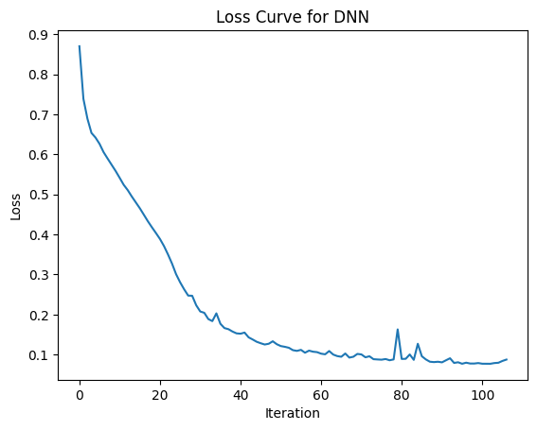
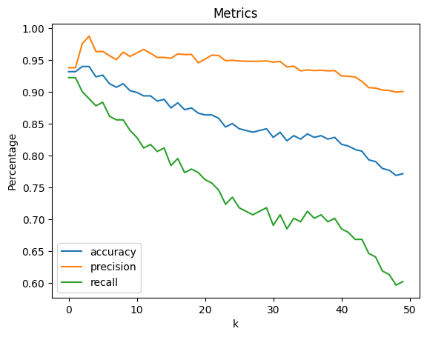
Graphs
Notes:
Left: loss curve. Used a deep linear neural network with 6 hidden layers and stochastic gradient descent.
Right: accuracy, precision, and recall per k. It actually looked like 2 or 3 was the best k to go with, but I ended up using 3 on the final table. I ran it all the way from k = 1 to k = 50 to check that that was the max.

Slide 13
Dimensionality Reduction
Section 3

Slide 14
What is dimensionality reduction?
Reducing number of features while retaining as much information as possible
Pros
Reduce complexity
Easier visualization
Avoid the curse of dimensionality
Cons
Loss of information
Uninterpretability

Slide 15
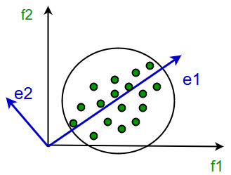
Methods of Dimensionality Reduction
Principal Component Analysis (PCA)
Computes the covariance matrix of the data, then utilizes k largest eigenvectors to reconstruct vector basis
Maintains maximum variance, compresses data, reduces computation time
Linear Discriminant Analysis (LDA)
Looks for linear combinations of features
Finds projection that best separates the classes from each other
Assumes normally-distributed data
Notes:
LDA
In LDA, the goal is to find a projection of the data that maximizes the separation between the classes.
LDA assumes that the data has a normal distribution and that the covariance matrices of the classes are equal.
Uses between-class and within-class scatter matrices to separate the classes.
Does not perform well where decision boundary is not linear

Slide 16
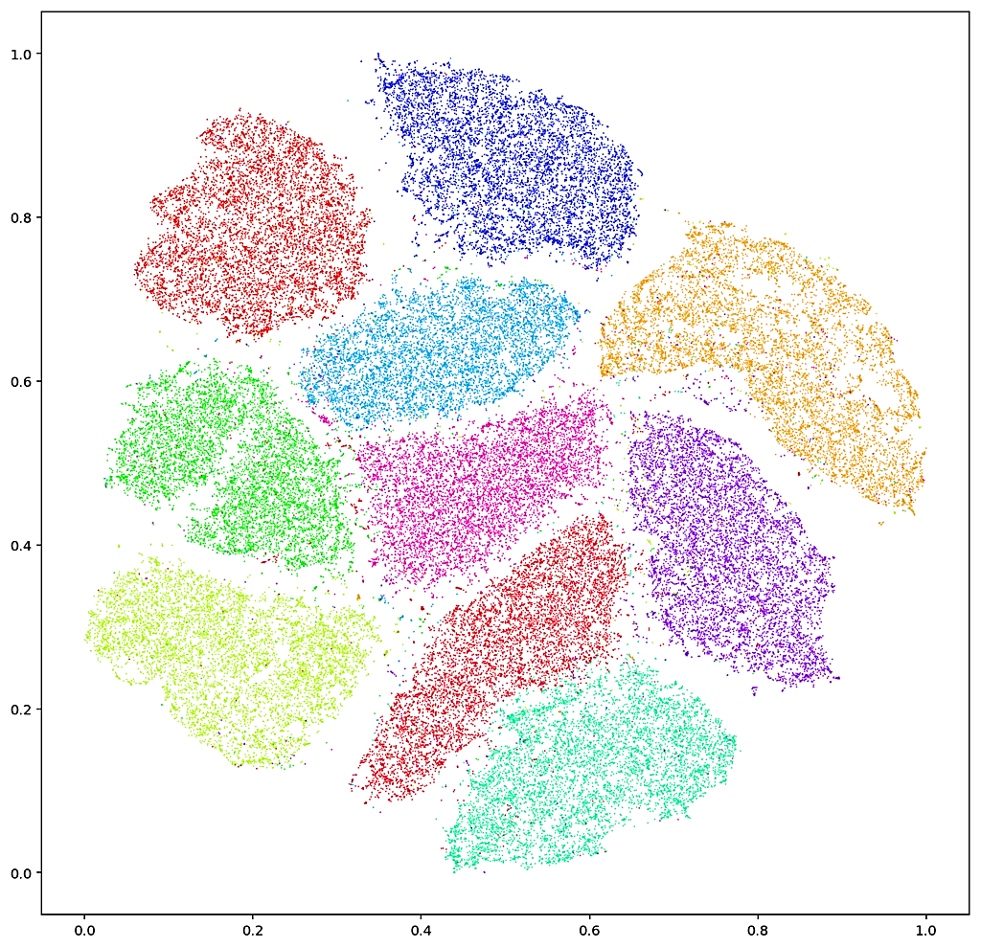
Methods of Dimensionality Reduction
T-distributed stochastic neighbor embedding (t-SNE)
Way to condense high-dimensional data into two or three dimensions
Good way to display clustering, even if it’s not a clustering algorithm per se
Feature Selection
Selecting a subset of features to be included rather than including the whole set.
Filter methods, wrapper methods, embedded methods
Notes:
An example of t-SNE is on the MNIST dataset, as seen on the right.
For feature selection, this is what I did during my pre-processing phase for this project, choosing only the sums of the scores in each category instead of using the individual scores for each section of each test. Although, because I grouped together the individual scores, I did lose information because of this, and perhaps I can run another simulation another time without leaving the individual scores out.

Slide 17
Thank You!

