Slide 1
(X)HTML
Internet Engineering
Fall 2014
Bahador Bakhshi
CE & IT Department, Amirkabir University of Technology

Slide 2
Questions
Q2) How is a web page organized?
Q2.1) What language is used for web pages?
Q2.2) What are major parts of a web page?
Q2.3) How to organize text?
Q2.4) How to insert link?
Q2.5) How to insert images?
Q2.6) How to insert tables?
Q2.7) How to get data from user?
Q2.8) Syntax / Semantic error?

Slide 3
Homework
HW-2: Client Side Static Web Site
HTML + CSS
No JS, PHP, …
Deadline
At least one week after finishing CSS lecture

Slide 4
Outline
Introduction
XHTML
Body
Head
XHTML in Practice

Slide 5
Outline
Introduction
XHTML
Body
Head
XHTML in Practice

Slide 6
Introduction
Remark: The idea of WWW is document sharing
Main question: How to format document?
Text, formatting (Bold, Italic, …), tables, figures, …
Assume you are in 1980s
Binary formats?
Useless
Different machines, no popular graphical desktops, no such popular format such as PDF, Doc, …
Text format
It is okay, everyone knows ASCII
But how to describe structure, layout, and formatting?
Add meaning to each part of text using special predefined markup, E.g., It is heading, It is paragraph, It is table …

Slide 7
Introduction (cont’d)
HTML (Hyper Text Markup Language)
A language to define structure of web docs
Tags specify the structure
HTML
Was defined with SGML
Is not a programming language
Cannot be used to describe computations
HTML does/should not specify presentation
Font family, style, color, …
Cascading Style Sheet (CSS) is responsible for presentation

Slide 8
Introduction (cont’d)
HTML 1 (Berners-Lee, 1989): very basic, limited integration of multimedia
1993, Mosaic added many new features (e.g., integrated images)
HTML 2.0 (IETF, 1994): tried to standardize these & other features
1994-96, Netscape & IE added many new, divergent features
HTML 3.2 (W3C, 1996): attempted to unify into a single standard
HTML 4.0 (W3C, 1997): attempted to map out future direction of HTML
XHTML 1.0 (W3C, 2000): HTML 4.01 modified to conform to XML standards
HTML 5 (Web Hypertext Application Technology Working Group, W3C): New version of HTML4, XHTML 1.0

Slide 9
Outline
Introduction
Tags
XHTML
Body
Head
XHTML in Practice

Slide 10
HTML Basics: Tags
XHTML is a text document collecting elements
Element: (usually) a tag pair (opening & closing) + content between them
E.g., <h1>This is header</h1>
Not all tags have content
Tags specify markups for the content
Tags
<tagname>: opening (start) tag
</tagname>: closing (end) tag
<tagname />: self-closing tag

Slide 11
HTML Basics: Attributes
Each tag can have some attributes
Attributes customize tags
<tagname attrib1=“setting” attrib2=“setting” …>
…
</tagname>
Core attributes can be used for most of elements
id: A unique identifier to element starting with "A-Z"
class: Assign a class to the element, multiple classes are allowed
title: Assign a title, the behavior depends on element

Slide 12
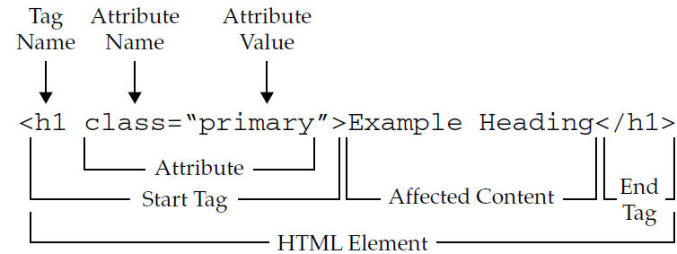
HTML Basics: Tag & Attribute & Element

Slide 13
HTML Processing
HTML document is processed (parsed) by web browser or search engines or other applications
Search engine objectives:
Analyze page, extract elements, prioritize, ranking, …
Each tag has meaning, used for ranking
E.g., paragraphs are not as important as headings
Web browser objectives:
Display the document to client
Rendering
Generate layout for the document
Display elements

Slide 14
HTML Processing: Rendering
The processing of displaying HMTL in browser
Not all tags are to be displayed
E.g. Tags in <head>
For tags which should be displayed
Tags by themselves are not displayed
Each tag has its own default presentation specification
If tag has content, the presentation is applied to content
E.g. <i>This is italic</i>
If tag has not content, the specification is displayed (if it is needed)
E.g. <br />

Slide 15
HTML Processing: Rendering (cont’d)
Web browsers ignore
1) Comments
<!-- … -->
2) Tags that don’t recognize
3) More than single whitespaces
E.g., Multiple newlines + tabs + spaces → single space

Slide 16
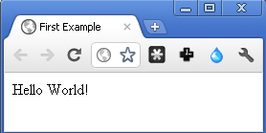
The “Hello World” Example
<!-- This is the “Hello World” Example -->
<html>
<head>
<title>First Example</title>
</head>
<body>
<p> Hello World! </p>
</body>
</html>

Slide 17
Nested Tags
Nested Tags
Tree of elements
Parent & Child relationship
<html> </html>
<head> </head>
<body> </body>
<title> </title> other stuff <p></p> <br /> <table></table>
This is some text!

Slide 18
Special Characters/Symbols
Some characters and symbols are encoded
Because cannot be used directly in text files
E.g.,
Character | Coding | Number code
‘<’ | &lt; | &#60;
‘>’ | &gt; | &#62;
‘&’ | &amp; | &#38;
‘ ’ | &nbsp; | &#160;
‘©’ | &copy; | &#169;
‘λ’ | &lambda | &#955;

Slide 19
Outline
Introduction
XHTML
Body
Head
XHTML in Practice

Slide 20
XHTML
HTML is an application of Standard General Markup Language (SGML)
XHTML is an application of Extensible Markup Language (XML)
W3C: “a reformulation of the three HTML 4 document types as applications of XML 1.0”
XML is more restricted that SGML
XHTML has more restrictions vs. HTML
XHTML is more well-defined

Slide 21
XHTML Rules (vs. HTML)
All tags have ending (closing) tags
Some tags are self closing <br />
Tags cannot be overlapped
<b><i>test</b></i>
All tags are lowercase
Attributes’ value must be in double quotation
Browsers ignore unknown tags and attributes
Layout (styles) are separated from markup
Markup is used for meaning & structure

Slide 22
XHTML Skeleton
<?xml …>
<!DOCTYPE …>
<html …>
<head>
</head>
<body>
</body>
</html>
HEAD contains setup information for the browser & the web page, e.g., the title for the browser window, style definitions, JavaScript code, …
BODY contains the actual content to be displayed in the Web page

Slide 23
Document Types
There are three versions of XHTML
Transitional XHTML: Deprecated features from HTML 4.1 are allowed
Strict XHTML: No deprecated feature from HTML is allowed
Frameset XHTML: Mainly used to create frames
The version is specified by DOCTYPE tag
For transitional:
<!DOCTYPE html PUBLIC "-//W3C//DTD XHTML 1.0 Transitional//EN" "http://www.w3.org/TR/xhtml1/DTD/xhtml1-transitional.dtd">
For strict:
<!DOCTYPE html PUBLIC "-//W3C//DTD XHTML 1.0 Strict//EN" "http://www.w3.org/TR/xhtml1/DTD/xhtml1-strict.dtd">
For frameset:
<!DOCTYPE html PUBLIC "-//W3C//DTD XHTML 1.0 Frameset//EN" "http://www.w3.org/TR/xhtml1/DTD/xhtml1-frameset.dtd">
Status of tags in DOCTYPEs: http://www.w3schools.com/tags/ref_html_dtd.asp

Slide 24
XHTML Document Template
<?xml version="1.0" encoding="utf-8"?>
<!DOCTYPE html PUBLIC "-//W3C//DTD XHTML 1.0 Strict//EN" "http://www.w3.org/TR/xhtml1/DTD/xhtml1-strict.dtd">
<html xmlns="http://www.w3.org/1999/xhtml">
<head>
<meta http-equiv="Content-Type" content="text-html; charset=utf-8" />
<title> ... </title>
</head>
<body> ... </body>
</html>

Slide 25
Outline
Introduction
XHTML
Body
Heading & Paragraph
Lists & Definitions
Images & Tables
Links
Forms
Head
XHTML in Practice

Slide 26
<body> </body>
The content of the document to be shared on Internet
To display for user in web browser
To be searched and ranked by search engines
Which contents
General contents
Text
Image
Table
Web contents
Links
Forms
Multimedia

Slide 27
Text Layout
Default rules:
1) Layout of the text is left to the browser
2) Every sequence of whitespace is interpreted as a single space
3) Browser automatically wraps the text to fit the window size

Slide 28
Text Elements
Headings
Paragraphs
Lists
Definitions
Spaces
Line break
Text presentation (italic) & Meaning (strong)

Slide 29
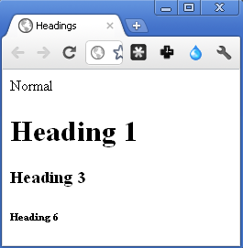
Text: Headings
XHTML offers 6 levels of heading
<h1> <h2> … <h6>
<h1> is the largest heading
<h6> is the smallest heading
Normal
<h1> Heading 1 </h1>
<h3> Heading 3 </h3>
<h6> Heading 6 </h6>

Slide 30
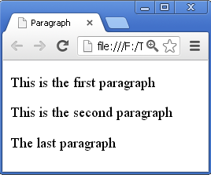
Text: Paragraphs
<p> </p> is to create paragraphs
Create a line break and vertical spaces
Attribute: align: left, right, center
<p>This is the first paragraph</p>
<p>This
is
the second paragraph</p><p>The last
paragraph</p>

Slide 31
Text: Lists & Definitions
Unordered list: <ul> </ul>
Ordered list: <ol> </ol>
Definition list: <dl> </dl>
List elements:
Unordered & Ordered list: <li> </li>
Definition list:
Entity: <dt> </dt> Definition: <dd> </dd>
Lists can be nested

Slide 32
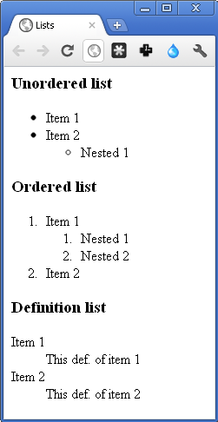
Text: Lists & Definitions (cont’d)
<h3>Unordered list</h3>
<ul>
<li> Item 1 </li> <li> Item 2 </li>
<ul>
<li> Nested 1</li>
</ul>
</ul>
<h3>Ordered list</h3>
<ol>
<li> Item 1 </li>
<ol>
<li> Nested 1 </li> <li> Nested 2 </li>
</ol>
<li> Item 2 </li>
</ol>
<h3>Definition list</h3>
<dl>
<dt>Item 1 </dt> <dd> This def. of item 1 </dd>
<dt>Item 2 </dt> <dd> This def. of item 2 </dd>
</dl>

Slide 33
Text: Lists & Definitions (cont’d)
There are some deprecated attributes to control list appearance
<ul type="shape">
Shape: square, circle, disc
<ol type="format" start="value">
Format: 1 (number), i & I (Roman), a & A (Letter)
Value: a number

Slide 34
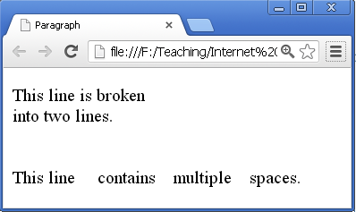
Text: Line break & Spaces
Remark: By default line break and spaces are ignored
To add line break: <br />
To add space: &nbsp;
Preserving white spaces: <pre> </pre>
<p>
This line is broken<br />into two lines.
<br />
<br /><br />
This line &nbsp;
&nbsp;&nbsp; contains &nbsp;
&nbsp; multiple &nbsp;
&nbsp; spaces.
</p>

Slide 35
Text: Presentation & Meaning
Physical appearance for web browsers
Bold, Italic, Underline, Superscript, Fonts, size, color, …
In older versions, controlled by HTML tags
In XHTML, these are deprecated
Is controlled by CSS
We will see later
Logical meaning for search engines
Emphasize, Code, Variable, Citation, …

Slide 36
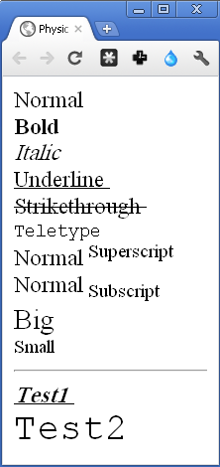
Text: Physical Appearance
Normal <br />
<b> Bold </b> <br />
<i> Italic </i> <br />
<u> Underline </u> <br />
<s> Strikethrough </s> <br />
<tt> Teletype </tt> <br />
Normal<sup> Superscript </sup> <br />
Normal<sub> Subscript </sub> <br />
<big> Big </big> <br />
<small> Small </small> <br />
<hr />
<b> <i> <u> Test1 </u> </i> </b> <br />
<big> <big> <big> <big> <tt> Test2 </tt> </big> </big> </big> </big> <br />

Slide 37
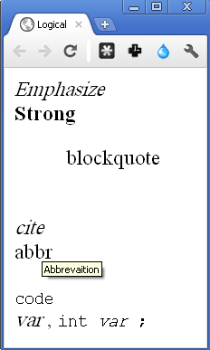
Text: Logical Meaning
Mainly used in automatic processing of web page
Search engines
Appearances are similar to some physical tags
E.g. <em> is like to <i>
<em> Emphasize </em> <br />
<strong> Strong </strong> <br />
<blockquote> blockquote </blockquote> <br />
<cite> cite </cite> <br />
<abbr title="Abbreviation"> abbr </abbr><br />
<code> code </code> <br />
<var> var </var>, <code>int<var>var</var> ; </code>

Slide 38
Images
Images are included by
<img src="URL" alt="text" height="number" width="number" align="alignment"/>
src: address of file (local or remote)
alt: alternative message shown if image cannot be displayed
align: alignment of image with respect to text line (deprecated)
There is no caption for images!!!

Slide 39
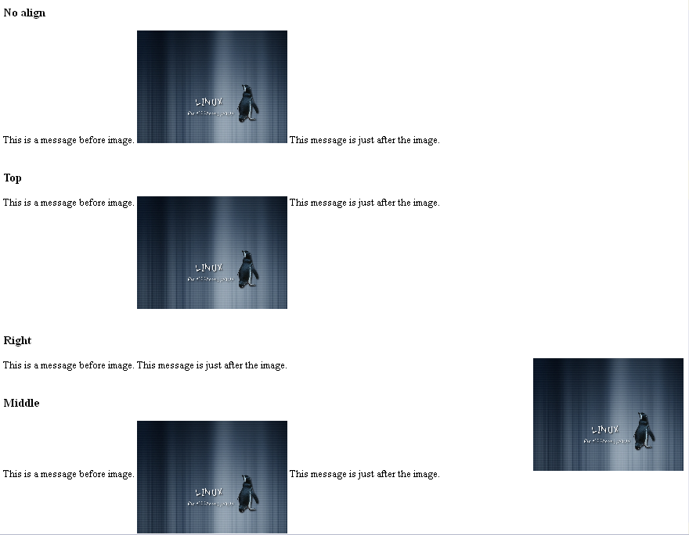

Slide 40
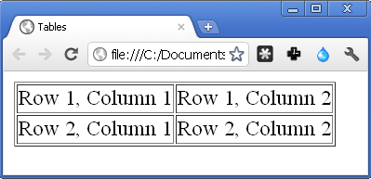
Tables
Tables are created by <table> </table>
Each row is created by <tr> </tr>
Each column inside a row is created by <td> </td>
<table border="1">
<tr>
<td> Row 1, Column 1 </td>
<td> Row 1, Column 2 </td>
</tr>
<tr>
<td> Row 2, Column 1 </td>
<td> Row 2, Column 2 </td>
</tr>
</table>

Slide 41
Tables (cont’d)
Caption is by <caption> </caption>
Heading of a column is by <th> </th>
Table attributes
align: table alignment
frame: type of border, “box”, “above”, “blow”, …
border: border width
bgcolor: background color, “red”, “green”, …
cellpading: extra space in each cell
cellspacing: vertical space between rows
width: absolute or % of window width

Slide 42
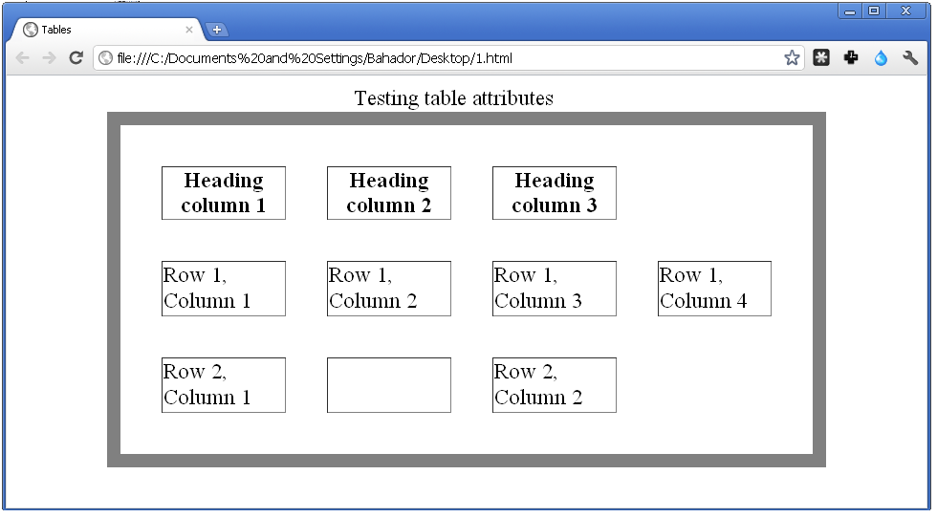
Tables (cont’d)
<table align="center" frame="box" border="10" cellspacing="30" width="80%">
<caption>Testing table attributes</caption>
<tr>
<th>Heading Column 1</th>
<th>Heading Column 2</th>
<th>Heading Column 3</th>
</tr>
<tr>
<td>Row1, Column 1</td> <td>Row1, Column 2</td>
<td>Row1, Column 3</td><td>Row1, Column 4</td></tr>
<tr> <td>Row2, Column 1</td><td></td><td>Row2, Column 2</td></tr>
</table>

Slide 43
Tables (cont’d)
<tr> attributes
align: text align in row: "left", "right", "center"
valign: text vertical align: "top", "middle", …
bgcolor: Row background color
<td> or <th> attributes
align, valign, bgcolor, height , width
colspan: Span multiple columns
rowspan: Span multiple rows

Slide 44
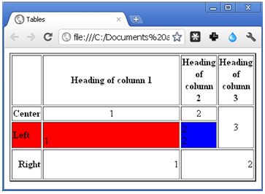
Tables (cont’d)
<table border="2">
<tr>
<th></th> <th>Heading of column 1</th> <th>Heading of column 2</th> <th>Heading of column 3</th>
</tr>
<tr align="center">
<th>Center</th> <td>1</td> <td>2</td>
<td rowspan="2">3</td>
</tr>
<tr align="left" bgcolor="red">
<th>Left</th> <td valign="bottom">1</td>
<td bgcolor="blue">2 <br /> 2</td>
</tr>
<tr align="right">
<th>Right</th> <td height="50" width="300">1</td> <td colspan="2">2</td>
</tr>
</table>

Slide 45
General Document Contents Summary
Text
Headings: <h1> … <h6>
Paragraphs: <p>
Lists: <ol> <ul> <li>
Definitions: <dl> <dt> <dd>
Spaces & Line break: &nbsp; <br />
Text presentation (italic) & Meaning (strong): <i> <b> <strong> <em> …
Image: <img src>
Table: <table> <tr> <td>

Slide 46
Links
The most important feature of HTML
Hyperlink (anchor) → the Web
<a href="URL">link name</a>
When scheme is not give in the URL & base is not set in <head>, it is assumed as a file in current domain & path
href=“http://www.google.com” → open Google
href=“www.google.com” → open a file in current directory named www.google.com
href=“/www.google.com” → open a file in the root directory named www.google.com

Slide 47
Links (cont’d)
Scheme can be any supported protocol
E.g. mailto for sending email
E.g. javascript to run code
By default links are opened in the same window, o open link in new window
Attribute targe="_blank“
Everything between <a> </a> is considered as link name
Avoid spaces after <a> and before </a>

Slide 48
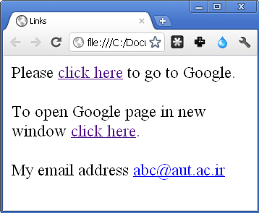
Links (cont’d)
<body>
Please <a href="http://www.google.com">click here</a> to go to Google. <br /><br />
To open Google page in new window <a href="http://www.google.com" target="_blank">click here</a>. <br /><br/>
My email address <a href="mailto:abc@aut.ac.ir">abc@aut.ac.ir</a>
</body>

Slide 49
Links (cont’d)
#frag part in URL is used to jump middle of a large document
Step one: assign an ID/name to the part
<h2><a id="SctionResult">Results</a></h2>
<h2><a name="SctionResult">Results</a></h2>
Step two: create link using #frag feature
To see result <a href="#SctionResult">click here</a>

Slide 50
Forms
Forms are used to get information from user
XHTML is only responsible to gather information from user
It does not responsible to process
Data are processed by server side scripts (preprocessing in client)
Major form components
Text input
Checkboxes and radio buttons
Select boxes
File select boxes
Buttons

Slide 51
Forms (cont’d)
Forms are created by <form>
Each form must have action and method attributes
action is a URL
Server side script that process the data
method is a HTTP method
get: User input data is sent through the query part of URL by HTTP GET method
post: User input data is sent as the body of HTTP message by HTTP POST method

Slide 52
Forms (cont’d)
A from is composed of input components
Each component has type, name, and value attributes
type specifies the type of component
name is the name of the component
value (except buttons)
If not empty, is the default value
Is the input value from user
On submission, name=value of components (except buttons) are sent to server (POST, GET)
Server processes the values according to the names
It must know the names

Slide 53
Forms: Buttons
Buttons: <input type=“T” value=“L”/>
Predefined buttons
To submit data to server: type="submit"
To reset all inputs to default values: type="reset"
To run client side script: type="button"
Attribute value is the label of button
<input type=“T” value=“L”/> can be replaced by <button type=“T”> L </button>
Using image as a button
type="image" src="image path" alt="text"
Attribute name is required if more than same type button in a form

Slide 54
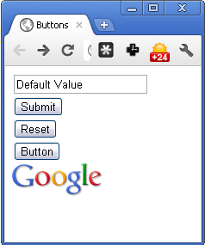
Forms: Buttons (cont’d)
<form action="http://127.0.0.1/" method="get">
<input type="text" name="input" value="Default Value" /> <br />
<input type="submit" value="Submit" /> <br />
<button type="reset"> Reset</button> <br />
<input type="button" value="Button" /> <br />
<input type="image" src="google_logo.gif" />
</form>

Slide 55
Forms: Text Input
Text input components
Single-line text
type="text"
Password (instead of real input, other character is shown)
type="password"
Multi-line text
Instead of <input>, we use <textarea> </textarea>
cols & rows specifies # of columns & rows
name=value of component is sent to server
Password in plain text format

Slide 56
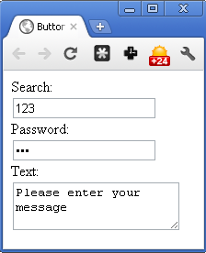
Forms: Text Input (cont’d)
<form action="http://127.0.0.1" method="get">
Search:
<input type="text" name="txtSearch" value="" size="20" maxlength="64" /> <br />
Password:
<input type="password" name="pass" value="" size="20" maxlength="64" /> <br />
Text:
<textarea name="inputtext" cols="30" rows="3">Please enter your message</textarea>
</form>

Slide 57
Forms: Checkbox
Check boxes
type="checkbox"
If checked, its name=value is sent to server
To be checked by default:
checked="checked"
To draw border around a group of components
<fieldset> </fieldset>
To assign name to the group
<legend> </legend>

Slide 58
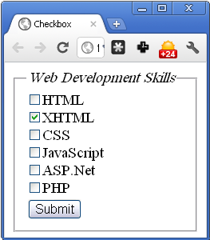
Forms: Checkbox (cont’d)
<form action="http://www.google.com" method="get" name="frmCV">
<fieldset>
<legend><em>Web Development Skills</em></legend>
<input type="checkbox" name="skill_1" value="html" />HTML <br />
<input type="checkbox" name="skill_2" value="xhtml" checked="checked"/>XHTML <br />
<input type="checkbox" name="skill_3" value="CSS" />CSS<br />
<input type="checkbox" name="skill_4" value="JavaScript" />JavaScript<br />
<input type="checkbox" name="skill_5" value="aspnet" />ASP.Net<br />
<input type="checkbox" name="skill_6" value="php" />PHP <br />
<input type="submit" value="Submit" />
</fieldset>
</form>

Slide 59
Forms: Radio Buttons
Radio buttons
type="radio"
Only one of button can be selected in a group of buttons with the same name
name=value of the selected button will sent

Slide 60
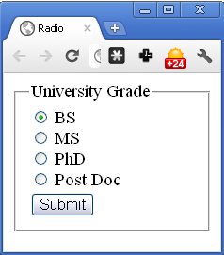
Forms: Radio Buttons (cont’d)
<form action="www.aut.ac.ir" method="get">
<fieldset>
<legend>University Grade</legend>
<input type="radio" name="grade" value="B" /> BS <br />
<input type="radio" name="grade" value="M" /> MS <br />
<input type="radio" name="grade" value="P" /> PhD <br />
<input type="radio" name="grade" value="PD" /> Post Doc <br />
<input type="submit" value="Submit" />
</fieldset>
</form>

Slide 61
Forms: Select Boxes
Select boxes
The same functionality of radio buttons
Just save spaces
Created by <select name="selname"> </select>
Options are given by <option value="val"> text </option>
slename=value of selected item sent to server

Slide 62
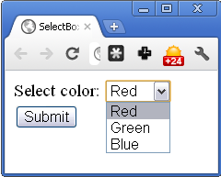
Forms: Select Boxes (cont’d)
<form action="http://127.0.0.1/" method="get" name="frmColors">
Select color:
<select name="selColor">
<option value="r">Red</option>
<option value="g">Green</option>
<option value="b">Blue</option>
</select>
<input type="submit" value="Submit" />
</form>

Slide 63
Forms: File Input
File select & upload
In <input>
type="file"
accept= A MIME type to specify default acceptable file format
In <form>
method="post"
enctype="multipart/form-data"
To encode file as MIME message

Slide 64
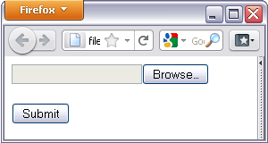
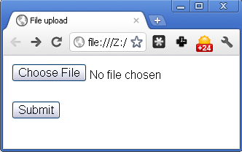
Forms: File Input (cont’d)
<form action="http://127.0.0.1" method="post" name="fromImageUpload" enctype="multipart/form-data">
<input type="file" name="fileUpload" accept="image/*" />
<br /><br />
<input type="submit" value="Submit" />
</form>

Slide 65
Real Examples
Capture form submission
GET
POST

Slide 66
Form Summary
Form: <form action=“” method=“”>
Button: <input type="button"> or <button>
Text:
<input type="text" …
<input type="password" …
<textarea …
Checkbox: <input type="checkbox" …
Radio: <input type="radio" …
Select box: <select name= … and <option value=
File: <select type="file" …

Slide 67
Multimedia
XHTML (HTML 4) does not support multimedia
Browser plug-in needs to be used
Flash
Quicktime
…
Next version of HTML (HTML 5) supports multimedia without any plug-in
We will see later

Slide 68
Inline & Block-level Elements
Block-level: Line break before & after elements
Next block-level goes underneath of this block
Examples: Paragraphs: <p>, Headings: <h1>, …, <h6>, Lists: <ul>, <ol>, <dl>, Blocks: <pre>, <blockquote>
<div> is used to create a block
Without any presentation
Nested <div> are used to define structure of complex pages, e.g., Gmail
Inline: No line break
Next inline elements goes right after this element
Example: Text, <b>, <i>, <em>, <strong>, …
<span> is used to create an inline element without any presentation

Slide 69
Outline
Introduction
XHTML
Body
Head
XHTML in Practice

Slide 70
<head> </head>
The element not for displaying
Usually, the info in head is not for user
This element is additional information for
Web browsers: How to render the page
CSS rules definitions and inclusions
JavaScript codes
…
Search engines: Control the ranking of the page
Keywords for the page
Extra description for the page

Slide 71
<head> </head> (cont’d)
<title>: Page title
Browser dependent
Usually displayed as the browser window name
<title>My page Title</title>
<base>: Base URL for all links in the document, e.g.,
<base href="http://www.abc.com" />
<a href="test.html">link1</a> → http://www.abc.com/test.html
<a href="http://test.html">link2</a> → http://test.html

Slide 72
<head> </head> (cont’d)
<meta>: Information about the document
HTTP parameters, Search engine optimization (keywords), Description, …
<meta> attributes
(name, content), (http-equiv , content)
name & content, http-equiv & content pairs
name can be anything, e.g., author, description, ...
http-equiv is the name of a HTTP header field
Content-Type, Expire, Cache-Control, Refresh, …

Slide 73
<head> </head> (cont’d)
Example of <meta>
<head>
<meta name="description" content="Ali Karimi’s home page" />
<meta name="author" content="Ali Karimi" />
<meta name="keyword" content="Football" />
<meta http-equiv="expires" content="6 April 2015 23:59:59 GMT" />
<meta http-equiv="refresh" content="10" />
<meta http-equiv="Content-Type" content="text/html" />
</head>

Slide 74
<head> </head> (cont’d)
<script>: Introduce scripts used in the document
The script can be internal (defined in the document) or external (somewhere on web)
We will discussed in next lectures
<style>: Enclose document-wide styles
CSS rules
Either internal or external
We will discussed in the next lecture
<link>: To link some other documents to this HTML file
External CSS

Slide 75
Outline
Introduction
XHTML
Body
Head
XHTML in Practice

Slide 76
HTML Remarks
HTML is open source
We can find how others do amazing things in web
Learning by reading others’ codes
Copy/Past is strictly prohibited (copyright)
XHTML is not a programming language
No compiler or interpreter
What happen if there is an error ….
Depends on browser
Developer should check with multiple browsers

Slide 77
HTML Development Toolbox
A HTML editor (http://en.wikipedia.org/wiki/List_of_HTML_editors)
A simple text editor
e.g. notepad :-P, …
HTML source code editor (syntax highlight, …)
E.g. Aptana, ….
WYSIWYG editors (you have not work with tags)
E.g. MS. FrontPage, Word (export to HTML), …
A rendering software
Common browsers
Try different browsers
Additional debugging tools
E.g. Firebug, …

Slide 78
HTML Debugging
Browser reads XHTML document
Parses it → tree
Document Object Model (DOM) tree
Shows how browser interprets your XHTML file
Google Chrome “Inspect element”
Firefox extensions
Firebug
Web Developer toolbar
Total Validator

Slide 79
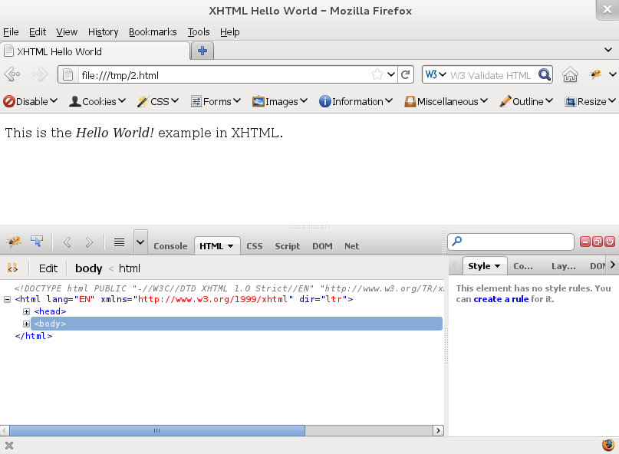
Firefox: Firebug

Slide 80
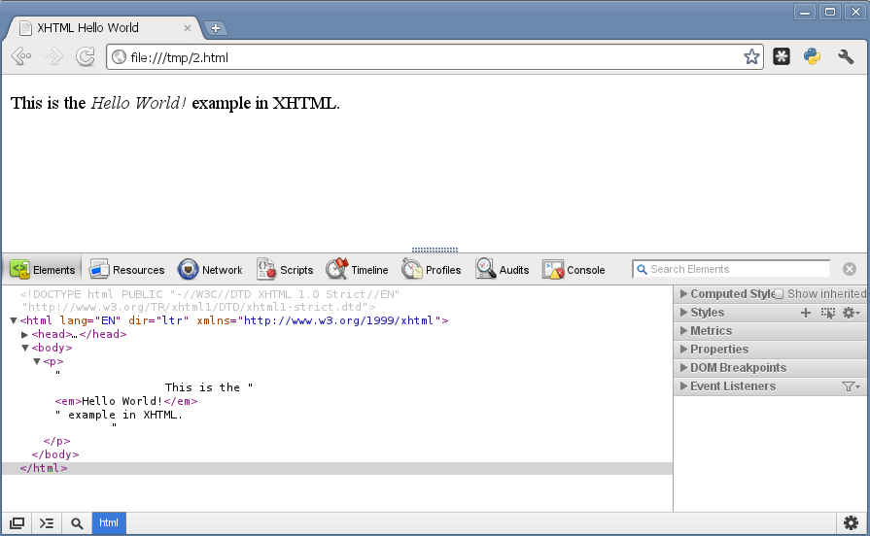
Chrome: Inspect Element

Slide 81
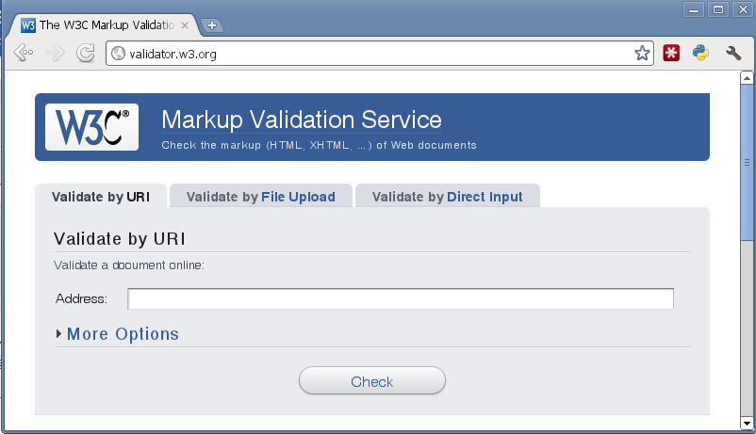
HTML Validation
validator.w3.org

Slide 82
Answers
Q2.1) What language is used for web pages? HTML
Q2.2) What are major parts of a web page? <head> & <body>
Q2.3) How to organize text? <p>, <hx>, <ol>, <ul>, …
Q2.4) How to insert link? <a href=""></a>
Q2.5) How to insert images? <img src="" />
Q2.6) How to insert tables? <table><tr><td></td></tr></table>
Q2.7) How to get data from user? <form action="" method=""> <input type=""> <file>… </form>
Q2.8) Syntax / Semantic error? Validation

Slide 83
References
Reading Assignment: Chapter 2 of “Programming the World Wide Web”
Additional References
Jon Duckett, “Beginning HTML, XHTML, CSS, and JavaScript”, Chapters 1-6
Thomas A. Powell, “HTML & CSS: The Complete Reference, 5th Edition”, Chapters 1 and 3

