Slide 1
MATERNAL HEALTH ANALYTICS DASHBOARD
A Data-Driven Dashboard for Global and Clinical Insight
By Aya Masri

Slide 2
INTRODUCTION
The Scale of the Problem
~800
94%
<70
women die every day from
preventable causes related
to pregnancy
of maternal deaths occur in
low- and middle-income
countries
is the SDG 3.1 target for
MMR by 2030
(per 100,000 births)
Maternal mortality is one of the clearest markers of how well a health system serves its population. Despite steady global progress since 1990, the burden remains heavily concentrated in Sub-Saharan Africa and South Asia, reflecting persistent gaps in access to skilled birth attendance, antenatal care, and emergency obstetric services.
This project responds to that gap by building an analytics tool that lets healthcare decision-makers explore the problem from both a population and an individual patient lens.
2

Slide 3
LITERATURE REVIEW
Key Findings from Prior Research
•
WHO / UNICEF / UNFPA / World Bank (2023)
Their joint estimation report tracks MMR from 2000-2020 and confirms global mortality fell by roughly 34% over two decades, yet progress has slowed since 2016, putting the SDG 3.1 target out of reach on current trends.
•
Sustainable Development Goal 3.1
Sets the global target of fewer than 70 maternal deaths per 100,000 live births by 2030 - the benchmark this project uses to frame country and regional performance.
•
Clinical risk prediction literature
Prior work (e.g. Ahmed et al., the source of our patient dataset) shows that vitals such as blood pressure and blood sugar are reliable, low-cost predictors of maternal risk - supporting machine-learning-based early screening tools like the one built here.
3

Slide 4
METHODOLOGY
Data Sources
WHO Maternal Mortality Ratio
Maternal Health Risk Dataset
Source: WHO MNCAH Data Portal
Coverage: 185+ countries, 1985-2023
Key fields: MMR value, WHO region, World Bank income group, confidence intervals
Source: Kaggle / UCI ML Repository
Coverage: 1,014 patient records
Key fields: Age, blood pressure, blood sugar, temperature, heart rate, risk level
The two datasets were kept separate and used on dedicated dashboard pages, since they operate at different units of analysis - country-year versus individual patient.
4

Slide 5
METHODOLOGY
Build Process
1
2
3
4
Clean & Prepare
Build Dashboard
Train Model
Deploy
Loaded WHO Excel data and Kaggle CSV; verified zero nulls; encoded risk labels
6-page Streamlit app: Overview, Trends, Map, Regional, Patient Explorer, Predictor
Random Forest Classifier, 80/20 split, 100 trees, ~82% test accuracy
Pushed to GitHub, deployed on Streamlit Community Cloud with password protection
Tools: Python, Streamlit, Plotly, Pandas, Scikit-learn, GitHub, Streamlit Community Cloud
5

Slide 6
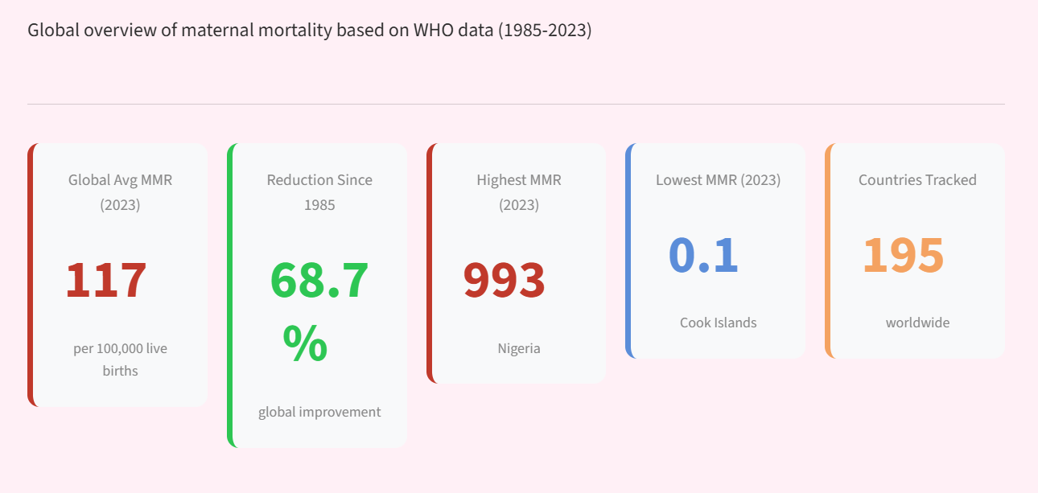
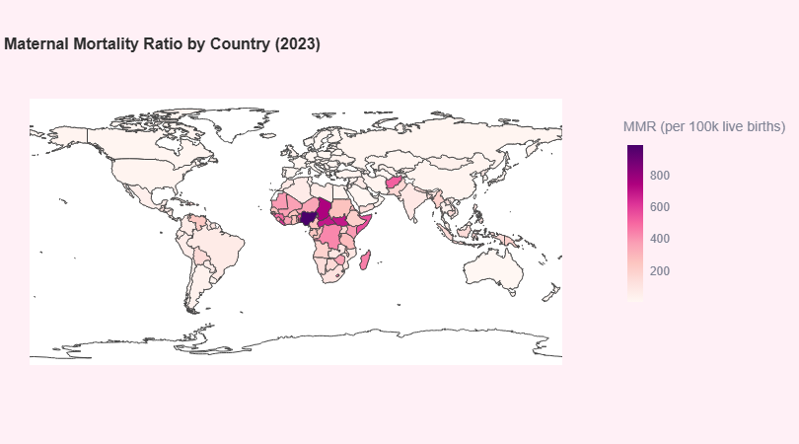
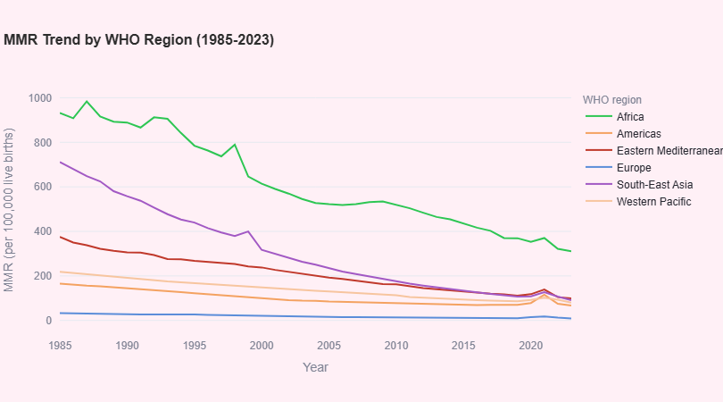
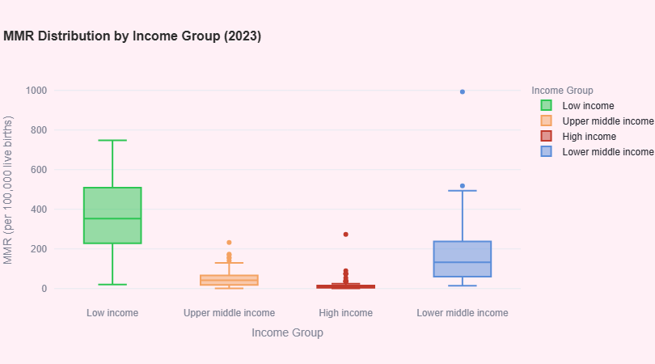
RESULTS
Global Picture
Geographic Map
Regional Trend (1985-2023)
Income Group Distribution
Africa carries the highest regional burden; low-income countries show the widest spread in outcomes.
6

Slide 7
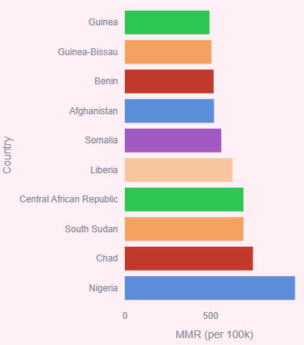
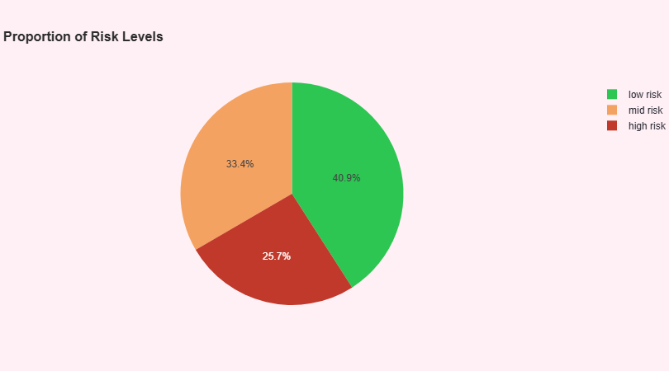
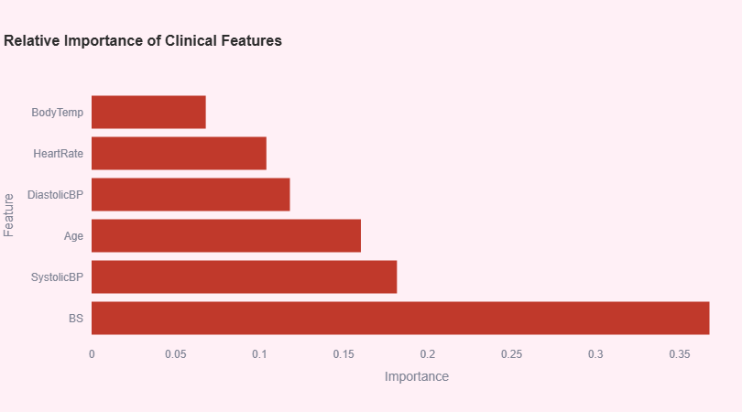
RESULTS
Clinical Picture & Top Burden
Patient Risk Distribution
Income Group Spread
Blood sugar and systolic blood pressure are the strongest predictors of patient risk; Nigeria, Chad, and South Sudan top the country burden.
Top 10 Countries by MMR
Feature Importance (ML Model)
7

Slide 8
CONCLUSIONS
Key Findings
117
68.7%
993
82%
Global average MMR (2023)
per 100,000 live births
Reduction in global MMR
since 1985
Highest MMR in 2023
Nigeria
Risk prediction model
test accuracy
Africa carries the highest regional burden by a wide margin, and a strong income gradient persists: low-income countries average over 350 per 100,000, compared to near zero in high-income countries. Blood sugar and systolic blood pressure emerged as the strongest clinical predictors of patient risk.
8

Slide 9
CONCLUSIONS
Recommendations
•
Target interventions toward Sub-Saharan Africa, where the burden is highest
•
Standardize routine blood sugar and blood pressure screening in antenatal care
•
Direct international health financing toward low-income countries
•
Expand the training dataset to improve model accuracy and generalizability
•
Add a visible SDG 3.1 target line to trend charts for ongoing monitoring
9

Slide 10
Thank You
Explore the live dashboard:
maternal-health-dashboard-pmu2wupa6nfyvcrmtthxtn.streamlit.app

