Slide 1

Data Science Assignment
Co2 Emission Control / Cab Occupancy Prediction / Taxi Clustering
Madhusudhanan Srinivasan

Slide 2
Contents
S. No. | Description | Slide Number
1 | Business Case & Data | 3
2 | Data Preparation & Understanding | 4
3 | Exploratory Data Analysis | 5
5 | Case 1: CO2 Reduction Analysis | 6 - 7
6 | Case 2. To build a predictor for taxi drivers, predicting the next place a passenger will hail a cab | 8 - 11
7 | Case 3 - Bonus Question - Clustering Taxi Cabs | 12 - 14
8 | Deployment Strategy | 15

Slide 3
Business Case & Data
Business Case
The goal of this data science challenge is twofold:
To calculate the potential for a yearly reduction in CO2 emissions, caused by the taxi cabs roaming without passengers. In your calculation, please assume that the taxicab fleet is changing at the rate of 15% per month (from combustion engine-powered vehicles to electric vehicles). Assume also that the average passenger vehicle emits about 404 grams of CO2 per mile.
To build a predictor for taxi drivers, predicting the next place a passenger will hail a cab.
(Bonus question) Identify clusters of taxi cabs that you find being relevant from the taxicab company point of view.
Data
For this data science challenge, we have a dataset containing mobility traces of ~500 taxi cabs in San Francisco collected over ~30 days.
The format of each mobility trace file is the following - each line contains [latitude, longitude, occupancy, time], e.g.: [37.75134 -122.39488 0 1213084687], were,
latitude and longitude are in decimal degrees
occupancy shows if a cab has a fare (1 = occupied, 0 = free)
time is in UNIX epoch format.

Slide 4



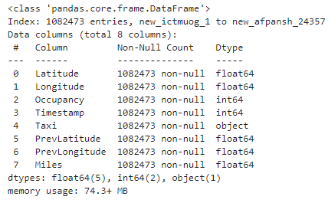
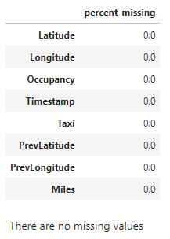
Data Preparation & Understanding
Data Used
For All the experiments I have used 10% of .txt files [To accommodate dev environment’s configurational limitation and computational strength ]
Data Preparation
Load the text files into data frame
Extract the file name and combine it with the index and create new index
Name the columns as 'Latitude', 'Longitude', 'Occupancy', 'Timestamp’
Create a new column ‘Taxi’ with the file name
Create columns with Previous Coordinates
Create 2 more columns ‘PrevLatitude’ and ‘PrevLongitude’ from ‘Latitude’ and ‘Longitude’ respectively
Create another column ‘Miles’ and calculate the distance in miles using the following formula
3959 * (acos(sin(Latitude) * sin(PrevLatitude) + cos(Latitude) * cos(PrevLatitude) * cos(Longitude - PrevLongitude)))
Data Dimension
Data Structure
Missing Values

Slide 5
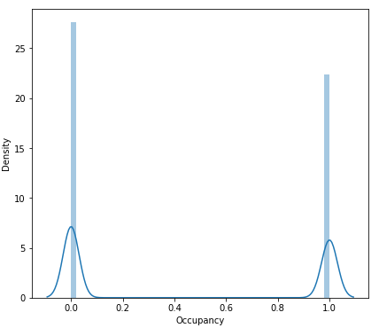
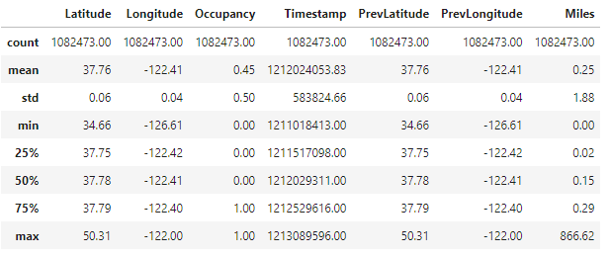
Exploratory Data Analysis
Descriptive Stats
Maximum time is Jun 10, 2008, 11:19:56 GMT+0200 (Central European Summer Time) and minimum time is May 17, 2008, 12:00:13 GMT+0200 (Central European Summer Time)
Occupancy and Vacancy rate seems to be almost equally and normally distributed.
By inspecting the data, I found that some coordinates are places in the Pacific ocean but we can assume that this is a GPS error.
All Variable Stats
We see good correlation between Miles and Latitude / Longitude as it is feature created from Latitude / Longitude .

Slide 6
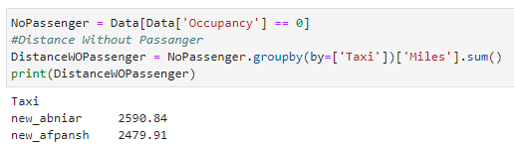
Case 1: CO2 Reduction Analysis
Assumptions & Approach
In order to find yearly CO2 emission reduction,
Distance is calculated in miles metric because in the question it is given, by average passenger vehicle emits about 404 grams of CO2 per mile.
The occupancy filtered on zero. Because we need to see CO2 reduction in taxi cabs roaming without passengers.
Calculate the distances of all drivers to have the total distance of interest for one month.
I multiply the result by 12 and get the yearly distance of interest for the CO2 emissions. As the assumptions is that the taxicab fleet is changing to electric vehicle from combustion engine at the rate of 15% per month. This policy means that the number of taxis with combustion engines is reduced by 15% every month.
Accordingly, I assume that the distance for CO2 emissions is also reduced by 15% every month. Applying this policy for 12 months gives me the new distance for the CO2 emissions with Electric Vehicles.
Then, I take the two distances, divide them by 0.1. Because I only took 10% of the files for my calculation and thus approximate the total distance of all taxis.
Finally, I get the CO2 reduction by multiplying the total distance with the number of CO2 grams per mile and comparing the difference in terms of percentage.

Slide 7
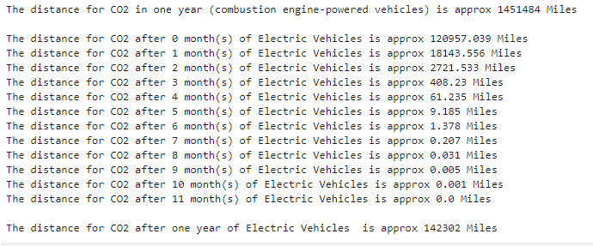

Case 1: CO2 Reduction Analysis …
Results
Reduction in CO2 Emissions

Slide 8
Case 2. To build a predictor for taxi drivers, predicting the next place a passenger will hail a cab
Assumptions & Approach
Based on the given dataset with Lat, Lon, Time data, To predict the next place a passenger will hail a cab, I divided the question in to two phases.
First Phase - To predict the next place that cab will go.
Second Phase - To predict occupancy - customer hail the cab.
First Phase
We can think it as time series problem. I built a model that predict the location at a time ‘t’ by using as previous location in t-1, t-2 and t-3.
Set Lat, Long offset to normalize the Latitudes and Longitudes
First, created a neural network model with one input layer, one hidden layer and one output layer for one taxi driver. The same must be done for other taxis
Alternatively, I predict longitude and latitude separately with Gradient Boosting algorithm. In order to increase performance of GBM model, we can change the previous window and hyper-parameter tuning.
Second Phase
To predict occupancy, I built a Random Forest Classifier to predict whether next location is a pick-up point or not.
I subset 10% of the total data and all data and using timestamp data I generate day of week, hour and time data.
I think also adding holiday and weather data will be very useful to our model. So, I added holiday data as a flag and retrain Random Forest Classifier model.
There is only 1 holiday in the given period which are Memorial Day(26th of May).
Result of Holiday Flag added model has 1% increase in F1 and Precision of predicting hailing a cab.
Therefore, we can use holiday flag for our model, and having other data such as weather will be valuable.
Note: I did not do hyper-parameter optimization because of the time / resource constraint. Other algorithms logistic regression, SVM, XgBoost, light GBM etc. could also be tried.
Finding next pick-up point (Final Occupancy Model)
We can get the next pick-up location by combining the next location predictor for each taxi driver and the occupancy classifier.
The next location prediction coordinates can be fed into the pick-up point classifier which will indicate the next pick-up location with a certain probability.

Slide 9
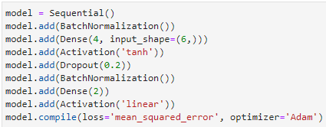


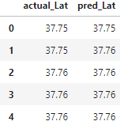
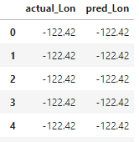
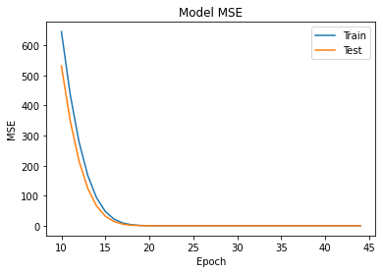
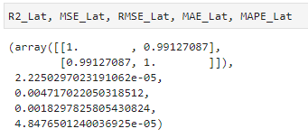
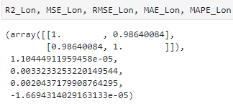
Case 2. To build a predictor for taxi drivers, predicting the next place a passenger will hail a cab …
Phase 1 - To predict the next place that cab will go [ For Single Taxi ]
Models Built and Evaluated
Model 2 : Gradient Boosting Regressor To Predict Latitude and Longitude Separately
Model 1 : Neural Network
Latitude Prediction
Longitude Prediction

Slide 10
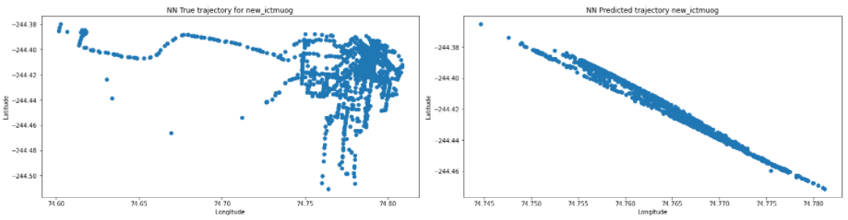
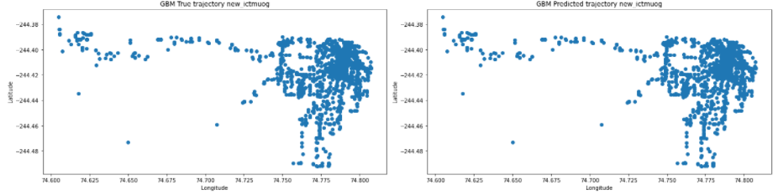

Case 2. To build a predictor for taxi drivers, predicting the next place a passenger will hail a cab …
Phase 1 - Model Evaluation (NN and GBM Models)
First column is exact route for new_ictmuog taxi.
Second column is predictions of models Neural Network and Gradient Boosting, respectively.
As you can see in plot GBM results are much better than Neural Network model.
Also, when we compare Mean Squared Error of NN and GBM's Longitude, Latitude models GBM models’ results are much better than NN model.
Note: The mean squared error tells you how close a regression line is to a set of points. It does this by taking the distances from the points to the regression line (these distances are the “errors”) and squaring them. The squaring is necessary to remove any negative signs. It also gives more weight to larger differences. It’s called the mean squared error as you’re finding the average of a set of errors.

Slide 11






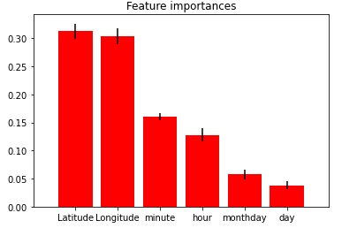
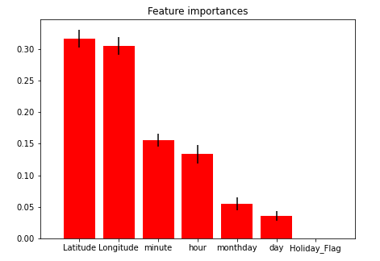
Case 2. To build a predictor for taxi drivers, predicting the next place a passenger will hail a cab …
Phase 2 - To predict the occupancy
Models Built and Evaluated
Model 1 : Random Forrest Model on Data Without Holiday Flag
Model 2 : Random Forrest Model on Data With Holiday Flag
Model Comparison & Selection
Result of Holiday Flag added models has % increase in F1 score and precision of predicting hailing a cab is increased by 1%. Therefore, we can use holiday flag for our model for better prediction.
Also, if we have other data like Weather Information, the predictions could be much better

Slide 12
Case 3 - Bonus Question - Clustering Taxi Cabs
Assumptions & Approach
I apply two different methods to identify cluster of taxi cabs.
First Approach:
Using DBSCAN (Density-Based Spatial Clustering of Applications with Noise) that is a popular unsupervised learning method utilized in model building and machine learning algorithms
I subset 10% of the total data and divided into two in terms of occupancy flag
I looked other cabs where they are driving in the past and where they will go after it
By doing so, I clustered its cabs together based on similarity of behavior
Second Approach
Implementing RFM [Recency, Frequency, Monetary Value ] methodology
I subset 10% of the total data and I found total miles per cab, total occupied miles per cab and average active minutes per day
Using mindset of RFM, I split the data into 4 in terms of quantile
Using this quantiles, I create 7 sample of segments
Segments in slide 14

Slide 13
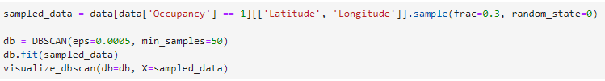

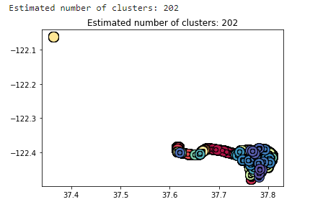
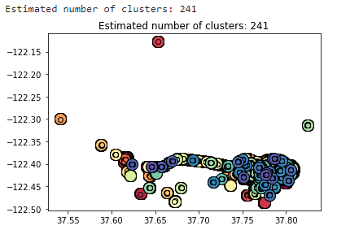
Case 3 - Bonus Question - Clustering Taxi Cabs
Clustering Results
DBSCAN (Density-Based Spatial Clustering of Applications with Noise)
Occupancy = 1
Occupancy = 0

Slide 14
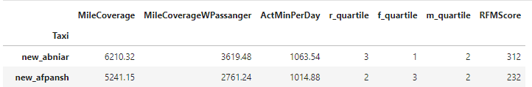
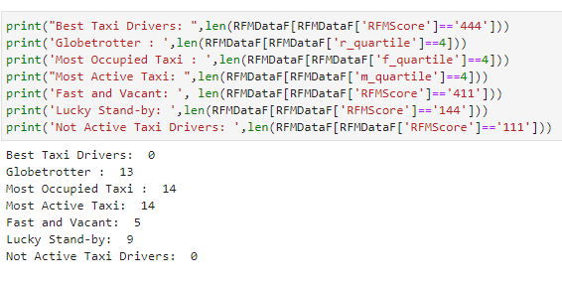
Case 3 - Bonus Question - Clustering Taxi Cabs
Clustering Results
RFM [Recency, Frequency, Monetary Value ] methodology
Clusters Formed
Best Taxi Drivers: Actively driving cab and working much more than other per day
(if mile coverage, mile coverage with passenger and active minutes per day are in the top %25)
Globetrotter : Actively driving cab
(if mile coverage is in the top %25)
Most Occupied Taxi : Actively driving cab with passenger
(if mile coverage with passenger is in the top %25)
Most Active Taxi: Working much more than other per day
(if active minutes per day is in the top %25)
Fast and Vacant: Actively driving more miles but less minutes per day. That means he/she drives fast with more vacant
(if mile coverage is in the top %25 and mile coverage with passenger and active minutes per day are in the bottom %25)
Lucky Stand-by: Driver is not driving without passenger, but he/she drive more than other in terms of mile coverage with passenger and active minutes per day.
(if mile coverage is in the bottom %25 and mile coverage with passenger and active minutes per day are in the top %25)
Not Active Taxi Drivers: Not actively driving cab and working much more than other per day
(if mile coverage, mile coverage with passenger and active minutes per day are in the bottom %25)

Slide 15
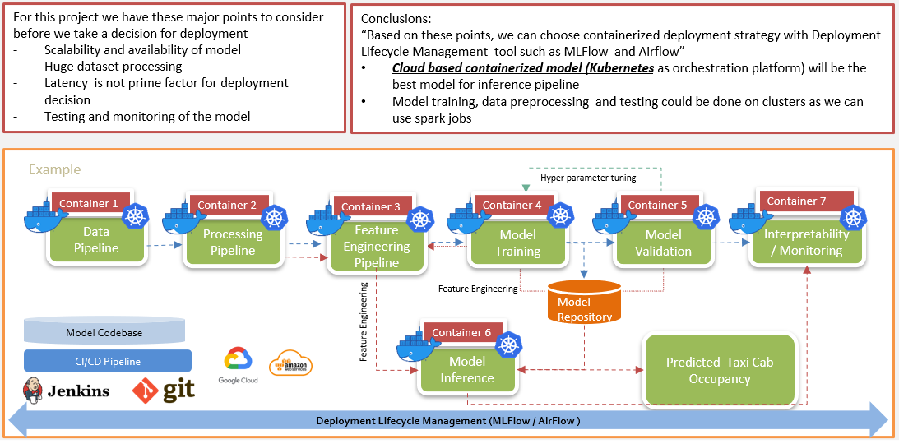
Deployment Strategy
Models Deployment
Model artifacts like the Encoders, Scalers and Model Object to be saved
Complete pipeline to be deployed with separate containers for each steps like data collection, preparation, feature engineering, Model Training, Prediction, Monitoring and Retraining
Jobs to be scheduled using ML Flow or Airflow

Slide 16
Thank You
Madhusudhanan Srinivasan

