Slide 1
Item Level Weekly Unit Sales Forecast
Madhusudhanan Srinivasan

Slide 2
Table of Contents
Contents | Slide No.
Business Case & Assumptions | 3
Data Preparation & Feature Engineering | 4
Exploratory Data Analysis | 5 - 10
Methods and Models | 11
Model Comparison and Evaluation | 12 - 13
Model Selection | 14
Deployment Ideas | 15 - 17

Slide 3
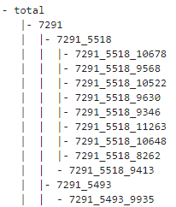
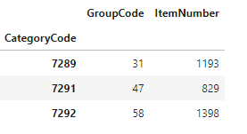
Business Case & Assumptions
Case
A significant part of the sales at retail stores are promotion sales. In order to run a successful promotion campaign, it is important to obtain an understanding of the uplift in sales of certain items when put on promotion. This is not only necessary to decide on what type of promotions to run, but also to get an idea on the required levels of stock to discuss with our suppliers. The Commerce Business Unit is developing a planning tool in which they want to see the effect of promotions for the upcoming weeks
Task
Create one or more models to forecast the Unit Sales one week ahead in case of a promotion or no promotion on an article level.
Assumptions
As Sales forecast is expected at an article level, I am making the following assumptions
In the dataset we have the following Product hierarchy
Category Code -> Group Code -> Item Number
For Example,
Category Code : Food
Group Code : Meat
Item Number : Chicken, Beef, Pork, etc.
Group Code : Dairy
Item Number : Milk, Cheese, Butter, etc.
Based on the above assumption let us forecast the sale at an article level using Item Number

Slide 4
Data Preparation & Feature Engineering
Data Preparation and feature engineering for EDA
Initial level of data was prepared for the Exploratory Analysis. Further level of model specific feature engineering and data preparations were done to evaluate models' performance
Baselevel Data Preparation
Missing value check and imputation
Features with more than 60% of missing values were dropped
Unit Promotion Threshold', 'School Holiday Middle', 'School Holiday North’, 'School Holiday South', ‘Min Age’, Alcohol Percentage’, 'Communication Channel', 'Base Price', 'Discount Percentage', RainFallSum
Features with less nulls were imputed with mean if they were of integer or float type. Mean imputation was done to visualize the outliers if any .
Date column was converted to Datetime
IsPromo was converted to Binary 0/1 from Boolean
National Holidays were converted to a single column as ‘Is_Holiday’
New features Week, Month, Year were obtained from Date
Final list of columns used for EDA
'Date', 'Category Code', 'Group Code', 'Item Number', ‘Is Promo’, 'Is_Holiday', 'Unit Sales', 'Week', 'Month', 'Year'

Slide 5
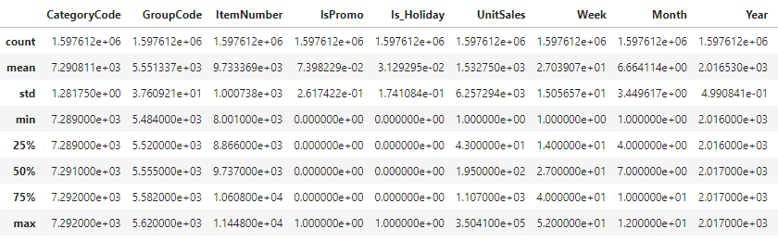
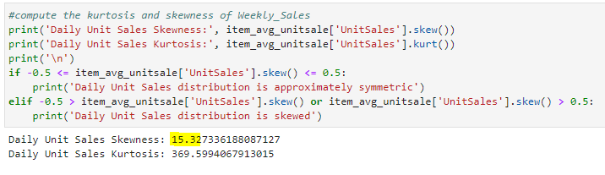
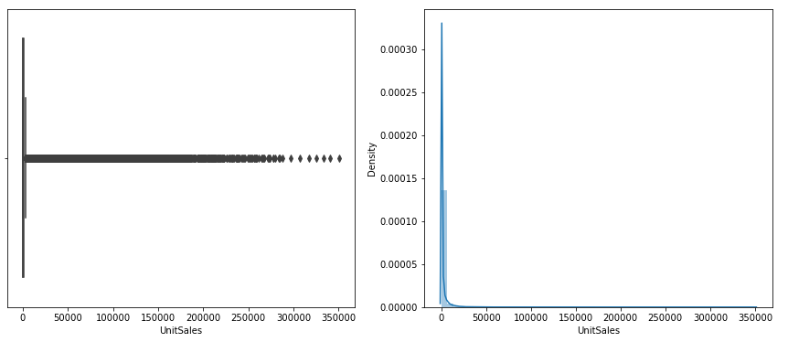
Exploratory Data Analysis
Descriptive statistics of quantitative data
Here we can see the Unit Sales has Outliers with min and max between 1 and ~ 0.3 million respectively
Data Skewness – Outliers Check on Daily Unit Sales – Shows it is positively skewed

Slide 6
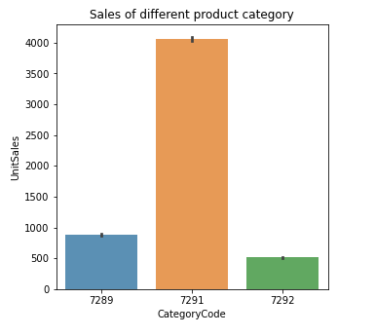
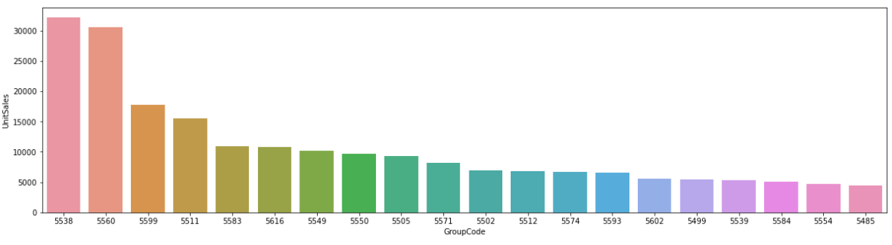
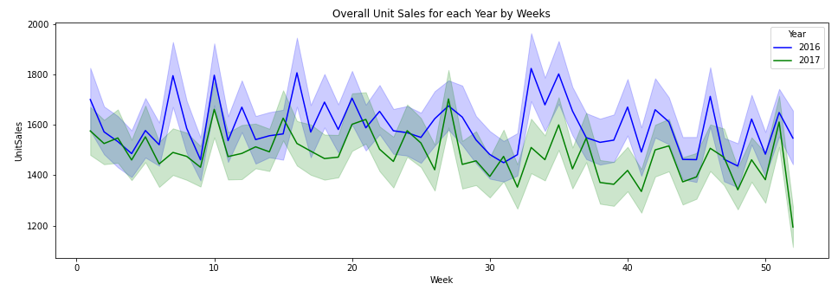
Exploratory Data Analysis …
Daily Trends
Daily sales performance of all product categories Top 20 Groups – Based daily unit sales
Weekly Trends
Visualize features & trends (Daily / Weekly / Monthly) of Unit Sales
Here we see that the daily unit sales of a category '7291' is high, while the other 2 categories are quite low in comparison.
There could be various influencing factors for this.

Slide 7
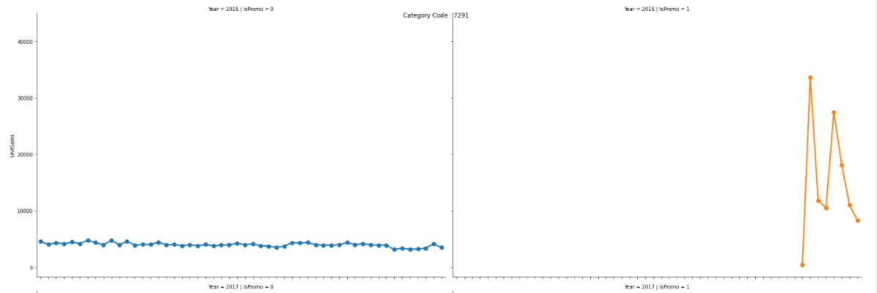
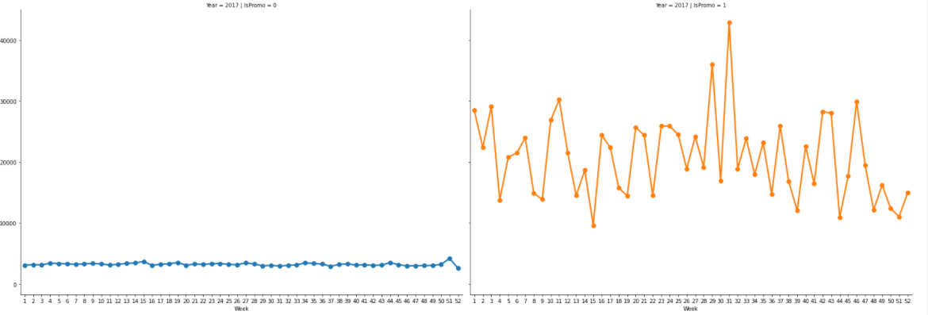
Exploratory Data Analysis …
Sample : Trend for Category 7291 in 2016 & 2017
The overall weekly sales across all 3 categories (7289,7291,7292) has increased in both 2016 and 2017 with promotion
In 2016 The Promotion of all 3 categories of product was done only towards the year end
In 2017 the promotion for all 3 categories has been done throughout the year
In2017 With Promotion,
Category 7292 has seen significant spikes around week 14 -15 (April) and week 34 -39 (Aug - September)
Category 7289 has seen significant spikes around week 15 - 20 (April-May), week 32 -38 (August-Sep),and week 45 -49 (November-Dec)
Category 7291 has seen significant spikes around week 27 - 32 (July - August)
Category wise Unit Sales vary across week, year with and without Promo

Slide 8
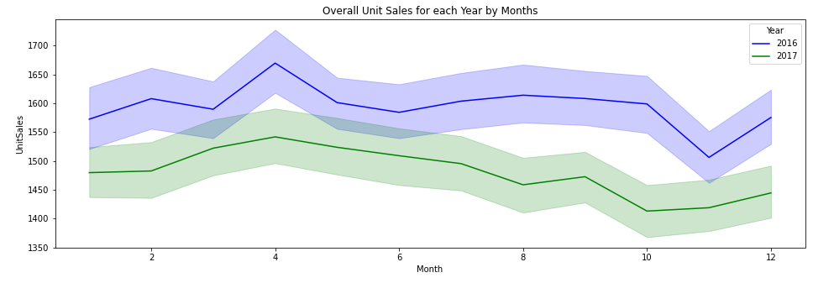
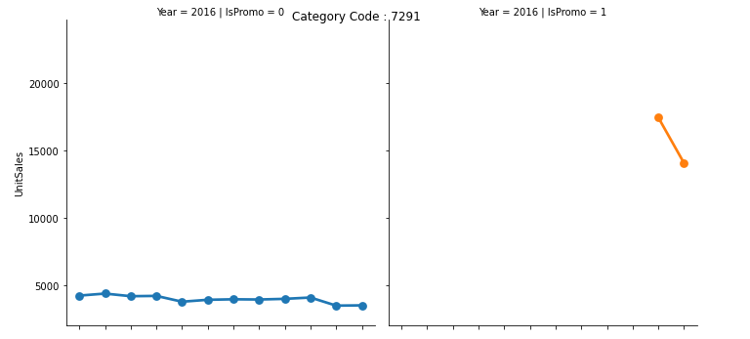
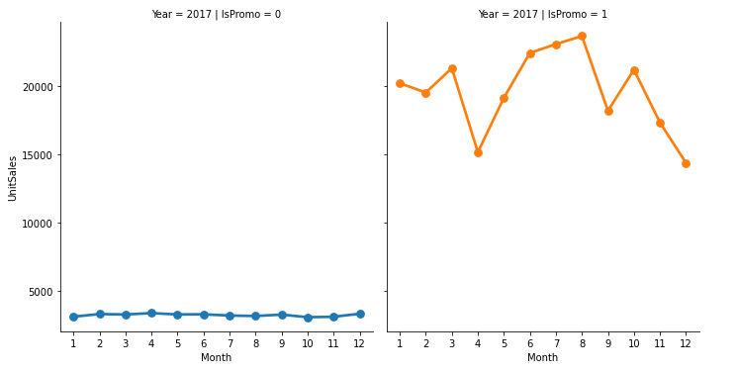
Exploratory Data Analysis …
The overall monthly sales in both 2016 and 2017 has seen an increase in unit sales around Summer months (April – Aug), (Sep –Oct) and slight decrease towards November and again increase in December.
Category wise Unit Sales vary across month, year with and without Promo [Sample : Category 7291]
Monthly Trends
Trends are similar to weekly trends

Slide 9
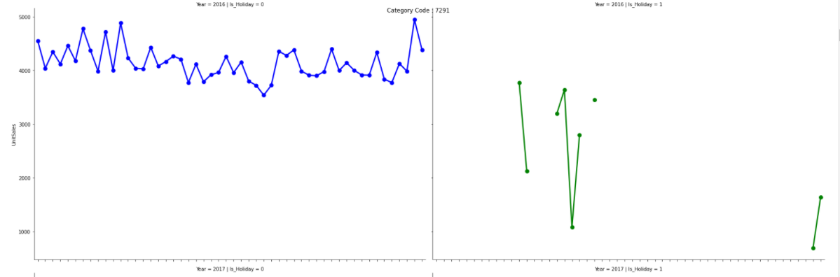
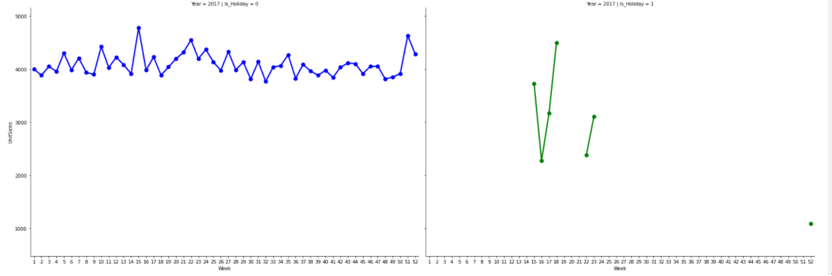
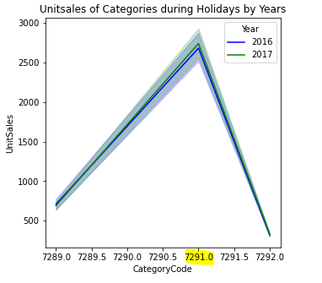
Exploratory Data Analysis …
Effect of National Holidays on Sales
Category Wise Unit Sale during National Holidays Weeks [Sample : Category 7291]
The Weekly Sales during Holiday Weeks is not very similar to sales during non holidays, the sales during holidays has gradations and tends to slightly go down as people might be travelling on vacation or could be eating at restaurants.
7291
2016 - Slight decrease during holidays
2017 - Sales was more or less similar to non holiday days with slight gradations
7289
2016 - Sales was more or less similar to non holiday days with slight gradations
2017 - Sales was more or less similar to non holiday days with slight gradations
7292
2016 - Sales decreased during Holidays
2017 - Sales decreased during Holidays
In Both the Years across all weeks irrespective of holiday or not the Sales of category 7291 was always been high amongst the 3 categories

Slide 10
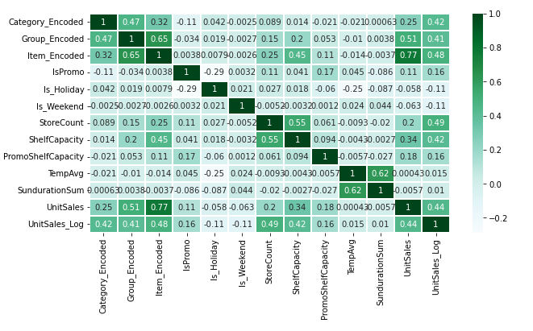
Exploratory Data Analysis …
Correlation between various features and unit sales – used for regression
we see good correlation between Unit sales and,
Item_encoded,
Group Encoded, Category_encoded,
Is_Promo,
Is_Holiday,
Is_Weekend,
StoreCount,
Shelf Capacity
Promo Shelf Capacity

Slide 11

Methods and Models
1. Time Series Forecasting (On Single Item – Trial)
Running Time Series Models at Item Level is very time consuming as we have more than 3000 Items. Finding Stationarity of data at an item level and making it stationary if it isn't using loops is a computationally costly and inefficient process
Therefore, for First Trial, 1 Item that was promoted and not promoted was and the forecast was done on weekly resampled data
Models Used – SARIMAX and Prophet
2. Hierarchical Time Series Forecast (HTS Regressor)
A hierarchical time series (HTS) is a collection of time series that follows a hierarchical aggregation structure. As we have the Category -> Group -> Item hierarchy, this hierarchical forecasting could be a better approach to forecast at each level of hierarchy
Created Separate Hierarchy data frame on weekly resample based on promotion and not on promotion
Models Used
On Promotion
Bottom-Up Approach – Auto-Arima, Sarimax
Reconciliation - optimal combination using OLS
Sarimax , Prophet
Not On Promotion
Reconciliation - optimal combination using OLS
Sarimax , Prophet
3. Regression Models
Though regression models are not for time series forecasting, they generally work well on any regression problem
Separate Feature engineering was done, new features were created, and weekly level resampled data was created.
Features used for predicting Unit sale
Models Used
Linear Regression
Random Forrest Regressor [Bagging Model]
XG Boost Regressor [ Boosting Model ]

Slide 12
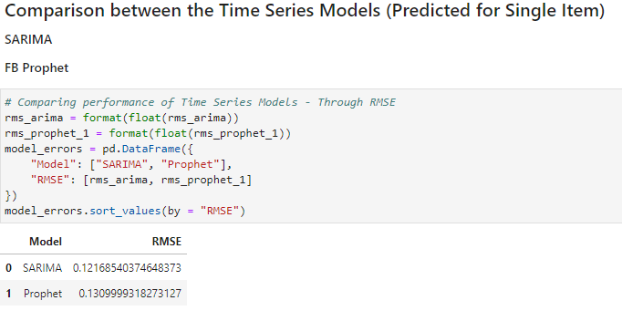
Model Comparison and Evaluation
Models Evaluation Metrics Used
Time Series and Hierarchical Time Series Forecasting Models
Root Mean Squared Error (RMSE ) : Root Mean Square Error (RMSE) is the standard deviation of the residuals (prediction errors). Residuals are a measure of how far from the regression line data points are; RMSE is a measure of how spread out these residuals
Regression Models
RMSE
R2 Score : R-squared (R2) is a statistical measure that represents the proportion of the variance for a dependent variable that's explained by an independent variable or variables in a regression model.

Slide 13
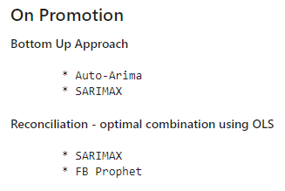
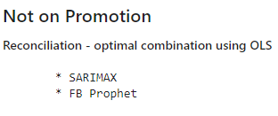
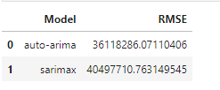
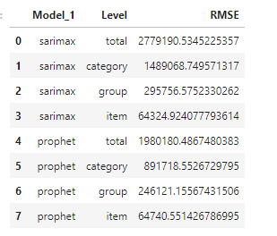
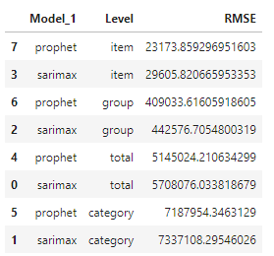
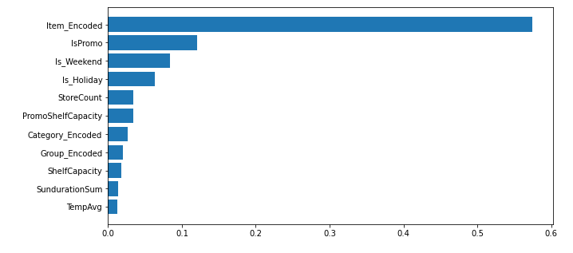
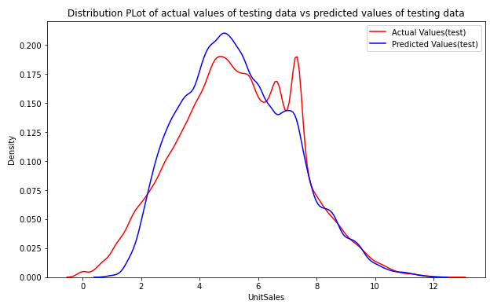
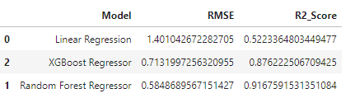
Model Comparison and Evaluation …
Comparison between the Hierarchical Time Series Forecasting Models - HTS Regressor
Comparison between the Regression Models
Feature Importance from XG Boost & performance graph

Slide 14
Model Selection
The Timeseries models both SARIMAX and FB Prophet performs reasonably well for the single item trial.
It works well by considering major patterns in the data such as seasonality, trend, residual noises
But running Time Series approach on an Item Level is Time Consuming as we would need separate forecast for each product and may require production servers with significant configuration and computational strengths.
So provided we have a high-end production environment (On Premises or Cloud) the best option would be is to use Timeseries forecasting for any future nonstationary Data.
The Hierarchical Time Series Forecasting (HTS Regressor)
The Hierarchical Time Series Forecasting using SARIMAX, and Prophet with OLS Reconciliation on both Promotion and Non-Promotion DF worked well on a Total and Category level, reasonably at group level, but not significant on Item Level.
Might need further Hyper Parameter Tuning to improve the performance
Regression Methods
Though Regression models are not specifically built for Time-series data, They tend to work well in cases like this where we need predict sales on an item level.
Models like XGBoost is an optimized distributed gradient boosting library designed to be highly efficient, flexible and portable. It performs perform extremely well in all kinds of regression problems.
Final Model Selected : XGBoost Regressor
Though the Random Forest Regressor had better R2 score and low RMSE , based on the feature importance the proportion of the variance for unit sales that's explained by the features of importance was less significant. Top reasons were not captured.
XGBoost Regressor had good accuracy and relatively low MSE, beyond that, it was able to capture the top reasons that affects the Unit Sales per item
Item
Promotion
Is_Weekend
Is_Holiday
Store Count / Promoshelf Capacity
Category

Slide 15
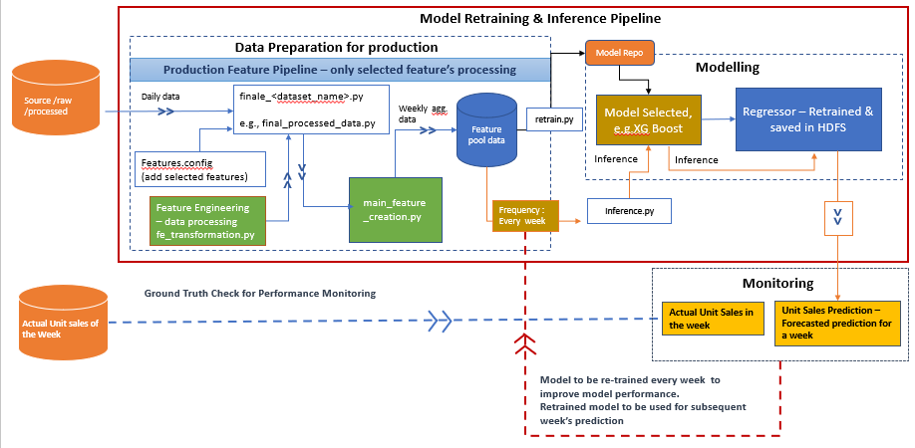
Deployment Ideas
Approach 1 - Deployment on premises environment, using HDFS storage, Ansible for Config management, Jenkins to create Builds, Airflow for Scheduling and ELK stack for dashboarding
Create an Ansible playbook configuration
To read input from HDFS and write it back to HDFS
Create the Kafka topics to which the output from HDFS must be pushed to
Create the Elastic Search Index to which the data from Kafka topic must be pushed to.
Read data from hdfs and process it as per above steps
Load the pre-trained model saved in HDFS , make predictions and push back the resulted dataframe to hdfs.
Output from HDFS is pushed to Elastic Search using Kafka brokers
Dockerize and create builds using Jenkins
Create the Airflow dags using Jinja2 templates for executing the steps above
When the scheduled job along with it's configurations gets executed in Airflow, Iput is read from HDFS, the processed, pretrained model is loaded and prediction happens, predicted output is pushed to HDFS, then to Kafka topic, then to Elastic Search index
The visual dashboard can be created on Grafana / Kibana using the data from the Elastic Search

Slide 16
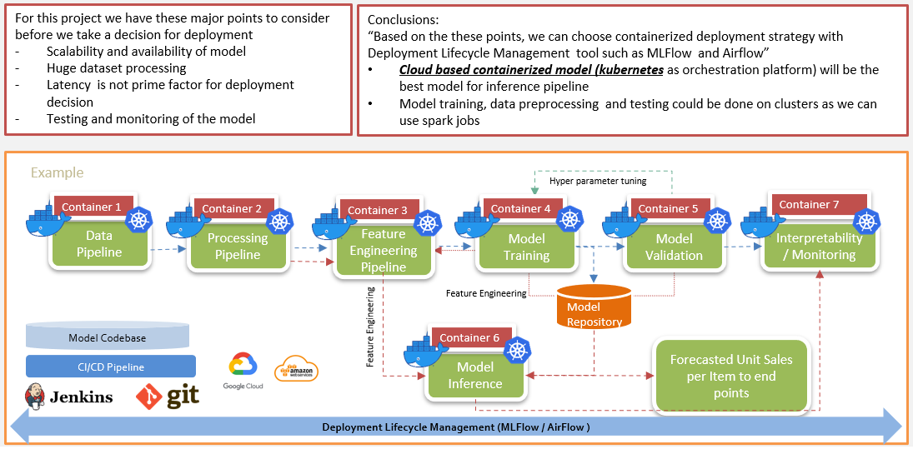
Deployment Ideas…
Approach 2 - Deployment Using Containers orchestrated with Kubernetes (On Cloud or On Premises)

Slide 17
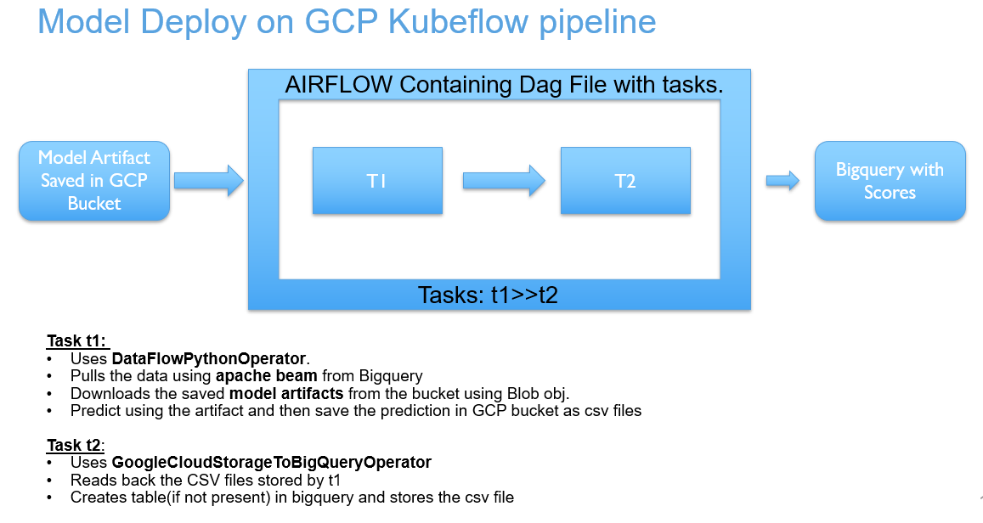
Deployment Ideas…
Approach 3 – Deployment on Google Cloud Using Kubeflow

