Slide 1
Naqsha-e-Safar
BSCS22005/12/18/85/99

Slide 2
Identifying and Classifying Public Transit Deserts in Lahore Using Graph Neural Networks
This project identifies areas in Lahore with high population density but poor
access to public transport i.e “transit deserts.” Using population data
(WorldPop), transit routes (CityLines), and the city’s road network
(OpenStreetMap), we model Lahore as a spatial graph and apply a Graph Neural
Network to classify underserved regions. The outcome is a data-driven map of
transit accessibility gaps to guide future transport planning.

Slide 3
Datasets
1. [WorldPop (Population Density Data)](https://hub.worldpop.org/geodata/summary?id=48110)
2. [OpenStreetMap](https://www.openstreetmap.org/)
3. [CityLines](https://www.citylines.co/lahore)
4. [Zameen - Speedo Bus Routes in Lahore](https://www.zameen.com/blog/speedo-bus-routes-lahore.html)

Slide 4
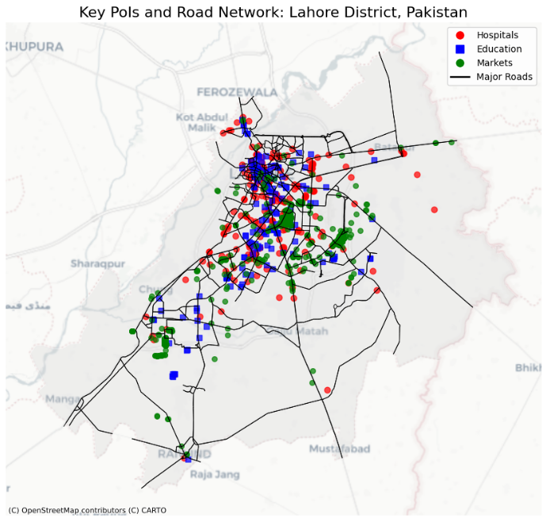
Steps (01)
Programmatically download and clean up data
Manually cleaned up Speedo’s CSV data
Get Lahore’s points of interest (PoI) via OSMNX
Feature engineering: PoI geometry

Slide 5
Steps (02)
Load Metro + Speedo data into separate GeoDataFrames
Insert new nodes into graph
  To ensure connectivity, we add an edge between a stop and the nearest other PoI (necessary for community detection)
  Nodes: ~140,000 // Edges: ~200,000
Add features: distribute population evenly amongst all nodes in vicinity & compute distance to nearest public transit stop
  These were deemed as crucial features for the GNN
  We were previously quantizing every PoI to its nearest population reading, but that inflated population density erroneously

Slide 6
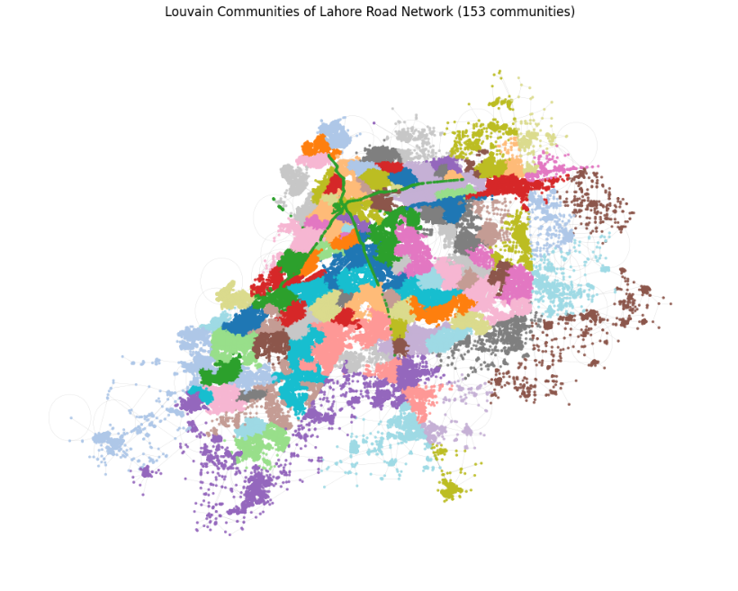
Steps (03)
Run Louvain to partition ~160 communities
One-hot encode communities as node features
Feature Management
  Convert to numeric types where necessary
  Remove string attributes
  Generate labels
    Label corresponds to whether this node
    is in a transit desert or not
    Idea: pick very ‘obvious’ nodes, using
    tight constraints

Slide 7
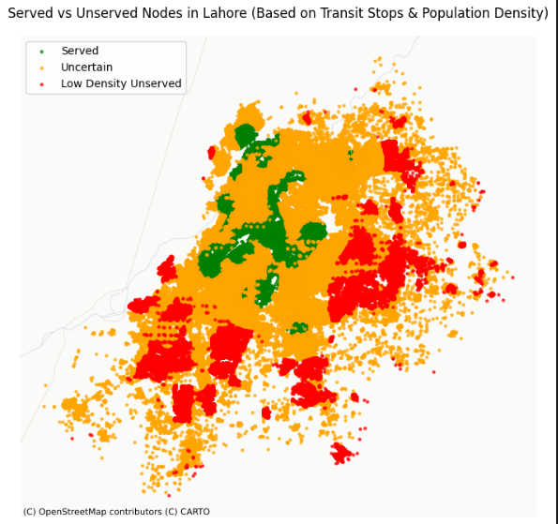
Steps (04)
Label generation (cont.)
  Benefit of picking obvious nodes: natural train/
  test partitioning
  Which nodes are ‘obvious’?
    Population > Mean population &
    Distance to stop < 1500; OR
    Population < Mean population &
    Distance to stop > 4500
  The obvious nodes are used for training
  Every single other node is ‘uncertain’
  and becomes part of the ‘test’ set of our GNN

Slide 8
Steps (05)
Final node features: x, y, population, distance_to_nearest_stop, street_count, is_transit_stop, comm_1, comm_2 … comm_k
Train a simple GCN, and run it on the test set, to get label predictions
‘Back-project’ node classifications onto communities
  Take a ratio of the number of nodes in that community w/ positively-predicted labels, against the total number of nodes within that community
Sort all communities using this aforementioned ratio

Slide 9
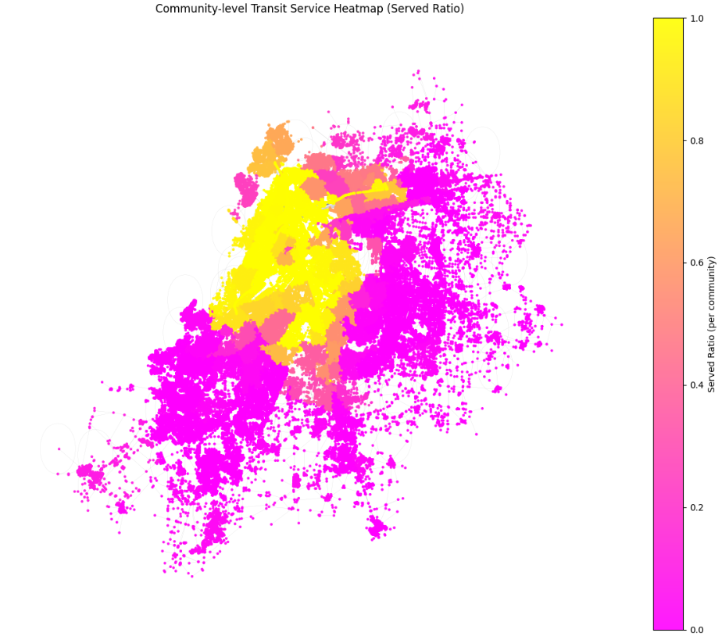
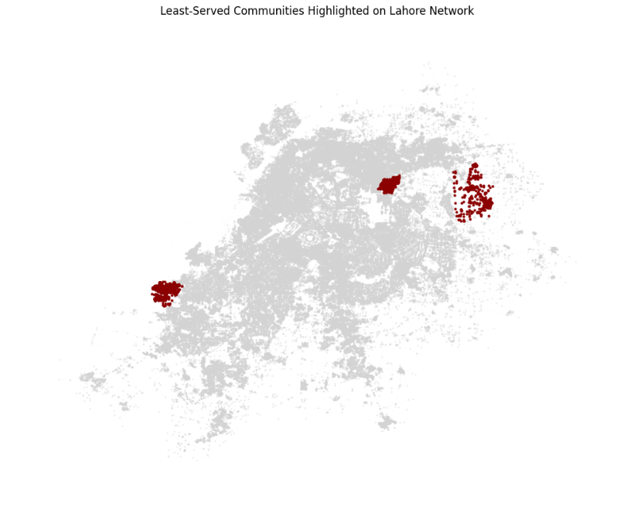
Results

Slide 10
Conclusion
Our results are mildly exaggerated, by virtue of incomplete data, but I do believe that they are a step in the right direction.
Additionally, I think that more PoIs lying towards the urban center of the city probably skewed the GNN.
Communities towards the edges of the city are more ‘scattered’ in terms of PoIs, which is not necessarily representative of the truth.

Slide 11
Alternate Approaches (01)
Community Detection
  Label-propagation algorithm – it worked, but it generated way too many communities.
  DBSCAN – communities were too ambiguous; probably an error on our side, but we decided to not waste time. This would’ve helped to to suggest a route for transit deserts
Node Classification
  GAT – scrapped due to computational-intensity (1.5hr+ training times)
    Perhaps because of the abundance of one-hot encoded community labels?
      May reconsider when we have manual (and thereby fewer + more realistic) community partitions
    Might have performed better because it learns edge weights & considers neighbouring nodes differently (which is a practical feature in a city network)

Slide 12
Alternate Approaches (02)
An alternative to node classification I concerned was treating this problem as a graph classification problem.
Convert Louvain’s generated communities to separate subgraphs
Take a few ‘obvious picks’ (manually) and label them accordingly
Train a GNN
Run it on the remaining/uncertain communities

Slide 13
Logistic Concerns w.r.t Development
Jupyter notebooks are intrinsically deeply flawed
  Large heap-allocations during data-wrangling subsequently result in frequent OOMs on older hardware; garbage collection is a sin
  Irreproducible outputs due to mismanagement of variable state
Python tooling conflict; `pyproject.toml` files weren’t updated
Version control clobbering w.r.t Jupyter notebook metadata
Coordinate Reference System (CRS) ambiguity wasted crucial hours and mental fortitude – ESPG:4326 <-> ESPG:32643

Slide 14
Postmortem
In hindsight, our primary problem was that data preprocessing took way too long.
We also should have been using a Git hook to wipe out notebook metadata, to prevent needless changes.
In praise of our project, one extremely powerful observation w.r.t our work is how easy it is to scale to other cities.
  Most ‘modules’ (be it data preprocessing, community detection, or the GNN) are interchangeable (w/ a little hassle to ensure the inputs/outputs line up).

Slide 15
Future Work
Below lie my assumptions/caveats/limitations. These can be ameliorated/removed as future directions of work.
Few stops; we only have the Red Metro, Orange Line, and 70 unique Speedo stops
'Communities' returned by Louvain are not representative of actual residential 'societies' in Lahore
Don't account for 'self-sufficient' methods of transport e.g communities w/ a teeming qingqi culture
Missing data e.g stops along Speedo routes (we ignore these)

