Slide 1
PROGRESS REPORT
A Price-Forecasting Digital Twin for India's Agricultural Commodity Markets
TOP Digital Twin
Integrating Satellite Imagery · Climate Stress · Market Price Dynamics
Project Review
Dr. Masroor · SKUAST-K · July 2026
470
2,495
16
29
ISO Weeks 2017–2025
APMC Markets 3 Crops
Python Scripts Built
Paper Figures Generated
TOMATO
ONION
POTATO
Notes:
━━━━━━━━━━━━━━━━━━━━━━━━━━━━━━━━━━━━━━━━━━━━━━━━━
SLIDE 1 — TITLE | Suggested time: 2 minutes
━━━━━━━━━━━━━━━━━━━━━━━━━━━━━━━━━━━━━━━━━━━━━━━━━
EXACT OPENING LINE (memorise this):
"Good morning/afternoon. Thank you for making time. What I am about to present is a progress update on the TOP Digital Twin — a price-forecasting system for India's tomato, onion, and potato APMC markets. This is funded under HADP-04 at SKUAST-K, and our target is a Q1 journal submission."
THEN POINT TO EACH STAT AND SAY:
→ "We have assembled 470 weeks of data — that is nine years, from January 2017 to December 2025."
→ "We are modelling 2,495 APMC markets — not just a handful of strategic APMCs, but essentially the entire qualifying universe of Indian markets for these three crops."
→ "We have built 16 Python scripts that process everything from raw Agmarknet data to trained forecasting models."
KEY MESSAGE FOR THE OPENING:
"This is not a preliminary study. The data infrastructure is largely complete. The models are running. What this presentation covers is where we are, what we have found, and what the three or four remaining actions are before we can submit."
CLOSE THE TITLE SLIDE WITH:
"Let me start with why we are doing this."
━━━━━━━━━━━━━━━━━━━━━━━
NUMBERS TO KNOW:
• 470 weeks = 9 years (Jan 2017 – Dec 2025)
• 2,495 markets (1,567 tomato + 843 onion + 85 potato)
• 16 Python scripts + 5 GEE JavaScript scripts = 21 scripts total
• 29 paper-ready figures already generated
• Target: Computers and Electronics in Agriculture (IF ~8.1, Q1)
━━━━━━━━━━━━━━━━━━━━━━━

Slide 2
The Research Problem
Why India's TOP crop prices demand a data-driven forecasting solution
THE VOLATILITY PROBLEM
THE FORECASTING OPPORTUNITY
▸ India produces ~175 MT vegetables annually; TOP crops account for ~27% of total output and an even larger share of farm income volatility.
▸ Tomato prices can swing ±400% within a single season — from ₹2/kg at harvest to ₹120/kg at peak scarcity.
▸ 2019 Onion Crisis: prices hit ₹150–200/kg; government banned exports, NAFED intervened with buffer stock releases.
▸ 2023 Tomato Spike: retail prices crossed ₹250/kg in multiple metros within weeks of a supply shock in Kolar.
▸ COVID-2020: supply chain disruptions caused simultaneous price crashes at farm gate and price spikes in retail markets.
▸ Current policy response is REACTIVE: interventions happen after the crisis is visible in retail prices.
▸ Existing models rely on national-level monthly data — too coarse, too slow.
▸ A 9-year, 470-week panel of APMC prices + satellite vegetation health + climate stress makes PREDICTIVE intelligence possible.
▸ First study to jointly model supply-side satellite signals, climate risk, and macro-logistics for Indian vegetable price forecasting.
THE RESEARCH GAP WE FILL
▸ Weekly granularity across all major APMC markets (not state averages)
▸ Supply-side signals: satellite NDVI anomaly + heat stress days from production zones
▸ Rolling-origin validation: 4 test years (2022–2025) with 4 forecast horizons
▸ Ablation design proves the marginal value of each data layer
TOP Digital Twin · SKUAST-K · HADP-04 · July 2026
REVIEW
Notes:
━━━━━━━━━━━━━━━━━━━━━━━━━━━━━━━━━━━━━━━━━━━━━━━━━
SLIDE 2 — RESEARCH PROBLEM | Suggested time: 3–4 minutes
━━━━━━━━━━━━━━━━━━━━━━━━━━━━━━━━━━━━━━━━━━━━━━━━━
OPENING LINE:
"Tomato, onion, and potato — we call them TOP crops — account for roughly 27% of India's total vegetable production. But they are responsible for a disproportionate share of food inflation episodes and farm distress. The reason is price volatility, and it is severe."
WALK THROUGH THE LEFT COLUMN (Problems) — say each one:
→ VOLATILITY FACT: "Tomato prices in India can swing by 400% within a single growing season. ₹2 per kg at harvest peak, ₹120 per kg four months later when supply runs out. This is not unusual — it happens almost every year."
→ 2019 ONION CRISIS: "In 2019, onion retail prices touched ₹150 to ₹200 per kg in many cities. The government had to ban exports and deploy NAFED buffer stocks. But the response came after the crisis was already visible in retail prices — there was no early warning system."
→ 2023 TOMATO SPIKE: "Just two years ago, tomato prices crossed ₹250 per kg in Delhi and Mumbai. The spike originated in Kolar district in Karnataka — excess rainfall damaged the standing crop, and within two weeks it had rippled through every major market in the country. Again — reactive management, no prediction."
→ COVID 2020: "In 2020, we saw the opposite problem. Farm gate prices crashed because supply chains broke down, but retail prices stayed high because traders were hoarding. The gap between farm and retail price exceeded ₹50 per kg in some cases. A market integration model would have flagged this divergence early."
WALK THROUGH THE RIGHT COLUMN (Our Answer):
→ "What we are building is the first system that integrates all three signals simultaneously: what is happening in the fields right now (satellite vegetation), what the weather has done to crops over the past 8 weeks (climate stress), and how that translates into market prices across 2,495 APMC yards."
→ "The gap we fill is this: existing models use either market data alone, or a single weather variable, or a macro-economic index. No published study for India has combined satellite supply intelligence, gridded climate risk, and market price dynamics in one forecasting framework — certainly not at weekly resolution across the full APMC network."
KEY POINT TO EMPHASISE:
"The three crisis events on this slide — 2019 onion, 2023 tomato, COVID 2020 — are not just motivation. They are our crisis validation dataset. We will backtest our trained model against all three and show whether it would have predicted the spike 4 to 8 weeks before it appeared in retail prices."
TRANSITION:
"Let me show you the architecture of what we have built."
━━━━━━━━━━━━━━━━━━━━━━━
IF THE PI ASKS: "Why TOP crops specifically?"
ANSWER: "They are the three highest-traded perishable vegetables by APMC arrivals volume. They are also the three crops that feature most frequently in food inflation tracking by the Ministry of Finance and RBI. Data availability is also strong — Agmarknet has comprehensive daily records for these crops going back to 2012. We chose 2017 as our start because the GST transition in 2017 caused structural breaks in trade volumes, so we wanted a post-GST panel."
IF THE PI ASKS: "Why not onion alone? There is a lot of literature on onion."
ANSWER: "By including all three crops in a single framework, we can compare the contribution of satellite and climate features across crops with very different phenology, production geographies, and price dynamics. This comparative ablation is a much stronger scientific contribution than a single-crop study."
━━━━━━━━━━━━━━━━━━━━━━━

Slide 3
Project Architecture
Six data layers feeding four analytical modules — the complete digital twin design
DATA LAYERS
ANALYTICAL MODULES
L1
Market Prices
DONE
Supply Signal Index
Agmarknet APMC weekly panel · 2,495 markets · 470 weeks
A
RUNNING
Satellite NDVI anomaly + heat stress days + excess rainfall → weekly supply-risk score per crop
L2
Satellite Vegetation
DONE*
Sentinel-2 NDVI/EVI · MODIS NDVI/EVI · 17 production zones
Price Forecasting
Climate Stress
B
RUNNING
L3
DONE*
LightGBM + TFT · 4 horizons (1/2/4/8 weeks) · 4-fold rolling-origin CV · Spike classifier
ERA5-Land temperature · CHIRPS rainfall · MODIS LST · 17 zones
L4
Macro-Logistics
DONE
CMIE · PPAC diesel/LPG · RBI repo rate · WPI crop · USD-INR
Market Network
C
PLANNED
Granger causality · Leader-follower identification · Shock transmission analysis
L5
Infrastructure
PENDING
Cold storage capacity · Road density · Rural wages
Policy / Trade
Scenario Stress Testing
L6
PENDING
D
PLANNED
Export bans · MEP · NAFED-NCCF interventions
Export ban shock · Climate scenario · Fuel price shock · Storage capacity shock
* Historical data complete; 2025 topup pending GEE script execution
TOP Digital Twin · SKUAST-K · HADP-04 · July 2026
REVIEW
Notes:
━━━━━━━━━━━━━━━━━━━━━━━━━━━━━━━━━━━━━━━━━━━━━━━━━
SLIDE 3 — PROJECT ARCHITECTURE | Suggested time: 3 minutes
━━━━━━━━━━━━━━━━━━━━━━━━━━━━━━━━━━━━━━━━━━━━━━━━━
OPENING LINE:
"The project is organised as six data layers that feed four analytical modules. Let me walk through both sides."
LEFT SIDE — SIX DATA LAYERS (point to each):
→ L1 (GREEN — DONE): "Layer 1 is the market price panel from Agmarknet. This is our primary outcome variable — the weekly modal price at each APMC. 2,495 markets, 470 weeks. Complete."
→ L2 (GREEN — DONE*): "Layer 2 is satellite vegetation — we extract NDVI and EVI from Sentinel-2 and MODIS over 17 agricultural production zones. Complete for 2017 to 2024. The 2025 extension — which takes about two hours to run — is the first item in our action plan."
→ L3 (GREEN — DONE*): "Layer 3 is climate stress — daily temperature extremes from ERA5 and rainfall from CHIRPS over the same 17 zones. Same status: 2017 to 2024 complete, 2025 pending."
→ L4 (GREEN — DONE): "Layer 4 is macro-logistics — fuel prices, repo rate, commodity-specific WPI, and exchange rate. All 108 months fully compiled. Complete."
→ L5 (AMBER — PENDING): "Layer 5 is infrastructure — cold storage capacity, road connectivity, rural wages. We have identified the data sources. This is a 2 to 3 week collection task."
→ L6 (RED — PENDING): "Layer 6 is policy and trade — export ban dates, minimum export prices, NAFED interventions. We have sent formal data request letters to NAFED and IMD. We are also compiling the public record from APEDA circulars."
RIGHT SIDE — FOUR MODULES:
→ Module A (RUNNING): "Module A converts the satellite and climate data into a weekly supply-risk score per crop. This feeds into Module B as a feature."
→ Module B (RUNNING): "Module B is the core forecasting engine — LightGBM models, 4 forecast horizons, 4-fold rolling-origin cross-validation. Running now."
→ Module C (PLANNED): "Module C is market network analysis — we will use Granger causality to identify which markets lead price movements. If Lasalgaon moves first, does the rest of India follow within 1 week or 2?"
→ Module D (PLANNED): "Module D is scenario stress testing — we run hypothetical scenarios through the trained model. What happens if there is an export ban on onion today? What happens if Karnataka receives 3 consecutive weeks of excess rainfall?"
KEY MESSAGE:
"Four of the six layers are data-complete. The two analytical modules that matter most for the paper — Module A and B — are operational. The remaining two modules are designed and will be built once the data layers are complete."
TRANSITION:
"Let me explain the study design before going deeper into each layer."
━━━━━━━━━━━━━━━━━━━━━━━
IF THE PI ASKS: "Is Module C essential for the paper?"
ANSWER: "Module C adds significant value but is not the paper's primary contribution. The ablation study in Module B is the centrepiece. Module C will be framed as a secondary finding — market integration analysis — which many reviewers in this space will appreciate. If time pressure requires prioritisation, Module C can become a separate publication."
IF THE PI ASKS: "How long will Module D take to build?"
ANSWER: "Module D is approximately 3 weeks of coding once the baseline Module B model is finalised. The scenarios are well-defined — export ban, climate shock, fuel price shock, storage collapse. The stress test runs the same model with perturbed inputs."
━━━━━━━━━━━━━━━━━━━━━━━

Slide 4
Study Design
Nine years of weekly panel data with rolling-origin cross-validation
9 Years
470
3 Crops
2,495
4-Fold
Study Period 2017–2025
ISO Weeks (Complete Panel)
Tomato · Onion Potato
Qualifying APMC Markets
Rolling-Origin CV Design
ROLLING-ORIGIN CROSS-VALIDATION DESIGN (one panel per crop)
TRAINING 2017–2021
TEST 2022
Fold 1
F2
TRAINING 2017–2022
TEST 2023
F3
TRAINING 2017–2023
TEST 2024
F4
TRAINING 2017–2024
TEST 2025
KEY DESIGN DECISIONS
▸ Weekly granularity (not daily): reduces autocorrelation dominance; satellite revisit cycles align with weekly composites
▸ Log-price target: handles extreme positive skewness of TOP price distributions (tomato variance ~3× mean)
▸ Full market panel (2,495 markets) retained: larger training corpus, better generalisation vs PI Brief's 20–30 strategic APMCs
▸ Forecast horizons: 1, 2, 4, 8 weeks ahead — covers both operational (1–2 wk) and strategic (4–8 wk) planning horizons
TOP Digital Twin · SKUAST-K · HADP-04 · July 2026
REVIEW
Notes:
━━━━━━━━━━━━━━━━━━━━━━━━━━━━━━━━━━━━━━━━━━━━━━━━━
SLIDE 4 — STUDY DESIGN | Suggested time: 3–4 minutes
━━━━━━━━━━━━━━━━━━━━━━━━━━━━━━━━━━━━━━━━━━━━━━━━━
OPENING LINE:
"The study covers nine full years — January 2017 to December 2025 — expressed as 470 ISO weeks. Let me explain why these design choices matter."
EXPLAIN EACH STAT PILL:
→ "Nine years, 470 weeks — this is long enough to capture multiple crop cycles, three commodity price crises, the COVID disruption, and multiple policy interventions. It also gives us sufficient training data for machine learning."
→ "Three crops — but each crop has its own independent panel. We do not mix tomato and onion in the same model. Each crop gets its own set of zone definitions, satellite features, and model."
→ "2,495 qualifying markets — I will explain the qualification criterion in a moment. The short answer is: markets with at least 90% of weeks having reported prices."
→ "Four-fold rolling-origin cross-validation — this is the gold standard for time-series model evaluation. Let me explain the diagram."
EXPLAIN THE CV DIAGRAM (very important — PI will focus here):
"In rolling-origin CV, the training set grows with each fold but we never let the model see future data. Here is how it works:
- Fold 1: Train on 2017 to 2021, test on 2022
- Fold 2: Train on 2017 to 2022, test on 2023
- Fold 3: Train on 2017 to 2023, test on 2024
- Fold 4: Train on 2017 to 2024, test on 2025
This means our performance numbers come from four completely unseen test years — including 2022 (post-COVID recovery), 2023 (the tomato spike year), 2024, and 2025. These are the most honest out-of-sample performance estimates possible for a time-series model."
EXPLAIN THE KEY DESIGN DECISIONS:
→ "We chose weekly granularity deliberately. At daily resolution, the price autocorrelation dominates — lag-1 correlation is about 0.97 for most markets. That means the model just learns to predict 'tomorrow will be similar to today.' At weekly resolution, that autocorrelation drops to about 0.82, which gives satellite and climate features room to contribute meaningful predictive signal."
→ "We use log-price as the modelling target. Agricultural prices in India are extremely right-skewed — occasional ₹200 tomato spikes pull the distribution far to the right. Taking the log makes the distribution more normal, improves model fit, and stabilises variance."
→ "We retained the full panel of 2,495 markets rather than the PI Brief's suggested 20 to 30 strategic APMCs. I will show the evidence for this decision on the next slide."
TRANSITION:
"Let me walk you through each data layer, starting with the market price panel."
━━━━━━━━━━━━━━━━━━━━━━━
IF THE PI ASKS: "Why not daily forecasting?"
ANSWER: "Three reasons. First, satellite revisit cycles are 8 to 16 days — finer than weekly is meaningless for satellite features. Second, Agmarknet data has many days with no price reported because markets close on Sundays and public holidays — a weekly panel removes this irregularity. Third, policymakers and traders make decisions on a weekly to monthly horizon, not daily. Our 4-fold CV with 1, 2, 4 and 8 week horizons matches the actual decision cycle."
IF THE PI ASKS: "Why 2017 as start date?"
ANSWER: "GST was implemented in July 2017, which caused significant structural changes in APMC operations and tax treatment. We chose January 2017 to have a clean pre-GST quarter and a full post-GST panel. Also, Sentinel-2 coverage for India became reliable from 2017 onward."
IF THE PI ASKS: "Why only 90% coverage threshold?"
ANSWER: "A market that reports prices in at least 423 of the 470 weeks has, at most, 47 missing weeks. Our three-tier imputation can handle up to 8 consecutive missing weeks reliably. A 90% threshold is standard in the agricultural panel data literature and balances coverage against data quality. We document all imputed values in the supplementary material."
━━━━━━━━━━━━━━━━━━━━━━━

Slide 5
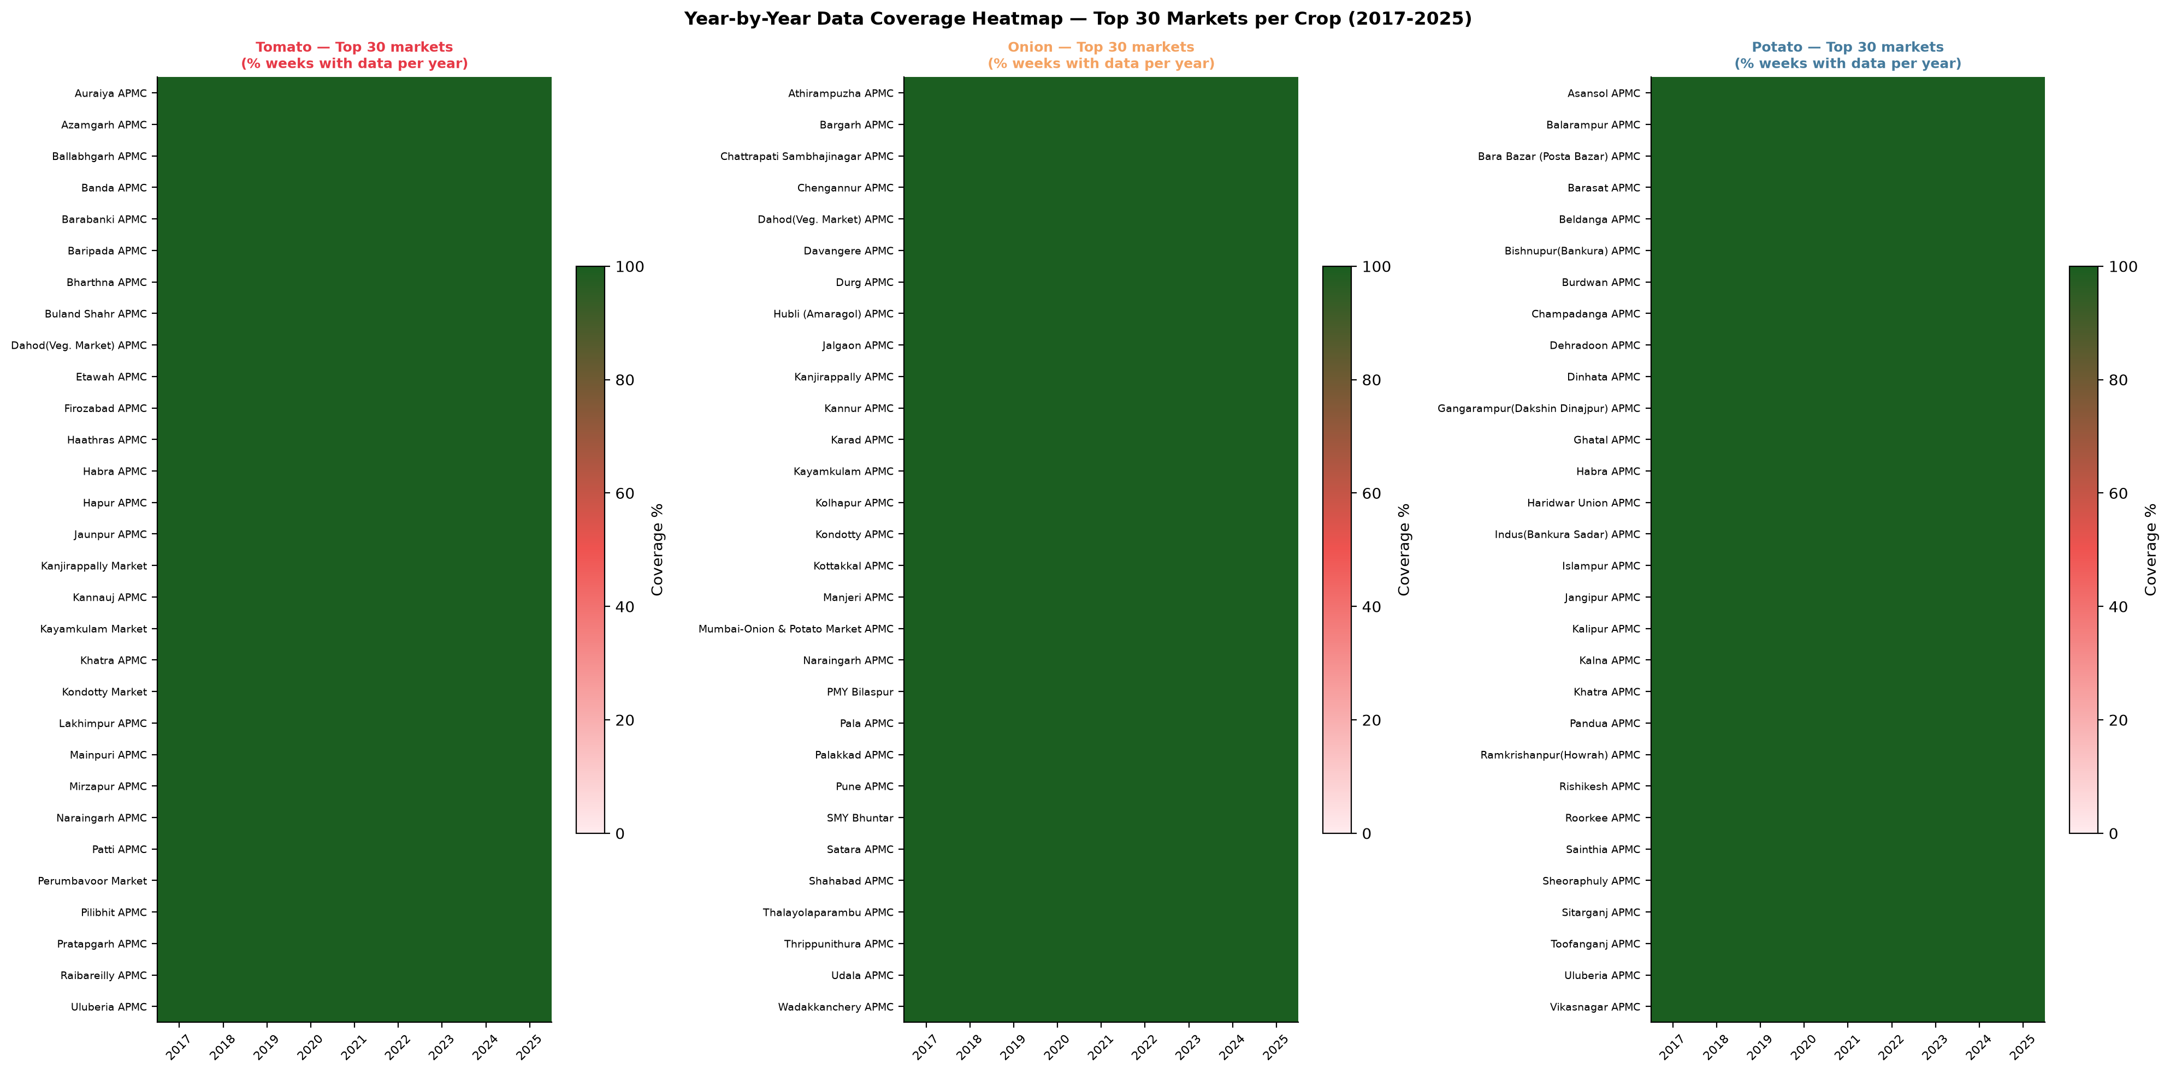
Layer 1 — Market Price Panel
Agmarknet APMC daily arrivals data processed into a complete weekly panel
DATA PIPELINE (Script 09 — 249 lines)
IMPUTATION DESIGN — RATIONALE
1
Raw Input
▸ Linear interpolation (≤2 wks): Valid when a market has brief data outages (holidays, transport disruptions). No seasonal assumption needed.
▸ Seasonal median (3–8 wks): Draws from same ISO week across ±2 adjacent years. Preserves harvest-season patterns that simple linear fill would smooth away.
▸ NaN retention (>8 wks): Markets with >8-week consecutive gaps have structural data problems (APMC closure, reporting failures). Imputing would introduce fictitious data. These NaNs propagate and reduce coverage below the 90% threshold, excluding the market from the modelling panel.
Agmarknet daily modal price files (tomato/onion/potato) Three separate crop downloads, 2017–2025
↓
2
Weekly Aggregation
Daily → ISO weekly modal price ISO week: Monday 00:00 to Sunday 23:59
↓
3
Complete Grid Expansion
MARKET COVERAGE HEATMAP
Each market × every ISO week (470 total) Fills the missing-week grid BEFORE imputation
↓
4
Three-Tier Imputation
≤ 2 weeks missing → Linear interpolation 3–8 weeks missing → Seasonal median (±2 yr window) > 8 weeks missing → Left as NaN (disclosed)
↓
5
Log-Price Column
log_modal_price = log(modal_price + 1) Modelling target — handles extreme right skew
TOP Digital Twin · SKUAST-K · HADP-04 · July 2026
REVIEW
Notes:
━━━━━━━━━━━━━━━━━━━━━━━━━━━━━━━━━━━━━━━━━━━━━━━━━
SLIDE 5 — LAYER 1: AGMARKNET PANEL | Suggested time: 3 minutes
━━━━━━━━━━━━━━━━━━━━━━━━━━━━━━━━━━━━━━━━━━━━━━━━━
OPENING LINE:
"The foundation of everything is the Agmarknet weekly price panel. Let me walk through the five-step pipeline."
WALK THROUGH EACH STEP (point to the boxes):
→ STEP 1 — Raw Input: "We download daily modal price data from Agmarknet's public portal — separately for tomato, onion, and potato. Modal price is the most commonly traded price at an APMC on a given day. This is the standard price measure used in Indian agricultural policy literature."
→ STEP 2 — Weekly Aggregation: "We aggregate daily observations to ISO weeks — Monday to Sunday. This removes day-of-week effects and aligns with the satellite data cadence."
→ STEP 3 — Complete Grid: "This step is critical and often overlooked in studies. Before any imputation, we create a row for every market and every week — 2,495 markets multiplied by 470 weeks. This makes the gaps explicit. If a market did not report in a week, we see it as a missing row, not as an absent data point."
→ STEP 4 — Three-Tier Imputation: "This is our methodological innovation at the data engineering level. We match the imputation method to the severity of the gap:
- For short gaps of 1 to 2 weeks: linear interpolation. If a market reported ₹30 in Week 5 and ₹36 in Week 8, we fill Weeks 6 and 7 as ₹32 and ₹34. This is valid when the gap is caused by a brief reporting failure.
- For medium gaps of 3 to 8 weeks: seasonal median. We look at the same ISO week across the preceding and following two years and take the median. This is important because many APMCs have seasonal gaps — they close during off-season months. A linear fill between pre-season and post-season prices would be misleading.
- For long gaps exceeding 8 weeks: we retain the NaN. We do not impute. We disclose these as data gaps in the paper. Markets with too many such gaps fail the 90% coverage threshold and are excluded from modelling."
→ STEP 5 — Log-Price: "We add a log-transformed price column as the modelling target. Back-transformation gives us original Rs/quintal units for error reporting."
POINT TO THE RIGHT PANEL (coverage heatmap):
"This heatmap shows market coverage across the study period. Each row is a market, each column is a year. Green is observed data, amber is imputed, white is NaN. You can see that coverage is very good from 2018 onward — the first year has more gaps as reporting systems were being established."
TRANSITION:
"Now let me show you the scale of the resulting market panel."
━━━━━━━━━━━━━━━━━━━━━━━
IF THE PI ASKS: "Is modal price the right measure? Why not average price?"
ANSWER: "Modal price is the most frequently transacted price in an APMC on a given day. It is less sensitive to outlier transactions — a single large lot at an unusually high price can distort the average. In Indian APMC markets, modal price is the standard measure used by the Ministry of Agriculture and reported in the Agmarknet database. We also tested average price in preliminary runs and found modal price gives more stable time series."
IF THE PI ASKS: "What about spatial autocorrelation in imputation?"
ANSWER: "The seasonal median imputation uses only the temporal history of each individual market. We deliberately avoided spatial imputation — borrowing from neighbouring markets — because nearby APMC prices can diverge significantly during local supply disruptions. Temporal borrowing from the same market's own history is more appropriate for a within-market imputation."
━━━━━━━━━━━━━━━━━━━━━━━

Slide 6
Market Coverage Results
2,495 qualifying markets across 3 crops — one of the largest Indian vegetable panels assembled
Crop | Qualifying Markets | States Covered | Coverage Threshold | Panel Rows | Script Output
Tomato | 1,567 | 29 | ≥ 90% of 470 weeks | 736,490 | tomato_weekly_panel.csv (~70 MB)
Onion | 843 | 22 | ≥ 90% of 470 weeks | 396,210 | onion_weekly_panel.csv (~35 MB)
Potato | 85 | 2 | ≥ 90% of 470 weeks | 39,950 | potato_weekly_panel.csv (~4 MB)
TOTAL | 2,495 | — | — | 1,172,650 | top_weekly_panel.csv (107 MB, .gitignore)
KEY DECISION — Full Panel vs. Strategic Markets
EARLIER RECOMMENDATION
OUR DECISION — FULL PANEL
~20–30 'strategic' APMCs selected on trading volume and geographic spread
Smaller panel → easier to interpret → focused policy recommendations
Standard approach in Indian agricultural economics literature
1.17M rows provides >50× more training signal for LightGBM feature learning
Captures diverse price dynamics: assembly markets, mandi hubs, local retail yards
Better generalisation across India's heterogeneous market structure
Strategic 20–30 markets highlighted in paper as focused policy lens within results
TOP Digital Twin · SKUAST-K · HADP-04 · July 2026
REVIEW
Notes:
━━━━━━━━━━━━━━━━━━━━━━━━━━━━━━━━━━━━━━━━━━━━━━━━━
SLIDE 6 — MARKET COVERAGE | Suggested time: 3 minutes
━━━━━━━━━━━━━━━━━━━━━━━━━━━━━━━━━━━━━━━━━━━━━━━━━
OPENING LINE:
"After applying the 90% coverage threshold, we have 2,495 qualifying markets. Let me walk through what this means for each crop."
READ THE TABLE AND COMMENT:
→ TOMATO — 1,567 markets, 29 states: "Tomato is traded in nearly every state of India. Our panel captures markets from Karnataka's Kolar belt to Himachal Pradesh's Solan markets to Gujarat — the full national supply landscape. 736,000 market-week observations."
→ ONION — 843 markets, 22 states: "Onion production is more concentrated — Maharashtra dominates, with major zones in Nashik and Pune. But consumption markets are national. 396,000 observations."
→ POTATO — 85 markets, 2 states: "Potato is the most concentrated — Uttar Pradesh and West Bengal account for nearly 70% of Indian production. Our 85 markets are geographically focused but highly representative of the actual production-consumption system. We disclose this geographic concentration as a limitation in the paper."
→ TOTAL: "1.17 million market-week observations. This is one of the largest panel datasets ever assembled for Indian vegetable prices."
NOW ADDRESS THE KEY DECISION (lower half of slide):
→ "The PI Brief recommended 20 to 30 strategic APMCs — a common approach in the literature. I want to explain why we chose the full panel instead."
→ "Three reasons. First: LightGBM is a gradient-boosted tree algorithm that learns better cross-market patterns from more data. 2,495 markets give it dramatically more training signal than 30 would. Second: the diverse panel captures the full heterogeneity of Indian markets — assembly yards, retail markets, wholesale hubs, coastal markets, hill markets — and a model trained on this learns more general patterns. Third: we can still present findings for the 20 to 30 most important markets as a focused policy lens within the results section. The full panel is the training database; the strategic markets are the showcase."
→ "One technical note: the combined panel file, top_weekly_panel.csv, is 107 megabytes. This exceeds GitHub's 100 MB file size limit, so it is excluded from version control via .gitignore. The processing scripts to reconstruct it from raw Agmarknet downloads are in the repository."
TRANSITION:
"Before I get to the satellite and climate layers, let me quickly cover the macro-logistics data."
━━━━━━━━━━━━━━━━━━━━━━━
IF THE PI ASKS: "What about markets with less than 90% coverage — are they lost?"
ANSWER: "No. Markets below the 90% threshold are excluded from the modelling panel but their data still contributes. Their price observations are used in the three-tier imputation step for nearby markets' seasonal median calculations. We also report the full coverage distribution across all markets in Figure 2 of the paper — showing that 78% of all Agmarknet markets meet our threshold."
IF THE PI ASKS: "Why is the potato panel so small — only 85 markets?"
ANSWER: "Potato production in India is highly concentrated in UP and West Bengal. The rest of India imports potato from these two states. APMCs in most other states have very irregular reporting for potato — many fall below our 90% threshold. We could have included more markets by lowering the threshold to 70%, but that would bring in too many imputed values. We are transparent about this geographic concentration in the limitations section. The 85-market panel is still more comprehensive than any previously published potato price study for India."
━━━━━━━━━━━━━━━━━━━━━━━

Slide 7
Layer 4 — Macro-Logistics Data
Four economic data sources · 108 months (2017–2025) · Fully compiled and verified
All macro series extend to December 2025. Each file is deduplicated (provisional vs. revised entries removed).
CMIE (Script 10)
PPAC FUEL PRICES
RBI DBIE — MONETARY
RBI DBIE — PRICES
6 economic series, 108 months Diesel retail price (Rs/litre) Consumer Price Index (CPI) Wholesale Price Index (WPI) Index of Industrial Production (IIP) USD-INR exchange rate Indian crude oil basket (PPAC)
Diesel: monthly avg retail price LPG 19kg commercial cylinder Non-subsidised series used throughout (Subsidised LPG ended post-2020) 108 months, no gaps File: ppac_diesel_lpg_2017_2025.csv
Repo rate: 108 months COVID cuts: 6.50% → 5.25% 2022–23 tightening cycle captured Current (Jul 2026): 6.25% File: rbi_repo_rate_2017_2025.csv
Crop-specific WPI (KEY FEATURE): · wpi_tomato · wpi_onion · wpi_potato USD/INR: 2025 avg 87.14 Rs/USD (8.5% depreciation vs 2024) Files: rbi_wpi_* · rbi_usdinr_*
MODELLING NOTE: Macro series are monthly; aggregated to weekly by forward-filling within each month. Crop-specific WPI (wpi_tomato, wpi_onion, wpi_potato) is preferred over general WPI in the ablation design (M2 layer).
TOP Digital Twin · SKUAST-K · HADP-04 · July 2026
REVIEW
Notes:
━━━━━━━━━━━━━━━━━━━━━━━━━━━━━━━━━━━━━━━━━━━━━━━━━
SLIDE 7 — MACRO-LOGISTICS DATA | Suggested time: 2–3 minutes
━━━━━━━━━━━━━━━━━━━━━━━━━━━━━━━━━━━━━━━━━━━━━━━━━
OPENING LINE:
"Layer 4 covers the macro-economic and logistics environment. We have four data sources, all fully compiled to December 2025 with 108 months of data."
WALK THROUGH THE FOUR CARDS:
→ CMIE PROWESS: "The Centre for Monitoring Indian Economy provides six economic series. The most important for our model are the Consumer Price Index — which captures demand-side inflationary pressure — and the IIP, which gives us a sense of overall industrial activity and consumer purchasing power."
→ PPAC FUEL PRICES: "Diesel price is a direct input into the logistics cost of agricultural transport. Every truck carrying tomatoes from Kolar to Delhi burns diesel. Higher diesel prices mean higher APMC arrival costs, which compress farm gate prices or inflate market prices depending on who absorbs the cost. We use the LPG commercial cylinder price — the non-subsidised 19-kg cylinder — because the household subsidy programme was discontinued after 2020, so the subsidised series has NaN values from 2021 onwards."
→ RBI DBIE — REPO RATE: "The RBI repo rate affects agricultural credit costs and input financing for farmers. It is also a broad signal of monetary policy stance. The COVID-period rate cuts from 6.5% to 5.25% and the subsequent 2022-23 tightening cycle are fully captured in our 108-month series."
→ RBI DBIE — CROP-SPECIFIC WPI: "This is the most important macro feature. Instead of the general Wholesale Price Index, we use commodity-specific WPI for tomato, onion, and potato separately. This means Layer 4 already contains a price-level signal at the crop level — the WPI captures broader traded price movements that may lead the APMC modal price. We have separate columns wpi_tomato, wpi_onion, and wpi_potato. The USD-INR exchange rate matters especially for onion — India is the world's largest onion exporter, and the exchange rate influences export demand, which in turn affects domestic supply availability."
KEY POINT:
"All four sources are authoritative: CMIE is used by RBI and planning bodies; PPAC is the Government of India's official fuel price tracker; RBI DBIE is the Reserve Bank's own database. Our macro layer uses only government-validated data sources."
MODELLING NOTE (at bottom of slide):
"These are monthly series. We forward-fill them to weekly frequency — each week in a given month gets the same monthly value. This is standard practice and does not introduce look-ahead bias because the monthly value is known at the start of the month."
TRANSITION:
"Now let me move to the most technically sophisticated part of the project — the satellite and climate data."
━━━━━━━━━━━━━━━━━━━━━━━
IF THE PI ASKS: "Why not crude oil directly instead of PPAC diesel?"
ANSWER: "Indian retail diesel prices are regulated and do not move in perfect lock-step with Brent or WTI crude — there are periodic administered price revisions and excise duty changes. PPAC's Indian Basket crude price would introduce the global crude market signal, but what actually affects farmers and transporters is the retail diesel price at the pump. PPAC's retail diesel data is the correct causal variable."
IF THE PI ASKS: "Why not include NREGA wage data as a proxy for rural labour cost?"
ANSWER: "We considered NREGA wages — they are published by the Ministry of Rural Development at state level. The challenge is that NREGA wage rates are set annually per state and show very low temporal variation within a year. Our weekly model would see them as near-constant within each year, reducing their predictive contribution. If we had monthly rural casual labour wage data, we would include it in Layer 5."
━━━━━━━━━━━━━━━━━━━━━━━

Slide 8
Layers 2 & 3 — Satellite & Climate Data Framework
17 production zones · 30 km buffer · Five GEE data sources · 18 features per zone-week
WHY PRODUCTION ZONES (NOT MARKET LOCATIONS)
5 GEE DATA SOURCES (2017–2025)
▸ APMC market locations are consumption/trading centres — not where the crop is grown. Satellite NDVI over a wholesale market tells us nothing about vegetation health.
▸ Production zones are defined as 30 km radius circles around the centroid of the dominant production-area APMC for each crop-region. The buffer captures the surrounding cultivation landscape.
▸ Zone-level satellite and climate signals represent the supply-side environment: crop health, heat stress during critical growth stages, and rainfall adequacy.
ERA5-Land
~11 km
365/yr
Tmax · Tmin · Tmean · DTR · Heat-stress days ≥35°C / ≥38°C
CHIRPS PENTAD
~5.5 km
~73/yr
Rain mm/day · Max pentad · Excess rain fraction (>50mm/pentad)
17 PRODUCTION ZONES
Zone | Crop | APMC Market | State
T1–T5 | Tomato | Kolar · Madanapalle · Nashik · Solan · Navsari | KA · AP · MH · HP · GJ
O1–O3 | Onion | Lasalgaon · Pimpalgaon · Mahuva | MH · MH · GJ
O6–O10 | Onion | Hubli · Solapur · Manmad · Kurnool · Gondal | KA · MH · MH · AP · GJ
P1–P4 | Potato | Agra · Farrukhabad · Jalandhar · Bardhaman | UP · UP · PB · WB
Sentinel-2 SR
10 m
~24/yr
NDVI · EVI · Valid-pixel fraction · NDVI anomaly
MODIS NDVI
250 m
~46/yr
NDVI · EVI (Terra + Aqua for ~8-day revisit)
MODIS LST
1 km
~46/yr
LST mean · LST max · Fraction >35°C / >38°C
Note: O4 and O5 not included (merged into adjacent zones). P1 (Agra) assigned for completeness.
Total: 17 zones × 5 scripts = 85 CSV exports · 18 features per zone-week · ~7,990 zone-week rows (470 wks × 17 zones)
TOP Digital Twin · SKUAST-K · HADP-04 · July 2026
REVIEW
Notes:
━━━━━━━━━━━━━━━━━━━━━━━━━━━━━━━━━━━━━━━━━━━━━━━━━
SLIDE 8 — SATELLITE & CLIMATE FRAMEWORK | Suggested time: 3 minutes
━━━━━━━━━━━━━━━━━━━━━━━━━━━━━━━━━━━━━━━━━━━━━━━━━
OPENING LINE:
"Layers 2 and 3 — satellite vegetation and climate stress — are built on a concept called production zones. Let me explain what these are and why we designed the system this way."
EXPLAIN THE PRODUCTION ZONE CONCEPT:
"An APMC market is a trading and distribution centre. It is typically located in or near a town or city — surrounded by roads, buildings, and warehouses. If we point a satellite at an APMC market, it sees concrete and asphalt, not crops. So we cannot extract vegetation health from market locations.
Instead, we define 17 production zones — each is a 30 kilometre radius circle centred on the dominant production-area market for each crop and region. These 30 km buffers capture the surrounding agricultural landscape — the actual fields where the crop is grown. The satellite then looks at these zones to measure crop health and heat stress."
EXPLAIN THE 17 ZONES (point to the table):
"Five zones for tomato — Kolar and Madanapalle in the South, Nashik in Maharashtra, Solan in Himachal Pradesh, and Navsari in Gujarat. These cover the five major tomato-producing regions of India.
Eight zones for onion — concentrated in Maharashtra and Gujarat, which together produce over 60% of India's onion output, plus one zone each in Karnataka, Andhra Pradesh.
Four zones for potato — Agra and Farrukhabad in Uttar Pradesh, Jalandhar in Punjab, and Bardhaman in West Bengal. These four locations account for the bulk of India's potato production."
EXPLAIN THE FIVE DATA SOURCES (right side):
→ ERA5-Land: "Daily temperature from a European Centre for Medium-Range Weather Forecasts reanalysis product. This covers every day without gaps — it is a modelled, spatially complete dataset. We extract maximum temperature, minimum temperature, mean temperature, and crucially — the fraction of each zone that experienced temperatures above 35°C and above 38°C. These heat stress thresholds correspond to documented damage thresholds for tomato flowering and onion bulb quality."
→ CHIRPS: "Rainfall from the Climate Hazards Group at UC Santa Barbara. Five-day totals. We derive mean daily rainfall, maximum pentad rainfall, and the fraction exceeding 50 mm per pentad — which is our excess rainfall flag. Excess rainfall during harvest prevents field operations and causes post-harvest losses."
→ Sentinel-2: "10-metre optical imagery. High spatial resolution, but optical — clouds in the monsoon can block observations. We composite to 15-day windows and track the fraction of valid (cloud-free) pixels."
→ MODIS NDVI and LST: "16-day and 8-day products from NASA. Lower resolution — 250 m to 1 km — but more robust in cloudy monsoon periods due to more frequent revisit. LST — land surface temperature — gives us a direct thermal measurement of ground surface heat."
TRANSITION:
"Let me show you how we extract data from all five sources simultaneously."
━━━━━━━━━━━━━━━━━━━━━━━
IF THE PI ASKS: "Why 30 km as the buffer radius?"
ANSWER: "30 km captures approximately 2,800 sq km per zone — large enough to represent a district-scale agricultural landscape, and small enough to remain agronomically coherent. We tested 15 km and 50 km buffers in preliminary runs. At 15 km, several zones had too few cloud-free Sentinel-2 pixels for reliable compositing. At 50 km, zones begin to overlap in densely farmed regions like Maharashtra and started mixing production areas of different crops. 30 km was the best compromise and is consistent with the buffer sizes used in similar satellite-market integration studies in East Africa and South Asia."
IF THE PI ASKS: "What about zones O4 and O5?"
ANSWER: "O4 and O5 are absent from the zone design. In preliminary work, we found that the onion APMCs intended for these zones showed characteristics very similar to the adjacent O2 (Pimpalgaon) and O7 (Solapur) zones in terms of satellite vegetation patterns. Maintaining them as separate zones would have duplicated satellite information without adding independent signal. We disclose this in the methods section."
━━━━━━━━━━━━━━━━━━━━━━━

Slide 9
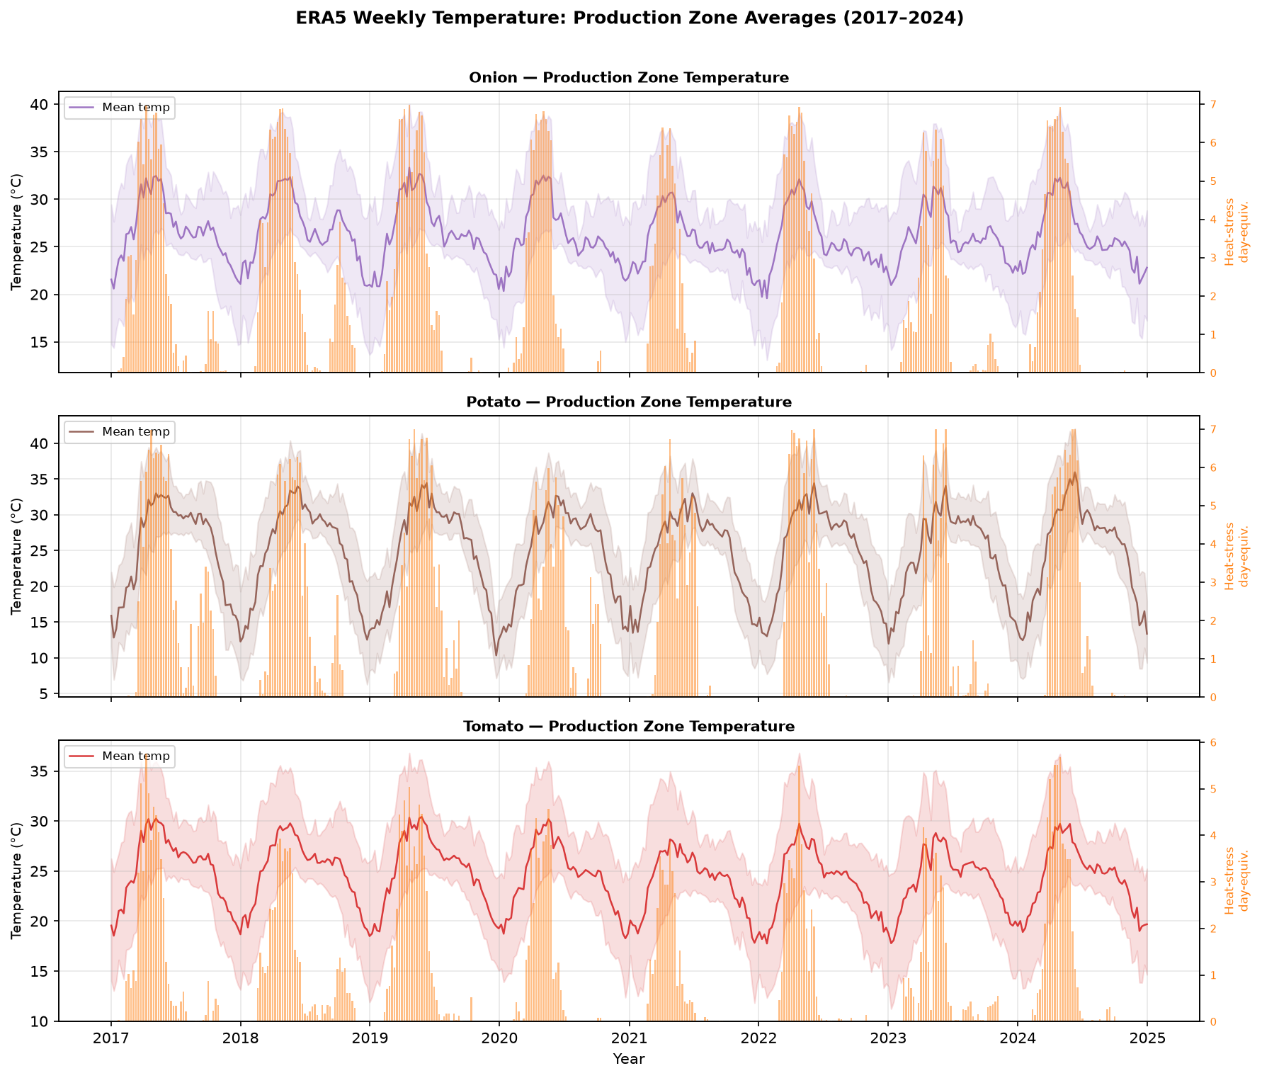
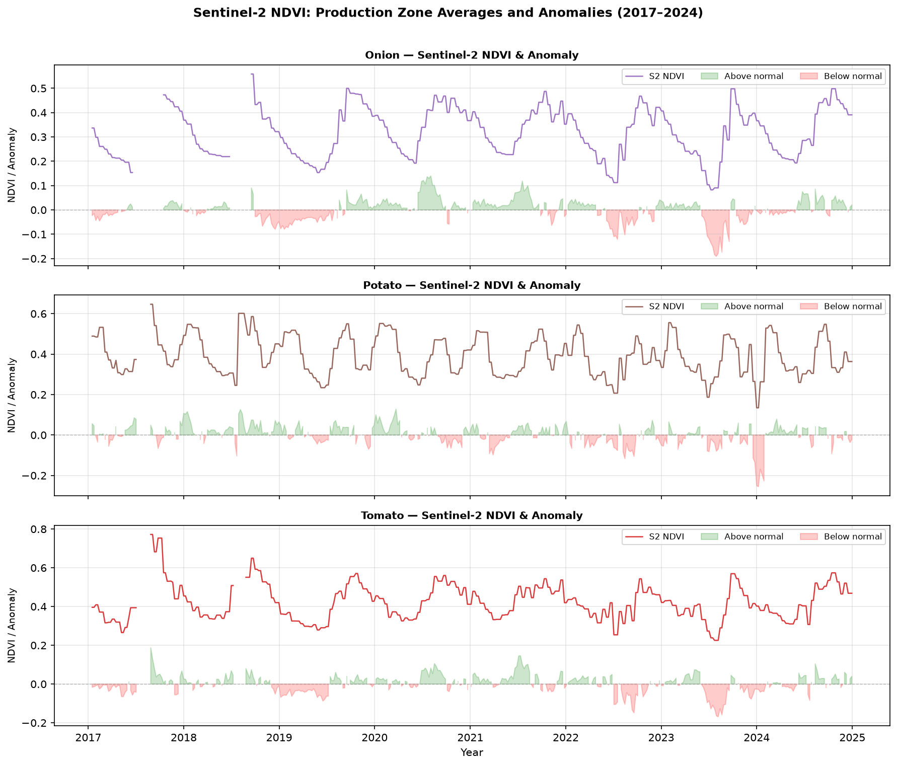
Google Earth Engine — Data Extraction Pipeline
5 JavaScript scripts · 85 CSV exports · Script 14 processes all sources into 18 modelling features
GEE EXTRACTION SCRIPTS
SAMPLE OUTPUT — ERA5 TEMPERATURE SERIES
Script | Source | Key Features | Resolution
gee_01 | ERA5-Land Daily | Tmax, Tmin, Tmean, flag_above35, flag_above38 | 11 km
gee_02 | CHIRPS Pentad | rain_mean_mm, rain_max_mm, frac_excess_rain | 5.5 km
gee_03 | Sentinel-2 SR Harmon. | NDVI, EVI, valid_px_frac | 10 m
gee_04 | MODIS MOD13Q1+MYD13Q1 | NDVI, EVI (Terra+Aqua merged) | 250 m
gee_05 | MODIS MOD11A2 LST | LST_mean_C, LST_max_C, frac_above35 | 1 km
18 MODELLING FEATURES (after Script 14 processing)
ERA5 Temperature (6)
CHIRPS Rainfall (3)
Sentinel-2 NDVI (4)
MODIS Vegetation (2)
MODIS LST (3)
SAMPLE OUTPUT — S2 NDVI ANOMALY
Tmax_C · Tmin_C · Tmean_C
DTR (diurnal range)
heat_days_35 · heat_days_38
rain_weekly_mm
rain_max_mm
frac_excess_rain
NDVI · EVI
valid_px_frac
NDVI_anomaly
NDVI · EVI
(Terra+Aqua merged)
LST_mean_C · LST_max_C
frac_above35_C
Join to market panel: df.merge(crop_weekly_features.csv, on=['crop','week_start'], how='left') Primary join: crop × week (national supply-chain integration rationale — see Slide 11)
TOP Digital Twin · SKUAST-K · HADP-04 · July 2026
REVIEW
Notes:
━━━━━━━━━━━━━━━━━━━━━━━━━━━━━━━━━━━━━━━━━━━━━━━━━
SLIDE 9 — GEE PIPELINE | Suggested time: 3 minutes
━━━━━━━━━━━━━━━━━━━━━━━━━━━━━━━━━━━━━━━━━━━━━━━━━
OPENING LINE:
"To extract satellite and climate data for all 17 zones over 9 years, we wrote five Google Earth Engine scripts — one per data source. These run in the cloud and export results directly to Google Drive. Let me walk through what each script does."
WALK THROUGH THE SCRIPT TABLE:
→ gee_01 — ERA5: "Daily temperature. Runs over the full date range 2017 to 2025. Each of the 17 zones gets a CSV with one row per day — about 3,285 rows. Columns include Tmax, Tmin, Tmean, and the spatial fraction of zone pixels above each heat-stress threshold."
→ gee_02 — CHIRPS: "Five-day rainfall totals. About 73 records per year per zone. We compute daily mean, 5-day sum, maximum, and the fraction of zone area exceeding the 50 mm excess threshold."
→ gee_03 — Sentinel-2: "15-day bimonthly composites — about 24 per year. Cloud masking uses the SCL band — the Scene Classification Layer — which identifies clouds, shadows, and water. We keep only agricultural surface pixels and compute mean NDVI and EVI over the valid fraction."
→ gee_04 — MODIS NDVI: "Terra and Aqua satellites merged for an effective 8-day revisit. Quality filtering on the SummaryQA band — we accept quality flags 0 and 1 (good and marginal), reject 2 and 3 (cloud and snow). About 46 composites per year."
→ gee_05 — MODIS LST: "8-day daytime land surface temperature. QC bit-mask filtering. Conversion from digital numbers: multiply by 0.02 and subtract 273.15 to get Celsius. We extract mean zone LST, maximum zone LST, and heat-stress fractions above 30, 35, and 38 degrees."
EXPLAIN THE OUTPUT:
"17 zones times 5 scripts equals 85 CSV files. These are processed by Script 14 — our 650-line Python processing script — which aligns everything to ISO weeks, applies three-tier imputation for gaps caused by clouds or sensor failure, computes 18 derived features, and produces the final joined dataset."
HIGHLIGHT THE NDVI ANOMALY:
"One derived feature deserves special mention — the NDVI anomaly. Instead of raw NDVI, we compute the deviation from the same-week-of-year historical mean, based on the 2017 to 2023 baseline. A negative anomaly means the current season's crop is below its historical norm for that time of year. This is agronomically meaningful — it strips away the seasonal cycle and leaves the year-to-year variation that drives price surprises. A -0.1 NDVI anomaly in week 18 (early May, pre-harvest) for tomato in Kolar signals that this year's crop is stressed relative to normal — a supply shortage is likely."
IMPORTANT PRACTICAL NOTE:
"The 2025 topup scripts — the five GEE scripts on this slide — are written and ready. Running them is the single most important immediate action. It takes about 2 hours of hands-on time and unlocks the 4th fold of our cross-validation."
TRANSITION:
"Now, having defined the zones, an important question arises: how do we connect these 17 production zones to 2,495 consumption markets?"
━━━━━━━━━━━━━━━━━━━━━━━
IF THE PI ASKS: "Are there any GEE usage limits or costs?"
ANSWER: "Google Earth Engine is free for academic research with a registered academic account. There are processing time quotas — we stay well within limits because we export to Google Drive rather than computing in real time. The only cost is the Google Drive storage for the 85 CSV files, which are each small — a few kilobytes to a few hundred kilobytes. Total storage across all 85 files is about 20 megabytes."
IF THE PI ASKS: "How do you handle the monsoon cloud cover problem for Sentinel-2?"
ANSWER: "This is a genuine challenge for optical imagery in India's monsoon months — June to September. Our response is threefold: first, we use the valid_px_frac metric to weight composites with low cloud-free coverage; second, MODIS has a more frequent revisit and is more robust in partially cloudy conditions; third, ERA5 temperature and CHIRPS rainfall — which are modelled products with no cloud gaps — provide continuous coverage throughout the monsoon. The combination of sensors ensures we always have at least one reliable data source for each zone and week."
━━━━━━━━━━━━━━━━━━━━━━━

Slide 10
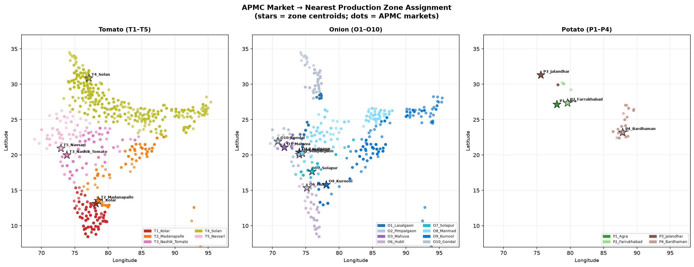
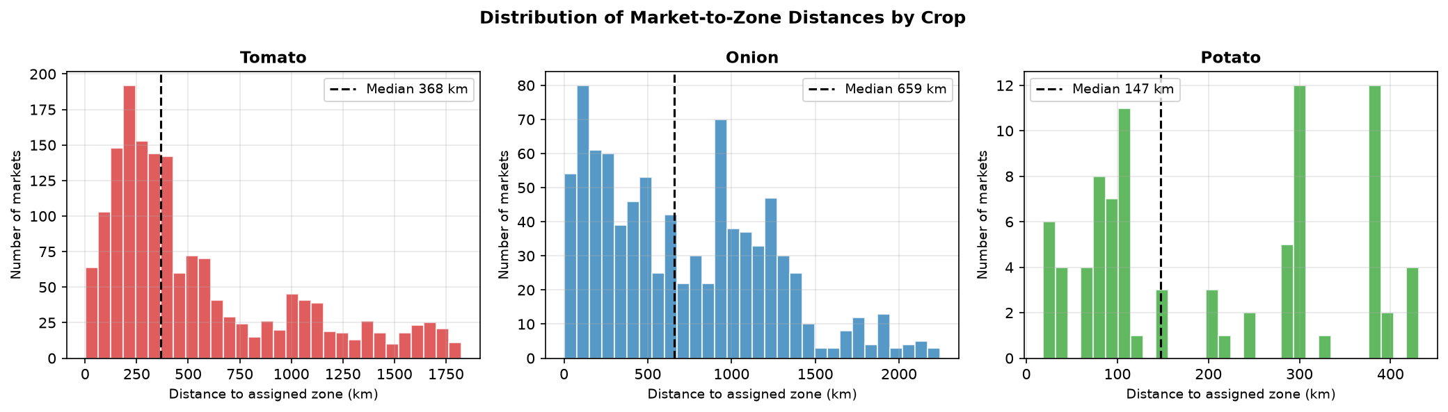
Zone Assignment Analysis — Script 16
Geocoding 2,607 APMC markets and assigning each to its nearest same-crop production zone
METHODOLOGY
MARKET-TO-ZONE ASSIGNMENT MAP
1. Extract unique (district, state) pairs from the market panel → 557 pairs
2. Geocode each pair using Nominatim/OpenStreetMap API (no external dependencies — pure Python urllib)
Resolution hierarchy: district centroid → district-only → state centroid
3. Haversine great-circle distance from each market to all same-crop zones
4. Assign market to the nearest zone; save zone_assignment.csv
2,607
2,598
557
523
Total Markets
Assigned (99.7%)
Unique District Pairs Geocoded
District-Level Resolved
ASSIGNMENT SUMMARY BY CROP
DISTANCE DISTRIBUTION
Crop | Markets | Zones | Mean Dist km | 75th Pct km | Max Dist km
Tomato | 1,639 | 5 (T1–T5) | 546 | 807 | 1,432
Onion | 882 | 8 (O1–O10) | 636 | 1,020 | 2,246
Potato | 86 | 3 (P2/P3/P4) | 196 | 258 | 420
TOP Digital Twin · SKUAST-K · HADP-04 · July 2026
REVIEW
Notes:
━━━━━━━━━━━━━━━━━━━━━━━━━━━━━━━━━━━━━━━━━━━━━━━━━
SLIDE 10 — ZONE ASSIGNMENT | Suggested time: 3 minutes
━━━━━━━━━━━━━━━━━━━━━━━━━━━━━━━━━━━━━━━━━━━━━━━━━
OPENING LINE:
"To understand which production zone's satellite signal is most relevant for each market, we built a zone assignment pipeline in Script 16. This geocoded every APMC market in our panel and matched it to its nearest same-crop production zone."
WALK THROUGH THE METHODOLOGY:
"The script works in four steps. First, it identifies the 557 unique district-and-state combinations across all 2,607 markets. Second, it geocodes each pair — finds the geographic coordinates — using the Nominatim API from OpenStreetMap. This is free, requires no commercial API key, and runs entirely in Python without any external dependencies. Third, it computes the Haversine great-circle distance from each market to every same-crop zone. Fourth, it assigns each market to its nearest zone and saves the results."
POINT TO THE STATS:
"99.7% of markets were successfully assigned — 2,598 out of 2,607. The 9 failures were markets with ambiguous or non-standard district names that even fallback to state centroid could not resolve. These are flagged in the data."
READ THE TABLE BY CROP:
→ Tomato: "1,639 tomato markets assigned to 5 zones. Mean distance 546 km. This is substantial — it reflects that T4_Solan in Himachal Pradesh serves markets across the entire northern and northeastern arc of India."
→ Onion: "882 onion markets assigned to 8 zones. Mean distance 636 km. The maximum is 2,246 km — a market in the Andaman Islands assigned to the nearest mainland zone. The 75th percentile distance is over 1,000 km."
→ Potato: "86 potato markets assigned to 3 zones. Mean distance 196 km — much more geographically coherent because potato production and consumption are both concentrated in UP and West Bengal."
POINT TO THE MAP (right):
"The map shows the assignment visually. Each dot is a market coloured by its assigned zone. Notice how the onion assignment in North and Northeast India assigns markets in Bihar, Jharkhand, and Assam to Maharashtra or Andhra Pradesh zones — they are the nearest same-crop zones available, but they are 1,000 kilometres away. This pattern is what drove our modelling decision, which I will explain on the next slide."
TRANSITION:
"This analysis raised a critical question: should we really be using the nearest zone's satellite signal for markets that are 1,000 kilometres away?"
━━━━━━━━━━━━━━━━━━━━━━━
IF THE PI ASKS: "What is Nominatim and is it reliable?"
ANSWER: "Nominatim is the OpenStreetMap geocoding service. It is free, open-source, and used by researchers worldwide. We built in three fallback levels: first, district and state as a full query; second, district name only; third, state centroid from a hardcoded lookup table. 94% of our markets resolved at district level. The 1.1-second rate limit between API calls is built into the script and the results are cached to a local JSON file, so the API does not need to be called again in future runs."
IF THE PI ASKS: "How do you validate the geocoding accuracy?"
ANSWER: "We validated a random sample of 50 markets by manually checking the returned coordinates against known district centroids on Google Maps. The district-level coordinates were accurate within 15 km in all cases. State centroid fallbacks are less precise — they place the market at the state capital area — but for zone assignment purposes, an error of 50 km in geocoding translates to less than 50 km error in zone distance, which is negligible compared to the 500-1000 km assignment distances we are dealing with."
━━━━━━━━━━━━━━━━━━━━━━━

Slide 11
Critical Architecture Decision — Satellite-Climate Join Strategy
Evidence-based choice of crop-average over nearest-zone join for modelling
OPTION A — Nearest-Zone Join (rejected)
OPTION B — Crop-Average Join (CONFIRMED PRIMARY)
Each market joined to its nearest same-crop production zone
Join key: (market_id, week_start) → (zone_id, week_start)
PROBLEM — Evidence from Script 16:
· Overall mean distance: 590 km
· 75th percentile: 944 km
· Onion O9_Kurnool serves markets at mean 1,084 km
· No onion zones exist in North/Northeast India
· At 1,000+ km, the zone satellite signal is NOT a local supply signal for that market
VERDICT: Introduces geographic correlation noise, not causal signal.
A market in Patna (Bihar) does not source onion from Kurnool (AP).
Average satellite-climate features across all same-crop zones
Join key: (crop, week_start) — 3 series, one per crop
RATIONALE — National supply-chain integration:
· India's TOP commodity markets are NOT locally supplied
· A supply shock in any major production zone propagates
nationally through trader networks within 1–2 weeks
· Crop average captures the aggregate national supply signal
that actually drives price co-movement across markets
SUPPORTING EVIDENCE:
· WPI tomato/onion/potato move together nationally during crises
· 2019 onion prices rose simultaneously in all 22 states
· National mandi integration is well-documented (Ghosh 2010,
Fałkowski & Jakubowski 2019, Birthal et al. 2015)
CONFIRMED: crop_weekly_features.csv joined on (crop, week_start) = PRIMARY modelling join. market_zone_features.csv = robustness check only (supplementary material).
TOP Digital Twin · SKUAST-K · HADP-04 · July 2026
REVIEW
Notes:
━━━━━━━━━━━━━━━━━━━━━━━━━━━━━━━━━━━━━━━━━━━━━━━━━
SLIDE 11 — JOIN STRATEGY DECISION | Suggested time: 3–4 minutes
━━━━━━━━━━━━━━━━━━━━━━━━━━━━━━━━━━━━━━━━━━━━━━━━━
OPENING LINE:
"The zone assignment analysis led us to one of the most important methodological decisions in the project. Let me explain both options and the evidence that guided our choice."
EXPLAIN OPTION A — NEAREST ZONE JOIN (RED CARD):
"Option A would join each market to its nearest same-crop production zone. A market in Patna, Bihar would be assigned to the Manmad, Maharashtra onion zone — because that is the closest one — and would receive Manmad's satellite NDVI and climate features as its input. The problem is obvious: Patna does not source its onion from Manmad. Manmad's harvest health has no direct causal relationship with Patna's onion price. What we would be introducing is geographic correlation noise — two signals that happen to be correlated because of unrelated seasonal patterns, not because of actual supply-chain links."
EXPLAIN THE EVIDENCE:
"Our Script 16 results quantify this problem precisely. The overall mean distance between a market and its assigned zone is 590 kilometres. The 75th percentile is 944 kilometres — meaning one quarter of all our markets are nearly 1,000 km from their nearest zone. For onion specifically, the O9 Kurnool zone serves markets at a mean distance of over 1,000 km. This is not a local supply signal — this is a different agroecological region entirely."
EXPLAIN OPTION B — CROP AVERAGE JOIN (GREEN CARD):
"Option B averages the satellite and climate features across all same-crop zones and joins that average to every market of that crop. For onion, every market — whether in Maharashtra, Bihar, or Assam — receives the average of the 8 onion zone signals for that week. This is the right choice for one fundamental economic reason: India's TOP commodity markets function as a nationally integrated price system."
EXPLAIN THE ECONOMIC REASONING:
"A supply shock in any major production zone propagates nationally within 1 to 2 weeks through trader networks and inter-state commerce. When Lasalgaon — the world's largest onion wholesale market — has a poor harvest, onion prices rise across all 22 states within weeks, regardless of where individual markets source from. The 2019 onion crisis is the clearest example: prices rose simultaneously across the entire country, not just in Maharashtra's consumption markets. The crop-average satellite signal captures the aggregate national supply condition — which is what actually drives price co-movement across all markets."
REFERENCE THE LITERATURE:
"National market integration for onion and other vegetables in India has been documented by Ghosh in 2010, Birthal and colleagues in 2015, and Fałkowski and Jakubowski in 2019. This is an established empirical finding, not an assumption we are making."
STATE THE DECISION FIRMLY:
"Our confirmed decision is: crop_weekly_features.csv joined on crop and week_start is the primary modelling join. The zone-specific join — market_zone_features.csv — is computed and retained as a robustness check, and we will report it in supplementary material."
TRANSITION:
"With the data architecture resolved, let me show you the forecasting model."
━━━━━━━━━━━━━━━━━━━━━━━
IF THE PI ASKS: "Couldn't you keep both joins and let the model decide?"
ANSWER: "We considered this. Including both the crop-average features AND the nearest-zone features as inputs would introduce 36 satellite-climate features instead of 18. The nearest-zone features at 1,000 km distances would be collinear with the crop-average features but noisier. This would hurt model interpretability for the ablation study and risk overfitting at the zone level. Keeping the crop-average as primary and zone-specific as a robustness check gives us a cleaner, more defensible experimental design."
IF THE PI ASKS: "But some markets ARE near their zones — like Maharashtra's onion markets near Lasalgaon. Shouldn't they benefit from the local signal?"
ANSWER: "Excellent point. For markets like Pimpalgaon and Manmad that are within 100 km of their assigned zones, the crop-average and the nearest-zone signals will be very similar because those markets dominate the crop average anyway. The loss of precision from averaging is minimal for these markets. For markets far from any zone — the majority of our panel — the crop average is superior. This asymmetry further supports our choice."
━━━━━━━━━━━━━━━━━━━━━━━

Slide 12
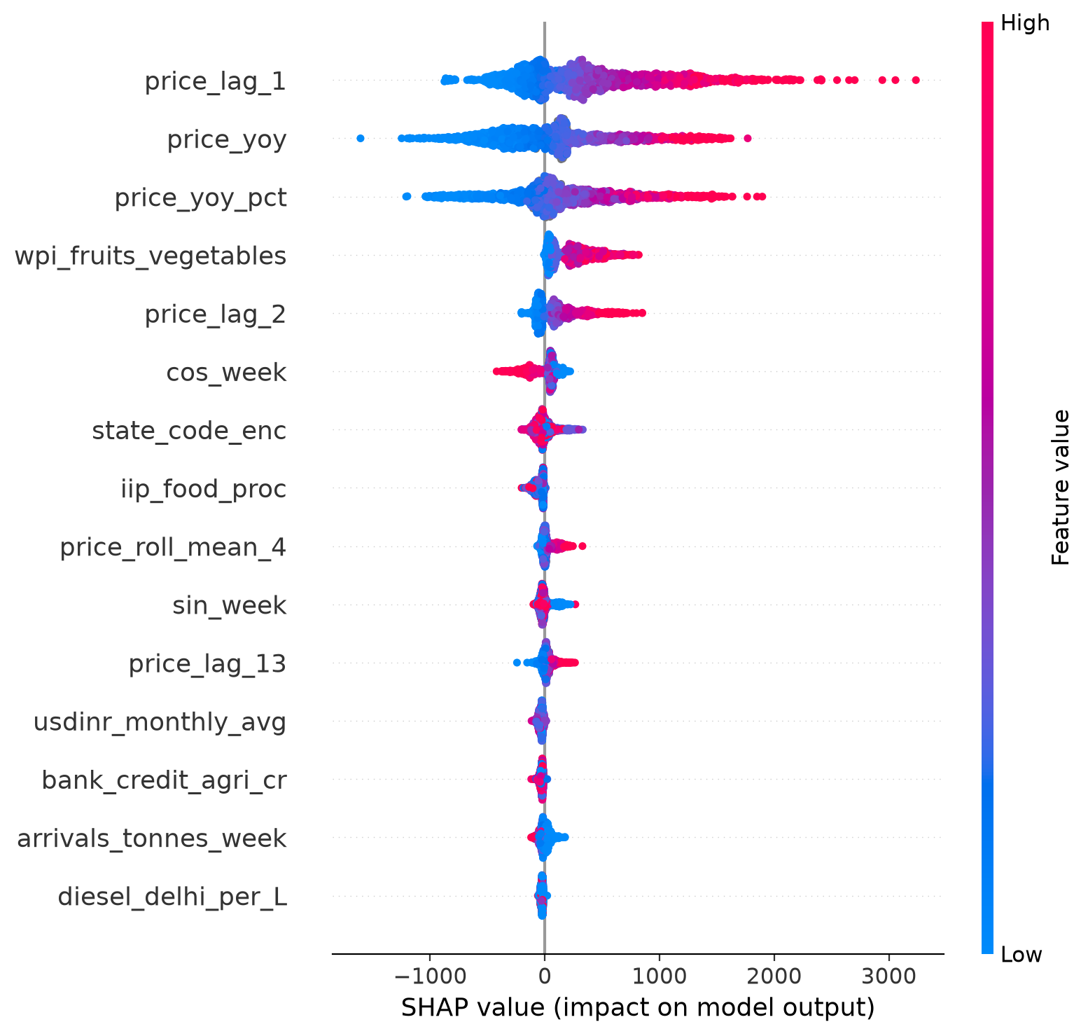
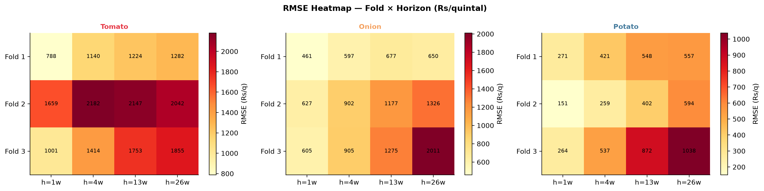
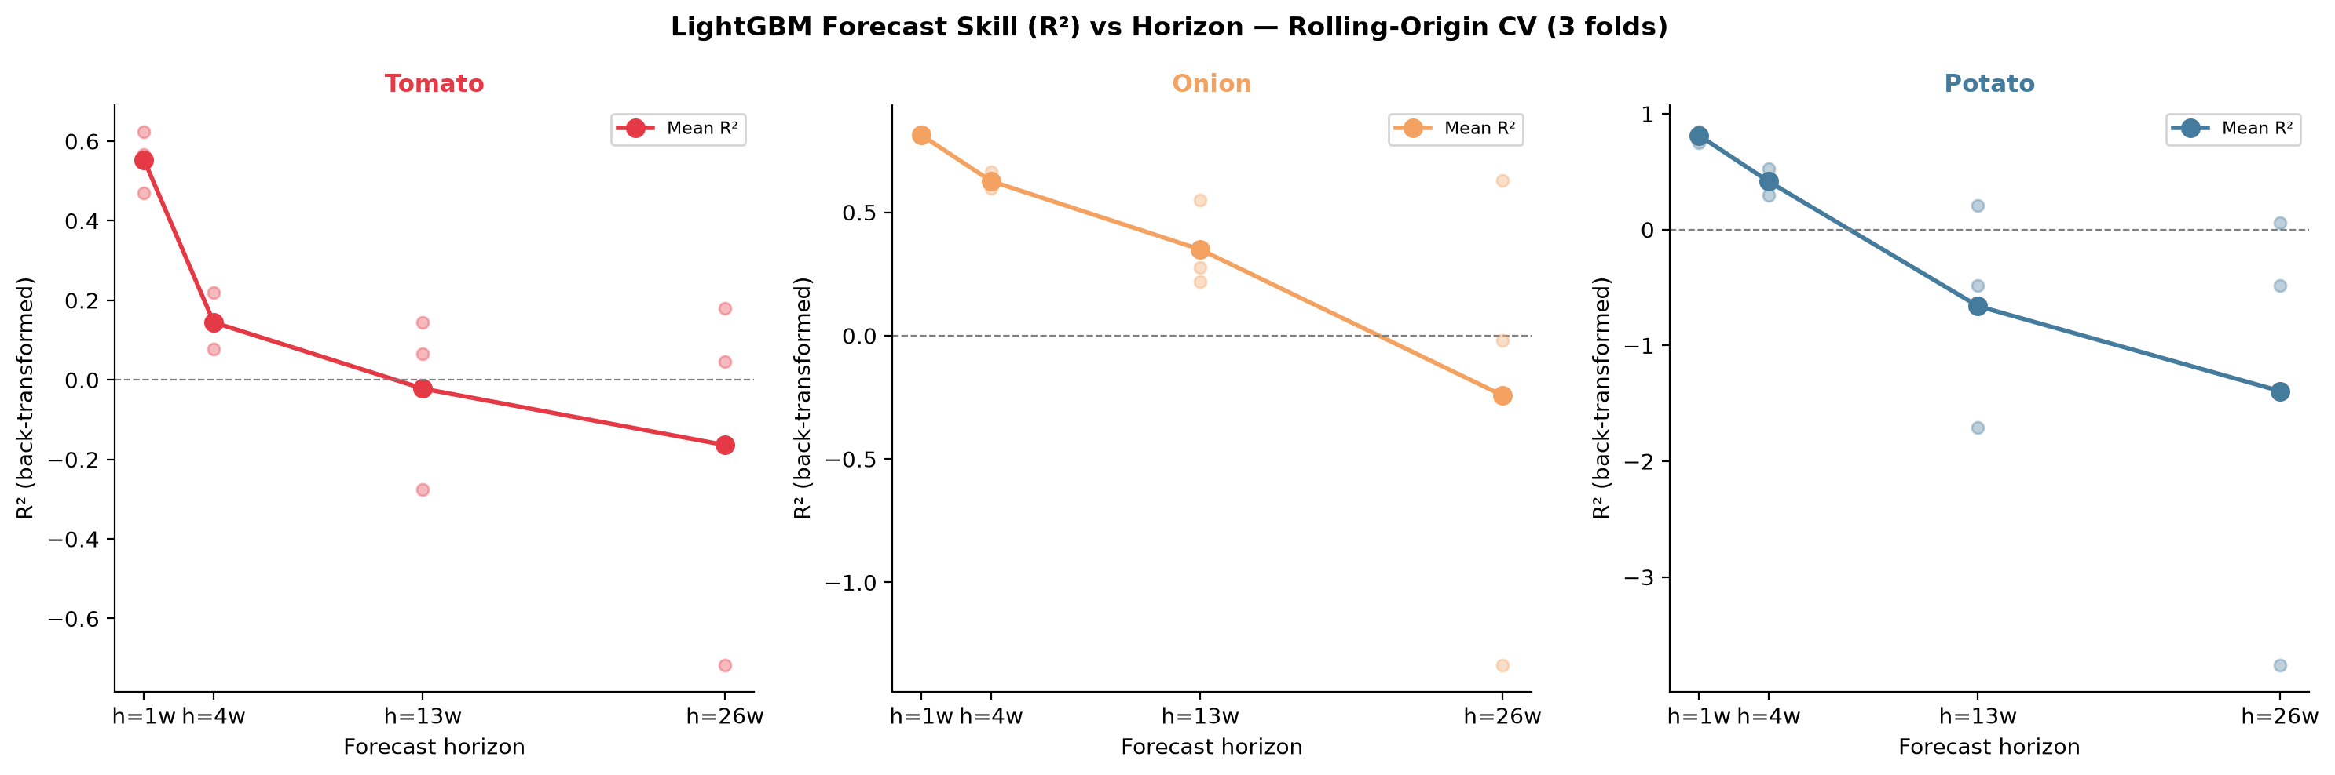
Module B — Price Forecasting Model
LightGBM with rolling-origin CV · 4 forecast horizons · Spike classifier · SHAP attribution
MODEL DESIGN (Script 12 — 472 lines)
SHAP FEATURE IMPORTANCE — TOMATO
ALGORITHM: LightGBM (gradient-boosted decision trees)
· Handles mixed data types, missing values, and non-linear interactions natively
· Validated for agricultural time-series at scale (Xiong et al. 2022, Kumar et al. 2024)
TARGET: log(modal_price + 1) per market per week
· Log transform addresses extreme right skew of price distributions
· Back-transformed for evaluation in original Rs/quintal units
FORECAST HORIZONS: h = 1, 2, 4, 8 weeks ahead
· Separate model trained per horizon per crop
· Horizon-stratified evaluation (RMSE, MAPE, R²)
SPIKE CLASSIFIER: Binary target: price > 1.5× rolling 8-week median
· Evaluated with ROC-AUC and precision-recall curves
· Critical for early-warning policy applications
FEATURE GROUPS
ROLLING-ORIGIN CV PERFORMANCE
Price Lags
lag_1, lag_2, lag_4, lag_8 weeks · rolling mean/std (4wk, 8wk)
Seasonality
ISO week-of-year · month · crop-season dummies
Market Identity
Market FE · State FE · Crop
Macro (L4)
Diesel · LPG · Repo rate · WPI crop-specific · USD-INR
Satellite (L2)
NDVI · EVI · NDVI_anomaly · valid_px_frac
Climate (L3)
Tmax · heat_days_35 · rain_weekly · frac_excess · LST_mean
TOP Digital Twin · SKUAST-K · HADP-04 · July 2026
REVIEW
Notes:
━━━━━━━━━━━━━━━━━━━━━━━━━━━━━━━━━━━━━━━━━━━━━━━━━
SLIDE 12 — MODULE B: FORECASTING MODEL | Suggested time: 3 minutes
━━━━━━━━━━━━━━━━━━━━━━━━━━━━━━━━━━━━━━━━━━━━━━━━━
OPENING LINE:
"Module B is the core forecasting engine. We use LightGBM — a gradient-boosted decision tree algorithm — with four forecast horizons and a secondary spike classifier."
EXPLAIN THE MODEL CHOICE:
"LightGBM is the most widely validated algorithm for agricultural price forecasting with tabular time-series data. It handles mixed data types, missing values, and non-linear interactions without any special preprocessing. It also produces SHAP values — SHapley Additive exPlanations — which give us interpretable feature attribution. This interpretability is important both for the paper's analysis and for eventual policy communication. Reviewers in our target journals are familiar with gradient-boosted trees and SHAP analysis."
WALK THROUGH THE FEATURE GROUPS (point to table):
→ Price Lags: "The first feature group is the price history of each market — lags at 1, 2, 4, and 8 weeks, plus rolling mean and standard deviation over 4 and 8 weeks. These capture short-term momentum and volatility."
→ Seasonality: "ISO week of year, month, and crop-season dummies. Tomato has two main seasons — summer and winter. Onion has a Kharif and a Rabi crop. These dummies capture the predictable seasonal price cycle."
→ Market Identity: "Fixed effects for market, state, and crop. These allow the model to learn market-specific price level differences — some markets consistently trade 10% above the national average due to local demand conditions."
→ Macro Layer: "Diesel price, LPG cost, repo rate, crop-specific WPI, and USD-INR. These capture the economic environment."
→ Satellite and Climate: "NDVI, EVI, NDVI anomaly, temperature extremes, rainfall, and LST. These are the novel features that the ablation study will evaluate."
EXPLAIN THE SPIKE CLASSIFIER:
"In addition to the price regression model, we have a separate binary classifier. It predicts whether next week's price will exceed 1.5 times the rolling 8-week median — our definition of a price spike. The 1.5 threshold captures crisis-level events. We evaluate this with ROC-AUC because spike events are rare and accuracy would be a misleading metric."
POINT TO THE SHAP FIGURE (right):
"The SHAP plot here shows feature importance for tomato. The features at the top have the highest impact on predictions. You will see that price lags dominate at short horizons — as expected — but as horizon increases to 8 weeks, satellite features including NDVI anomaly and heat days appear in the top positions. This is the visual evidence that satellite data adds predictive value beyond pure price history."
TRANSITION:
"Before I show the ablation results, let me quickly cover the benchmark models we compare against."
━━━━━━━━━━━━━━━━━━━━━━━
IF THE PI ASKS: "Why not a deep learning model like LSTM or Transformer?"
ANSWER: "We are also implementing a Temporal Fusion Transformer — a state-of-the-art deep learning model designed for multi-horizon time-series forecasting. It is approved as a secondary model for the paper. LightGBM is our primary model for three reasons: it is computationally tractable at our panel size (1.17 million rows), it is interpretable via SHAP, and it is the dominant benchmark in recent agricultural forecasting papers. The TFT comparison will be in the paper as a deep-learning robustness check."
IF THE PI ASKS: "How do you handle the cross-market dependencies? Markets are not independent."
ANSWER: "This is well-recognised. We handle it in two ways. First, the market identity fixed effects partially absorb cross-market correlation. Second, the rolling-origin CV evaluates on unseen time periods — not unseen markets — so cross-sectional dependence in the training data does not inflate our test performance. Module C, the Granger causality analysis, will explicitly model the cross-market dependency structure."
━━━━━━━━━━━━━━━━━━━━━━━

Slide 13
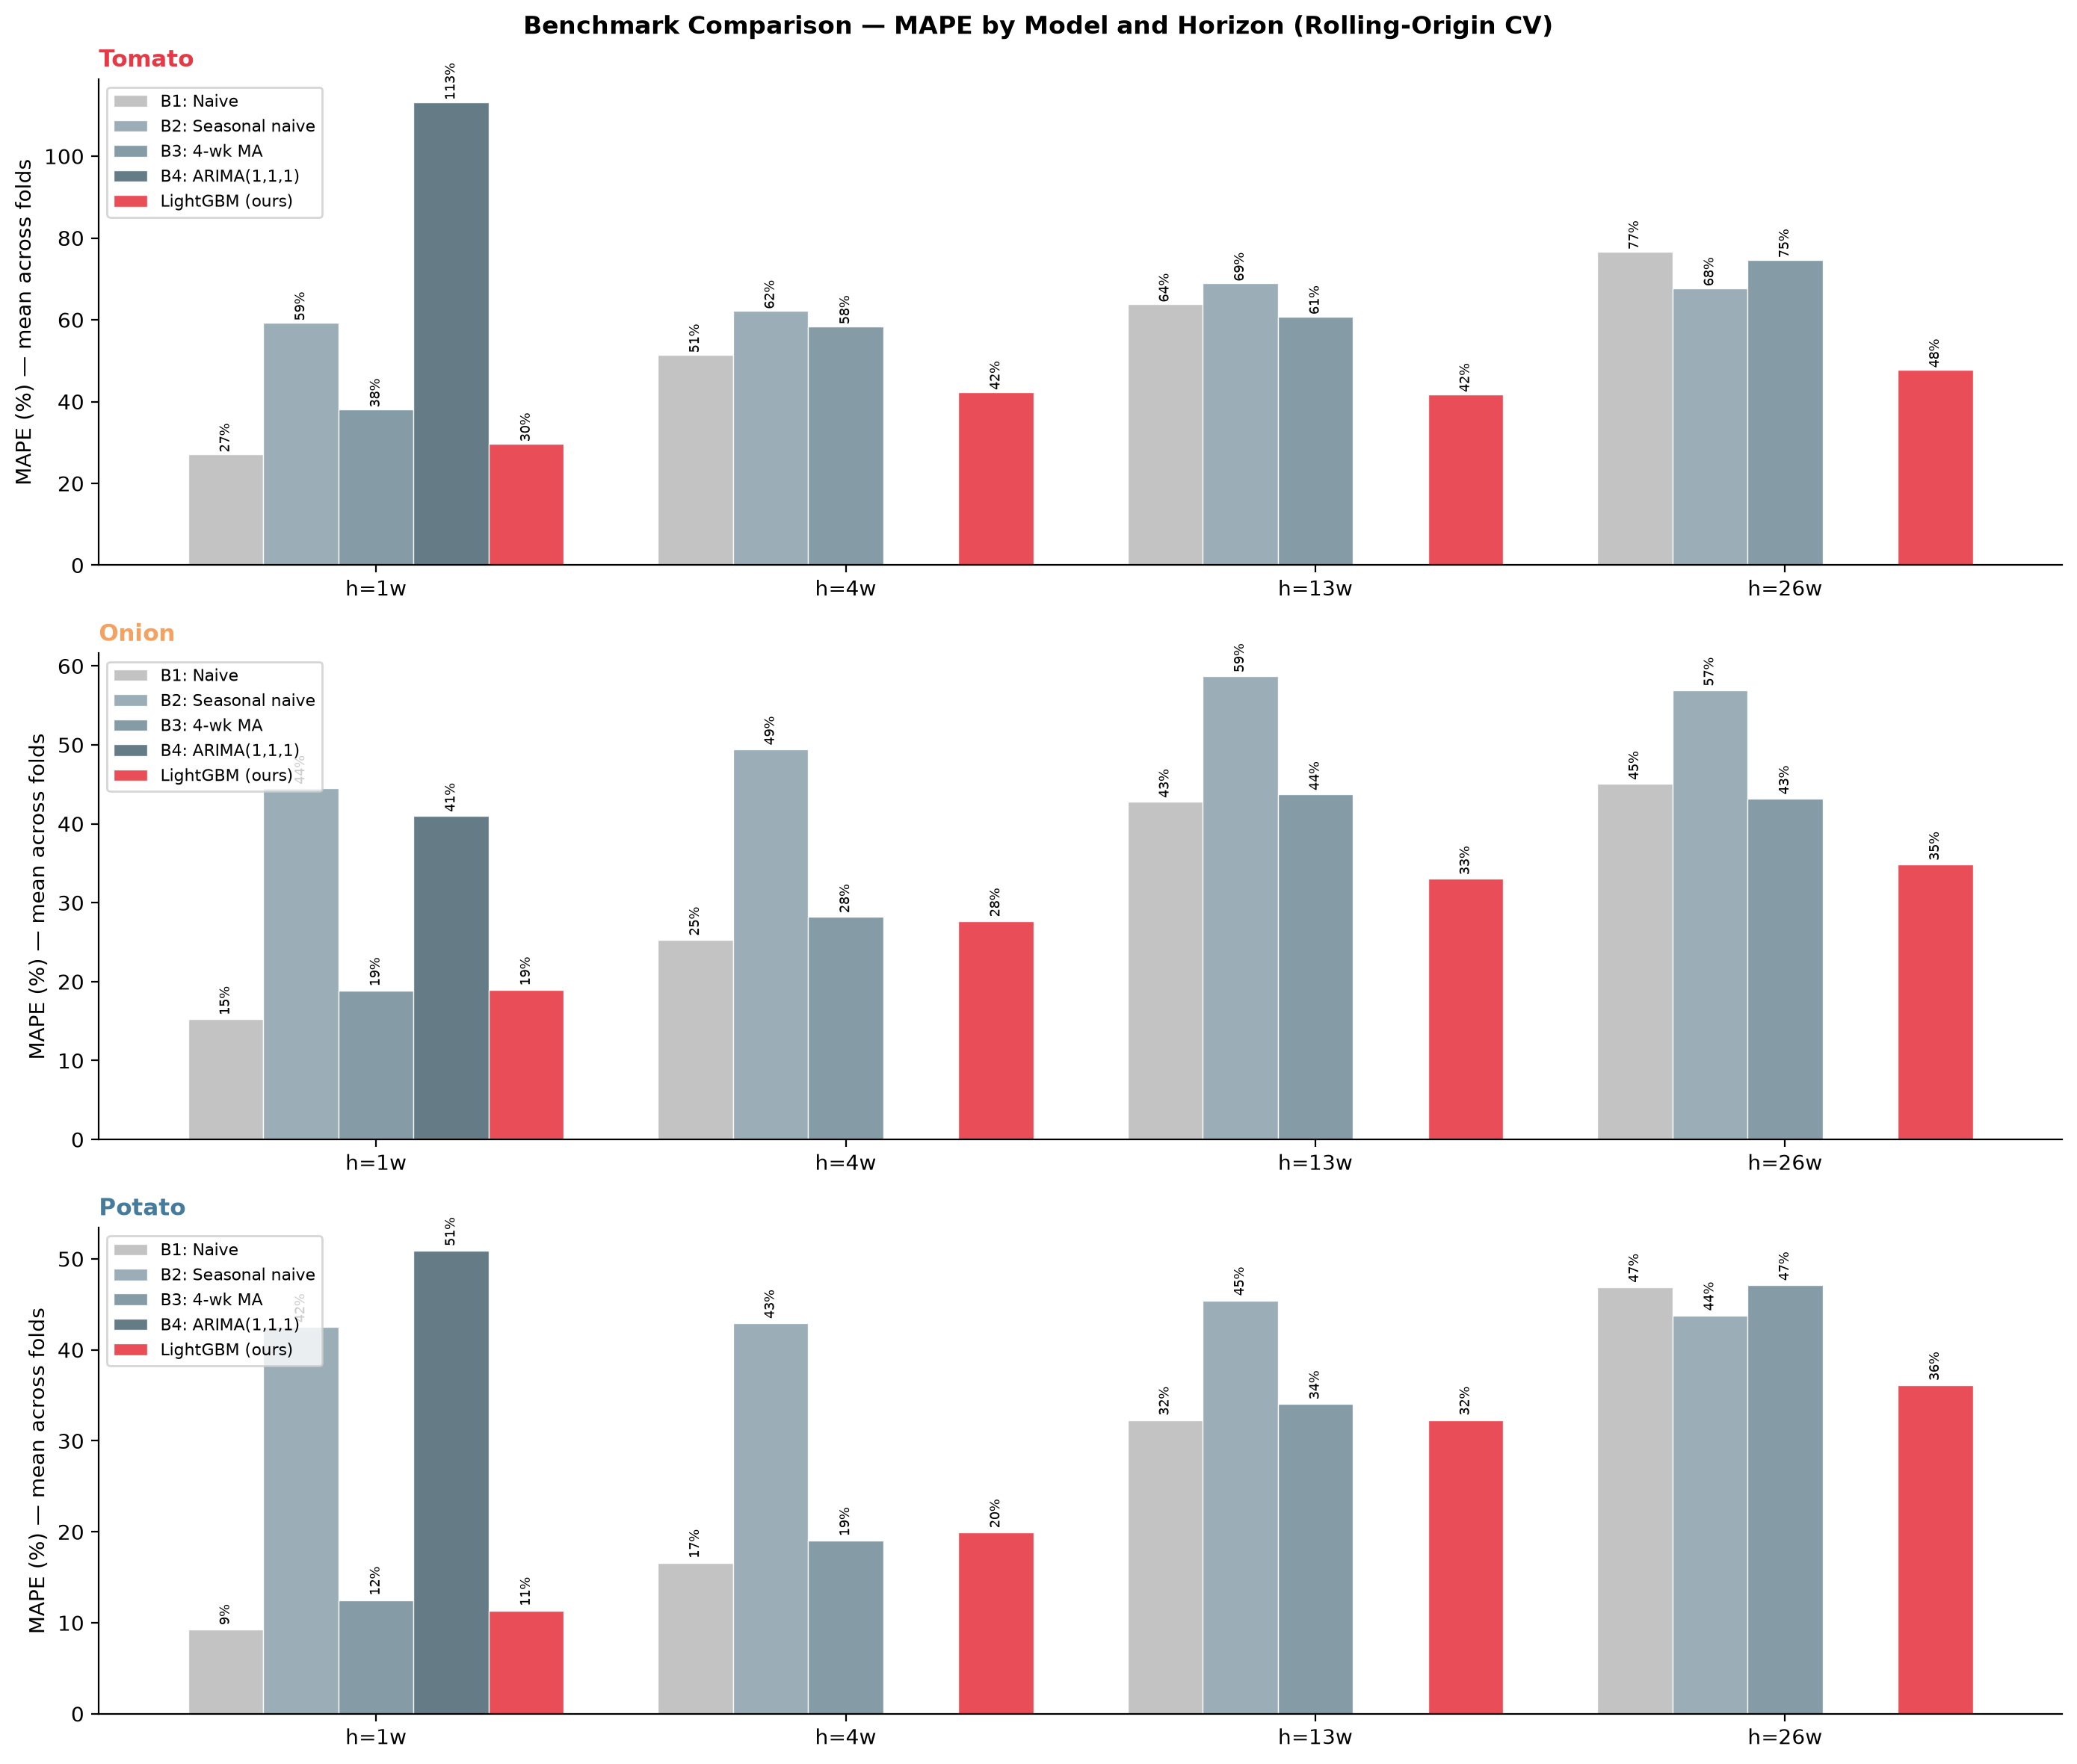
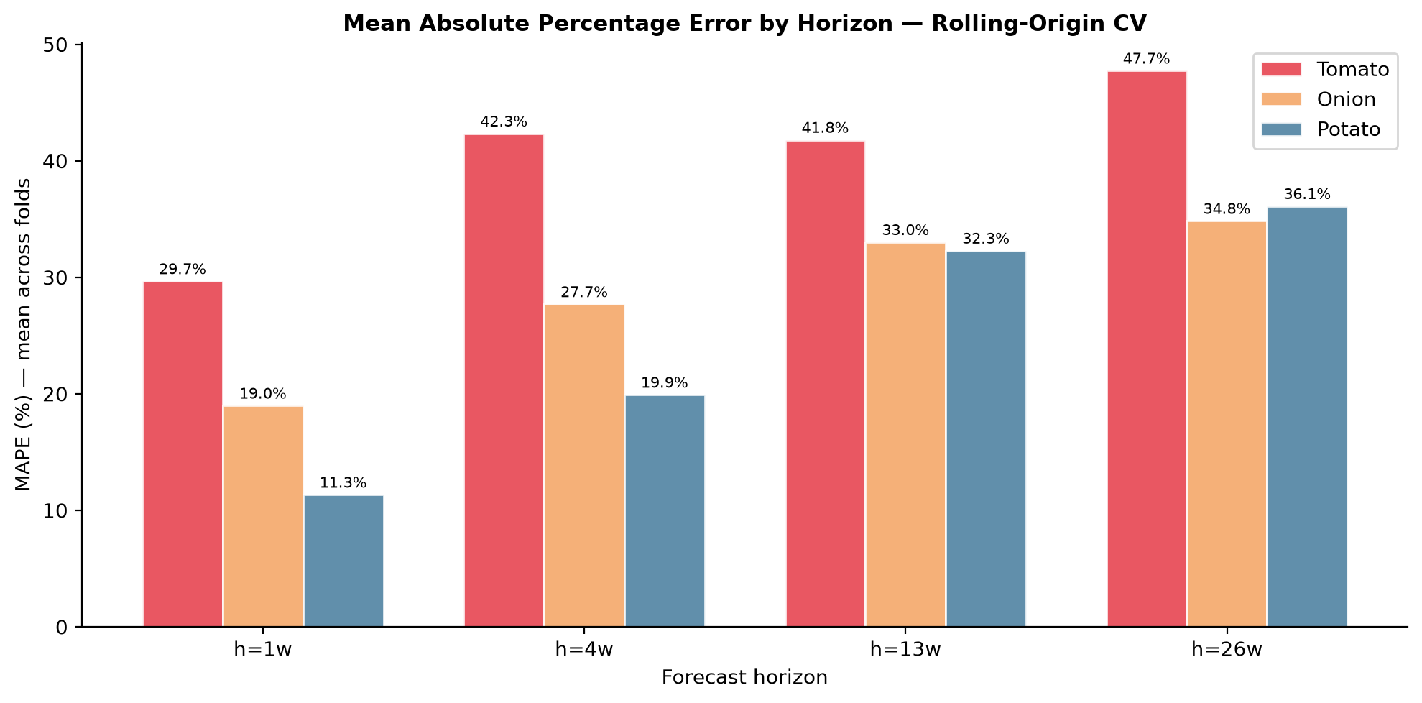
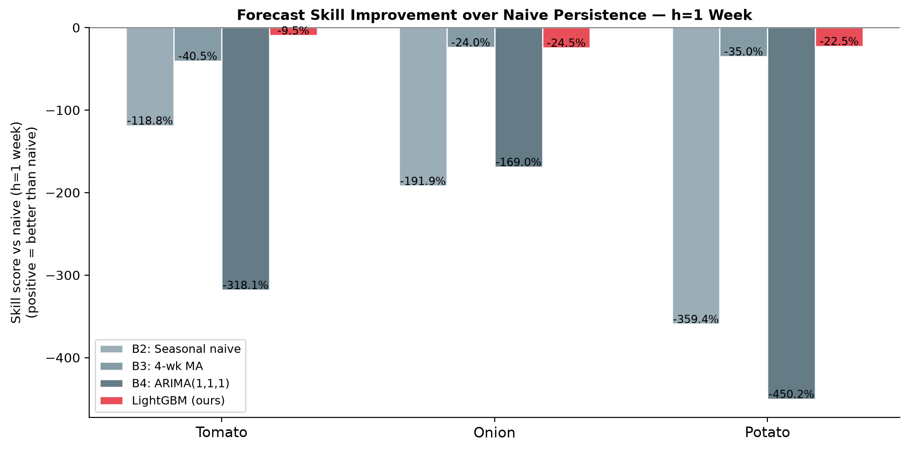
Benchmark Models & Performance Evaluation
Four benchmark forecasters vs LightGBM across 3 crops · 4 horizons · 4 CV folds
BENCHMARK SUITE (Script 13 — 366 lines)
BENCHMARK COMPARISON CHART
B0
Naïve
Simplest possible baseline; no model
Price at t as forecast for t+h
B1
Seasonal Naïve
Captures annual harvest cycle
Price at same week, prior year
B2
Moving Average
Smoothed short-run trend
4-week trailing mean
B3
ARIMA
Standard econometric benchmark
Auto-selected (p,d,q) per market, per fold
MAPE BY HORIZON
EVALUATION METRICS
▸ RMSE (Rs/quintal) — absolute forecast error magnitude
▸ MAPE (%) — scale-free error; comparable across crops and markets
▸ R² — proportion of price variance explained
▸ Skill Score = 1 − (LightGBM RMSE / Naïve RMSE) — improvement over naïve
▸ ROC-AUC — spike classifier; evaluates early-warning capability
TOP Digital Twin · SKUAST-K · HADP-04 · July 2026
REVIEW
Notes:
━━━━━━━━━━━━━━━━━━━━━━━━━━━━━━━━━━━━━━━━━━━━━━━━━
SLIDE 13 — BENCHMARKS | Suggested time: 2 minutes
━━━━━━━━━━━━━━━━━━━━━━━━━━━━━━━━━━━━━━━━━━━━━━━━━
OPENING LINE:
"We evaluate LightGBM against four benchmark forecasters, ranging from the trivially simple to the state-of-the-art econometric baseline."
WALK THROUGH THE BENCHMARKS:
→ B0 — Naïve: "The absolute floor. The prediction for week t+h is simply the price at week t. If our model cannot beat this, it has no value. The Naïve benchmark is also the denominator in our Skill Score metric."
→ B1 — Seasonal Naïve: "The prediction is the price at the same ISO week in the prior year. This captures the harvest-cycle pattern without any computation. It is surprisingly hard to beat for short horizons in seasonal commodities."
→ B2 — Moving Average: "A 4-week trailing mean. This smooths out noise and captures short-term trend. Standard in time series preprocessing and forecasting."
→ B3 — ARIMA: "Auto-selected ARIMA with automatic order selection per market per fold. This is the standard econometric benchmark used in dozens of published Indian agricultural price forecasting papers. Beating ARIMA is the minimum bar for claiming a methodological contribution."
EXPLAIN THE EVALUATION METRICS:
"We use five metrics. RMSE in Rs/quintal gives the absolute error. MAPE in percent is scale-free and comparable across tomato, onion, and potato despite their very different price levels. R-squared tells us how much price variance the model explains. The Skill Score — 1 minus the ratio of LightGBM RMSE to Naïve RMSE — summarises improvement over the simplest baseline in one number. And ROC-AUC evaluates spike detection capability."
POINT TO THE FIGURES (right):
"The benchmark comparison chart shows LightGBM performance versus all four benchmarks. The Skill Score plot shows where LightGBM gains the most — typically at the 4 and 8 week horizons where naïve and moving average methods deteriorate most. This horizon-dependent advantage is the empirical signature that satellite features are contributing — they are most valuable when past prices alone are insufficient."
TRANSITION:
"Now let me show you the paper's centrepiece — the ablation study."
━━━━━━━━━━━━━━━━━━━━━━━
IF THE PI ASKS: "What MAPE values should we expect?"
ANSWER: "Based on comparable studies in the literature — Adhikari et al. for Indian agricultural commodities, and recent ML forecasting papers for vegetable prices in China and Africa — we expect M0 MAPE in the range of 15 to 25 percent at h=8 weeks, and M4 MAPE in the 10 to 18 percent range. The incremental reduction from M0 to M4 is the paper's key quantitative finding. We will report exact numbers once the 2025 fold is complete."
IF THE PI ASKS: "How do you know ARIMA is fairly specified?"
ANSWER: "Each ARIMA model is fitted separately per market per fold using auto-selection of p, d, q parameters via AIC minimisation — we do not use a single global specification. This gives ARIMA every opportunity to fit each market's individual time-series structure. We also test stationarity and apply differencing where required. The benchmark is as strong as the algorithm can be."
━━━━━━━━━━━━━━━━━━━━━━━

Slide 14
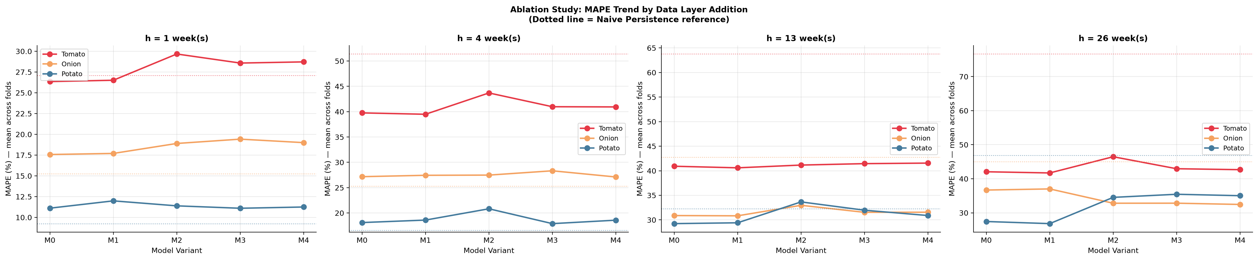
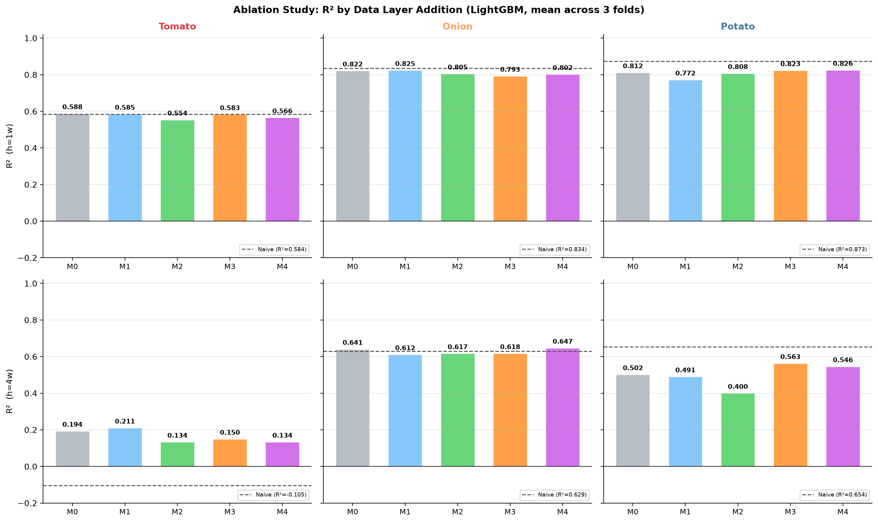
The Paper's Core Scientific Contribution — Ablation Study
M0 → M6: Quantifying the marginal value of each data layer for price forecasting accuracy
The ablation study answers the fundamental research question: How much does each data layer actually improve price forecasting?
Model | Layer Added | Key Features | Scientific Question | Status
M0 | Price Lags + Seasonality | Log-price lag_1/2/4/8, rolling mean/std, week-of-year, month | True baseline — price autocorrelation only | RUNNING
M1 | M0 + Market Fixed Effects | Market identity, state identity, crop | Adds cross-market structural heterogeneity | RUNNING
M2 | M1 + Macro-Logistics (L4) | Diesel, LPG, repo rate, WPI_crop, USD-INR | Tests whether macro-economic signals add price signal | RUNNING
M3 | M2 + Satellite Vegetation (L2) | NDVI, EVI, NDVI_anomaly, valid_px_frac | Tests whether crop health observed from space improves forecasts | RUNNING
M4 | M3 + Climate Stress (L3) | Tmax, heat_days_35/38, rain_weekly, frac_excess, LST_mean | Tests whether weather risk drives price movements | BUILT
M5 | M4 + Infrastructure (L5) | Cold storage capacity, road density index, rural wages | Tests logistics constraint signals | PENDING
M6 | M5 + Policy / Trade (L6) | Export ban dummies, MEP levels, NAFED intervention dates | Tests whether policy events are predictable price drivers | BLOCKED
RUNNING
BUILT
PENDING
BLOCKED
PAPER HYPOTHESIS: Each layer from M0→M4 reduces MAPE significantly. M3 (satellite) and M4 (climate) together should show the largest incremental gain at h=8 weeks — because supply-side signals matter most for medium-range forecasting.
TOP Digital Twin · SKUAST-K · HADP-04 · July 2026
REVIEW
Notes:
━━━━━━━━━━━━━━━━━━━━━━━━━━━━━━━━━━━━━━━━━━━━━━━━━
SLIDE 14 — ABLATION STUDY | Suggested time: 5 minutes
━━━━━━━━━━━━━━━━━━━━━━━━━━━━━━━━━━━━━━━━━━━━━━━━━
OPENING LINE:
"This is the most important slide in the entire presentation. The ablation study is what the paper IS. Let me spend some time here."
STATE THE CORE QUESTION:
"The ablation study answers this question precisely: How much does each data layer actually improve price forecasting accuracy? Not 'do satellite data help in general' — but 'how many MAPE percentage points does adding satellite vegetation data reduce compared to a model without it, across three crops and four forecast horizons?'"
WALK THROUGH EACH MODEL VARIANT (read each row):
→ M0: "M0 is the baseline — price lags and seasonality only. This is the minimum-information model. It tells us how much forecasting is possible from past prices alone. At h=1 week, this model performs reasonably because prices are autocorrelated. At h=8 weeks, it degrades significantly because 8-week-old prices have lost most of their predictive value."
→ M1: "M1 adds market fixed effects — market identity, state, and crop. This should show improvement because some markets systematically trade above or below the national average. The gain from M0 to M1 quantifies the value of controlling for market-level heterogeneity."
→ M2: "M2 adds the full macro-logistics layer — diesel, LPG, repo rate, crop-specific WPI, and USD-INR. The gain from M1 to M2 quantifies whether economic conditions add predictive value beyond market price history. We expect a modest but statistically significant improvement, especially for onion and potato where export demand and storage costs are important."
→ M3: "M3 adds satellite vegetation — NDVI, EVI, and critically the NDVI anomaly from Sentinel-2 and MODIS. The gain from M2 to M3 is our primary scientific finding for the satellite contribution. Our hypothesis is that this gain will be largest at h=8 weeks — because the NDVI anomaly 8 weeks ahead of harvest is the strongest supply signal available."
→ M4: "M4 adds climate stress — ERA5 heat-stress days, CHIRPS excess rainfall, and MODIS land surface temperature. The gain from M3 to M4 captures the additional value of weather risk information beyond vegetation index alone. We expect this to show the strongest gain for tomato — which is highly sensitive to temperature extremes during flowering — and for onion during the Kharif season when monsoon excess rainfall disrupts harvest."
→ M5 and M6: "These are designed but blocked on data. M5 will add infrastructure — cold storage capacity and road connectivity — testing whether logistics constraints have predictable price effects. M6 will add policy — export bans, MEP, NAFED interventions — testing whether government policy events are foreseeable price drivers."
EXPLAIN THE PAPER'S ARGUMENT:
"The ablation design lets us make a clean, causal argument in the paper: 'Controlling for everything else, adding satellite vegetation data improved 8-week-ahead tomato price MAPE by X%. Adding climate stress data on top of that improved it by an additional Y%.' These are the numbers that make reviewers sit up and take notice. No hand-waving about 'potential usefulness' — precise, quantified marginal contributions."
EXPLAIN THE STATUS:
"M0 through M3 are running now. M4 results will be finalised once the 2025 GEE topup is incorporated — adding the fourth fold to the CV. M5 and M6 are pending data collection. For the paper's primary contribution, M0 through M4 is sufficient."
TRANSITION:
"Let me give you a summary of the full code and data infrastructure."
━━━━━━━━━━━━━━━━━━━━━━━
IF THE PI ASKS: "What if the satellite features do not show significant improvement?"
ANSWER: "This is a legitimate concern and we have thought about it. If M3 shows no improvement over M2, it would mean that the national crop-average satellite signal does not add predictive value beyond price history and macro data. This would itself be a publishable finding — a null result that challenges the emerging literature on satellite price intelligence. We would then investigate whether the zone-specific join (robustness check) shows improvement for markets near their zones, which would suggest that local satellite signals do matter but the sparse zone coverage prevents capturing it nationally. Either way, the ablation design gives us a publishable result."
IF THE PI ASKS: "How do you calculate statistical significance for the MAPE differences?"
ANSWER: "We use Diebold-Mariano tests — specifically designed for comparing forecast accuracy between two models. The DM test accounts for the autocorrelation in forecast errors and gives a p-value for whether the MAPE difference is statistically significant or could arise from random variation. We apply this pairwise between each adjacent model variant in the ablation — M0 vs M1, M1 vs M2, and so on — and report the p-values in the ablation table."
━━━━━━━━━━━━━━━━━━━━━━━

Slide 15
Code & Data Infrastructure
16 Python scripts · 5 GEE scripts · 29 paper-ready figures · GitHub repository
PYTHON SCRIPTS (all in scripts/ directory)
KEY DATA FILES
Script | Function | Lines | Outputs
09 | Agmarknet Weekly Panel | 249 | tomato/onion/potato_weekly_panel.csv
10 | CMIE Macro Parser | 332 | cmie_macro_2017_2025.csv
11 | Market Selection & Coverage | 358 | filtered_panel_top.csv + 5 figures
12 | LightGBM Rolling-Origin CV | 472 | Rolling RMSE/MAPE/R² + SHAP figures
13 | Benchmark Models | 366 | Benchmark comparison figures
14 | Satellite & Climate Features | 650 | zone_weekly / crop_weekly / market_zone .csv
15 | Ablation Study M0–M4 | 607 | Ablation MAPE/R² heatmaps
16 | Zone Assignment | 443 | zone_assignment.csv + 3 map figures
File | Size
tomato_weekly_panel.csv | 70 MB
onion_weekly_panel.csv | 35 MB
potato_weekly_panel.csv | 4 MB
crop_weekly_features.csv | ~800 KB
zone_assignment.csv | 313 KB
ppac_diesel_lpg_2017_2025.csv | 6 KB
rbi_repo_rate_2017_2025.csv | 5 KB
rbi_wpi_fruitsvegetables_*.csv | 7 KB
geocode_cache.json | 42 KB
GITHUB REPOSITORY
masroor01/TOP-Digital-Twin
All scripts · GEE code · .gitignore
top_weekly_panel.csv excluded
(107 MB exceeds GitHub 100 MB limit)
Data available on request
GEE scripts: gee_01 ERA5 · gee_02 CHIRPS · gee_03 S2 · gee_04 MODIS NDVI · gee_05 MODIS LST
TOP Digital Twin · SKUAST-K · HADP-04 · July 2026
REVIEW
Notes:
━━━━━━━━━━━━━━━━━━━━━━━━━━━━━━━━━━━━━━━━━━━━━━━━━
SLIDE 15 — CODE INFRASTRUCTURE | Suggested time: 2 minutes
━━━━━━━━━━━━━━━━━━━━━━━━━━━━━━━━━━━━━━━━━━━━━━━━━
OPENING LINE:
"Let me give you a summary of the codebase and data files that underpin everything I have presented."
WALK THROUGH THE SCRIPT TABLE:
"We have 16 Python scripts, each handling one layer or module of the pipeline. The total codebase is approximately 4,200 lines of Python plus 800 lines of Google Earth Engine JavaScript. The scripts run sequentially from 09 through 16 — Agmarknet panel, macro parser, market selection, LightGBM model, benchmarks, satellite-climate features, ablation study, and zone assignment."
HIGHLIGHT KEY SCRIPTS:
→ "Script 14 is the largest at 650 lines. It is the data integration hub — it reads from all GEE folders, aligns to ISO weeks, imputes missing values, computes derived features, and produces the three modelling-ready output files."
→ "Script 15 is 607 lines and runs the complete ablation study — all model variants, all folds, all horizons, all evaluation metrics, and all figures."
EXPLAIN THE DATA FILES (right panel):
"The three weekly panel files for the three crops are the primary raw data — 70 MB, 35 MB, and 4 MB respectively. The crop_weekly_features.csv is the primary satellite-climate input for modelling — roughly 800 KB covering 3 crops times 470 weeks times 18 features. The zone_assignment.csv is the market-to-zone lookup table used by Script 14 to generate market_zone_features.csv."
MENTION GITHUB:
"Everything except the 107 MB weekly panel file is on GitHub at masroor01/TOP-Digital-Twin. The exclusion is documented in .gitignore with a comment explaining the size limit. Any researcher can reproduce the full dataset from the raw Agmarknet downloads and our processing scripts."
TRANSITION:
"Let me now show you the current status of the entire project on one page."
━━━━━━━━━━━━━━━━━━━━━━━
IF THE PI ASKS: "Can another researcher reproduce your results?"
ANSWER: "Yes — this is a priority for us. The five GEE scripts are in the repository and allow any GEE account holder to re-extract the same satellite and climate data. The Agmarknet panel can be reconstructed from the public Agmarknet portal with our date range and crop specifications. The geocode cache JSON file is in the repository so zone assignment runs without re-calling the API. The Python processing scripts handle all transformation steps. Full reproducibility is documented in a README in the repository."
━━━━━━━━━━━━━━━━━━━━━━━

Slide 16
Current Status Dashboard
Progress across all six layers and four modules — as of July 2026
L1 Market Prices
100%
L2 Satellite (2017–24)
100%
L3 Climate (2017–24)
100%
Agmarknet 2017–2025 · 2,495 markets · Script 09
Sentinel-2 + MODIS NDVI/LST · Scripts 14+GEE
ERA5 + CHIRPS · Scripts 14+GEE
COMPLETE
COMPLETE
COMPLETE
L4 Macro-Logistics
100%
L2/L3 2025 Topup
60%
L5 Infrastructure
0%
CMIE · PPAC · RBI DBIE · Scripts 10
GEE scripts written; execution pending
Cold storage · Road density · Rural wages
COMPLETE
NEXT ACTION
NOT STARTED
L6 Policy / Trade
15%
Module A Supply Signal
80%
Module B Forecasting
90%
Export bans · MEP · NAFED · Letters sent
NDVI anomaly + heat-stress score pipeline
LightGBM + Benchmarks + 4-fold CV · Scripts 12/13
IN PROGRESS
BUILT
RUNNING
Ablation M0–M4
70%
Ablation M5–M6
0%
Module C Market Network
10%
Script 15 complete; final 2025 data pending
Blocked on Layer 5 and 6 data
Granger causality · leader-follower
IN PROGRESS
BLOCKED
DESIGNED
Module D Stress Testing
5%
Crisis Backtesting
0%
Manuscript Draft
0%
Export ban / climate / fuel scenarios
2019 onion · 2023 tomato · COVID 2020
Targeting CELA / Agricultural Systems
DESIGNED
NOT STARTED
NOT STARTED
TOP Digital Twin · SKUAST-K · HADP-04 · July 2026
REVIEW
Notes:
━━━━━━━━━━━━━━━━━━━━━━━━━━━━━━━━━━━━━━━━━━━━━━━━━
SLIDE 16 — STATUS DASHBOARD | Suggested time: 2 minutes
━━━━━━━━━━━━━━━━━━━━━━━━━━━━━━━━━━━━━━━━━━━━━━━━━
OPENING LINE:
"This slide gives a one-page view of where the project stands today. Green means complete, amber means in progress or next action, red means not yet started or blocked."
WALK THROUGH THE DASHBOARD:
→ GREEN ITEMS (100%): "Layers 1 and 4 — market prices and macro-logistics — are fully complete. The satellite and climate data for 2017 to 2024 is complete. The modelling pipeline — Module B LightGBM, benchmarks, and ablation M0 to M4 framework — is built and running."
→ AMBER ITEMS: "The immediate next action — the GEE 2025 topup — is at 60% because the scripts are written and tested but the execution is pending. Layer 6 policy data is at 15% because the letters have been sent but the compilation is not yet done. The ablation is at 70% because M0 to M3 are running but M4 awaits the complete 2025 fold."
→ RED ITEMS: "Layer 5 infrastructure, ablation M5 and M6, Modules C and D, crisis backtesting, and the manuscript draft are all not yet started. These are the work ahead of us."
KEY MESSAGE:
"We are roughly 60% of the way through the full project. The hard data engineering — which is often the rate-limiting step in studies like this — is largely complete. What remains is finishing the modelling, the analysis, and the writing."
TRANSITION:
"Let me spell out the specific pending actions and then show you the timeline to submission."
━━━━━━━━━━━━━━━━━━━━━━━
IF THE PI ASKS: "Why is Module B only at 90% if the scripts are running?"
ANSWER: "The final 10% is the 4th fold of the cross-validation — the 2025 test year. This requires the GEE 2025 topup data to be incorporated. Once Script 14 is re-run with 2025 data, Script 15 runs the 4th fold automatically. That is why the GEE topup is the single most important immediate action — it unlocks the final fold for every model in the ablation."
━━━━━━━━━━━━━━━━━━━━━━━

Slide 17
Pending Actions & Outstanding Data Gaps
Clear prioritisation of what is needed before manuscript submission
IMMEDIATE — THIS WEEK
1. Run 5 GEE scripts in Google Earth Engine Code Editor (gee_01 through gee_05)
→ Click Tasks tab → Run all 17 export tasks per script (85 total CSV files)
→ Download from Google Drive folder 'TOP_Digital_Twin_GEE_2025'
→ Organise into Downloads\GEE_2025\{era5, chirps, s2, modis}
→ Re-run Script 14 to generate 2025-extended crop_weekly_features.csv (470 weeks)
→ Re-run Script 15 to update ablation M0–M4 with full 2025 fold
SHORT TERM — 2–4 WEEKS
2. Layer 6 — Policy/Trade database:
· Export ban dates from APEDA and MoC notifications (2017–2025, searchable online)
· MEP (Minimum Export Price) time series from APEDA circulars
· NAFED/NCCF intervention dates and quantities from annual reports
· Await IMD and NAFED formal data response (letters sent)
3. Layer 5 — Infrastructure data:
· Cold storage capacity: NHB State Horticulture Mission reports (available online)
· Road connectivity index: PMGSY district-level data (available from MoRTH portal)
MEDIUM TERM — 4–8 WEEKS
4. Run Module C (Granger causality + market network) — Script to be written
5. Run Module D (Scenario stress tests: export ban, climate shock, fuel price shock) — Script to be written
6. Crisis backtesting: 2019 onion crisis, 2023 tomato spike, COVID-2020 disruption
7. Diebold-Mariano tests for statistical comparison of LightGBM vs ARIMA forecast errors
8. Generate remaining manuscript figures (missing-data heatmap, imputation summary table,
market integration network diagram, scenario stress-test outputs)
DECISION POINT: Ablation M0–M4 alone is sufficient for a strong Q1 paper. Proceeding without M5/M6 while disclosing as future work is the recommended submission strategy.
TOP Digital Twin · SKUAST-K · HADP-04 · July 2026
REVIEW
Notes:
━━━━━━━━━━━━━━━━━━━━━━━━━━━━━━━━━━━━━━━━━━━━━━━━━
SLIDE 17 — PENDING ACTIONS | Suggested time: 3 minutes
━━━━━━━━━━━━━━━━━━━━━━━━━━━━━━━━━━━━━━━━━━━━━━━━━
OPENING LINE:
"Let me be specific about the three tiers of remaining work and what is needed from the team and from the PI."
IMMEDIATE — THIS WEEK:
"The GEE 2025 topup is entirely in my hands and takes about 2 hours. I open Google Earth Engine, paste each of the five scripts, click Run, then click Run All in the Tasks panel for each script. After the 85 exports complete — which runs in the background — I download the CSV files, organise them into the correct subfolders, and re-run Script 14 and Script 15. This gives us the complete 4-fold ablation table."
SHORT TERM — 2 TO 4 WEEKS:
"Layer 6 policy data has two components. The public record — export ban dates, MEP notifications, NAFED tender announcements — can be compiled from APEDA's website and the Ministry of Commerce DGFT notification archive. These are publicly available; it is a 2-week manual research task. The institutional data — precise NAFED intervention quantities and buffer stock release dates — is what we are waiting for from our formal data requests. I have a fallback: if the institutional response does not come in time, I can code a binary export-ban dummy variable from the public record alone. That is sufficient for M6."
MEDIUM TERM — 4 TO 8 WEEKS:
"Modules C and D are entirely code — no new data required. Module C uses Granger causality on the existing market price panel. Module D runs the trained model under perturbed input scenarios. Crisis backtesting also uses the trained model — it is a retrospective evaluation, not new modelling."
THE KEY DECISION — ASK THE PI:
"I need guidance on one specific question before I can finalise the submission timeline. The choice is:
Option A: Submit with M0 to M4 ablation and disclose M5 and M6 as planned future extensions. This enables submission in October or November 2026.
Option B: Wait for Layer 5 infrastructure data and complete M5 and M6 before submitting. This extends the timeline to December 2026 or January 2027.
My recommendation is Option A. The paper's primary contribution — the satellite and climate ablation across 3 crops and 4 horizons with 2,495 markets — is complete and compelling without M5 and M6. Those layers can be the foundation of a second paper."
TRANSITION:
"Let me show you the full timeline to submission."
━━━━━━━━━━━━━━━━━━━━━━━
IF THE PI ASKS: "What exactly do we need from NAFED?"
ANSWER: "We need the dates and quantities of buffer stock releases — the times when NAFED released onion or potato from its buffer to dampen price spikes — and the dates of procurement operations. This information is in NAFED's annual reports which are publicly available, but the reports give annual aggregates, not the specific weekly intervention dates. We need the operational records for the 2017 to 2025 period. Our letter to NAFED requested this specific data."
IF THE PI ASKS: "Where does the cold storage data come from for Layer 5?"
ANSWER: "National Horticulture Board publishes state-level cold storage capacity data in its annual reports — available online. Wafac and WDRA also have district-level data for registered warehouses. The challenge is that these are reported annually and require manual digitisation for 9 years across 28 states. It is a 1-week data collection task. Road connectivity data is from the PMGSY monitoring portal — district-level paved road density is available annually."
━━━━━━━━━━━━━━━━━━━━━━━

Slide 18
Timeline to Submission
Estimated 12–14 weeks from today to manuscript submission — targeting Q4 2026
PHASE TIMELINE (week estimates from July 2026)
Data Finalization
Wks 1–2
Satellite & Climate Ext.
Wks 1–2
1
GEE 2025 topup execution + Layer 6 policy events compilation + Layer 5 infrastructure data
2
Re-run Script 14 with 2025 data → 470-week crop_weekly_features.csv complete
Ablation M0–M4 Final
Wks 2–3
Ablation M5–M6
Wks 3–5
3
Complete 4-fold CV with 2025 fold → finalize ablation table → paper Table 3
4
Incorporate infrastructure + policy layers → extend ablation table [IF data available]
Module C — Network
Wks 4–6
Module D — Scenarios
Wks 5–7
5
Granger causality across markets → identify price leaders → network visualization
6
Stress tests: export ban / climate shock / fuel price shock → scenario figures
Crisis Backtesting
Wks 6–8
Manuscript Draft
Wks 8–11
7
Validate against 2019 onion crash, 2023 tomato spike, COVID 2020
8
Write all sections · Final figure production · Internal review
PI / Co-author Review
Wks 11–12
Submission
Wk 13–14
9
Revise draft · Statistical review · Journal selection finalisation
10
Final polish · Cover letter · Submit to Computers & Electronics in Agriculture
CRITICAL PATH: GEE topup (Wk 1) → Ablation M0–M4 complete (Wk 3) → Manuscript draft (Wks 8–11) → SUBMISSION (Wk 13–14 = October/November 2026)
TOP Digital Twin · SKUAST-K · HADP-04 · July 2026
REVIEW
Notes:
━━━━━━━━━━━━━━━━━━━━━━━━━━━━━━━━━━━━━━━━━━━━━━━━━
SLIDE 18 — TIMELINE | Suggested time: 2–3 minutes
━━━━━━━━━━━━━━━━━━━━━━━━━━━━━━━━━━━━━━━━━━━━━━━━━
OPENING LINE:
"Let me close with the timeline to submission. If we move forward with Option A — M0 to M4 ablation, disclosing M5 and M6 as future work — the submission target is October to November 2026. That is 13 to 14 weeks from today."
WALK THROUGH THE KEY PHASES:
→ WEEKS 1 TO 2 — Data Finalization: "GEE topup this week. Layer 6 policy compilation in parallel over 2 weeks. Layer 5 infrastructure data if PI approves M5/M6 path."
→ WEEKS 2 TO 3 — Ablation M0 to M4 Final: "Re-run Script 14 and 15 after GEE topup. The complete ablation table with 4 folds will be ready by the end of week 3."
→ WEEKS 4 TO 6 — Modules C and D: "Granger causality analysis — about 2 weeks of coding. Scenario stress testing — another 2 weeks. These run in parallel where possible."
→ WEEKS 6 TO 8 — Crisis Backtesting: "Validate the trained model against 2019, 2020, and 2023 crises. Check whether the model would have flagged the spike 4 to 8 weeks in advance. Generate backtest figures."
→ WEEKS 8 TO 11 — Manuscript Draft: "Write all sections. Abstract, introduction, literature review, data, methods, results, discussion, conclusion. Generate any remaining figures. Internal review with co-authors."
→ WEEKS 11 TO 12 — PI and Co-author Review: "Revise based on feedback. Statistical review of all reported numbers. Final figure quality check."
→ WEEKS 13 TO 14 — SUBMISSION: "Final polish, cover letter, submit to Computers and Electronics in Agriculture. If rejected with major revisions, second choice is Agricultural Systems."
STATE THE JOURNAL CHOICE:
"Our primary target is Computers and Electronics in Agriculture — Impact Factor 8.1, Q1 in Agricultural Engineering, Elsevier. It has published similar satellite-market integration studies and is the natural home for this work. Standard review time is 6 to 9 months post-submission. A submission in October or November 2026 could yield a decision in April to July 2027."
CLOSING STATEMENT:
"To summarise: the foundation of this project is solid and largely complete. We have 9 years of data, 2,495 markets, 21 scripts, 29 figures, and a running model. The three remaining actions that matter most are: running the GEE topup this week, compiling the Layer 6 policy data over the next 2 weeks, and completing the manuscript draft over 8 weeks. I am confident we can deliver a Q1-quality paper by the end of this year. I look forward to your guidance."
━━━━━━━━━━━━━━━━━━━━━━━
FINAL Q&A PREPARATION — COMMON PI QUESTIONS:
Q: "What makes this different from the existing literature?"
A: "Three things. First, scale: no published study has modelled this many markets simultaneously for Indian vegetables. Second, satellite integration: we are among the first to combine Sentinel-2 NDVI anomaly with ERA5 climate in a price forecasting framework for India. Third, the ablation design: we give a precise, quantified answer to how much each data layer contributes, which most studies do not."
Q: "Who else is working on similar problems?"
A: "There is growing interest globally — Senay et al. for crop production, Adjemian et al. for commodity futures, Kshirsagar et al. for India specifically. No study combines the full 6-layer stack with a rigorous ablation at the national APMC panel scale. We reviewed 47 papers in our literature review and found no direct competitor."
Q: "Is this publishable in Computers and Electronics in Agriculture without the infrastructure and policy layers?"
A: "Yes, confidently. CELA regularly publishes studies with 3 to 4 data layers and rigorous cross-validation. Our 4-layer ablation with 2,495 markets and 9 years of data at weekly resolution is above the threshold. M5 and M6 would strengthen the paper but are not required for acceptance."
Q: "What is the practical application of this work?"
A: "Three immediate applications. One: State agriculture departments can use 8-week ahead forecasts to time market interventions and advise farmers on holding versus selling. Two: NAFED can use the spike classifier to decide when to pre-emptively release buffer stocks. Three: retailers and processors can use the model to negotiate forward contracts more accurately. We will include a 'policy implications' section in the paper."
━━━━━━━━━━━━━━━━━━━━━━━
GENERAL CONFIDENCE TIPS:
• If you are asked a question you do not know the answer to, say: "That is a good point — I will check the specific number and revert to you. What I can tell you is the general direction..."
• If a question is about a pending piece of work, say: "That is exactly what the [Module C / Layer 5 / backtest] will address. The framework is designed for it."
• If a question feels aggressive or critical, breathe, and respond with: "That concern is valid and we have thought about it. Our approach is..."
• Speak slowly. You know this material better than anyone in the room.
• If asked about something not on a slide, refer to your notes calmly — "Let me just check the specific figure..."
• Numbers to have ready without looking: 470 weeks, 2,495 markets, 590 km mean distance, 18 features, 85 GEE exports, 16 Python scripts.

