Slide 1
TOP DIGITAL TWIN
An Agricultural Price Forecasting & Policy-Analytics System for Tomato, Onion & Potato
Progress Review — Achievements, Validated Results & Open Questions
Presented by: Dr. Masroor SKUAST-Kashmir HADP-04 Digital Agriculture Initiative
TOP Digital Twin | Tomato · Onion · Potato Price Forecasting & Policy Analytics
1
Notes:
Good morning / good afternoon everyone, and thank you for making time for this review. Today I want to walk you through the full progress on the TOP Digital Twin project -- our forecasting and policy-analytics system for tomato, onion, and potato prices, built under the HADP-04 digital agriculture initiative. This has been a genuinely large body of work, so rather than just showing you the headline numbers, I want to take you through the whole pipeline -- the data we built it on, the models we tested and rejected as well as the ones we kept, the causal policy analysis, the early-warning system we developed, and the live dashboard that's already public. I also want to be upfront about what we found that we did NOT expect, and about the things that are still open, because I think that honesty is exactly what makes this work presentable. Let's get into it.

Slide 2
ROADMAP
What I'll Cover Today
01
Motivation & the problem we set out to solve
06
Early-warning system: the escalation-signature detector
02
Data foundation: six layers, 1,736 markets, 9-year panel
07
Causal policy analysis: did the 2023-24 onion ban work?
03
Forecasting model: ablation study & what actually helps
08
Market network, formal stress testing, live dashboard
04
Interpretability: what the model is really using
09
Scientific housekeeping: bugs found & fixed, paths rejected
05
Real-world stress test: 4 verified price crises, 2023-2025
10
This week's work, open items, and what's next
TOP Digital Twin | Tomato · Onion · Potato Price Forecasting & Policy Analytics
2
Notes:
Here's the shape of the talk. I'll start with why we built this at all, then walk through the data foundation, because everything downstream depends on how solid that is. From there I'll cover the core forecasting model and what we learned from the ablation study, then interpretability -- what the model is actually paying attention to. The middle section is the part I'm most proud of: a real backtest against four verified price crises, the early-warning detector we built and validated, and the causal policy analysis asking whether the 2023-24 onion export ban actually worked. Then I'll cover the market network analysis, the formal stress-testing battery, and the live public dashboard. Finally -- and I think this matters for how you evaluate this work -- I'll walk through the bugs we found and fixed, the architectures we tried and deliberately rejected, and what's still open. Please stop me with questions anywhere.

Slide 3
THE PROBLEM
Why Tomato, Onion & Potato Prices Matter
TOP crops are the most price-volatile staple vegetables in India, and volatility hurts both sides — consumers face sudden retail spikes, producers face crashes that wipe out a season's margin.
Government intervenes reactively: export bans, minimum export prices, duty changes, buffer-stock releases — but these decisions are usually made after a spike is already visible in the data, not ahead of it.
A credible short-horizon forecast, an early-warning signal for escalating episodes, and a rigorous estimate of whether past interventions actually worked, are three tools policymakers currently do not have in one place.
That is the gap this project targets: a single, validated digital twin spanning forecasting, early warning, and causal policy evaluation — not just another price-prediction model.
Three Deliverables
1
Short-horizon price forecasts
per market, per crop, 1-26 weeks ahead
2
Early-warning detector
flags escalating episodes before they peak
3
Causal policy evaluation
did the 2023-24 export ban actually work?
TOP Digital Twin | Tomato · Onion · Potato Price Forecasting & Policy Analytics
3
Notes:
Let me start with why this project exists at all. Tomato, onion, and potato -- the TOP crops -- are the most price-volatile staple vegetables in the Indian consumption basket. When prices spike, it's a consumer-facing crisis; when they crash, it's a producer-facing one, and often we see both within the same season for the same crop. The policy response today is almost entirely reactive -- export bans, minimum export prices, duty changes -- and by the time these are announced, the price move that triggered them is already visible in the data. What's missing is three things in one integrated system: a forecast you can actually trust at short horizons, an early-warning signal that flags an escalating episode before it peaks, and a rigorous, honest answer to whether a given intervention actually moved prices the way it was supposed to. That's the three-part deliverable this project targets, and everything I show you today maps back to one of these three pillars.

Slide 4
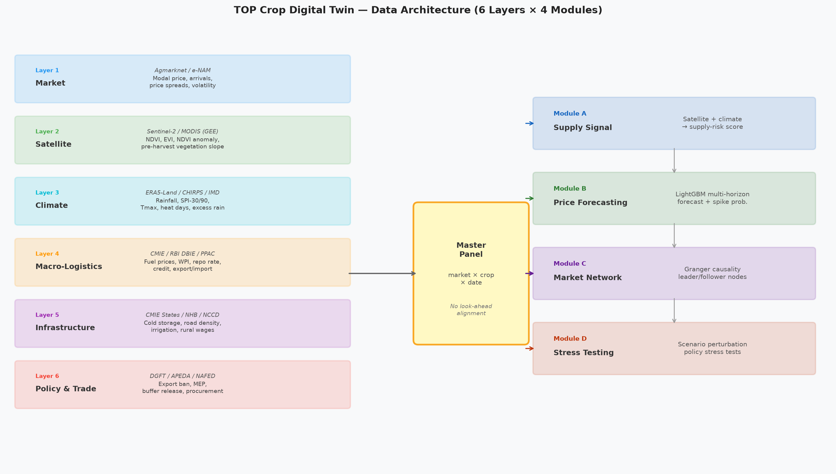
SYSTEM DESIGN
Six Data Layers Feed the Model
Market
Weekly Agmarknet price + arrivals, 2017-2026
Satellite
Sentinel-2 / MODIS vegetation indices (NDVI/EVI)
Climate
ERA5-Land temperature, CHIRPS rainfall
Macro
CMIE/RBI/PPAC — WPI, USD/INR, diesel, repo rate
Infrastructure
Cold-storage capacity, road density
Policy
Verified export bans, duty, MEP, buffer releases
TOP Digital Twin | Tomato · Onion · Potato Price Forecasting & Policy Analytics
4
Notes:
The model isn't just trained on price history. We built a six-layer data architecture: the market layer itself, which is weekly Agmarknet price and arrivals from 2017 through today; a satellite layer using Sentinel-2 and MODIS vegetation indices as a proxy for crop condition; a climate layer from ERA5-Land and CHIRPS for temperature and rainfall; a macro layer from CMIE, RBI, and PPAC covering wholesale price indices, the exchange rate, diesel prices, and the repo rate; an infrastructure layer capturing cold-storage capacity and road density per market; and a policy layer of hand-verified export bans, duties, minimum export prices, and buffer-stock releases, cross-checked against primary government sources, not scraped news. I'll come back to the policy layer specifically later, because one of our more interesting findings is about how little the model actually uses it, and why that's not a flaw.

Slide 5
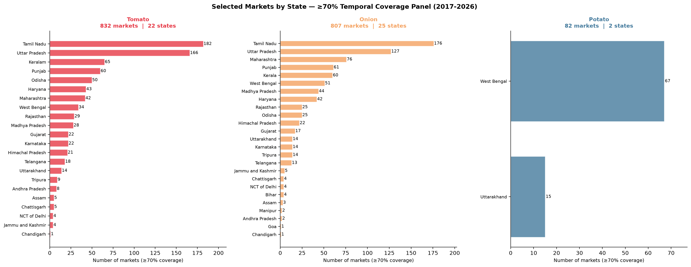
DATA FOUNDATION
Market Coverage: 1,736 Markets, 9-Year Panel
840
814
82
≥70%
Tomato markets
Onion markets
Potato markets
Real-data coverage floor
Retained markets by state and crop, after the ≥70% real-coverage filter (figure below: 832/807/82, Script 11's snapshot — panel has since grown to the 840/814/82 shown above as later 2026 weeks pushed borderline markets past the threshold). Source: Script 09/11 (data/agmarknet_weekly).
TOP Digital Twin | Tomato · Onion · Potato Price Forecasting & Policy Analytics
5
Notes:
Here's the scale of the underlying panel. We're covering 840 tomato markets, 814 onion markets, and 82 potato markets, every one of them required to have at least 70 percent real, non-imputed weekly observations over a nine-year window from 2017 to 2026 -- so this isn't a thin or cherry-picked panel, these are markets with a genuine trading history. Geographically the retained markets cluster exactly where you'd expect from agronomic knowledge -- Tamil Nadu, Uttar Pradesh and Kerala dominate tomato; Maharashtra's Nashik belt dominates onion; West Bengal dominates potato. That geographic coherence is itself a sanity check that the data is behaving the way real agricultural markets should.

Slide 6
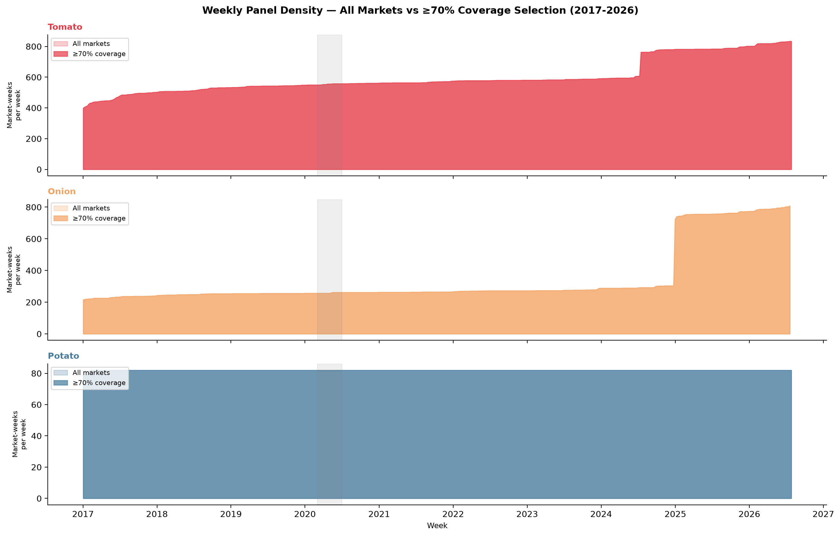
DATA QUALITY
A Real Bug We Found and Fixed: The Grid-Adaptivity Fix
Original design built one fixed calendar grid (2017-2026) for every market — a market that only started reporting in, say, 2021 was scored "missing" for every week before it existed.
That silently dragged down real-coverage ratios for markets with nothing wrong with their actual data — purely an artifact of the grid construction.
Fixed 2026-08-01: each market's grid now starts at its own first real observed week.
Impact was large, not cosmetic:
Tomato: 517 → 834 markets
Onion: 246 → 809 markets
Potato: unchanged (82) — its separate ≥8-year balanced-panel filter already avoided this artifact
Median real coverage of the newly-recovered markets: 92-96% — not thin, borderline data.
TOP Digital Twin | Tomato · Onion · Potato Price Forecasting & Policy Analytics
6
Notes:
I want to spend a moment on this because it's a good example of the kind of rigor we've tried to hold this project to. Early on, the panel-building script constructed one fixed calendar grid running the full nine years for every single market. That sounds harmless, but it means a market that only started reporting in, say, 2021, was being scored as 'missing data' for every week before it even existed in the Agmarknet system -- which silently and wrongly dragged its real-coverage percentage down. We caught this while investigating a completely different question, fixed the grid so each market starts its own clock at its first real observation, and the impact was substantial, not cosmetic: tomato went from 517 to 834 qualifying markets, onion from 246 to 809. Potato was unaffected because its own filter design happened to sidestep this artifact already. And critically, the newly recovered markets aren't thin data -- their median real coverage is 92 to 96 percent. Given the scale of that change, we re-ran the entire downstream pipeline -- every model, every table you'll see today reflects this corrected panel.

Slide 7
FORECASTING MODEL
Ablation Study: Isolating What Actually Helps
LightGBM gradient-boosted trees, forecasting log-price at 4 horizons: 1, 4, 13, and 26 weeks ahead.
7 progressively richer feature variants (M0 → M6), each adding one data layer on top of the last, so we can isolate each layer's marginal contribution rather than just reporting one black-box accuracy number.
Naive persistence (B1) as the baseline every variant must beat to be worth its complexity.
5 rolling-origin cross-validation folds (extended from 4 on 2026-08-13, adding a partial 2026 fold) — 420 total LightGBM fits across the full study.
Monotonic sign constraint on export-ban / duty / MEP features, so the model can't learn a policy relationship backwards from spurious correlation.
M0
Price only
→
M1
+Calendar
→
M2
+Arrivals
→
M3
+Climate
→
M4
+Satellite
→
M5
+Macro/Infra
→
M6
+Policy
TOP Digital Twin | Tomato · Onion · Potato Price Forecasting & Policy Analytics
7
Notes:
For the core forecasting engine we use LightGBM, gradient-boosted trees, predicting log price at four horizons -- one week, four weeks, thirteen weeks, and twenty-six weeks out. Rather than just reporting one accuracy number for a fully-loaded model, we designed an ablation study: seven feature variants, M0 through M6, each one adding exactly one more data layer on top of the last, all the way from price-only up to the full six-layer model including policy. This lets us isolate each layer's actual marginal contribution instead of just asserting the model is good. Every variant is measured against naive persistence -- literally just carrying forward last week's price -- because if a variant can't beat that trivial baseline, its added complexity isn't earning its keep. We use five rolling-origin cross-validation folds, extended from four in August after new 2026 data came in, giving us 420 total model fits across the whole study. One more design choice worth flagging: we put a monotonic sign constraint on the three policy features -- export ban, duty, MEP -- so the model is structurally prevented from learning a policy relationship backwards purely from spurious correlation in a small sample.

Slide 8
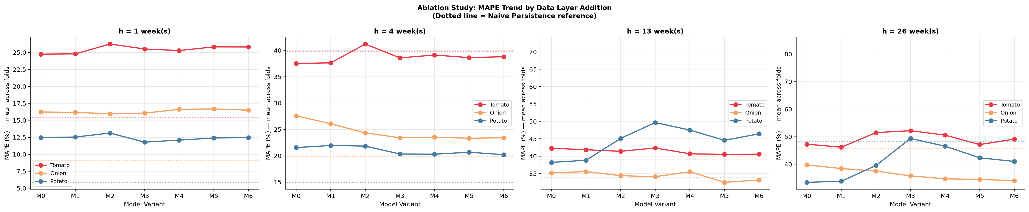
HEADLINE RESULT
The Full Model Wins Decisively at Long Horizons
Crop / Horizon | Naive MAPE | M6 MAPE | Skill vs. Naive
Tomato, 13w | 72.3% | 40.6% | +43.9%
Tomato, 26w | 83.7% | 49.1% | +41.3%
Onion, 26w | 45.7% | 34.0% | +25.4%
Potato, 26w | 48.2% | 41.0% | +15.0%
Tomato, 1w | 15.4% | 25.8% | −67.2% (naive wins)
Onion, 1w | 9.1% | 16.5% | −81.1% (naive wins)
Source: table_ablation.csv (Script 15). MAPE = Mean Absolute Percentage Error, lower is better. 5-fold rolling-origin CV.
TOP Digital Twin | Tomato · Onion · Potato Price Forecasting & Policy Analytics
8
Notes:
Here's the headline result, and I want to be precise about what it says rather than oversell it. The full six-layer model, M6, wins decisively at the longer horizons: forty-four percent skill improvement over naive persistence for tomato at thirteen weeks, forty-one percent at twenty-six weeks, twenty-five percent for onion at twenty-six weeks. But -- and this is important -- at the one-week horizon, naive persistence actually wins, by a wide margin, for tomato and onion specifically. This is not a failure of the model. At one week out, this week's price IS almost the best predictor of next week's price -- that's just how these markets behave at short horizons, there's very little the extra data layers can add over simple momentum. The real story is horizon-dependent skill: naive wins short, the full model wins long, and knowing exactly where that crossover happens is itself a genuinely useful result for anyone trying to decide which forecast to trust at what lead time.

Slide 9
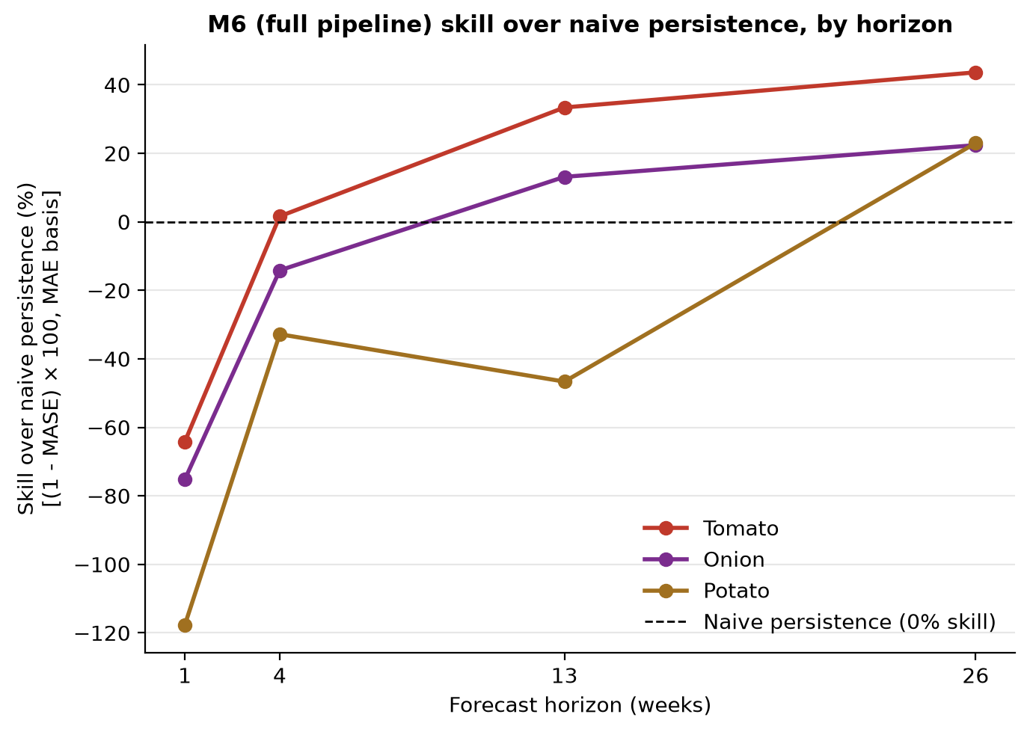
WHERE WE WIN
Horizon-Dependent Skill & the Model Confidence Set
Crossover Horizon (where M6 first beats naive)
Tomato
4 weeks
Onion
13 weeks
Potato
26 weeks
Model Confidence Set (Hansen, Lunde & Nason 2011)
At h=1 week, naive persistence (B1) is the sole 90%-confidence-set survivor for all three crops — statistically, nothing beats it that early. Every richer variant is formally eliminated at that horizon, not just numerically behind.
TOP Digital Twin | Tomato · Onion · Potato Price Forecasting & Policy Analytics
9
Notes:
This slide makes that horizon story precise. For each crop we identified the exact crossover horizon -- the first point at which the full model overtakes naive persistence. For tomato that's four weeks out, for onion it's thirteen weeks, for potato it's twenty-six weeks -- the full six-month horizon. We also ran a Model Confidence Set analysis, a formal statistical procedure from Hansen, Lunde and Nason, which jointly tests all eight model variants per crop and horizon with proper error control, rather than just comparing point estimates. At the one-week horizon, naive persistence is the SOLE statistical survivor at ninety percent confidence for all three crops -- meaning every richer model variant is formally, statistically eliminated at that horizon, not just numerically a little behind. That's a stronger and more honest statement than just showing you a bar chart, and it tells any downstream user exactly which forecast to trust at which lead time.

Slide 10
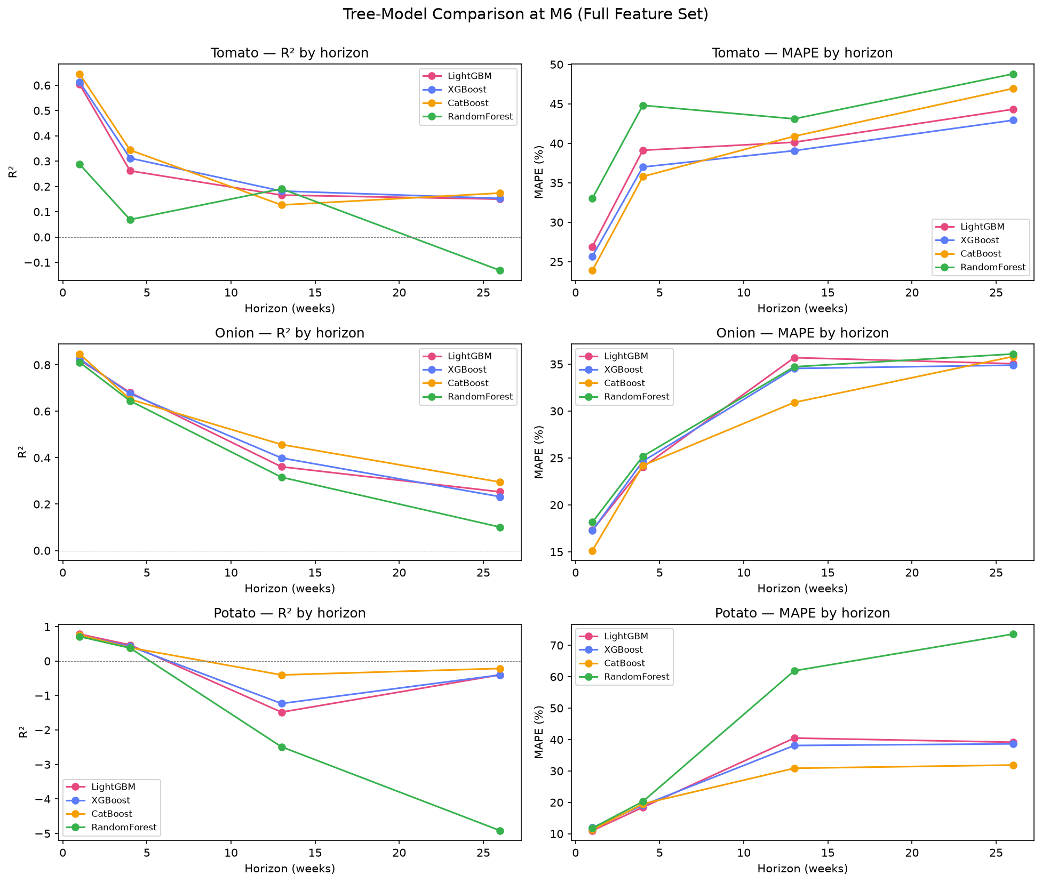
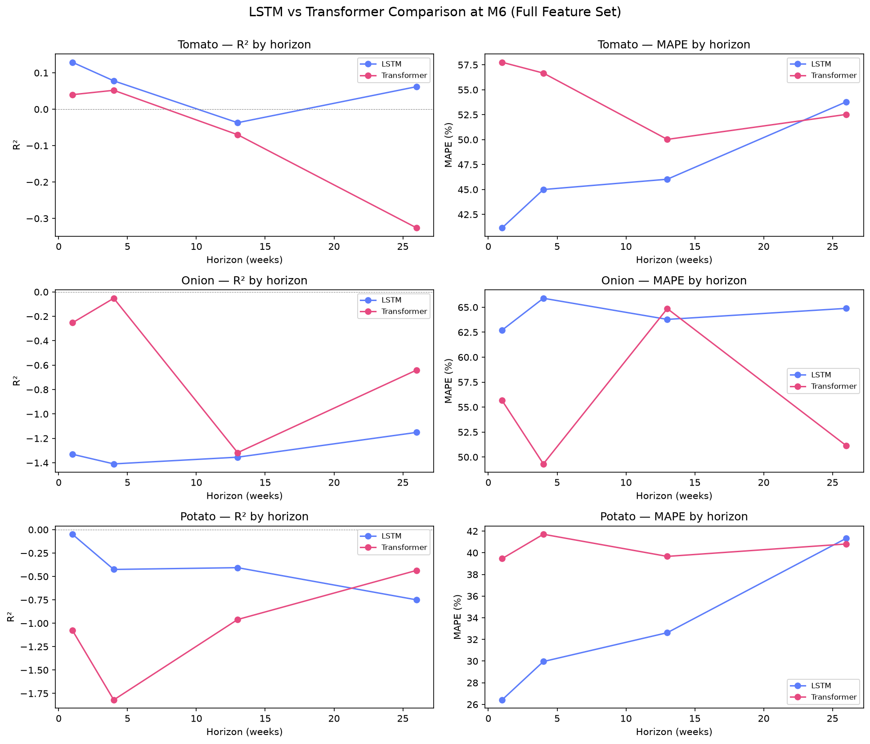
ROBUSTNESS CHECK
Is LightGBM the Right Model Family?
Left: LightGBM vs. XGBoost, CatBoost, RandomForest — all tree-based methods competitive, RandomForest consistently worst. Right: LSTM vs. Transformer (deep learning) — competitive with trees but no clear edge that justifies the extra training cost.
TOP Digital Twin | Tomato · Onion · Potato Price Forecasting & Policy Analytics
10
Notes:
Before settling on LightGBM as the production model, we tested whether a different model family would have done meaningfully better. On the left, tree-based alternatives -- XGBoost, CatBoost, RandomForest -- against our LightGBM baseline: the boosted-tree methods are all broadly competitive with each other, RandomForest is consistently the weakest of the four. On the right, we also tried deep learning: an LSTM and a Transformer architecture. Both are competitive with the tree-based models, but neither shows a clear enough edge to justify the extra training cost and complexity for this problem. We also attempted a full Temporal Fusion Transformer run, which I'll flag honestly as still an open item -- it's been attempted twice and neither run completed at full capacity, so that specific comparison remains a reduced-scope, not-fully-fair test for now. Net conclusion: LightGBM was the right choice, and we didn't just assume that, we tested it against four alternative model families before committing.

Slide 11
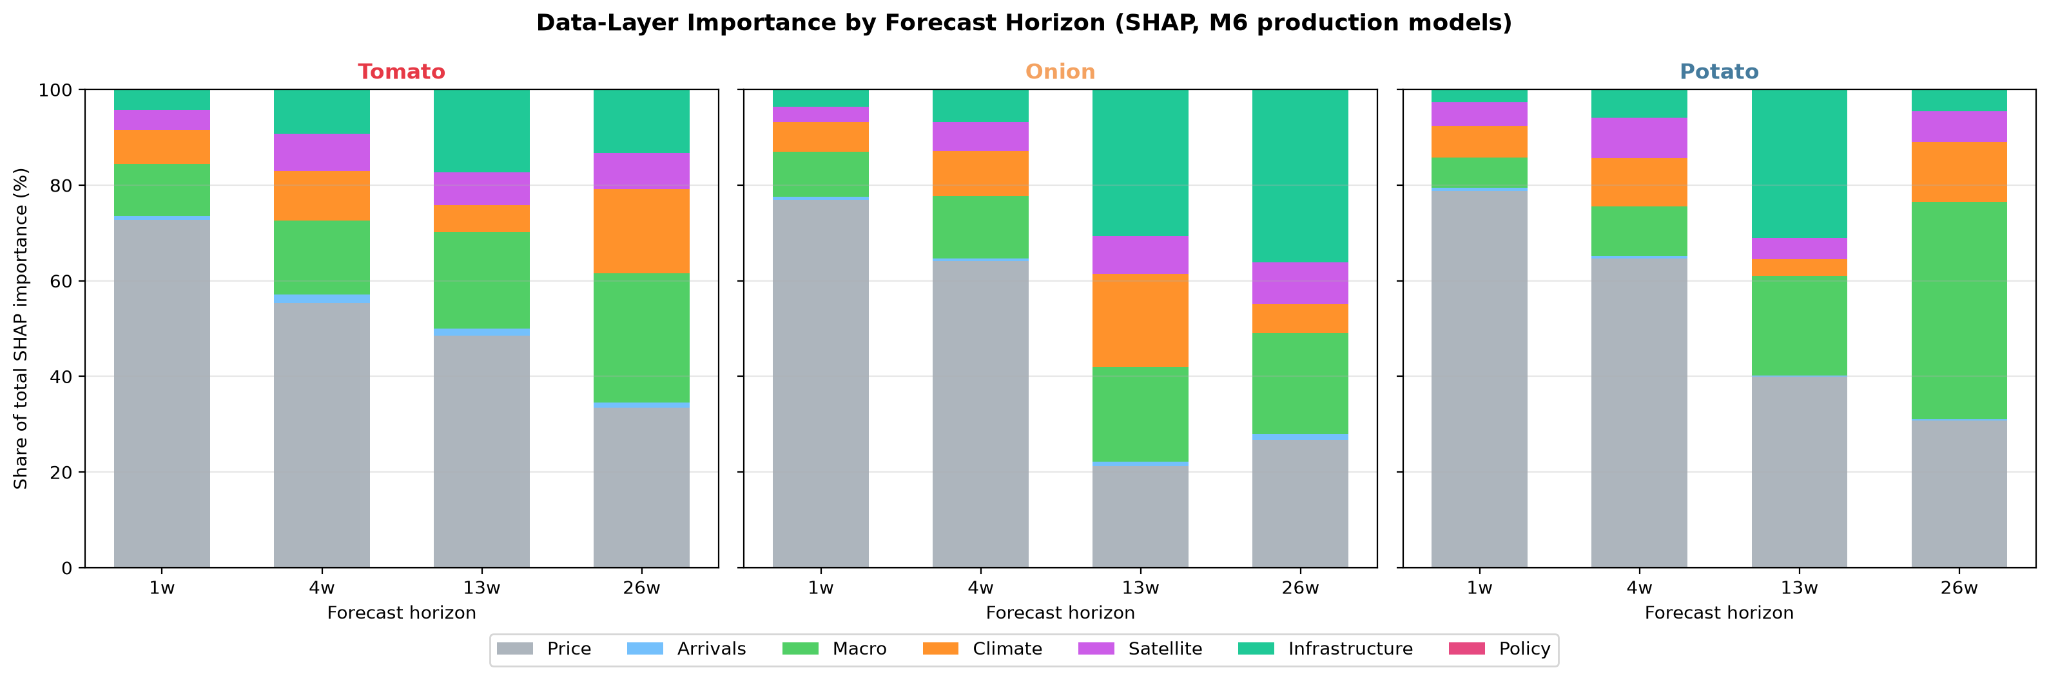
INTERPRETABILITY
What Is the Model Actually Using?
51%
18%
14%
10%
6%
0.02%
Price history
Macro
Infrastructure
Climate
Satellite
Policy
Average SHAP attribution share across all crop × horizon cells. Source: table_shap_by_layer.csv (Script 25).
TOP Digital Twin | Tomato · Onion · Potato Price Forecasting & Policy Analytics
11
Notes:
This is a SHAP interpretability analysis -- it shows us, layer by layer, how much of the model's prediction each data source is actually contributing, averaged across every crop and horizon. Price history dominates, at fifty-one percent, which makes sense given what we just discussed about short-horizon momentum. Macro variables are the second largest contributor at eighteen percent, then infrastructure at fourteen, climate at ten, satellite vegetation indices at six. And then there's policy, at essentially zero -- 0.02 percent. Now, I want to be careful about how I frame that last number, because it is genuinely important and easy to misread. It is NOT that the policy layer is broken or the features are wrong -- it's a real, structural finding: policy events are rare, and by the time a ban or duty change happens, its effect is already showing up through price and macro variables, which are much richer and more continuous signals. The model doesn't need the policy flag to know something changed, because price already told it. This finding is actually one of the motivations for building a completely separate causal-inference pipeline, which I'll get to shortly, because a forecasting model's feature importance is the wrong tool for answering 'did this policy work' in the first place.

Slide 12
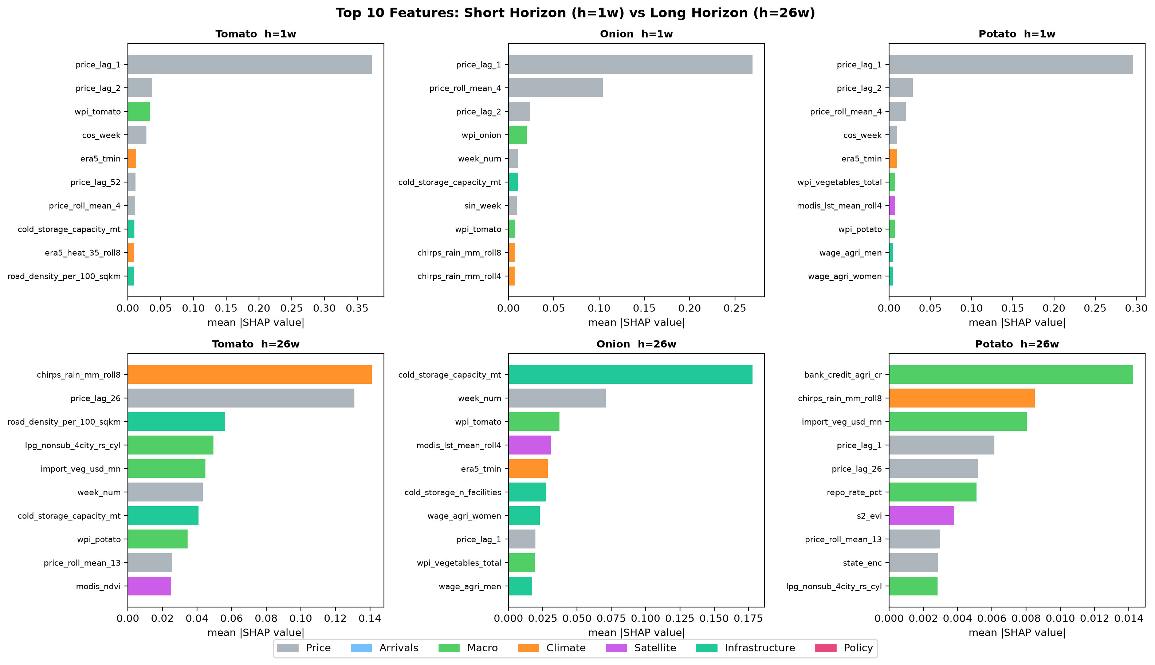
INTERPRETABILITY
Top Individual Features (1-Week Horizon)
1. price_lag_1
last week's price — by far the strongest single feature
2. price_lag_2
two weeks back
3. wpi_tomato
wholesale price index
4. cos_week
seasonal calendar signal
5. era5_tmin
minimum temperature
8. cold_storage_capacity_mt
infrastructure — first non-obvious feature to break the top ranks
TOP Digital Twin | Tomato · Onion · Potato Price Forecasting & Policy Analytics
12
Notes:
Zooming from layers down to individual features at the one-week horizon: the single strongest feature by a wide margin is last week's own price, followed by price two weeks back. Then we see the wholesale price index enter, a seasonal calendar signal, and minimum temperature. The first genuinely 'non-obvious' feature to break into the top ranks is cold-storage capacity, at rank eight -- which is a nice sanity check, because agronomically cold storage really should matter for potato price stability, and the model is picking that up on its own without us telling it to. This kind of feature ranking is also how we catch problems -- if something implausible showed up at rank one, that would be a red flag for a leakage bug rather than a real signal, and we did in fact find and fix exactly one such leakage issue during this project, which I'll mention later.

Slide 13
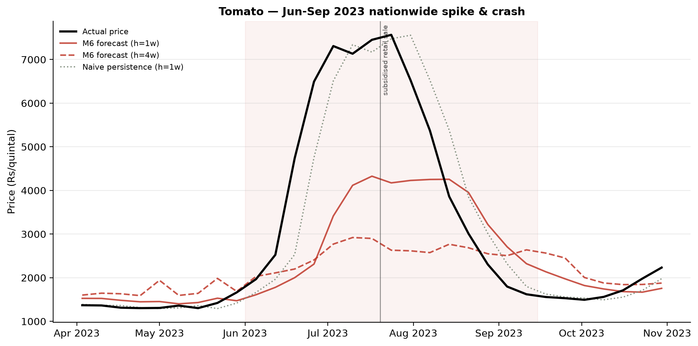
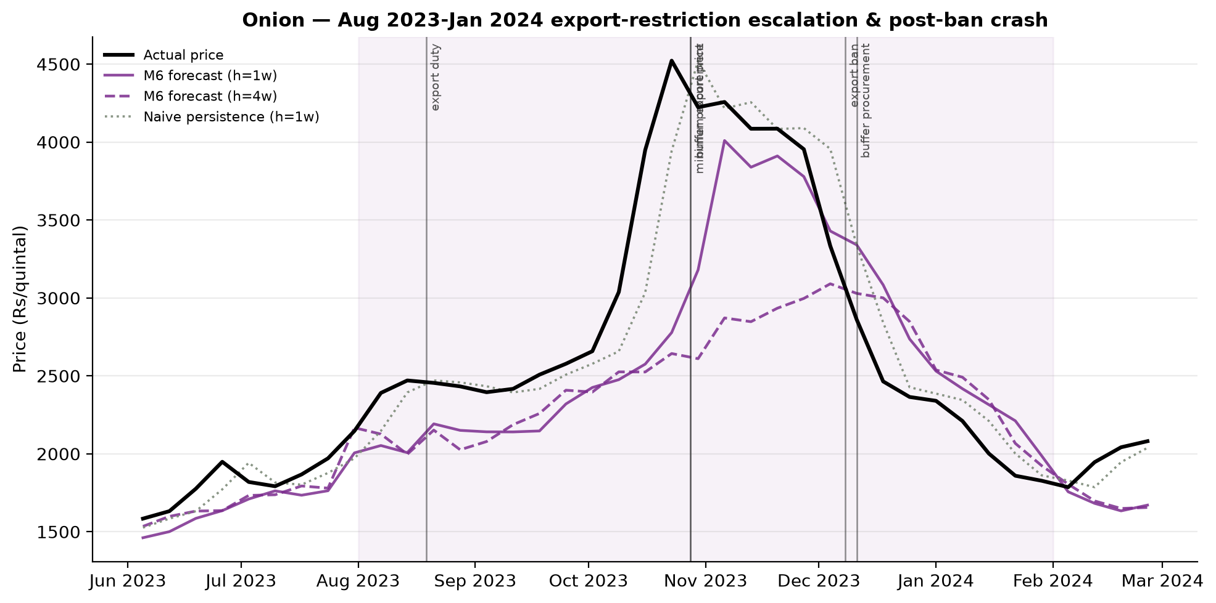
REAL-WORLD STRESS TEST
Backtesting 4 Verified Price Crises, 2023-2025
Episode | h=1w | h=13w | h=26w
Tomato Jun-Sep 2023 spike/crash | wins: Naive | wins: M6 | wins: M6
Onion Aug 2023-Jan 2024 escalation | wins: Naive | wins: M6 | wins: M6
Potato Apr 2024 spike | wins: Naive | wins: Naive | wins: Naive
Potato Jan 2025 crash | wins: Naive | wins: M6 | wins: M6
Source: table_crisis_backtests.csv (Script 28). "Wins" = lower MAPE than the other method during the crisis window.
TOP Digital Twin | Tomato · Onion · Potato Price Forecasting & Policy Analytics
13
Notes:
Aggregate accuracy numbers are one thing, but what we really care about is: does this model actually help during a real crisis, when it matters most? So we backtested it against four independently verified, real price episodes: the tomato spike and crash of mid-2023, the onion escalation running from August 2023 through the January 2024 export ban, potato's April 2024 spike, and potato's January 2025 crash. The pattern holds up: naive persistence still wins at the one-week horizon even during a crisis -- that short-horizon momentum effect doesn't go away just because prices are moving fast -- but the full model decisively wins at thirteen and twenty-six weeks for both the tomato and onion crises. The one honest exception is potato's April 2024 spike, where naive actually wins at every horizon we tested. We don't paper over that -- it's a genuine limitation, and it tells us something about that specific episode's dynamics that we haven't fully explained yet.

Slide 14
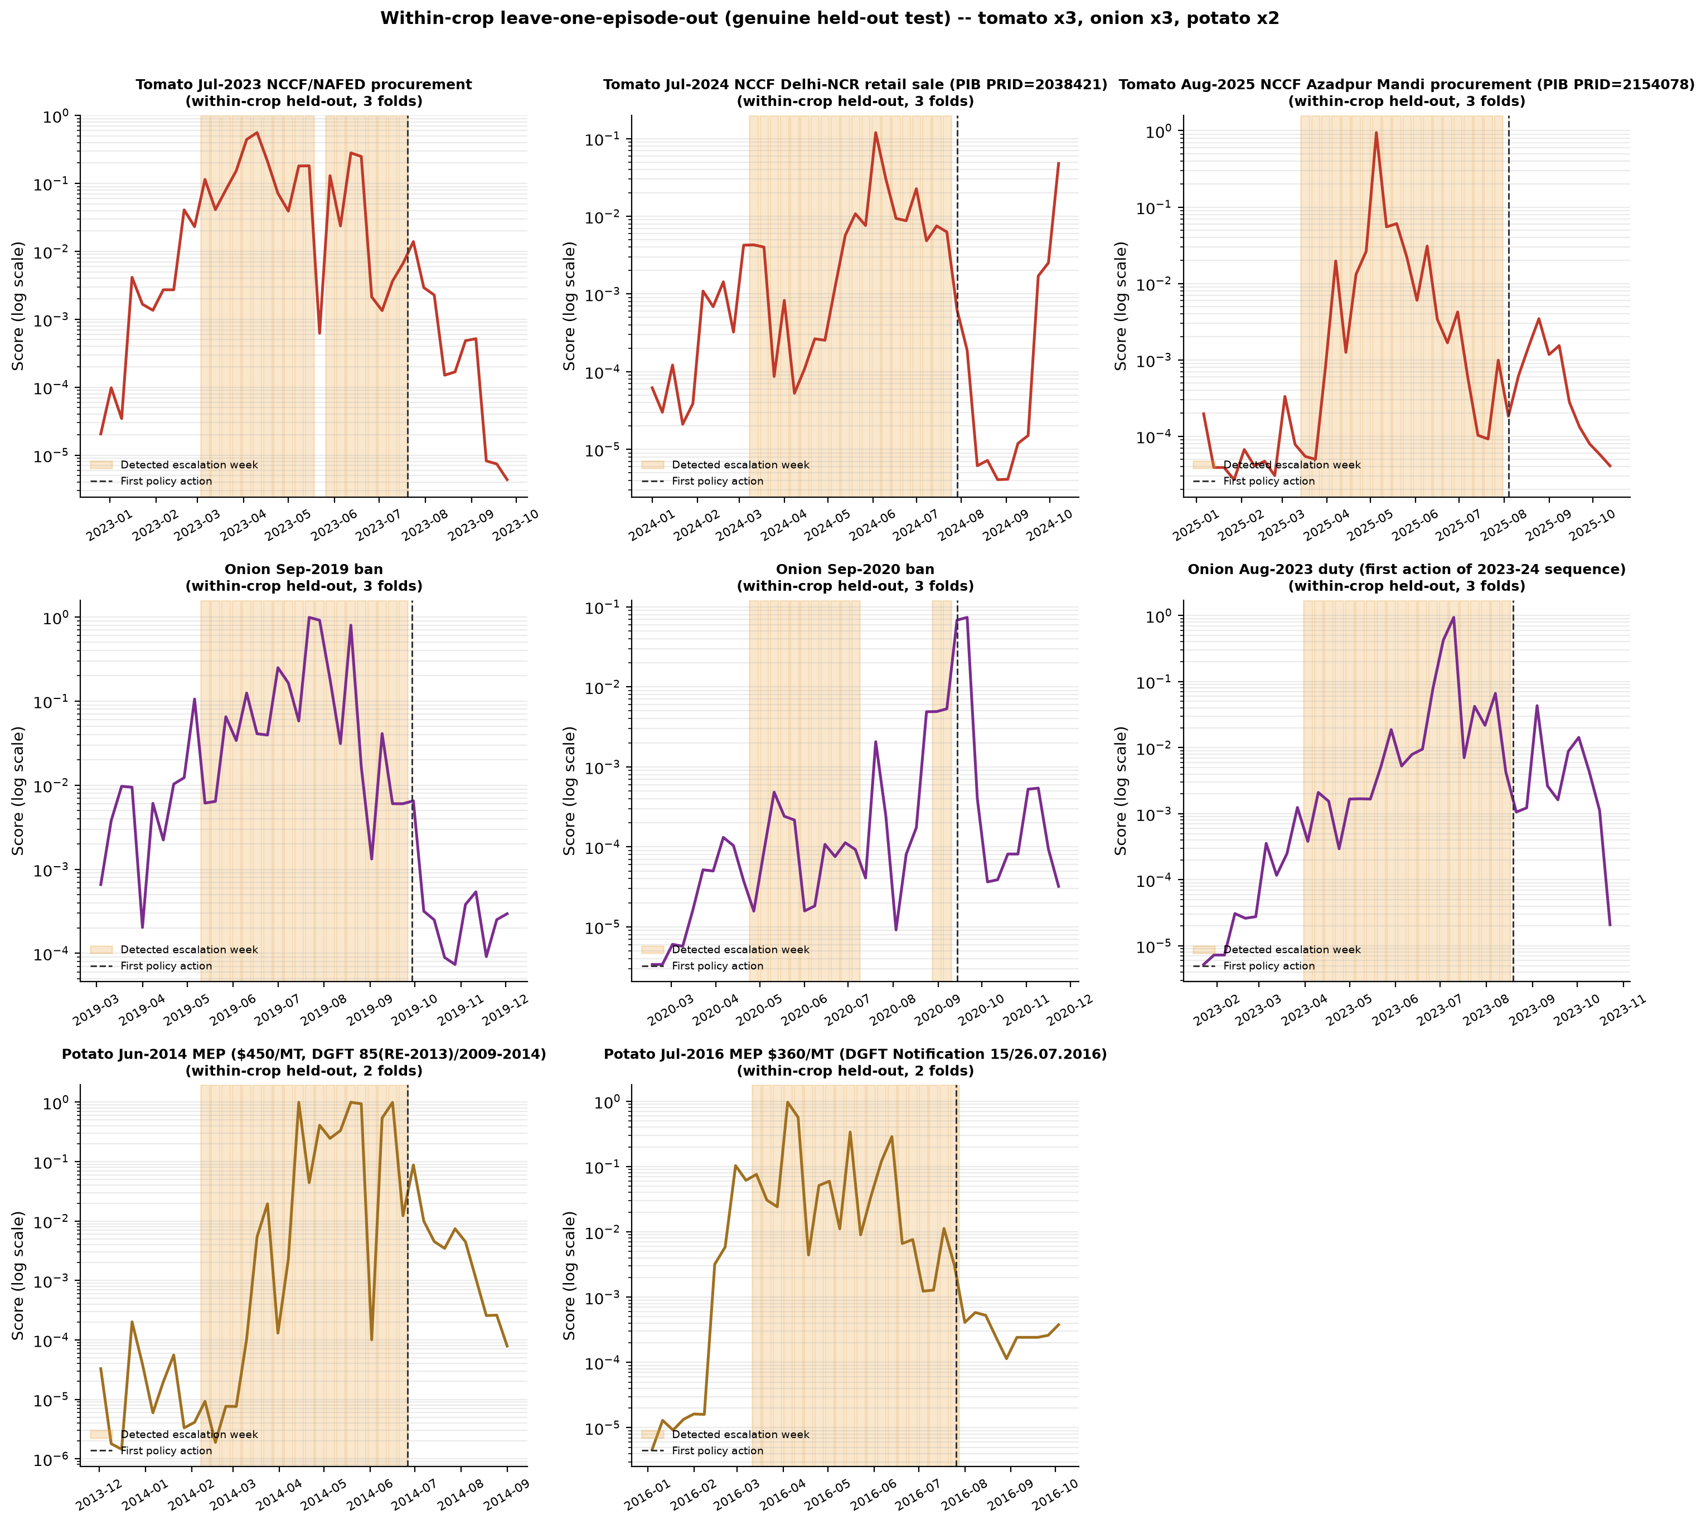
EARLY-WARNING SYSTEM
The Escalation-Signature Detector
A LightGBM classifier trained to flag an escalating price episode BEFORE it peaks, using only pre-crisis signal shape.
Validated with leave-one-episode-out (LOEO): the model never sees the episode it's tested on, even indirectly.
Expanded 2026-08-19/20 from a partial 4-episode design to a genuine, fully held-out 8-episode design across all three crops — closing an undisclosed confidence gap we found during our own fact-check pass.
Onion: 2019, 2020, 2023 bans · Tomato: 2023, 2024, 2025 procurement actions · Potato: 2014, 2016 MEP episodes
Mean Held-Out AUC
0.801
0.831
0.849
Tomato
Onion
Potato
5 of 8 episodes reach placebo significance at p<0.05 (both potato episodes, onion 2019 & 2023, tomato 2023). Onion 2020 and tomato 2024/2025 do not — reported honestly, not hidden.
TOP Digital Twin | Tomato · Onion · Potato Price Forecasting & Policy Analytics
14
Notes:
This is the early-warning piece: a classifier trained to recognize the SHAPE of an escalating price episode before it peaks, so it can flag a crisis while there's still time to act, not after the fact. We validate it with leave-one-episode-out cross-validation -- for every episode we test on, the model has never seen anything from that specific episode during training, directly or indirectly. I want to highlight something we did here that I think reflects well on the process: during our own fact-check pass on the disclosure materials, we found that tomato and potato had each only been evaluated on a single episode, in-sample, while onion had three episodes and genuine held-out validation -- an undisclosed confidence gap between crops that nobody had flagged. Rather than leave that as-is, we went and researched, verified against primary sources, and added three more real episodes, so now every single crop has a genuine, fully held-out, multi-episode test. The honest result: mean held-out AUC of point-eight-oh-one for tomato, point-eight-three-one for onion, point-eight-four-nine for potato -- all comfortably above chance. And of the eight total episodes, five reach statistical significance against a placebo null; three don't, and we report that directly rather than only showing the ones that worked.

Slide 15
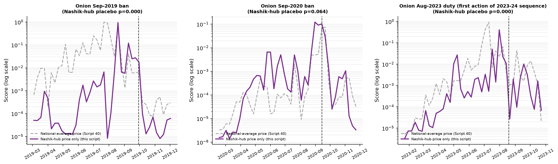
DIAGNOSING A WEAK SIGNAL
Localizing Onion 2020: National Dilution
Onion 2020's national-level placebo p-value (0.660) was the weakest of the 8 episodes — but its trigger was Nashik-region flooding specifically, a local shock, not a national one.
Hypothesis: the signal is real but diluted by averaging across markets nowhere near the actual shock.
Test: re-run the detector on Nashik-hub markets only. Result: p falls tenfold, 0.660 → 0.064 — strongly supports localization, though it doesn't formally cross the 0.05 threshold.
TOP Digital Twin | Tomato · Onion · Potato Price Forecasting & Policy Analytics
15
Notes:
One episode, onion in 2020, came out as the weakest of the eight -- its placebo p-value of point-six-six-oh was clearly not significant at the national level. Rather than just reporting that as a null result and moving on, we asked why. The 2020 episode's actual trigger was regional flooding around Nashik specifically, not a national-scale shock -- so our hypothesis was that the signal is genuinely there, but gets diluted when we average across hundreds of markets that were nowhere near the actual event. We tested that directly: re-ran the same detector restricted to Nashik-hub markets only. The p-value fell tenfold, from point-six-six down to point-zero-six-four. That's a striking, honest partial result -- it doesn't formally cross the conventional point-zero-five significance threshold, so I'm not going to claim it as a clean win, but it strongly supports the localization explanation and tells us something real about how to interpret a weak national-level signal rather than just dismissing it.

Slide 16
CAUSAL POLICY ANALYSIS
Did the 2023-24 Onion Export Ban Actually Work?
A forecasting model's feature importance cannot answer this — we already saw the policy layer sits near zero, because its effect leaks through price before the flag ever fires.
Government banned onion exports in Dec 2023 in response to a price spike — the natural next question is: did the ban itself lower prices, beyond what would have happened anyway?
Method: Synthetic Difference-in-Differences (Arkhangelsky et al., 2021) — builds a weighted synthetic "what would have happened without the ban" control from untreated markets/crops.
Why not simpler regression: duty, MEP, and the outright ban only ever moved together once in our window — a classic under-identification problem a simple before/after comparison cannot resolve.
We ran it three ways — cross-crop donors, within-onion hub-vs-non-hub, and a full event-study decomposition — then subjected every result to formal placebo testing before trusting any of it.
Design A
Design B
Design C
Cross-crop donors
Within-onion hub test
Event-study decomposition
Onion vs. tomato/potato as synthetic control
Nashik export hub vs. non-hub markets
Each static ATT broken into a weekly path
TOP Digital Twin | Tomato · Onion · Potato Price Forecasting & Policy Analytics
16
Notes:
This brings us to what I think is the most methodologically serious part of the project: did the December 2023 onion export ban actually work? A forecasting model's feature importance genuinely cannot answer that question -- we just saw the policy layer sits at essentially zero importance, precisely because its effect leaks through price before the policy flag itself ever fires. To answer causally, we used Synthetic Difference-in-Differences, following Arkhangelsky and colleagues' 2021 method, which builds a weighted synthetic control -- essentially a 'what would have happened without the ban' counterfactual -- from markets and crops that weren't treated. Why not a simpler regression? Because duty, minimum export price, and the outright ban all moved together exactly once in our study window -- that's a classic identification problem, you literally cannot separate their individual effects from a single natural experiment with ordinary regression. We ran the synthetic DID design three separate ways -- across crops using tomato and potato as donors, within onion comparing the Nashik export hub against non-hub markets, and a full dynamic event-study decomposition -- and then, critically, we didn't stop at the point estimates. We subjected every single one to formal placebo testing before trusting any of it, which is exactly what I'll show you next.

Slide 17
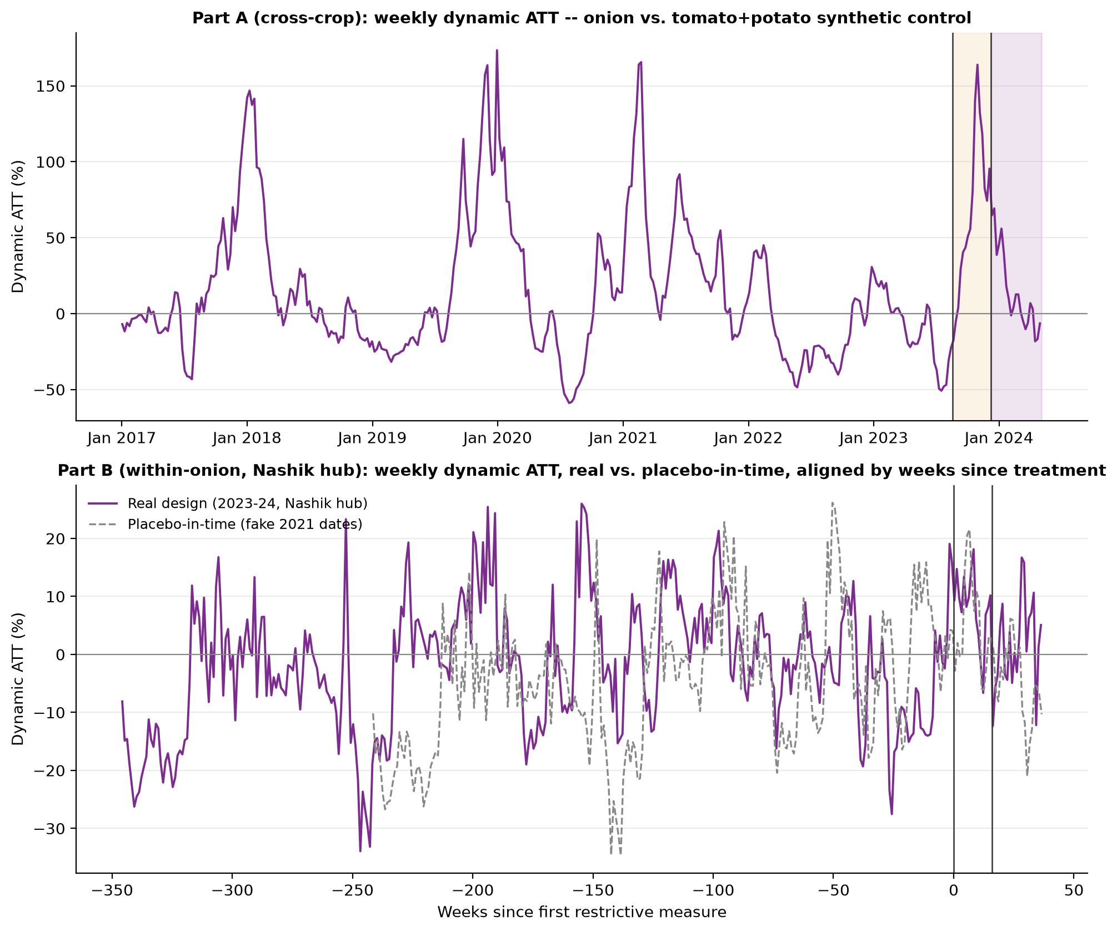
CAUSAL POLICY ANALYSIS
A Real Effect — But Only Before the Ban Took Effect
Escalation phase (pre-ban)
+56.2% ATT
vs. tomato placebo −30.7% — a real, credible gap; survives placebo testing.
Post-ban phase
+14.5% ATT
Indistinguishable from same-window tomato (+14.5%) and potato (+15.2%) placebo ATTs — fails its own placebo check.
TOP Digital Twin | Tomato · Onion · Potato Price Forecasting & Policy Analytics
17
Notes:
Here's the core finding, and it's genuinely interesting precisely because it's not the simple story you might expect. During the escalation phase -- BEFORE the ban took effect -- the synthetic DID estimate shows a real fifty-six percent average treatment effect on onion prices, and this is credible: it sits nowhere near the same-window placebo effect on tomato, which is negative thirty percent. That gap is large and it survives every robustness check we threw at it. But here's the twist: in the POST-ban phase -- after the export ban actually took effect -- the estimated effect is plus fourteen and a half percent, and when we check that against the placebo distribution, it is statistically indistinguishable from what tomato and potato show over that exact same window, at plus fourteen and plus fifteen percent respectively, even though neither of those crops was ever banned. In plain terms: prices were already rising sharply before the ban, for reasons unrelated to the ban itself, and once it took effect we cannot statistically distinguish the ban's own contribution from ordinary market-wide price movement. That's a genuinely important, and somewhat uncomfortable, finding about how these interventions actually get triggered.

Slide 18
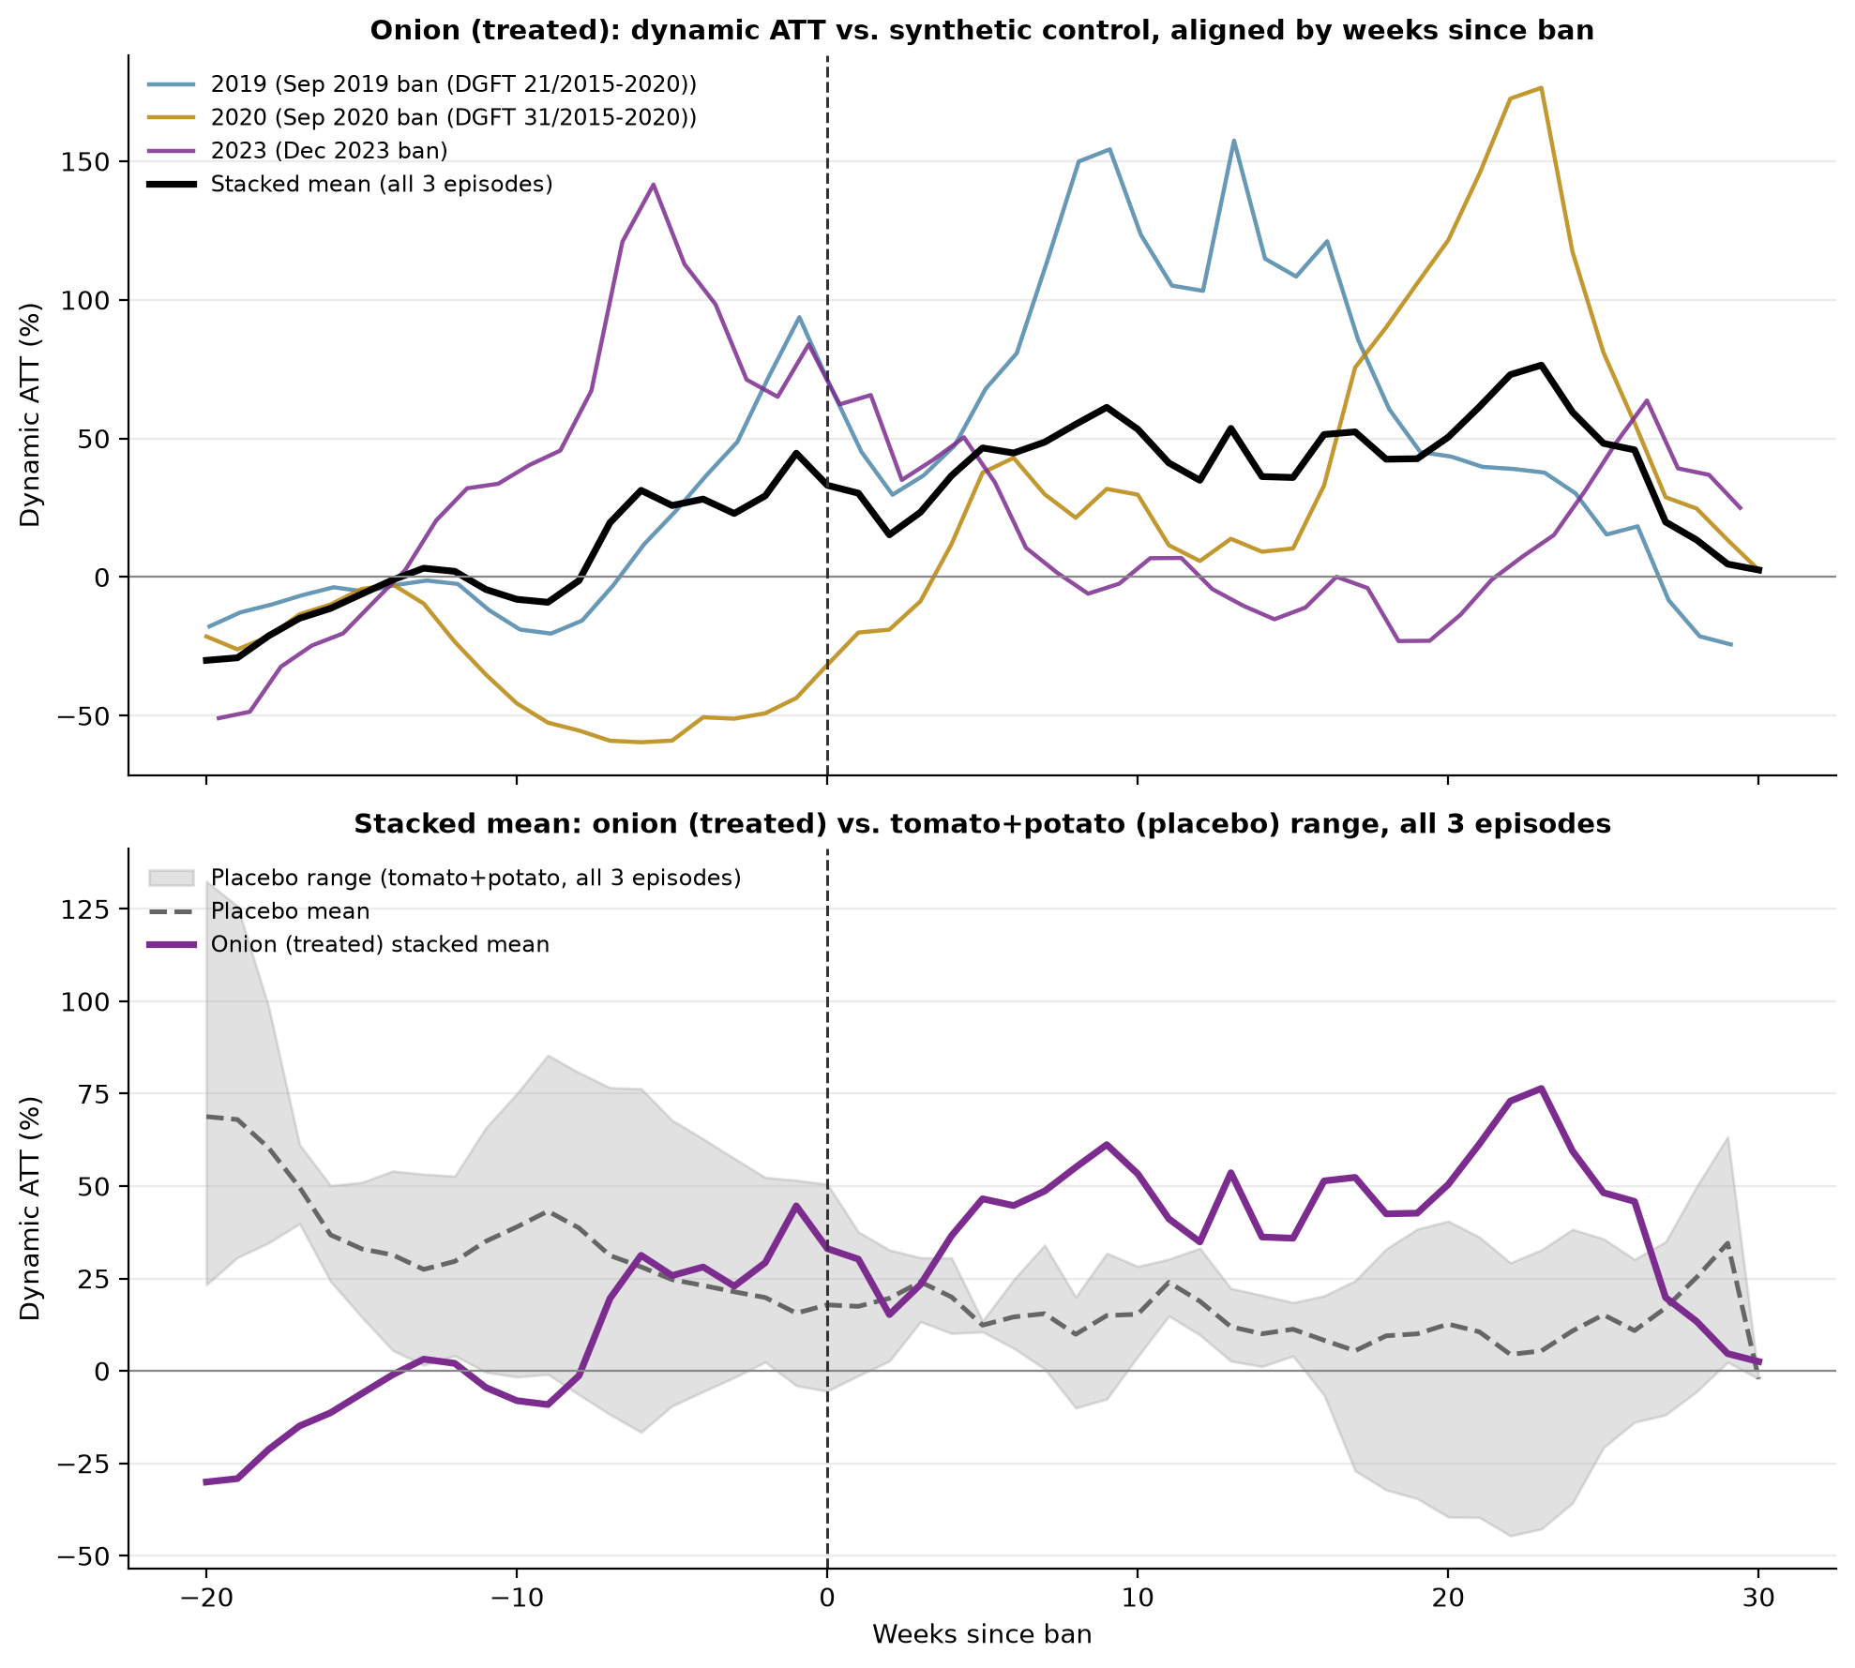
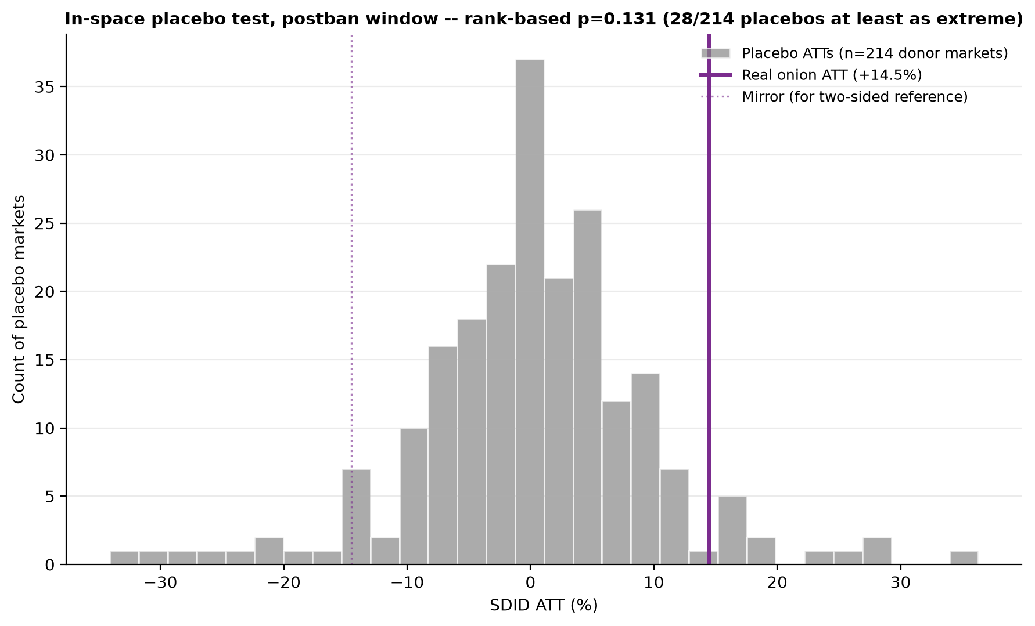
ROBUSTNESS
Stress-Testing the Post-Ban Estimate Two More Ways
Left — In-space placebo (Abadie, Diamond & Hainmueller 2010): every one of 214 tomato/potato markets treated as a fake "treated" unit. Real onion ATT ranks against this null distribution at p=0.131 — does not clear significance. Right — Stacked event study across all 3 onion bans (2019, 2020, 2023-24): pooling three independent episodes to address the n=1 identification problem. Same conclusion holds.
TOP Digital Twin | Tomato · Onion · Potato Price Forecasting & Policy Analytics
18
Notes:
So we didn't stop at one placebo comparison -- we ran two independent, stronger robustness checks on that post-ban estimate. On the left is an in-space placebo test, following the standard design from Abadie, Diamond and Hainmueller: we take every single one of two hundred and fourteen tomato and potato markets, one at a time, and pretend each one was the 'treated' unit, building a full null distribution of what a fake ATT looks like under this design when nothing was actually banned. The real onion post-ban effect ranks against that null distribution with a p-value of point-one-three-one -- it does not clear conventional significance. On the right, we extended the design to all three of the onion export bans in our study window -- 2019, 2020, and the 2023-24 episode -- stacking them into one multi-episode event study specifically to address the fact that a single natural experiment can't distinguish the ban's effect from whatever else was happening at the same time. Same conclusion holds across all three episodes pooled together. I want to be direct about what this means: we are NOT claiming the ban had zero effect. We're reporting, honestly, that no single design in this analysis fully isolates and confirms a ban-specific causal magnitude, separate from the price movement that was already happening. That's a real, useful, and publishable negative result -- not a failure of the analysis.

Slide 19
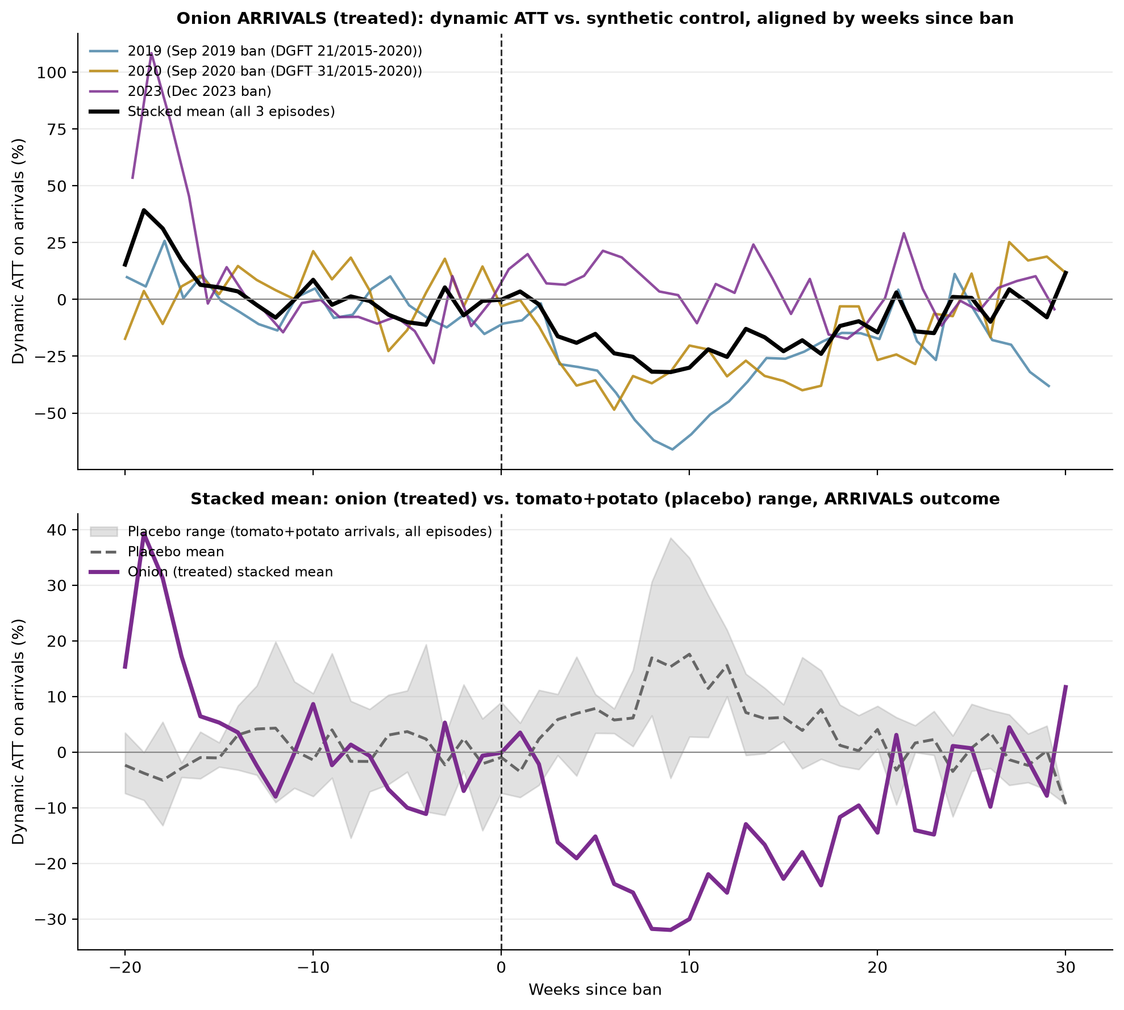
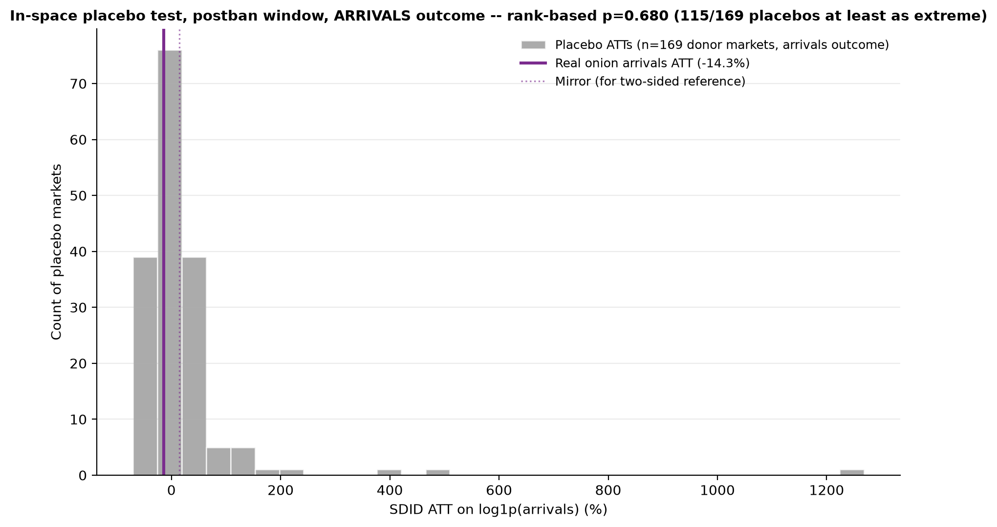
THIS WEEK'S ANALYSIS
A Second Outcome Variable: Did the Ban Move Quantity?
Everything so far tested PRICE. If the ban worked as intended, market arrivals (quantity) should have RISEN — supply kept at home instead of exported.
Ran the identical two robustness tests on log(arrivals) instead of log(price), added this week (2026-08-21).
Left — In-space placebo on arrivals: p=0.680 — fails decisively. Right — Stacked event study: onion arrivals DO separate from the placebo band in 10/13 post-ban week-bins — but wrong-signed (arrivals FELL, not rose) and already negative before the ban took effect. Reads as corroborating reverse-causality, not an independent ban effect.
TOP Digital Twin | Tomato · Onion · Potato Price Forecasting & Policy Analytics
19
Notes:
This is the most recent analysis in the whole project, completed just this week. Everything I've shown so far tested the effect on PRICE. But there's a second, equally important outcome: if an export ban is working as intended, it should keep supply at home, meaning market ARRIVALS -- quantity -- should rise, not fall. So we ran the identical two robustness designs on log arrivals instead of log price. The in-space placebo test fails decisively -- p equals point-six-eight-zero, the real effect sits well inside ordinary market noise. The stacked event study is more interesting: onion arrivals DO separate from the tomato and potato placebo band in ten of thirteen post-ban week-bins, which on its face looks like a real signal. But look closer and it's wrong-signed -- arrivals FELL under the ban, when a working export restriction should make them rise -- and that decline was already present and even larger BEFORE the ban took effect. So rather than reading this as 'the ban reduced arrivals,' the honest interpretation is that this corroborates our earlier finding: these interventions are triggered by, not the cause of, the market movements we see. That's a coherent, not a contradictory, story once you look at the sign and the timing together.

Slide 20
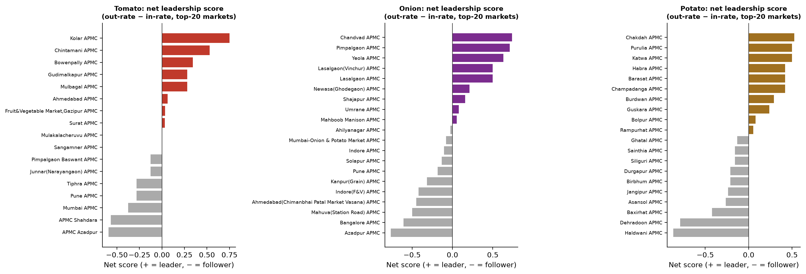
MARKET STRUCTURE
Who Leads, Who Follows: A Market Network
Bidirectional Granger causality + net-leadership scoring across the top-20 markets per crop, FDR-corrected.
Clear, geographically coherent leader clusters: Karnataka for tomato, the Nashik belt for onion, West Bengal for potato — consumption hubs (Azadpur, Shahdara) are consistent followers, not leaders, in both tomato and onion independently.
Confound-checked: leadership isn't a reporting-coverage artifact (ρ=0.06-0.37, p>0.10 for all 3 crops). Stability checked across an early/late period split — tomato/potato leaders hold rank; onion's single top market shuffles rank, though the Nashik cluster as a whole stays dominant — reported honestly, not smoothed over.
TOP Digital Twin | Tomato · Onion · Potato Price Forecasting & Policy Analytics
20
Notes:
Beyond price levels, we also mapped the market NETWORK -- which markets lead and which follow. Using bidirectional Granger causality with false-discovery-rate correction, extended to the top twenty markets by volume per crop, we compute a net-leadership score for each. The result is geographically coherent, which is itself reassuring: Karnataka leads tomato, the Nashik belt leads onion, West Bengal leads potato -- and interestingly, the big consumption hubs like Azadpur and Shahdara in Delhi are consistent FOLLOWERS, not leaders, and that holds independently for both tomato and onion. We also explicitly checked whether this leadership finding was just an artifact of which markets happen to report more consistently -- it isn't, the correlation there is weak and not significant for all three crops. And we checked stability across an early versus late time-period split: tomato and potato's leaders hold their rank, but onion's single top-ranked market does shuffle rank between periods, even though the Nashik cluster as a whole stays dominant in both. We report that instability directly rather than smoothing it over.

Slide 21
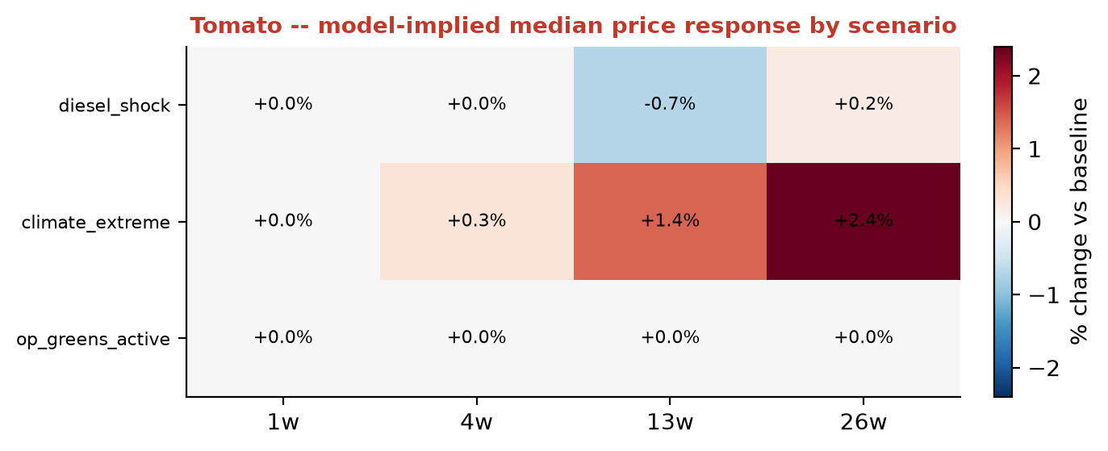
SCENARIO ANALYSIS
A Reproducible What-If Stress-Testing Battery
8 named scenarios run across every market using the saved production models — no retraining: diesel shock, climate extremes, Operation Greens activation, export duty 40%, MEP $800/tonne, export ban, a full crisis replay, and a cold-storage-capacity cut.
Found and fixed a real bug: an earlier unconstrained model gave a wrong-signed prediction for the export-duty scenario — same reactive-not-causal issue Granger analysis flagged. Fixed via the monotonic constraint at negligible accuracy cost.
Honest limitation: even after the sign fix, the model can't recover a realistic MAGNITUDE for policy scenarios (median response ~0%) — this is exactly why we built the separate SDID causal pipeline rather than trusting this number.
TOP Digital Twin | Tomato · Onion · Potato Price Forecasting & Policy Analytics
21
Notes:
Beyond the crisis backtests, we built a fully reproducible battery of eight named stress-test scenarios, run across every single market using the already-saved production models -- no retraining needed each time, which makes this genuinely useful as an ongoing decision tool. Scenarios include a diesel-price shock, climate extremes, activation of the government's Operation Greens program, an export duty of forty percent, a minimum export price of eight hundred dollars a tonne, a full export ban, a replay of an actual past crisis, and a twenty percent cut in cold-storage capacity. While building this, we found and fixed a real bug -- an earlier, unconstrained version of the model gave a wrong-signed prediction for the export-duty scenario, the same reactive-not-causal issue our Granger analysis independently flagged. We fixed that with the monotonic constraint I mentioned earlier, at negligible cost to overall accuracy. But I want to flag an honest limitation here too: even after fixing the sign, the model still can't recover a realistic MAGNITUDE for these policy scenarios -- the median response collapses to roughly zero. That's precisely why we built the separate synthetic-DID causal pipeline rather than trusting this forecasting model's number for anything policy-magnitude related.

Slide 22
PRODUCTION SYSTEM
A Live, Public Dashboard
12
3×4
Live
Saved production models
Crops × horizons
Public Streamlit deployment
Per-market price forecast at all 4 trained horizons on a single ticker.
Macro/climate/policy scenario sliders — export ban, MEP, duty, diesel price, USD/INR, temperature, rainfall — each carrying an explicit "carried forward, N weeks stale" caption when the underlying series has gone stale.
A data-quality flag (% imputed in the last 52 weeks) and a validated ±RMSE uncertainty band on every forecast chart — the dashboard tells the user how much to trust each number, not just what the number is.
Top-15-market comparison charts, a price-trend comparison tool, and a button-triggered AI policy-recommendation feature grounded strictly in the scenario's own computed feature effects.
Public GitHub repo (deliberate decision — all data is public government data) enabling free-tier hosting.
TOP Digital Twin | Tomato · Onion · Potato Price Forecasting & Policy Analytics
22
Notes:
All of this research feeds a genuinely live, public production system, not just a set of offline notebooks. We have twelve saved LightGBM models -- three crops times four horizons -- serving a public Streamlit dashboard that auto-redeploys whenever we push to the main branch. It gives a per-market forecast at all four trained horizons on a single ticker; scenario sliders for every macro, climate, and policy input, each one honestly labeled with how stale its underlying data currently is; a data-quality flag showing what fraction of the last year was imputed for that specific market; and a validated uncertainty band on every single forecast, so the dashboard is telling the user how much to trust the number, not just handing over a bare point estimate. There's also a top-fifteen-market comparison view, a price-trend comparison tool, and a button-triggered AI policy-recommendation feature that's deliberately grounded only in the scenario's own computed feature effects, not free-form generation. And the underlying GitHub repository is public, a deliberate choice after confirming nothing sensitive is in it, since all the data is public government data -- that decision is also what lets us run this on free-tier hosting.

Slide 23
SCIENTIFIC HOUSEKEEPING
Why I'm Showing You Our Bugs, Not Just Our Results
A handful of market NAMES repeat across different STATES (e.g. "Fatehabad APMC" exists in both Haryana and Uttar Pradesh) — 4 true collisions out of 800+ markets per crop.
Any script grouping by market NAME instead of the unique market_id silently merged these physically distinct markets, corrupting features for the affected markets specifically.
Found via a market-count audit, fixed across 11 scripts by switching the join key to market_id. Two were missed in the first pass and found later — both confirmed bit-for-bit identical results after the fix.
Net effect on every headline conclusion in this deck: zero — the collision only ever touched 2-4 small markets. We verified that, rather than assuming it.
4
800+
11
0
true (crop, market) collisions
markets per crop, unaffected
scripts fixed
headline conclusions changed
TOP Digital Twin | Tomato · Onion · Potato Price Forecasting & Policy Analytics
23
Notes:
I want to spend one slide specifically on the bugs we found and fixed, because I think how a project handles its own mistakes says as much about its quality as the headline numbers do. The one I'll highlight: a handful of market NAMES repeat across different STATES -- for example, there's a 'Fatehabad APMC' in both Haryana and Uttar Pradesh -- four true collisions like this out of over eight hundred markets per crop. Any script that grouped or joined on the market NAME instead of the unique market ID would silently merge two physically different markets together, corrupting the lag and rolling features specifically for those affected markets. We found this through a routine market-count audit, and fixed it across eleven separate scripts by switching every join key to the unique ID. Two scripts were missed in the first pass and found later during a follow-up audit -- both were re-run and produced results that were bit-for-bit identical to before the fix, which we CONFIRMED rather than just assumed. And the net effect on every single headline conclusion in this entire presentation is zero, because the collision only ever touched two to four small markets out of hundreds. I'm showing you this not because it changed anything, but because finding it, fixing it everywhere, and verifying the fix rather than assuming it worked, is exactly the standard I want this project held to.

Slide 24
THIS WEEK'S WORK
Finding and Fixing a Trailing-Gap Imputation Bug
The automated pipeline sanity checker flagged potato's latest week as 80.5% imputed — an order of magnitude higher than usual.
Traced it, not dismissed it: the imputation logic could interpolate INTERIOR gaps and fill 3-8 week gaps with a seasonal median, but had no method at all for a 1-2 week gap sitting at the very end of a market's series — mathematically, interpolation needs a future anchor point that doesn't exist yet.
Root cause was general (confirmed in Uttarakhand too), not a West Bengal data-quality problem — it just showed up starkest in potato because West Bengal is 82% of potato's market panel.
Fixed: added a forward-fill stage for genuinely trailing short gaps, re-ran the full pipeline, verified zero rows left unlabeled.
Downstream safety already confirmed: every modeling script already excluded these rows from training — the fix improves what a blank cell now honestly contains, it does not touch any published result.
BEFORE
AFTER
65 rows
0 rows
raw NaN, imputed_method = blank — no estimate at all
unlabeled — all 65 now carry a labeled trailing_ffill estimate
TOP Digital Twin | Tomato · Onion · Potato Price Forecasting & Policy Analytics
24
Notes:
Let me show you something we did literally this week, because I think it's a good illustration of how we treat a warning sign. Our automated pipeline sanity checker flagged potato's most recent week as eighty point five percent imputed -- far higher than normal. We didn't just note it and move on -- we traced it to its actual root cause. It turned out the imputation logic could correctly interpolate gaps sitting in the MIDDLE of a market's time series, and could fill three-to-eight-week gaps with a seasonal median, but had no method at all for a very short, one-to-two-week gap sitting at the very END of a series -- because mathematically, interpolation needs a future data point to anchor to, which doesn't exist yet for the most recent week. And critically, we confirmed this was a general mechanism, not a West Bengal-specific data problem -- we found the exact same pattern in Uttarakhand. It just showed up as an extreme percentage for potato specifically because West Bengal happens to make up eighty-two percent of potato's market panel. We fixed it by adding a proper forward-fill stage for these short trailing gaps, re-ran the full pipeline, and verified there are zero rows left unlabeled. And we also checked downstream: every modeling script was already excluding these rows from training regardless, so this fix improves what a blank cell honestly contains -- it doesn't change a single published result.

Slide 25
IN PROGRESS
Validating a Fresher Raw-Data Pull (Live This Week)
Received new potato and onion raw scraper pulls reaching real, per-day data through 2026-08-21 — today — versus the previous cutoffs of 2026-07-27 (potato) and 2026-08-12 (onion).
Did not trust it on receipt — validated first, the same way every previous raw-data refresh in this project has been validated:
Schema and commodity-label check — clean
Overlap cross-check against the currently-trusted file — after correctly deduping multi-row-per-day records, only 0.01-0.014% of overlapping rows differ by more than ₹1
market_id consistency check across both files — zero genuine conflicts found
Daily row-volume pattern through the new cutoff — realistic weekday/weekend shape, not a fabrication red flag
Result: validated as legitimate. Tomato file expected shortly to complete the set before we merge and re-run.
✓
✓
✓
✓
Schema & commodity label
Overlap vs. trusted file
market_id consistency
Daily volume pattern
Clean
99.99% match
Zero conflicts
Realistic
TOP Digital Twin | Tomato · Onion · Potato Price Forecasting & Policy Analytics
25
Notes:
This is genuinely happening as we speak. This week I received two fresher raw-data pulls for potato and onion, reaching real per-day data all the way through today, the twenty-first of August -- a meaningful extension over our previous cutoffs of late July for potato and mid-August for onion. I want to be clear that I did not just drop these into the pipeline on receipt. We validated them the same rigorous way we validate every raw-data refresh in this project: checking the schema and commodity labels are clean, cross-checking the overlapping period against the currently-trusted file -- and after correctly accounting for multiple transaction rows per market per day, only about one-hundredth of a percent of overlapping rows differ by more than a rupee, which is essentially noise, not tampering -- checking that market IDs map consistently between the old and new files with zero genuine conflicts, and checking that the daily row-volume pattern looks like real reporting, with realistic weekday and weekend dips, rather than something fabricated. Both files passed. We're waiting on the equivalent tomato file to complete the set before merging all three and re-running the pipeline, and I'll have that story finished by our next check-in.

Slide 26
SCIENTIFIC RIGOR
Two Paths We Explored — and Deliberately Rejected
The Two-Phase, 23-Year Architecture
The Crash Detector
Idea: extend training history from 9 to 23 years (2003-2026) with a baseline + Sentinel-2 residual stack. Initial signal: real, modest ~1.2pp MAPE improvement in a controlled comparison — enough to justify building it out fully. Formal verdict: combined forecast worse than both Phase-1-alone AND production M6 at nearly every cell. Phase-1's own apparent edge over M6 does not survive formal Diebold-Mariano testing (1/12 cells significant). REJECTED, 2026-08-04.
Idea: extend the escalation-signature approach to price CRASHES, not just spikes. Blocker 1: the seasonal-norm baseline used for spikes structurally cannot detect a crash on a crop with a rising multi-year trend — the baseline itself never dips below the trend during a real crash. Blocker 2: even after fixing the baseline, only potato's candidate crash episode reached placebo significance — tested two different baseline designs and a GJR-GARCH volatility alternative, same result both times. PAUSED, not force-fit into the pipeline.
TOP Digital Twin | Tomato · Onion · Potato Price Forecasting & Policy Analytics
26
Notes:
I want to give equal airtime to what we tried and did NOT keep, because a project that only shows you what worked is showing you a curated story, not a scientific one. First: we explored extending the training history from nine years to a full twenty-three years, 2003 through 2026, using a baseline-plus-satellite-residual two-phase architecture. The initial signal was real -- a modest but genuine one-point-two percentage point average MAPE improvement in a controlled comparison, enough that we thought it was worth building out properly rather than dismissing. But once we built the full two-phase stack and formally tested it, the combined forecast came out WORSE than both the baseline alone and our production model at nearly every crop and horizon cell, and the baseline's own apparent edge over production did not survive formal statistical testing -- only one of twelve cells was significant. We formally rejected that architecture in early August. Second: we explored extending our escalation detector to price CRASHES, not just spikes. We hit two real methodological blockers -- the baseline we use for spikes structurally can't detect a crash on a crop that's on a rising multi-year trend, and even after fixing that, only potato's crash episode reached significance, confirmed with two different approaches. We've paused that rather than force it into the pipeline half-validated.

Slide 27
HONEST ACCOUNTING
What's Still Open
Item | Status
Full-capacity Temporal Fusion Transformer run | Attempted twice, neither completed — reduced-scope comparison only
Scripts 12, 13, 15b, 15c, 17, 26 (spike detector, benchmarks, tree/LSTM comparisons, TFT, daily disaggregation) | Deliberately deferred re-runs — predate several fixes, still directionally valid
Rejected two-phase scripts (34-36) | Never re-verified against the market_id collision fix — low priority, architecture already rejected
3 CMIE macro series (export/import value, crude oil) | Not extended past original vintage — lag the rest of the macro layer
Cold-storage stress-test null vs. SHAP's top-feature finding for potato | A real, unresolved tension worth investigating directly
Live dashboard AI-recommendation API key | Whether a real (non-placeholder) key is saved in Streamlit Cloud secrets — unconfirmed
Manuscript | Working drafts intentionally cleared 2026-08-21 to start a fresh, fully section-by-section pass
TOP Digital Twin | Tomato · Onion · Potato Price Forecasting & Policy Analytics
27
Notes:
I promised an honest accounting, so here it is in one place -- everything that is genuinely still open, not yet resolved. A full-capacity Temporal Fusion Transformer run has been attempted twice and neither attempt completed, so that specific comparison remains reduced-scope. Six scripts -- covering the spike detector, older benchmark models, the tree and LSTM comparisons, TFT, and the daily-disaggregation view -- have deliberately deferred re-runs because they predate several of our fixes; they're still directionally valid but not numerically current. The rejected two-phase architecture's own scripts were never re-verified against the market-ID collision fix -- low priority given it's already rejected, but genuinely open, not silently ignored. Three CMIE macro series haven't been extended to the current vintage. There's a real tension we haven't resolved between the stress test's null result for cold storage and SHAP's finding that cold storage is potato's single most important individual feature -- that's worth digging into properly rather than either ignoring or over-explaining away. Whether a real API key is configured for the dashboard's AI feature is unconfirmed. And the manuscript itself: we deliberately cleared the working drafts folder days ago to start a fresh, complete, section-by-section pass, precisely so that nothing gets missed the way an earlier draft-then-consolidate approach risked.

Slide 28
TRAJECTORY
Milestones at a Glance
Jul 23
GitHub repo made public; live dashboard deployed
Jul 27
Full 2026 data refresh across all 6 layers
Aug 01
Grid-adaptivity fix — panel grows 517→834 (tomato), 246→809 (onion)
Aug 04
Two-phase architecture formally tested and rejected
Aug 05
SDID causal analysis closed as an honest non-identifiable result
Aug 14
Project-wide market_id collision bug found and fixed (11 scripts)
Aug 19-20
Escalation detector expanded to full 8-episode, held-out design
Aug 21
Arrivals-outcome SDID robustness checks; imputation trailing-gap bug fixed; fresh raw-data validation in progress
TOP Digital Twin | Tomato · Onion · Potato Price Forecasting & Policy Analytics
28
Notes:
Just to give a sense of pace: in late July we made the repository public and deployed the live dashboard, and did a full data refresh across all six layers. Early August brought the grid-adaptivity fix that substantially grew our market panel, followed within days by the formal rejection of the two-phase architecture and the honest closure of the causal SDID analysis as a non-identifiable result rather than forcing a false positive conclusion. Mid-August we found and fixed the project-wide market-ID collision bug across eleven scripts. Just this past week, we expanded the escalation detector to a genuine eight-episode design, ran the new arrivals-outcome causal robustness checks, fixed the imputation trailing-gap bug, and are mid-way through validating a fresh raw-data pull. I show this timeline mainly to make the point that this has been a continuously active, continuously self-correcting process, not a project that was built once and left alone.

Slide 29
SUMMARY
What This Project Has Delivered
A validated forecasting engine
A market-structure map
840/814/82 markets, horizon-dependent skill up to +44% over naive, formally confirmed via Model Confidence Set testing.
Geographically coherent leader-follower network, confound-checked.
A real-world-tested system
A live public production system
Backtested against 4 independently verified price crises, not just held-out folds.
12 models, a public dashboard, a public repository.
An early-warning detector
A demonstrated culture of verification
8 episodes, all crops, genuine held-out validation — 5/8 statistically significant, weak cases diagnosed not hidden.
Bugs found and fixed across 11+ scripts, 2 architectures explored and honestly rejected, every fix confirmed not assumed.
A rigorous causal policy analysis
Multiple SDID designs + placebo/jackknife robustness on BOTH price and arrivals outcomes — an honest, defensible answer, not a convenient one.
TOP Digital Twin | Tomato · Onion · Potato Price Forecasting & Policy Analytics
29
Notes:
So, pulling all of this together into one summary. We have a validated forecasting engine covering over seventeen hundred markets, with horizon-dependent skill up to forty-four percent better than naive persistence, formally confirmed through Model Confidence Set testing rather than a bare point estimate. We have a system that's been tested against real, independently verified crises, not just statistical holdout folds. We have an early-warning detector spanning eight genuine episodes across all three crops, with honest reporting of which cases are weak. We have a rigorous causal policy analysis that tested multiple designs on both price and quantity outcomes and gave us an honest, defensible answer rather than a convenient one. We have a geographically coherent market-structure map. We have a live, public production system already serving real users. And underneath all of that, we have a demonstrated culture of actually verifying our own work -- bugs found and fixed across more than a dozen scripts, two entire architectures explored and honestly rejected when the evidence didn't support them, and every single fix confirmed against its actual effect rather than assumed. I think that last point is, in its own way, as much of an achievement as any individual number on this slide.

Slide 30
LOOKING AHEAD
Next Steps
Immediate
Receive and validate the tomato raw-data file; merge all 3 crops' fresher pulls and re-run the full pipeline.
Short term
Re-run the 6 deferred scripts against the current panel; resolve the cold-storage stress-test/SHAP tension.
Medium term
Complete a full-capacity TFT run; confirm the live dashboard's AI-recommendation API key.
Ongoing
Write the manuscript fresh, section by section, directly against this verified body of results — not the other way around.
TOP Digital Twin | Tomato · Onion · Potato Price Forecasting & Policy Analytics
30
Notes:
So where do we go from here. Immediately: finish receiving and validating the tomato raw-data file, merge all three crops' fresher pulls together, and re-run the full pipeline against them. In the short term: work through the six deferred script re-runs so the whole pipeline is current against every fix, and specifically resolve that tension between the stress test's null cold-storage result and SHAP's finding that cold storage matters a great deal for potato -- I don't want to leave that unexplained. In the medium term: get a genuine full-capacity TFT run completed, and confirm whether the dashboard's AI feature has a real API key configured in production. And ongoing, in parallel with all of that: write the manuscript fresh, section by section, directly against this verified body of results, which is exactly why I asked you all today to see everything laid out first, in full, before that writing begins -- so nothing gets missed.

Slide 31
Thank You
Questions & Discussion
TOP Digital Twin · Dr. Masroor · SKUAST-Kashmir · HADP-04 Digital Agriculture Initiative
TOP Digital Twin | Tomato · Onion · Potato Price Forecasting & Policy Analytics
31
Notes:
That's everything I wanted to cover today. To close: this project set out to build three things -- a trustworthy forecast, an early-warning signal, and a causal answer on policy -- and I believe we now have credible, honestly reported evidence on all three, along with a live system already serving that work publicly. I've tried to be just as direct about what's still open and what we tried and rejected as I have about what worked, because I think that's what makes the parts that DID work trustworthy. I'm very happy to take questions, go deeper into any single result, or open up any of the underlying tables and figures right now if that would be useful. Thank you all for your time.

