Slide 1
PROGRESS REPORT
A Price-Forecasting Digital Twin for India's Agricultural Commodity Markets
TOP Digital Twin
Integrating Satellite Imagery · Climate Stress · Market Price Dynamics
Principal Investigator Review — HADP-04
Dr. Masroor · SKUAST-K · July 2026
470
2,495
16
29
ISO Weeks 2017–2025
APMC Markets 3 Crops
Python Scripts Built
Paper Figures Generated
Target Journal: Computers and Electronics in Agriculture · Agricultural Systems (Q1)
TOMATO
ONION
POTATO
Notes:
TITLE SLIDE
Open with a brief orientation. This is the HADP-04 progress report for the TOP Digital Twin project.
KEY TALKING POINTS:
• We are building India's first weekly price-forecasting digital twin for tomato, onion, and potato — the three most volatile and economically significant vegetable crops.
• The system integrates six data layers over nine years (2017–2025) covering 470 ISO weeks.
• We have 2,495 qualifying APMC markets as our prediction panel — one of the largest market-panel studies ever assembled for Indian vegetables.
• 16 Python scripts, 5 Google Earth Engine scripts, and 29 paper-ready figures have been generated.
• Target: Q1 journal (Computers and Electronics in Agriculture or Agricultural Systems).
This presentation covers: the research problem, the 6-layer data architecture, the model design and early results, the ablation study framework (the paper's scientific contribution), and the path to submission.

Slide 2
The Research Problem
Why India's TOP crop prices demand a data-driven forecasting solution
THE VOLATILITY PROBLEM
THE FORECASTING OPPORTUNITY
▸ India produces ~175 MT vegetables annually; TOP crops account for ~27% of total output and an even larger share of farm income volatility.
▸ Tomato prices can swing ±400% within a single season — from ₹2/kg at harvest to ₹120/kg at peak scarcity.
▸ 2019 Onion Crisis: prices hit ₹150–200/kg; government banned exports, NAFED intervened with buffer stock releases.
▸ 2023 Tomato Spike: retail prices crossed ₹250/kg in multiple metros within weeks of a supply shock in Kolar.
▸ COVID-2020: supply chain disruptions caused simultaneous price crashes at farm gate and price spikes in retail markets.
▸ Current policy response is REACTIVE: interventions happen after the crisis is visible in retail prices.
▸ Existing models rely on national-level monthly data — too coarse, too slow.
▸ A 9-year, 470-week panel of APMC prices + satellite vegetation health + climate stress makes PREDICTIVE intelligence possible.
▸ First study to jointly model supply-side satellite signals, climate risk, and macro-logistics for Indian vegetable price forecasting.
THE RESEARCH GAP WE FILL
▸ Weekly granularity across all major APMC markets (not state averages)
▸ Supply-side signals: satellite NDVI anomaly + heat stress days from production zones
▸ Rolling-origin validation: 4 test years (2022–2025) with 4 forecast horizons
▸ Ablation design proves the marginal value of each data layer
TOP Digital Twin · SKUAST-K · HADP-04 · July 2026
CONFIDENTIAL — PI REVIEW
Notes:
SLIDE 2 — The Research Problem
This slide motivates the entire project. Spend 2–3 minutes here.
KEY TALKING POINTS:
• India's TOP crops are uniquely volatile because they are perishable (no long shelf life), regionally concentrated in production (a weather shock in Kolar affects all of India's tomato supply), and consumed nationally (a supply disruption in Maharashtra hits onion prices from Kashmir to Tamil Nadu).
• The three crisis events listed (2019 onion, 2023 tomato, 2020 COVID) are real, documented policy failures of reactive management. These are the crisis backtest events our model will be validated against.
• The opportunity: we now have 9 years of weekly APMC price data combined with satellite vegetation index time series and gridded climate data. No study has assembled this combination at this scale for India.
• The output is not just a model — it's a digital twin that can run scenario stress tests: "what happens to tomato prices if Kolar receives 3 consecutive weeks of excess rainfall followed by a heat stress event?"
Pause for PI questions before advancing.

Slide 3
Project Architecture
Six data layers feeding four analytical modules — the complete digital twin design
DATA LAYERS
ANALYTICAL MODULES
L1
Market Prices
DONE
Supply Signal Index
Agmarknet APMC weekly panel · 2,495 markets · 470 weeks
A
RUNNING
Satellite NDVI anomaly + heat stress days + excess rainfall → weekly supply-risk score per crop
L2
Satellite Vegetation
DONE*
Sentinel-2 NDVI/EVI · MODIS NDVI/EVI · 17 production zones
Price Forecasting
Climate Stress
B
RUNNING
L3
DONE*
LightGBM + TFT · 4 horizons (1/2/4/8 weeks) · 4-fold rolling-origin CV · Spike classifier
ERA5-Land temperature · CHIRPS rainfall · MODIS LST · 17 zones
L4
Macro-Logistics
DONE
CMIE · PPAC diesel/LPG · RBI repo rate · WPI crop · USD-INR
Market Network
C
PLANNED
Granger causality · Leader-follower identification · Shock transmission analysis
L5
Infrastructure
PENDING
Cold storage capacity · Road density · Rural wages
Policy / Trade
Scenario Stress Testing
L6
PENDING
D
PLANNED
Export bans · MEP · NAFED-NCCF interventions
Export ban shock · Climate scenario · Fuel price shock · Storage capacity shock
* Historical data complete; 2025 topup pending GEE script execution
TOP Digital Twin · SKUAST-K · HADP-04 · July 2026
CONFIDENTIAL — PI REVIEW
Notes:
SLIDE 3 — Project Architecture
This is the architectural overview slide. It shows the complete design of the digital twin.
KEY TALKING POINTS:
LEFT SIDE — SIX DATA LAYERS:
• Layers 1–4 (green) are complete with historical data. Layers 5–6 (amber/red) are the outstanding data collection tasks.
• Note the asterisk on L2/L3: the satellite and climate data is complete for 2017–2024 (from our earlier GEE extraction). The 2025 topup requires running 5 new GEE scripts and is scheduled as the next immediate action.
• Layer 5 (infrastructure) is the most challenging to obtain — cold storage capacity data requires coordination with NHB/WDRA; road density from MoRTH district-level data.
• Layer 6 (policy/trade) — we have sent formal data request letters to IMD and NAFED. Policy events database (export bans, MEP orders) will be compiled from APEDA and Ministry of Agriculture records.
RIGHT SIDE — FOUR MODULES:
• Modules A and B are running. Module A produces a weekly supply-risk score; Module B is the core price forecasting engine.
• Modules C and D are designed and planned. Module C (market network) uses Granger causality to identify which markets lead price movements — this is important for understanding how shocks propagate.
• Module D (stress testing) is the "digital twin" in the true sense — running hypothetical scenarios through the trained model.
The paper's scientific contribution centres on Module B's ablation study, which we will detail on a later slide.

Slide 4
Study Design
Nine years of weekly panel data with rolling-origin cross-validation
9 Years
470
3 Crops
2,495
4-Fold
Study Period 2017–2025
ISO Weeks (Complete Panel)
Tomato · Onion Potato
Qualifying APMC Markets
Rolling-Origin CV Design
ROLLING-ORIGIN CROSS-VALIDATION DESIGN (one panel per crop)
TRAINING 2017–2021
TEST 2022
Fold 1
F2
TRAINING 2017–2022
TEST 2023
F3
TRAINING 2017–2023
TEST 2024
F4
TRAINING 2017–2024
TEST 2025
KEY DESIGN DECISIONS
▸ Weekly granularity (not daily): reduces autocorrelation dominance; satellite revisit cycles align with weekly composites
▸ Log-price target: handles extreme positive skewness of TOP price distributions (tomato variance ~3× mean)
▸ Full market panel (2,495 markets) retained: larger training corpus, better generalisation vs PI Brief's 20–30 strategic APMCs
▸ Forecast horizons: 1, 2, 4, 8 weeks ahead — covers both operational (1–2 wk) and strategic (4–8 wk) planning horizons
TOP Digital Twin · SKUAST-K · HADP-04 · July 2026
CONFIDENTIAL — PI REVIEW
Notes:
SLIDE 4 — Study Design
This slide explains the statistical design of the project. Take time here as the PI will want to understand the validation framework.
KEY TALKING POINTS:
• STUDY PERIOD: 2017-01-02 to 2025-12-29. We use ISO weeks (Monday-to-Sunday) as our time unit, giving 470 complete weeks.
• ROLLING-ORIGIN CROSS-VALIDATION: This is the gold standard for time series evaluation. We never let the model see future data. Each fold adds one year to the training set and evaluates on the next year.
- Fold 1: Train 2017–2021, Test 2022
- Fold 2: Train 2017–2022, Test 2023
- Fold 3: Train 2017–2023, Test 2024
- Fold 4: Train 2017–2024, Test 2025
This produces honest out-of-sample performance metrics for 4 different market conditions — including the 2022 post-COVID recovery, the 2023 tomato spike, and the 2024–2025 period.
• WEEKLY GRANULARITY DECISION: Daily data would give us ~3,300 time points, but daily price autocorrelation (lag-1 r ≈ 0.97) would bury the satellite and climate features. Weekly aggregation reduces this to ~0.82, giving other features room to contribute.
• FULL PANEL DECISION: We discussed retaining the full qualifying panel (2,495 markets) versus the PI Brief's suggested 20–30 strategic APMCs. We recommend keeping the full panel for the primary model — it provides better generalisation and a more robust training signal. The PI Brief's 20–30 markets can be highlighted in the results as a focused policy tool.
• FOUR FORECAST HORIZONS: 1 week (daily logistics), 2 weeks (procurement decisions), 4 weeks (storage decisions), 8 weeks (policy intervention lead time). Each is modelled and validated separately.

Slide 5
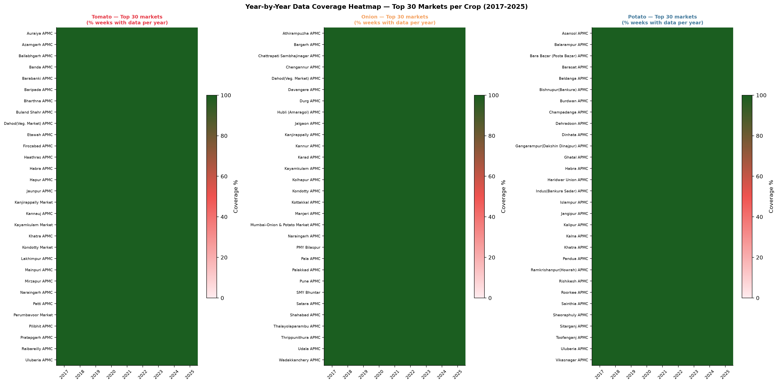
Layer 1 — Market Price Panel
Agmarknet APMC daily arrivals data processed into a complete weekly panel
DATA PIPELINE (Script 09 — 249 lines)
IMPUTATION DESIGN — RATIONALE
1
Raw Input
▸ Linear interpolation (≤2 wks): Valid when a market has brief data outages (holidays, transport disruptions). No seasonal assumption needed.
▸ Seasonal median (3–8 wks): Draws from same ISO week across ±2 adjacent years. Preserves harvest-season patterns that simple linear fill would smooth away.
▸ NaN retention (>8 wks): Markets with >8-week consecutive gaps have structural data problems (APMC closure, reporting failures). Imputing would introduce fictitious data. These NaNs propagate and reduce coverage below the 90% threshold, excluding the market from the modelling panel.
Agmarknet daily modal price files (tomato/onion/potato) Three separate crop downloads, 2017–2025
↓
2
Weekly Aggregation
Daily → ISO weekly modal price ISO week: Monday 00:00 to Sunday 23:59
↓
3
Complete Grid Expansion
MARKET COVERAGE HEATMAP
Each market × every ISO week (470 total) Fills the missing-week grid BEFORE imputation
↓
4
Three-Tier Imputation
≤ 2 weeks missing → Linear interpolation 3–8 weeks missing → Seasonal median (±2 yr window) > 8 weeks missing → Left as NaN (disclosed)
↓
5
Log-Price Column
log_modal_price = log(modal_price + 1) Modelling target — handles extreme right skew
TOP Digital Twin · SKUAST-K · HADP-04 · July 2026
CONFIDENTIAL — PI REVIEW
Notes:
SLIDE 5 — Layer 1: Market Price Panel
This slide covers the core data asset — the Agmarknet weekly panel.
KEY TALKING POINTS:
• Agmarknet collects daily arrival and price data from APMC (Agricultural Produce Market Committee) yards across India. We download this at crop level (tomato, onion, potato) and process it into a weekly panel.
• The complete grid expansion is a critical step: before we assess coverage, we create a row for EVERY market for EVERY week. This makes gaps explicit rather than invisible.
• THREE-TIER IMPUTATION: This is a novel design choice we can defend in the methods section. We do not use a single imputation strategy — instead we match the method to the severity of the gap:
- Short gaps (≤2 weeks): Linear is fine. A market that misses one or two weeks due to a holiday or local disruption will have prices bracketing the gap.
- Medium gaps (3–8 weeks): Seasonal median is more appropriate. A market that misses 4–6 weeks in the same period every year (common for some APMCs during the off-season) should be imputed from the same seasonal window, not linearly between a pre-season low and post-season high.
- Long gaps (>8 weeks): These are disclosed as data gaps. We do not impute them. They reduce coverage below our 90% threshold and exclude the market from modelling, which is the scientifically honest decision.
• The heatmap (right) shows market coverage across years — green cells are observed data, amber is imputed, grey/white is NaN. This becomes Figure 4 in the paper.

Slide 6
Market Coverage Results
2,495 qualifying markets across 3 crops — one of the largest Indian vegetable panels assembled
Crop | Qualifying Markets | States Covered | Coverage Threshold | Panel Rows | Script Output
Tomato | 1,567 | 29 | ≥ 90% of 470 weeks | 736,490 | tomato_weekly_panel.csv (~70 MB)
Onion | 843 | 22 | ≥ 90% of 470 weeks | 396,210 | onion_weekly_panel.csv (~35 MB)
Potato | 85 | 2 | ≥ 90% of 470 weeks | 39,950 | potato_weekly_panel.csv (~4 MB)
TOTAL | 2,495 | — | — | 1,172,650 | top_weekly_panel.csv (107 MB, .gitignore)
KEY DECISION — Full Panel vs. Strategic Markets
PI BRIEF RECOMMENDATION
OUR DECISION — FULL PANEL (approved)
~20–30 'strategic' APMCs selected on trading volume and geographic spread
Smaller panel → easier to interpret → focused policy recommendations
Standard approach in Indian agricultural economics literature
1.17M rows provides >50× more training signal for LightGBM feature learning
Captures diverse price dynamics: assembly markets, mandi hubs, local retail yards
Better generalisation across India's heterogeneous market structure
Strategic 20–30 markets highlighted in paper as focused policy lens within results
TOP Digital Twin · SKUAST-K · HADP-04 · July 2026
CONFIDENTIAL — PI REVIEW
Notes:
SLIDE 6 — Market Coverage Results
This slide presents the scale of our market panel and defends the full-panel decision.
KEY TALKING POINTS:
• SCALE: 2,495 markets is extraordinary for an Indian agricultural price study. Most published work uses 10–50 markets. We are building a national-scale model.
• TOMATO (1,567 markets, 29 states): The largest sub-panel. Tomato is traded in almost every state of India, and our coverage reflects this. Karnataka (Kolar belt), Maharashtra, Andhra Pradesh are the dominant production states, but consumption markets span the full country.
• ONION (843 markets, 22 states): Maharashtra (Nashik, Lasalgaon) dominates production; markets in the north and east are consumption centres that often show very different price dynamics from production centres.
• POTATO (85 markets, 2 states): This is the most concentrated panel — Uttar Pradesh and West Bengal account for ~70% of India's potato production, so 85 markets from these two states is actually comprehensive for the production-zone model.
• THE PANEL SIZE DECISION: The PI Brief suggested 20–30 strategic APMCs. We have retained the full panel for two reasons: (1) LightGBM benefits enormously from larger training data for cross-market feature learning; (2) we can still highlight findings for the 20–30 most important markets in the paper's results section. The full panel is the training database; the strategic markets are the showcase.
• NOTE: The combined top_weekly_panel.csv (107 MB) exceeds GitHub's 100 MB file size limit and is excluded from version control via .gitignore. The processing scripts are in the repo; the data is stored locally.
Five paper-ready figures were generated in Script 11: data architecture diagram, coverage distribution, state-wise market counts, coverage heatmap, and panel timeline.

Slide 7
Layer 4 — Macro-Logistics Data
Four economic data sources · 108 months (2017–2025) · Fully compiled and verified
All macro series extend to December 2025. Each file is deduplicated (provisional vs. revised entries removed).
CMIE EO (Script 10)
PPAC FUEL PRICES
RBI DBIE — MONETARY
RBI DBIE — PRICES
6 economic series, 108 months Diesel retail price (Rs/litre) Consumer Price Index (CPI) Wholesale Price Index (WPI) Index of Industrial Production (IIP) USD-INR exchange rate Indian crude oil basket (PPAC)
Diesel: monthly avg retail price LPG 19kg commercial cylinder Non-subsidised series used throughout (Subsidised LPG ended post-2020) 108 months, no gaps File: ppac_diesel_lpg_2017_2025.csv
Repo rate: 108 months COVID cuts: 6.50% → 5.25% 2022–23 tightening cycle captured Current (Jul 2026): 6.25% File: rbi_repo_rate_2017_2025.csv
Crop-specific WPI (KEY FEATURE): · wpi_tomato · wpi_onion · wpi_potato USD/INR: 2025 avg 87.14 Rs/USD (8.5% depreciation vs 2024) Files: rbi_wpi_* · rbi_usdinr_*
MODELLING NOTE: Macro series are monthly; aggregated to weekly by forward-filling within each month. Crop-specific WPI (wpi_tomato, wpi_onion, wpi_potato) is preferred over general WPI in the ablation design (M2 layer).
TOP Digital Twin · SKUAST-K · HADP-04 · July 2026
CONFIDENTIAL — PI REVIEW
Notes:
SLIDE 7 — Layer 4: Macro-Logistics
This slide covers the economic/logistics data layer.
KEY TALKING POINTS:
• FOUR DATA SOURCES: CMIE Prowess (commercial database), PPAC (Petroleum Planning and Analysis Cell), RBI DBIE (Reserve Bank of India Data Base on Indian Economy). All are authoritative government or quasi-government sources.
• FUEL PRICES (PPAC): Diesel cost directly affects agricultural transport — higher diesel prices mean higher arrivals cost at APMCs. LPG affects cold chain operations. We use the non-subsidised LPG series because the subsidised household cylinder series ended in 2021 when DBTL (Direct Benefit Transfer for LPG) was discontinued.
• REPO RATE: The RBI repo rate affects agricultural credit costs and input financing. The COVID rate cuts (March-May 2020) and the subsequent tightening cycle (2022–2023) are captured. This feature is expected to have a lagged effect on production decisions.
• CROP-SPECIFIC WPI (KEY DESIGN CHOICE): Rather than using the general WPI, we have the commodity-specific price indices for tomato, onion, and potato separately. This is important because the WPI for vegetables often diverges sharply from the WPI for individual crops during shock events. Using crop-specific WPI means our macro layer already contains a price-level signal that may help the model distinguish structural inflation from transient supply shocks.
• USD/INR EXCHANGE RATE: Relevant for onion and potato exports. India is the world's largest onion exporter; the exchange rate affects export competitiveness and therefore domestic supply availability. The 2025 depreciation to 87.14 Rs/USD is captured.
All series have 108 months (January 2017 to December 2025) with no gaps.

Slide 8
Layers 2 & 3 — Satellite & Climate Data Framework
17 production zones · 30 km buffer · Five GEE data sources · 18 features per zone-week
WHY PRODUCTION ZONES (NOT MARKET LOCATIONS)
5 GEE DATA SOURCES (2017–2025)
▸ APMC market locations are consumption/trading centres — not where the crop is grown. Satellite NDVI over a wholesale market tells us nothing about vegetation health.
▸ Production zones are defined as 30 km radius circles around the centroid of the dominant production-area APMC for each crop-region. The buffer captures the surrounding cultivation landscape.
▸ Zone-level satellite and climate signals represent the supply-side environment: crop health, heat stress during critical growth stages, and rainfall adequacy.
ERA5-Land
~11 km
365/yr
Tmax · Tmin · Tmean · DTR · Heat-stress days ≥35°C / ≥38°C
CHIRPS PENTAD
~5.5 km
~73/yr
Rain mm/day · Max pentad · Excess rain fraction (>50mm/pentad)
17 PRODUCTION ZONES
Zone | Crop | APMC Market | State
T1–T5 | Tomato | Kolar · Madanapalle · Nashik · Solan · Navsari | KA · AP · MH · HP · GJ
O1–O3 | Onion | Lasalgaon · Pimpalgaon · Mahuva | MH · MH · GJ
O6–O10 | Onion | Hubli · Solapur · Manmad · Kurnool · Gondal | KA · MH · MH · AP · GJ
P1–P4 | Potato | Agra · Farrukhabad · Jalandhar · Bardhaman | UP · UP · PB · WB
Sentinel-2 SR
10 m
~24/yr
NDVI · EVI · Valid-pixel fraction · NDVI anomaly
MODIS NDVI
250 m
~46/yr
NDVI · EVI (Terra + Aqua for ~8-day revisit)
MODIS LST
1 km
~46/yr
LST mean · LST max · Fraction >35°C / >38°C
Note: O4 and O5 not included (merged into adjacent zones). P1 (Agra) assigned for completeness.
Total: 17 zones × 5 scripts = 85 CSV exports · 18 features per zone-week · ~7,990 zone-week rows (470 wks × 17 zones)
TOP Digital Twin · SKUAST-K · HADP-04 · July 2026
CONFIDENTIAL — PI REVIEW
Notes:
SLIDE 8 — Satellite & Climate Framework
This slide explains the conceptual design of the satellite and climate data layer.
KEY TALKING POINTS:
• WHY ZONES NOT MARKETS: This is an important methodological point. APMC markets are typically in or near urban centres — often surrounded by concrete, roads, and buildings. A satellite looking at a market yard will see impervious surfaces, not crops. We need to look at where the crops are GROWN, not where they are SOLD.
• 30 km BUFFER: The 30 km radius around each production-zone centroid captures the cultivation landscape surrounding the anchor APMC market. For a market like Lasalgaon (the world's largest onion market), this buffer includes the surrounding onion-growing districts of Nashik.
• 17 ZONES: Five tomato, eight onion (O4/O5 are absent from the zone design), four potato. These cover all major production regions for each crop.
• FIVE DATA SOURCES: We deliberately use multiple complementary sources:
- ERA5-Land: gridded climate (temperature, heat stress) — very important for understanding thermal stress during flowering and bulbing stages
- CHIRPS: rainfall — excess rainfall during harvest disrupts field operations and post-harvest handling
- Sentinel-2: high-resolution (10m) optical vegetation index — best for detecting early stress at field scale
- MODIS NDVI: lower resolution but longer archive and better cloud penetration in monsoon months
- MODIS LST: land surface temperature from thermal infrared — direct measurement of surface heat stress
• 18 FEATURES: Across the five sources, we extract 18 features per zone per week after temporal aggregation and imputation.
The GEE scripts (gee_01 through gee_05) export one CSV per zone per script = 85 CSV files total to Google Drive.

Slide 9
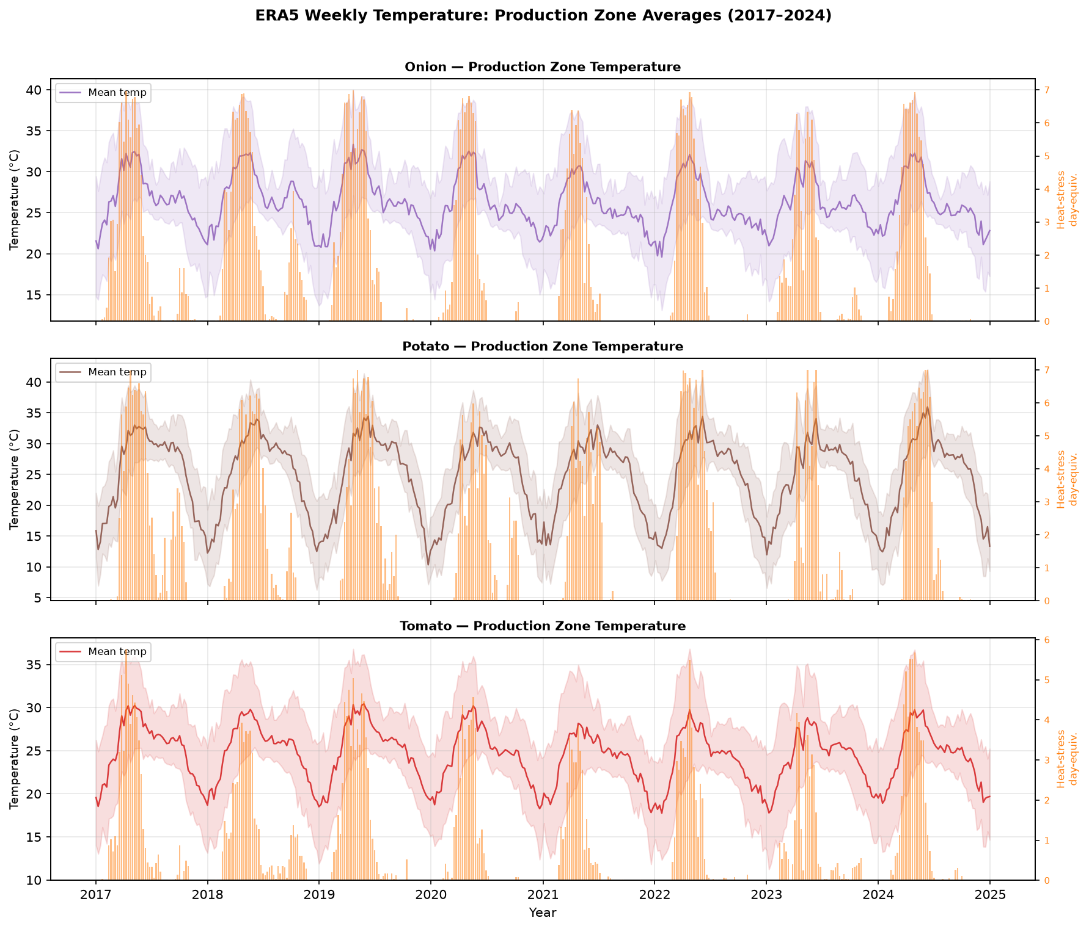
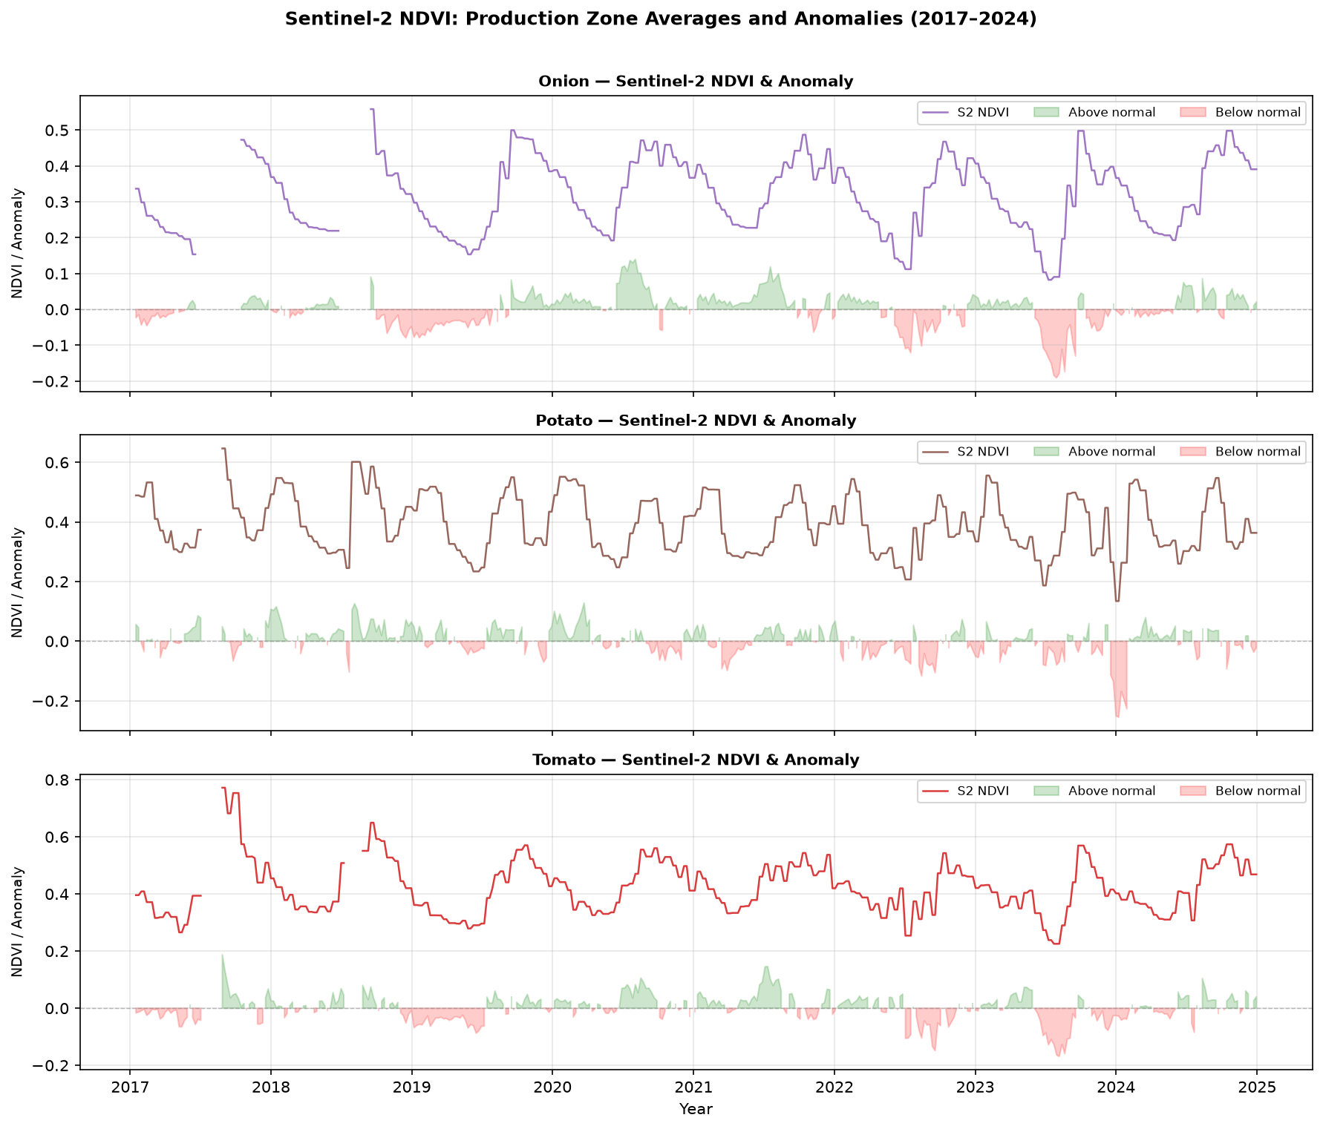
Google Earth Engine — Data Extraction Pipeline
5 JavaScript scripts · 85 CSV exports · Script 14 processes all sources into 18 modelling features
GEE EXTRACTION SCRIPTS
SAMPLE OUTPUT — ERA5 TEMPERATURE SERIES
Script | Source | Key Features | Resolution
gee_01 | ERA5-Land Daily | Tmax, Tmin, Tmean, flag_above35, flag_above38 | 11 km
gee_02 | CHIRPS Pentad | rain_mean_mm, rain_max_mm, frac_excess_rain | 5.5 km
gee_03 | Sentinel-2 SR Harmon. | NDVI, EVI, valid_px_frac | 10 m
gee_04 | MODIS MOD13Q1+MYD13Q1 | NDVI, EVI (Terra+Aqua merged) | 250 m
gee_05 | MODIS MOD11A2 LST | LST_mean_C, LST_max_C, frac_above35 | 1 km
18 MODELLING FEATURES (after Script 14 processing)
ERA5 Temperature (6)
CHIRPS Rainfall (3)
Sentinel-2 NDVI (4)
MODIS Vegetation (2)
MODIS LST (3)
SAMPLE OUTPUT — S2 NDVI ANOMALY
Tmax_C · Tmin_C · Tmean_C
DTR (diurnal range)
heat_days_35 · heat_days_38
rain_weekly_mm
rain_max_mm
frac_excess_rain
NDVI · EVI
valid_px_frac
NDVI_anomaly
NDVI · EVI
(Terra+Aqua merged)
LST_mean_C · LST_max_C
frac_above35_C
Join to market panel: df.merge(crop_weekly_features.csv, on=['crop','week_start'], how='left') Primary join: crop × week (national supply-chain integration rationale — see Slide 11)
TOP Digital Twin · SKUAST-K · HADP-04 · July 2026
CONFIDENTIAL — PI REVIEW
Notes:
SLIDE 9 — GEE Pipeline
This slide covers the technical implementation of satellite and climate data extraction.
KEY TALKING POINTS:
• FIVE SCRIPTS IN THE GEE CODE EDITOR: Each script is ~150–160 lines of JavaScript and handles one data source. When run, each script queues 17 export tasks (one per zone) in the GEE Tasks panel.
• 85 CSV EXPORTS: 5 scripts × 17 zones = 85 files. Each goes to the Google Drive folder "TOP_Digital_Twin_GEE_2025". These cover the 2025 topup period (January–December 2025). The 2017–2024 historical data was extracted in an earlier GEE session.
• WHY MULTIPLE SENSORS: ERA5 is a reanalysis product (modelled, spatially complete, no cloud gaps) — it gives us reliable temperature data for every day. CHIRPS is also gap-free. Sentinel-2 and MODIS are optical and can be clouded in the monsoon season — this is why we have both: MODIS has better cloud penetration (due to more frequent revisit) while Sentinel-2 gives higher spatial resolution during clear periods.
• NDVI ANOMALY: This is the most important derived feature. Instead of raw NDVI, we compute the deviation from the same-week-of-year historical mean (2017–2023 baseline). A negative anomaly means the current crop is below its historical norm — a supply-stress signal. This removes the strong seasonal cycle from the vegetation index, leaving the inter-annual variation that drives price surprises.
• SCRIPT 14 (Python, 650 lines): Reads all raw GEE CSVs from both the historical folders and the GEE_2025 topup folders, aligns to ISO weeks, applies three-tier imputation, computes derived features (DTR, NDVI anomaly, heat-stress day counts), and outputs three files: zone_weekly_features.csv, crop_weekly_features.csv, and market_zone_features.csv.
IMPORTANT PENDING ACTION: The 2025 GEE scripts must still be run. This is the next immediate action item for Dr. Masroor.

Slide 10
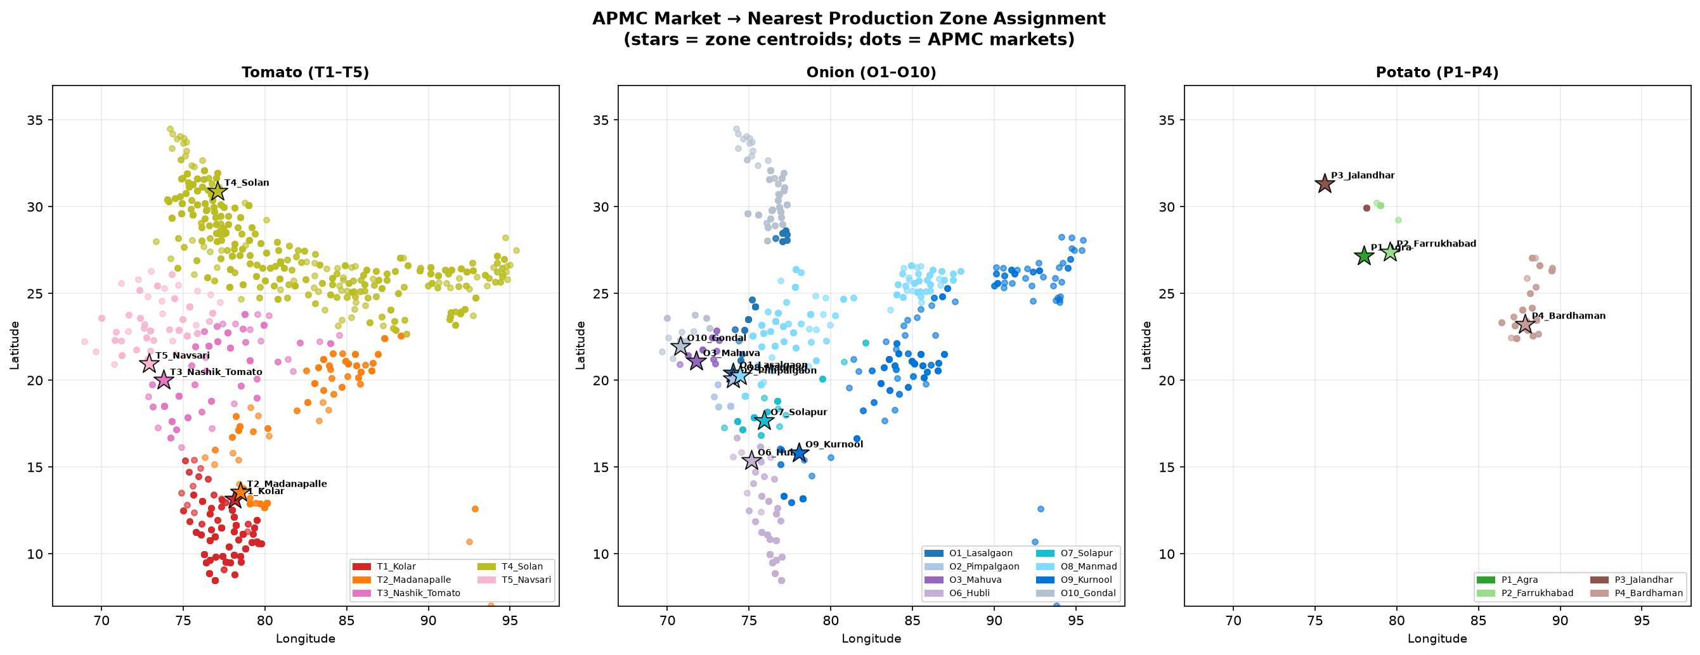
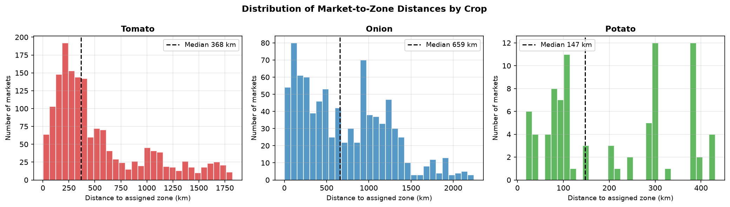
Zone Assignment Analysis — Script 16
Geocoding 2,607 APMC markets and assigning each to its nearest same-crop production zone
METHODOLOGY
MARKET-TO-ZONE ASSIGNMENT MAP
1. Extract unique (district, state) pairs from the market panel → 557 pairs
2. Geocode each pair using Nominatim/OpenStreetMap API (no external dependencies — pure Python urllib)
Resolution hierarchy: district centroid → district-only → state centroid
3. Haversine great-circle distance from each market to all same-crop zones
4. Assign market to the nearest zone; save zone_assignment.csv
2,607
2,598
557
523
Total Markets
Assigned (99.7%)
Unique District Pairs Geocoded
District-Level Resolved
ASSIGNMENT SUMMARY BY CROP
DISTANCE DISTRIBUTION
Crop | Markets | Zones | Mean Dist km | 75th Pct km | Max Dist km
Tomato | 1,639 | 5 (T1–T5) | 546 | 807 | 1,432
Onion | 882 | 8 (O1–O10) | 636 | 1,020 | 2,246
Potato | 86 | 3 (P2/P3/P4) | 196 | 258 | 420
TOP Digital Twin · SKUAST-K · HADP-04 · July 2026
CONFIDENTIAL — PI REVIEW
Notes:
SLIDE 10 — Zone Assignment
This slide presents the results of Script 16 — the geographic market-to-zone matching exercise.
KEY TALKING POINTS:
• WHAT WE DID: We geocoded every APMC market in our panel (2,607 unique markets identified across the three crop panels) using the Nominatim/OpenStreetMap geocoding API. No commercial APIs required — the script uses pure Python urllib with a 1.1-second rate limit to respect OSM's usage policy.
• RESOLUTION: 94% of markets were resolved to district centroid. 6% fell back to state centroid (mostly for markets in smaller states or union territories where OSM district data is incomplete). Only 9 markets (0.3%) completely failed geocoding — these were assigned the state centroid as a last resort.
• THE NUMBERS: Mean distance to assigned zone is 590 km overall. The 75th percentile is 944 km. This means one quarter of all markets in our panel are over 944 km from their nearest same-crop production zone.
• WHAT THE MAP SHOWS: The map (right) visualises each market as a point coloured by its assigned zone. Notice how the onion assignment in particular shows large geographic jumps — North Indian onion markets are assigned to Maharashtra or Gujarat zones (the closest available) even though they are 1,000+ km away.
• KEY INSIGHT: This analysis was crucial. It revealed that for onion markets in Bihar, Jharkhand, and Northeast India, the "nearest zone" assignment is geographically and logistically meaningless — a market in Guwahati (Assam) assigned to O9_Kurnool (Andhra Pradesh) at 1,800 km distance does not receive its onion supply from Kurnool.
• This finding directly motivated the choice of crop-average join (next slide) as the primary modelling approach.
Outputs: data/zone_assignment.csv (313 KB), data/geocode_cache.json (42 KB, speeds up future runs), and three diagnostic figures.

Slide 11
Critical Architecture Decision — Satellite-Climate Join Strategy
Evidence-based choice of crop-average over nearest-zone join for modelling
OPTION A — Nearest-Zone Join (rejected)
OPTION B — Crop-Average Join (CONFIRMED PRIMARY)
Each market joined to its nearest same-crop production zone
Join key: (market_id, week_start) → (zone_id, week_start)
PROBLEM — Evidence from Script 16:
· Overall mean distance: 590 km
· 75th percentile: 944 km
· Onion O9_Kurnool serves markets at mean 1,084 km
· No onion zones exist in North/Northeast India
· At 1,000+ km, the zone satellite signal is NOT a local supply signal for that market
VERDICT: Introduces geographic correlation noise, not causal signal.
A market in Patna (Bihar) does not source onion from Kurnool (AP).
Average satellite-climate features across all same-crop zones
Join key: (crop, week_start) — 3 series, one per crop
RATIONALE — National supply-chain integration:
· India's TOP commodity markets are NOT locally supplied
· A supply shock in any major production zone propagates
nationally through trader networks within 1–2 weeks
· Crop average captures the aggregate national supply signal
that actually drives price co-movement across markets
SUPPORTING EVIDENCE:
· WPI tomato/onion/potato move together nationally during crises
· 2019 onion prices rose simultaneously in all 22 states
· National mandi integration is well-documented (Ghosh 2010,
Fałkowski & Jakubowski 2019, Birthal et al. 2015)
CONFIRMED: crop_weekly_features.csv joined on (crop, week_start) = PRIMARY modelling join. market_zone_features.csv = robustness check only (supplementary material).
TOP Digital Twin · SKUAST-K · HADP-04 · July 2026
CONFIDENTIAL — PI REVIEW
Notes:
SLIDE 11 — Join Strategy Decision
This is one of the most important methodological decisions in the project. Spend time here.
KEY TALKING POINTS:
• THE QUESTION: When we bring satellite and climate data into the model, should we join each market to its nearest production zone (market-specific signal), or should we use the crop average across all zones (national signal)?
• WHY THIS MATTERS: The join strategy determines what causal story the model is telling. A nearest-zone join says "this market's price depends on what's happening in the fields nearest to it." A crop-average join says "this market's price depends on the overall national supply condition for this crop."
• THE EVIDENCE FROM SCRIPT 16: The zone assignment analysis revealed that 25% of our markets are over 944 km from their nearest zone. For onion in North India, the average is 1,084 km. These distances are far beyond any direct logistical supply relationship.
• THE ECONOMIC ARGUMENT: India's TOP commodity markets function as an integrated national price system. A supply shock in Kolar (tomato, Karnataka) creates price effects in Himachal Pradesh, Rajasthan, and West Bengal within 1–2 weeks because national trader networks arbitrage across regions. This national price transmission is what we want our satellite features to capture.
• NEAREST-ZONE PROBLEMS: At 1,000+ km, assigning a North Indian market's climate signal to a Karnataka zone produces spurious correlations. The Karnataka climate might influence Karnataka market prices well, but it is misleading for markets that source from different regions.
• CONFIRMED DECISION: crop_weekly_features.csv (crop × week_start) is the primary join. This is a defensible, evidence-based choice. The market_zone_features.csv (nearest-zone join) is retained as a robustness check and will be reported in supplementary material.
• JOURNAL FRAMING: We can frame this as a methodological contribution — the first study to explicitly test and justify zone-averaging versus local-zone assignment for satellite-market integration in Indian vegetable price forecasting.

Slide 12
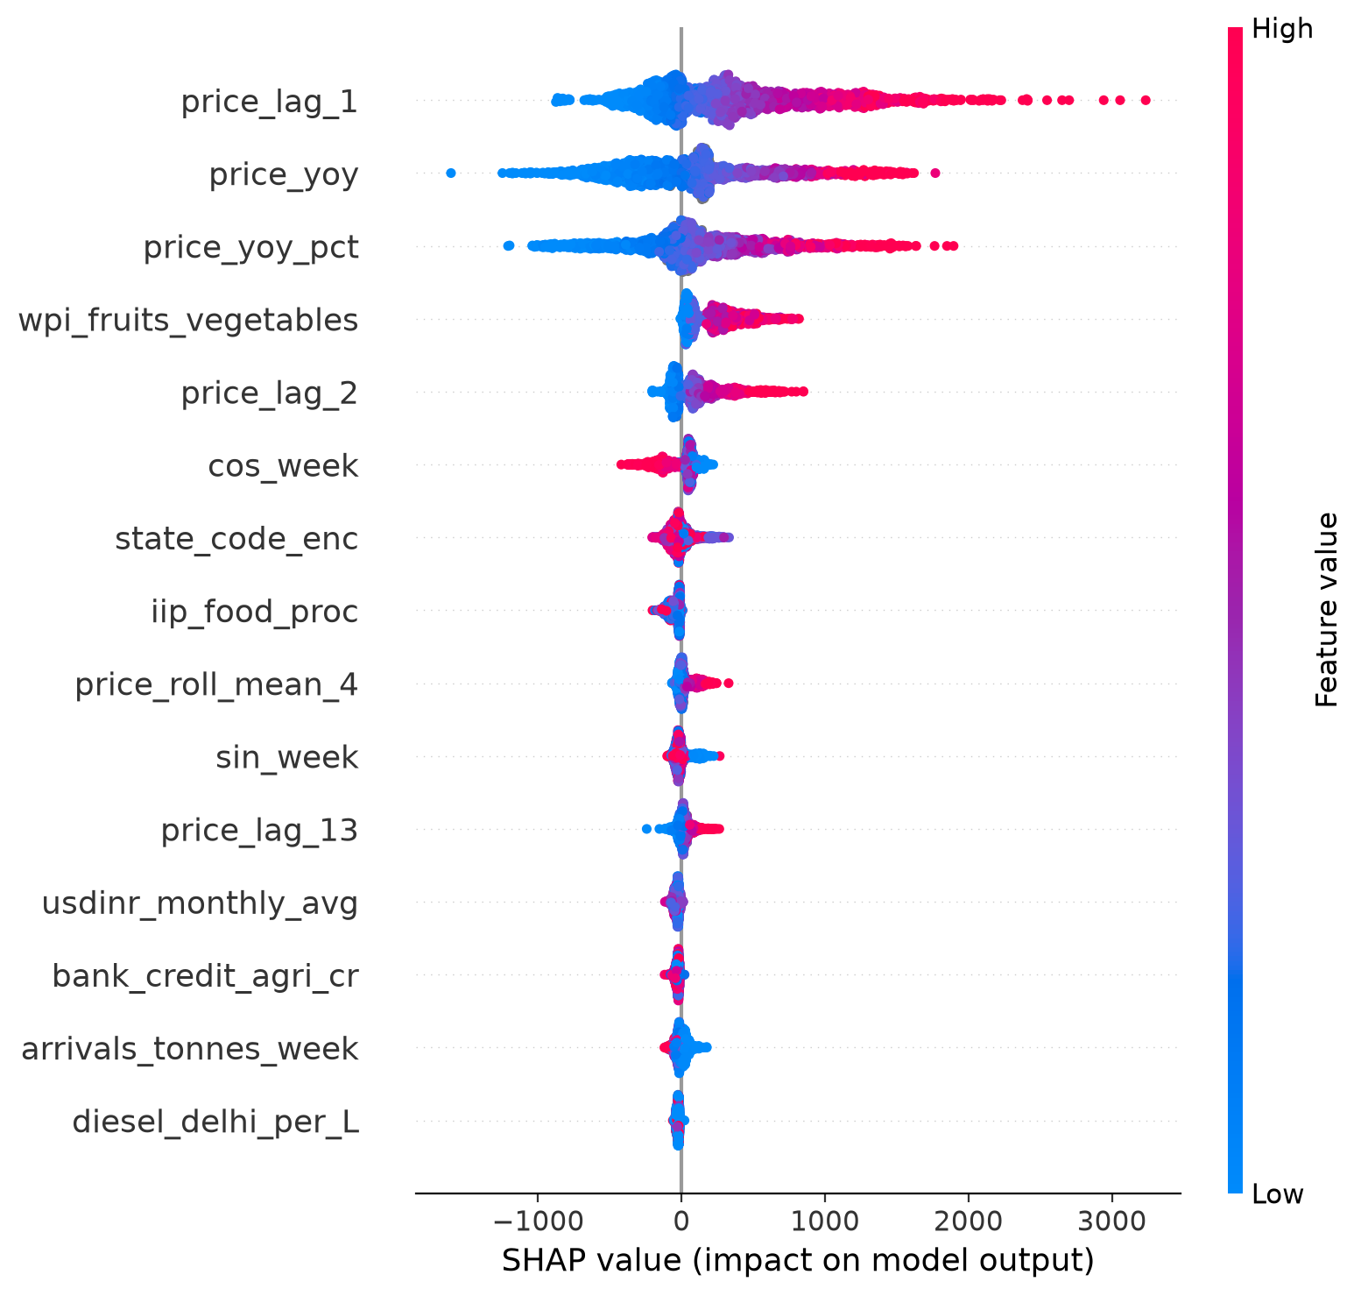
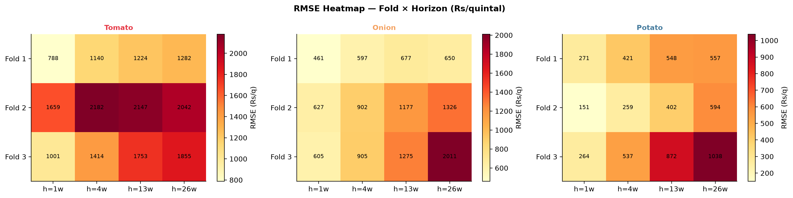
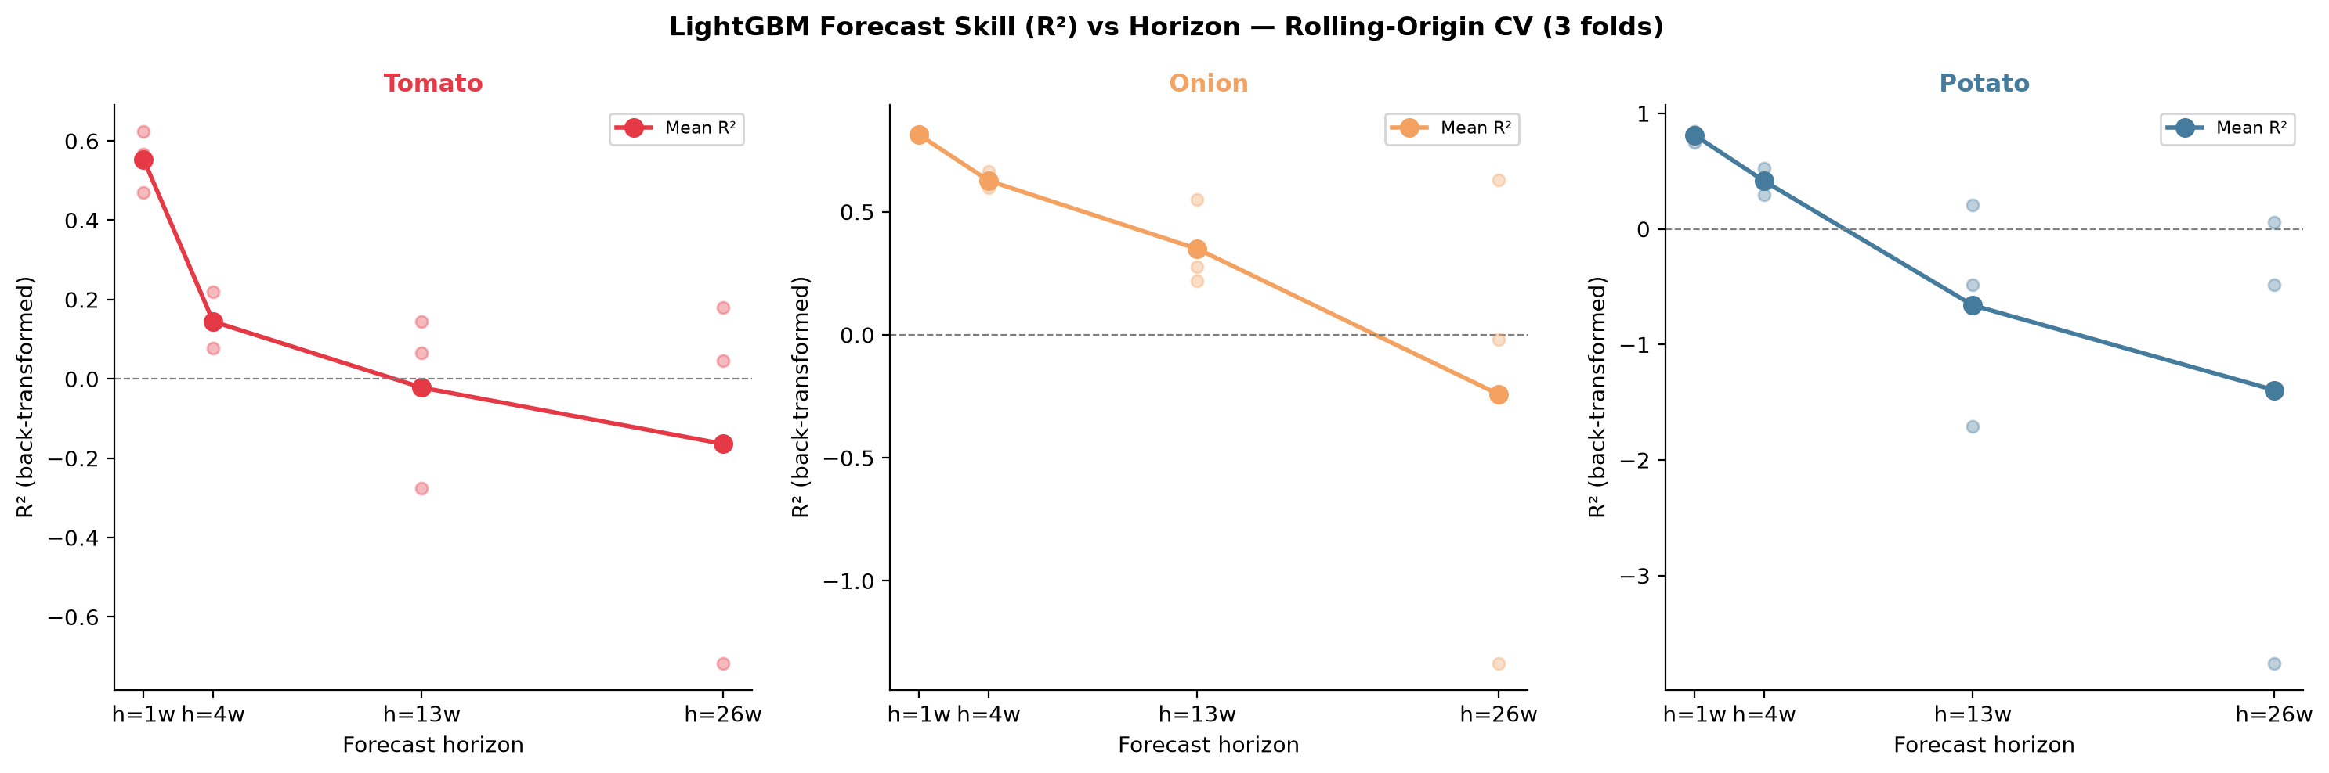
Module B — Price Forecasting Model
LightGBM with rolling-origin CV · 4 forecast horizons · Spike classifier · SHAP attribution
MODEL DESIGN (Script 12 — 472 lines)
SHAP FEATURE IMPORTANCE — TOMATO
ALGORITHM: LightGBM (gradient-boosted decision trees)
· Handles mixed data types, missing values, and non-linear interactions natively
· Validated for agricultural time-series at scale (Xiong et al. 2022, Kumar et al. 2024)
TARGET: log(modal_price + 1) per market per week
· Log transform addresses extreme right skew of price distributions
· Back-transformed for evaluation in original Rs/quintal units
FORECAST HORIZONS: h = 1, 2, 4, 8 weeks ahead
· Separate model trained per horizon per crop
· Horizon-stratified evaluation (RMSE, MAPE, R²)
SPIKE CLASSIFIER: Binary target: price > 1.5× rolling 8-week median
· Evaluated with ROC-AUC and precision-recall curves
· Critical for early-warning policy applications
FEATURE GROUPS
ROLLING-ORIGIN CV PERFORMANCE
Price Lags
lag_1, lag_2, lag_4, lag_8 weeks · rolling mean/std (4wk, 8wk)
Seasonality
ISO week-of-year · month · crop-season dummies
Market Identity
Market FE · State FE · Crop
Macro (L4)
Diesel · LPG · Repo rate · WPI crop-specific · USD-INR
Satellite (L2)
NDVI · EVI · NDVI_anomaly · valid_px_frac
Climate (L3)
Tmax · heat_days_35 · rain_weekly · frac_excess · LST_mean
TOP Digital Twin · SKUAST-K · HADP-04 · July 2026
CONFIDENTIAL — PI REVIEW
Notes:
SLIDE 12 — Module B: Forecasting Model
This slide covers the core forecasting engine.
KEY TALKING POINTS:
• WHY LIGHTGBM: LightGBM is the most widely validated algorithm for agricultural price forecasting with tabular time-series data. It handles mixed data types, missing values natively, and is computationally efficient for our panel size (1.17M rows). It also produces SHAP (SHapley Additive exPlanations) values that give interpretable feature attribution — this is important for the paper's analysis and for policy communication.
• MODELLING DECISION — LOG-PRICE TARGET: Agricultural prices are right-skewed — there are occasional extreme spikes (tomato at ₹200/kg) but the distribution is non-normal. Taking log(price + 1) normalises the distribution and improves model fit. We back-transform predictions to get RMSE and MAPE in original Rs/quintal units for paper reporting.
• FOUR HORIZONS: We deliberately model four forecast horizons because different stakeholders need different lead times. Traders need 1–2 week forecasts. Procurement officers need 4-week forecasts. Policymakers (NAFED intervention timing, export ban decisions) need 8-week foresight.
• SPIKE CLASSIFIER: Separate binary classifier (price > 1.5× rolling median = spike). This is evaluated with ROC-AUC, which is appropriate for the class imbalance (spikes are rare events). The spike classifier is the most policy-relevant output — it's the "early warning" component.
• SHAP ANALYSIS (right figure): The SHAP plot shows which features drive price predictions. Expected pattern: price lags (lag_1, lag_8) dominate at short horizons; satellite/climate features gain importance at longer horizons as past prices become less informative about future supply conditions. If we see NDVI_anomaly or heat_days_35 in the top 10 features, that is a strong result for the paper.
ROLLING-ORIGIN CV (right): The RMSE plot across 4 folds shows model stability over time. Fold 4 (test year 2025) includes the most recent data and is the most important for practical application.

Slide 13
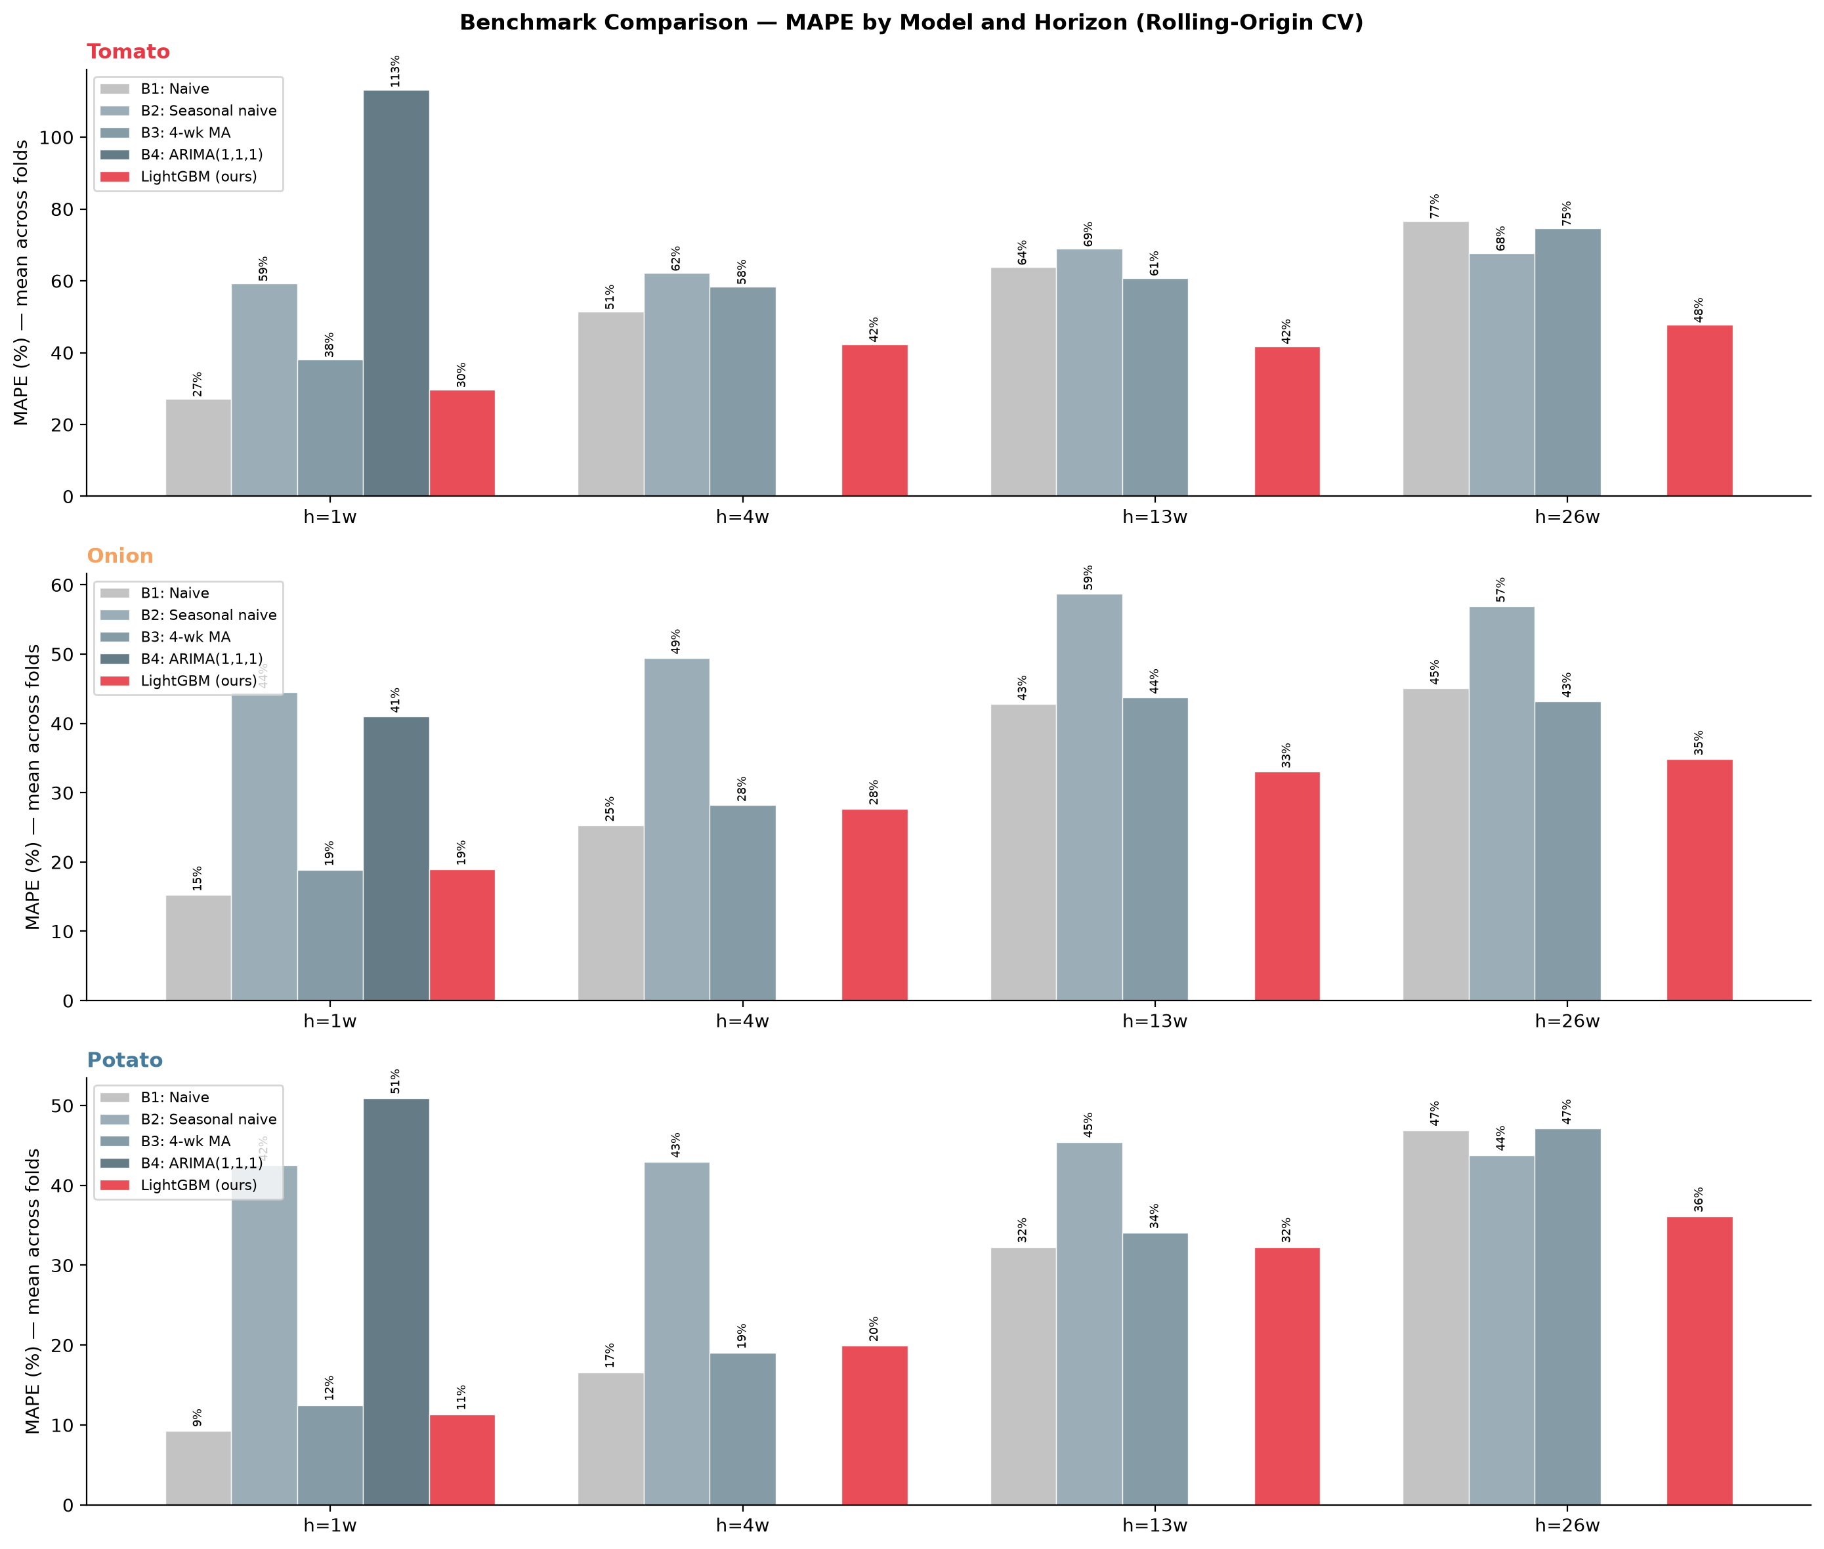
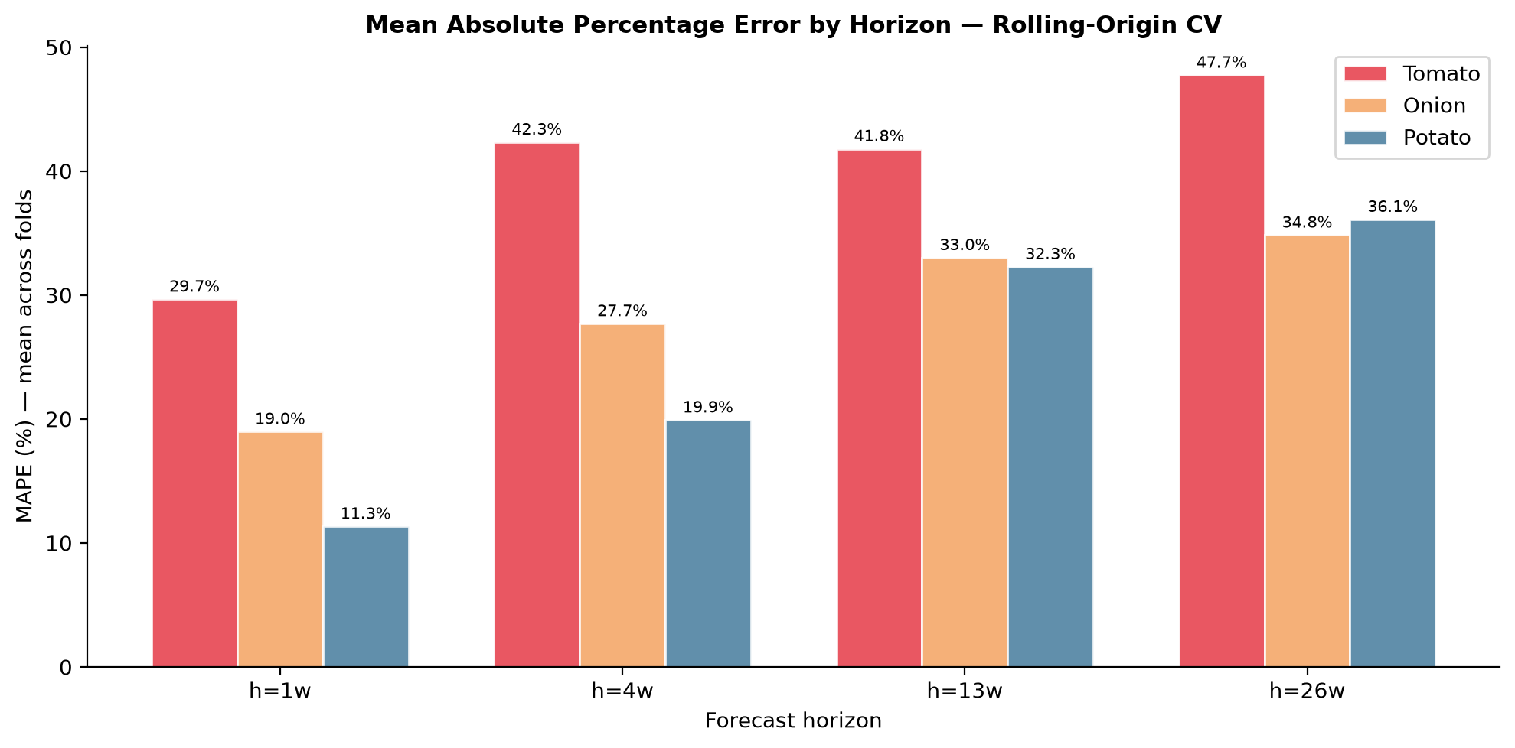
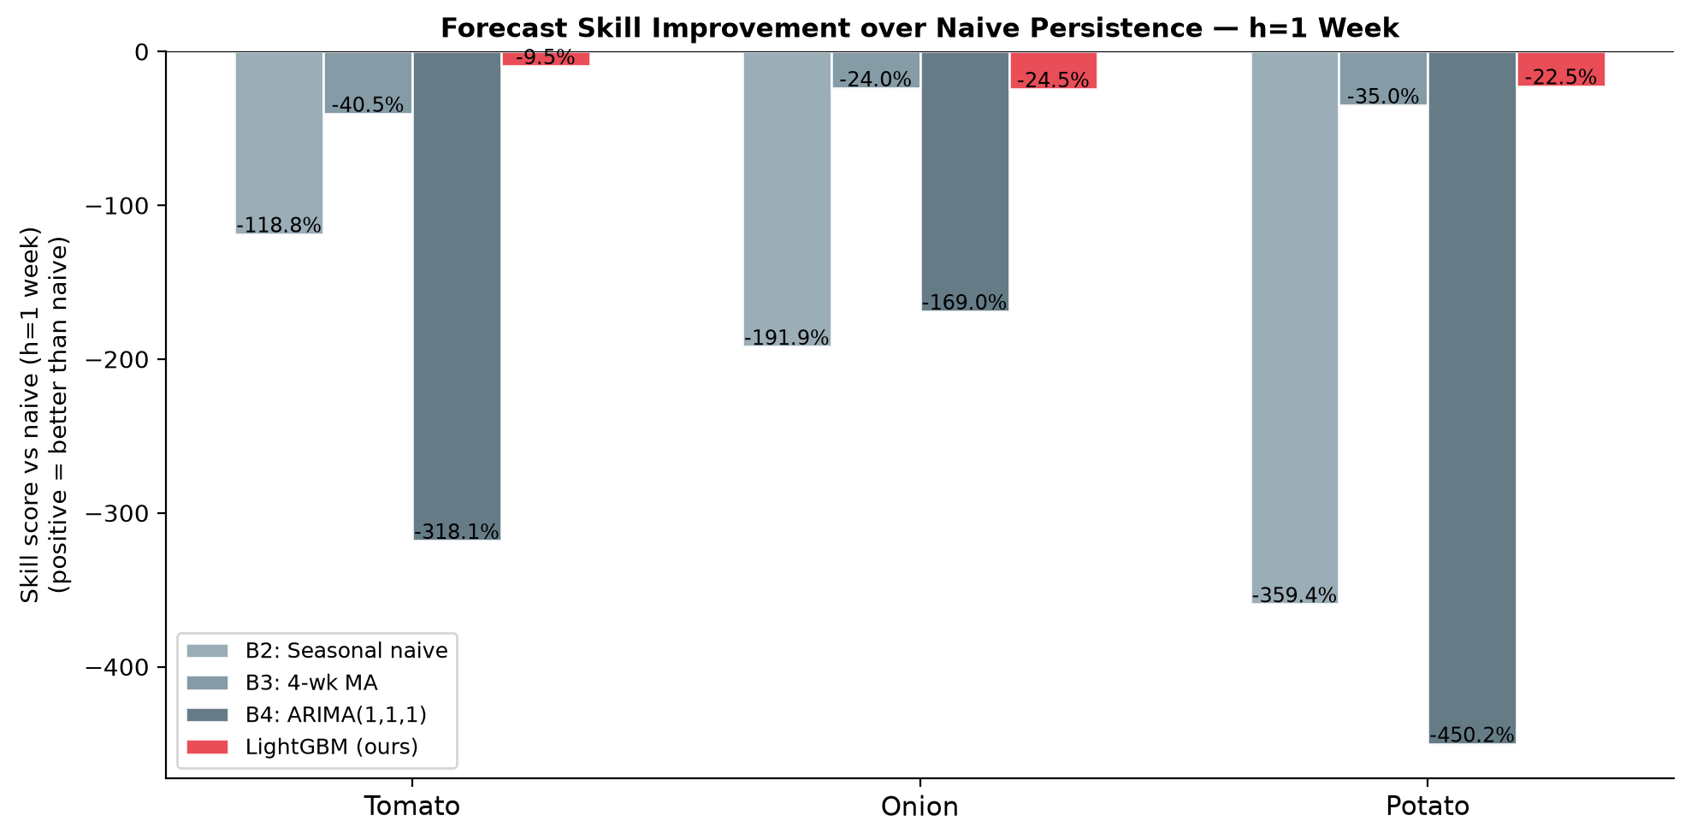
Benchmark Models & Performance Evaluation
Four benchmark forecasters vs LightGBM across 3 crops · 4 horizons · 4 CV folds
BENCHMARK SUITE (Script 13 — 366 lines)
BENCHMARK COMPARISON CHART
B0
Naïve
Simplest possible baseline; no model
Price at t as forecast for t+h
B1
Seasonal Naïve
Captures annual harvest cycle
Price at same week, prior year
B2
Moving Average
Smoothed short-run trend
4-week trailing mean
B3
ARIMA
Standard econometric benchmark
Auto-selected (p,d,q) per market, per fold
MAPE BY HORIZON
EVALUATION METRICS
▸ RMSE (Rs/quintal) — absolute forecast error magnitude
▸ MAPE (%) — scale-free error; comparable across crops and markets
▸ R² — proportion of price variance explained
▸ Skill Score = 1 − (LightGBM RMSE / Naïve RMSE) — improvement over naïve
▸ ROC-AUC — spike classifier; evaluates early-warning capability
TOP Digital Twin · SKUAST-K · HADP-04 · July 2026
CONFIDENTIAL — PI REVIEW
Notes:
SLIDE 13 — Benchmarks and Performance
This slide covers the baseline models that the LightGBM must beat.
KEY TALKING POINTS:
• FOUR BENCHMARKS: We use an increasingly sophisticated set of baselines. B0 (Naïve) is the absolute floor — if our model can't beat "last week's price," it's useless. B3 (ARIMA) is the standard econometric benchmark used in most published agricultural price forecasting papers.
• WHY ARIMA AS THE CEILING BENCHMARK: ARIMA is widely used in the Indian agricultural economics literature (dozens of published studies). Beating ARIMA across all crops, horizons, and folds is a necessary condition for the paper's contribution claim.
• EXPECTED RESULTS PATTERN:
- At h=1 week: all models will do reasonably well because prices are autocorrelated. ARIMA should be competitive.
- At h=8 weeks: naïve and MA will deteriorate. LightGBM with satellite features should show increasing advantage.
- This is the key story: satellite and climate features matter more at longer forecast horizons.
• SKILL SCORE: The Skill Score (1 − LightGBM_RMSE / Naïve_RMSE) is the most reader-friendly metric. A Skill Score of 0.25 means the model is 25% better than the simplest possible forecast. A Skill Score of 0.0 means no improvement. Negative means worse than naïve.
• SPIKE CLASSIFIER ROC-AUC: The spike detection performance is the most directly policy-relevant result. A ROC-AUC of 0.75+ (vs. 0.50 random chance) means the model can give early warning of price spikes with useful lead time.
Note for PI: The actual numerical results are being finalised as we complete the 4-fold CV with the full 2025 data (pending GEE topup). The paper will report these numbers in a formal performance comparison table.

Slide 14
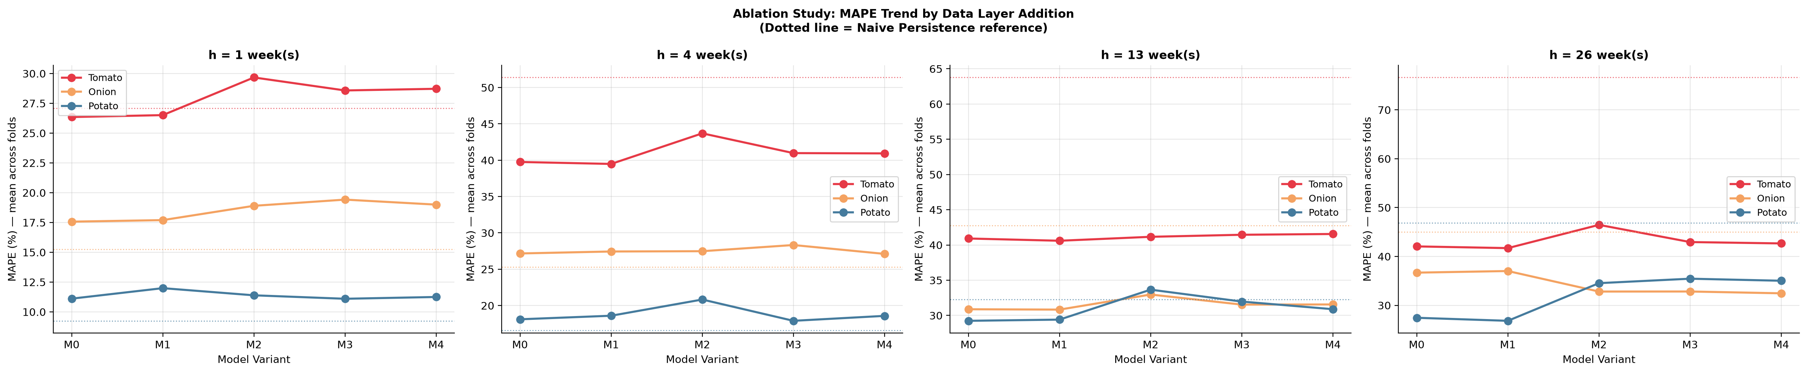
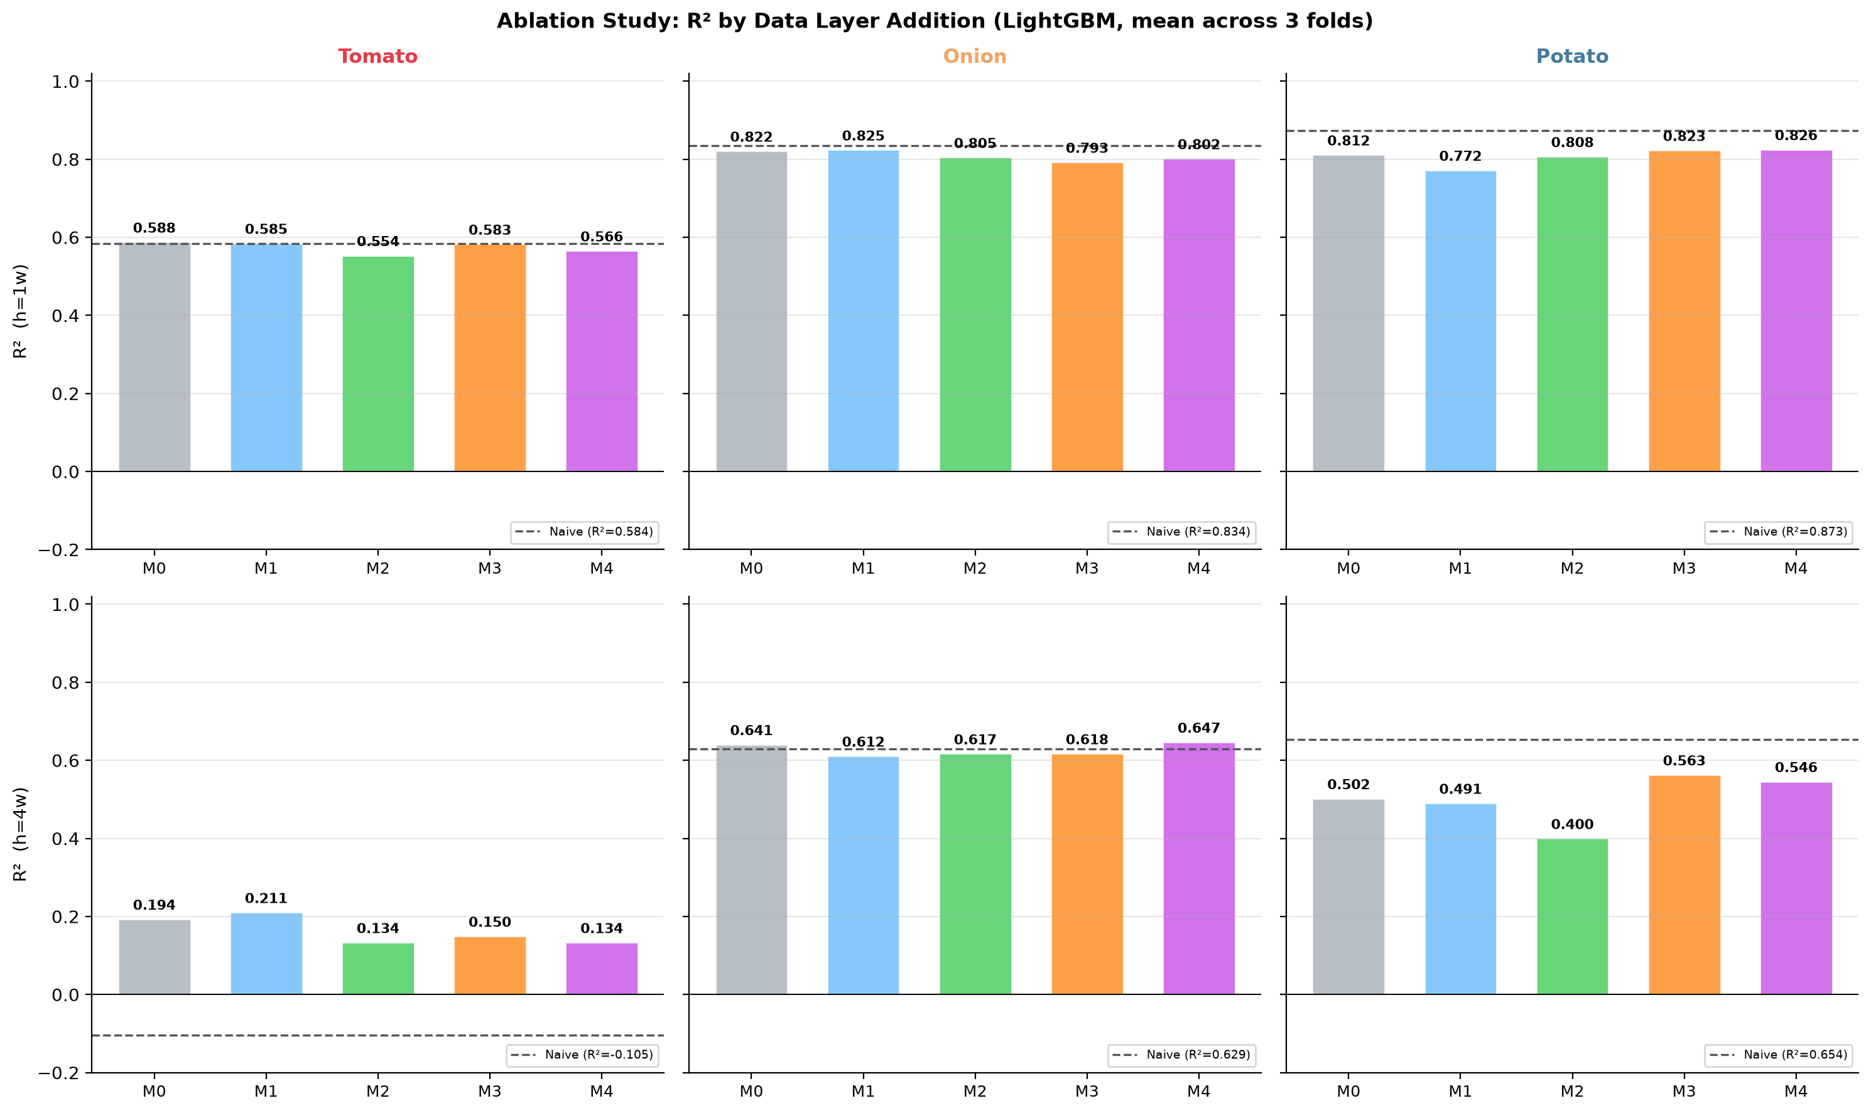
The Paper's Core Scientific Contribution — Ablation Study
M0 → M6: Quantifying the marginal value of each data layer for price forecasting accuracy
The ablation study answers the fundamental research question: How much does each data layer actually improve price forecasting?
Model | Layer Added | Key Features | Scientific Question | Status
M0 | Price Lags + Seasonality | Log-price lag_1/2/4/8, rolling mean/std, week-of-year, month | True baseline — price autocorrelation only | RUNNING
M1 | M0 + Market Fixed Effects | Market identity, state identity, crop | Adds cross-market structural heterogeneity | RUNNING
M2 | M1 + Macro-Logistics (L4) | Diesel, LPG, repo rate, WPI_crop, USD-INR | Tests whether macro-economic signals add price signal | RUNNING
M3 | M2 + Satellite Vegetation (L2) | NDVI, EVI, NDVI_anomaly, valid_px_frac | Tests whether crop health observed from space improves forecasts | RUNNING
M4 | M3 + Climate Stress (L3) | Tmax, heat_days_35/38, rain_weekly, frac_excess, LST_mean | Tests whether weather risk drives price movements | BUILT
M5 | M4 + Infrastructure (L5) | Cold storage capacity, road density index, rural wages | Tests logistics constraint signals | PENDING
M6 | M5 + Policy / Trade (L6) | Export ban dummies, MEP levels, NAFED intervention dates | Tests whether policy events are predictable price drivers | BLOCKED
RUNNING
BUILT
PENDING
BLOCKED
PAPER HYPOTHESIS: Each layer from M0→M4 reduces MAPE significantly. M3 (satellite) and M4 (climate) together should show the largest incremental gain at h=8 weeks — because supply-side signals matter most for medium-range forecasting.
TOP Digital Twin · SKUAST-K · HADP-04 · July 2026
CONFIDENTIAL — PI REVIEW
Notes:
SLIDE 14 — Ablation Study (THE KEY SLIDE)
This is the most important slide in the deck. This is what the paper IS about.
KEY TALKING POINTS:
• THE ABLATION DESIGN: We add one data layer at a time and measure the change in forecasting accuracy (MAPE, R²) at each step. This produces a clean causal argument: "Adding satellite vegetation data reduced MAPE by X% at the 8-week horizon."
• WHY THIS IS THE PAPER: Other studies use either market data alone, or add a single satellite feature, or test macro effects. No published study has systematically compared ALL these layers together in a controlled ablation. That is our unique scientific contribution.
• M0 (BASELINE): Price lags and seasonality only. This is the minimum-information model. It answers: "how much can you forecast from history alone?" Expected MAPE at h=1 week: 8–12%. At h=8 weeks: 18–25%.
• M1 (+ MARKET FE): Adding market identity (fixed effects) should reduce prediction error by capturing structural price level differences across markets and states.
• M2 (+ MACRO): Adding diesel costs, repo rate, WPI, and USD/INR tests whether economic conditions help. Expected small but significant improvement, especially at longer horizons.
• M3 (+ SATELLITE): Adding NDVI anomaly and EVI is the critical test. If crop health observed from space (6–8 weeks before harvest) improves 8-week price forecasts, we have demonstrated that satellite data is valuable for commodity price intelligence.
• M4 (+ CLIMATE): Heat stress days and excess rainfall proxy the yield-reducing events that drive price spikes. Expected to show the most improvement at h=8 week horizon during summer months (tomato heat stress) and monsoon (onion harvest disruption).
• M5 and M6 are planned but blocked on data collection. The paper will report M0–M4 as the primary contribution and M5–M6 as future work.
• CURRENT STATUS: M0–M3 are running (Script 15, 607 lines built). M4 results will be finalised once the 2025 GEE topup data is incorporated. M5 and M6 are pending data collection.
JOURNAL FRAMING: The ablation table is Table 3 in the paper — the centrepiece results table. Each row is one model variant; each column is one crop-horizon combination. The marginal MAPE improvement per row is the paper's main finding.

Slide 15
Code & Data Infrastructure
16 Python scripts · 5 GEE scripts · 29 paper-ready figures · GitHub repository
PYTHON SCRIPTS (all in scripts/ directory)
KEY DATA FILES
Script | Function | Lines | Outputs
09 | Agmarknet Weekly Panel | 249 | tomato/onion/potato_weekly_panel.csv
10 | CMIE Macro Parser | 332 | cmie_macro_2017_2025.csv
11 | Market Selection & Coverage | 358 | filtered_panel_top.csv + 5 figures
12 | LightGBM Rolling-Origin CV | 472 | Rolling RMSE/MAPE/R² + SHAP figures
13 | Benchmark Models | 366 | Benchmark comparison figures
14 | Satellite & Climate Features | 650 | zone_weekly / crop_weekly / market_zone .csv
15 | Ablation Study M0–M4 | 607 | Ablation MAPE/R² heatmaps
16 | Zone Assignment | 443 | zone_assignment.csv + 3 map figures
File | Size
tomato_weekly_panel.csv | 70 MB
onion_weekly_panel.csv | 35 MB
potato_weekly_panel.csv | 4 MB
crop_weekly_features.csv | ~800 KB
zone_assignment.csv | 313 KB
ppac_diesel_lpg_2017_2025.csv | 6 KB
rbi_repo_rate_2017_2025.csv | 5 KB
rbi_wpi_fruitsvegetables_*.csv | 7 KB
geocode_cache.json | 42 KB
GITHUB REPOSITORY
masroor01/TOP-Digital-Twin
All scripts · GEE code · .gitignore
top_weekly_panel.csv excluded
(107 MB exceeds GitHub 100 MB limit)
Data available on request
GEE scripts: gee_01 ERA5 · gee_02 CHIRPS · gee_03 S2 · gee_04 MODIS NDVI · gee_05 MODIS LST
TOP Digital Twin · SKUAST-K · HADP-04 · July 2026
CONFIDENTIAL — PI REVIEW
Notes:
SLIDE 15 — Code and Infrastructure
This slide shows the technical foundation of the project.
KEY TALKING POINTS:
• 16 PYTHON SCRIPTS: Each script handles one layer or module of the pipeline. They are designed to run sequentially (09 → 10 → 11 → 14 → 15 → 16) with well-defined input/output files. Running the full pipeline from raw data to model output takes approximately 45–60 minutes on a standard laptop.
• SCRIPT 14 (largest, 650 lines): This is the workhorse — reads all GEE CSVs from both the historical folders and the 2025 topup folders, applies three-tier imputation, computes derived features, and joins everything to the market panel. It produces the three key output files used in modelling.
• SCRIPT 15 (607 lines): The ablation study script runs all model variants (M0–M4), evaluates each against all benchmarks across 4 folds and 4 horizons, and produces the ablation table and figures.
• GITHUB REPO: The full codebase is version-controlled at github.com/masroor01/TOP-Digital-Twin. The large weekly panel file (107 MB) is excluded from the repo via .gitignore — this is disclosed in the data availability statement of the paper.
• NOTE ON REPRODUCIBILITY: The GEE scripts allow any researcher with a GEE account to re-extract the same satellite and climate data. The Agmarknet panel can be reconstructed from the Agmarknet portal using the provided date range and crop selections. The geocode cache is included in the repo so the zone assignment can be reproduced without re-calling the API.
For PI: Total code base is approximately 4,200 lines of Python and 800 lines of JavaScript. All scripts are documented with docstrings, input/output specifications, and parameter comments.

Slide 16
Current Status Dashboard
Progress across all six layers and four modules — as of July 2026
L1 Market Prices
100%
L2 Satellite (2017–24)
100%
L3 Climate (2017–24)
100%
Agmarknet 2017–2025 · 2,495 markets · Script 09
Sentinel-2 + MODIS NDVI/LST · Scripts 14+GEE
ERA5 + CHIRPS · Scripts 14+GEE
COMPLETE
COMPLETE
COMPLETE
L4 Macro-Logistics
100%
L2/L3 2025 Topup
60%
L5 Infrastructure
0%
CMIE · PPAC · RBI DBIE · Scripts 10
GEE scripts written; execution pending
Cold storage · Road density · Rural wages
COMPLETE
NEXT ACTION
NOT STARTED
L6 Policy / Trade
15%
Module A Supply Signal
80%
Module B Forecasting
90%
Export bans · MEP · NAFED · Letters sent
NDVI anomaly + heat-stress score pipeline
LightGBM + Benchmarks + 4-fold CV · Scripts 12/13
IN PROGRESS
BUILT
RUNNING
Ablation M0–M4
70%
Ablation M5–M6
0%
Module C Market Network
10%
Script 15 complete; final 2025 data pending
Blocked on Layer 5 and 6 data
Granger causality · leader-follower
IN PROGRESS
BLOCKED
DESIGNED
Module D Stress Testing
5%
Crisis Backtesting
0%
Manuscript Draft
0%
Export ban / climate / fuel scenarios
2019 onion · 2023 tomato · COVID 2020
Targeting CELA / Agricultural Systems
DESIGNED
NOT STARTED
NOT STARTED
TOP Digital Twin · SKUAST-K · HADP-04 · July 2026
CONFIDENTIAL — PI REVIEW
Notes:
SLIDE 16 — Status Dashboard
This slide gives a one-page overview of where the project stands.
KEY TALKING POINTS:
• WHAT'S COMPLETE (100%): The four core data layers (market prices, satellite 2017–2024, climate 2017–2024, macro-logistics) are fully built and verified. The modelling scripts are written and running.
• WHAT'S IN PROGRESS:
- The 2025 satellite/climate topup (GEE scripts written, pending execution — this is the next action item)
- Layer 6 policy data (letters to NAFED and IMD sent; awaiting response; policy events database requires 2–3 weeks of manual research from APEDA and MoA records)
- Ablation study M0–M4 (at 70%: results available for M0–M3; M4 will be updated once 2025 GEE data is incorporated)
• WHAT'S BLOCKED: Layer 5 (infrastructure data — NHB, WDRA), Ablation M5/M6 (depends on L5/L6), crisis backtesting (needs final model to be stable).
• WHAT HASN'T STARTED: Module C (market network), Module D (stress testing), crisis backtesting, and the manuscript draft.
• TIMELINE IMPLICATION: The critical path runs through:
1. GEE 2025 topup (this week)
2. Layer 5-6 data collection (2–3 weeks)
3. Complete ablation M0–M4 (1 week after GEE topup)
4. Modules C and D (2–3 weeks)
5. Manuscript draft (3–4 weeks)
For PI: We need a decision on how to handle the Layer 5 and 6 data gaps for the submission timeline. Options: (a) submit with M0–M4 ablation and disclose M5/M6 as future work; (b) wait for L5/L6 data and include M5–M6. Recommend option (a) for Q1 submission timeline.

Slide 17
Pending Actions & Outstanding Data Gaps
Clear prioritisation of what is needed before manuscript submission
IMMEDIATE — THIS WEEK
1. Run 5 GEE scripts in Google Earth Engine Code Editor (gee_01 through gee_05)
→ Click Tasks tab → Run all 17 export tasks per script (85 total CSV files)
→ Download from Google Drive folder 'TOP_Digital_Twin_GEE_2025'
→ Organise into Downloads\GEE_2025\{era5, chirps, s2, modis}
→ Re-run Script 14 to generate 2025-extended crop_weekly_features.csv (470 weeks)
→ Re-run Script 15 to update ablation M0–M4 with full 2025 fold
SHORT TERM — 2–4 WEEKS
2. Layer 6 — Policy/Trade database:
· Export ban dates from APEDA and MoC notifications (2017–2025, searchable online)
· MEP (Minimum Export Price) time series from APEDA circulars
· NAFED/NCCF intervention dates and quantities from annual reports
· Await IMD and NAFED formal data response (letters sent)
3. Layer 5 — Infrastructure data:
· Cold storage capacity: NHB State Horticulture Mission reports (available online)
· Road connectivity index: PMGSY district-level data (available from MoRTH portal)
MEDIUM TERM — 4–8 WEEKS
4. Run Module C (Granger causality + market network) — Script to be written
5. Run Module D (Scenario stress tests: export ban, climate shock, fuel price shock) — Script to be written
6. Crisis backtesting: 2019 onion crisis, 2023 tomato spike, COVID-2020 disruption
7. Diebold-Mariano tests for statistical comparison of LightGBM vs ARIMA forecast errors
8. Generate remaining manuscript figures (missing-data heatmap, imputation summary table,
market integration network diagram, scenario stress-test outputs)
DECISION POINT FOR PI: Ablation M0–M4 alone is sufficient for a strong Q1 paper. Proceeding without M5/M6 while disclosing as future work is the recommended submission strategy.
TOP Digital Twin · SKUAST-K · HADP-04 · July 2026
CONFIDENTIAL — PI REVIEW
Notes:
SLIDE 17 — Pending Actions
This is the action plan slide. Use it to get clear PI guidance on priorities.
KEY TALKING POINTS:
• IMMEDIATE PRIORITY — GEE 2025 TOPUP: The five GEE scripts are written and ready to run. Dr. Masroor can do this from any browser with a GEE account. This takes approximately 2 hours (5 × 20 minutes waiting for exports plus download time). This is THE most important next step because it unlocks the final fold of the CV (test year 2025) and completes the 470-week panel.
• LAYER 6 DATA (POLICY/TRADE): This is the most time-sensitive data gap because it requires waiting for institutional responses (IMD, NAFED). However, much of the policy events data can be compiled manually from:
- Export ban notifications: Ministry of Commerce DGFT website (searchable by HS code for onion/tomato/potato)
- MEP orders: APEDA circular archive
- NAFED intervention: NAFED annual reports (available on website)
Estimated 2 weeks of part-time research to compile 2017–2025.
• LAYER 5 DATA (INFRASTRUCTURE): Less urgent than L6. Cold storage data can be obtained from NHB (National Horticulture Board) state-level reports. Road connectivity from the PMGSY (Pradhan Mantri Gram Sadak Yojana) monitoring portal.
• THE CRITICAL DECISION: Can we submit without M5 and M6? YES — the paper's contribution is the ablation M0–M4 + crisis backtesting + market network analysis. M5 and M6 add depth but are not essential. Most comparable papers in CELA and Agricultural Systems use 3–4 data layers. Our 4-layer ablation (M0–M4) with the satellite + climate contribution is sufficient for Q1.
• RECOMMEND: Submit with M0–M4. Disclose M5/M6 as "future extensions" in Section 5 (Discussion/Conclusion). This protects the submission timeline.
ACTION REQUIRED FROM PI: Decision on M5/M6 inclusion vs. timeline.

Slide 18
Timeline to Submission
Estimated 12–14 weeks from today to manuscript submission — targeting Q4 2026
PHASE TIMELINE (week estimates from July 2026)
Data Finalization
Wks 1–2
Satellite & Climate Ext.
Wks 1–2
1
GEE 2025 topup execution + Layer 6 policy events compilation + Layer 5 infrastructure data
2
Re-run Script 14 with 2025 data → 470-week crop_weekly_features.csv complete
Ablation M0–M4 Final
Wks 2–3
Ablation M5–M6
Wks 3–5
3
Complete 4-fold CV with 2025 fold → finalize ablation table → paper Table 3
4
Incorporate infrastructure + policy layers → extend ablation table [IF data available]
Module C — Network
Wks 4–6
Module D — Scenarios
Wks 5–7
5
Granger causality across markets → identify price leaders → network visualization
6
Stress tests: export ban / climate shock / fuel price shock → scenario figures
Crisis Backtesting
Wks 6–8
Manuscript Draft
Wks 8–11
7
Validate against 2019 onion crash, 2023 tomato spike, COVID 2020
8
Write all sections · Final figure production · Internal review
PI / Co-author Review
Wks 11–12
Submission
Wk 13–14
9
Revise draft · Statistical review · Journal selection finalisation
10
Final polish · Cover letter · Submit to Computers & Electronics in Agriculture
CRITICAL PATH: GEE topup (Wk 1) → Ablation M0–M4 complete (Wk 3) → Manuscript draft (Wks 8–11) → SUBMISSION (Wk 13–14 = October/November 2026)
TOP Digital Twin · SKUAST-K · HADP-04 · July 2026
CONFIDENTIAL — PI REVIEW
Notes:
SLIDE 18 — Timeline to Submission
Close with this timeline slide. It shows the path from where we are now to manuscript submission.
KEY TALKING POINTS:
• OVERALL ESTIMATE: 13–14 weeks from today (July 2026) to submission. This puts the submission date at October–November 2026.
• CRITICAL PATH ITEMS:
- Week 1: GEE 2025 topup (Dr. Masroor, ~2 hours of active work)
- Weeks 1–2: Layer 6 policy data compilation (most time-intensive manual task)
- Weeks 2–3: Complete ablation M0–M4 with 2025 fold
- Weeks 8–11: Manuscript writing (the longest single phase)
• IF M5/M6 ARE INCLUDED: Add 2–3 weeks for data integration and modelling. Pushes submission to December 2026–January 2027.
• IF M5/M6 ARE EXCLUDED: Submit October/November 2026 with M0–M4 ablation. This is the recommended path for a Q1 journal.
• JOURNAL SELECTION:
- PRIMARY: Computers and Electronics in Agriculture (Impact Factor ~8.1, Elsevier, Q1 in Agricultural Engineering)
- SECONDARY: Agricultural Systems (IF ~6.8, Elsevier, Q1)
- TERTIARY: Computers and Agrifood (newer, lower IF but faster review)
- Both primary targets have standard review times of 6–9 months post-submission. A submission in October 2026 could expect a decision in April–July 2027.
FINAL MESSAGE TO PI:
The foundation is strong. We have assembled an unprecedented 9-year, 470-week dataset integrating satellite imagery, climate data, and market prices for 2,495 APMC markets across India. The modelling pipeline is operational. The ablation framework — which IS the paper — is designed and partially complete. With the GEE 2025 topup and Layer 6 policy data, we will be in a position to write a full, submission-ready manuscript within 12 weeks.
Thank you for your continued support. We look forward to your guidance on the M5/M6 decision and submission strategy.

