Slide 1
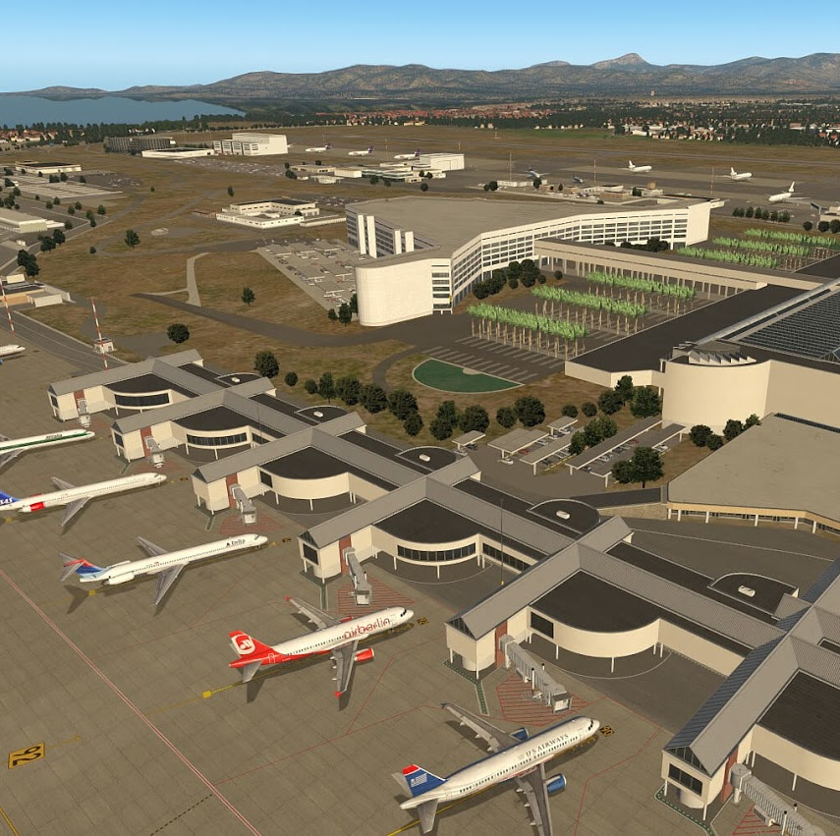
Aviation Security Awareness
Over View and Major Historical Events
This Photo by Unknown Author is licensed under CC BY-SA-NC

Slide 2
Introduction
Aviation security is a fundamental component of the global aviation system, aimed at protecting Passengers, Crew, Aircraft, and infrastructure from acts of unlawful interference.
Rising air traffic leads to increased Aviation security risk
Aviation has become a prime target for security threats such as terrorism, hijacking, and sabotage
The system focuses on:
Global regulations
Pakistan’s regulatory framework and implementation
Stakeholder roles and responsibilities

Slide 3
Sequence of Topics
Introduction of Aviation Security
Importance & Consequences
Difference between Safety & Security
Key Regulatory Organization IATA & ICAO
Role of PCAA and ASF
Airlines & Traffic Staff responsibilities
GHAs, Cargo and Catering Handling Staff
Major Historical Incidents and Improvements
Conclusion

Slide 4
Importance of Aviation Security
Protects Passengers and crew
Safeguards Aircraft and Airports and Infrastructure
Prevents terrorism and crime
Maintains public confidence
Supports global economy

Slide 5
Consequences of Security Failure
Loss of human life
Economic damage
Disruption of air travel
Loss of trust
National security risks

Slide 6
Difference between Safety & Security
Aviation safety focuses on preventing unintentional accidents caused by technical failures, human error, or environmental hazards (e.g., maintenance, training).
Aviation security (AVSEC) protects against intentional, malicious acts, including terrorism, hijacking, and sabotage

Slide 7
Key Organization : ICAO
International Civil Aviation Organization
UN specialized aviation agency
Develops global standards and Recommended Practices.
Ensures Aviation Safety & Security worldwide
ICAO Annex 17 : Core Aviation security regulations
Passenger & Baggage screening
Airport security
Cargo security
Framework for national programs

Slide 8
Key Organization : IATA
International Air Transport which represents global airlines
Works with ICAO , Ensures practical implementation
Develops best practices
Promotes Security Management Systems (SeMS)
Supports airlines globally
IATA plays a vital role in bridging regulatory frameworks and operational implementation.

Slide 9
Role of Pakistan Civil Aviation Authority
National Framework (Pakistan), Based on ICAO standards
Implemented through Law Enforcement agencies and PAA
Regulates aviation security
Develops NCASP (National Civil Aviation Security Program)
Conducts audits and inspections
Issues licenses (AOC, GHOC) etc

Slide 10
Airport Security Force
Main airport security agency (paramilitary force)
Ensures enforcement of security measures
Passenger & baggage screening (X-Ray Machines)
Access control
Surveillance & patrol
Emergency response
Coordination with Agencies, Airlines & GHAs

Slide 11
Airline Responsibilities
Ensure onboard and operational security
Comply with regulations
Passenger identity verification
Aircraft security checks
Crew & Personnel training
Reporting suspicious activity

Slide 12
Airline Local Security Department
Ensures Airline-level compliance
Coordinate with ASF & PCAA and other agencies/departments
Conduct audits
Monitor procedures
Train staff (Security & DGR etc)
Investigate incidents
AOSP (Aircraft Operator Security Program) Manual

Slide 13
Traffic Staff Responsibilities
Frontline airport staff
First interaction with passengers
Check travel documents
Verify identity
Detect suspicious behavior
Detect and isolate DGR items
Ensure secure boarding

Slide 14
Ground Handling Agents (GHAs)
Provide Airport Operational/Ground services (RAS, SAPs Gerry Dnata )
Handle aircraft and baggage
Secure baggage and cargo reconciliation and movement.
Follow procedures thru Ground Handling security manual
Identify prohibited items and DGR items
Coordinate with security agencies (ASF, ANF, Custom & Vigilance) for the search of the Aircraft and Baggage.

Slide 15
Cargo Department Responsibilities
Handles cargo and mail
Screen of cargo
Maintain secure supply chain
Known Consignor system
Prevent dangerous goods transport (DGR)
Implementation of Avn Security Program thru PCAA Guidelines

Slide 16
Catering Department Responsibies
Responsible for in-flight food security
Secure food preparation
Prevent tampering
Maintain sealed delivery
Follow hygiene standard
Implementation of Avn Security Program thru PCAA Guidelines

Slide 17
The Hijacking Era (1960s-1970s)
The 1960s and 1970s were marked by a surge in aircraft hijackings, often driven by political motives.
From 1968 to 1972, one hundred and thirty-seven planes were hijacked in the US alone.
These events exposed glaring vulnerabilities in aviation security, prompting governments and airlines to take action.
Introduction of passenger screening at airports.
Deployment of metal detectors and X-ray machines to detect weapons.
This era marked the beginning of a structured approach to aviation security, shifting the focus from reactive measures to proactive prevention.

Slide 18
The Lockerbie Bombing (1988)
On December 21, 1988, Pan Am Flight 103 was destroyed by a bomb over Lockerbie, Scotland, killing all 259 people on board and 11 on the ground.
Enhanced baggage screening procedures, including the use of explosive detection systems (EDS).
Stricter regulations on cargo and checked luggage.
Increased international cooperation in intelligence sharing and counterterrorism efforts.

Slide 19
The 9/11 Attacks (2001)
The September 11, 2001, terrorist took control of four commercial airplanes, using them as weapons to attack the World Trade Center and the Pentagon.
Creation of the Transportation Security Administration (TSA) in the United States.
Implementation of 100% passenger and baggage screening.
Introduction of reinforced cockpit doors to prevent unauthorized access.
Development of behavioral detection programs and advanced screening technologies.
Global adoption of stricter security protocols, including restrictions on liquids and gels in carry-on luggage.

Slide 20
The Shoe Bomber Incident (2001)
Just months after 9/11, Richard Reid, attempted to detonate an explosive device hidden in his shoe aboard American Airlines Flight 63.
The attack was thwarted by passengers and crew, it exposed yet another vulnerability.
Introduction of shoe removal during security screening.
Increased focus on in-flight security measures, including air marshals and crew training.
Development of advanced imaging technology (AIT) to detect non-metallic threats.
This incident reinforced the need for continuous innovation in security protocols to stay ahead of evolving threats.

Slide 21
The Underwear Bomber (2009)
On Christmas Day 2009, A Passenger attempted to detonate an explosive device hidden in his underwear aboard Northwest Airlines Flight 253.
The incident highlighted the limitations of existing screening methods.
Rapid deployment of full-body scanners at airports worldwide.
Enhanced intelligence-sharing and watchlist management.
Introduction of behavioral analysis techniques to identify potential threats.

Slide 22
The Rise of Cybersecurity Threats (2010s-Present)
As aviation systems become increasingly digitized, the industry faces a new frontier of threats: cyberattacks.
Incidents like the 2015 hacking of LOT Polish Airlines’ ground systems have highlighted the vulnerabilities of critical aviation infrastructure
Implementation of cybersecurity frameworks to protect aircraft systems and airport operations.
Increased investment in cyber resilience training for aviation professionals.
Collaboration between governments, airlines, and tech companies to safeguard digital assets.

Slide 23
Improvement in Avn Security
There has few cases of hijacking and Suspected sabotage (mostly failed attempts) of commercial aircraft within the last 20 years (2006–2026).
Such events have become rare due to tightened security, and strict implementation of Avn Security procedures particularly after September 11, 2001

Slide 24
Conclusion
Aviation security is a shared responsibility
ICAO & IATA provide global framework
PCAA & ASF enforce nationally
Stakeholders (Airlines and GHAs) ensure daily operations
Integrated System Approach
Continuous enhancement and evolution of Avn Security’s methodologies and procedures

