Slide 1
Presentation
Attendance Management System using Face Recognition
Syed Masroor Ali

Slide 2
Problem Statement
Maintaining student attendance using traditional methods is unattractive and inconsistent for educational institutes. This results in a need for an efficient, accurate, and secure attendance management system. Attendance Management System Using Face Recognition aims to address this problem by using biometric data, such as facial features, to identify students and mark their attendance. This system utilizes machine learning algorithms and HAAR Cascade technology to analyze images and provide a universal biometric solution that requires minimal effort from users. Implementing this system would save time, reduce the potential for fake attendance, and improve security in educational institutes.

Slide 3
Proposed System
Students register by entering ID and system capture student photos.
Faces will be detected from camera in real time.
Detected faces will be compared with images in the dataset.
If a match is found, attendance will be marked for that student and store in an Excel file.

Slide 4
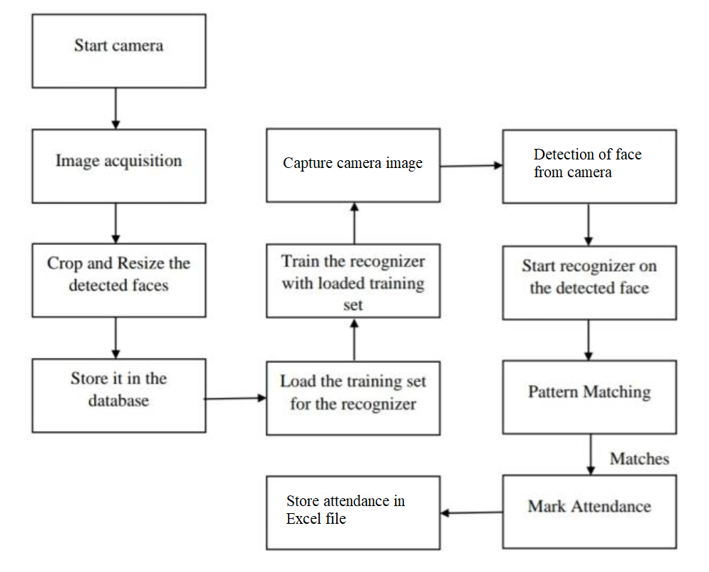
System Architecture

Slide 5
Methodology
This process can be divided into four stages
Dataset Creation
Face Detection
Face Recognition
Attendance Marking

Slide 6
Dataset Creation
A good quality camera is used to capture images of students.
Multiple images of each student will be taken with different angles.
These images go through a pre-processing process.
The images are cropped to focus on the Region of Interest (ROI) which will be used in the recognition process.
The cropped images are resized to a specific pixel position.
The images are converted from RGB to grayscale.
The images are saved in a folder name dataset with the student’s ID.

Slide 7
Face Detection
Face detection here is performed using Haar-Cascade Classifier with OpenCV.
Haar Cascade algorithm needs to be trained to detect human faces before it can be used for face detection.
This is called feature extraction.
The haar cascade training data used is an xml file haarcascade_frontalface_default. The haar features shown below figure in will be used for feature extraction.

Slide 8
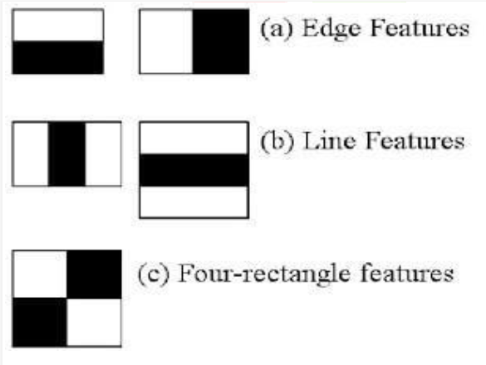
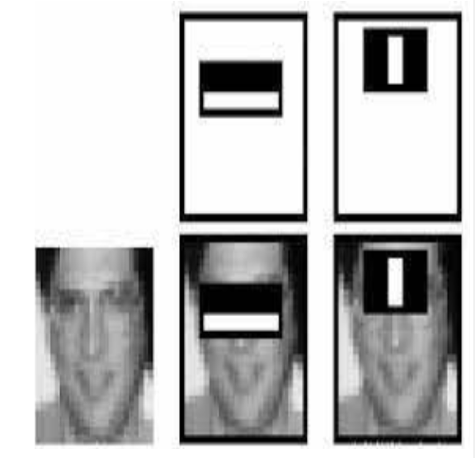
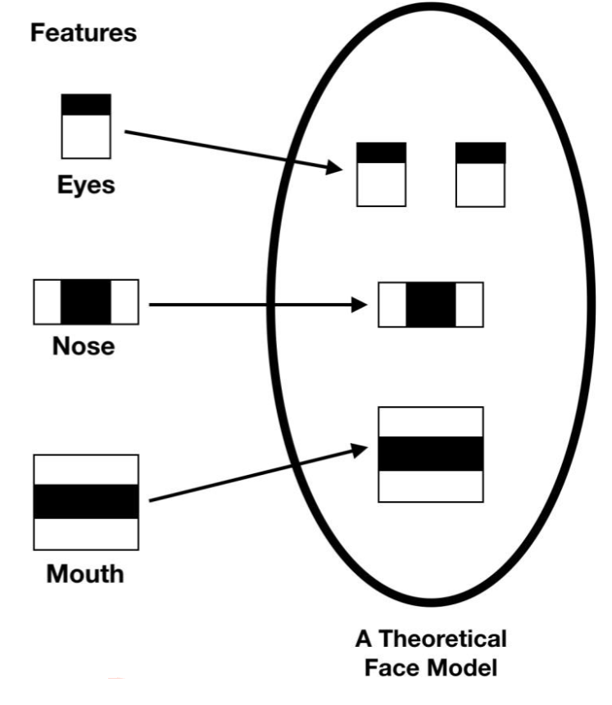
HAAR Classifier
Haar features are used to detect features in an image and are like convolutional kernels.
There are different types of Haar features, such as line feature, edge feature, and four-rectangle feature.

Slide 9
HAAR Classifier
Each feature is represented by a single value, which is calculated by subtracting the sum of pixels under the white rectangle from the sum of pixels under the black rectangle.
The Haar cascade algorithm uses 24x24 windows, which results in calculating over 160000 features in a window.
One of the key advantages of the HAAR classifier is that it is relatively fast and efficient, making it well-suited for real-time face recognition applications.

Slide 10
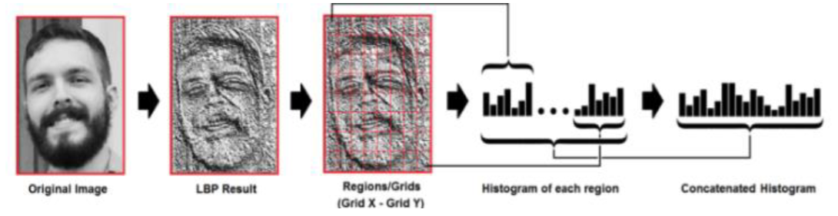
Face Recognition
Face recognition process involves: preparing training data, training the face recognizer and prediction.
The training data is images from a dataset, Each image labeled with the student belongs to.
The face recognizer used is Local Binary Pattern Histogram (LBPH), which converts images into histograms for comparison during recognition process.
During recognition, the histogram of the face to be recognized is compared with the previously computed histograms to determine the best match and returns the label associated with the student it belongs to.

Slide 11
Attendance Marking
Attendance marking is the final step of the system's procedures where the attendance of the student is recorded.
It happens after the overall development, which includes facial recognition process is completed.
Faces recognized by the system are marked as "present" in an excel sheet.

Slide 12
Conclusion
In conclusion, this system aims to develop an efficient class attendance system using face recognition techniques.
The proposed system utilizes a camera to detect faces and then recognize them. After recognition, it will mark the attendance of the recognized student and update the attendance record.
This system will help in automating the process of taking attendance and reducing the time and effort required to maintain attendance records manually.

Slide 13
REFERENCES
https://www.cs.cmu.edu/~efros/courses/LBMV07/Papers/viola-cvpr-01.pdf
https://www.ijert.org/research/attendance-management-system-using-face-recognition-IJERTV10IS080085.pdf
https://www.researchgate.net/publication/326261079_Face_detection_system_for_attendance_of_class’_students
https://becominghuman.ai/face-detection-using-opencv-with-haar-cascade-classifiers-941dbb25177
https://www.superdatascience.com/blogs/opencv-face-recognition

