Slide 1

CSE-402
System Analysis and Design Sessional
Notes:
NOTE:
To change the image on this slide, select the picture and delete it. Then click the Pictures icon in the placeholder to insert your own image.

Slide 2
GROUP 10
Maj Mahboobur Rahman
ID-201514001
Md. Ahasanul Alam
ID-201514033
Md. Masruk Aulia
ID-201514041
Akil Jawad
ID-201514057
Md. Mahmudul Hasan
ID-201414054
S. M. Mahmud Hasan
ID-201514141

Slide 3
Mist medical center management system

Slide 4
Data flow diagram(dfd)

Slide 5
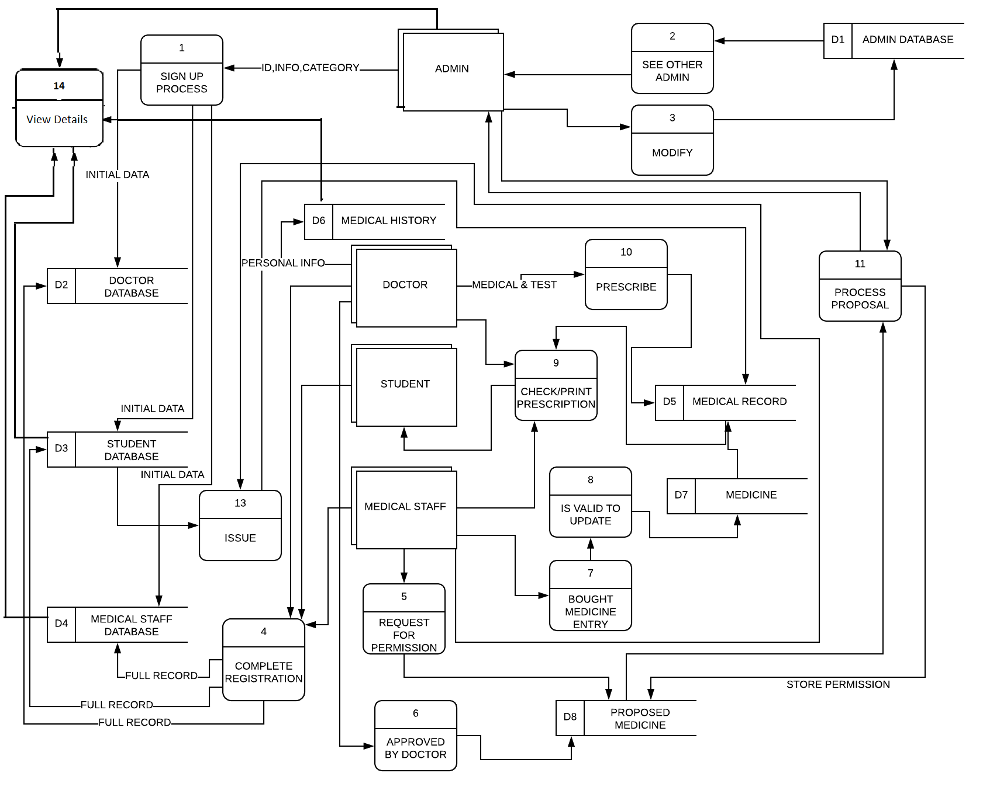

Slide 6
Class diagram

Slide 7
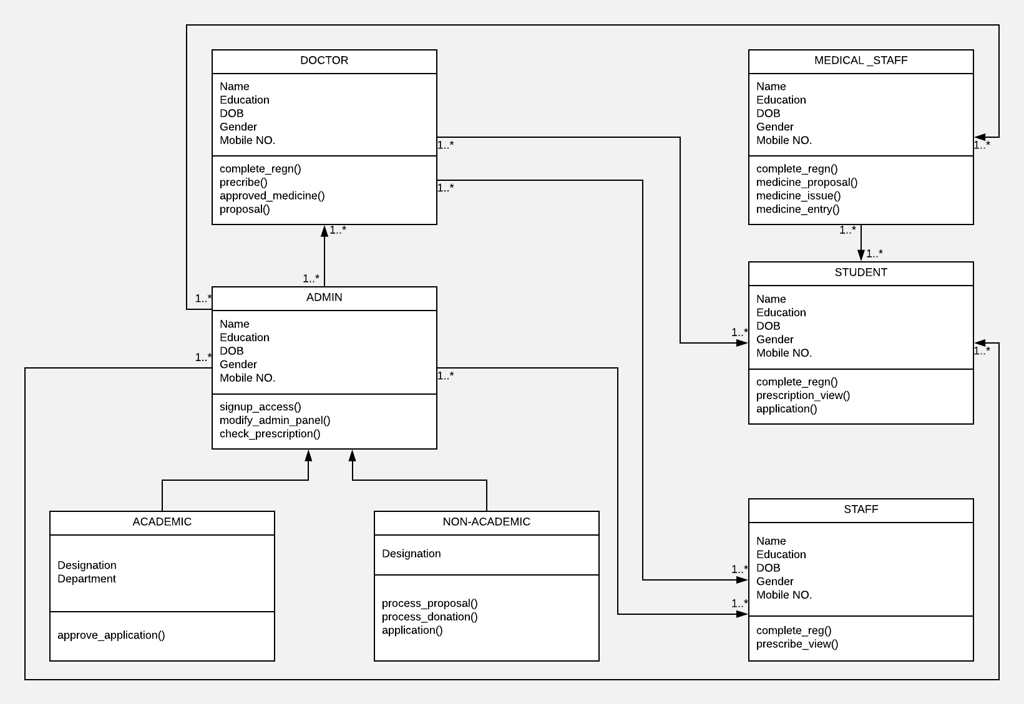

Slide 8
Use case diagram

Slide 9
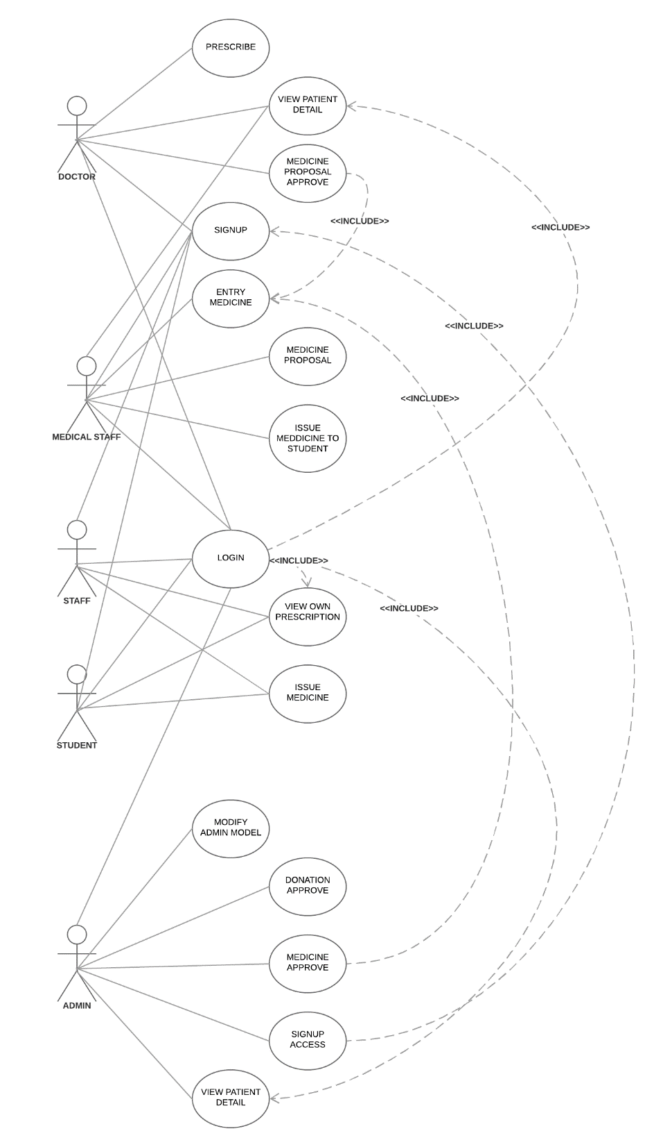

Slide 10


