Slide 1
INHERITANCE

Slide 2
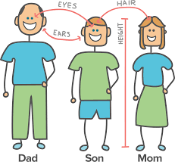

Slide 3
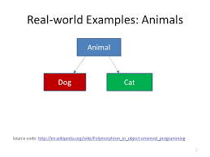
In Simple words, Inheritance is the ability to acquire properties from someone else.
In Programming we say, Getting properties from another class.

Slide 4
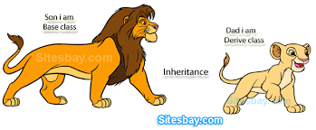
The Existing class is called the Base class or Super class and the new class is called the Derived class or Sub class.

Slide 5
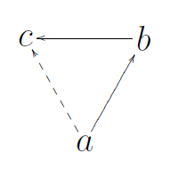
Advantages of Inheritance
Reusability
Reduced Size
Transitivity
Eg. Transitivity

Slide 6
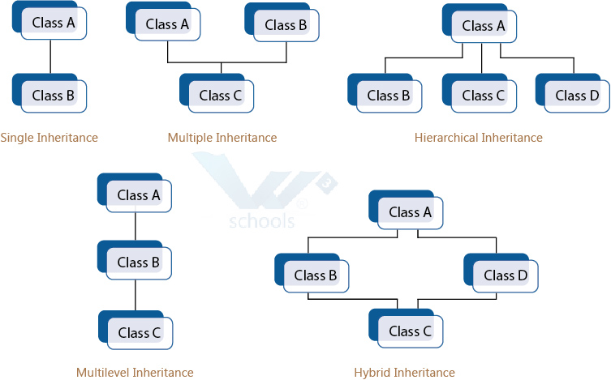
Types of Inheritance

Slide 7
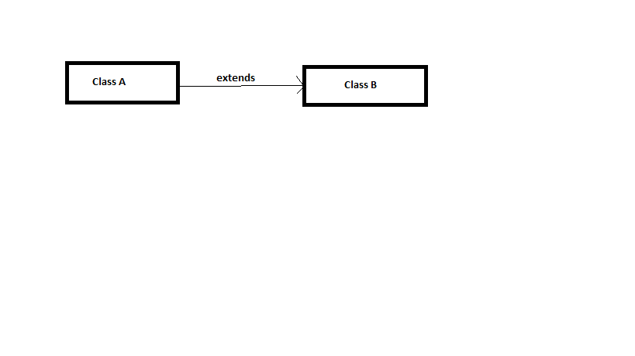
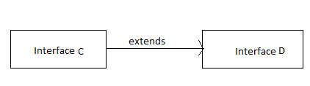
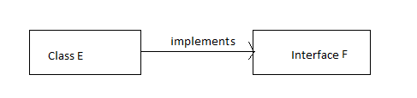
Inheritance in Java
Class to Class
Interface to Interface
Interface to Class

Slide 8
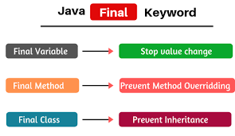
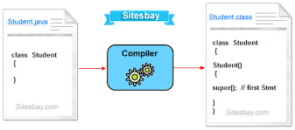
Super and Final Keyword

Slide 9
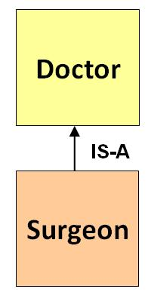
IS-A Relationship

Slide 10
Thank You

