Slide 1
INHERITANCE

Slide 2
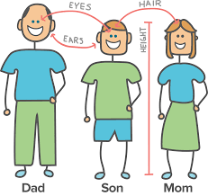

Slide 3
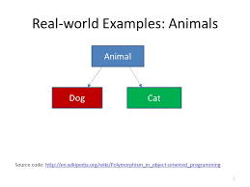
In Simple words, Inheritance is the ability to acquire properties from someone else.
In Programming we say, Getting properties from another class.

Slide 4
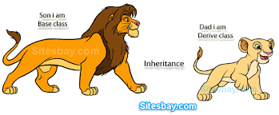
The Existing class is called the Base class or Super class and the new class is called the Derived class or Sub class.

Slide 5
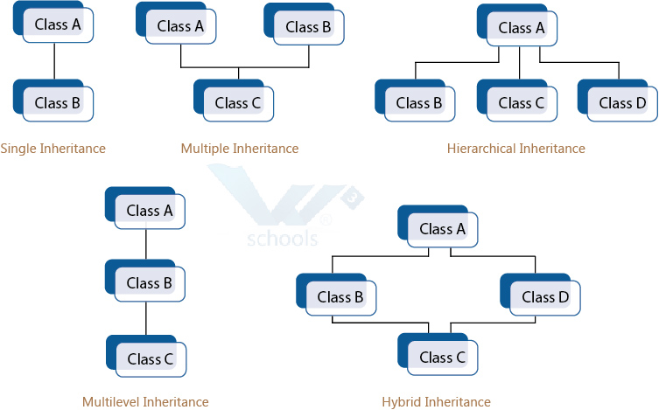
Types of Inheritance

Slide 6
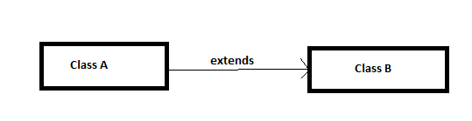
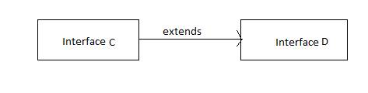
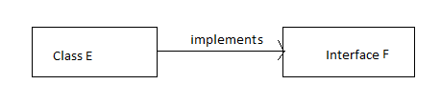
Inheritance in Java
Class to Class
Interface to Interface
Interface to Class

Slide 7
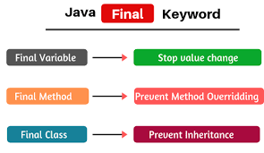
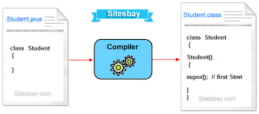
Super and Final keywords
super keyword is a reference variable that is used to refer to parent class object
final keyword is used to prohibit the inheritance

Slide 8
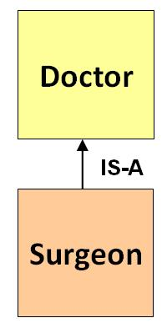
IS-A Relationship

Slide 9
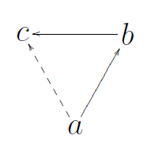
Advantages of Inheritance
Reusability
Reduced Size
Transitivity
Eg. Transitivity

Slide 10
Thank You

