Slide 1

PRESENTATION ON FILES in java

Slide 2
What is a file?

Slide 3
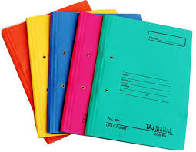

Files are used to store the data in the small quantity.

