Slide 1
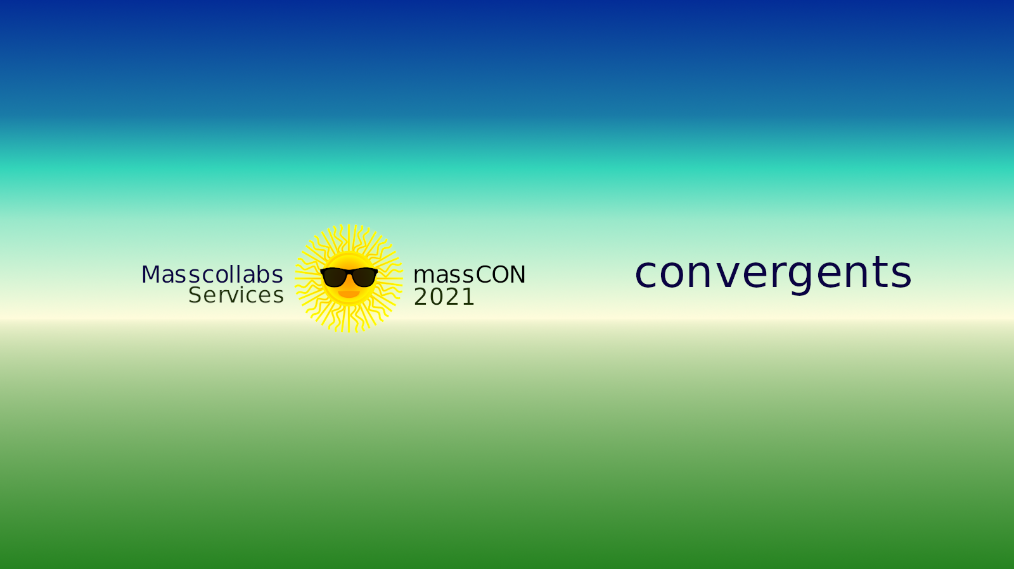
Convergents Maintainer Framework by
Masscollabs

Slide 2
Convergents Maintainer Framework by
Masscollabs
“Cloud” is our priority and we have to connect all devices over a “private” or “public” network.
While connecting all devices we need maintainers who will maintain the hardware and software
So we are building a project for Coreboot and Libreboot devices and for all devices “Free as in Freedom”. Which is licensed mainly for our services AGPLv3+ and other Copyleft and Permissive licenses will play together in the same framework.

Slide 3
Convergents Maintainer Framework by
Masscollabs
What we expect from this framework is to speed up the development and administration for the Internet Cyberspace.
And we will put this framework in each team and subteam for our projects. That is why we say it “cmf” “convergents” “convergents maintainer framework”

