Slide 1
Procyberian Systems Distribution
The last and up to date state of PSD
We are ready for contributions to the cyberspace and public. But we wait
for a couple of weeks to end up our alpha stage of general project process.
We can create an ISO for our PSD distribution and we will. But we want
to make a better opportunity for us and everyone. Like a better
framework and toolkit for data security, OS installation etc...
Thanks for being here and taking your part of this lovely adventure and
challange...
happy hacking !

Slide 2
Procyberian Systems Distribution
CC BY-SA 4.0 or later
by Mert Gör mertgor@procyberian.xyz
GPG Key ID : 0xD5A31B8B1A6F02BC

Slide 3
Procyberian Systems Distribution
Q&A
For your questions please join libera.chat server and #procyberian channel
Or to our Telegram group : https://t.me/procyberian_system_distribution

Slide 4
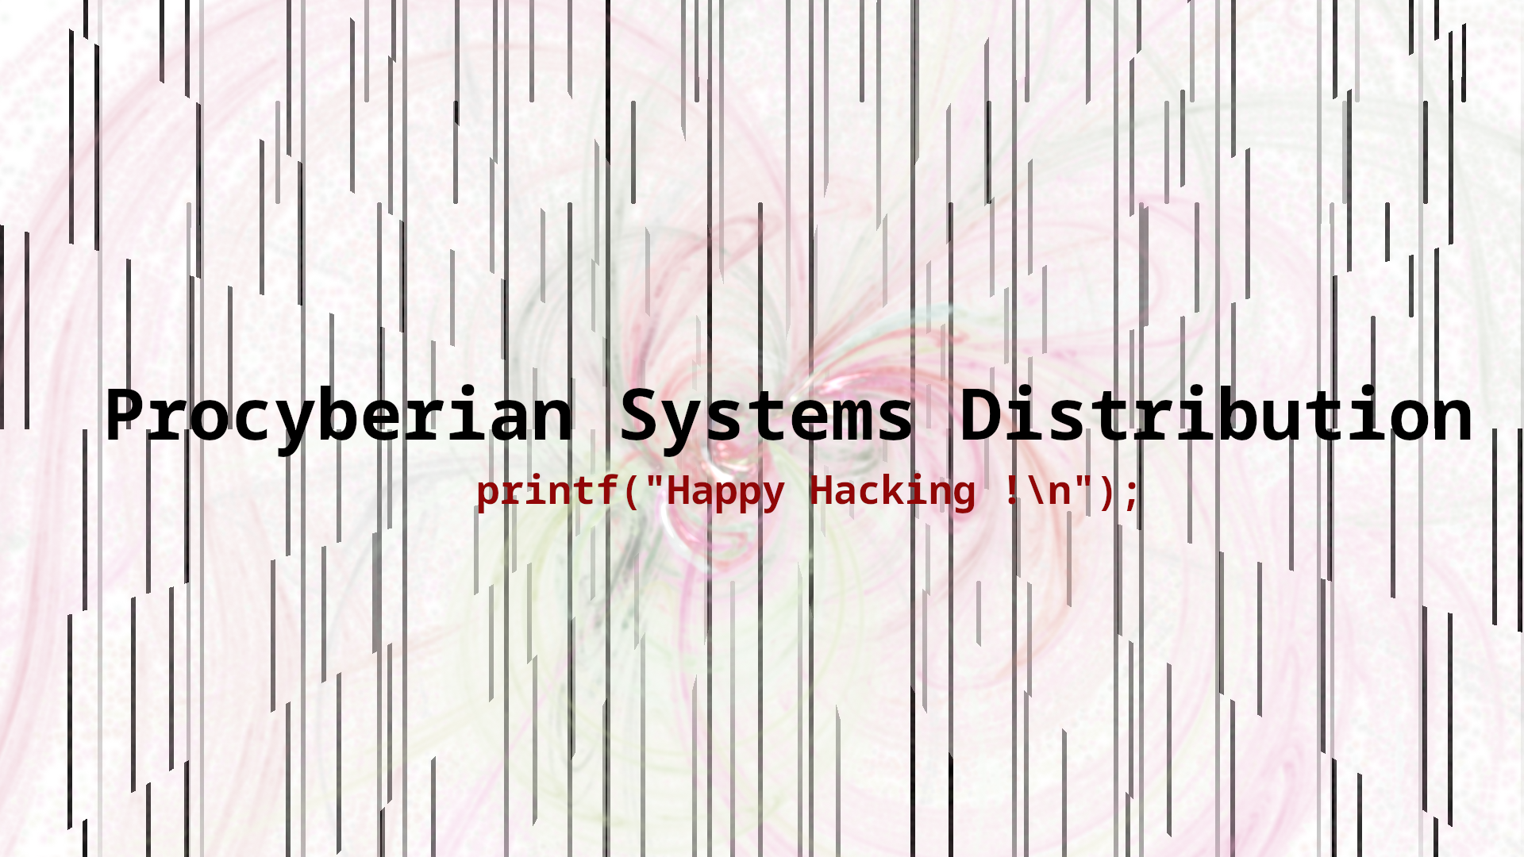
Procyberian Systems Distribution

