Slide 1
QB Networks & Masscollabs Services & PSD
How to empower a smart organization

Slide 2
QB Networks & Masscollabs Services & PSD
What we understand from hacker cultures
The way of source code
Why forking is a solution
Git enables the rapid development
Freedom respecting code hosting service software Forgejo

Slide 3
QB Networks & Masscollabs Services & PSD
BSD model with modifications like core team members for 24/7 active contributions committers almost same who have write permission and contributors are newbies
GNU,Linux and other cultures the decentralized development combined with BSD and centralized development model
The birth of PSD is not the death of others … on the contrary we support all systems

Slide 4
QB Networks & Masscollabs Services & PSD
PSD is not an OS or kernel only project. A complete solution for all kinds of needs with replaced Free Software which respects users freedom
PSD is a new hacker culture
PSD is holded by its members

Slide 5
QB Networks & Masscollabs Services & PSD
CC BY-SA 4.0 or later
By Mert Gör : mertgor@qbnetworks.xyz
GPG Key ID: 0xD200B456637BC4F3

Slide 6
QB Networks & Masscollabs Services & PSD
Telegram Group : https://t.me/masscollabs
libera.chat IRC Channel : #masscollabs

Slide 7
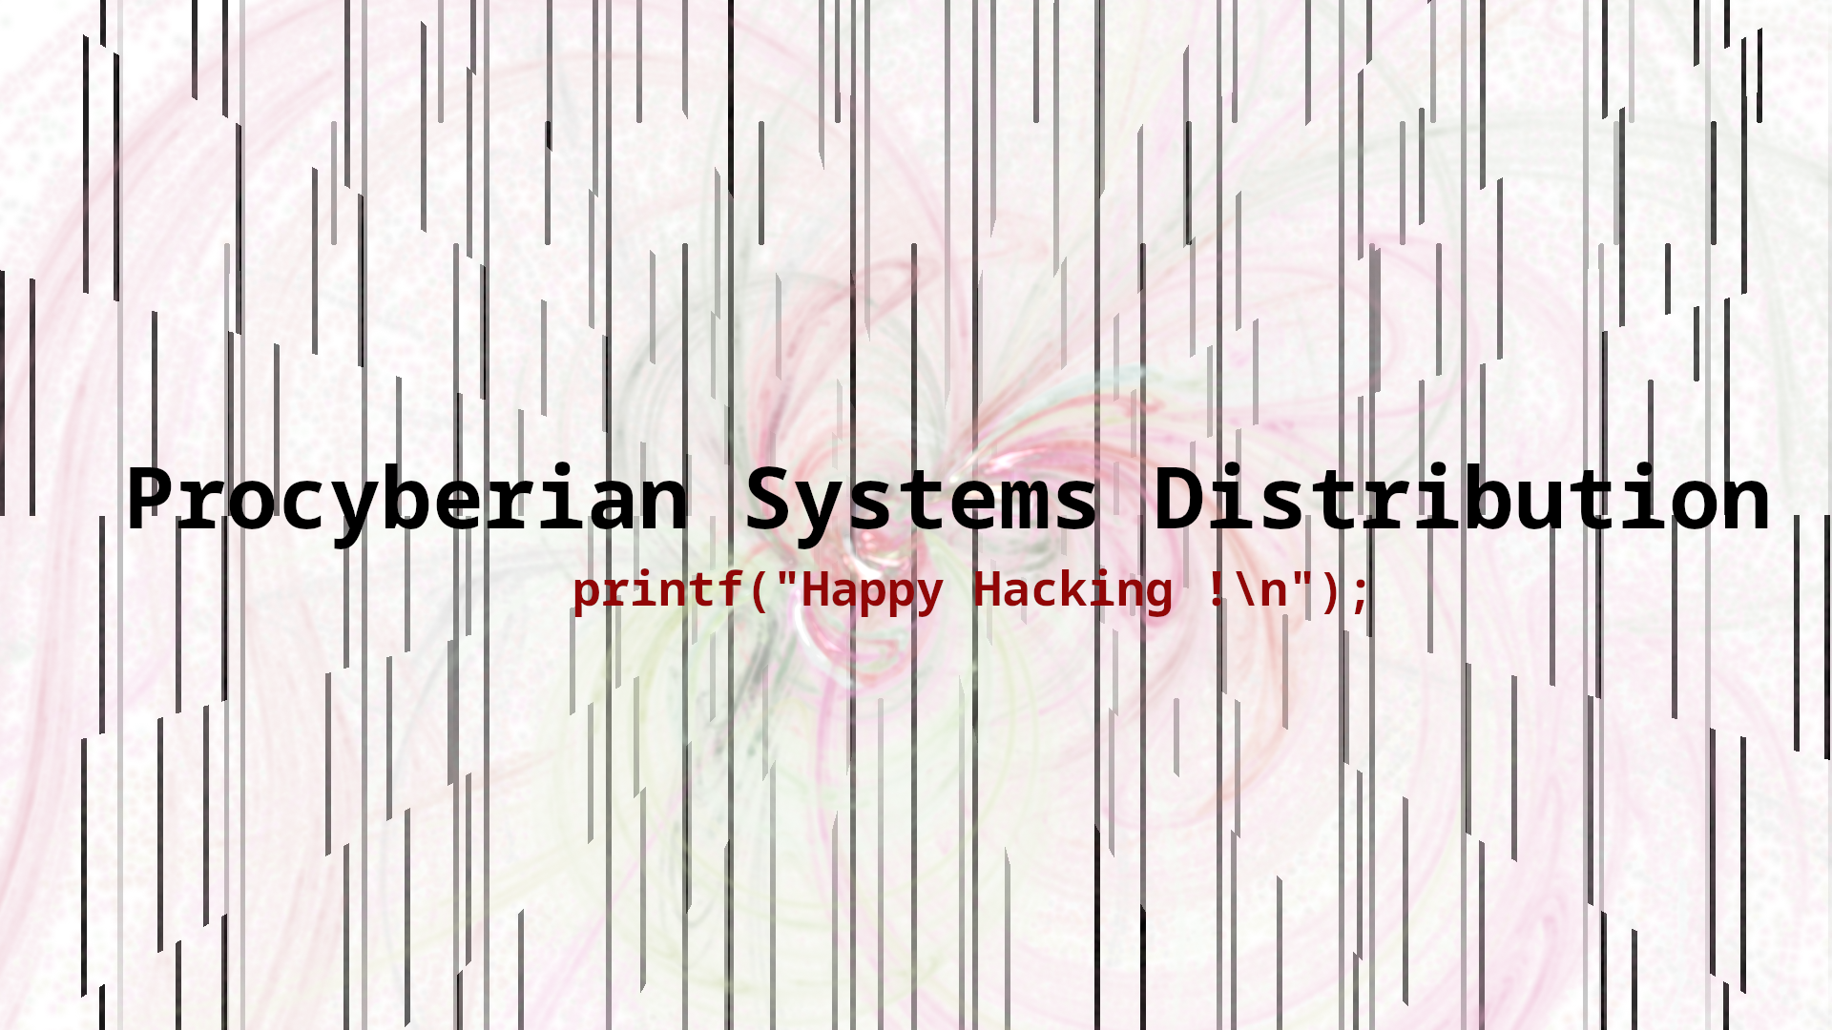
QB Networks & Masscollabs Services & PSD

