Slide 1
PSD
Welcome to Next Generation of the UNIX OS family
A fully convergent, intagrated and completed Free Software

Slide 2
PSD
Converging teams
Converging software over hardware
Socializing for commercial applications
Subscription model as a business model(next page)

Slide 3
PSD
Training
Development
Software test including Security test
Research and Development

Slide 4
PSD
CC BY-SA 4.0 or later
mertgor@procyberian.xyz
GPG Key ID: 0xD5A31B8B1A6F02BC

Slide 5
PSD
For your questions please visit libera.chat server #procyberian channel
Or https://t.me/procyberian_system_distribution

Slide 6
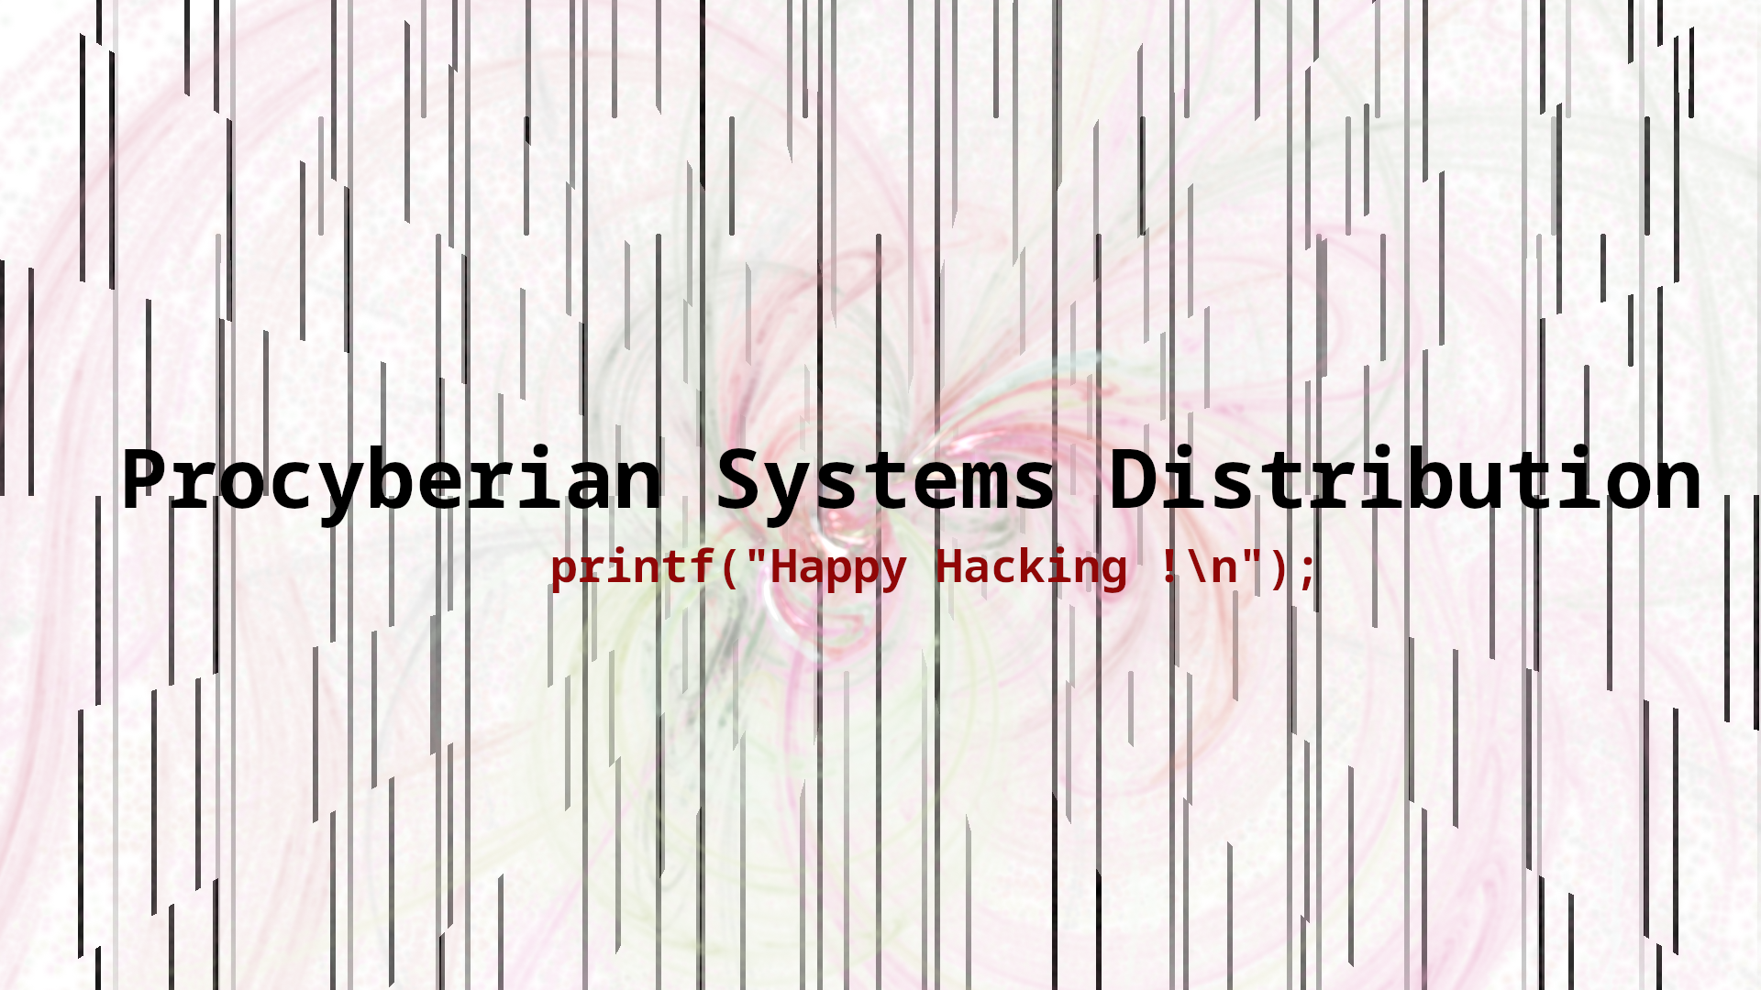
PSD

