Slide 1
QB Networks & Masscollabs Services
Challenge Everything !

Slide 2
QB Networks & Masscollabs Services
Building the core team
System, Network and Database administrators(in short admins)
Developers(software engineers in general but focused on Systems Programmers)
Security Researchers(penetration tester, reverse engineering)
Artists(For who use software for their art works)
Scientists(academicians)
Translators(for communication and documentation)
Lawyers(for licensing and other issues)

Slide 3
QB Networks & Masscollabs Services
How we work together
We have a collective approach for teamwork. All members work together three hours in a day collectively.
Then they have free time for their other research for our community and other communities or their personal skills.
Every Week we contribute to Free Software Directory

Slide 4
QB Networks & Masscollabs Services
How we work together
Procyberian Systems Distribution
We are coding a fully Free Software Operating System called PSD(Procyberian Systems Distribution) which is based on Debian GNU/Linux.
We are a community for other communities and we are a company for other companies. This is our culture and motto.
We contribute to Public and also contribute back to Debian. For our devices and software we never hide any piece of information from Public and Debian Community.

Slide 5
QB Networks & Masscollabs Services
CC BY-SA 4.0 or later
By Mert Gör : mertgor@qbnetworks.xyz
GPG Key ID: 0xD200B456637BC4F3

Slide 6
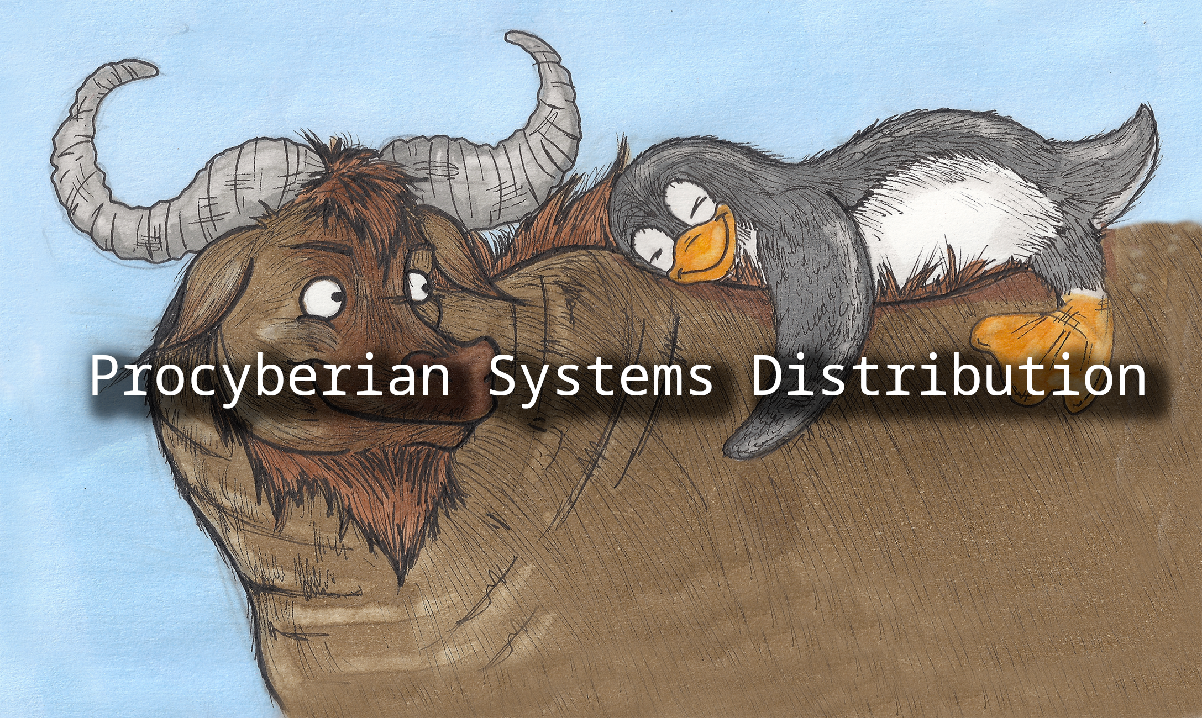
QB Networks & Masscollabs Services

Slide 7
QB Networks & Masscollabs Services
Q&A
Telegram Group : https://t.me/masscollabs
libera.chat IRC Channel : #masscollabs

Slide 8
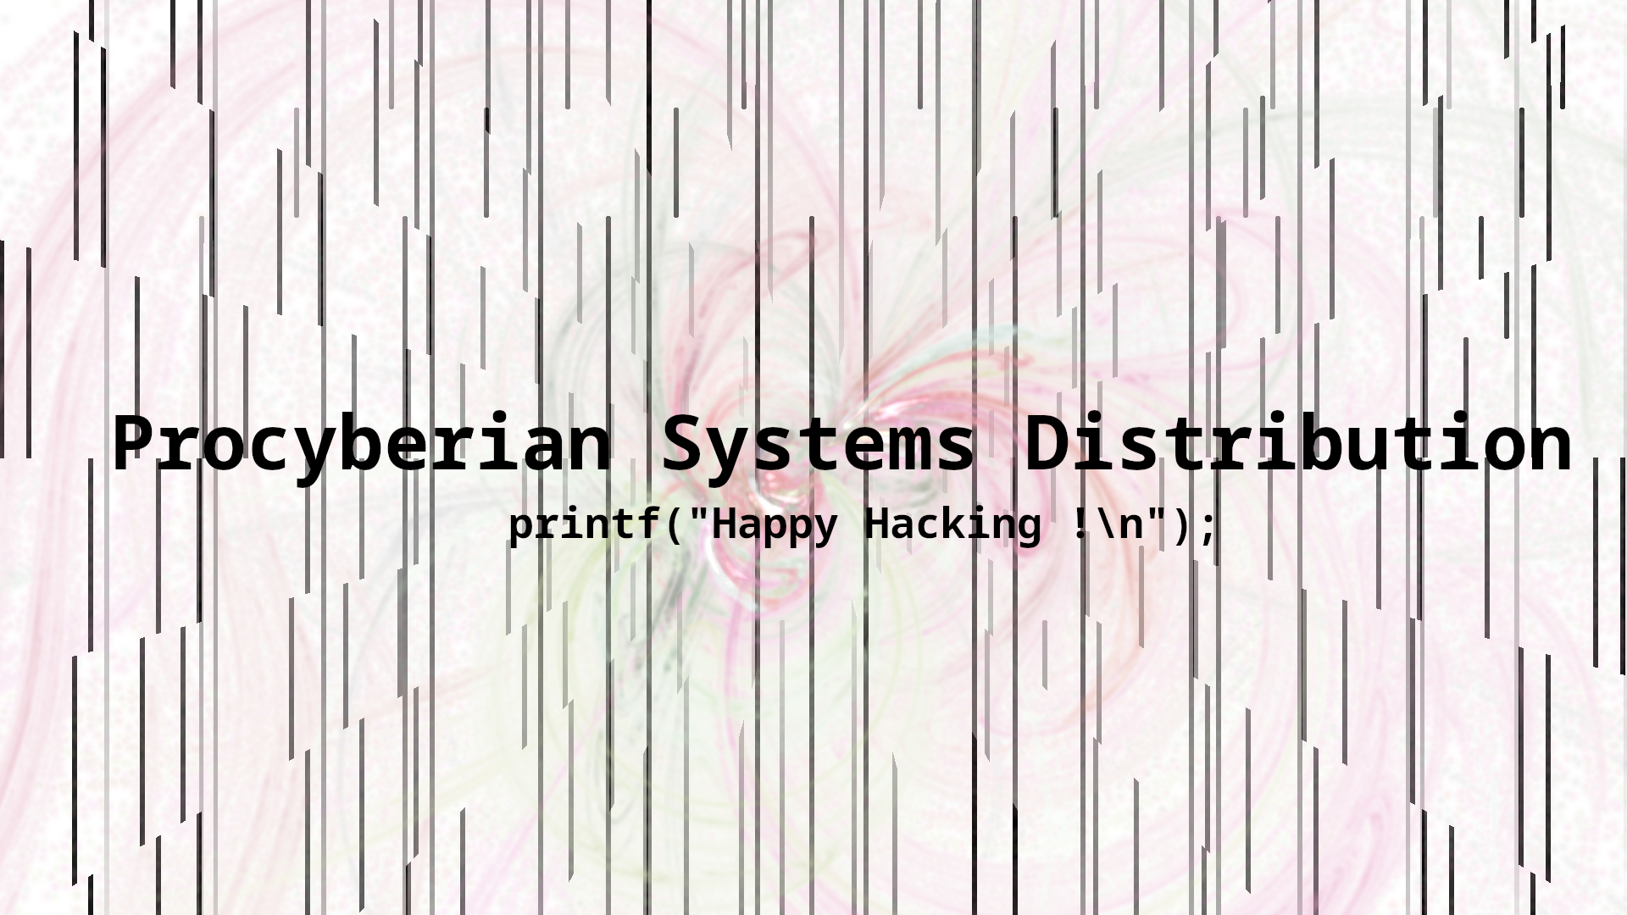
QB Networks & Masscollabs Services

