Slide 1
QB Networks
… freedom needs responsibility ...

Slide 2
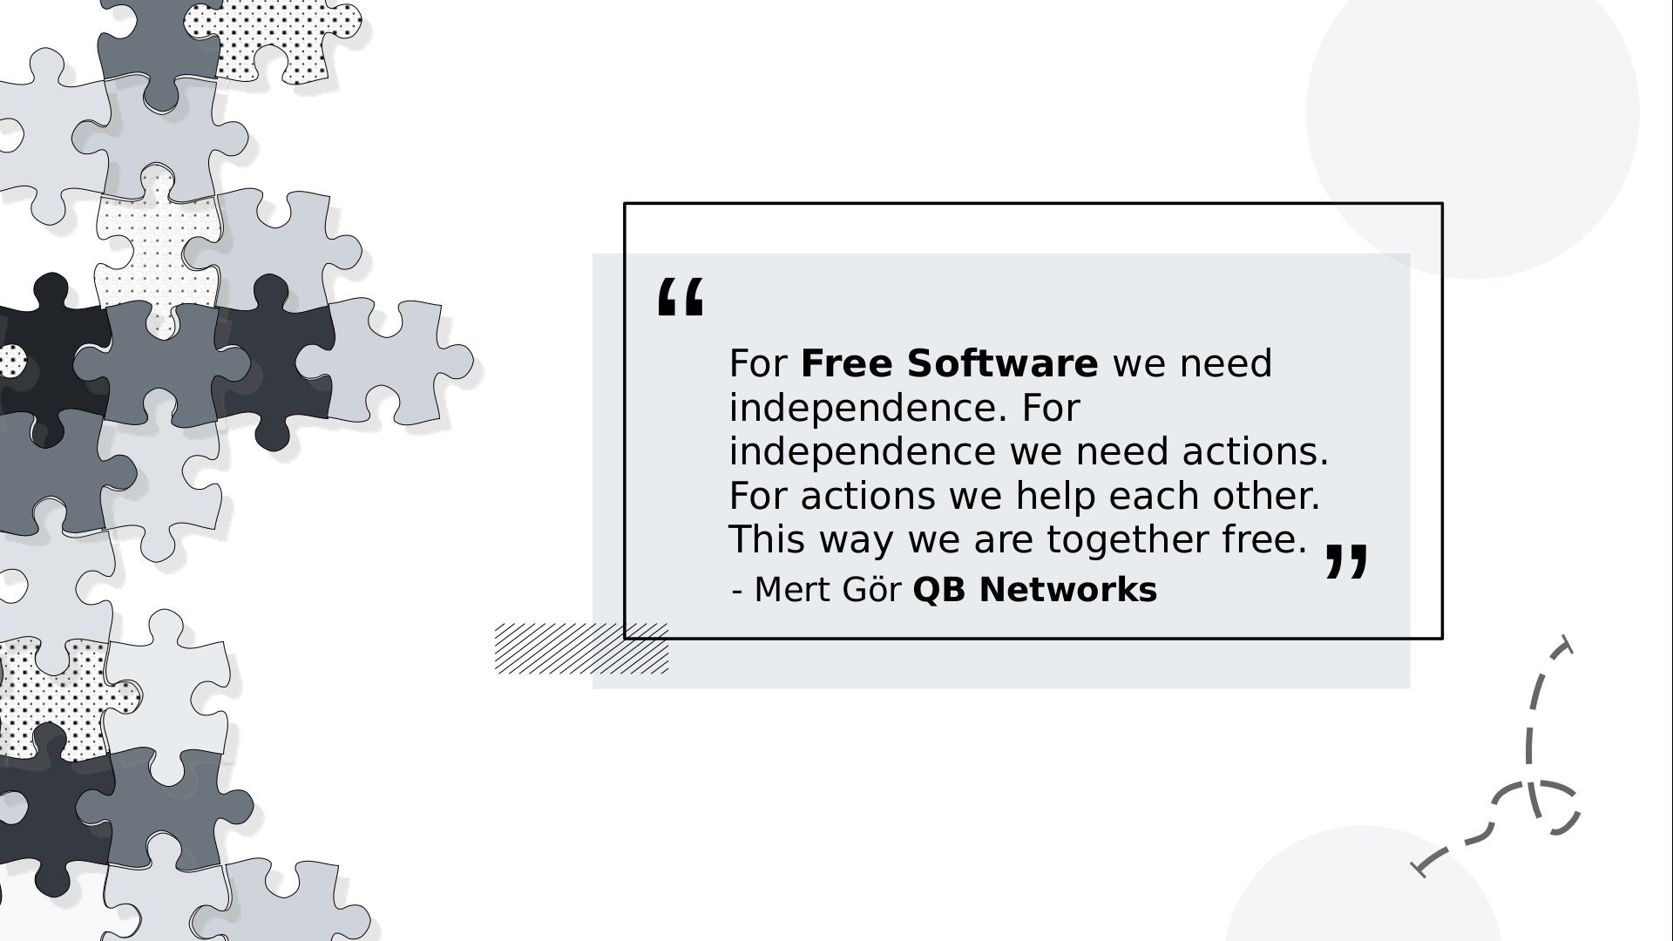
QB Networks

Slide 3
QB Networks Q&A
Email to : mertgor@qbnetworks.xyz
GPG Key ID : 0xCD9E83BD9F84F0AB
This document is licensed under the terms of CC BY-SA 4.0 or later license

