Slide 1
PSD
Only One GNU is “Free”

Slide 2
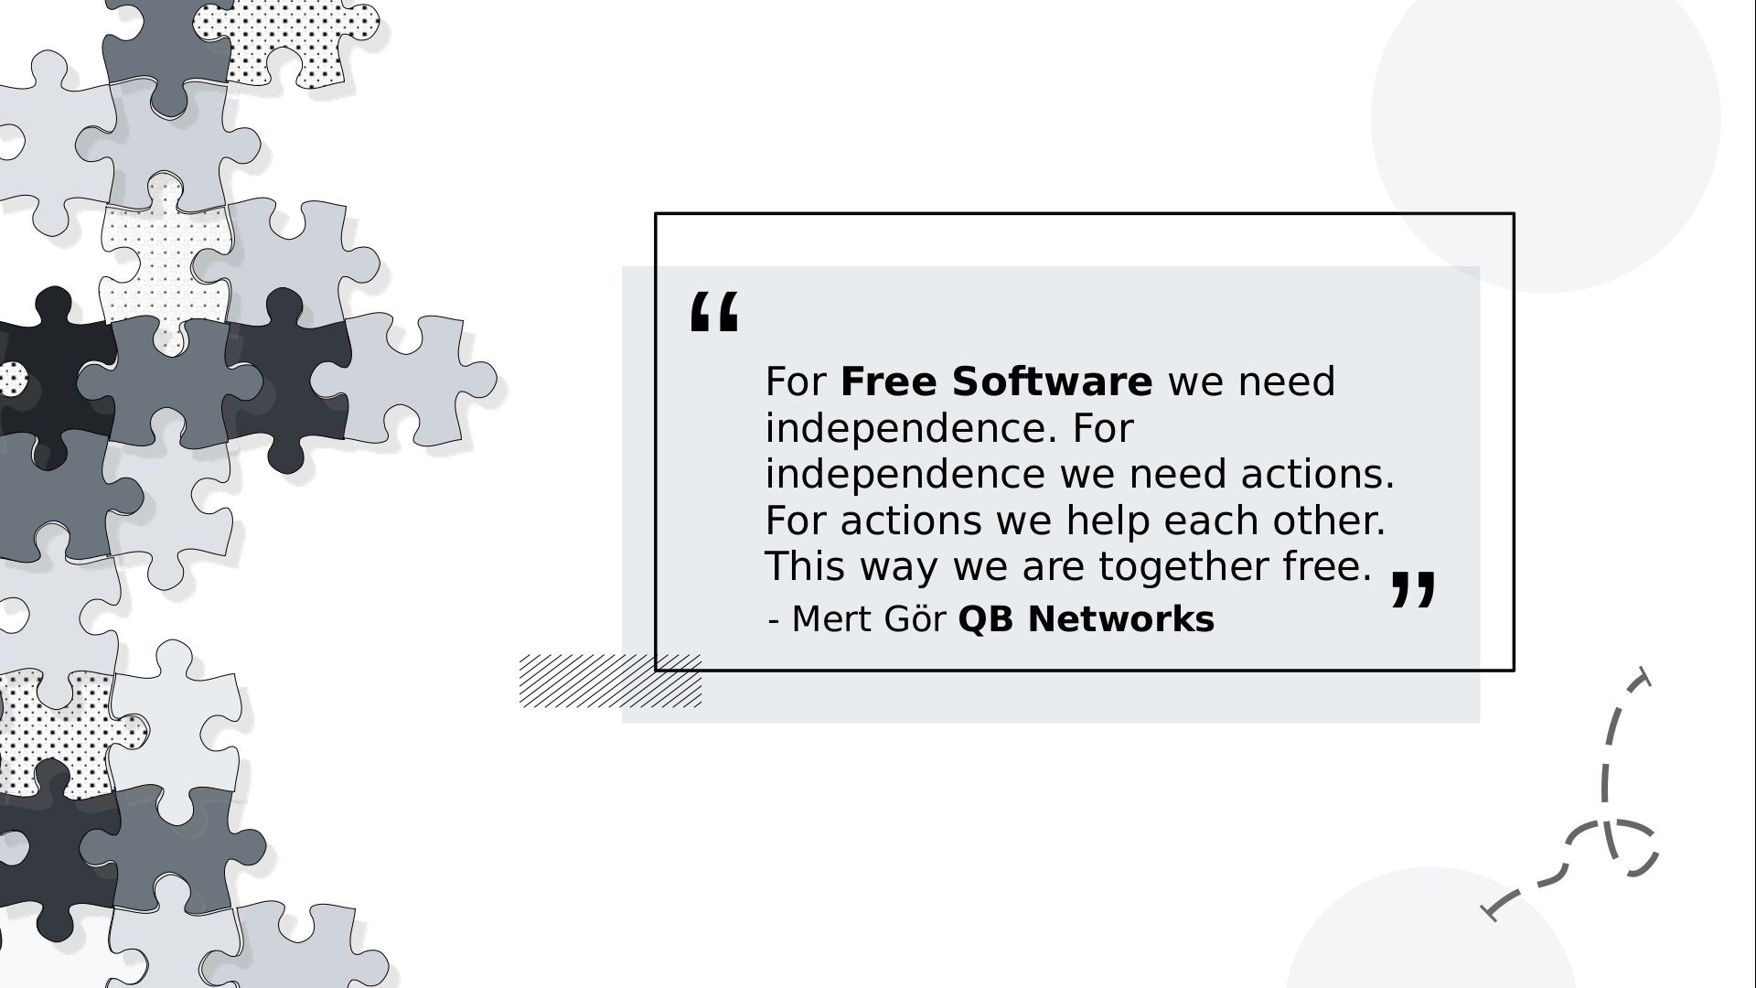
What we understand from Free Software ?

Slide 3
Q&A
E-mail : mert.gor@dynacore.tr
GPG Key ID : 0x000E76AAF4D30D58
Phone : +905538364618
This document is licensed under the terms of CC BY-SA 4.0 or later license

