Slide 1
Running Klarna mats cronqvist
How to run a multi-million dollar business on one server.
With boring anecdotes!

Slide 2
This talk
Famous Polish People.
The company.
The system.
The HW.
The architecture.
The DB.
The SW development process.
Operations.

Slide 3
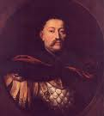
Sobieski
Fought a bunch of Turkish people, 1683.

Slide 4

Tomaszewski
Saved a penalty against Sweden, 1974.

Slide 5

Siemiatkowski
Founded Klarna (Kreditor), 2004.

Slide 6
Business idea
A wants to buy stuff from B
A and B does not trust each other
They need a middleman, K
K guarantees that B will be paid
K must be able to detect if A is a fraudster
On the Internet, this means real time (< 10 s)

Slide 7
Trust
What makes Klarna trust people?
  Previous business dealings with us
    The more history, the more trust
  Previous contact with trusted sources
    They have dealt with some partner of ours
  They exist
    Most actual people pay their bills

Slide 8
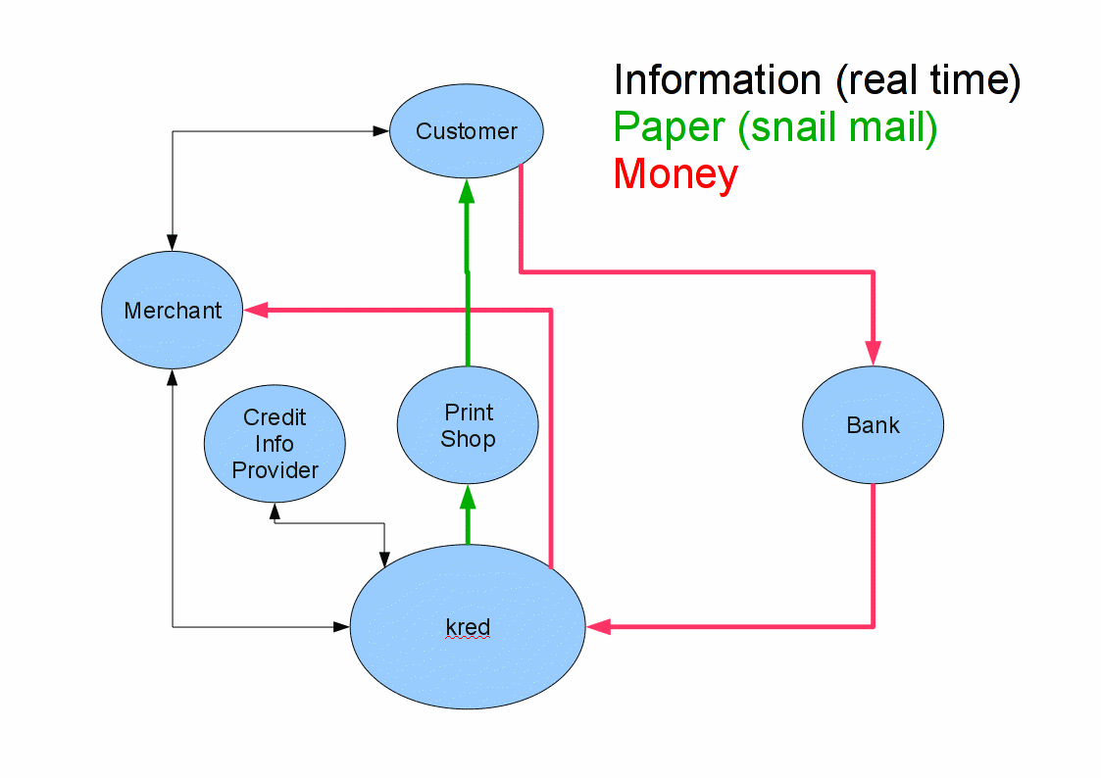
Flow of Stuff

Slide 9
Klarna <3 Erlang
The system is written in Erlang (200 Kloc)
  with smatterings of bash and C
Originally written by 4 old OTP guys
  (Bevemyr, Björklund, Grebenö and Wikström)
Now about 20 full time Erlang devs
  (including one mr Chrząszcz)
Support code in JavaScript, R, SQL...

Slide 10
The system (kred)
A distributed data base
  Mnesia with home made distribution
Services
  Transaction handler (real time)
  Risk quantification (real time)
  PDF generation (real time)
  GUI (real time)
  Dunning
  Bookkeeping

Slide 11
The Database

Slide 12
The Transaction Handler
XML-RPC
The essence of XML is this: the problem it solves is not hard, and it does not solve the problem well.
Phil Wadler, POPL 2003
http://homepages.inf.ed.ac.uk/wadler/papers/xml-essence/

Slide 13
PDF Generation
PDF's are generated in real time by code
Pro
  Real time
Con
  Real ugly...

Slide 14
Risk Quantification
Get risk and credit information
  Previous dealings
  Locally stored sourced data
  Credit information providers
  Address information providers
Process info with a Domain Specific Language
  Allow risk experts to implement risk and credit logic
  Same for fraud detection

Slide 15
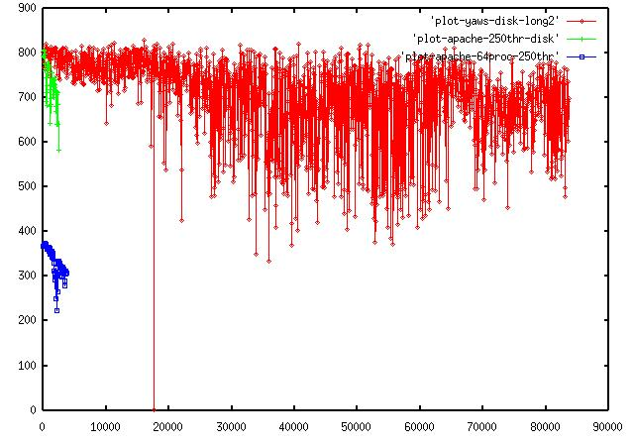
GUI pt.1
Web server is yaws (https://github.com/klacke/yaws)

Slide 16
GUI pt.2
Yaws ships dynamically generated HTML
The HTML is generated by Erlang code
  Old-fashioned...
  Ugly...
  Inflexible...
A move to REST/AJAX is in the pipeline
  Don't hold your breath...

Slide 17
Dunning and Bookkeping
Bookkeeping is the recording of financial transactions. Transactions include sales, purchases, income, and payments by an individual or organization. (wikipedia)
Dunning is the process of methodically communicating with customers to insure the collection of accounts receivable. It follows the process that progresses from gentle reminders to almost threatening letters as accounts become more past due. (wikipedia)
Done in a batch job run every night
Too boring to spend more time on

Slide 18
HW
Fabian-graph

Slide 19
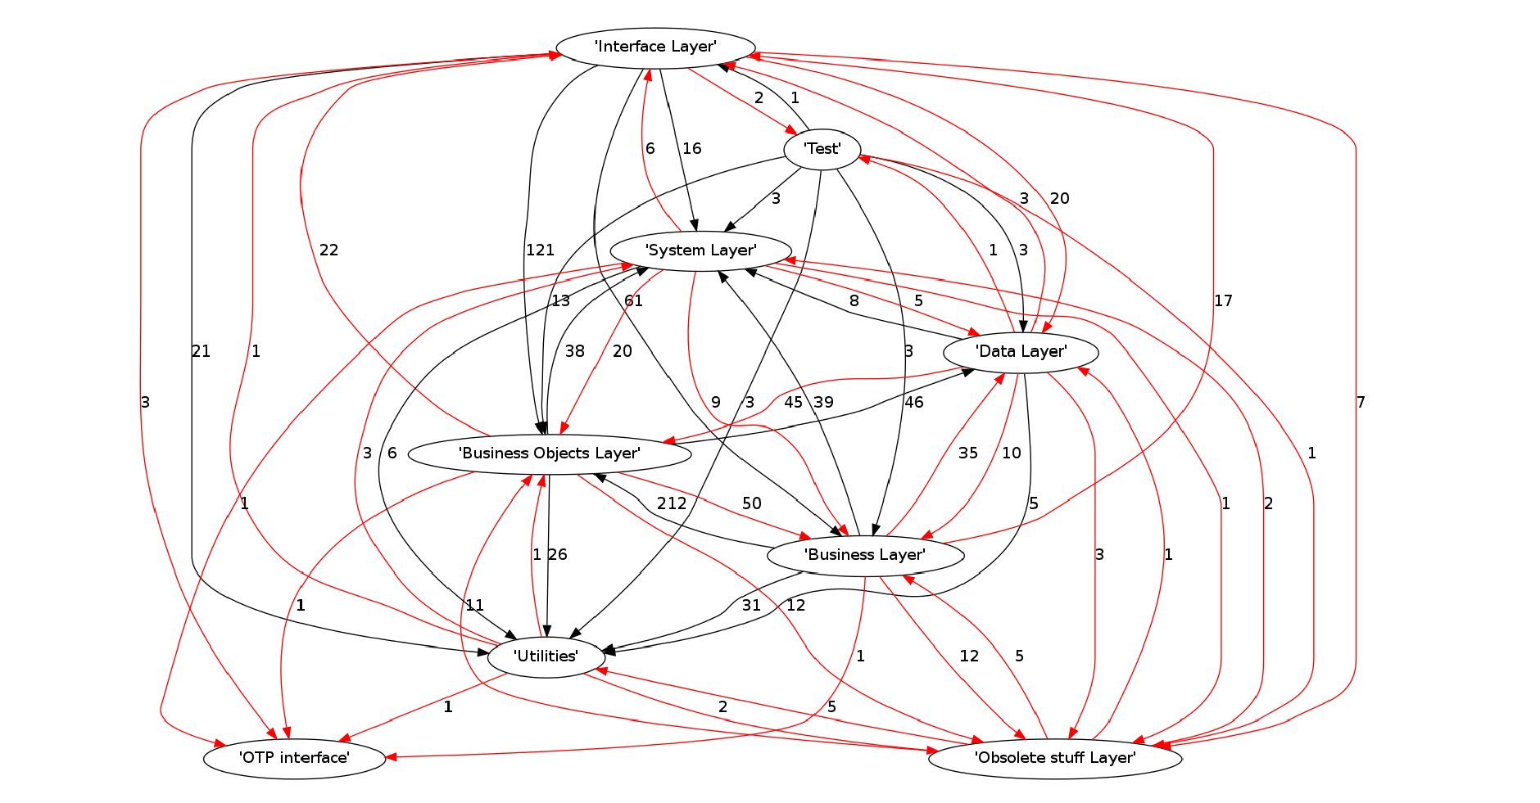
SW Architecture

Slide 20
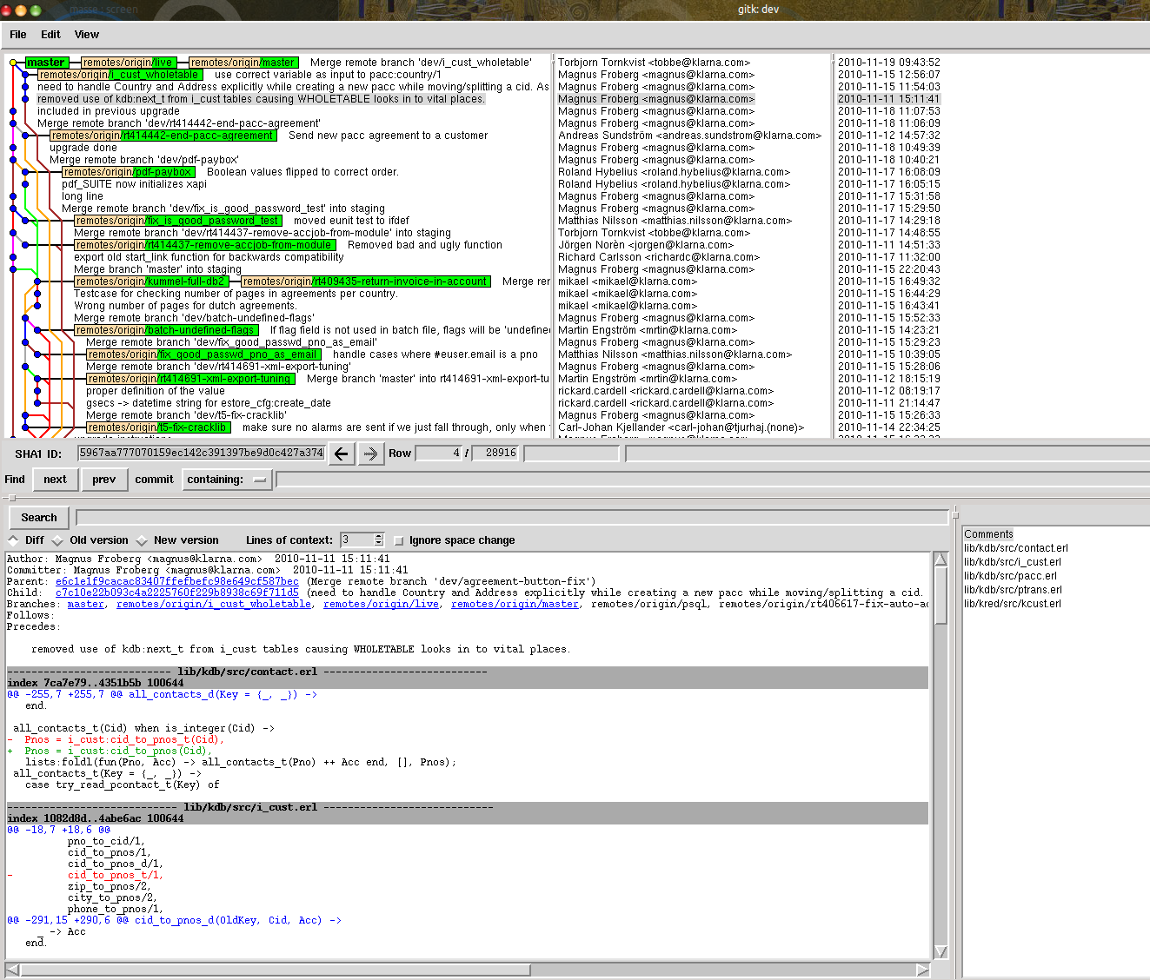
Development process
We use git.
  Awesome.

Slide 21
Operations
The goal is to know what the system is doing
  Right now...
  ...and in the near future
...and to discover problems...
...and solve them

Slide 22
Live monitoring
Live systems send UDP packages to office
Client
Live
Server
Fire-
wall
Monitor
Server
AJAX
Server
Client
Logfiles

Slide 23
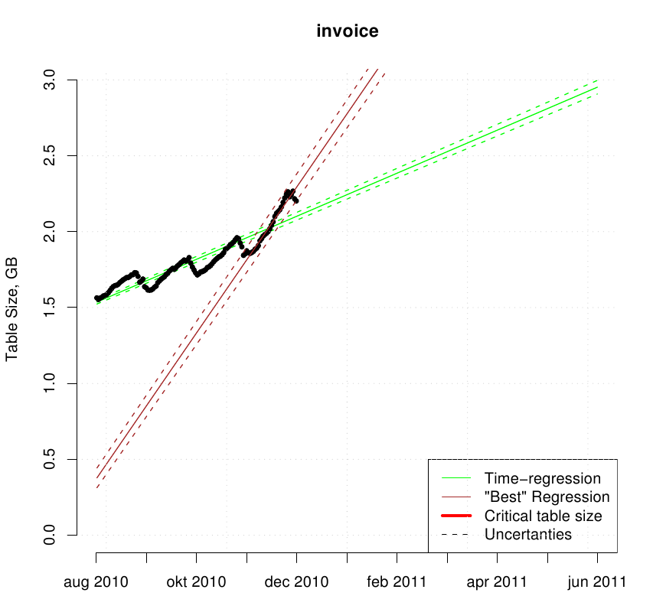
Prediction the future
Prediction of future table size

Slide 24
Masse goes to Denmark...
Embedded system running OTP R5.
Live in Denmark.
There was no way to log into the CPU.
There was no way to load new code.
There was no usable application debugging tool.
You could physically connect a terminal.
The node got overloaded after 90 days.
A tech traveled there and rebooted every 90 days.

Slide 25
...virtually...
Wrote a one-liner...
...that ran a one-minute trace and wrote to a file.
Sent it to the Danish tech by mail...
...who ran it by pasting it into a shell...
...before and after the reboot...
...and emailed the files to me (base-64 encoded)

Slide 26
...tracing saves the day!
Wrote a comparison profiler.
Compare the average execution time for each function, before and after the reboot.
ets:lookup/2
was 100 times slower before the reboot.

Slide 27
42
The hash function was broken for bignums.

