Slide 1


Efficient and Fair Multi-programming in GPUs via Effective Bandwidth Management
Haonan Wang, Fan Luo, Mohamed Ibrahim
(College of William and Mary), Onur Kayiran (AMD),
Adwait Jog (College of William and Mary)
Notes:
Hi, my name is Mohamed Assem Ibrahim. Today, I will present our work “Efficient and Fair Multi-programming in GPUs via Effective Bandwidth Management”. This work was jointly performed with my advisor and colleagues at The Collage of William and Mary and our collaborators at AMD.

Slide 2



Single-Application Execution on GPUs
GPU
Kernel-1 (K1)
Core 1
Core N
C
C
C
C
C
C
Underutilized
On-Chip Network
DRAM
DRAM
DRAM
Single Kernel Execution
Notes:
GPUs are a crucial part of most computing systems as they provide orders of magnitude faster and energy-efficient execution for many general-purpose applications. With each new generation of GPUs, number of cores, as well as peak memory bandwidth and throughput are growing at a steady pace.
Running a single kernel can lead to underutilization of resources on GPUs.

Slide 3
Multi-Application Execution on GPUs
GPU
K1
K2
KX
Core 1
Core N
C
C
C
C
C
C
On-Chip Network
DRAM
DRAM
DRAM
Multiple Kernels Execution
Notes:
To keep these growing compute and memory resources highly utilized, GPU multi-programming was proposed as a solution.
The idea of co-locating two or more kernels (originating from the same or different applications) has been shown to be beneficial in terms of both GPU resource utilization and throughput.

Slide 4
Executive Summary
Multi-application execution on GPUs
Difficult management of BW resources in GPUs
Goal: Address the BW interference problem via Thread-level Parallelism (TLP) modulation
Contributions:
Observe that prior single-application TLP modulation schemes do not provide optimal throughput (WS) and fairness (FI) in a multi-application environment
Propose a new metric Effective Bandwidth (EB) to quantify the effects of TLP modulation
Design new application-aware TLP management techniques (PBS) for a better throughput/fairness
PBS improves Throughput (up to 20%) and Fairness (up to 2x) over using single-application TLP modulation schemes in a multi-application environment
Notes:
As a quick overview of our work, we investigate multi-application execution on GPUs. It can increase the resource utilization and overall throughput. Also, it enables sharing GPUs in the cloud. However, it is difficult to efficiently manage the shared BW resources in such environment.
Our goal is to address the BW interference problem using Thread-level Parallelism modulation.
Our contribution is three-fold. First, we studied the prior single-application TLP modulation schemes in a multi-application environment, and found that they don’t provide optimal system throughput and fairness. Second, we propose Effective Bandwidth (EB), a new metric to understand performance in single- and multi-application execution context. Finally, we develop a new application-aware scheme, PBS, that utilizes EB to achieve better throughput and fairness.
PBS improves system throughput up to 20% and achieves up to 2x fairness compared to using single-application TLP modulation schemes in a multi-application environment.

Slide 5
Outline
Introduction
Motivation
Effective Bandwidth Metric
Pattern-based Searching Schemes
Evaluation
Conclusion
Notes:
This is our talk outline. We start by a quick introduction and motivation. Then, we discuss our proposed metric, Effective Bandwidth. After that, we present our EB-based searching schemes to find the optimal system throughput and fairness. Finally, we evaluate our schemes and conclude our work.

Slide 6

Managing TLP for Single-Application
Thread-level Parallelism
TLP
Number of Wavefronts/Warps
Change
Cache Hit/Miss Behavior
Cache
DRAM Bandwidth Behavior
DRAM
Notes:
TLP can be used as a knob to manage resources utilization. We start by showing how TLP modulation can be used in a single-application scenario.
As we see in the figure, TLP directly affects the number of wavefronts running, which affects the number of concurrent threads.
As a result, it affects the cache behavior in terms of hit and miss requests.
TLP also affect the DRAM BW behavior.
Now if we increase the TLP value, then we can see a change in both the cache and BW behavior.

Slide 7
Managing TLP for Single-Application
A single application is executed with
bestTLP | the best-performing TLP configuration
maxTLP | the maximum possible value of TLP
bestTLP
maxTLP
Notes:
For example, this figure shows how changing the TLP can affect the performance of an application. On the x-axis is the different TLP values, and on the y-axis in the normalized IPC.
We first identify two points. “bestTLP” is the TLP configuration with the best IPC, and “maxTLP” is the configuration with the maximum possible TLP value.
We point out two observations. First, using “maxTLP” doesn’t lead to the best IPC. This is because as the number of concurrently executing threads increases, the contention for cache and memory bandwidth also increases, which may lead to sub-optimal performance. Second, as the TLP value increases, the IPC increases till we reach “bestTLP”. After that IPC drops. This is because the increase in BW utilization cannot compensate the increase in cache miss rate.

Slide 8
Challenges of Managing TLP for Multi-Application
Two or more applications are executed concurrently with
++bestTLP | their own respective bestTLP configurations
++maxTLP | their own respective maxTLP configurations
optWS/optFI | their own TLP configurations such that WS/FI is maximized
++bestTLP
++bestTLP
Why?
Notes:
To understand the scope of TLP modulation in the context of two-application execution, we analyzed three different scenarios.
First, both applications executes with their respective “bestTLP” referred to as “++bestTLP”. Second, both applications executes with their respective “maxTLP” referred to as ”++maxTLP”. Finally, both applications executes with TLP configuration such that system throughput or fairness is maximized.
From the figure, we can see that there is a significant gap in WS between optWS and ++bestTLP/++maxTLP combinations running BFS2_FFT workload. The same applies for fairness (FI).
Thus, blindly using the single-application TLP modulation schemes in the context of multi-application execution is sub-optimal. But why?

Slide 9
Why?
L2 Cache
Some applications consume less/more resources compared to co-running application(s)
Difficult management of BW resources in GPUs
Application#1
TLP
Application#2
TLP
How to manage the application interference in the shared caches and main memory to achieve the maximum benefits of multi-application execution?
DRAM
BW Interference Problem
Notes:
This figure shows two co-running applications. Each is given half of the shared resources. We can see that application#1 is consuming its half of the resources as shown in blue, while application#2 is not as shown in green.
This underutilization of resources is because applications have different resources requirement. That is what makes managing the shared BW resources a challenging problem.
Specifically, the BW interference problem is how to manage the applications interference in the shared resources to achieve maximum benefits from multi-application execution.

Slide 10

Proposal
Goal
Address the BW interference problem in multi-application execution environment
Contribution
Design new TLP management techniques that can bridge the gap in System Throughput and Fairness
Optimizing performance by considering core-level metrics locally
Application-aware TLP management that make good and judicious use of all the shared resources available
Notes:
In this work, we address the BW interference problem in a multi-application environment.
We develop new TLP management schemes to bridge the gap in system throughput and fairness.
We don’t rely ONLY on local per-core metrics.
But we consider the shared resources as well.

Slide 11
Outline
Introduction
Motivation
Effective Bandwidth Metric
Pattern-based Searching Schemes
Evaluation
Conclusion
Notes:
Now, we present our new metric, Effective Bandwidth.

Slide 12
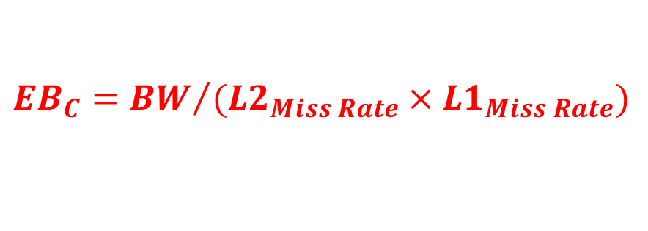
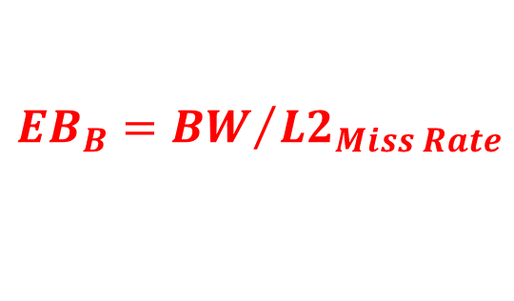

Effective Bandwidth: A New Metric to Quantify the Effects of TLP
An application-level utility metric defined as the ratio of attained DRAM bandwidth to the cache miss rate (based on current level of hierarchy)
Core
L1
L2
DRAM
$$EB={BW}/{Cache Miss Rate}$$
C
B
A
$${EB}_{B}={BW}/{{L2}_{Miss Rate}}$$
$${EB}_{C}={BW}/{({L2}_{Miss Rate}×{L1}_{Miss Rate})}$$
$${EB}_{A}=BW$$
Notes:
Effective Bandwidth, EB, is an application-level utility metric, defined as the ratio between the DRAM bandwidth and the cache miss rate based on level of hierarchy under consideration.
For example, in this figure, EB @ point A is the same as the DRAM BW. However, @ point B, EB is the ratio between DRAM BW and L2 miss rate. Finally, @ point C, @ the core, EB is ratio between DRAM BW and the combined miss rate. CMR is the product of L1 and L2 cache miss rates.

Slide 13

Effective Bandwidth: A New Metric to Quantify the Effects of TLP
Measures how well the DRAM bandwidth is utilized
Considers the usefulness of the caches in amplifying the performance
$IPC∝\frac{BW}{{r_{m}×L2}_{Miss Rate}×{L1}_{Miss Rate}}$ $∝\frac{EB}{r_{m}}$
Why EB?
Combined Miss Rate (CMR)
Notes:
But why EB?
EB measures both the DRAM BW utilization and the usefulness of the caches in amplifying the performance. Let us look at EB benefit analytically and experimentally.
Analytically, performance, in terms of IPC, is the ratio between DRAM BW and the product of rm (which is related to the compute to memory ratio) and the combined cache miss rate.
Then, IPC is directly proportional to EB.
This can be shown by monitoring the IPC and the EB. We can see that both IPC and EB follow the same trend when TLP changes. Also, we can see that up to TLP=4 both IPC and EB increases as the increase in BW is more that the increase in CMR. However, after TLP=4, EB drops as the increase in BW is not enough to compensate the increase in CMR. IPC also drops as the contention for cache and memory bandwidth increases.
This shows that EB is a good metric to optimize for performance in a single-application scenario, but what about multi-application?

Slide 14
EB in Multi-Application Environment
optFI
optWS
optIT
A mechanism that attempts to maximize IT may not be optimal to improve system throughput and fairness
Balance Individual SDs
Balance Individual EBs
Highest Sum of IPC
Not always Highest WS or FI
Highest Sum of SD
Highest Sum of EB
Notes:
The figure studies four two-application workloads under different TLP configurations. The LHS figure shows the sum of slowdowns (which is the weighted speedup) on the y-axis. The RHS figure reports the sum of EB on the y-axis.
Three observations are in order. First, the TLP configuration “optWS” leads to the highest sum of slowdowns and also the highest sum of EBs, as shown by the red circles. Second, the TLP configuration “optFI” leads to a fair balance between the individual SDs and between individual EBs as well, as shown by the red arrows. We can see that sum of EBs can be used to optimize for system throughput, and individual EBs to optimize for fairness.
Finally, the TLP configuration optIT, which maximizes the sum of the co-running applications IPC, doesn’t lead to the highest WS as shown by the blue arrow and does not achieve the optimal balance between the slowdowns as shown by the red arrows.
This means that a schemes that tries to maximize instruction throughput is not optimal for system throughput and fairness.

Slide 15
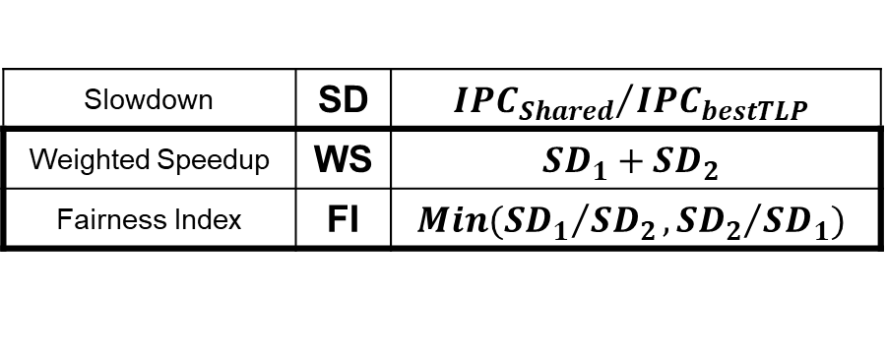
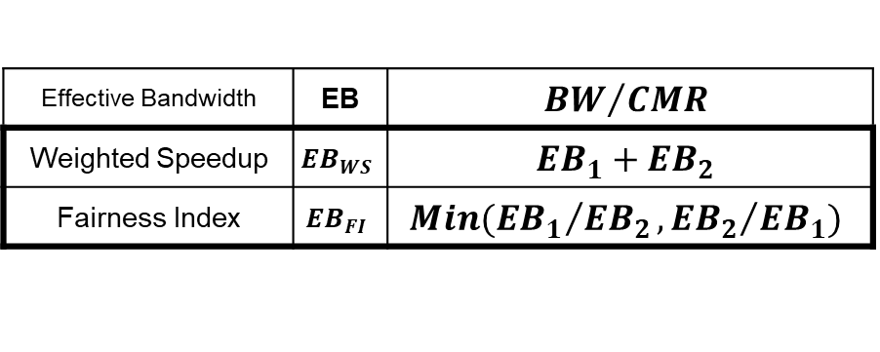
EB in Multi-Application Environment
A TLP management scheme that optimizes for EB-based metrics is useful in improving system throughput and fairness
SD-based Metrics
EB-based Metrics
Slowdown | SD | $${{IPC}_{Shared}}/{{IPC}_{bestTLP}}$$
Weighted Speedup | WS | $${SD}_{1}+{SD}_{2}$$
Fairness Index | FI | $$Min({{SD}_{1}}/{{SD}_{2}},{{SD}_{2}}/{{SD}_{1}})$$
Effective Bandwidth | EB | $${BW}/{CMR}$$
Weighted Speedup | $${EB}_{WS}$$ | $${EB}_{1}+{EB}_{2}$$
Fairness Index | $${EB}_{FI}$$ | $$Min({{EB}_{1}}/{{EB}_{2}},{{EB}_{2}}/{{EB}_{1}})$$
Easier to calculate in shared environment
Details in paper
Challenge?
Notes:
However, a management scheme that optimizes for EB-based metrics is useful in improving system throughput and fairness.
Thus, we introduce our version of the SD-based metrics for system throughput and fairness and utilize EB instead of slowdowns. For example, EB-WS is the sum of EBs instead of using the sum of slowdowns. Another, crucial factor here is that EB-based metrics don’t incorporate any alone-execution information. This makes EB-based metrics easier to calculate in a multi-application environment.
But what is the challenge in using EB?

Slide 16

Challenge? Search Space
Finding the TLP combination is difficult
Huge search space
Assume $n$ applications with $TLP= \left\{1, 2, 4, 8, 12, 16, 20, 24\right\}$
$Search Space=8^{n}$
Sampling period to collect $BW$ and $CMR$
Solution?
Notes:
Finding the optimal TLP configuration is difficult. This is due to the huge search space. For example, using n co-running applications, while selecting from 8 TLP values per application, leads to 8^n search space.
Add the sampling period required, per configuration, to collect BW and CMR, this shows how bad a naïve searching technique can fail.
So, what is the solution?

Slide 17
Outline
Introduction
Motivation
Effective Bandwidth Metric
Pattern-based Searching Schemes
Evaluation
Conclusion
Notes:
We now propose Pattern-based Searching (PBS) to quickly find the near-optimal TLP configuration.

Slide 18
Pattern-Based Searching (PBS)
Guideline-1
To reach optimal system throughput
Choose a TLP configuration that does not underutilize the shared resources
Guideline-2
To avoid sharp drops in one (or all) applications’ EB, hence inferior throughput and fairness
Choose a TLP configuration which would not overwhelm the DRAM BW
Pattern?
Notes:
We start by emphasizing two guidelines. First, EB-based metrics are sub-optimal if a TLP configuration leads to resources underutilization. Thus, to reach optimal system throughput, choose a TLP configuration that does not underutilize the shared resources.
Similarly, we should choose a TLP configuration that does not overwhelm the shared resources. This is because EB-based metrics start to drop when the increase in BW can no longer compensate the increase in CMR.
Now, we define the pattern used in the searching scheme.

Slide 19
Pattern-Based Searching (PBS)
Pattern
Significant drop in EB-based metric happens at a fixed TLP of a particular application, when the resources in the system are sufficiently utilized, regardless of TLP of other co-running application(s)
Notes:
The figure show the execution of BLK_TRD workload, with EB-WS on the y-axis. We vary the TLP values of BLK on the x-axis, and show the different TLP values of TRD as colored/dashed lines.
The pattern:
- is a significant drop in the EB-based metric
- that happens at a fixed TLP of a particular application
- when the resources are sufficiently utilized
- regardless of the TLP of the other co-running application
For example, we see that EB-WS drops @ TLP-BLK = 2 regardless the TLP value of TRD. We refer to this as the pattern for BLK.

Slide 20
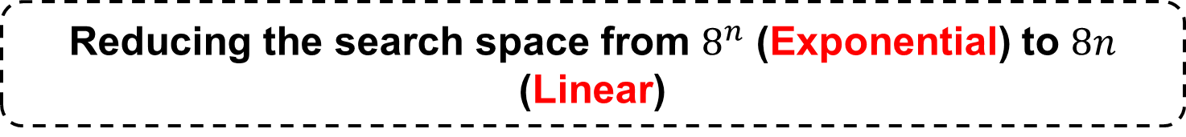
PBS – High-level Searching Process
1- Find the Critical Application
Sequentially check each application for the pattern while maintaining full resource utilization
2- Tune the Co-running Application(s)
Tune the co-running application TLP to optimize the EB-based metric
The sharpest drop in EB-based metrics is attributed to the critical application
Reducing the search space from $8^{n}$ (Exponential) to $8n$ (Linear)
Notes:
Now, we give a high-level overview for our searching scheme.
First, we search for what we refer to as the critical application. We do that by sequentially checking each of the co-running applications for the pattern.
The application with the sharpest drop in the EB-based metric is the critical application.
Second, we fix the TLP of the critical application @ its inflection point and sequentially tune the co-running application(s) to optimize the EB-based metric.
This process reduces the exponential search space to a linear one.

Slide 21
Optimizing Throughput via PBS-WS
1- Find the Critical Application
Use TLP = 24 → Ensure that the resources in the system are sufficiently utilized
Critical Application = BLK @ TLP=2
Notes:
We show here how PBS can be used to optimize system throughput via maximizing the total effective bandwidth.
First, we find the critical application.
We vary the TLP of one application while fixing the TLP of the co-running application @ 24. This is to ensure that the resources are not underutilized.
We can see that the drop in BLK is more than in TRD. Thus BLK is the critical application, and we fix its TLP @ 2.

Slide 22
Optimizing Throughput via PBS-WS
2- Tune the Co-running Application(s)
Fix BLK-TLP = 2 → Tune TRD to improve EB-WS
Fairness optimization can be found in paper
Searching process leads to the TLP combination (BLK, TRD) = (2,8) = optWS
Notes:
Now, we tune the TLP of the co-running application, while TLP-BLK is fixed @ 2, to optimize EB-WS.
The figure shows the EB-WS on the y-axis, while varying the TLP-TRD on the x-axis.
We sequentially vary the TRD TLP till we find a drop in EB-WS @ TLP=8.
Then, the searching schemes leads to TLP combination (2,8) which is equal to optWS.
Searching scheme for improving the fairness can be found in the paper.

Slide 23
Outline
Introduction
Motivation
Effective Bandwidth Metric
Pattern-based Searching Schemes
Evaluation
Conclusion
Notes:
Now, we evaluate our searching schemes.

Slide 24
Evaluation Methodology
Evaluated on MAFIA
A GPGPU-Sim based framework that can execute two or more applications concurrently
Baseline Configuration
30 SMs, 32-SIMT Lanes, 32 Threads/Wavefront, 48 Wavefronts
16KB L1 (4-way, 128B Cache Block) + 32KB Shared Memory per SM
256KB L2 (16-way, 128B Cache Block) per Memory Partition
6 Memory Partitions
1 Crossbar/Direction
Workloads
26 Single Applications
From Rodinia, Parboil, CUDA SDK, and SHOC
50 Two-application Workloads
20 Three-application Workloads
Notes:
We evaluate PBS on MAFIA, a GPGPU-Sim based framework that executes two (or more) applications concurrently.
We use 30 cores equally divided between the co-running applications. For example, in case of two-application scenario, each application is statically assigned 15 cores. However, the L2 cache and DRAM BW are shared.
We use 26 applications from different benchmarks suites to evaluate 50 two-application workloads, and 20 three-application workloads.

Slide 25
Evaluation – Throughput
[Kayiran+, PACT2013]
[Li+, DATE2016]
++bestTLP
++DynCTA
Mod+Bypass
optWS
+19.6%
+11.2%
+9.7%
-3%
Notes:
We start with system throughput. This figure shows the normalized WS on the y-axis normalized to ++bestTLP.
Our scheme, PBS-WS, achieves 19.6% improvement over ++bestTLP.
Also, PBS-WS achieves 11.2% improvement over a scheme that uses DynCTA, which is a single-application TLP modulation scheme, to determine the TLP for each co-running application.
PBS-WS achieves 9.7% improvement over a recently proposed TLP management mechanism Mod+Bypass, that use CTA modulation and cache bypassing to enhance the system throughput in multi-application scenario.
Finally, our scheme is within 3% from the optimal WS.

Slide 26
Evaluation – Throughput
TLP configuration (2,2) is the preferred TLP combination for BLK_BFS2 and is chosen for the longest duration of time
Other TLP combinations are chosen during other time intervals to boost the WS further
Sampling Period
Notes:
This figure shows how our scheme dynamically changes TLP during the execution time.
The shaded areas represent the sampling period.
We observe that the most chosen TLP configuration for BLK_BFS2 is (2,2) which is the optWS (from our analysis).
Also, note that the runtime tuning of TLP configuration provides benefits. Other TLP combinations are chosen during other intervals to boost the WS further.

Slide 27
Evaluation – Fairness
[Kayiran+, PACT2013]
[Li+, DATE2016]
++bestTLP
++DynCTA
Mod+Bypass
optFI
2X
+83.1%
+44.3%
-6%
Notes:
We move to fairness. This figure shows the normalized fairness index (FI) on the y-axis normalized to ++bestTLP.
Our scheme, PBS-FI, improves fairness by 2x compared to ++bestTLP.
Also, PBS-FI achieves 83.1% improvement over a scheme that uses DynCTA.
PBS-FI achieves 44.3% improvement over using Mod+Bypass.
Finally, our scheme is within 6% from the optimal FI.

Slide 28
Evaluation – Case Studies
Application Scalability
PBS benefits are stable as the number of applications scales
For a k-application workload with N is the number of TLP choices, the overall complexity is linear to the number of applications O(N × k)
Notes:
Finally, we show the scalability of our searching schemes using three-application workloads. We evaluate 20 three-application workloads and report the average in this figure.
We observe that system throughput and fairness are stable as the number of applications increases.
Our searching scheme complexity for a k-application workload, with N TLP values to choose from, is linear with the number of applications.

Slide 29
Conclusion
Observe an ample scope for TLP management techniques to improve WS and FI in GPUs running multiple applications
Propose a new metric EB to quantify the effects of TLP modulation
Design PBS, EB-based application-aware TLP management techniques for a better WS/FI in a multi-application environment
PBS is within 3% and 6% of optWS and optFI
Notes:
To conclude, we observed a large scope a TLP management scheme to improve system throughput and fairness in a multi-application environment.
We proposed a new metric called Effective Bandwidth to model the performance in a single- and multi-application scenarios.
Also, we designed PBS, EB-based application aware TLP management schemes to enhance WS and fairness. Our results are within 3% and 6% of optimal WS and fairness.

Slide 30
Thank You! Questions?
We acknowledge the support of the National Science Foundation (NSF) grants (#1657336 and #1717532)

Slide 31
Efficient and Fair Multi-programming in GPUs via Effective Bandwidth Management
Haonan Wang, Fan Luo, Mohamed Ibrahim
(College of William and Mary), Onur Kayiran (AMD),
Adwait Jog (College of William and Mary)

Slide 32
Backup
Why not IPC?
Implementation Details and Overheads
Case Studies – Core Partitioning
Case Studies – Cache Partitioning

Slide 33
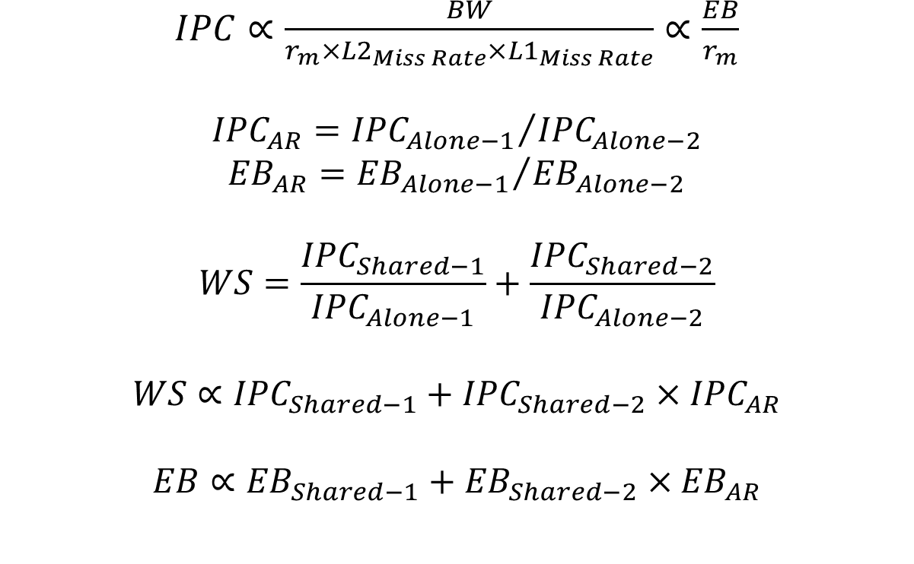
Why not IPC?
$IPC∝\frac{BW}{{r_{m}×L2}_{Miss Rate}×{L1}_{Miss Rate}}$ $∝\frac{EB}{r_{m}}$
$${IPC}_{AR}={{IPC}_{Alone−1}}/{{IPC}_{Alone−2}}$$
$${EB}_{AR}={{EB}_{Alone−1}}/{{EB}_{Alone−2}}$$
$$WS=\frac{{IPC}_{Shared−1}}{{IPC}_{Alone−1}}+\frac{{IPC}_{Shared−2}}{{IPC}_{Alone−2}}$$
$$WS∝{IPC}_{Shared−1}+{IPC}_{Shared−2}×{IPC}_{AR}$$
$$EB∝{EB}_{Shared−1}+{EB}_{Shared−2}×{EB}_{AR}$$

Slide 34
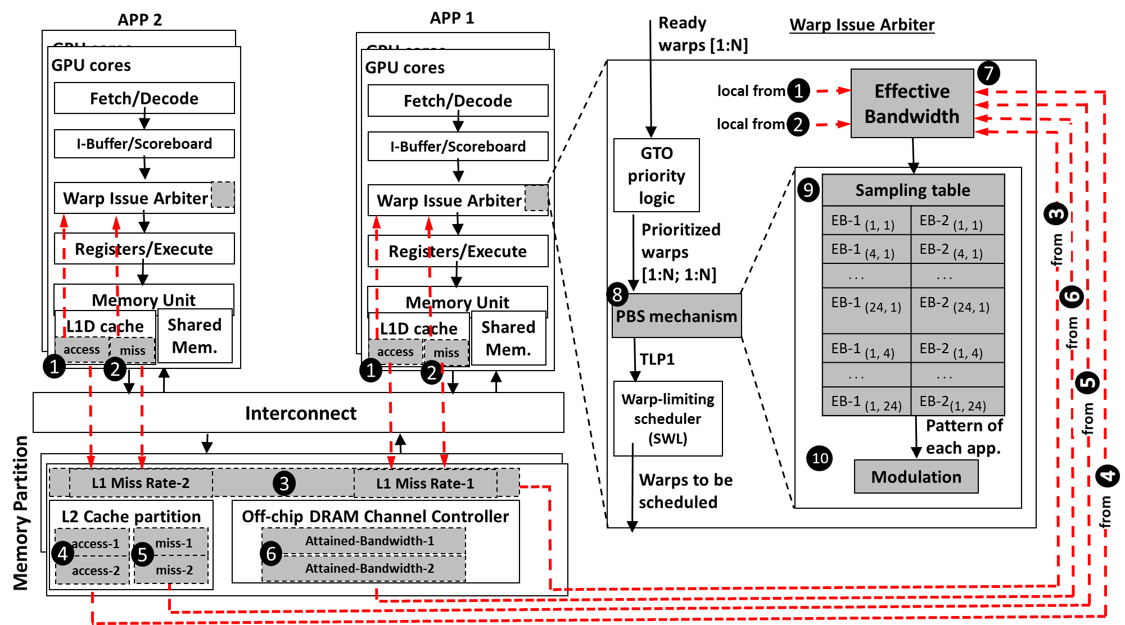
Implementation & Overhead

Slide 35
Evaluation – Case Studies
Core Partitioning
PBS enhances WS and FI under both equal and unequal core partitioning scenarios
PBS benefits reduce with unequal partitioning because with different core partitioning each application executes with a different amount of TLP
Core partitioning techniques do not completely solve the interference problem and PBS can provide additional benefits

Slide 36
Evaluation – Case Studies
Cache Partitioning
PBS improves WS and FI under both Shared and Equal scenarios
Cache partitioning can alleviate the interference at L2
Cache partitioning might be suboptimal (underutilization) when different applications utilize the caches differently

