Slide 1

On Enhancing the Performance of Bufferless Network-on-Chip
By
Mohamed Assem Abd ElMohsen Ibrahim
Under the Supervision of
Dr. Hatem M. El-Boghdadi
Master’s Thesis
Computer Engineering Department
2016

Slide 2
Publications
M. A. Abd ElMohsen and H. M. El-Boghdadi, "Investigating the Viability of Maximum Flexibility Selection Function in Bufferless 2D Meshes," in International Workshop on Many-core Embedded Systems, Portland, 2015, pp. 52-55

Slide 3
Outline
Introduction
Background
Motivation
Scope of Thesis
Contribution
Selection Function
Ranking Policies
Congestion Management
MaxFlex Fixed Step Size
MaxFlex Variable Step Size
Conclusion & Future Work

Slide 4
Introduction

Slide 5
Background
Node
Network-on-Chip (NoC)
A group of switches connecting homogeneous or heterogeneous nodes in a multiple point-to-point fashion
Bidirectional
Link
Switch
Notes:
Group of nodes and switches
Node is connected to the network using a switch
Switches are connected in a multiple point-to-point fashion
Switches forward the data to/from the nodes/switches over links
Topology defines the networks logical layout

Slide 6
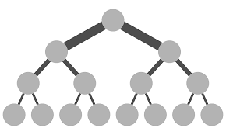
Background
2D Torus
2D Mesh
Fat Tree
Topology
Arrangement of links and nodes/switches
Notes:
Topology defines the networks logical layout i.e. static arrangement of links and nodes/switches.
Various NoC topologies exist (Mesh, Torus, Ring, Fat Tree, Butterfly …), but the most used topology is the 2D mesh, which is implemented in several commercial products and research prototype many-core processors.
In mesh topology, each switch has maximum of 5 input and 5 output channels/ports; one from each neighbouring switch and one from the node connected to it.

Slide 7
Background
Routing
Set of Productive Output Port(s)
Routing Function
Selection Function
Flit (Source, Destination)
Productive Output Port
Notes:
To route a packet successfully from a source node to a destination node, it is required to have a routing function and a selection function.
The routing function calculates the path to follow between a source–destination pair and offers a set of output ports to get closer to the destination.
The selection function selects an output port from the supplied set of ports.
Routing could be classified as deterministic or adaptive based on the selection function.
Routing is deterministic if the selection function delivers the same port for each source-destination combination each time.
Routing is adaptive if the selection function delivers a port based on the network status, thus the selection function may deliver different port each time it is used.

Slide 8
Background
Straight Line Selection Function
Maximum Flexibility Selection Function
D
Y
S
X
Notes:
MaxFlex is a selection function that is similar to the z² routing.
It selects the output port on the dimension with more hops to the destination. By doing this, MaxFlex allows the packet to have more routing options as it approaches its destination (not stuck in one dimension leading to one productive output port only).
MaxFlex tries to move the packets on a diagonal between the source and the destination. Packet initially follows the dimension with higher hop count. When it reaches a switch where the difference in the X dimension is equal to the difference in the Y dimension, it follows the diagonal.
MaxFlex causes the traffic to be concentrated in the central part of the network bisection as it tries to move on the diagonals. This leads to uneven switches utilization which degrades the performance.

Slide 9
Background
Link
A
B
C
Flit Ranking Policy
<
<
A
?
B
?
C
Notes:
During the NoC operation, any of the NoC switches may receive flit(s) from the different ports connected to the neighboring switches or from the node connected to it.
In both buffered and bufferless NoCs, a flit ranking policy determines the order by which the incoming flits will be served i.e. the order by which the flits will choose an output port.
Different ranking policies lead to different service order for the flits which in turn lead to a different arrival order for the NoC flits. This different arrival behavior for the flits may lead to a better or worse performance.
In bufferless NoC, due to the buffers elimination, the ranking policies have a greater effect on the overall performance as the flit that fails to get its productive port will be forced to take a detour.

Slide 10
Background
?

Slide 11
Background
Injection
N
Ejection
Nin
W
Switch
Nout
Sin
N
Sout
Ein
N
Eout
Win
Wout
E
Routing + Ranking
Notes:
Buffered NoC
Scalable, reliable, predictable
Power and chip area heavy consumers (The NoC fabric in the Intel Teraflops chip and the MIT RAW chip consumes 30% and 36% respectively of the required power. Also the network occupies large chip area, for example, 80% area, due to buffer usage)
More complex to design (Due to the need to implement different scenarios for handling the buffers logic)
To handle the contention at an output port that may occur between two flits arriving simultaneously, buffered NoCs use the input buffer to store incoming flits. By doing this, the switch can store the flits that lost the arbitration and forward the winning flits.

Slide 12
Background
Problems ?

Slide 13
Background
Injection
N
Ejection
Nin
W
Switch
Nout
Sin
N
Sout
Ein
N
Eout
Win
Wout
E
Routing + Ranking
N
N
Notes:
Bufferless NoCs has been proposed to reduce the power and area consumption and to simplify the design process. This is done by removing the input and output buffers.
Bufferless NoCs handles the output port contention by either dropping the losing packet or by deflecting it.
Bufferless NoCs that uses the dropping mechanism chooses to drop the packet that lost the contention competition. By dropping the packet the NoC has to retransmit this packet which leads to an increase in the network traffic and/or the hardware cost and design complexity.
The deflecting bufferless NoCs choose not to drop any contending packet. Instead, it forwards all the incoming packets to output ports even if it means to forward the packets through longer paths (non-productive ports). The deflecting buffered NoCs are preferred due to its simpler design and less power and area cost.
However, using bufferless NoCs can cause degradation in the performance. A recent study showed that the power and area gains exceed the degradation in the network performance when NoC load is low to medium, which matches many of the real-life applications.

Slide 14
Background
Problems ?

Slide 15
Background
Injection
Ejection
Nin
Switch
Nout
Sin
Sout
Ein
Eout
Win
Wout
Routing + Ranking
N
N
Notes:
Bufferless NoCs has been proposed to reduce the power and area consumption and to simplify the design process. This is done by removing the input and output buffers.
Bufferless NoCs handles the output port contention by either dropping the losing packet or by deflecting it.
Bufferless NoCs that uses the dropping mechanism chooses to drop the packet that lost the contention competition. By dropping the packet the NoC has to retransmit this packet which leads to an increase in the network traffic and/or the hardware cost and design complexity.
The deflecting bufferless NoCs choose not to drop any contending packet. Instead, it forwards all the incoming packets to output ports even if it means to forward the packets through longer paths (non-productive ports). The deflecting buffered NoCs are preferred due to its simpler design and less power and area cost.
However, using bufferless NoCs can cause degradation in the performance. A recent study showed that the power and area gains exceed the degradation in the network performance when NoC load is low to medium, which matches many of the real-life applications.

Slide 16
Motivation
Buffers Elimination
Pros
Cons
Power
Traffic Volume
Area
Available Link BW
Injection Rate
Under High Injection Rate
Buffered NoC > Bufferless NoC

Slide 17
Scope of the Thesis
Enhance Bufferless NoC
Selection Function
Deflection-based Ranking Policies
Congestion Prevention
MaxFlex Fixed Step Size
MaxFlex Variable Step Size
Notes:
Under high injection rates, the number of packets increases leading to more contention and using bufferless NoCs will lead to reducing the total available bandwidth (as a result of increasing the traffic volume due to retransmitting the flits or deflecting the flits away from their destination) which eventually leads to a performance worse than buffered NoCs.
We focus on enhancing latency-sensitive applications running on bufferless NoCs under high injection rates to approach the buffered NoCs performance.

Slide 18
Contribution
Push the injection rate boundary for the bufferless NoCs making it feasible in a wider range of practical latency-sensitive applications
Notes:
We aim to make the bufferless NoCs work in a fashion similar to buffered NoCs under high injection rates while keeping the area and power gains.
We optimize bufferless NoCs through adopting multiple approaches:
Enhance using selection functions
Enhance using ranking policies
Enhance using congestion prevention
The proposed approaches aim to:
Decrease the overall packet latency and average deflection count
Push the injection rate boundary for the bufferless NoCs making it feasible in a wider range of practical applications instead of using the heavy area and power consumer - the buffered NoCs

Slide 19
Modified Fixed Step Size MaxFlex Selection Function

Slide 20
Motivation
MaxFlex Selection Function
Required
MaxFlex Freedom
Relax Contention
Notes:
MaxFlex main problem:
Concentrate the traffic on the NoC central part
More contention
More deflection
More cycles to reach the destination i.e. higher average packet latency
We want to keep the freedom provided by the MaxFlex selection function but also want to relax the contention on the central NoC switches.

Slide 21
Proposed Approach
Straight Line Selection Function
Solution
MaxFlex + Straight Line
Notes:
As a way to relax the contention on the central NoC switches, we want to adapt the dimension order selection function property. Dimension order selection function tends to focus the flits’ movement on the NoC’s border switches.
We want to mix between the basic MaxFlex selection function and the dimension order selection function.

Slide 22
Proposed Approach
MMaxFlex
Step Size > 1
Borders Traffic
Central Switches Concentration
Contention
Deflection
Packet latency
Notes:
We want to mix between the basic MaxFlex selection function and the dimension order selection function. To achieve this idea, we updated the MaxFlex to use a step size greater than one. In other words, instead of using a step size of one, we use a step size greater than one as a way to move the traffic further towards the borders.
By this we aim to decrease the concentration on the NoC’s central switches and move part of the traffic to the borders.
This approach leads to less contention and subsequently less deflections and smaller packet latency.

Slide 23

Analysis of Fixed Step Size MMaxFlex
Study the effect of step size on the distribution of packets through $n×n$ mesh network
Assumptions:
Each node sends only one packet to each other node (i.e. n²-1 packets)
Packet length is one Flit
No deflections
Notes:
We study the effect of step size on the distribution of packets through 2D mesh network.
In doing that, for a certain step size, we count the number of packets passing through each switch (all ports included). To ease this counting, we divide the traffic going through a switch into 12 different types.

Slide 24
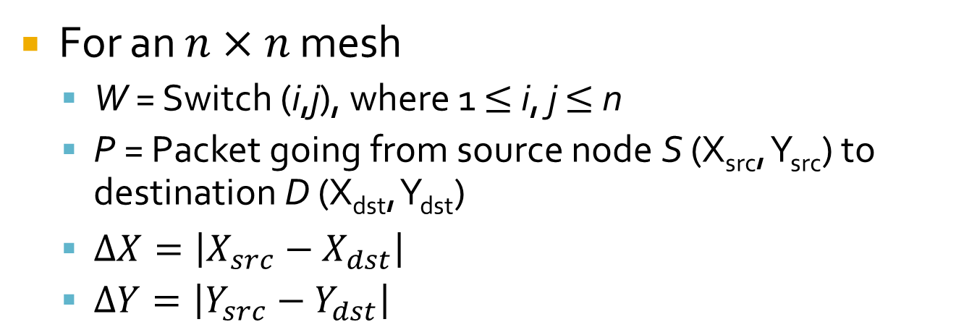
Analysis of Fixed Step Size MMaxFlex
For an $n×n$ mesh
W = Switch (i,j), where 1 $≤$ i, j $≤$ n
P = Packet going from source node S (X_{src}, Y_{src}) to destination D (X_{dst}, Y_{dst})
$∆X=\left|X_{src}−X_{dst}\right|$
$∆Y=\left|Y_{src}−Y_{dst}\right|$
Any packet passing through switch W falls under one of 12 types

Slide 25
Type 1 & 2 Packets
Node W
Injection
Switch W
Ejection

Slide 26
Type 3 & 4 Packets
Count = 6
A
W
B
C
D

Slide 27
Type 5 Packets
A
Down Traffic
W
Count = 6
B
C
Up Traffic
D

Slide 28
Type 6 Packets
A
Down Traffic
W
B
Up Traffic
C

Slide 29
Type 7 Packets
A
Down Traffic
W
B
C
Up Traffic

Slide 30
Type 8 Packets
Up Traffic
A
A
Down Traffic
B
W
B
C
C
D
E

Slide 31
Type 9 Packets
A
B
W
C
Up Traffic
D

Slide 32
Type 10 Packets
A
B
W
C
D
Up Traffic

Slide 33
Type 11 Packets
A
A
Up Traffic
B
W
B
Down Traffic
C
C
D
E

Slide 34
Type 12 Packets
A
Up Traffic
B
A
C
W
B
D
C
Down Traffic
D

Slide 35
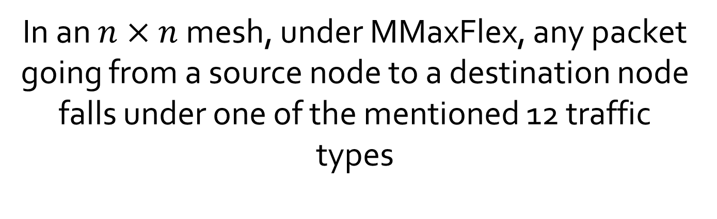
Proof of Packet Types Completeness
In an $n×n$mesh, under MMaxFlex, any packet going from a source node to a destination node falls under one of the mentioned 12 traffic types

Slide 36





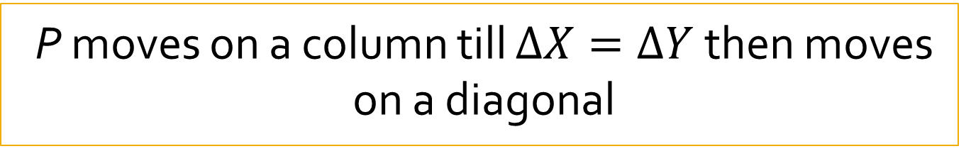


Proof of Packet Types Completeness
$$∆X ?∆Y$$
$$∆X=0$$
$$∆Y=0$$
$$∆X=∆Y$$
$$∆X>∆Y$$
$$∆X<∆Y$$
Type 4
Type 3
Type 5
Type 6
Type 7
Type 8
Type 11
Type 12
Type 9
Type 10
P moves on a column from S to D
P moves on a row from S to D
P moves on the diagonal from S to D
The movement on the diagonal leads the packet to pass through switches on nearby diagonals
P moves on a row till $∆X=∆Y$ then moves on a diagonal
P moves on a column till $∆X=∆Y$ then moves on a diagonal
Injection
Type 2
Ejection
Type 1
The previous cases cover the 12 mentioned patterns proving the lemma

Slide 37
Packets Distribution Analysis Results
Study effect of increasing the step size for MaxFlex
Count the packets passing through each switch
10x10 Mesh NoC
Border Switches
Representative Switches
Core Switches
Switch (0,0)
Switch (0,3)
Switch (0,6)
Switch (3,3)
Switch (3,6)
Switch (5,5)

Slide 38
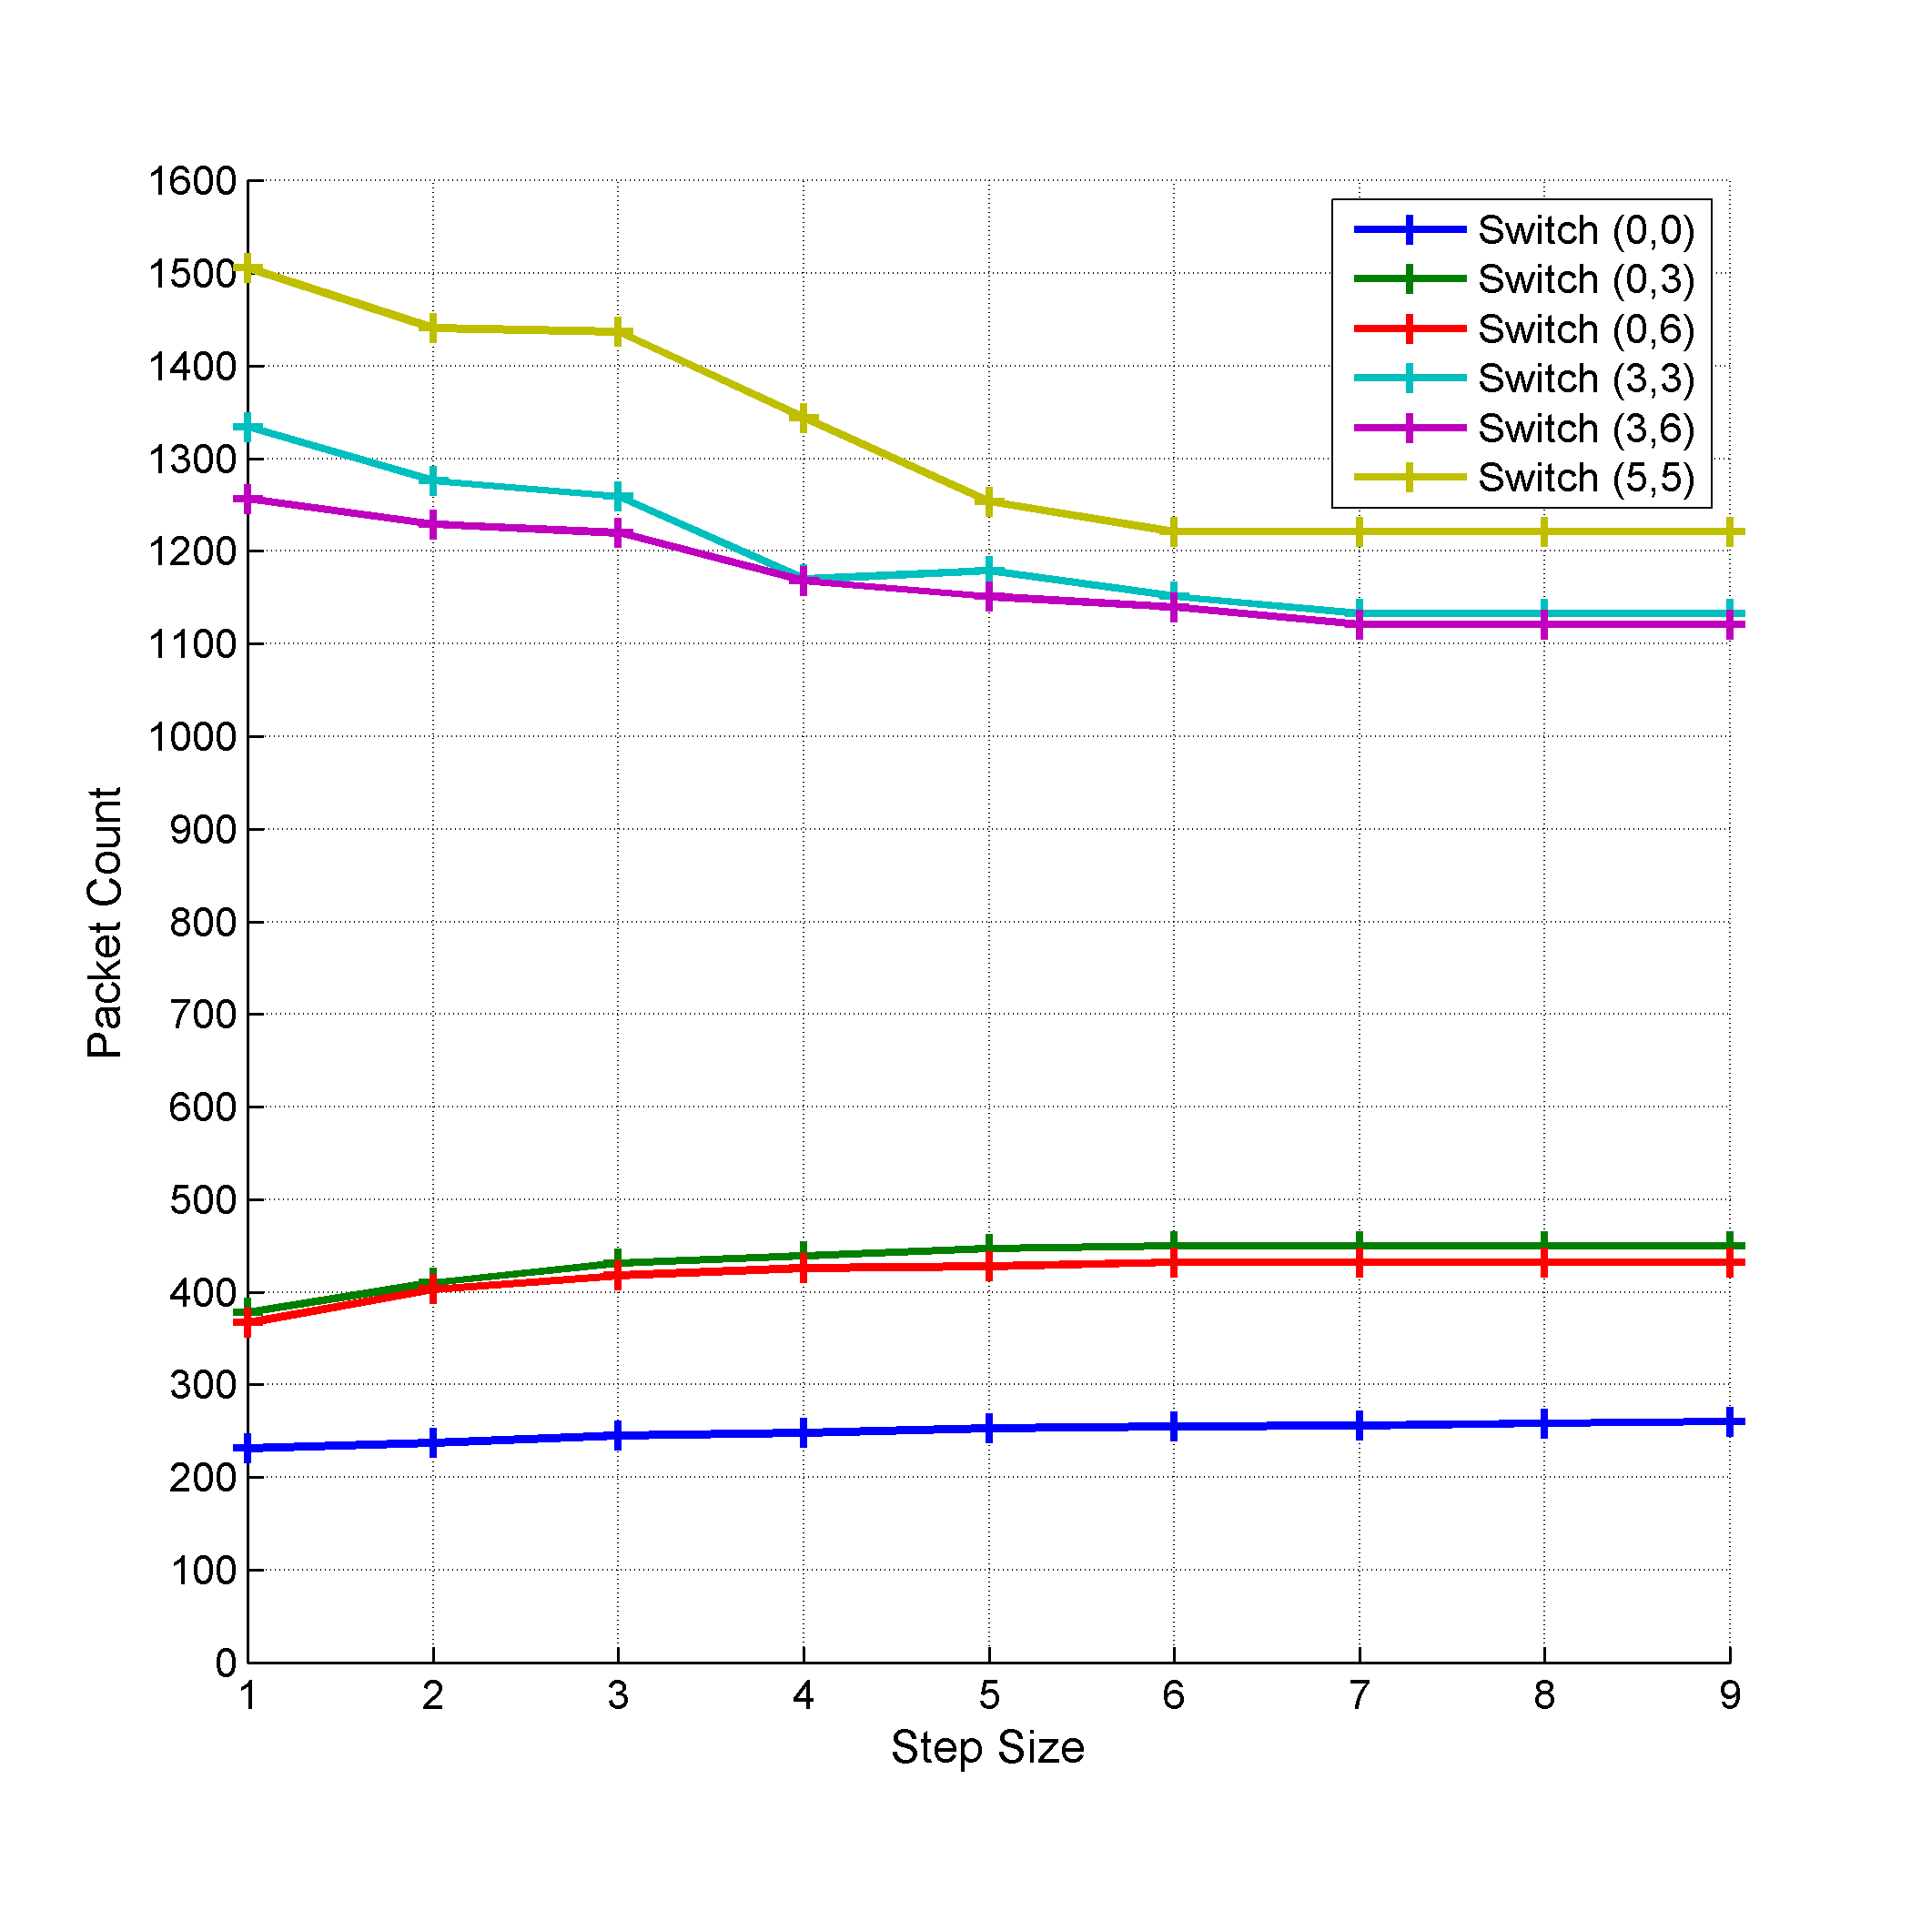
Packets Distribution Analysis Results
Notes:
Figure shows the number of packets passing through each of the mentioned switches with different step sizes.
From the figure, we notice different trends:
For the border nodes, the number of packets passing through the switch increases as the step size increases
For the core switches, the number of packets decreases as the step size increases. In other words, the concentration in the central part of network bisection is relaxed.
This is because, as the step size increases, the packet moves in one dimension for more steps before alternating the dimension. This movement enables the packet to reach farther switches (i.e. switches away from the diagonals) which allows some relaxation for the core diagonal switches.

Slide 39
Experimental Setup
Experimental Setup
Simulator
Topology
Traffic
Performance Metric
gpNoCsim
10x10 Mesh
Uniform
Packet Latency
Deflection Count
Notes:
Simulator: gpNoCsim
Topology: 2D mesh
Switch latency = Link latency = 1 cycle
Link width = 128 bit
Fixed length packet = 8 Flits
Flit = 128 bit
Variable mesh size
Traffic: Uniform
Warm-up = 100000 cycles
Terminate
Injecting 10000 packets per node
Receiving all injected packets
Performance Metric
Packet latency = Time the packet takes to reach the destination
Last Flit Ejection Time – First Flit Generation Time
Flit deflection count = Number of times the flit was forced to go through a non-productive port

Slide 40
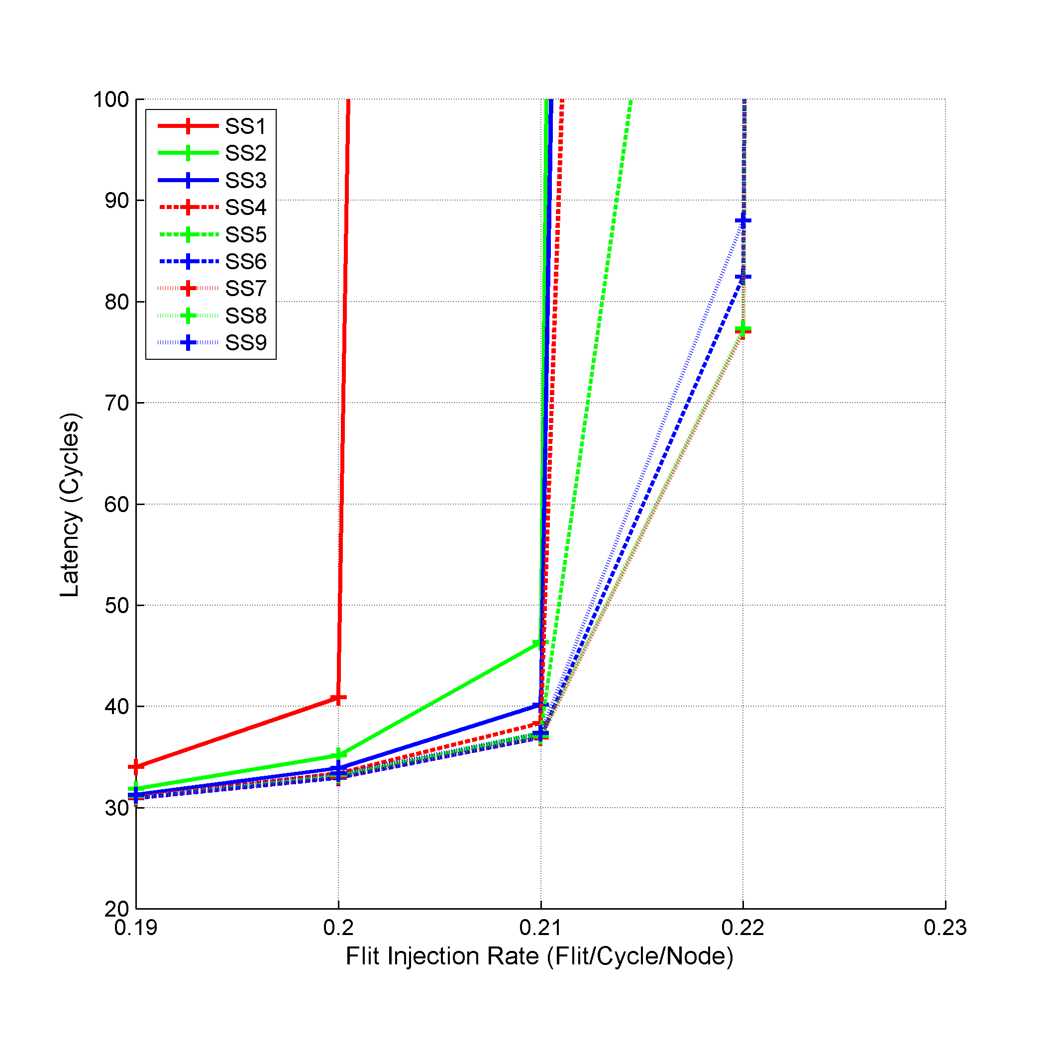
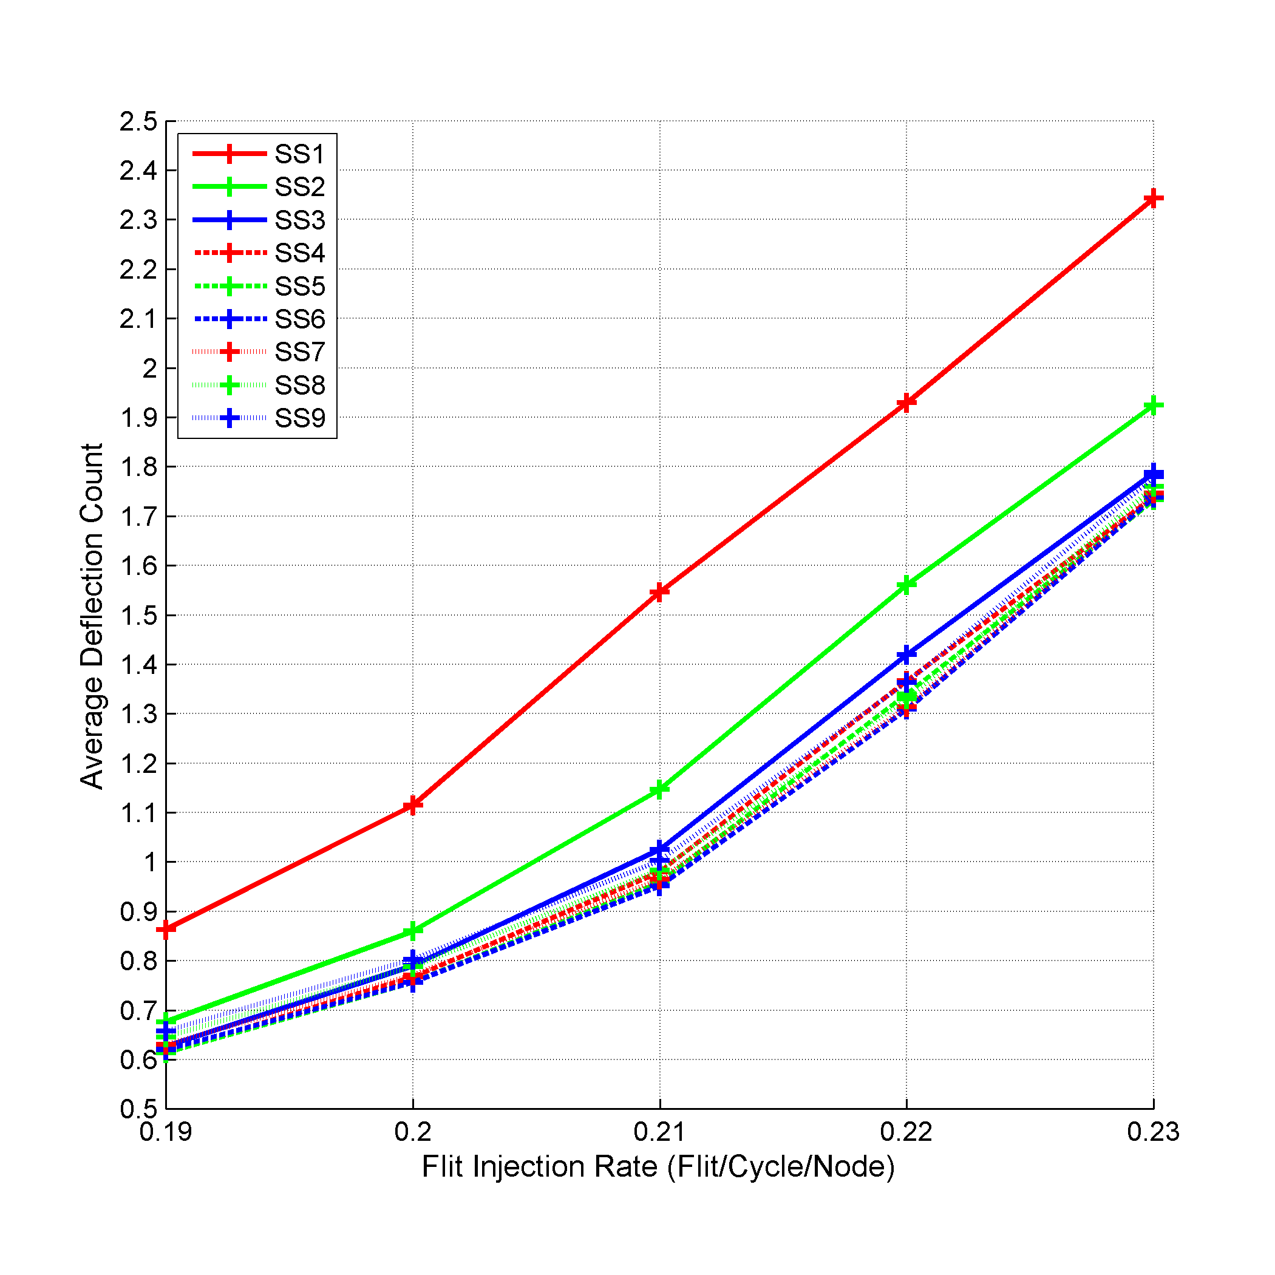
Experimental Results
98%
31%
Notes:
As the step size increases, both the average packet latency and the average deflection count decreases.
Results matches the analysis results, as the better traffic distribution showed in the analysis can lead to better link utilization which can lead to faster delivery for the packets and hence better packet latency and less misrouting due to contention.

Slide 41
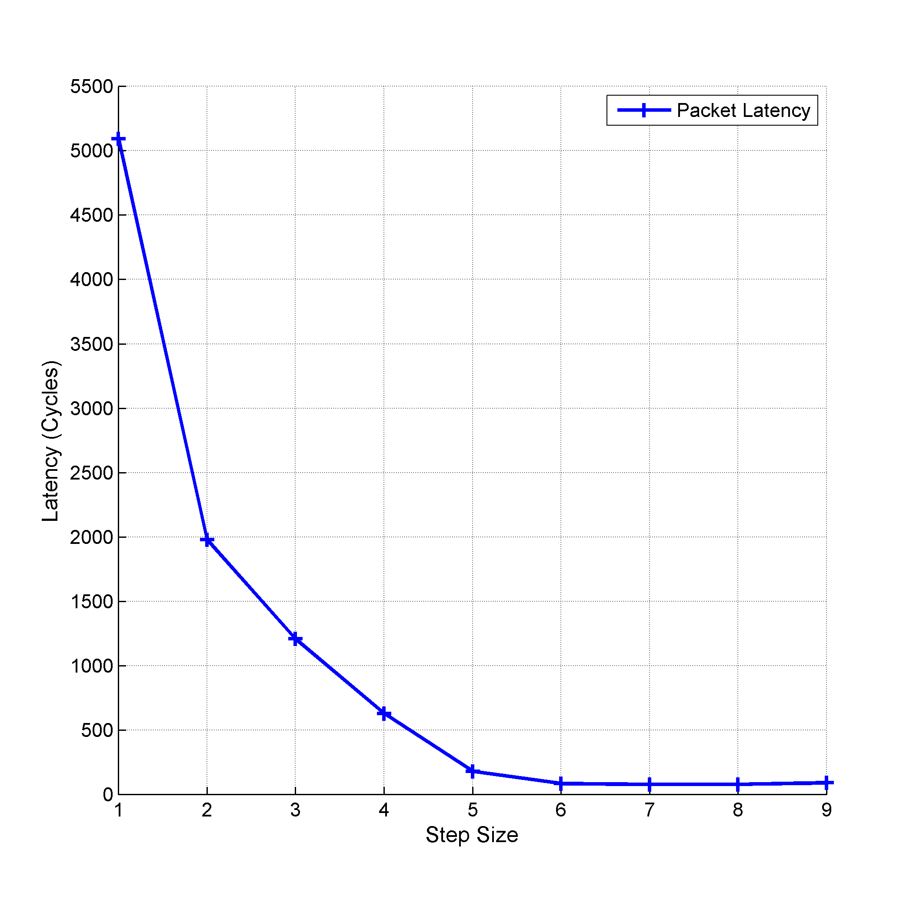
Experimental Results
Notes:
The figure focuses on the cut-off point of the flit injection rate of 0.22 flit/cycle/node i.e. the point after which the latency increases exponentially.
The figure shows that for smaller step sizes, the average packet latency is very high (magnitude of thousands of cycles). While for larger step sizes the average packet latency is much smaller with the smallest packet latency achieved using step size of 8.
The average packet latency using larger step sizes is almost equal as all these step size values lead to almost the same packet movements. For example, moving from node (0, 5) to (5, 10) under step size of 1 leads to moving one step in X then one step in Y till the destination is reached, while using a step size of 6 will lead to moving 6 steps in X then 6 steps in Y. Since the number of steps remaining in X is less than 6, the packet will move as if it uses dimension order routing (DO-XY).

Slide 42
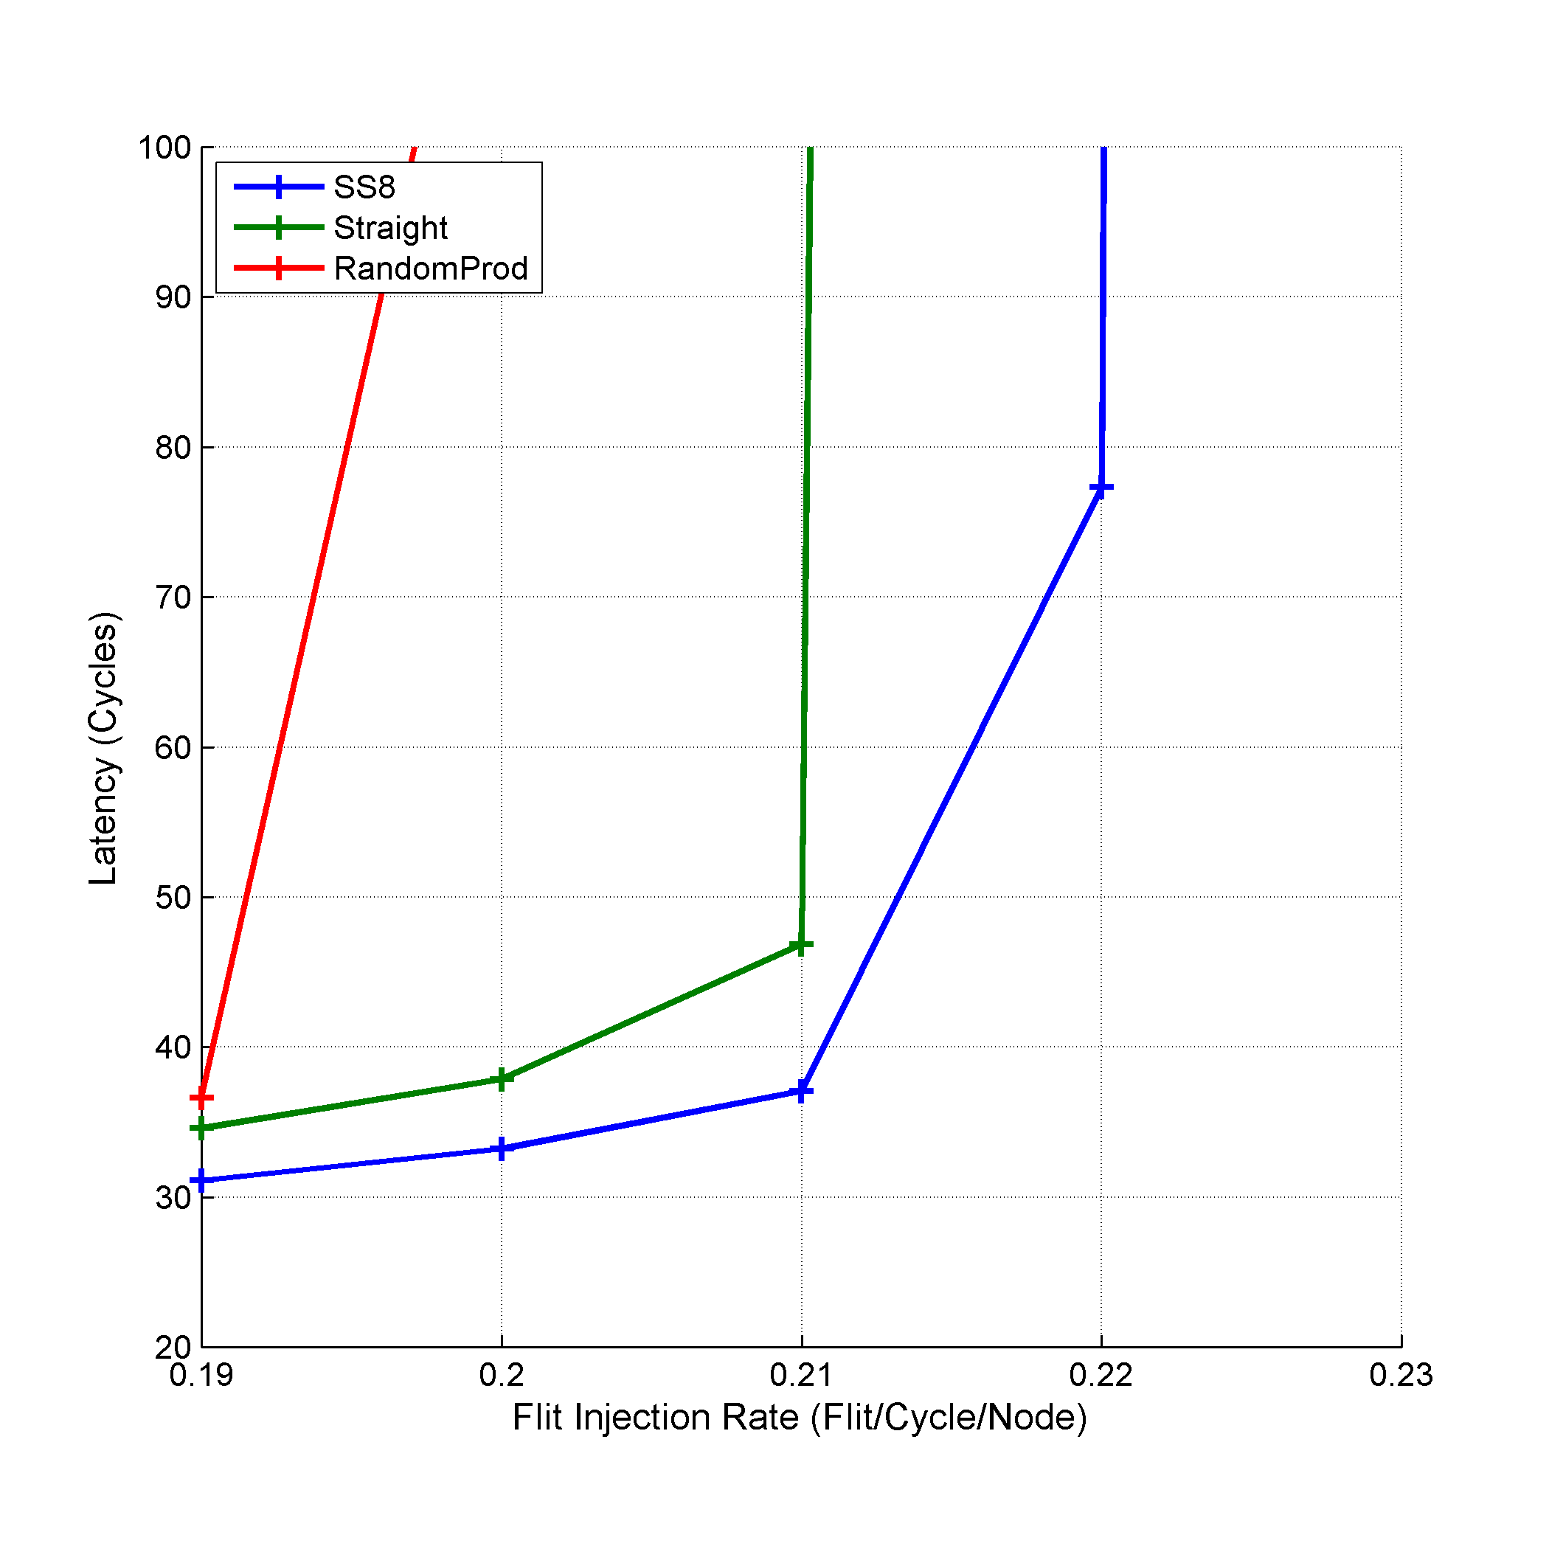
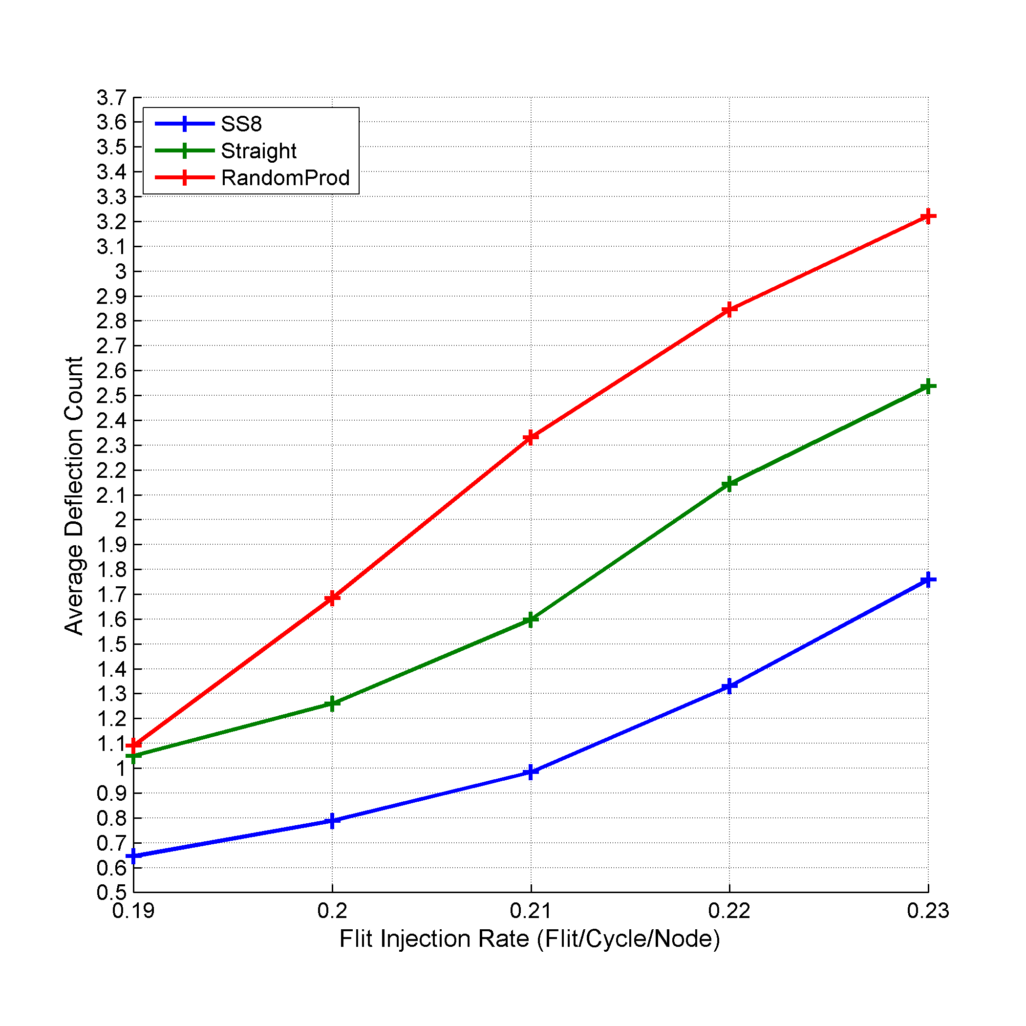
Experimental Results
95%
99%
38%
53%
Notes:
We compare increasing the step size under MaxFlex with other selection functions:
Straight line selection function
Random productive port selection function
In the straight line selection function, the flit favors the X axis movement till there are no steps remaining in X dimension then moves in Y dimension.
In the random productive port selection function, the flit randomly chooses from the list of productive ports available at each step.
Results show that increasing the fixed step size under MaxFlex leads to better average packet latency and smaller deflection count. Specifically, using a fixed step size of 8 enhances the average packet latency by around 95% and 99% over using straight line selection function and random productive port selection function respectively. Also, the average deflection count decreases by 38% and 53% compared with straight line selection function and random productive port selection function respectively.

Slide 43


Experimental Results
$n×n$ Mesh NoC
$SS$ Value?
Estimate
Step size = 60% to 80% of the 2D Mesh Dimension
Better Network Performance
Notes:
Simulate MaxFlex under different 2D mesh sizes
Mesh size ranging from 5x5 to 12x12
Step size ranging from 1 to n – 1
Table shows that using a step size with a value ranging from 60% to 80% of the 2D mesh dimension leads to better network performance.
Based on the fixed step size analysis and simulation results, we conclude that using a larger value for the step size leads to better network performance. This is due to the better distribution of traffic among the network switches.

Slide 44
Variable Step Size MaxFlex Selection Function

Slide 45
Motivation
Goal
Increase NoC Links Utilization
Enhance Traffic Distribution
Assign a Different Step Size for each Flit
Variable Step Size MaxFlex
Notes:
Fixed step size MaxFlex with step sizes greater than one managed to redistribute the traffic away from the central part of NoC switches and move more towards the border switches. This redistribution succeeded in decreasing the flits deflection count and thus decreasing the overall average packet latency.
We want to utilize the NoC switches and links more in a way that enhances the traffic distribution even better.
As a way to change the traffic distribution, we assign a different step size for each flit i.e. instead of assigning the same step size value to all the packets, each packet has a different step size.
The value of the step size depends on the approach used.

Slide 46
NoC Regions
Region (1,1)
Region (2,1)
A
B
C
W
B
D
C
Region (1,2)
Region (2,2)
Notes:
We divide the NoC into a number of rectangular regions and assign each node to a specific region. In other words, we distribute the nodes of the NoC to a group of non-interleaving rectangular regions such that each region contains a group of nodes (at least one node and up to $n×n$ nodes). Also, we assign indices to each region in a similar manner to the 2D NoC switches.

Slide 47
Proposed Approaches
Variable Step Size
NMDVS
RMDVS
IORVS
ORMDVS

Slide 48
NMDVS
Using the Manhattan distance between NoC nodes
Where
Notes:
This approach aims to assign small step size to near nodes and large step size to nodes far from each other.
By this approach, we want to use the information gained from the fixed step size analysis and then better distribute the traffic by using smaller step size to the traffic between nearby nodes.
Using large step size value for the traffic between nearby nodes may not be effective. This can be explained by the following; the distance between the source and destination nodes is small so the difference between the source and destination X axis or Y axis will be small (maximum value is equal to the distance between source and destination incase same row or column), so using large step size leads to sort of moving using Dimension Order selection function which leads to losing the freedom granted by MaxFlex. Given this insight and the analysis, we used smaller step size for the near nodes and larger step for the far nodes leading to the diversity we want in the traffic distribution.

Slide 49
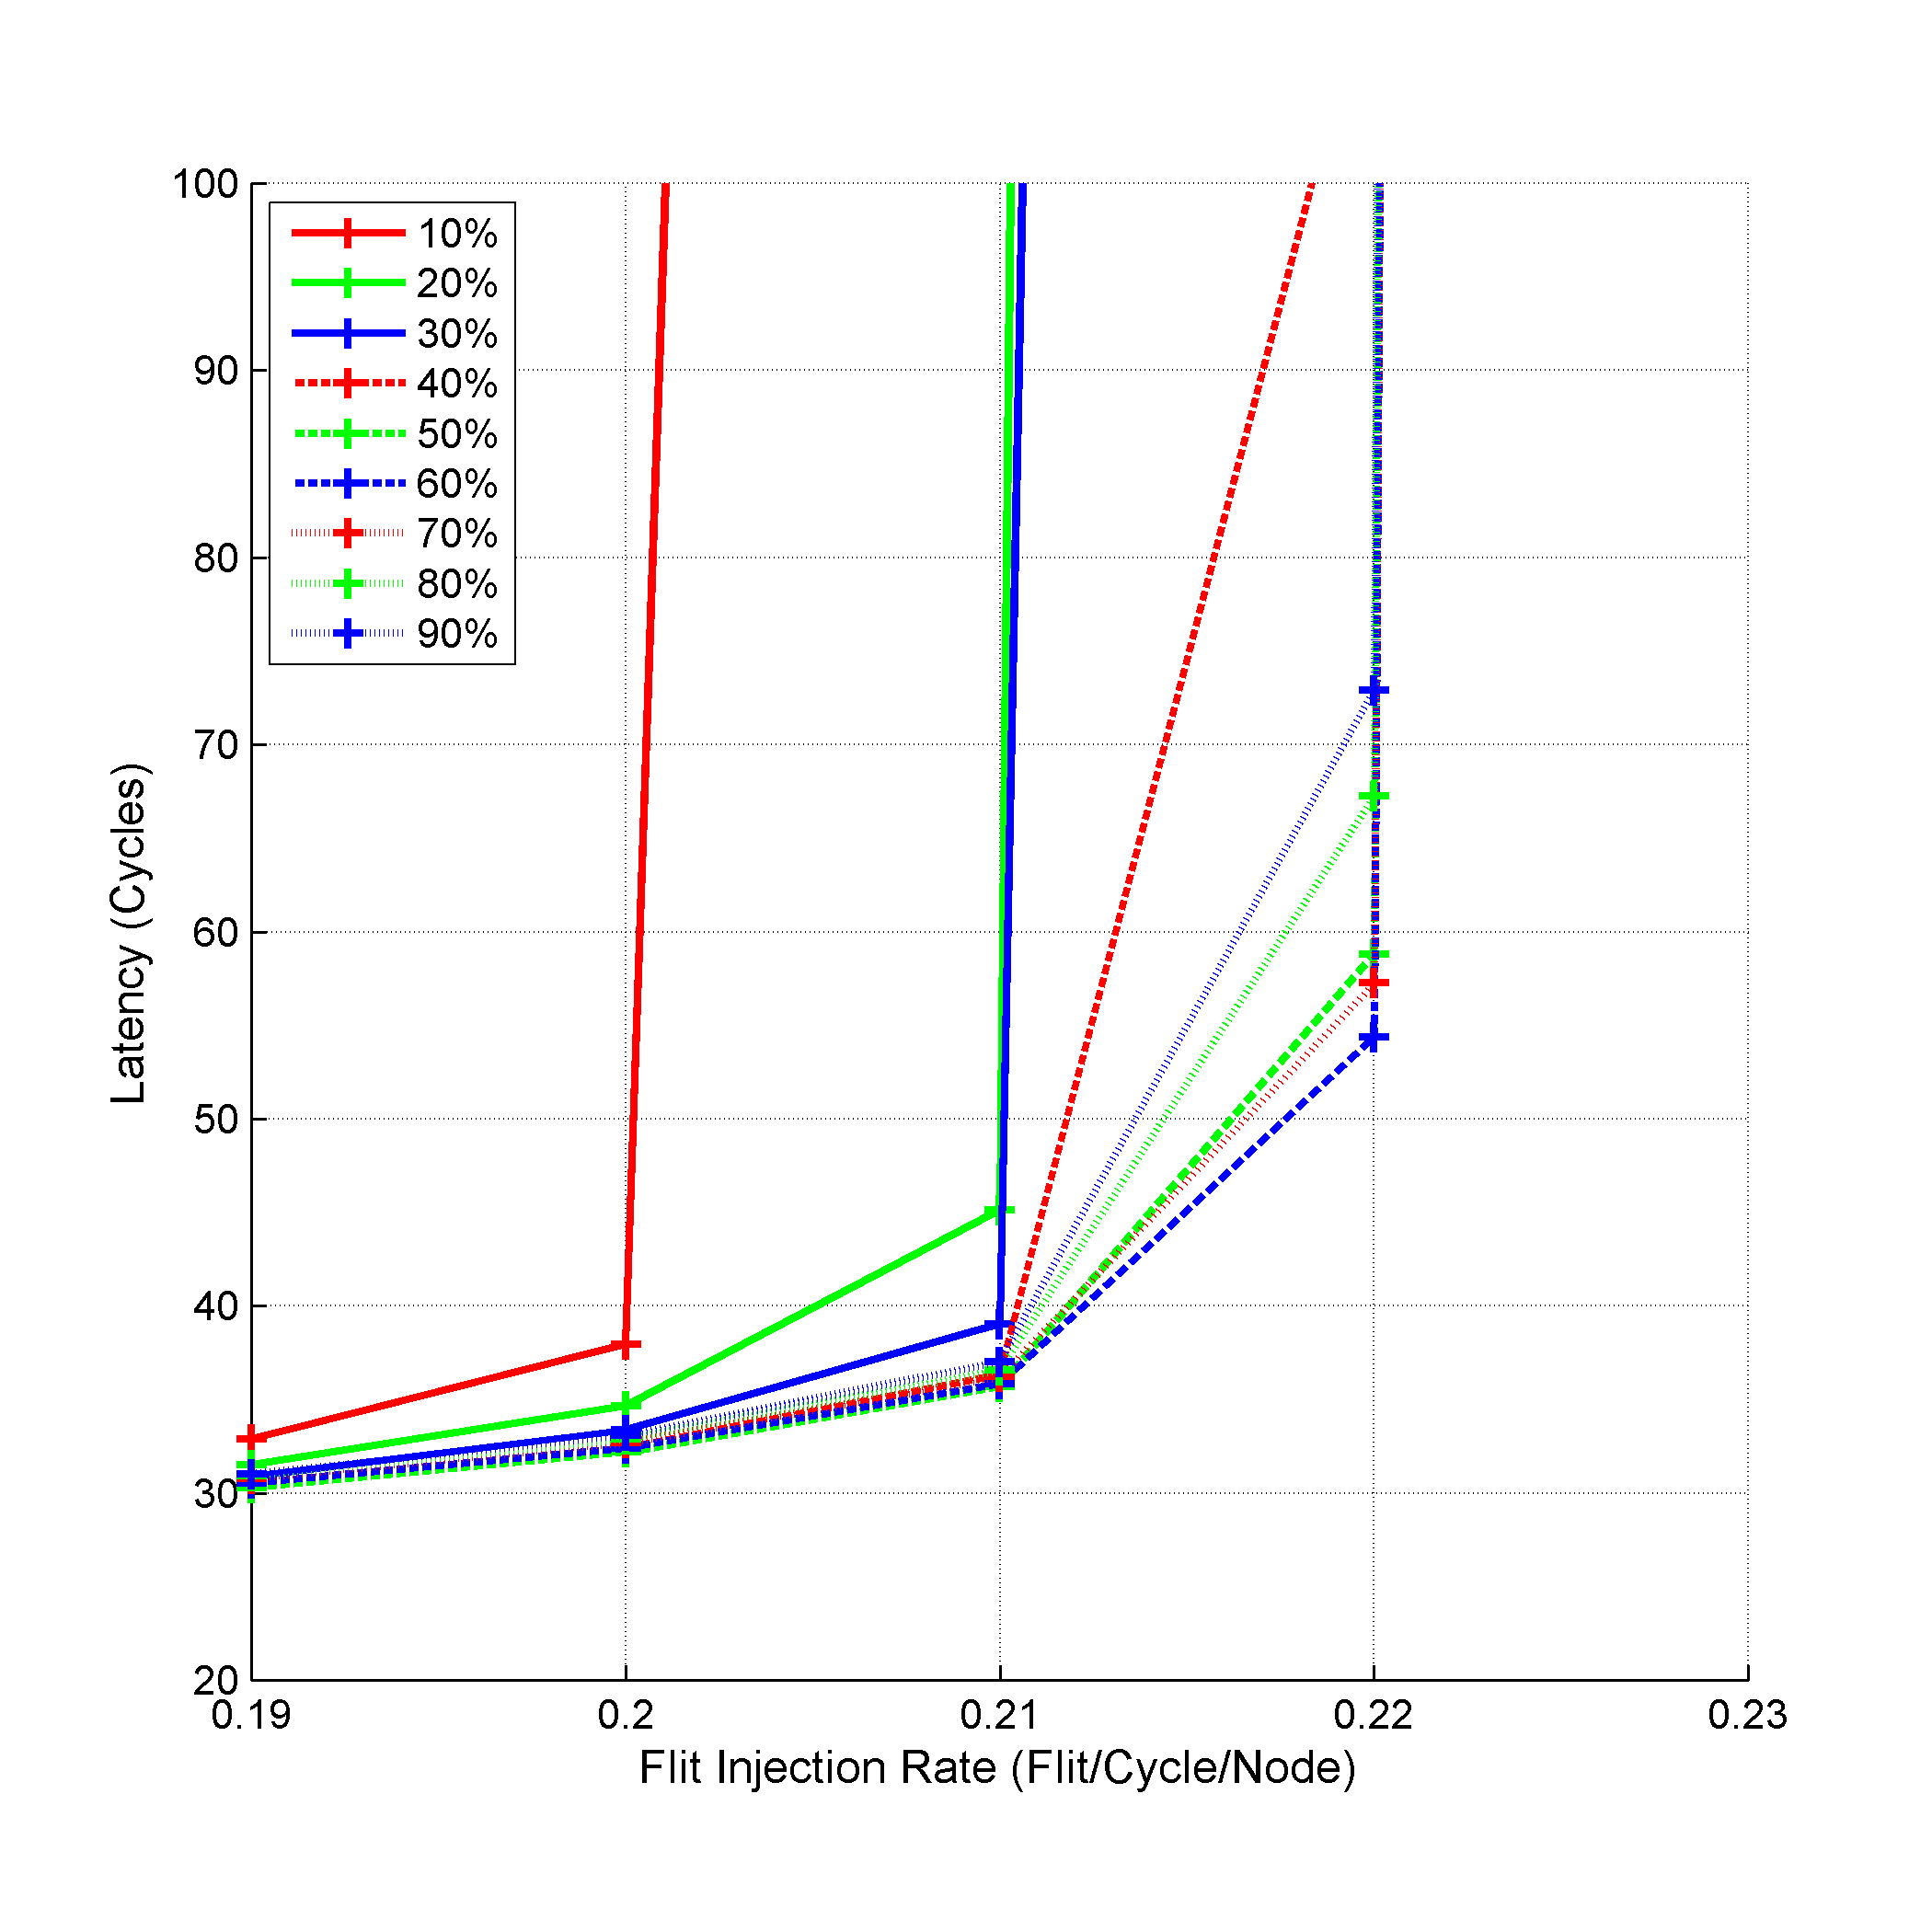
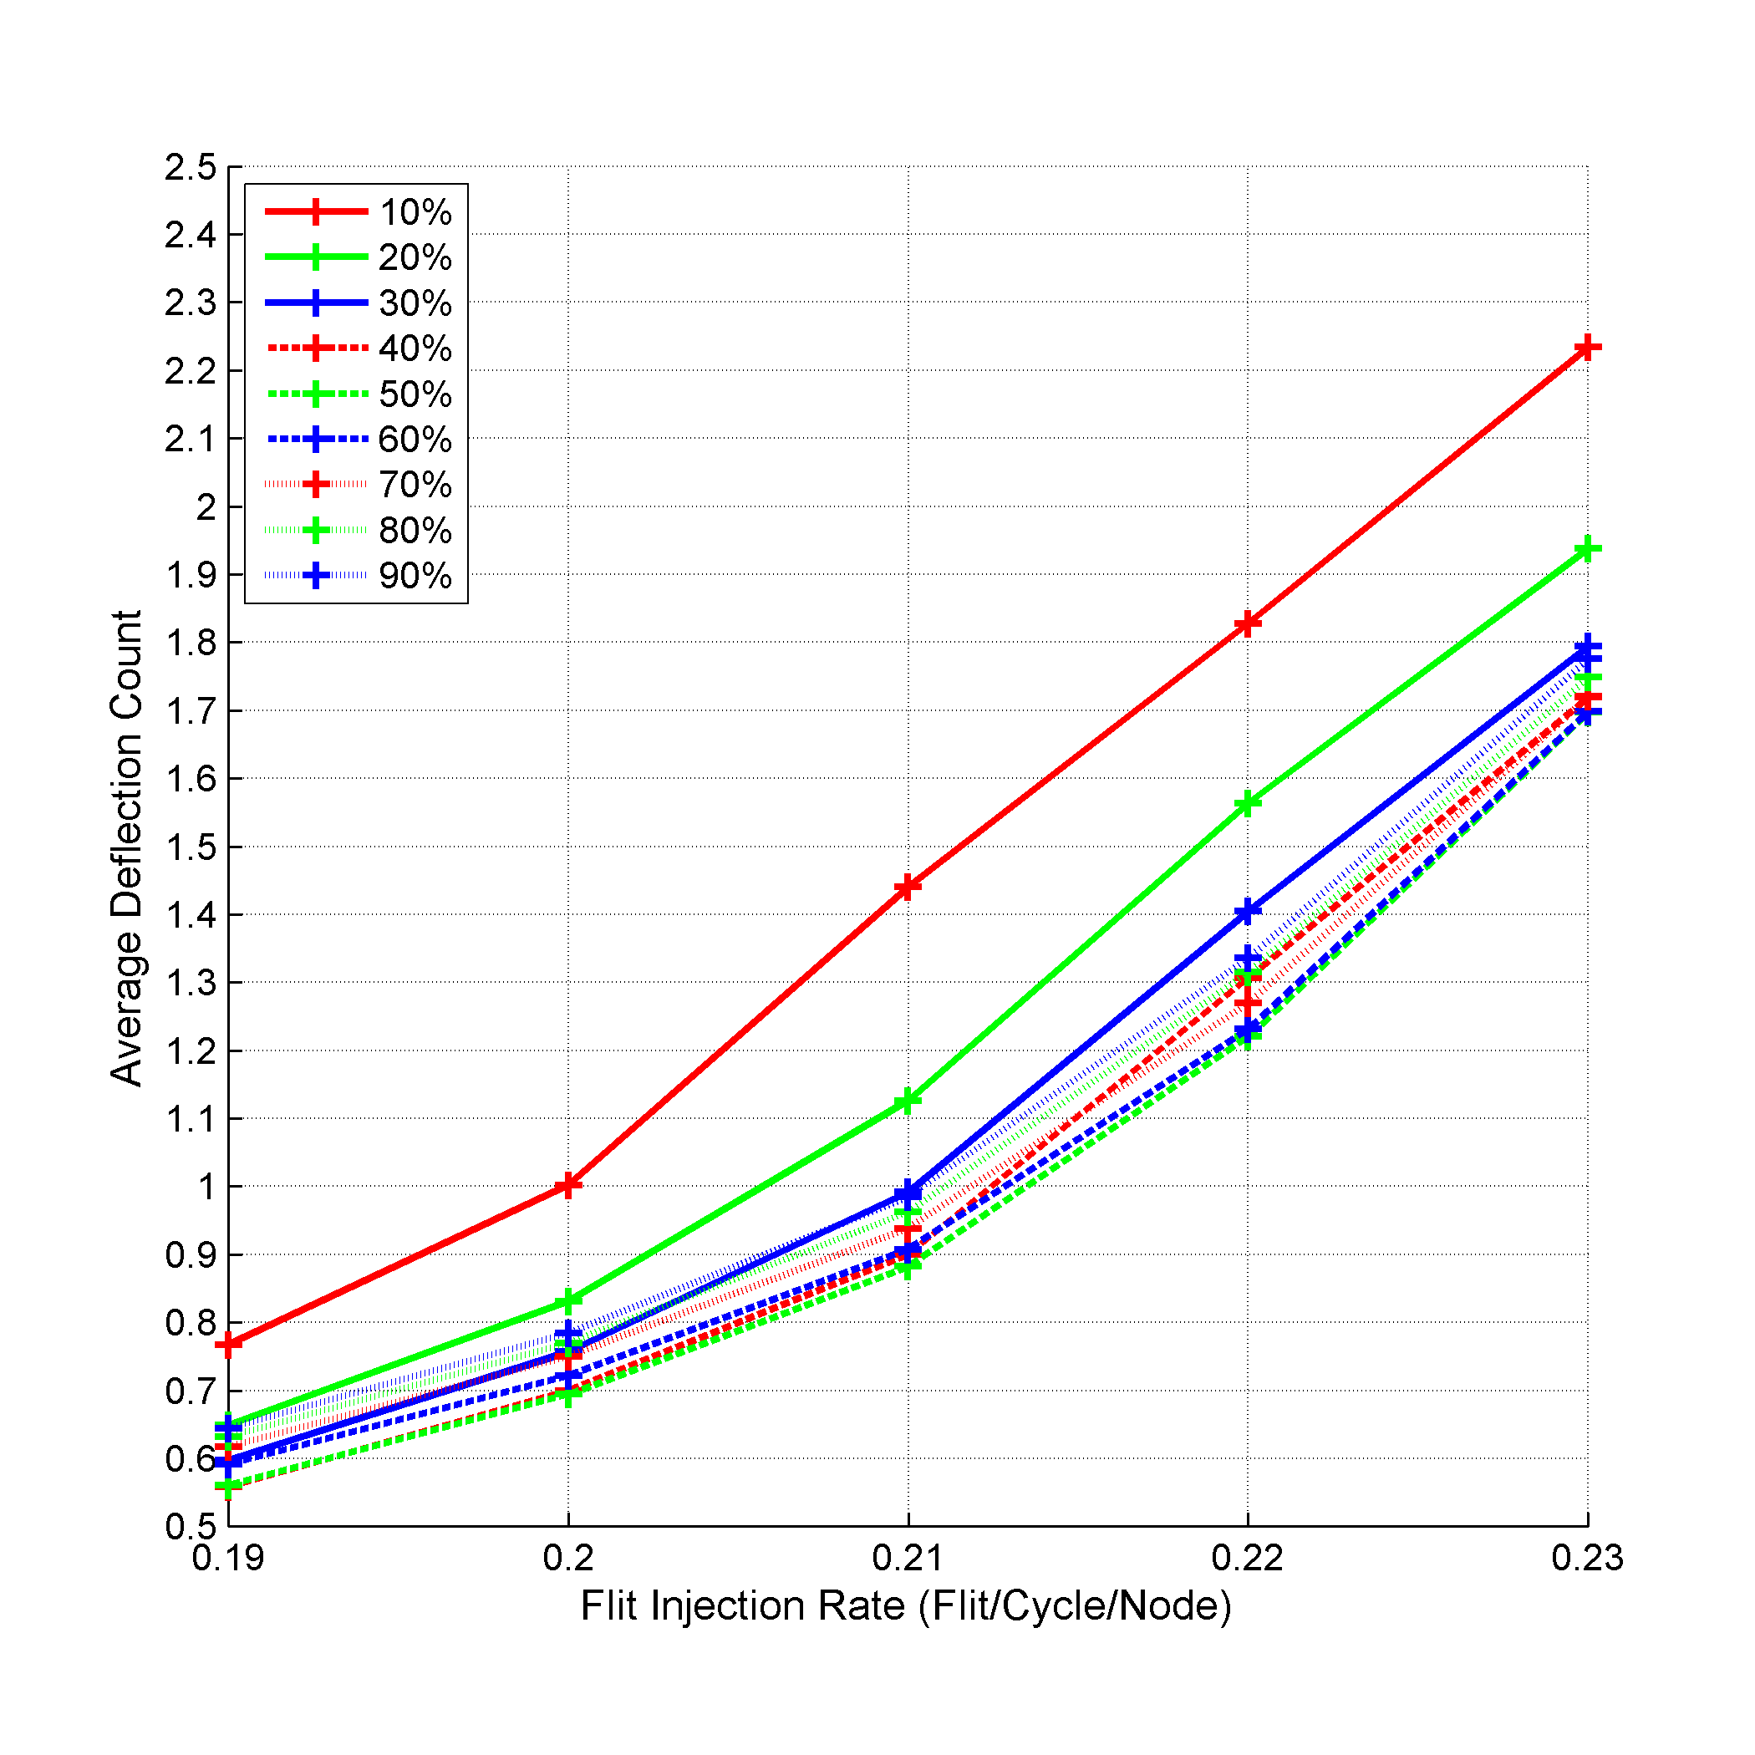
Experimental Results
98%
32%
Notes:
We examined different percentage value ranging from 10% to 90%.
As the percentage value increases, the average packet latency decreases.
The best percentage value is about 60% of the distance.
Using higher percentage values degrades the performance as it leads to step sizes that can be similar to using a large fixed step size. These results matches the results for the fixed step size, as using the percentage value of 60% leads to larger step size value for the packets with long distance to go and smaller step size for the packets with short distance to go.

Slide 50
RMDVS
Using the Manhattan distance between NoC regions
Where
Notes:
This approach aims to assign small step size to near nodes and large step size to nodes far from each other.
It uses the difference between regions X and Y axes.
If the nodes are in the same region then the difference is zero and the step size is one. Otherwise, if the nodes are in different regions, based on how near or far are the regions, the step size is calculated.
Near regions most probably leads to smaller difference in the X and Y region axes which leads to smaller step size. On the contrary, far regions lead to larger difference and hence larger step size.
This approach aligns with the presented analysis.

Slide 51
RMDVS`
Difference between the distance between the source and destination regions
Where
Notes:
This approach aims to test using small step size instead of using large step size.
By subtracting the differences between the X and Y axes, we tend to generate smaller step sizes even for the traffic between far nodes.
This approach did not perform well as expected due to using smaller step sizes which also conforms to the aforementioned fixed step size analysis.

Slide 52
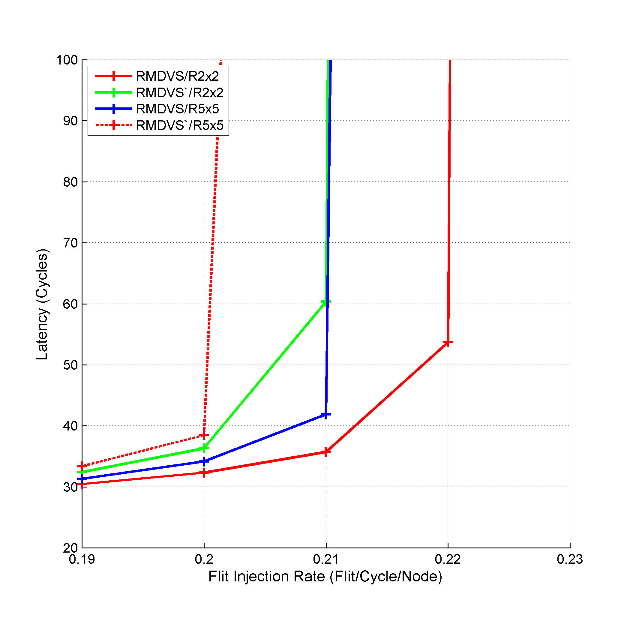
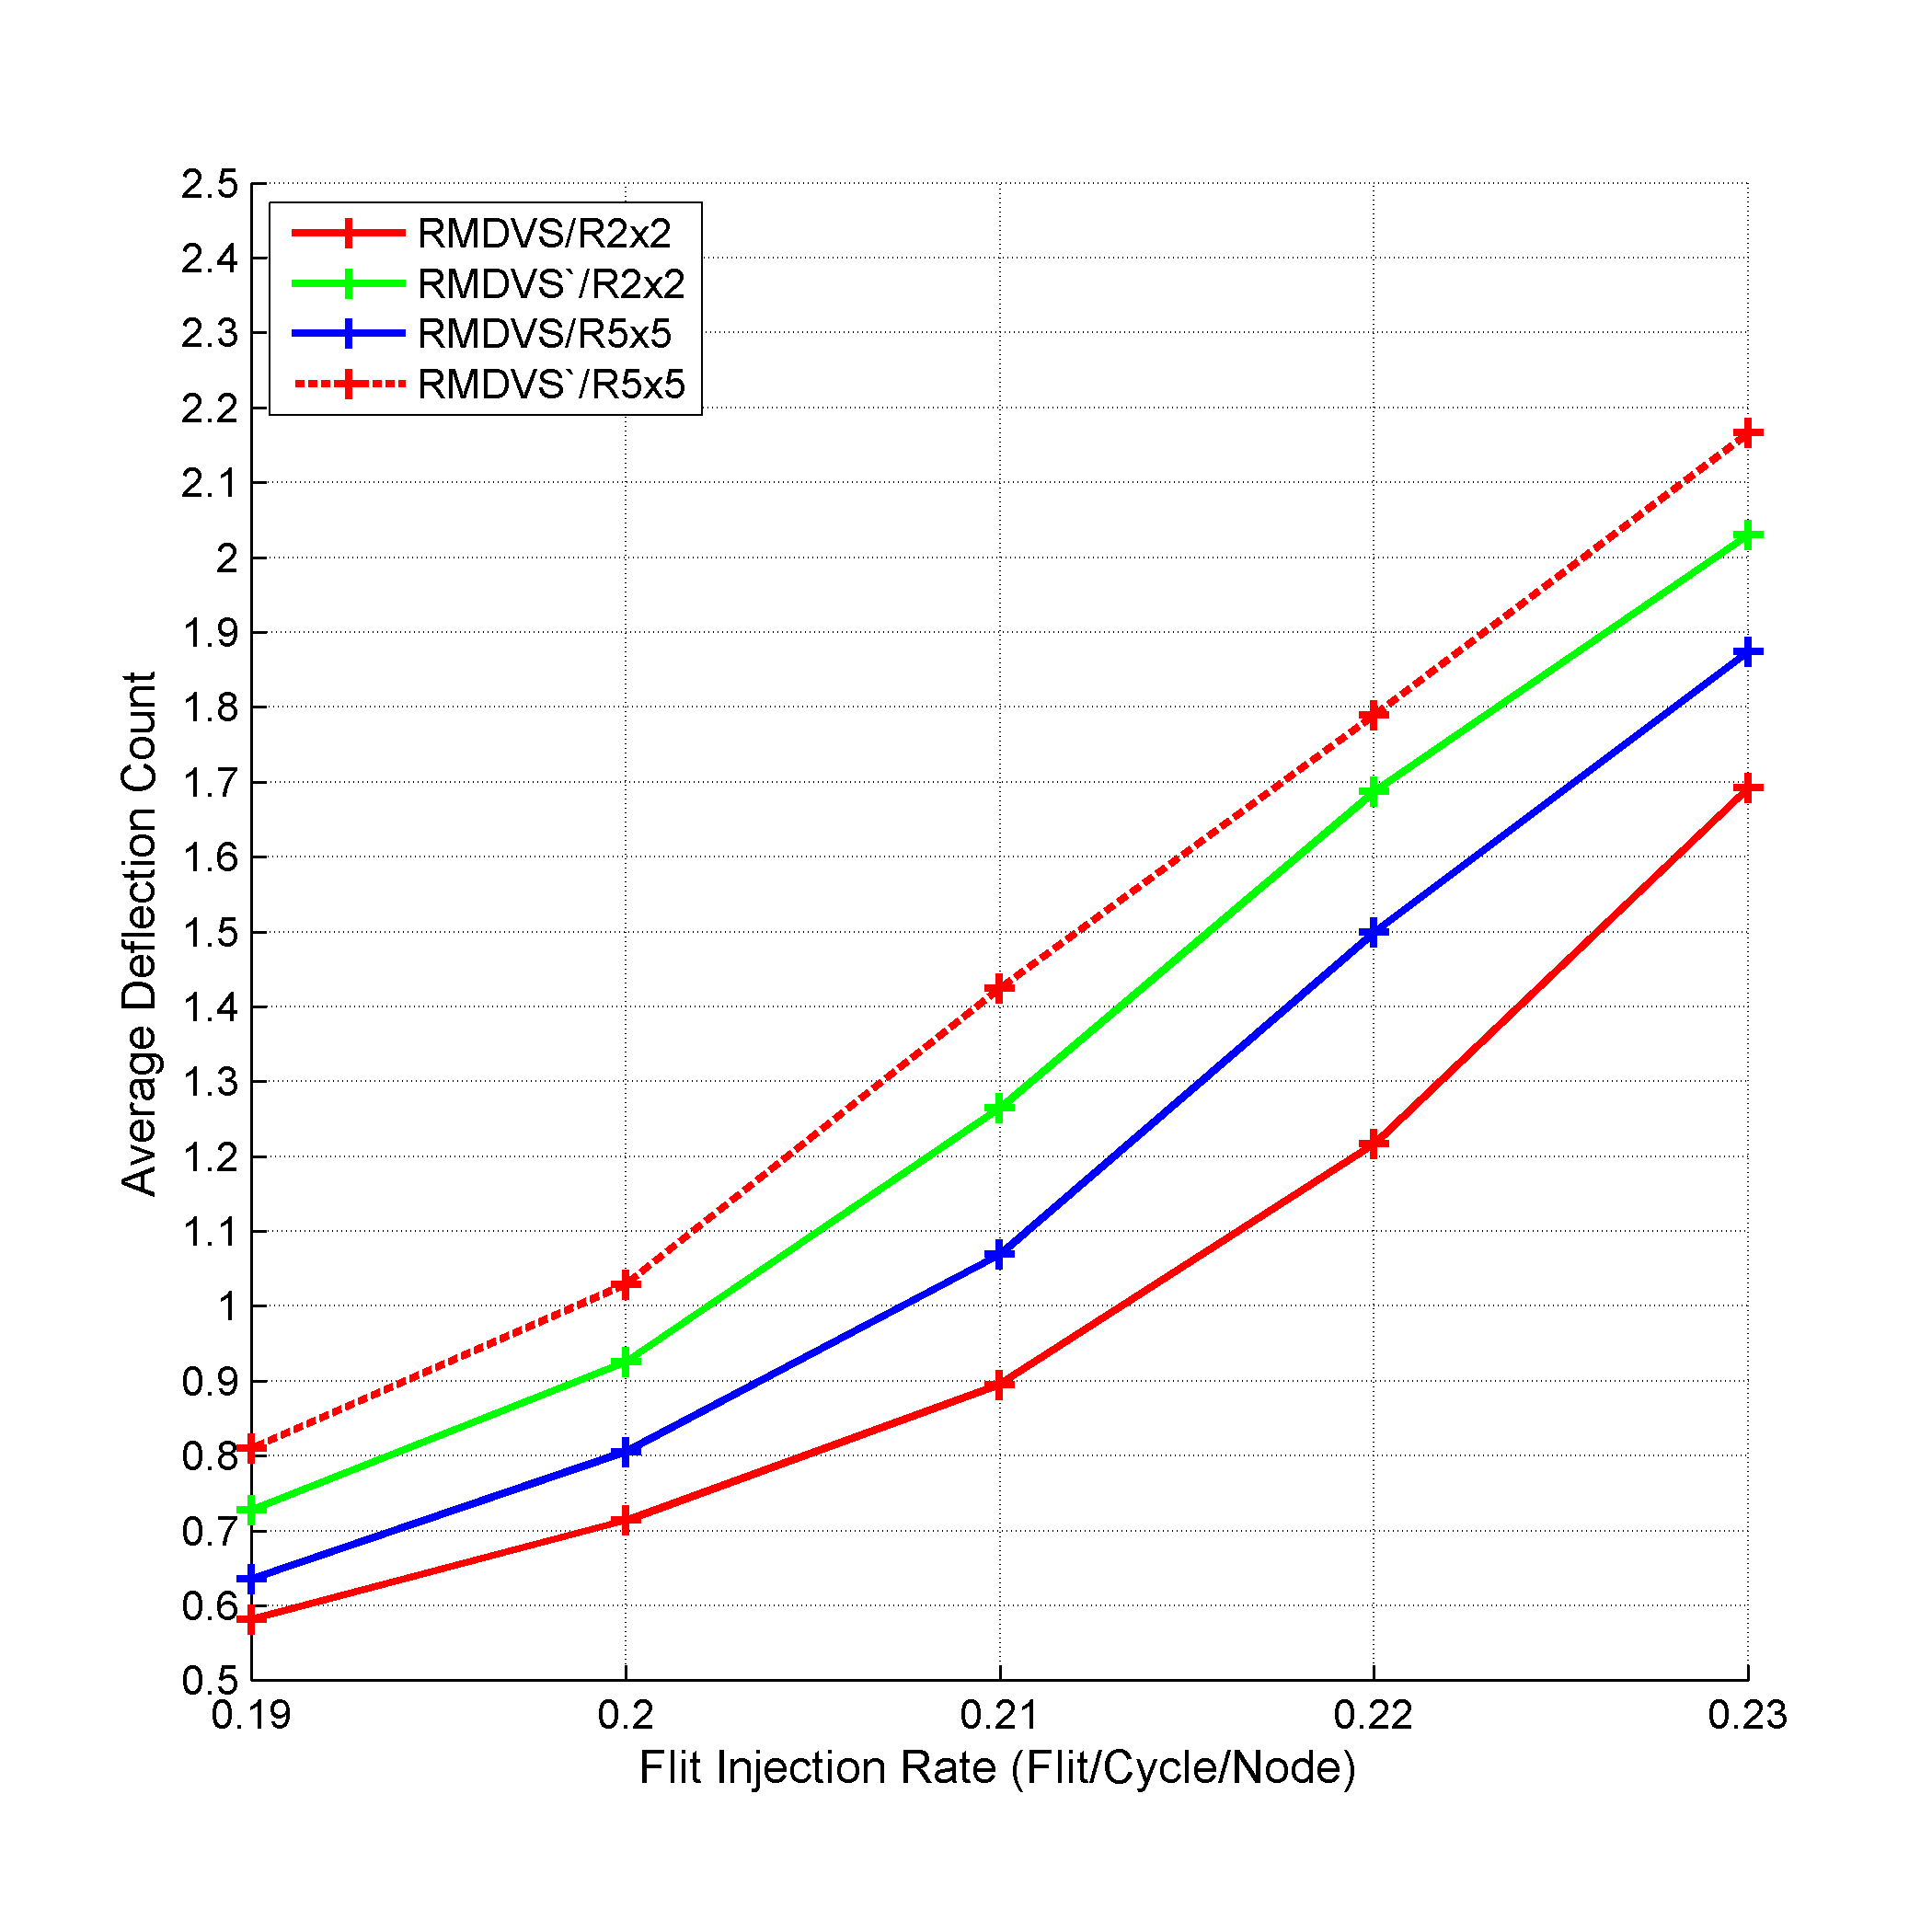
Experimental Results
96%
18%
Notes:
To study the effect of changing the region size, we simulated both RMDVS and RMDVS` using 2x2 region size and 5x5 region size under 10x10 mesh.
We expect RMDVS` to not perform well as it does not conform to the aforementioned fixed step size analysis.
RMDVS performance exceeds the performance of its opposite formula, RMDVS`, in terms of both average packet latency and average deflection count respectively.
The superior performance is accounted for how RMDVS step size calculation conforms to the analysis. RMDVS calculates a large step size for the far node communication, while RMDVS` calculates a small step size. As a result, assigning a large step size decreases the concentration on the NoC central switches and moves part of the traffic to the borders. Also, RMDVS calculates a small step size in case of near nodes communication which produces diversity in distributing the NoC traffic leading to better link utilization, thus better packet latency and deflection count.
Concerning the region size, using 2x2 regions resulted in better performance than using 5x5 regions. This is because using 2x2 region size resulted in 25 regions, while using 5x5 region size resulted in 4 regions only. Increasing the number of regions resulted in more fine control in the step size calculation, thus better distribution for the values of the calculated step size.

Slide 53


IORVS
Using In-Region and Out-Region routing
$${SS}_{In Region}=Fixed$$
$${SS}_{out Region}=Fixed$$
Freedom
Near Nodes Traffic X Far Nodes Traffic
Notes:
We differentiate between the traffic between nodes belonging to the same region (in-region routing), and the traffic between nodes from different regions (out-region routing).
In case of in-region routing, we consider each region to be a separate smaller NoC that can route the traffic between its own nodes using a step size that fits its characteristics. While in out-region routing, we look at the region as a whole unit and route the data between the regions using a step size that is tailored to the inter-region traffic.
Based on the value of both in-region and out-region step sizes, the performance of the MaxFlex varies. Thus, using the freedom granted by IORVS, we study the different behaviour between the near nodes traffic and the far nodes traffic under different in-region and out-region step sizes. Also, we study the effect of the region size on the overall performance.

Slide 54
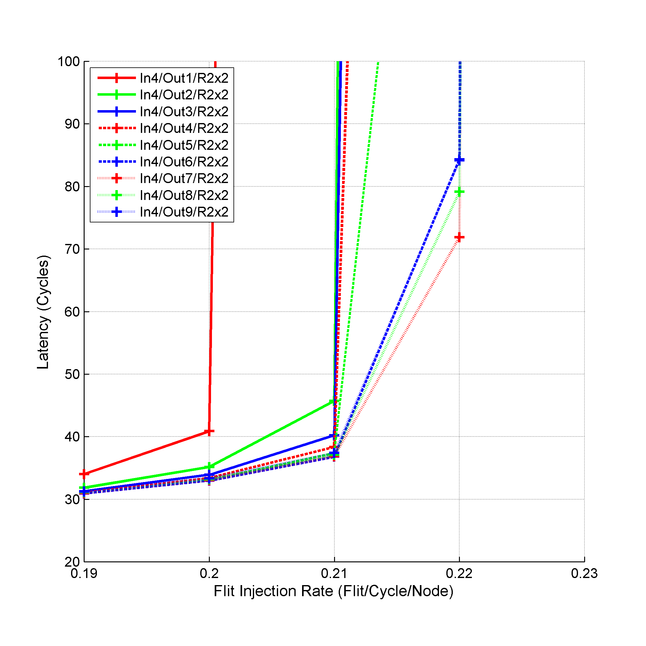
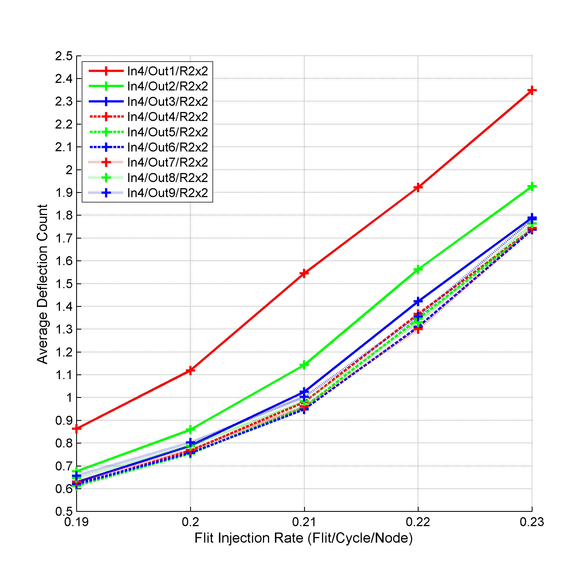
Experimental Results
Notes:
We simulated 10x10 mesh using 2x2 regions and 5x5 regions. Also, as the performance is affected by the in-region step size and out-region step size, we simulated all the possible combinations for the in-region and out-region step sizes.
Concerning far nodes traffic, we noted that under any in-region step size value, using a large step size for out-region communication leads to better performance under both region sizes. Specifically, step size of seven or eight leads to the best performance under the used in-region step size. This conforms to the analysis and step size estimation. It was estimated that using 60% to 80% of the NoC dimension n as a step size performs the best under MMaxFlex (7/10≡70% and 8/10≡80%).
As for the near region traffic, the performance varies based on the used in-region step size value, and the used region size value. For example, the best performance under region size 5x5 is achieved using in-region step size of three. This in-region step size for the 5x5 regions also conforms to the estimation (3/5≡60%). As for 2x2 regions, the best value is achieved using in-region step size of four. However, the performance of all the in-region step size values is almost similar as the used region size is small (2x2 regions). As a result, using any in-region step size value, ranging from one to nine, leads to a behaviour similar to DO routing inside 2x2 region. For the same reasons, using 5x5 regions, any value for in-region step size larger than three leads to similar performance.
As for the effect of the region size, the size of the region doesn’t have a clear cut effect on IORVS approach. This is due to the fact that the calculation of the in-region or out-region step size is not function in the region size or the number of regions as was in RMDVS. In other words, for any region size used and following the work done in Chapter 3, we can estimate a value for the in-region step size, and use large step size for out-region step size to achieve the best possible performance under the used region size.

Slide 55
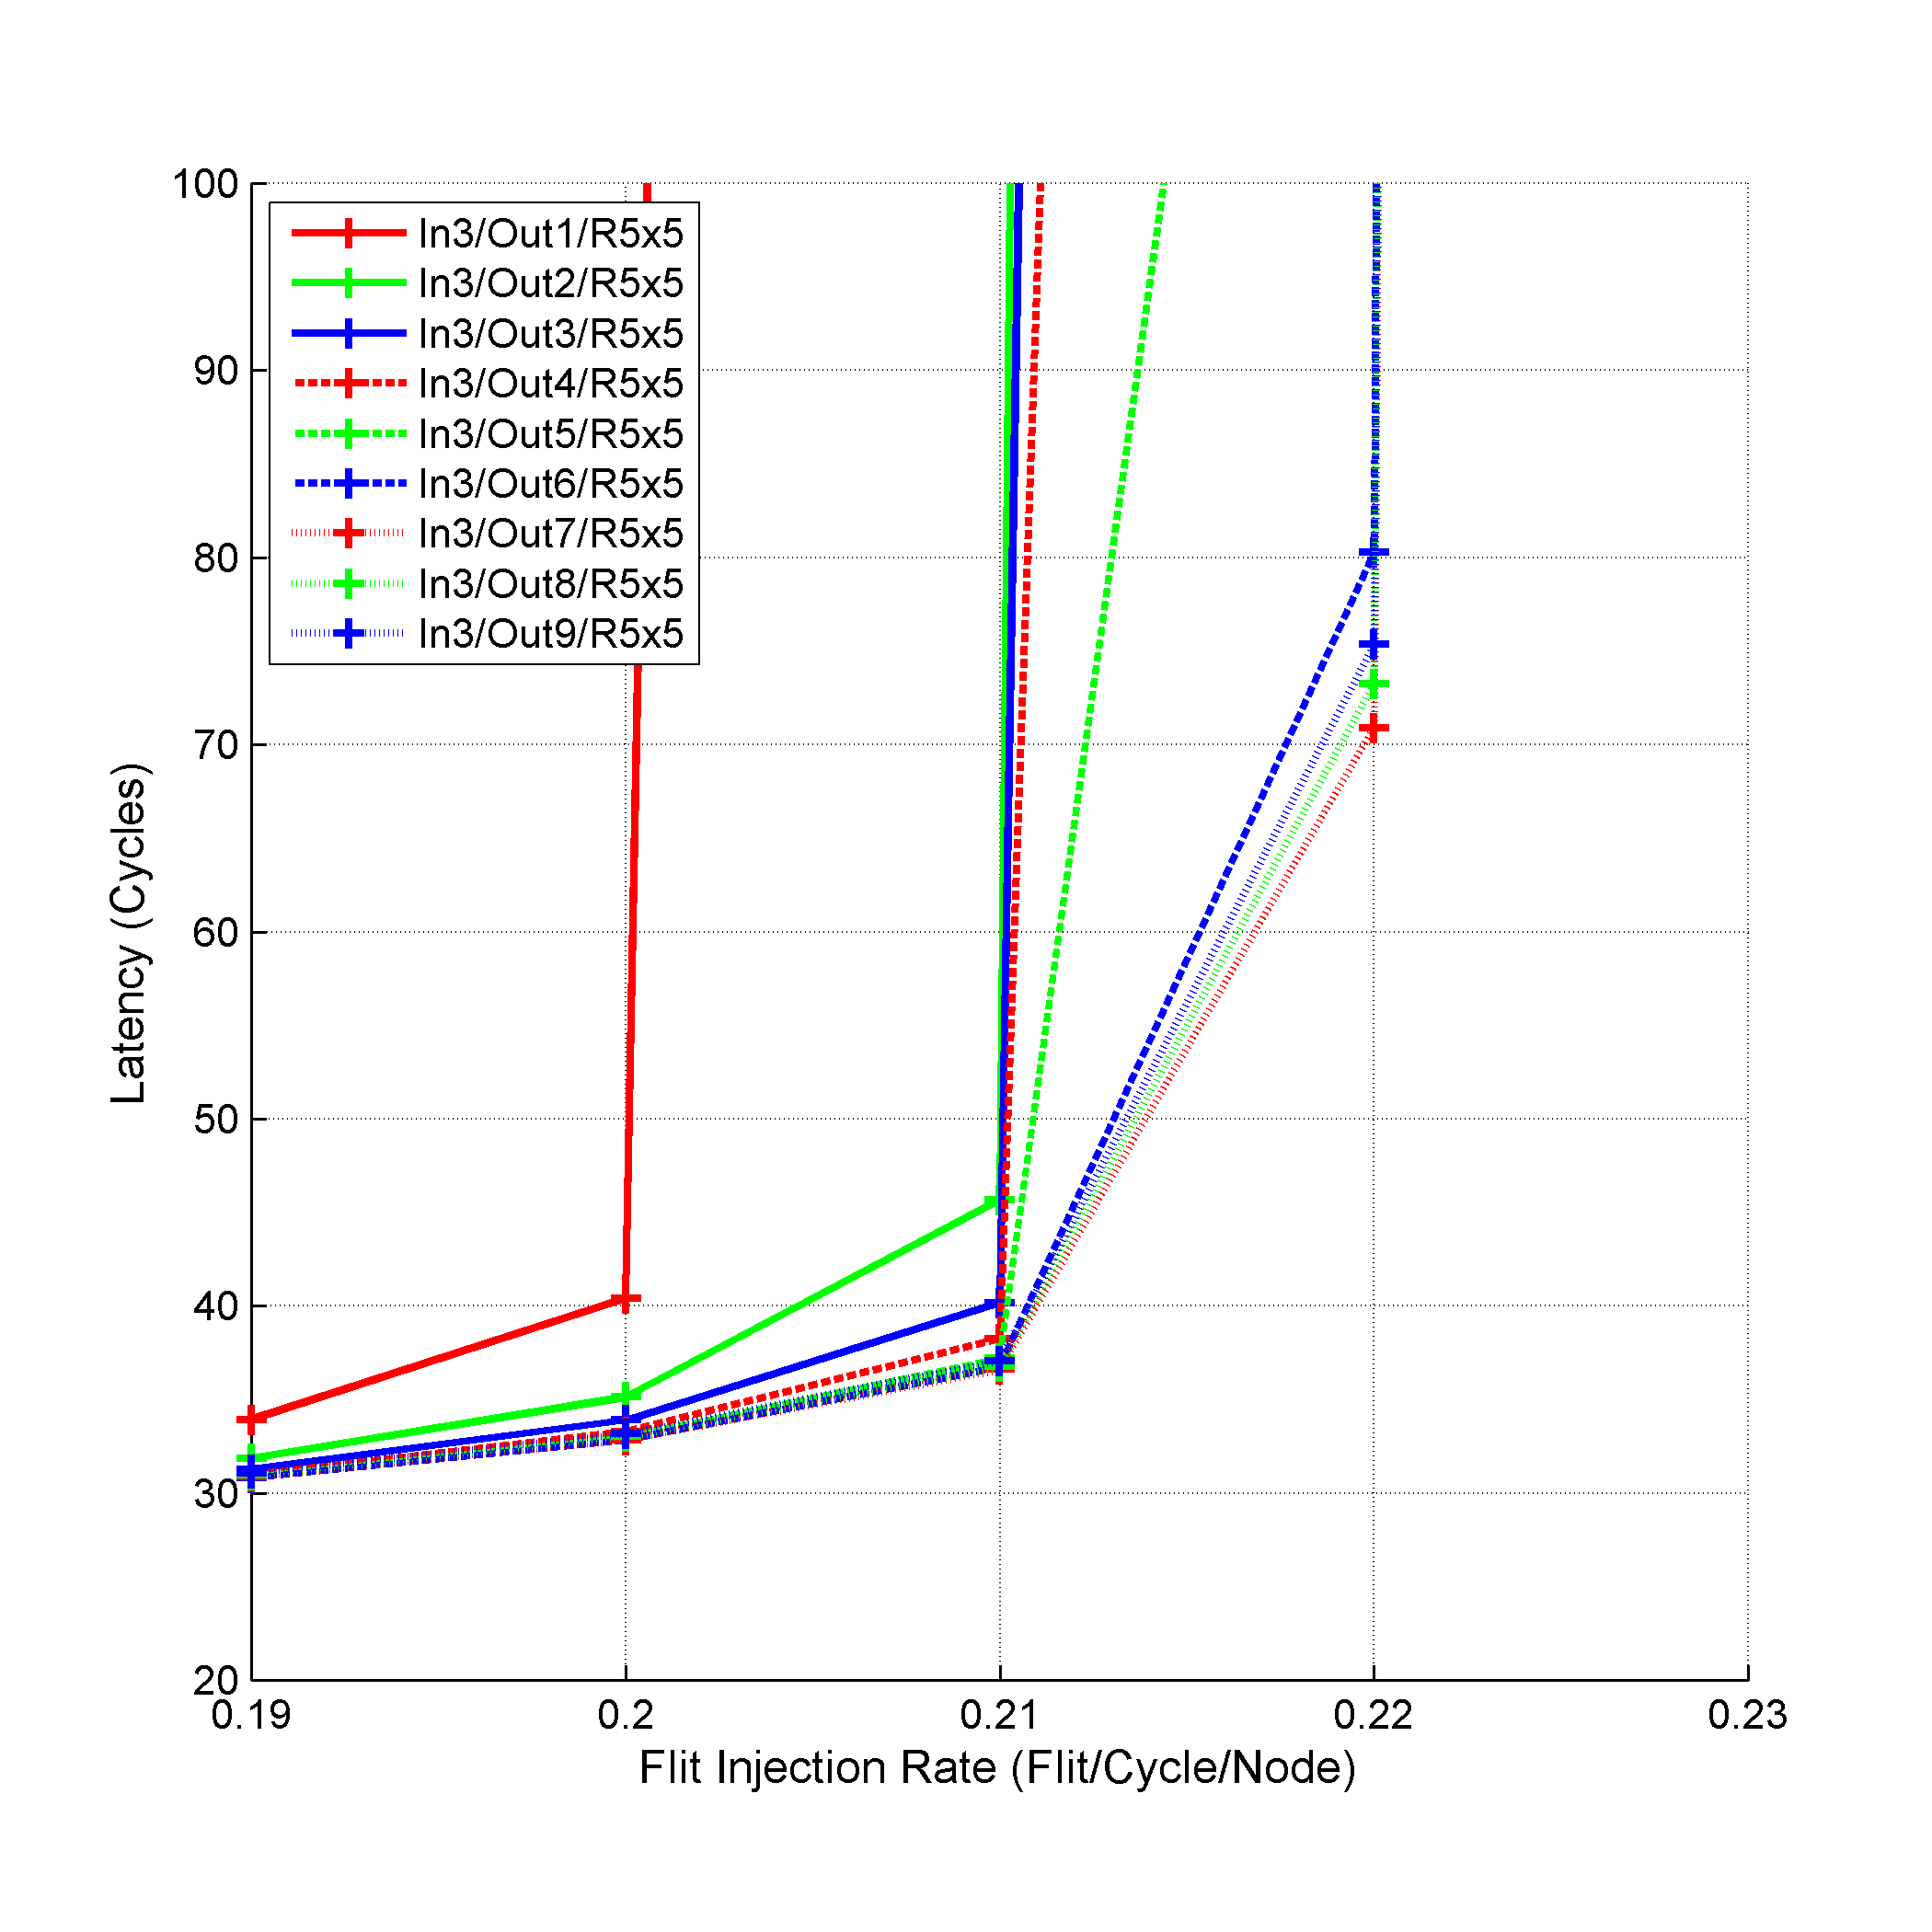
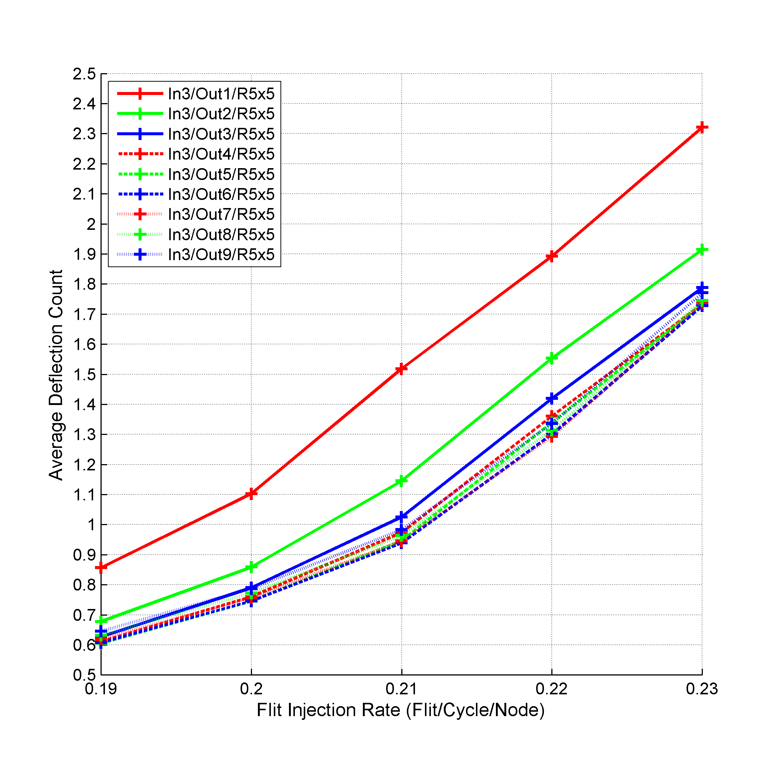
Experimental Results

Slide 56

ORMDVS
Using the Manhattan distance between NoC nodes for Out-Region routing
$${SS}_{In Region}=Fixed$$
$${SS}_{out Region}=Percentage × d_{Region} × {Size}_{Region}$$
Where
Notes:
In this approach, we mix between using the regions concepts as in IORVS with using the Manhattan distance between NoC nodes approach as in NMDVS. Specifically, we use a fixed step size customized for the in-region routing, and use the Manhattan distance between NoC nodes for calculating the out-region step size.
In other words, ORMDVS uses the idea of assigning the step size as a percentage of the distance between the source and destination nodes mentioned in NMDVS, but in order to calculate such distance, it uses the Manhattan distance between the regions and the region’s size instead of using the Manhattan distance between source and destination nodes. It aims to get the advantage of NMDVS and the flexibility of IORVS.

Slide 57
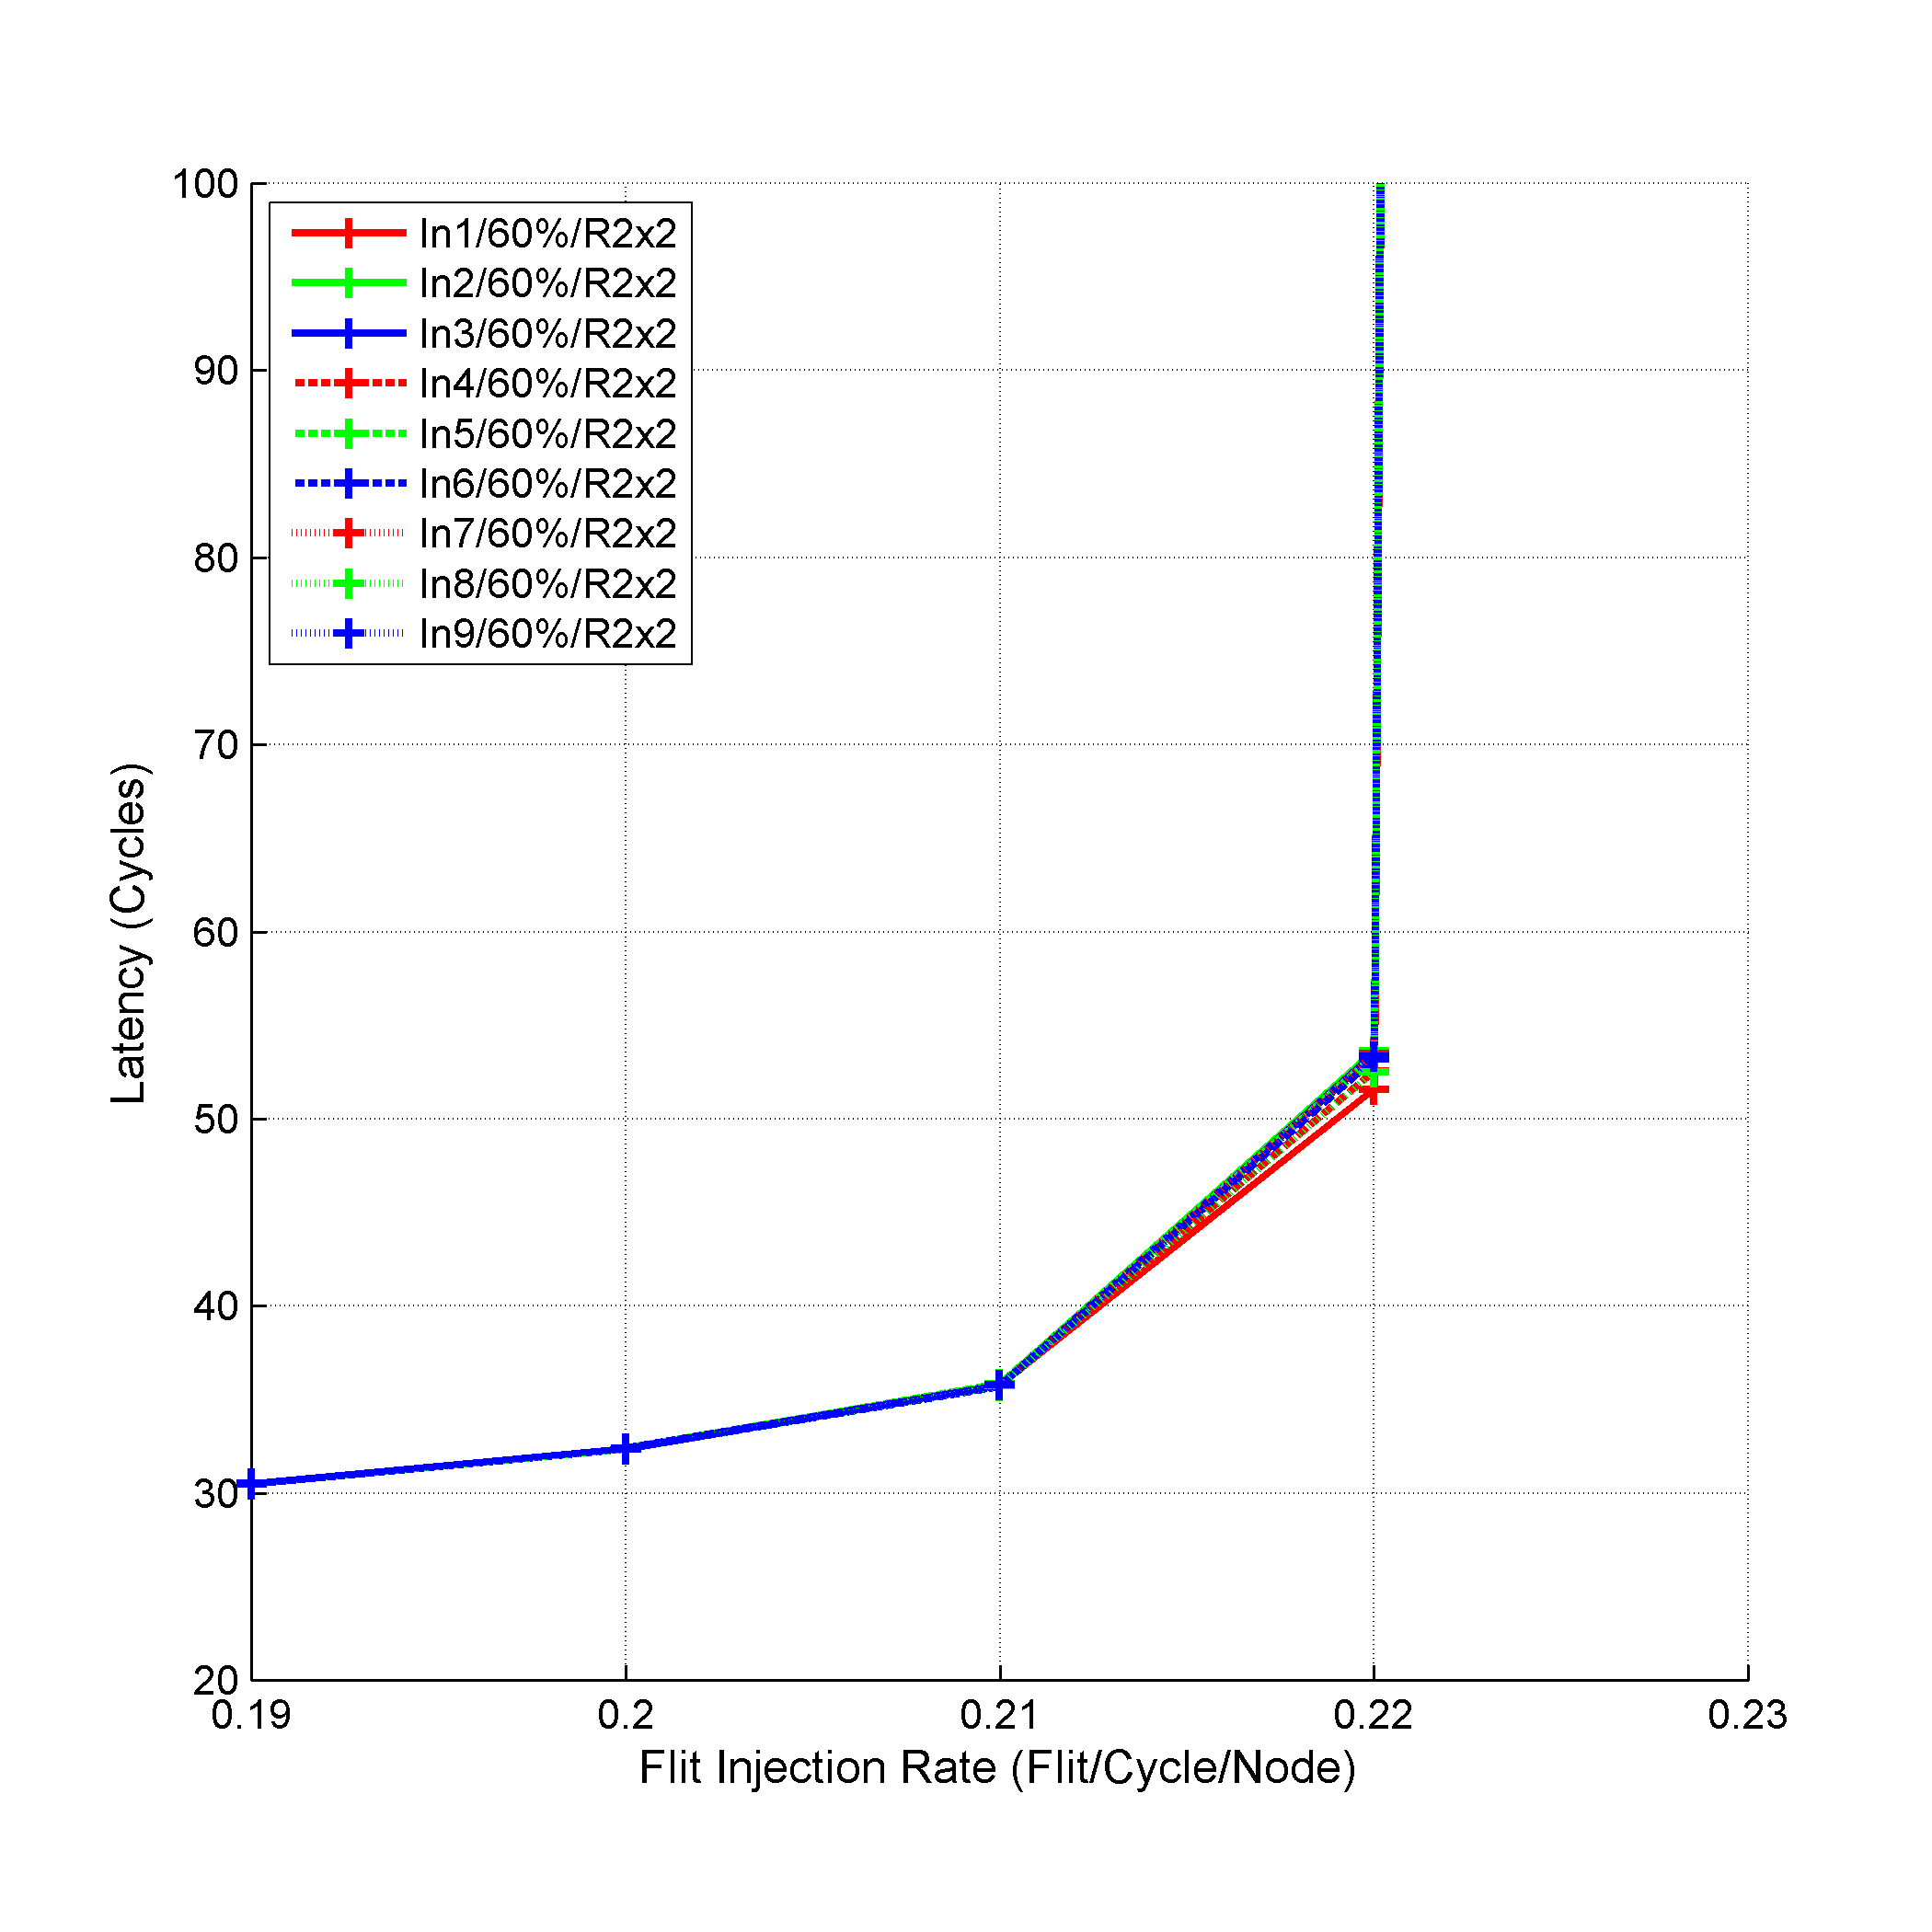
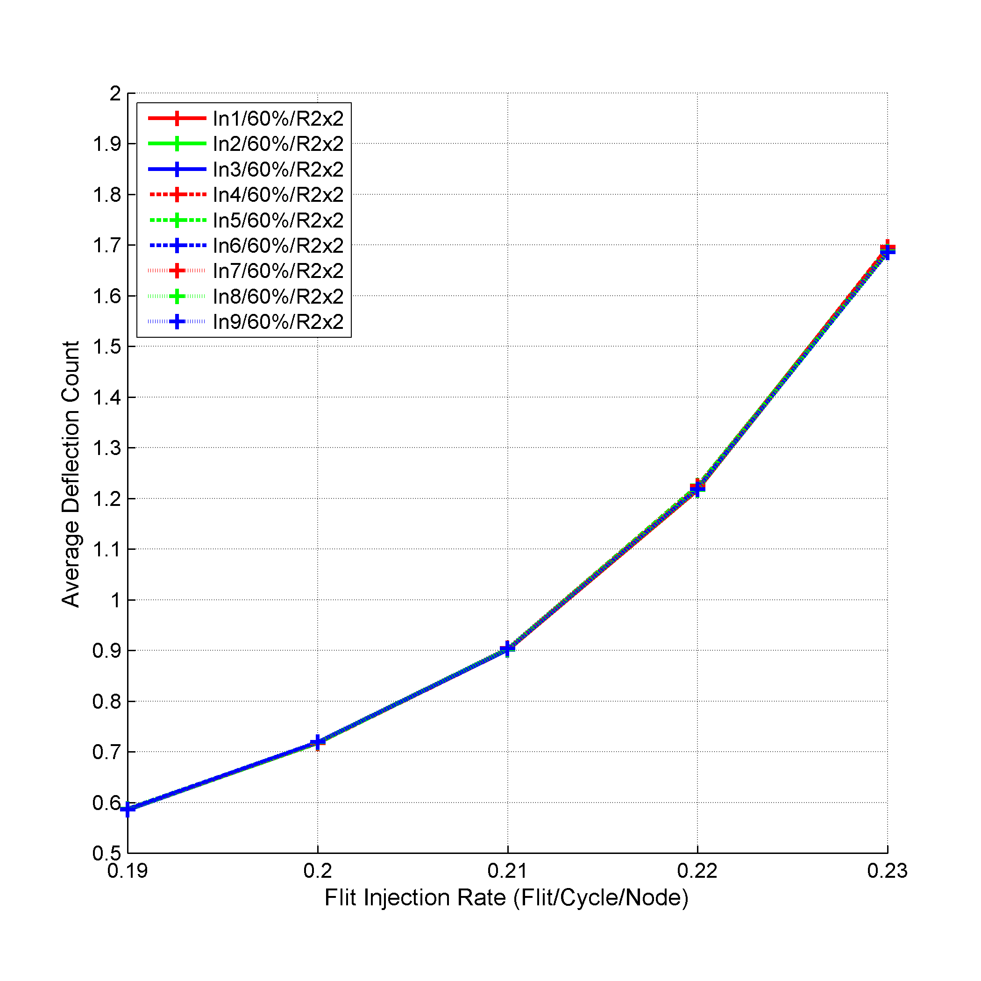
Experimental Results
Notes:
We simulated 10x10 mesh using 2x2 regions and 5x5 regions. For the percentage value, we used 60% as it achieved the best performance under NMDVS. For the in-region step size, we used different values ranging from one to nine to evaluate the effect of changing the in-region step size.
For 2x2 regions, the performance under any in-region step size is similar with a slight advantage for in-region step size of one. This is due to using small region size (2x2 regions). As a result, using any in-region step size value, ranging from one to nine, leads to a behavior similar to DO routing inside 2x2 region.

Slide 58
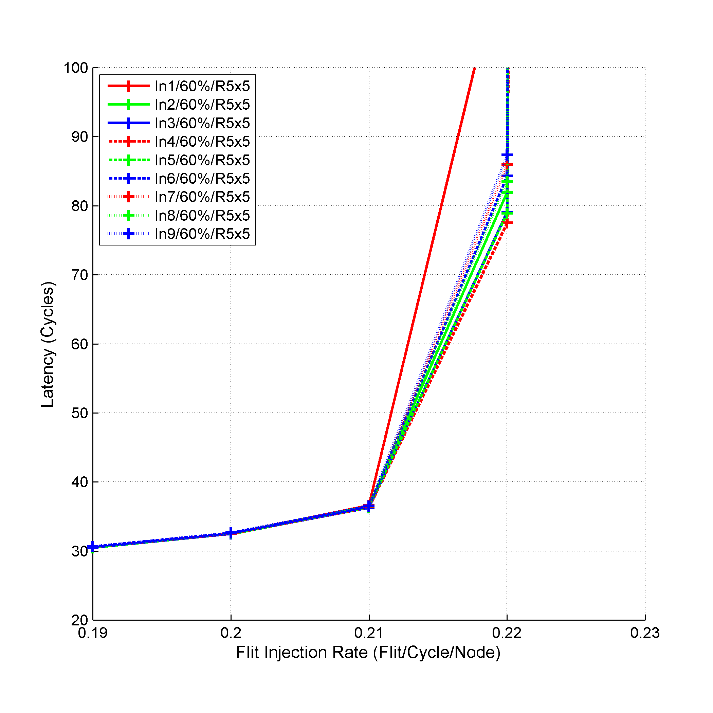
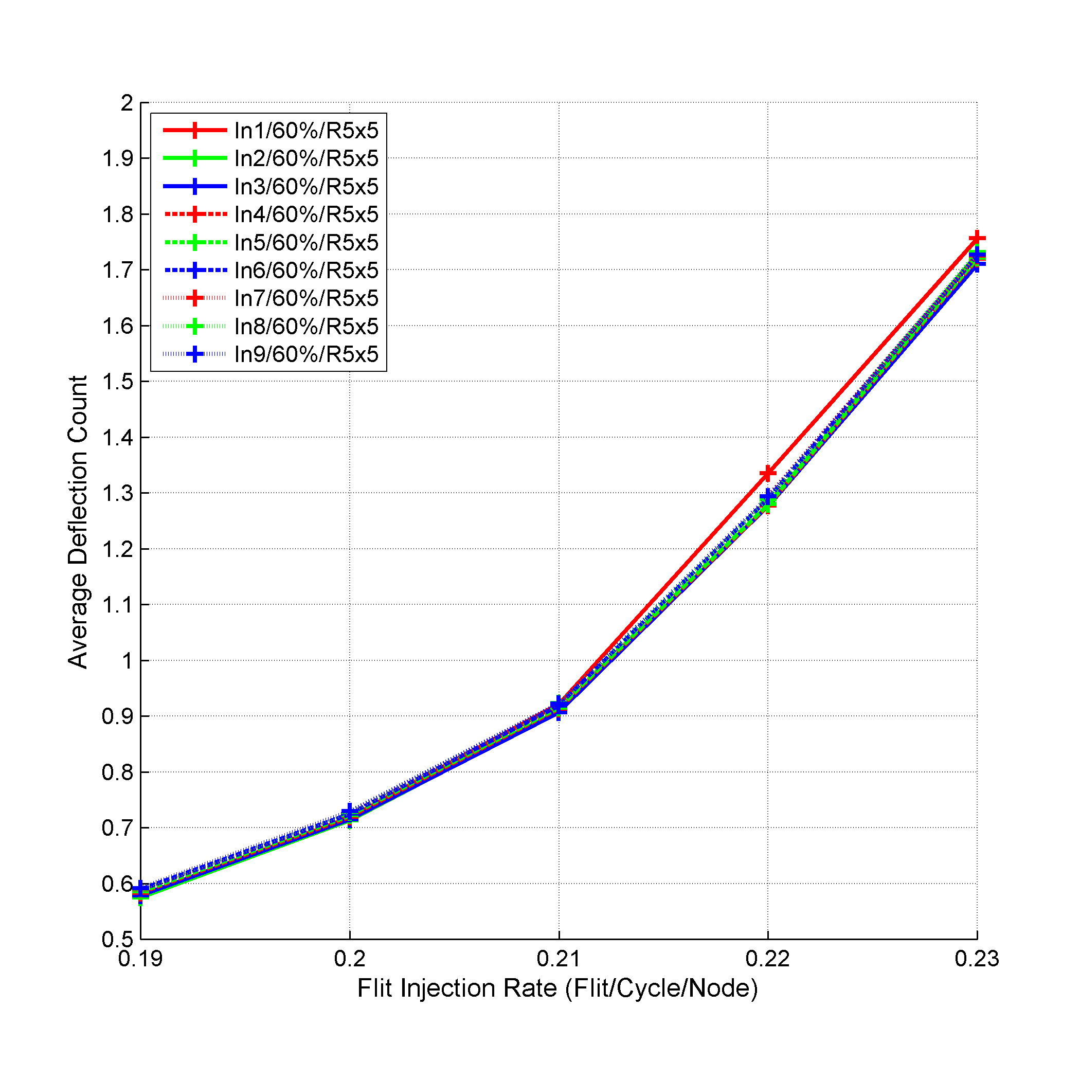
Experimental Results
33%
4%
Notes:
Using 5x5 regions leads to worse performance than using 2x2 regions. The best performance for 5x5 regions is achieved using in-region step size of four due to the step size estimation presented in Chapter 3.
Under ORMDVS, using 2x2 regions is better than using 5x5 regions as 2x2 regions generates more regions than using 5x5 regions (25 regions versus 4 regions). More regions means for flexibility in calculating the out-region step size. For example, using 5x5 regions (4 regions), the distance between regions can be one or two only. Thus, the distance estimated between the communicating nodes, based on the used formula, has a two values only (five or ten) leading to out-region step size values of three and six only. On the other hand, using more regions under 2x2 region size, gives more values for the distance between the regions, thus leading to more variability in the calculated out-region step size.

Slide 59
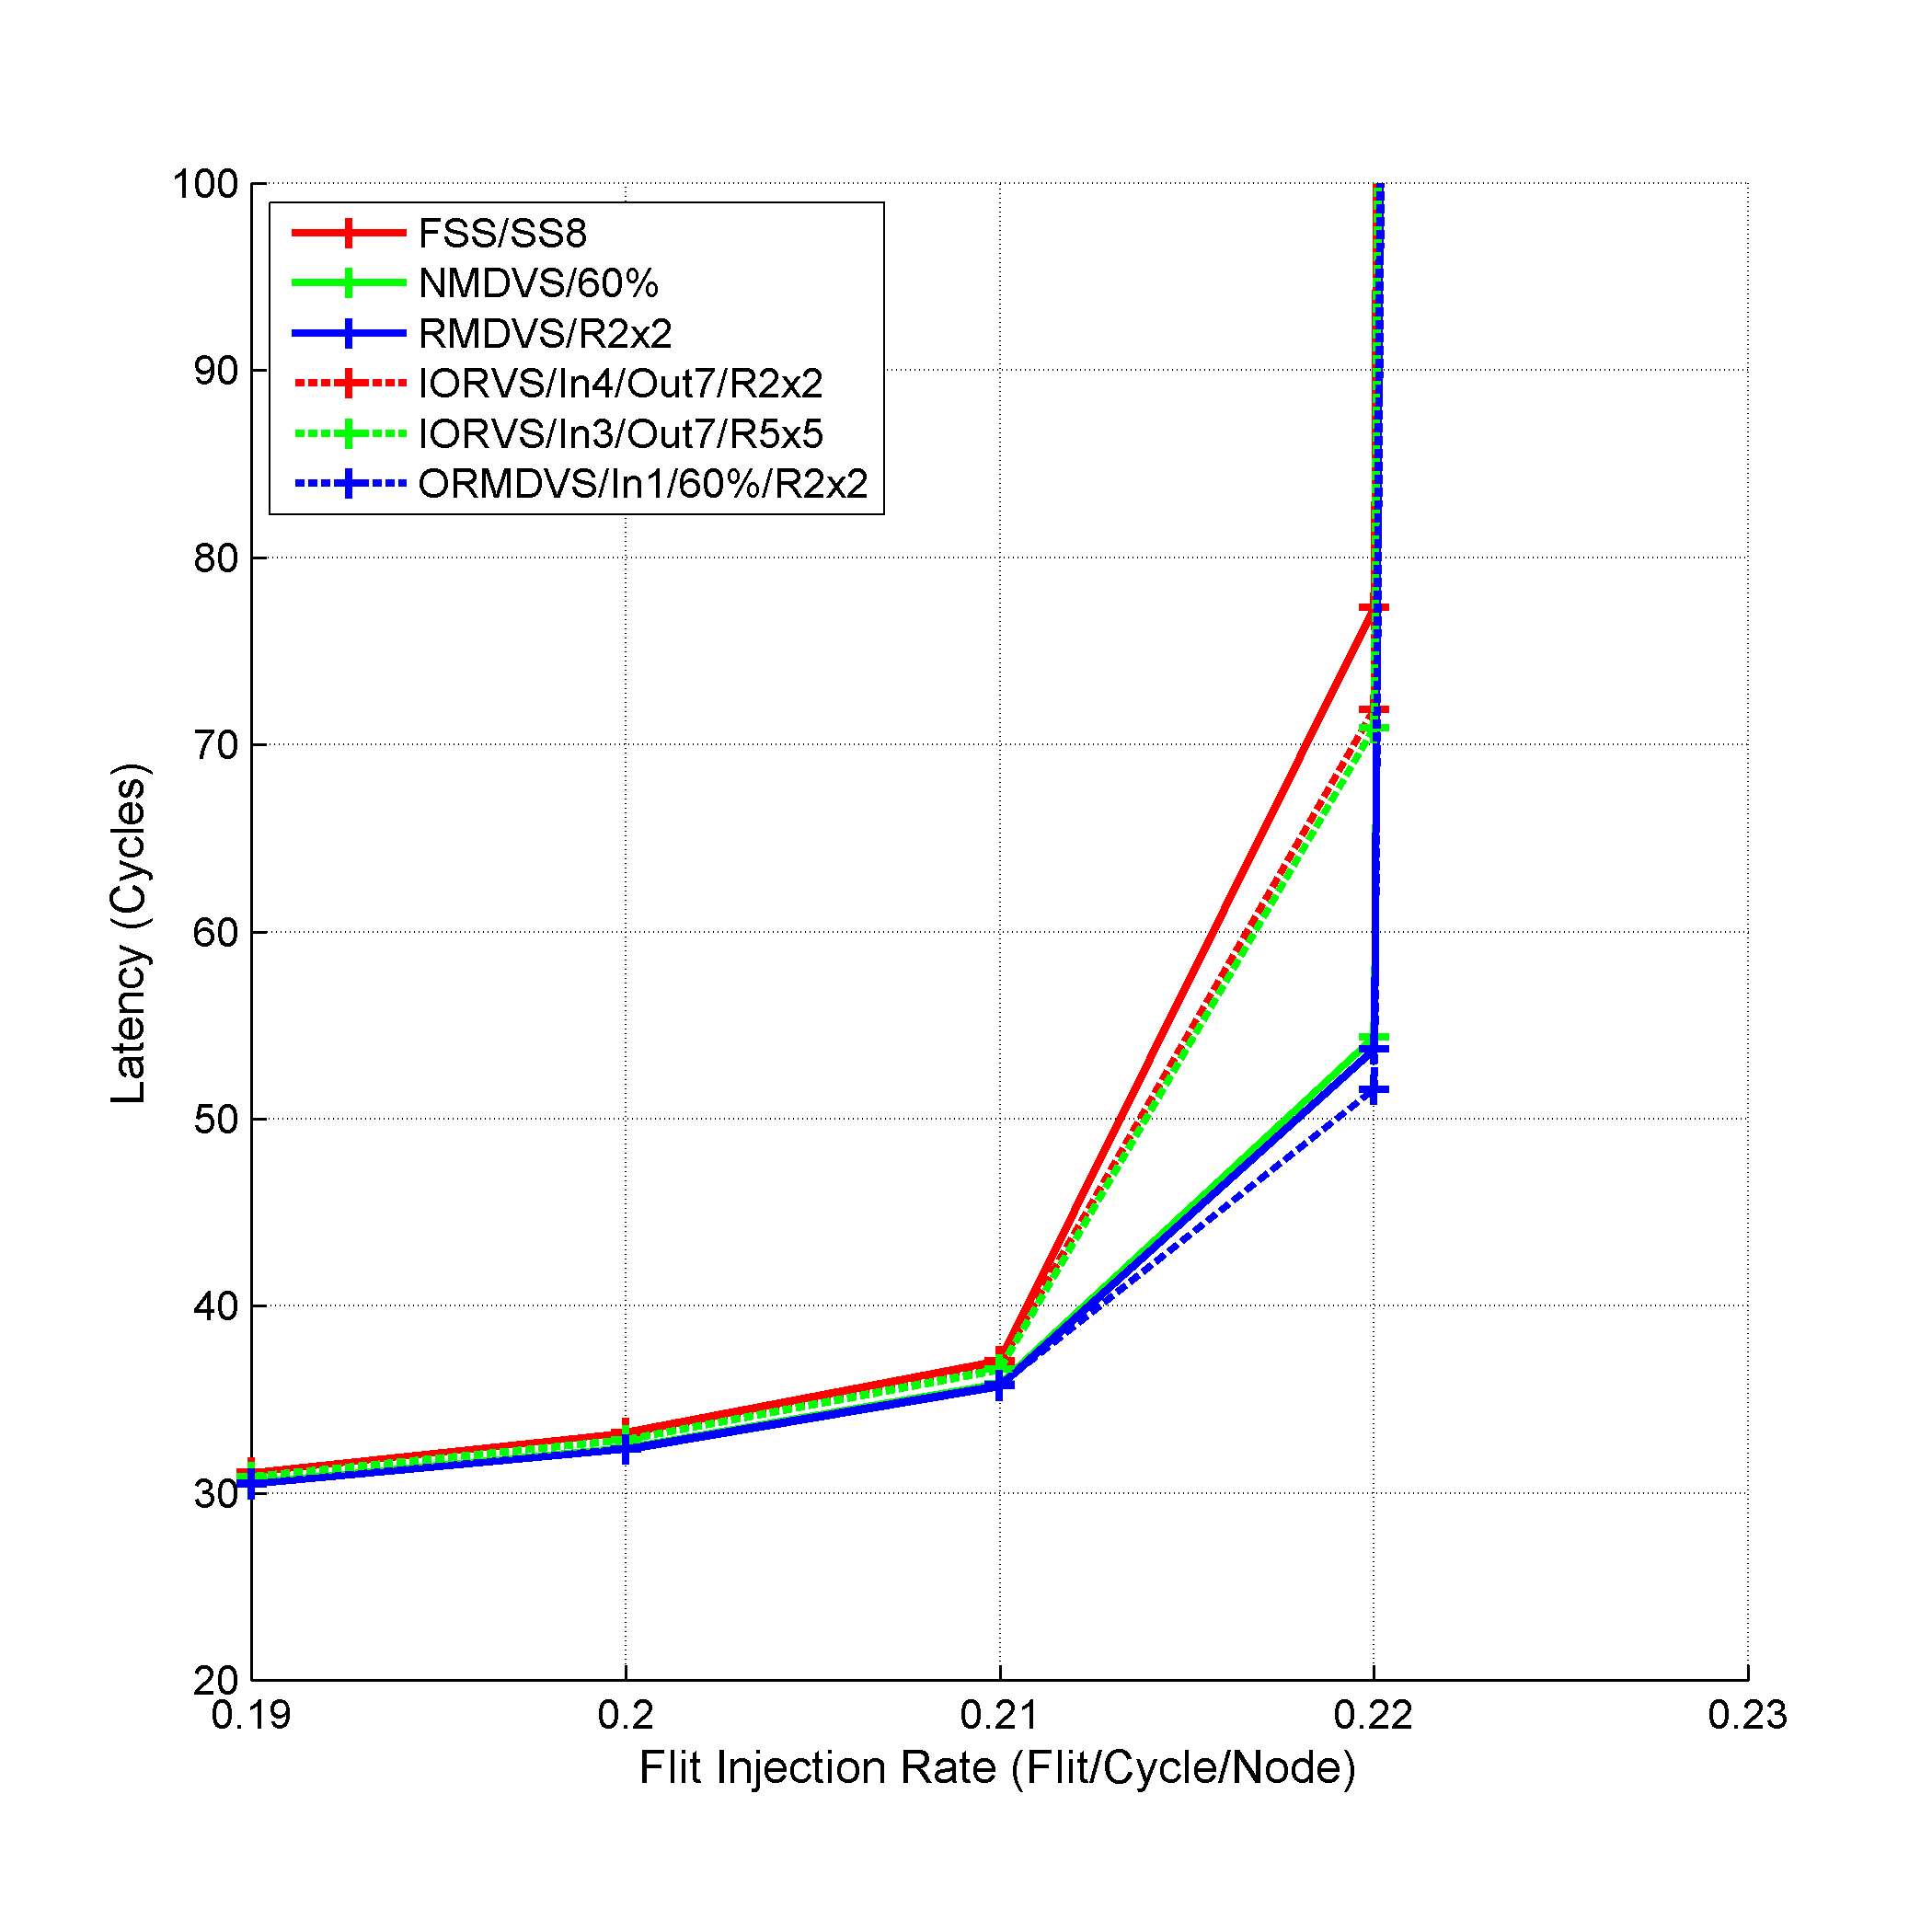
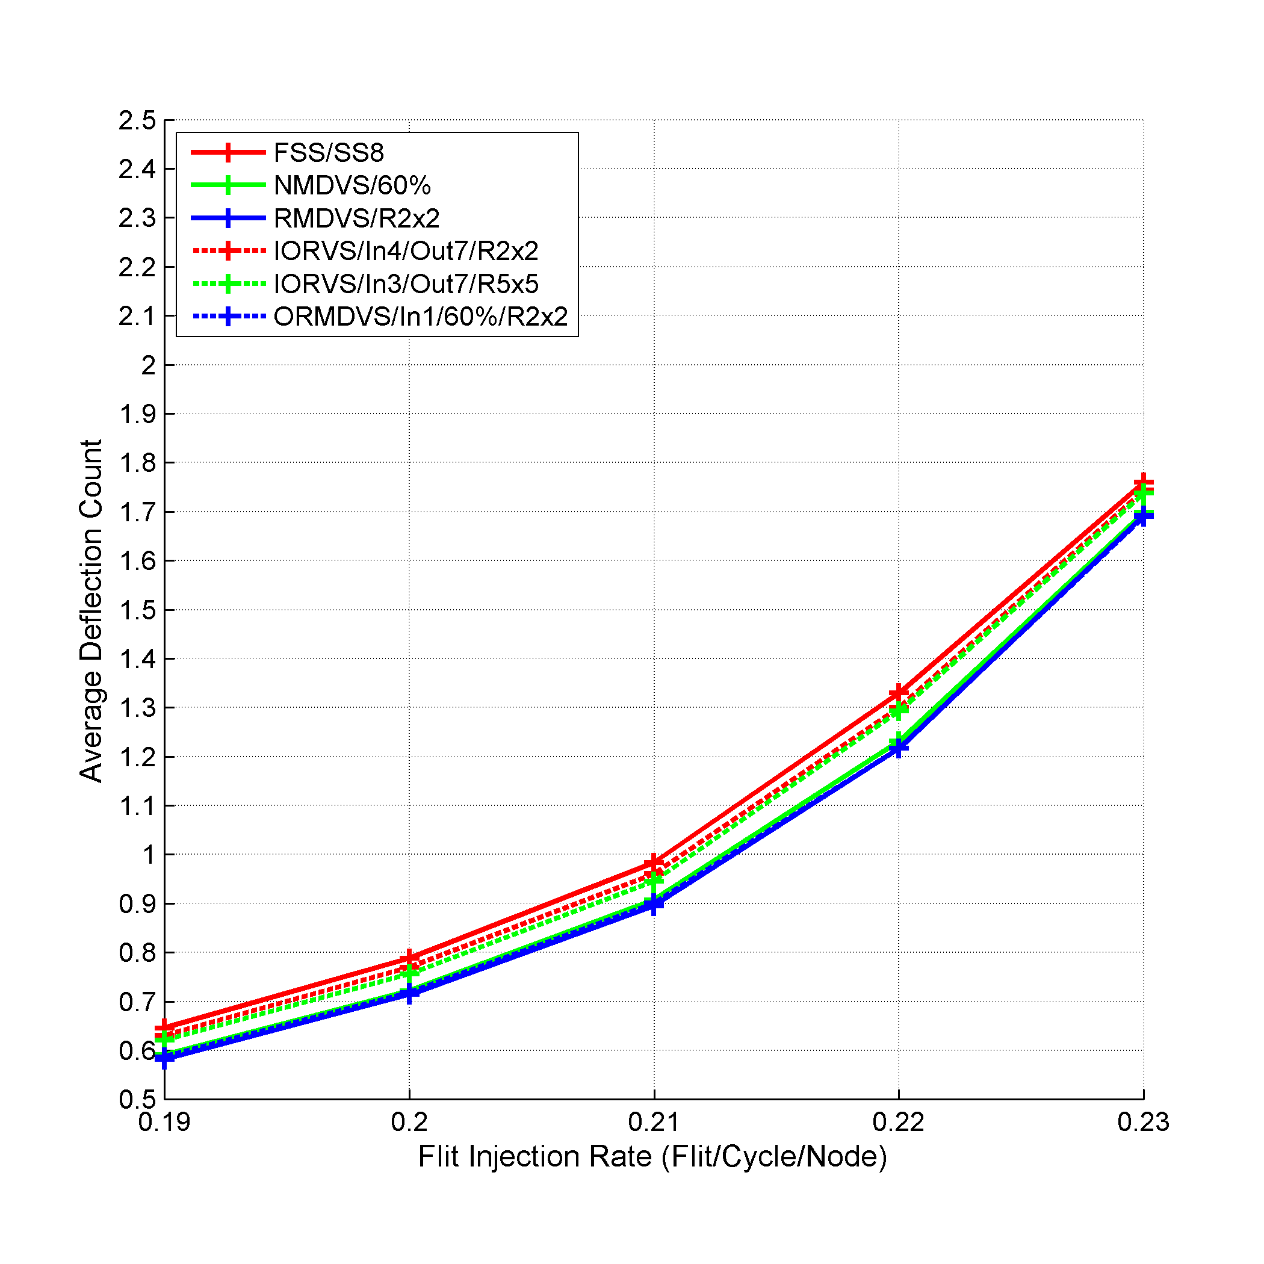
Experimental Results
29%
30%
7%
8%
33%
7%
8%
2%
2%
8%
Notes:
To evaluate the different approaches, we selected the best result achieved under each approach, and compared these results with using fixed step size of eight under MMaxFlex. For NMDVS, we used 60% as the percentage. For RMDVS, we used 2x2 region size. As for IORVS, we selected in-region step size of four and out-region step size of seven under 2x2 region size, and in-region step size of three and out-region step size of seven under 5x5 region size. Finally for ORMDVS, we used 60% as the percentage and in-region step size of one under 2x2 region size.
All the proposed approaches enhances the performance over using a fixed step size of eight under MMaxFlex in terms of both average packet latency and average deflection count. This is due to using different step size values for the packets instead of fixing the value for all the packets. This variability leads to better traffic distribution thus better utilization for the bufferless NoC links.
We note that IORVS approach achieves the least enhancement over the fixed step size. Specifically, using 2x2 regions, the enhancement is 7.03% and 2.23% in terms of average packet latency and average deflection count respectively. While using 5x5 regions enhances by 8.3% and 2.79% in terms of average packet latency and average deflection count respectively. This small enhancement is due minimum variability used in IORVS. IORVS can be seen as an update for using fixed step size; however, instead of fixing the step size for all the packets, we use two separate fixed values for in-region and out-region routing.
Also, the performance of NMDVS, RMDVS, and ORMDVS is almost similar with the best performance achieved by ORMDVS using 2x2 regions. ORMDVS enhances over fixed step size under MMaxFlex by 33.28% and 8.49% in terms of average packet latency and average deflection count respectively. The superiority of these approaches can be seen as a result of the higher variability achieved in calculating the step size. Additionally, ORMDVS superior enhancement is due to mixing NMDVS and IORVS. Using IORVS granted the flexibility in separating the in-region and out-region routing. While using NMDVS granted better distribution and variability for calculating the out-region step size.

Slide 60
New Flit Ranking Policies

Slide 61
Motivation
Deflection Count
Performance
Decrease Deflections
Favor the Flits with Higher Deflections
Better Network Performance

Slide 62
Flit Ranking Policies
Flit Ranking Policies
Oldest First
OF
Most Deflections First
MDF
Deflection Age Ratio
DAR
Deflection Distance Ratio
DDR
Last Dimension
LD

Slide 63






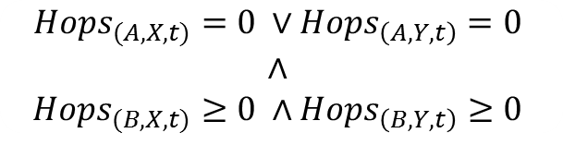


Flit Ranking Policies
OF
$${Age}_{(A,t)}≥{Age}_{(B,t)}$$
$${Priority}_{(A,t)}≥{Priority}_{(B,t)}$$
MDF
$${Deflection}_{(A,t)}≥{Deflection}_{B,t)}$$
$${Priority}_{(A,t)}≥{Priority}_{(B,t)}$$
DAR
$$\frac{{Deflection}_{(A,t)}}{{Age}_{(A,t)}}≥\frac{{Deflection}_{(B,t)}}{{Age}_{(B,t)}}$$
$${Priority}_{(A,t)}≥{Priority}_{(B,t)}$$
DDR
$$\frac{{Deflection}_{(A,t)}}{{Distance}_{A}}≥\frac{{Deflection}_{(B,t)}}{{Distance}_{B}}$$
$${Priority}_{(A,t)}≥{Priority}_{(B,t)}$$
$${Hops}_{(A,X,t)}=0 ∨{Hops}_{\left(A,Y,t\right)}=0$$
$$∧$$
$${Hops}_{(B,X,t)}≥0 ∧{Hops}_{\left(B,Y,t\right)}≥0$$
LD
$${Priority}_{(A,t)}≥{Priority}_{(B,t)}$$
Notes:
DAR ranking policy chooses the deflection/age ratio as its criteria. DAR prioritizes the flits with higher ratio. OF and MDF policies favor the oldest and most deflected respectively, however, the flit may be old or deflected many times because the distance between its source and destination is large. Thus, DAR takes into consideration both the time the flit has been in the NoC and its deflection count. DAR favors the flits that have suffered more deflections during its lifetime in the NoC.
DDR ranking policy chooses the deflection/distance ratio as its criteria. The distance is the Manhattan distance between the source and destination of the flit. DDR prioritizes the flits with higher ratio. Following the same idea as in DAR, DDR favors the flits that have suffered more deflections during the path from its source and destination.
LD is an enhancement that can work with any of the ranking schemes. It is designed to work specifically with bufferless NoCs and MaxFlex selection function. In case of competing flits, LD favors the flit that has hops in only one direction. In case of a draw, LD uses other ranking policies to break the draw. For example, it two flits are competing and one of the flits has only moves left in the X direction, while the other still has moves in both X and Y directions, then LD favors the first flit.
The motivation behind favoring the flit stuck in one direction is that any deflection for this flit leads to extra unnecessary detour. This detour needs at least two cycles to correct the path of the flit. Thus, if we choose not to deflect this flit, we enhance the overall packet latency as we decreases the overall deflection count.

Slide 64
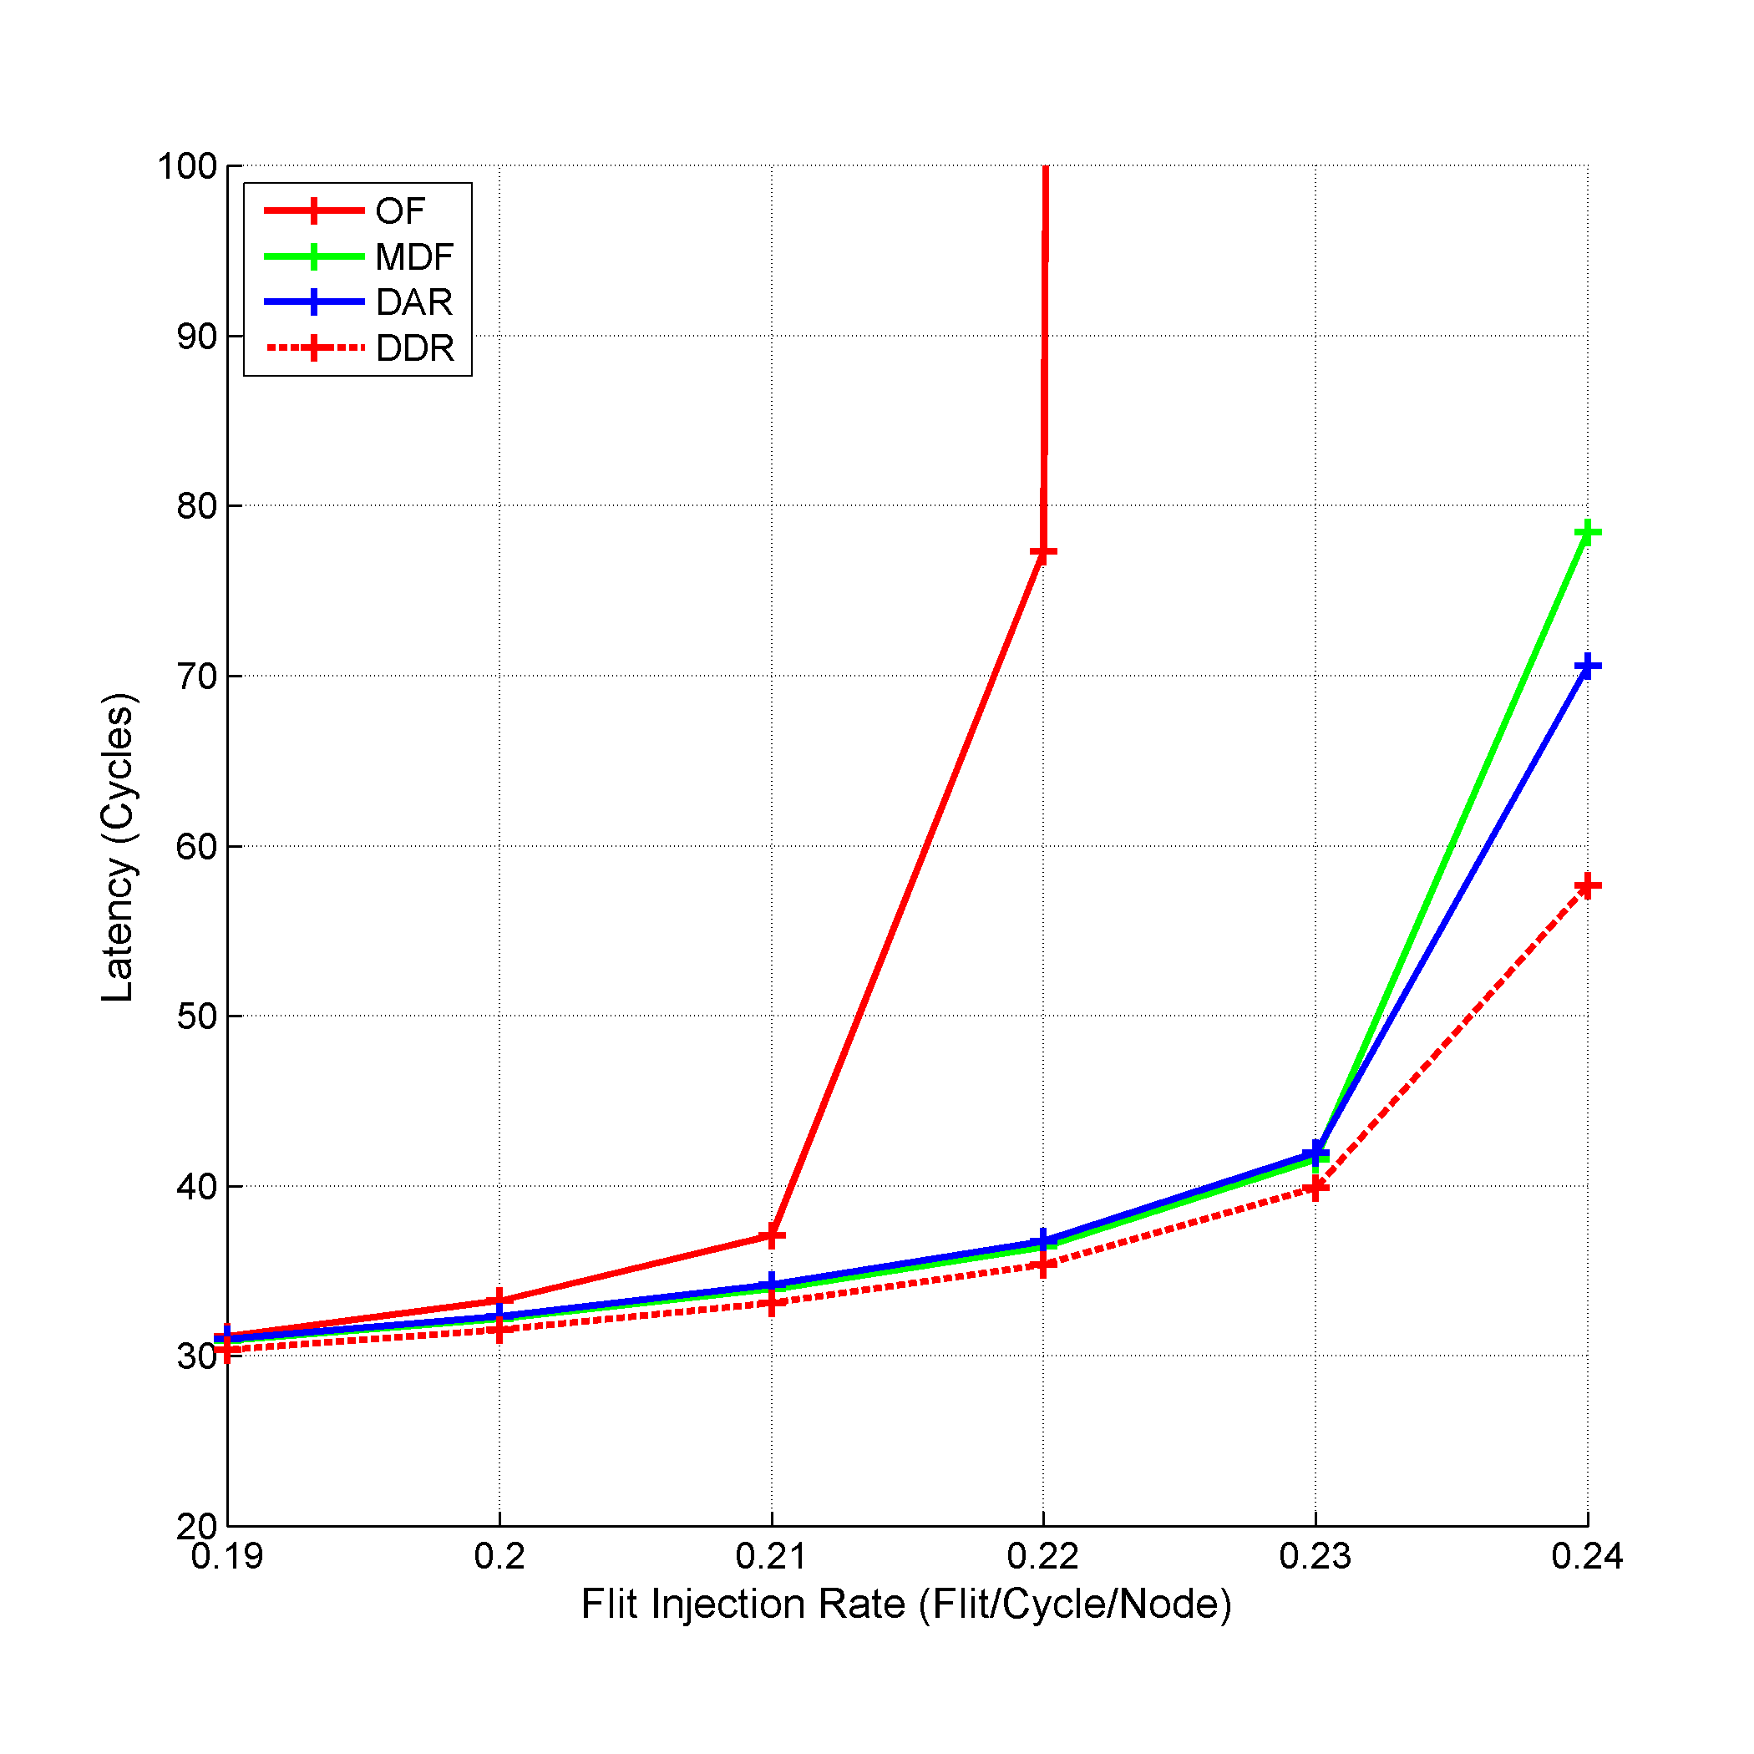
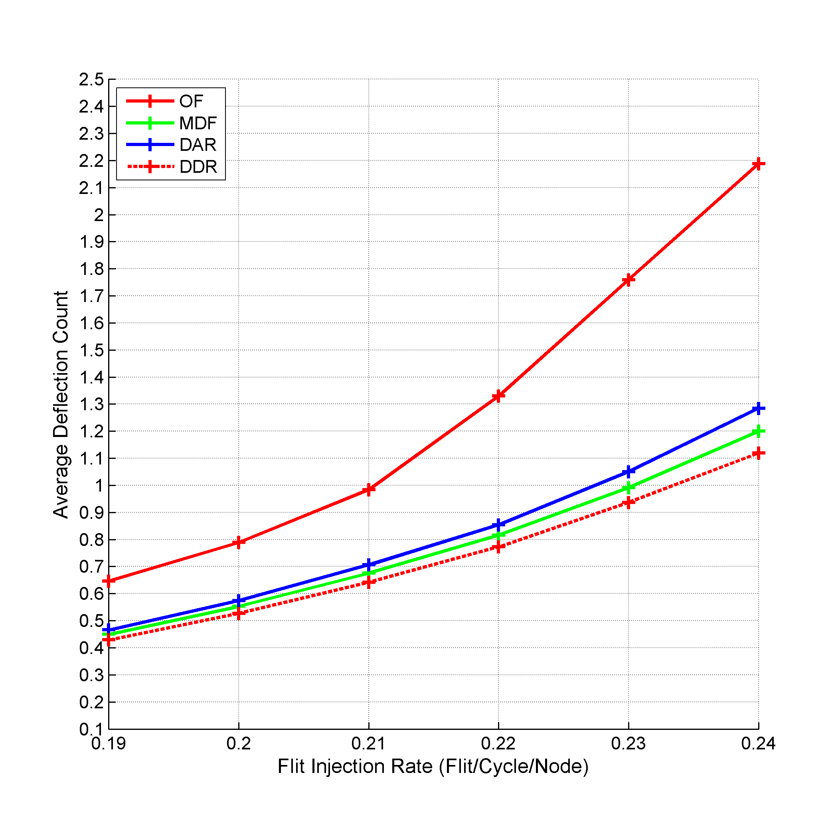
Experimental Results
Notes:
All the deflection based policies have a superior performance over the OF ranking policy in addition to operating under higher injection rates. Also, the proposed policies DAR and DDR exceed MDF performance in terms of packet latency. That is because MDF only focus on the deflections without considering the time spent in the NoC or the distance to be covered.
DDR has the best performance in terms of both packet latency and deflection count as it considers the shortest distance between the source and destination of the flit. The shortest distance between the source and destination is known and can be calculated upfront. As a result, if a flit suffered high deflection count while travelling short distance, it is favored over the flit that was deflected the same number of times but while travelling long distance. Thus, factoring the distance differentiates between the two flits even though they have the same deflection count.

Slide 65
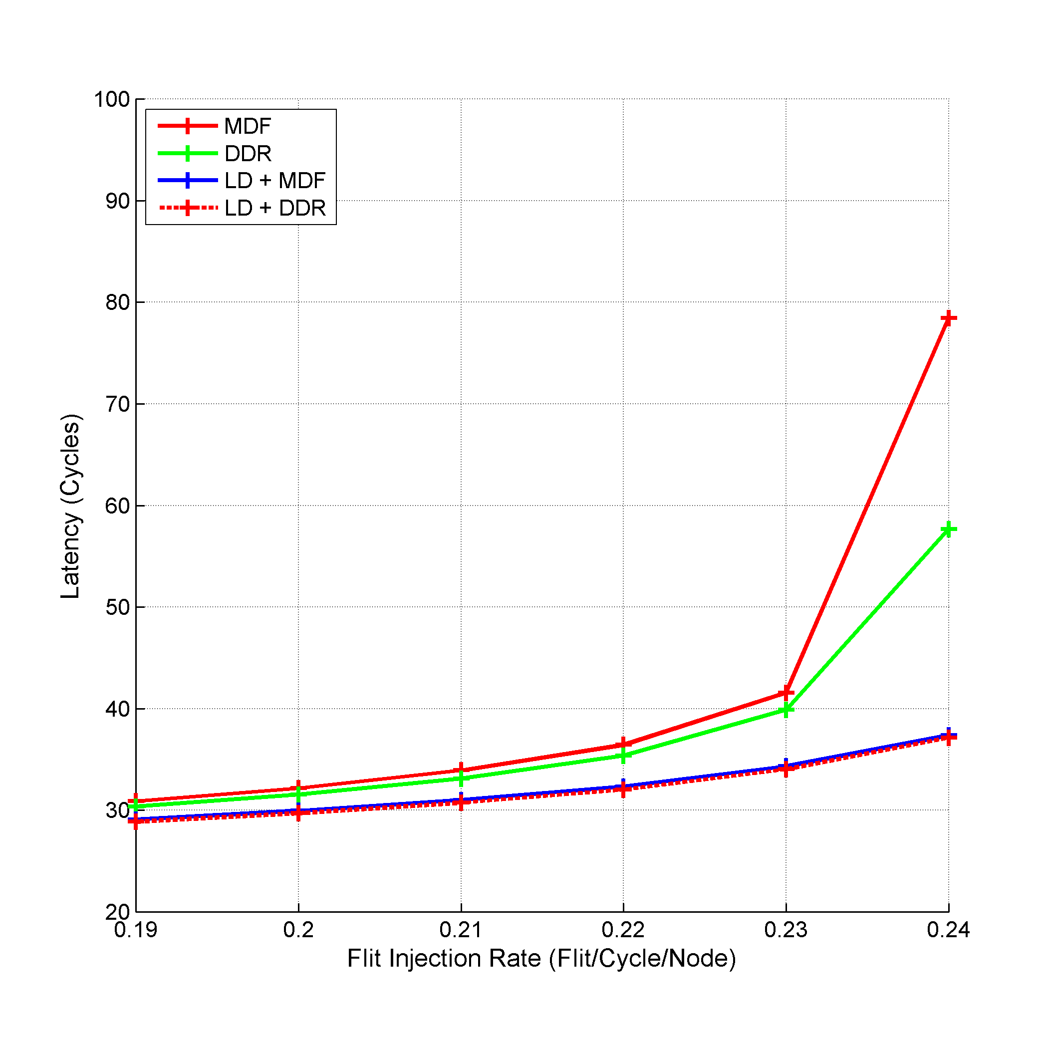
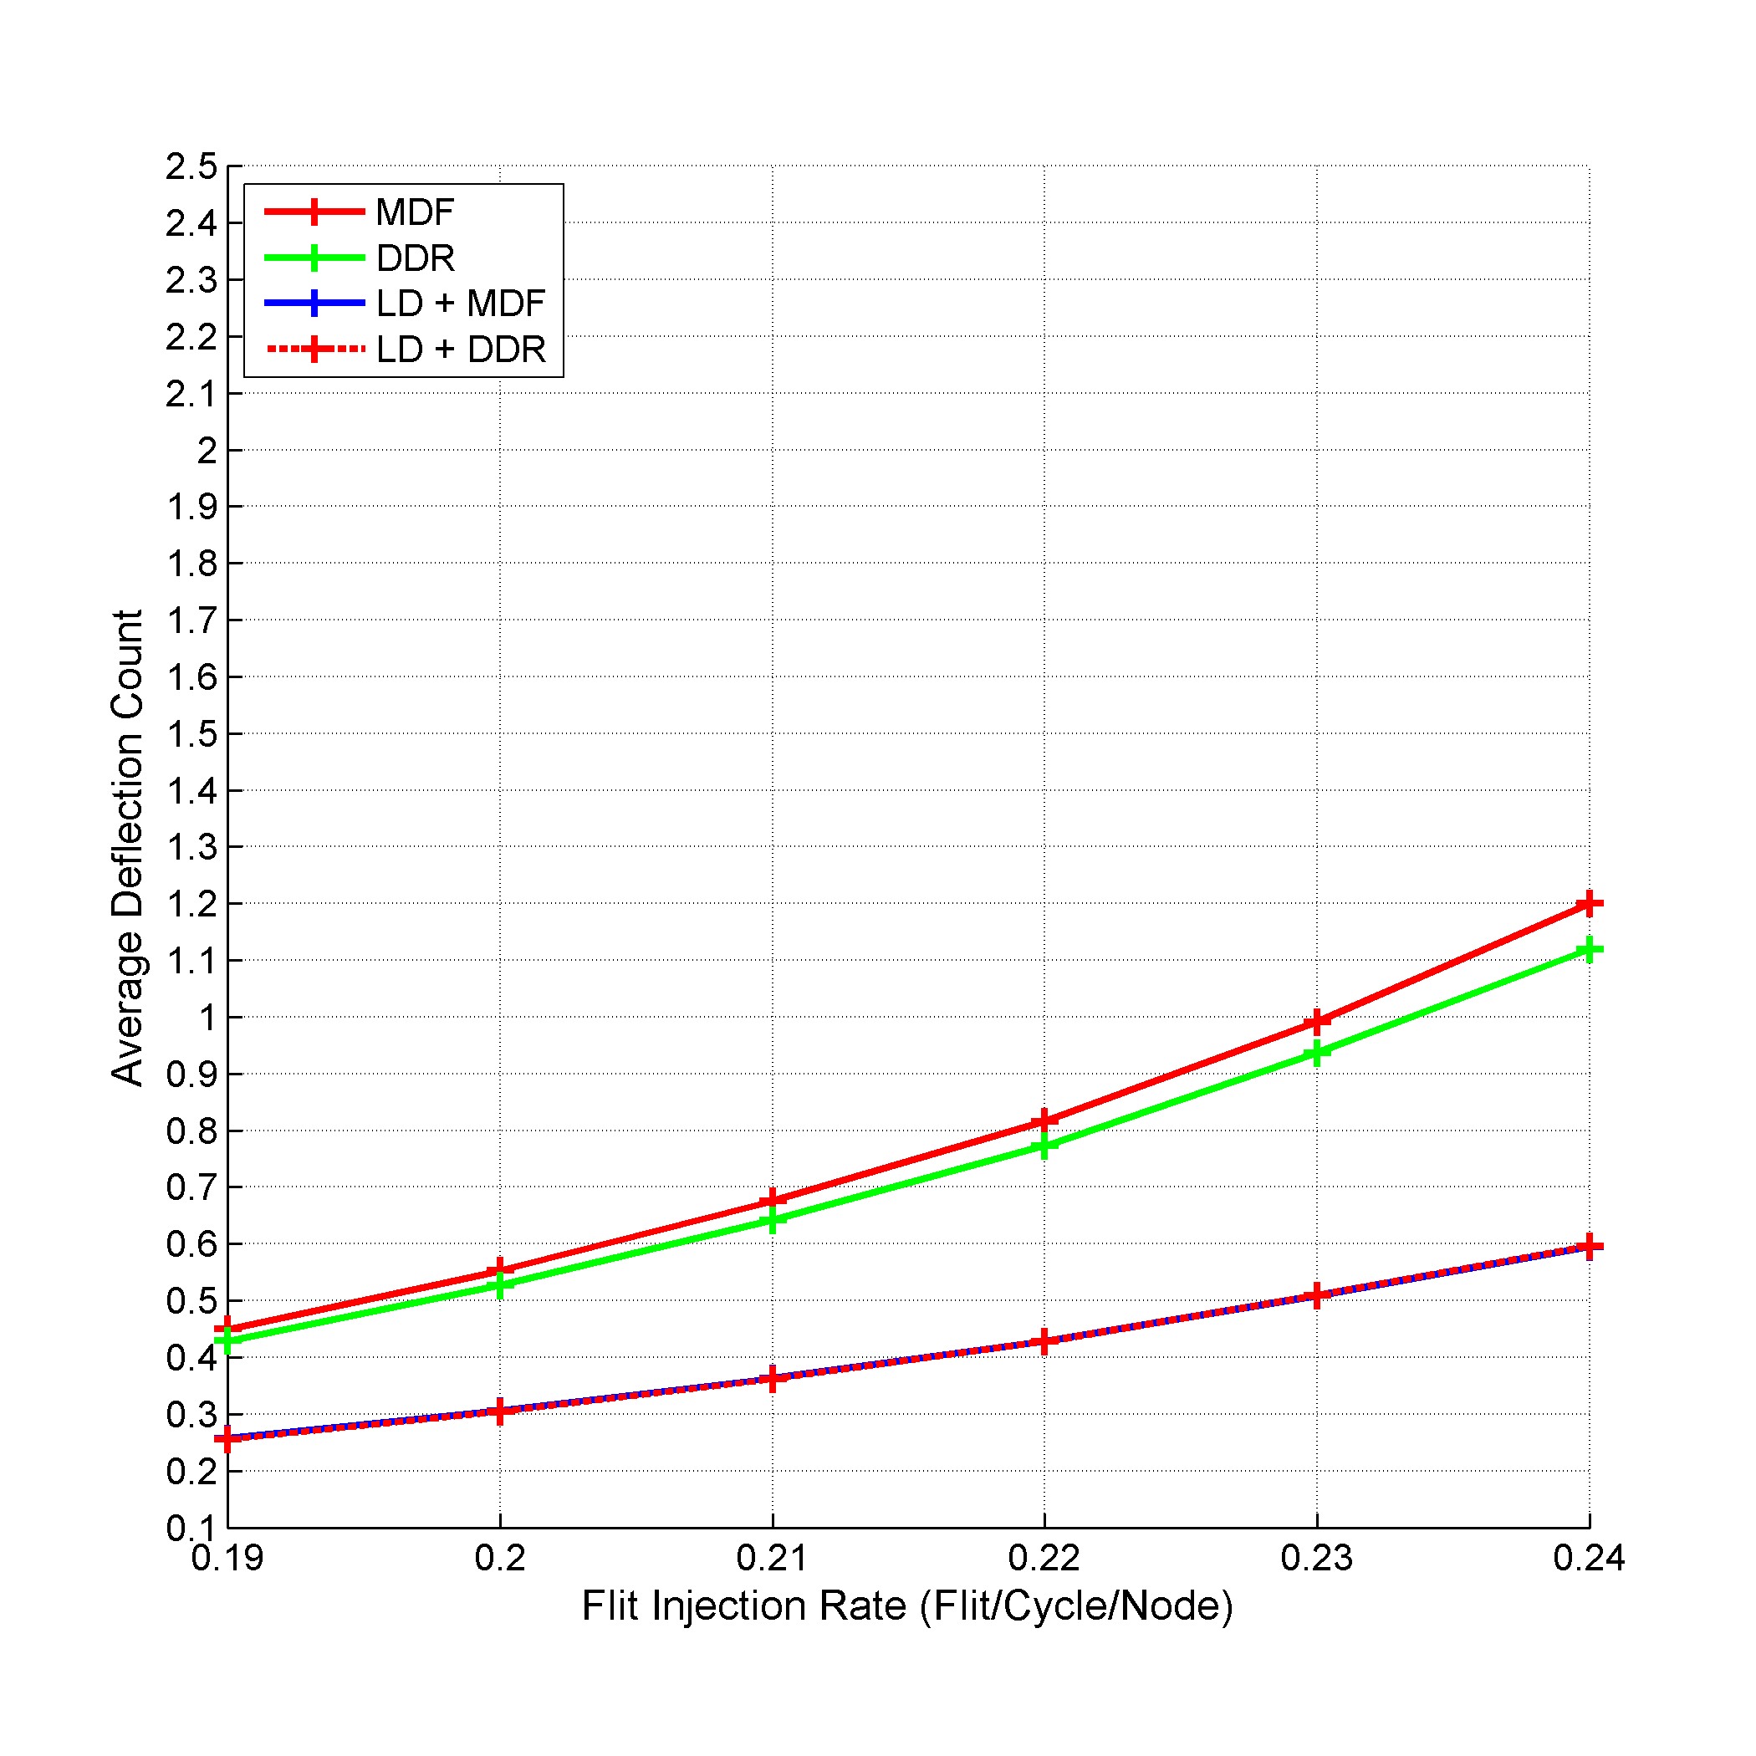
Experimental Results
52%
35%
50%
46%
Notes:
In order to show how the LD enhancement affects the performance, we simulated LD with MDF and DDR as draw breakers. We compared LD performance in contrast with MDF and DDR respectively.
The LD enhancement greatly boosts the performance under higher injection rates. Specifically, using LD along with MDF under injection rate of 0.24 flit/cycle/node enhances the packet latency and the deflection count over MDF by 52.3% and 50.4% respectively. While using LD along with DDR enhances the packet latency and the deflection count over DDR by 35.6% and 46.7% respectively.
To explain this superior performance, we refer to Figure 82. As shown in Figure 82, the average deflection count for LD along with either MDF or DDR dramatically decreases as LD removes any unnecessary detours for the flits. Decreasing the deflection count for the flits directly affects the overall packet latency.

Slide 66
Latency-Sensitive Congestion Management Mechanisms

Slide 67
Motivation
High Injection Rate
Traffic Volume
Link Bandwidth
Contention
Deflection
Source Nodes Starvation
Buffered X Bufferless
Notes:
Due to lack of buffers, congestion can quickly develop in bufferless NoC preventing it from competing with the buffered NoCs performance especially under high injection rates.
Combining high injection rate with the deflection behavior of the bufferless NoC leads to increased traffic volume which results in more contention between the flits. As the contention increases, the deflection rates increases and the starvation at the source nodes also increases (the source nodes are not able to inject new flits). This leads to a collapse in the performance of the NoC.

Slide 68
Congestion Management
Congestion Management
Detection
Heuristics
Prevention
Extra Resources
Control
Actions
Notes:
Various approaches exist for managing the NoC congestion. These approaches falls under one of two categories: detect and control the congestion, or prevent the congestion from developing.
The first category approaches apply heuristics and monitor the NoC performance to detect the congestion once it arises. If congestion is detected, these approaches apply a control mechanism to relieve the congested areas. The problem with the first category approaches is that if the heuristics used to monitor the performance or the actions taken to relieve the congestion are biased or excessive, the overall performance of the system is affected.
On the other hand, the prevention approaches uses extra resources to decrease the probability of developing the congestion. The idea is to use the extra resources to provide other options for the flits in case of contention under high traffic volume. For example, a buffered NoC can use extra buffers to host the flits in case of increased traffic volume. In bufferless NoCs, we don’t have the luxury of using buffers, so we investigate how to prevent the congestion with the only buffering resource available i.e. the NoC links.

Slide 69
Proposed Prevention Approaches
Congestion Prevention
Decrease Traffic Volume
More Link Bandwidth
More Freedom for the Flits
Using Larger NoCs
Using Sequential Injection

Slide 70
Using Larger NoCs
Larger NoC
LNoC
Extra Links
Extra Space for the Flits
Contention
Performance

Slide 71
Using Larger NoCs
4x4 Mesh
B
C
W
B
D
C
D
3x3 Mesh

Slide 72
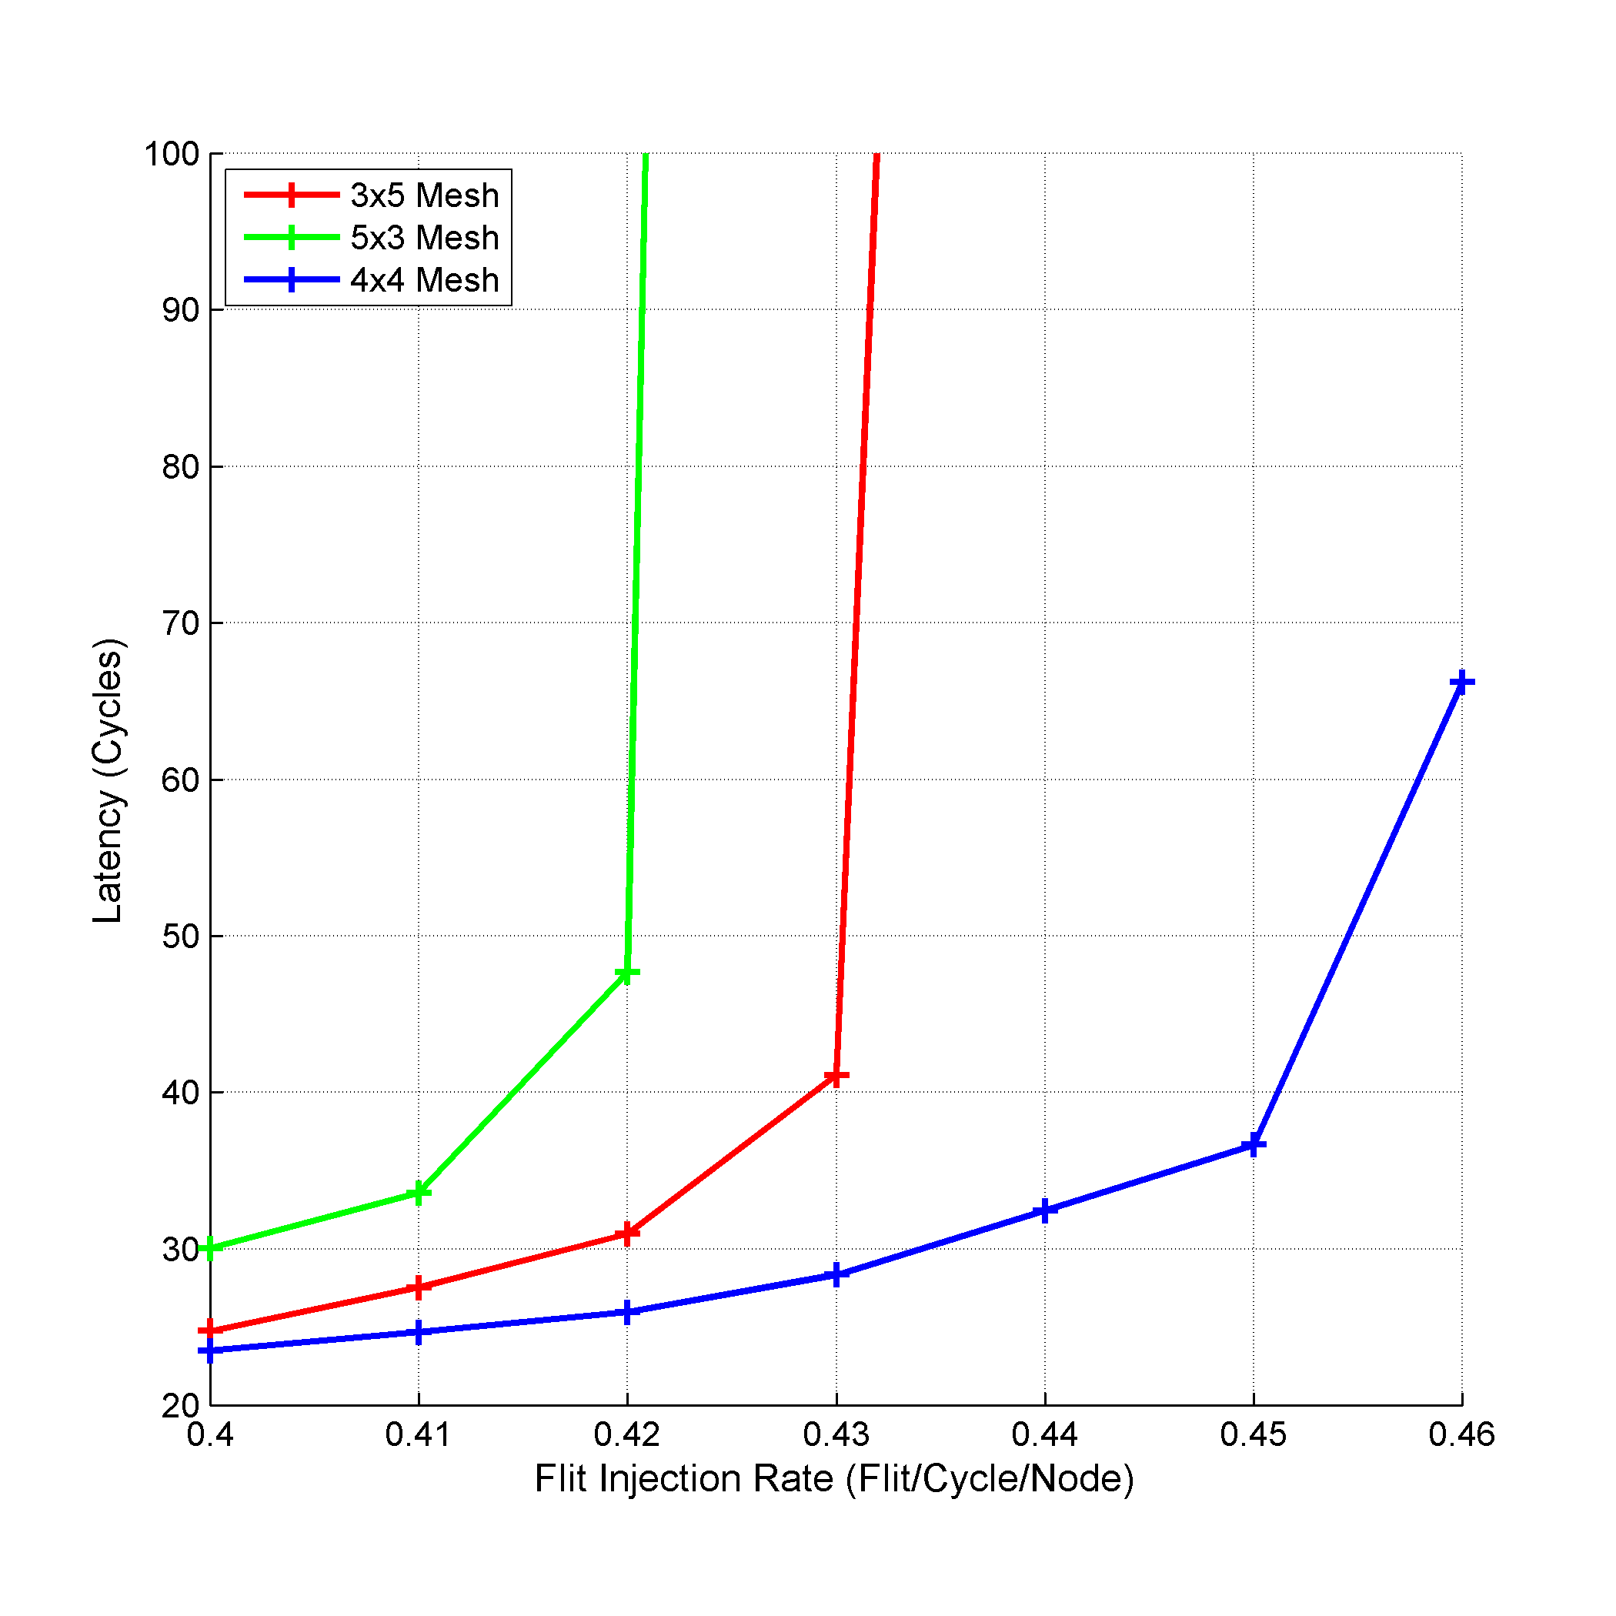
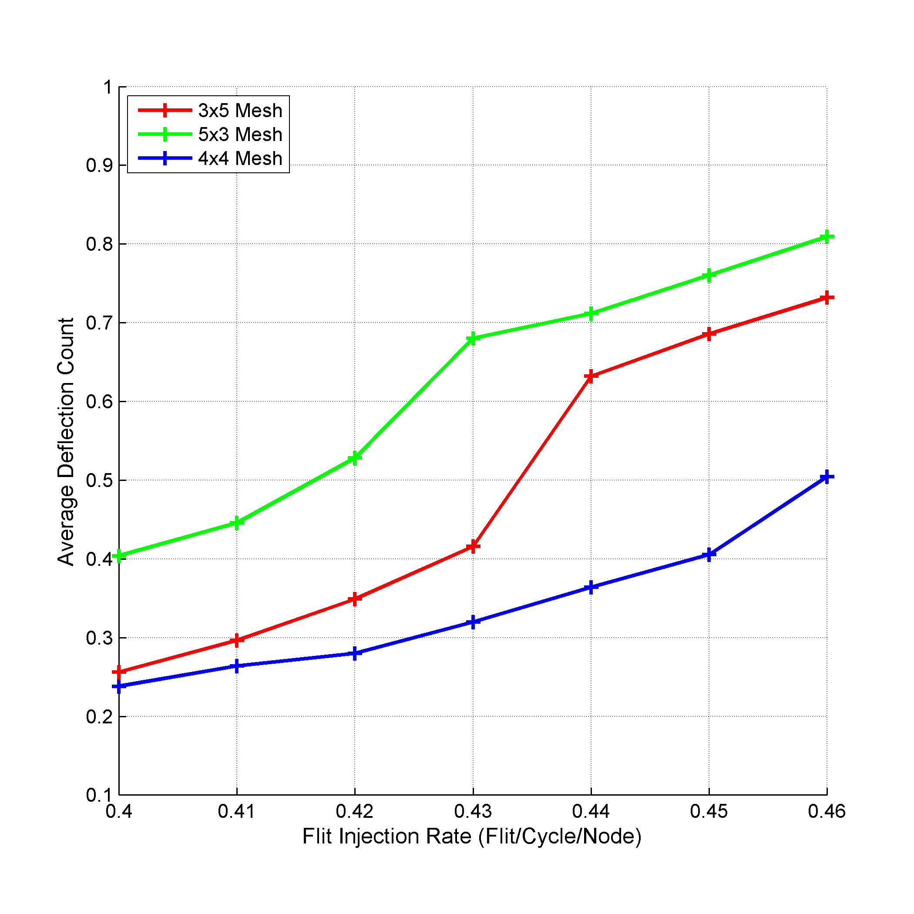
Experimental Results
98%
31%
Notes:
To evaluate the LNoC approach, we considered an application that uses fifteen nodes only and we arrange the nodes in three different mesh sizes: 3x5 mesh, 5x3 mesh, and 4x4 mesh with one extra node. We used MMaxFlex with step size of one to study the effect of using different arrangements and extra node(s).
Using 4x4 mesh resulted in better performance in both average packet latency and average deflection count. The enhancement is accounted for the use of extra node (switch) and the links connected to it which provided extra freedom for the flits to reach their destinations.
Specifically, using an extra node instead of the required fifteen nodes in 3x5 mesh enhances the average packet latency and the average deflection count at flit injection rate 0.48 flit/cycle/node by 98.85% and 31.07% respectively.
Also, we notice that using 3x5 mesh is better that using 5x3 mesh in both performance metrics. This is due to the default behavior of MaxFlex, namely, moving on X-dimension first then on Y-dimension. Thus, as the number of columns in 5x3 mesh is less than the number of columns in 3x5 mesh (three versus five), the flits have more freedom to move in the X-dimension in case of 3x5 mesh than in case of 5x3 mesh.

Slide 73
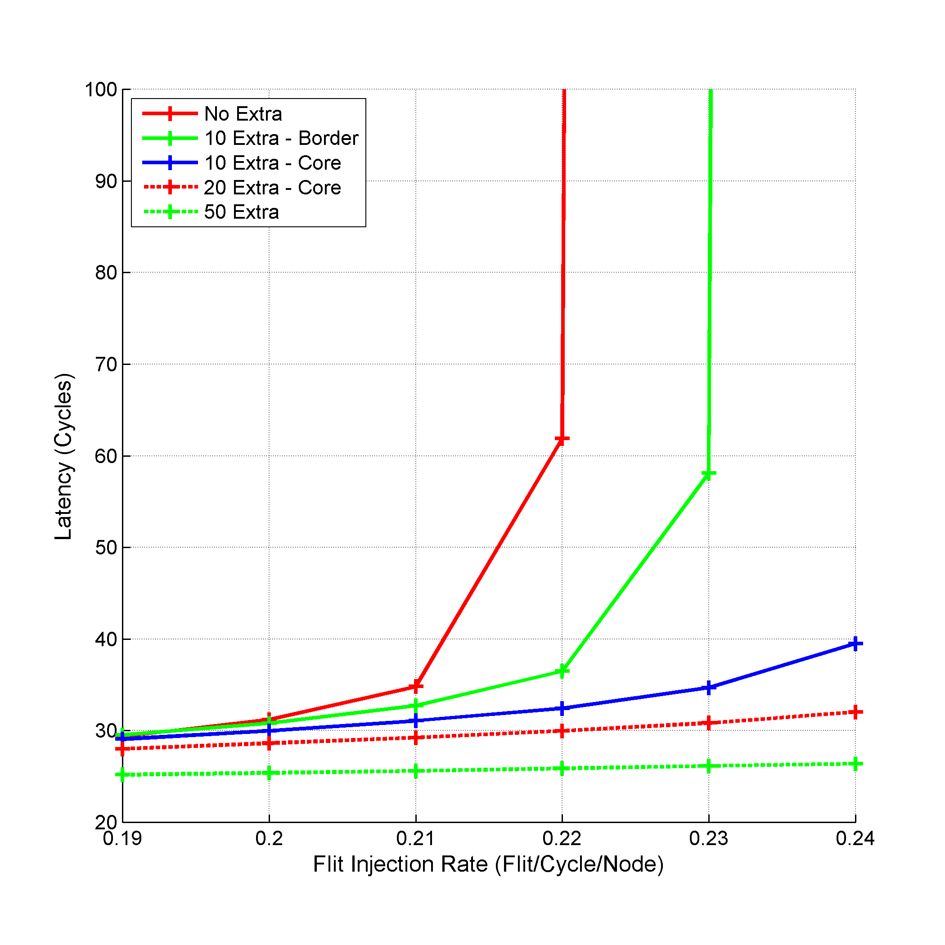
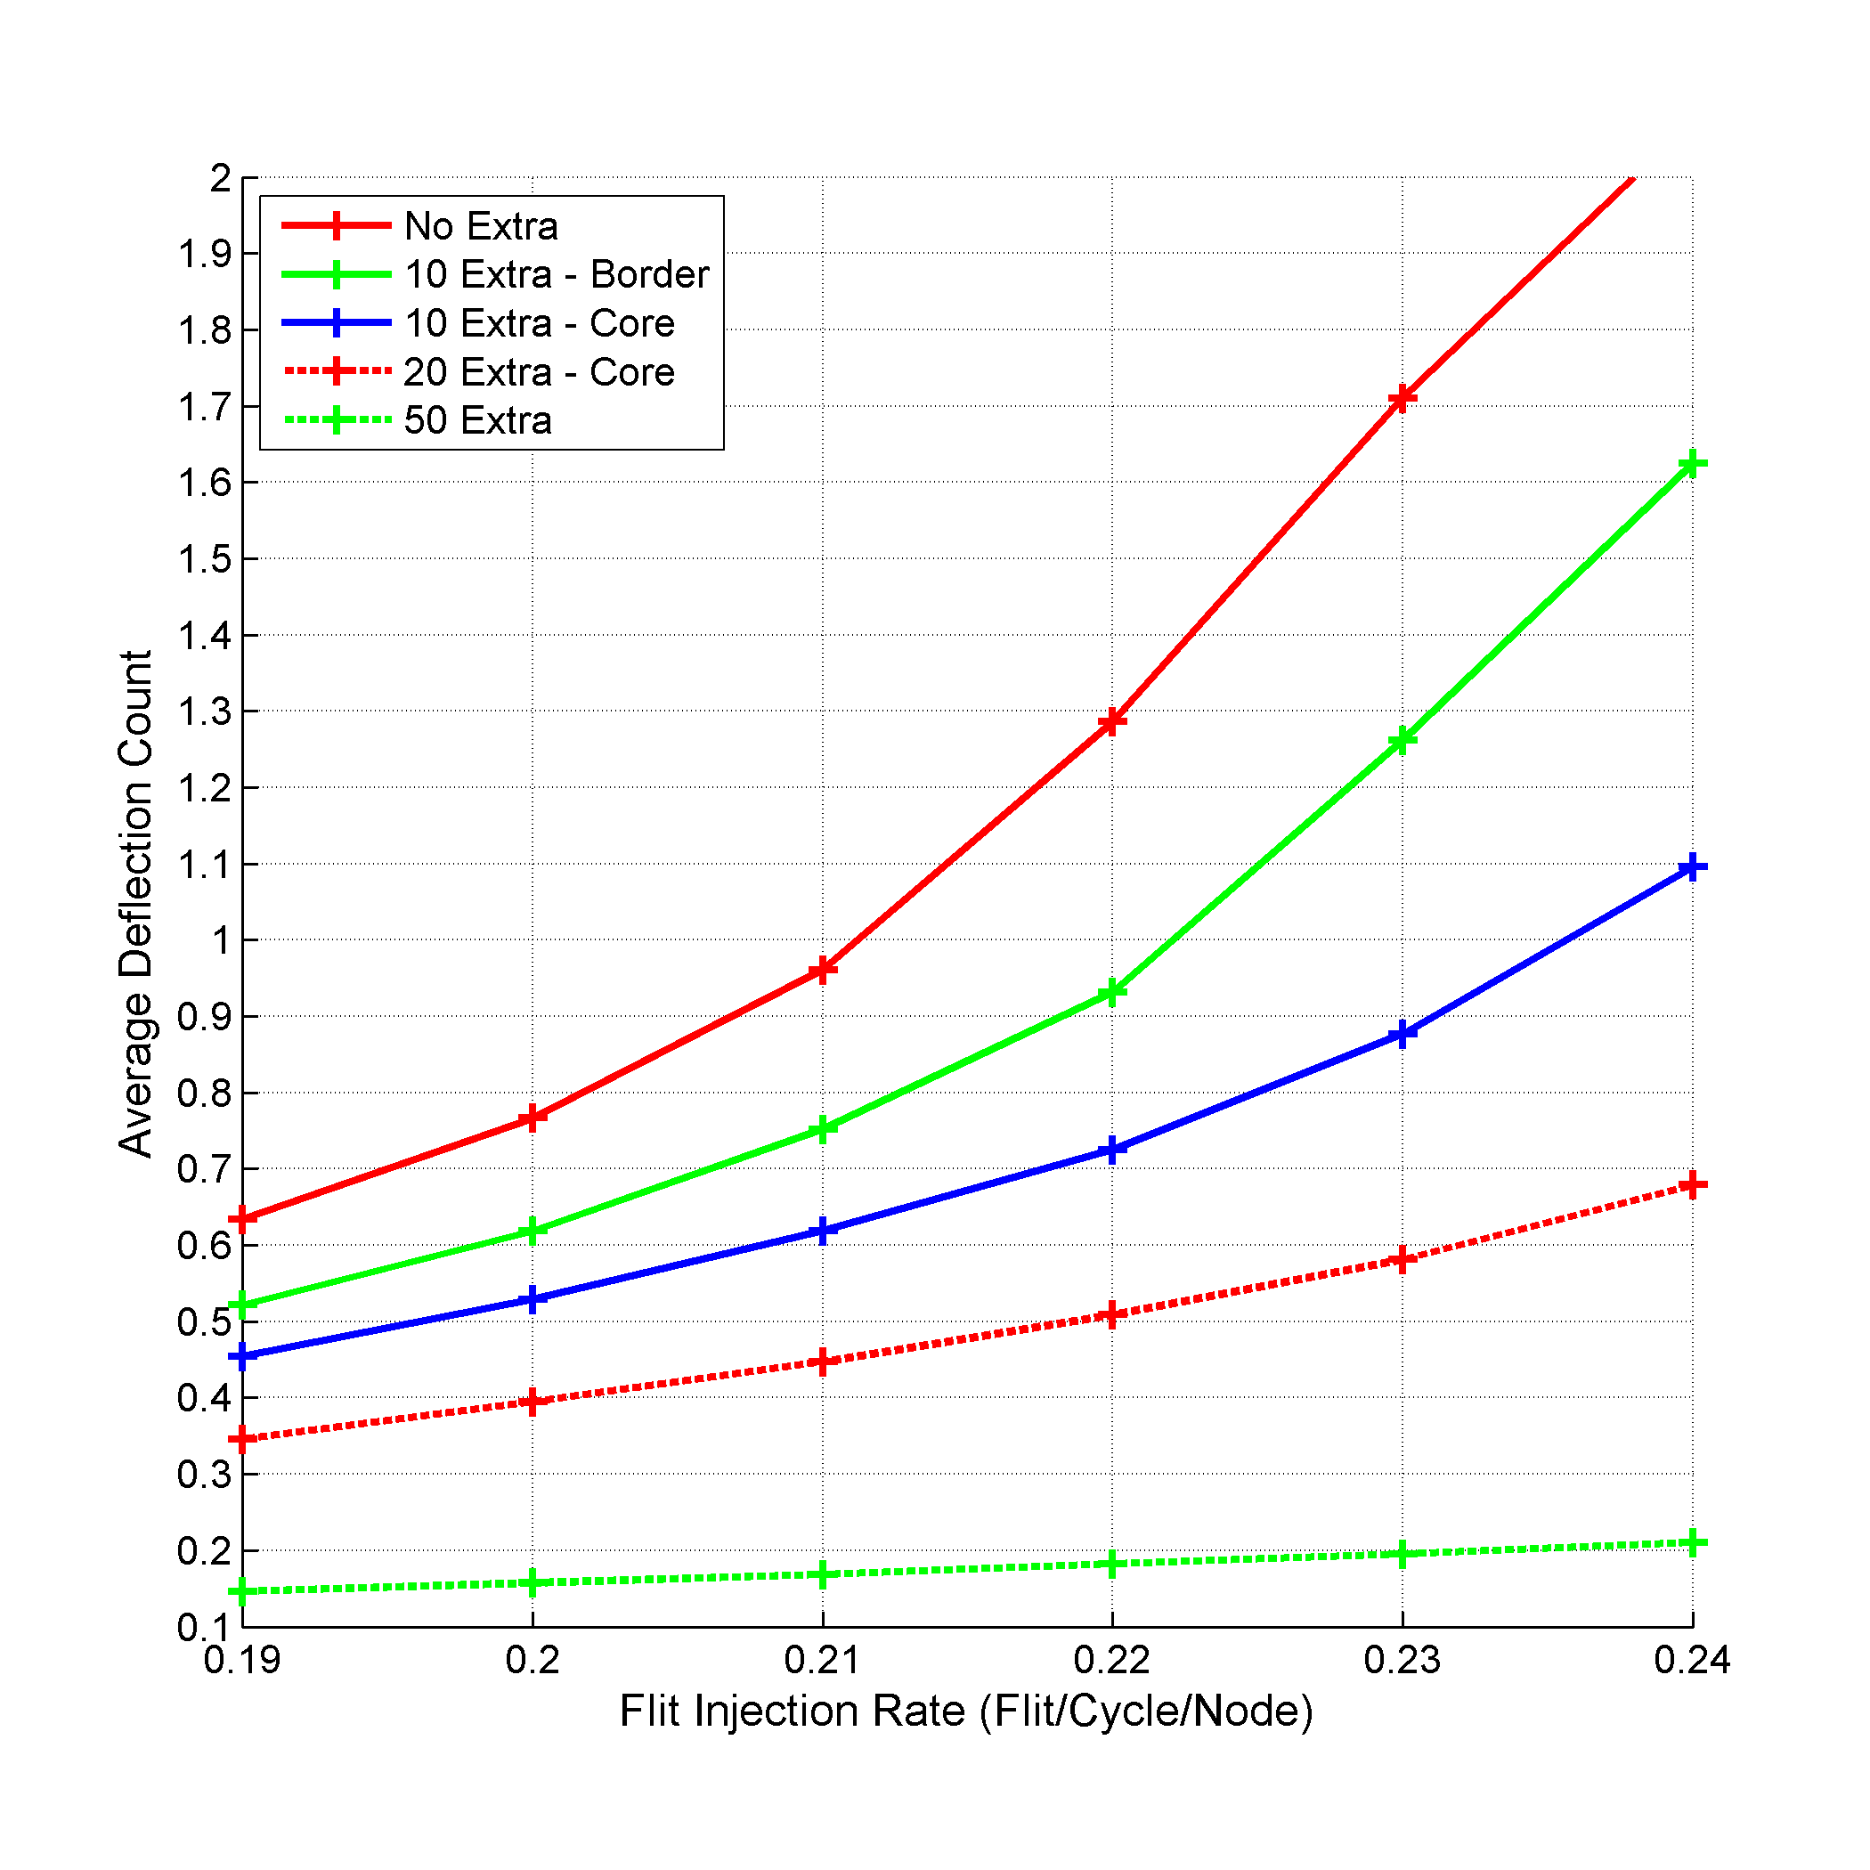
Experimental Results
99%
89%
Notes:
The previous experiment did not study the number of the extra nodes used and their placement in the NoC, so we simulated 10x10 mesh and varied the number of extra nodes and changed their location from border nodes to central nodes.
We compared using all the nodes in 10x10 mesh with the following: 90 nodes with 10 extra nodes placed as border nodes, 90 nodes with 10 extra nodes placed as central (core) nodes, 80 nodes with 20 extras nodes as central nodes, and 50 nodes with 50 extra nodes placed in the even columns of the 10x10 mesh. All of the previous experiments were simulated under MMaxFlex with step size of eight.
Using any extra nodes enhanced the performance over using all the 10x10 mesh nodes. This is also a result of the extra space provided for the flits in case of using extra nodes. For example, using only 90 nodes for injecting traffic instead of the provided 100 nodes leaves 10 switches in addition to their links to help in forwarding the traffic. The extra links works as extra roads for the flits to move.
Also, as the number of extra nodes increases, both the average packet latency and the average deflection count decreases. This is because using more extra nodes leads to more space for the flits to reach their destination. Concerning the placement of the extra nodes, placing the extra nodes in the center of the NoC enhanced the performance over placing them on the border in terms of average packet latency, average deflection count, and the flit injection rate. The enhancement is due to the fact that the central switches are responsible for more traffic forwarding and handling than the border switches, thus placing the extra nodes in the center frees the central switches for forwarding only and leaves the injection for the rest of the nodes.

Slide 74
Using Sequential Injection
Sequential Injection
SI
Divide the Application Mix to a Group of Smaller Mixes
Run the Smaller Mixes in Sequence
Traffic Volume
Injected Data
Performance
Notes:
In the SI approach, we propose dividing the application mix into smaller subsets where only a subset of the NoC nodes is allowed to inject it. Then, instead of running and injecting all the applications traffic at the same run, we divide the injection into sequential runs. In other words, we run the smaller application subsets sequentially on the whole NoC.
By doing that, we basically divide the problem of running the given application mix to a group of smaller application mixes that we can run in sequence. The smaller application mix, which results in smaller traffic volume, in combination with the sequential operation leads to injecting less data into the NoC in each smaller run which directly affects the deflection count and the packet latency in a positive way.

Slide 75
Using Sequential Injection
Phase 2
B
C
W
B
D
C
D
Phase 1

Slide 76
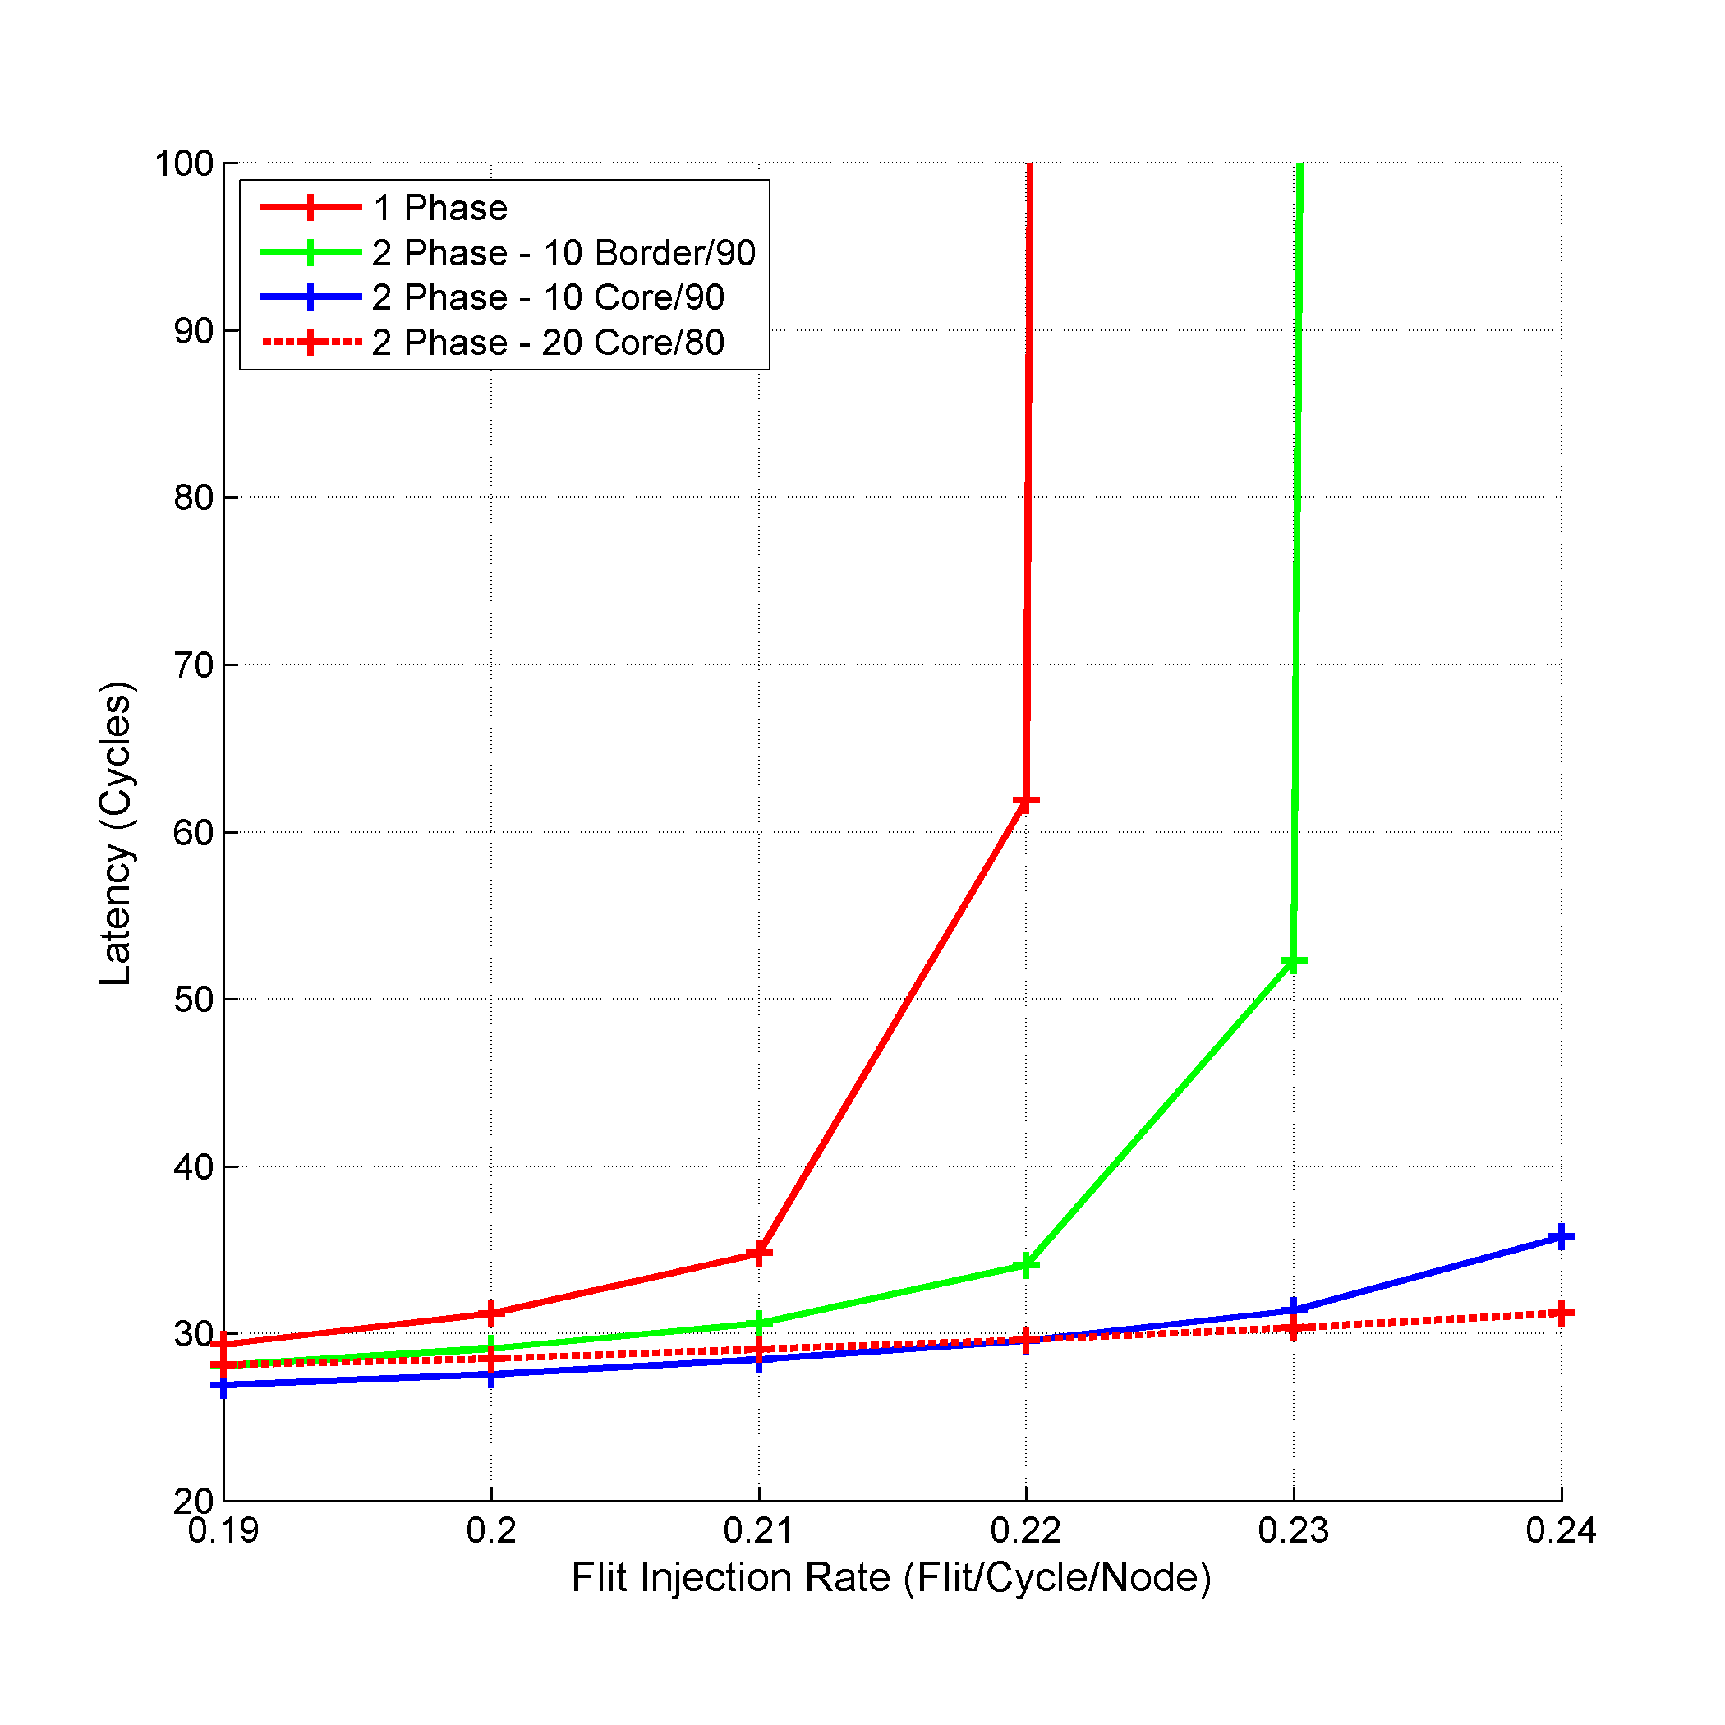
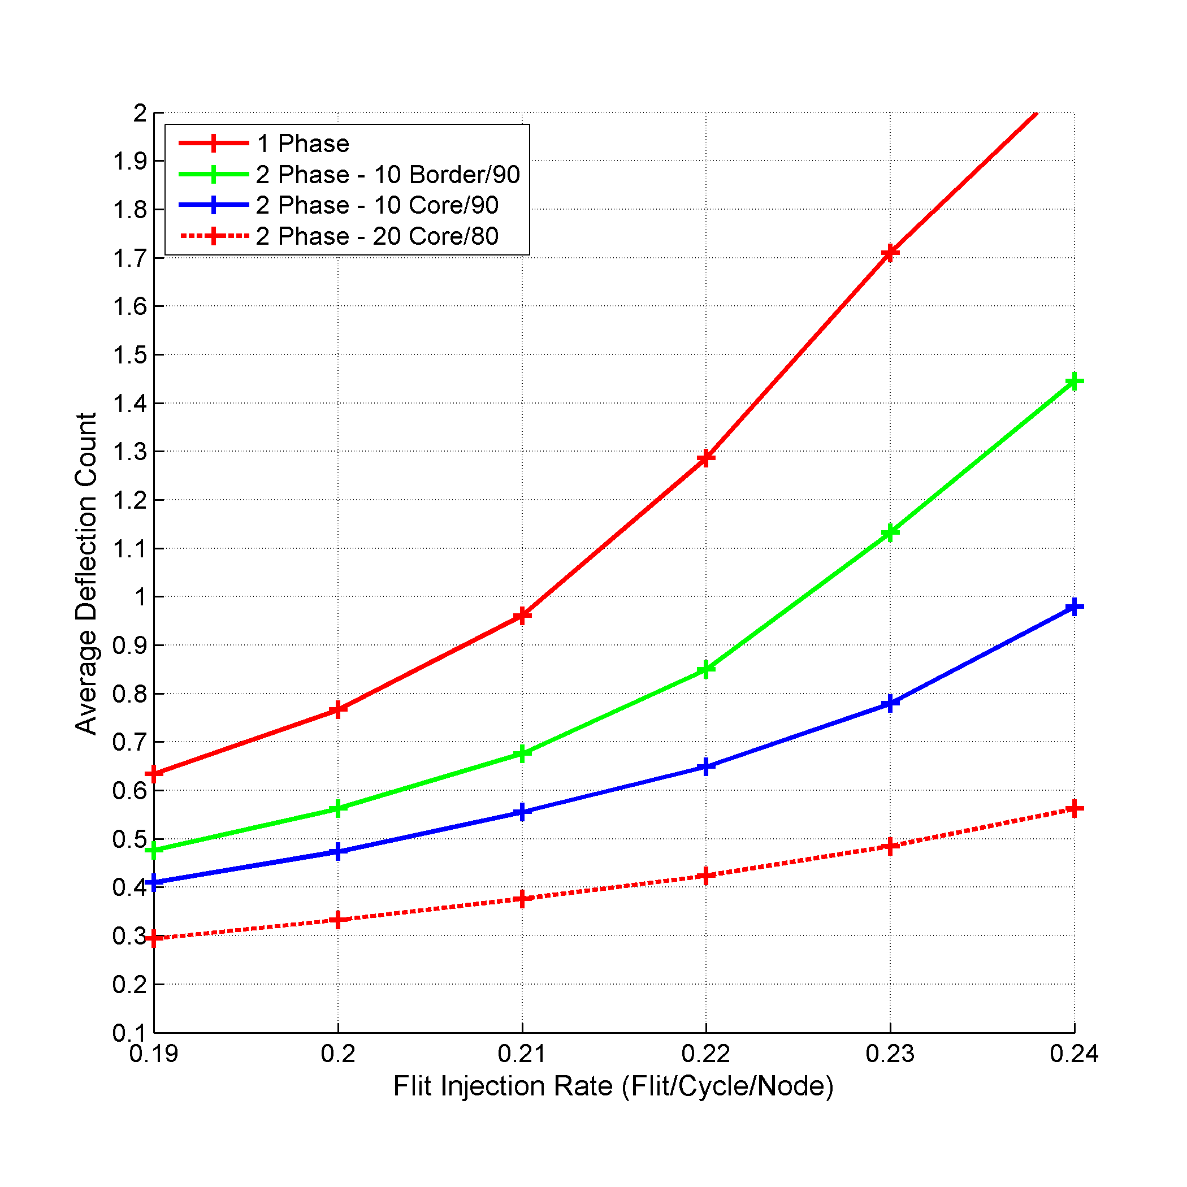
Experimental Results
99%
72%
Notes:
Concerning the SI approach evaluation, we used two phase sequential injection with different number of nodes at each phase. Also, we changed the location of the nodes in each phase to study the effect of the nodes placement.
By two phase sequential injection, we mean that we divide the NoC nodes into two groups that take turn in injecting their traffic.
For evaluation, we compared injecting the traffic from all the nodes in 10x10 mesh as one phase with the following: two phase with 90 nodes in the first phase and 10 nodes placed as border nodes in the second phase, two phase with 90 nodes in the first phase and 10 nodes placed as central nodes in the second phase, and two phase with 80 nodes in the first phase and 20 nodes placed as central nodes in the second phase. All of the previous experiments were simulated under MMaxFlex with step size of eight.
Using two phase SI injection enhances the performance over using one phase injection in terms of the used performance metrics. Specifically, the average deflection count decreases as ratio between the number of nodes in each phase increases. This can be explained as in LNoC approach, namely, dividing the nodes evenly between the phases lead to less nodes injecting in each phase which lead to less competition between the flits, hence less deflections. As for the packet latency, increasing the ratio between the number of nodes in each phase resulted in better average latency and achieves higher flit injection rates.
As for the nodes placement, changing the location of nodes from the border of the NoC to the center of the NoC decreased the average packet latency and the average deflection count by 98.36% and 32.2% respectively. This enhancement is accounted to the same reasons as in LNoC. Specifically, the central switches forward and handle more traffic than the border switches, thus separating the center nodes injection in different phase frees the center of the NoC to only forward the traffic of the rest of the nodes.

Slide 77
Conclusion

Slide 78
Conclusion
Pushing the boundaries of bufferless NoCs
Selection functions
Investigated using larger and variable step sizes under MaxFlex selection function
Flit ranking policies
Targeted decreasing the flits’ deflections
Congestion management
Congestion prevention
Our work showed a huge enhancement in both packet latency and deflection count

Slide 79
Future Work
Extension
Investigate the proper size for the regions based on the overall NoC size
Extend the regions concept to other aspects in NoC
Extend our approaches to consider throughput-sensitive applications
Investigate the effect of absorbing and re-injecting the NoC traffic via Sink Nodes
Silicon Interposer
Random Topologies
Notes:
Regions can be used to enhance the performance on the application level by assigning different applications to different regions and based on each application we can customize each region.
Beside the proposed extensions, we can investigate the bufferless NoCs usage in other hot topics. One of the current hot topics related to NoCs is the usage of die stacking technologies to incorporate memory stacks inside the chip. Currently, instead of using 3D stacking, researchers are investigating the usage of 2.5D stacking i.e. silicon interposer. In 2.5D stacking, instead of adding the memory or other processor die on the top of the base processor die, the silicon interposer is built to be large enough to hold the processor die and the memory stacks surrounding the die. The interposer is a layer rich in communication resources which can be harvested to connect several components in the chip with extra cost. Recent works proposed the usage of the silicon interposer instead of 3D stacking. The 2.5D stacking presents several challenges in designing the NoC to support the higher memory bandwidth required. We can look into using the bufferless NoC in the design to harvest the underlying rich interposer without the need to add extra buffers. Also, both 3D and 2.5D technologies can be investigated to see how using the bufferless NoC can enhance the overall design.
Also, recent works investigated the usage of random topologies for NoCs. They showed that random topologies provide better scalability in terms of network diameter and provide inherent load balancing. We can look into using the bufferless NoC design with these random topologies.

Slide 80
Questions

Slide 81
Types Packets Count
Type 1
Type 2
Type 3
Type 4
Type 5
Type 6
Type 7
Type 8
Type 9
Type 10
Type 11
Type 12
Notes:
$$n=Number of row/column nodes$$

Slide 82
Type 1 & Type 2 Packets
Type 1:
Packets destined to node (i,j)
Ejection
Type 2:
Packets injected by node (i,j)
Injection
Notes:
$$n=Number of row/column nodes$$

Slide 83
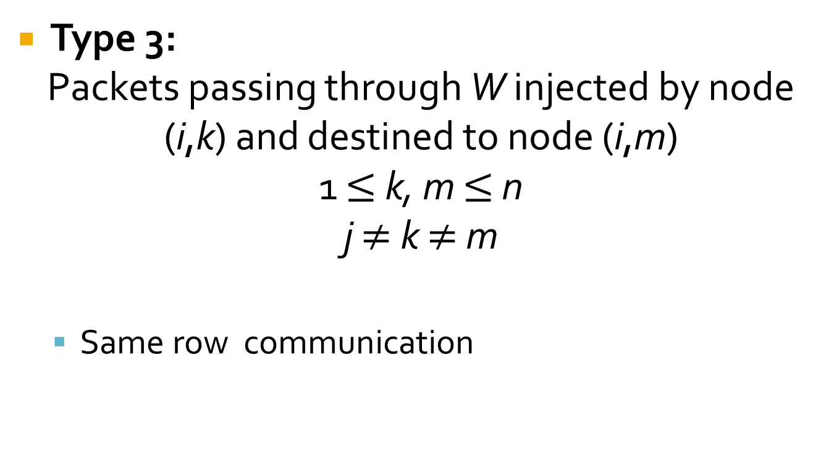
Type 3 Packets
Type 3:
Packets passing through W injected by node (i,k) and destined to node (i,m)
1 $≤$ k, m $≤$ n
j $≠$ k $≠$ m
Same row communication
Notes:
$$n=Number of row nodes$$
$$i=Index in row$$

Slide 84

Type 4 Packets
Type 4:
Packets passing through W injected by node (k,j) and destined to node (m,j)
1 $≤$ k, m $≤$ n
i $≠$ k $≠$ m
Same column communication
Notes:
$$n=Number of column nodes$$
$$i=Index in column$$

Slide 85
Type 5 Packets
Type 5:
Packets passing through W as a result of communication between nodes on the same diagonal as node (i,j)
Same diagonal communication
Notes:
$$n=Number of row nodes$$
$$n^{′}=Number of diagonal nodes$$
$$i=Index in diagonal$$
$$SS=Step size$$

Slide 86
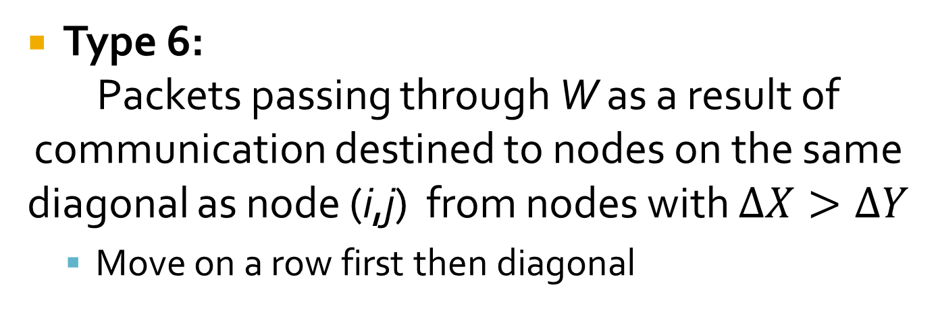
Type 6 Packets
Type 6:
Packets passing through W as a result of communication destined to nodes on the same diagonal as node (i,j) from nodes with $∆X>∆Y$
Move on a row first then diagonal
If diagonal is below main diagonal
Else
Notes:
$$n=Number of row nodes$$
$$n^{′}=Number of diagonal nodes$$
$$i=Index in diagonal$$
$$SS=Step size$$
Note:
Up traffic on increasing diagonal - Count the number of packets passing through switch as a result of row nodes communicating with nodes with lower index on increasing diagonal

Slide 87
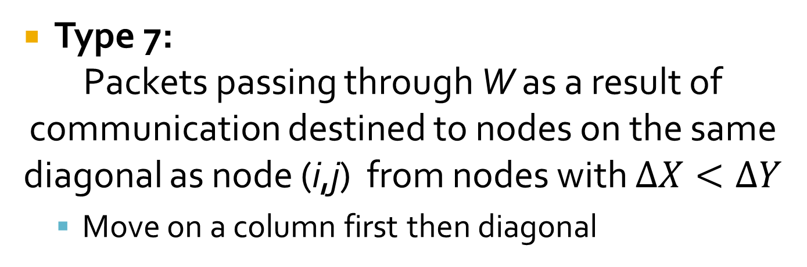
Type 7 Packets
Type 7:
Packets passing through W as a result of communication destined to nodes on the same diagonal as node (i,j) from nodes with $∆X<∆Y$
Move on a column first then diagonal
If diagonal is above main diagonal
Else
Notes:
$$n=Number of row nodes$$
$$n^{′}=Number of diagonal nodes$$
$$i=Index in diagonal$$
$$SS=Step size$$
Note:
Up traffic on increasing diagonal - Count the number of packets passing through switch as a result of column nodes communicating with nodes with lower index on increasing diagonal

Slide 88
Type 8 Packets
Type 8:
Packets passing through W as a result of communication between nodes on a diagonal other than node (i,j) diagonal
Effect of Type 5

Slide 89
Type 8 Packets
Notes:
$$n^{′}=Number of diagonal nodes$$
$$SS=Step size$$
Note:
Up traffic

Slide 90
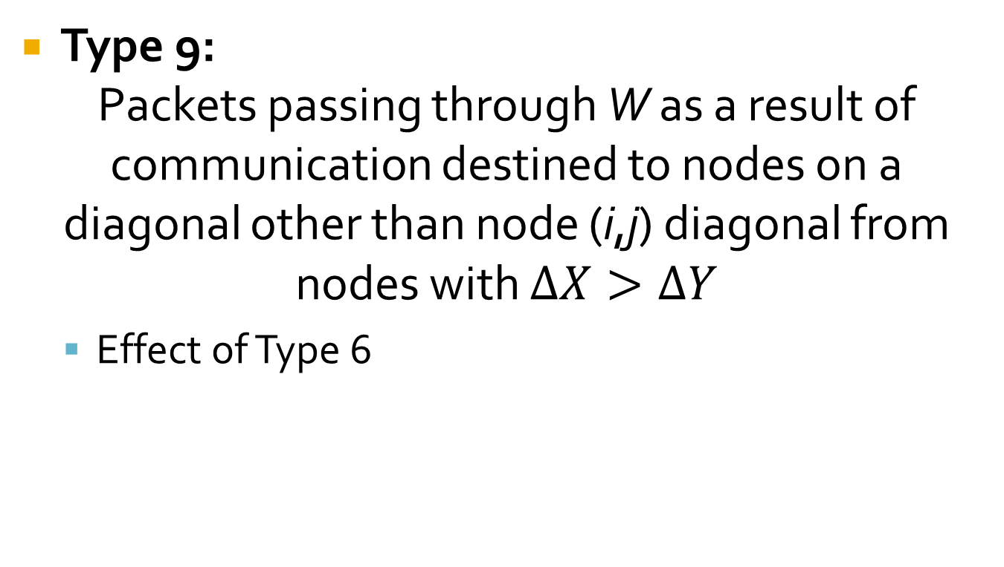
Type 9 Packets
Type 9:
Packets passing through W as a result of communication destined to nodes on a diagonal other than node (i,j) diagonal from nodes with $∆X>∆Y$
Effect of Type 6

Slide 91
Type 9 Packets
If diagonal is below main diagonal
Else
Notes:
$$n=Number of row nodes$$
$$n^{′}=Number of diagonal nodes$$
$$SS=Step size$$
Note:
Up traffic

Slide 92

Type 10 Packets
Type 10:
Packets passing through W as a result of communication destined to nodes on a diagonal other than node (i,j) diagonal from nodes with $∆X<∆Y$
Effect of Type 7

Slide 93
Type 10 Packets
If diagonal is above main diagonal
Else
Notes:
$$n=Number of column nodes$$
$$n^{′}=Number of diagonal nodes$$
$$SS=Step size$$
Note:
Up traffic

Slide 94
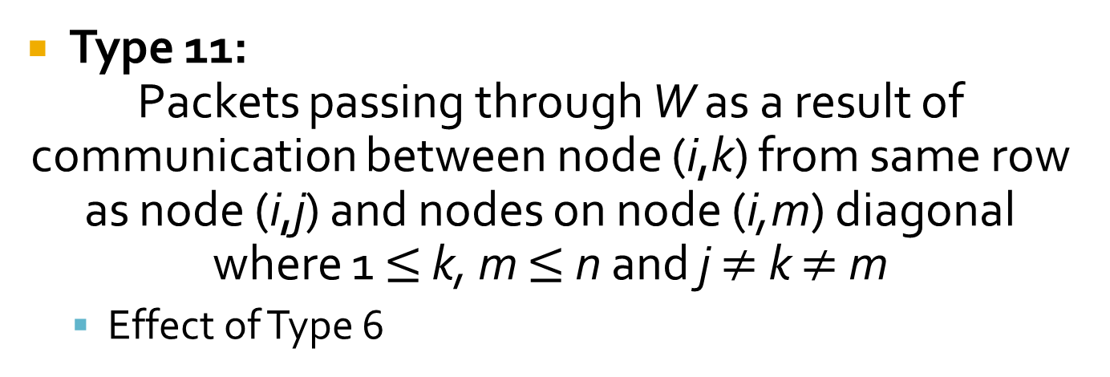
Type 11 Packets
Type 11:
Packets passing through W as a result of communication between node (i,k) from same row as node (i,j) and nodes on node (i,m) diagonal where 1 $≤$ k, m $≤$ n and j $≠$ k $≠$ m
Effect of Type 6
If diagonal is below main diagonal
Else
Notes:
$$n=Number of row nodes$$
$$n^{′}=Number of diagonal nodes$$
$$i=Index in diagonal$$
$$j=Index in row 1≤j≤L$$
Note:
Up traffic on increasing diagonal - Count the number of packets passing through switch as a result of same row nodes communicating with nodes with lower index on increasing diagonal

Slide 95

Type 12 Packets
Type 12:
Packets passing through W as a result of communication between node (k,j) from same row as node (i,j) and nodes on node (m,j) diagonal where 1 $≤$ k, m $≤$ n and i $≠$ k $≠$ m
Effect of Type 7
If diagonal is above main diagonal
Else
Notes:
$$n=Number of column nodes$$
$$n^{′}=Number of diagonal nodes$$
$$i=Index in diagonal$$
$$j=Index in column 1≤j≤L$$
Note:
Up traffic on increasing diagonal - Count the number of packets passing through switch as a result of same column nodes communicating with nodes with lower index on increasing diagonal

