Slide 1


Milestone 2
Harvard Extension School
CSCIE-99: Final Project
Biomedical Plate, Assay, and Results Management System
WE99: West-East Team
Sean Sinnott
Mark Ford
Alexander Zaman
Tim Stefanski
Alan Orcharton

Slide 2
WE99 Team Vision
The team focus is providing outstanding tools to assist in analyzing the dose response characteristics potential drugs.
We will provide beautiful interactive visualization tools that will assist the scientist in:
Creating and managing experimental plate sets for dose response experiments
Performing quality control checks on plate results and plate controls
Performing Interactive analysis of dose response results.
The team will store the experimental results and the analysis of the results so that the historic experimental analysis can be reviewed or reproduced at any time.
Scientists will be able to save the results for further analysis or publish their analysis, making it available to all other users.

Slide 3
Presentation Outline
Overview of Presentation
Project Status - Alan
System Demo – Sean / Alex
Features for Milestone 3 - Alex
System Design – Mark
Testing – Mark / Tim
Risks - Tim

Slide 4
Project Status
The We99 team is using some Agile development methods and planning practices. Progress of the project is measured in terms of the number of stories and number of story points that are delivered.
We will review project status based on:
Burn Up and Team Velocity
Projected Completion based on Velocity
Key Functionality Goals Estimated form Milestone 1
Demonstration of Functionality

Slide 5
Project Status

Slide 6
Project Status – Team Velocity
Average points / Iteration = 37.2
Team Velocity = 37.2 points / iteration

Slide 7
Project Status - Projection
Based on Projected Velocity Team is predicted to complete 372 / 395 points

Slide 8
Project Status – Milestone 2 Predictions
Predicted Deliverable | Status
Domain Model | Initial Version Complete
Web Service Interfaces | Initial Version Complete
Plate Map Editor | Initial Version Complete
Web Services for Plate Editor | Initial Version Complete
Web Services for Heat Maps | Initial Version Complete
Heat Maps | Initial Version Complete
Experiments Page | Initial Version Complete

Slide 9
Application Demonstration
Plate Map Editor
Heat Maps
Omni Map
Control Wells

Slide 10
Features for Milestone 3
Singe Dose Response Curve
Interactive Dose Response Curve
Knock-out points
Curve Fit – Modify Parameters on Single or Selection of Curves
Curve Fitting from Server Side
Multiple Curve Display
Compare Curves on Top of each other
User Documentation

Slide 11
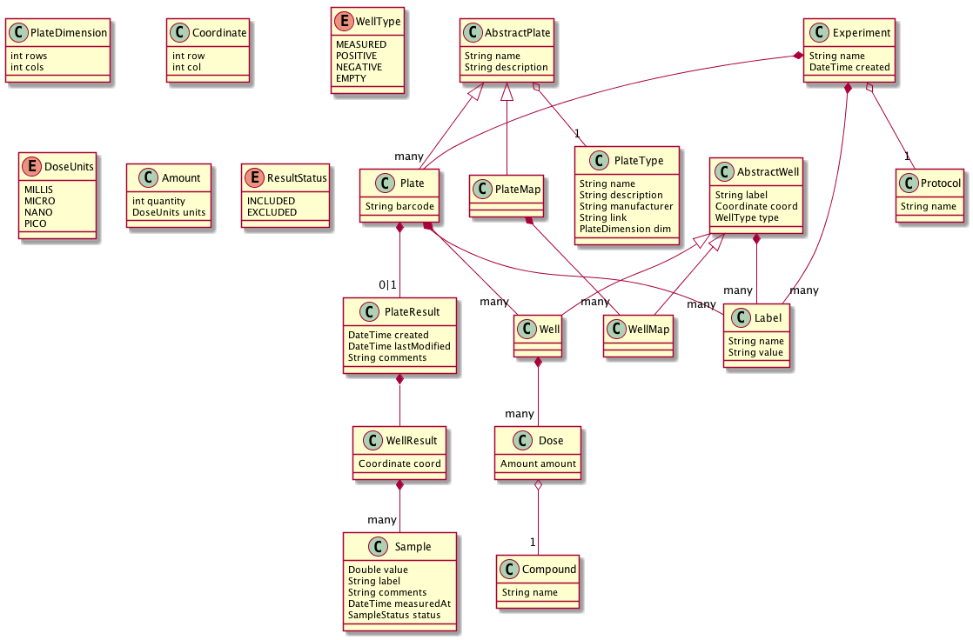
Domain Model
Plain old Java Objects
Using the same names from the slides
Database agnostic
Declarative JSON serialization
Numerous revisions following cross team meetings

Slide 12
JAX/RS Services
Experiment
Service
PlateMap
Service
Compound
Service
PlateType
Service
Protocol
Service
/experiment
/plateMap
/compound
/plateType
/protocol
Experiment
Resource
Top level services model independent Domain Models
Other levels represent sub-resources that are owned by a parent model
Thus, all Plates and Results are owned by an Experiment while PlateMap, Compounds and others can exist independent of an Experiment
/experiment/{id}
Plate
Resource
/experiment/{id}/plates/{plateId}
Results
/experiment/{id}/plates/{plateId}/results

Slide 13
Storage Layer
Each Domain Model has a Storage Interface responsible for all basic CRUD and listing operations
Storage Interface accepts/returns Domain Models and fully encapsulates the choice of storage architecture
Domain Models are mapped internally from POJO to JPA and back again via Orika Mappers
Compound
Service
Compound
Storage
Compound
Storage
Impl (JPA)

Slide 14
Testing Strategy – Back End
Junit for basic unit tests: JSON marshaling, functions, mapping between layers
Separate module for reusable code across tests (Junit Rules, JSON equality assertions)
Junit Integration Tests
Tests against the real web app
Easily run within the IDE or command line
Great for debugging
Tests leverage the Domain Models and Services directly so it’s easy to keep them up to date

Slide 15



Testing Strategy – Front End
For the frontend testing, we use the following tools:
Karma - Javascript test runner
PhantomJS - headless browser written in javascript
Jasmine - behavior-driven development framework for testing JavaScript
(Currently have 37 test cases defined)

Slide 16
Project Risks
Risks
Delivering Complete Functionality based on velocity
“Learning” does not count as points – velocity should increase
Cut some “Special Feature” Scope
Simplify the plate editor
Curve fitting with Java library (difficult to implement)
Shell out to Python LMFIT for now
Integration with other teams
Design meetings with other teams planned
Stories take longer that estimated
Keep a burn-up chart and prioritize stories
Getting of Good Test Data
Professor working on providing

