Slide 1


Milestone 1
Harvard Extension School
CSCIE-99: Final Project
Biomedical Plate, Assay, and Results Management System
WE99: West-East Team
Sean Sinnott
Mark Ford
Alexander Zaman
Tim Stefanski
Alan Orcharton

Slide 2
WE99 Team Vision
The team focus is providing outstanding tools to assist in analyzing the dose response characteristics potential drugs.
We will provide beautiful interactive visualization tools that will assist the scientist in:
Creating and managing experimental plate sets for dose response experiments
Performing quality control checks on plate results and plate controls
Performing Interactive analysis of dose response results.
The team will store the experimental results and the analysis of the results so that the historic experimental analysis can be reviewed or reproduced at any time.
Scientists will be able to save the results for further analysis or publish their analysis, making it available to all other users.

Slide 3
Business Opportunity
High throughput screening tests millions of potential drugs.
Commercial software is expensive
Enable Scientists to be organized and efficient when screening potential drugs.
Dynamic analysis tools help reduce the number of experiments.
Eliminate compounds earlier in the discovery cycle.

Slide 4
Presentation Outline
Overview of Presentation
Plate Editing and Creation – Alex
Results Analysis – Sean
Architecture – Mark
Front End / Risks – Tim
Project Planning/Estimates - Alan

Slide 5
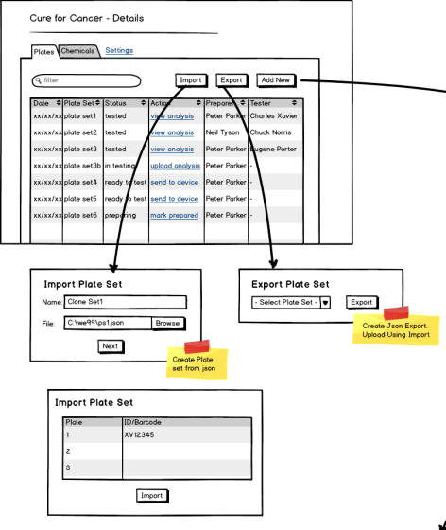
What “we99” are Delivering – Plate Map Editor
Plate Manager / Import – Export
Import to take data from json file.
Export to put details of the plate into a json file
Click actions to update status:
Mark prepared
Send to device
Upload analysis
View analysis

Slide 6
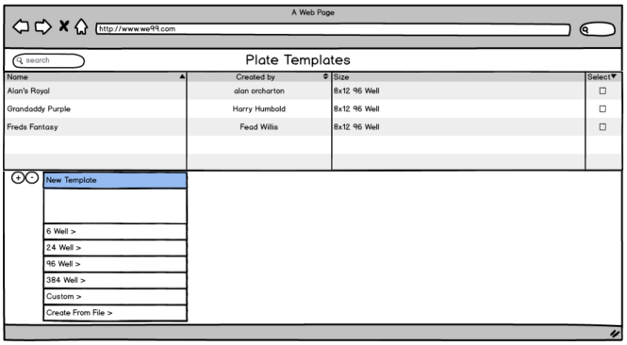
What “we99” are Delivering – Plate Map Editor
Plate Templates
Plate are created from plate templates

Slide 7
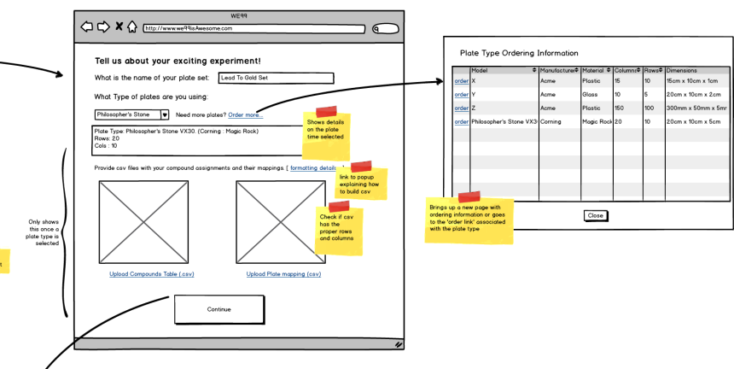
What “we99” are Delivering – Plate Map Editor
Add Plate Wizard – Part 1: Wells and Compounds

Slide 8
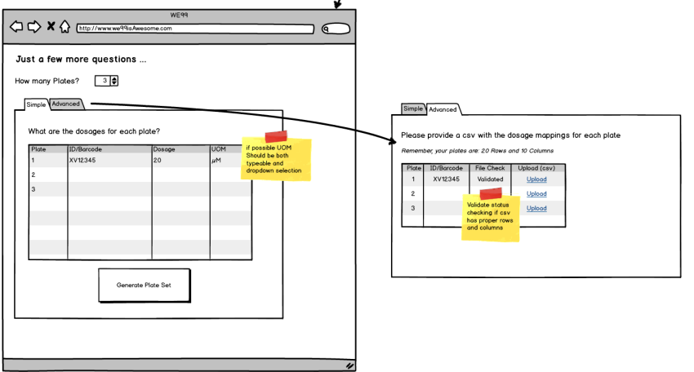
What “we99” are Delivering – Plate Map Editor
Add Plate Wizard – Part 2: Dosage

Slide 9
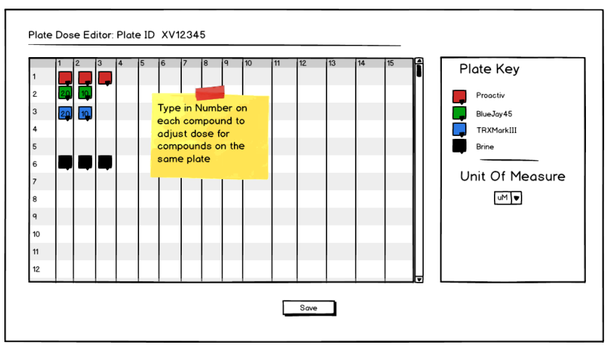
What “we99” are Delivering – Plate Map Editor
Add Plate Wizard – Plate Preview

Slide 10
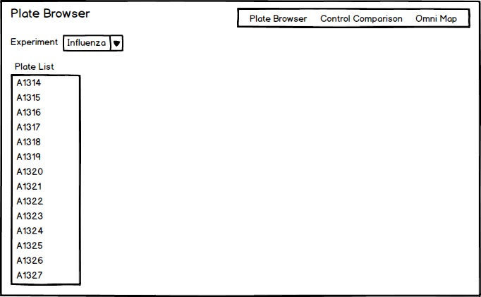
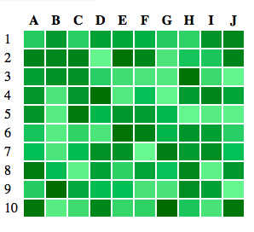
What “we99” are Delivering – Results Analysis

Slide 11
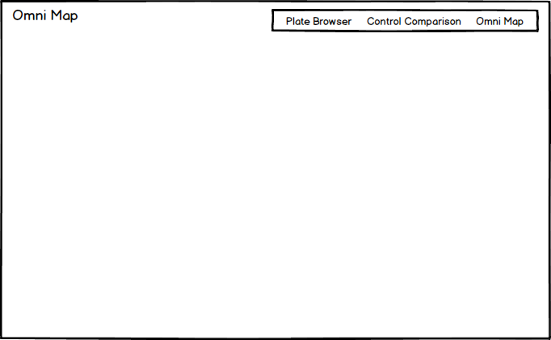
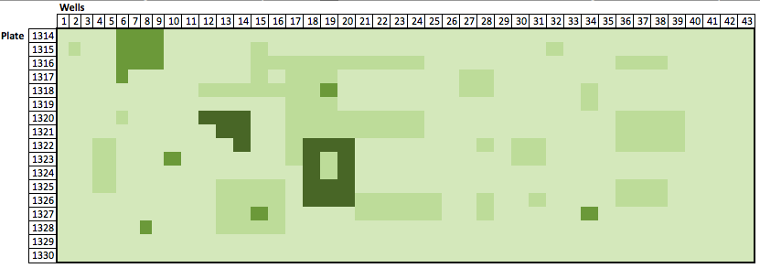
What we99” are Delivering – Results Analysis

Slide 12
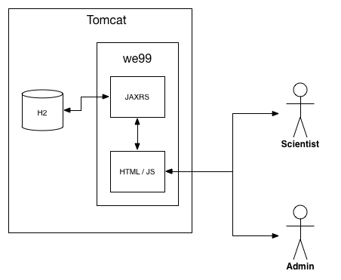
System Architecture

Slide 13
System Architecture
Model
The domain model uses the standard JPA annotations in order to be able to create a declarative persistence layer for the application
Controller
The controller portion of the application is implemented via REST services. The service classes are implemented using the JAXRS standard specification
View
The view component of the application is an application based on Angular JS.

Slide 14




Front End – Web Thin-Client
The front-end of the West-East project is designed to be a web application that is accessible via a browser
This setup enables our application to be reachable by a wide variety of different devices and form factors, allowing a high degree of flexibility for our end users
We99 Web App

Slide 15
Front End – Client Server Model
Benefits
Multithreaded, Multi-user support
Modern User Interface and Technologies – more code executed in Browser, reduces server load
Architectural pattern separate development of graphical user interface from the development of business logic or back end logic. The frontend uses REST services to interact with the backend. It does not need to know how the backend processes data or stores it.

Slide 16



Front End - Components
HTML5
The major technology markup language of the Internet used for structuring and presenting content. HTML5 is the latest revision of the standard.
Bootstrap A popular HTML, CSS, and JS framework for developing responsive, mobile first projects on the web
AngularJS
Popular Javascript framework for dynamic web applications developed by Google

Slide 17
Front End - Components
HTML5
The major technology markup language of the Internet used for structuring and presenting content. HTML5 is the latest revision of the standard.
Bootstrap A popular HTML, CSS, and JS framework for developing responsive, mobile first projects on the web
AngularJS
Popular Javascript framework for dynamic web applications developed by Google

Slide 18


Front End – Components (con’t)
JQuery
A fast, small, and feature-rich JavaScript library. It simplifies Javascript tasks like HTML document traversal and manipulation, event handling, animation, and Ajax. It also helps provide a common API for cross-browser compatibility
D3 A javascript library for displaying beautiful and interactive data graphics.

Slide 19
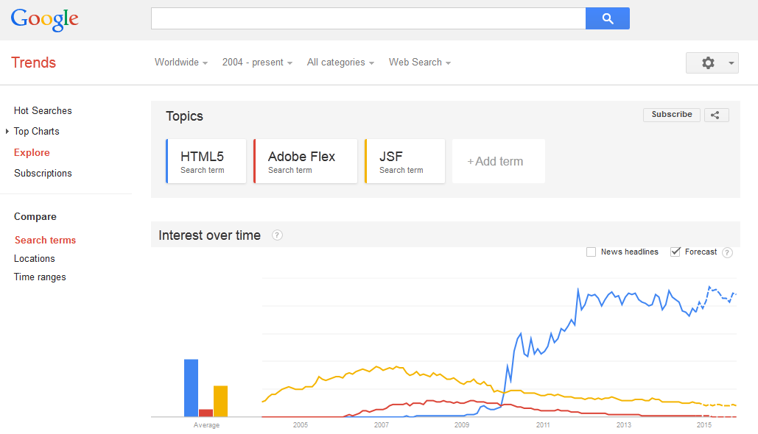
Front End – Rationale
We chose our frontend stack with an eye towards the future. HTML5 is becoming the de facto web front-end standard, in contrast to older technologies like Adobe Flex and JSF.

Slide 20



Front End – Build Tools
Grunt
Task tool for automating front-end jobs, such as minification, concatentation, controller unit tests, and other jobs
Bower
Dependency management tool developed by Twitter
Yeoman
Automatic code generation tool for rapid prototyping and development

Slide 21
Project Risks
Risks
Integration with other teams
Design meetings with other teams planned
Stories take longer that estimated
Keep a burn-up chart and prioritize stories
Getting of Good Test Data
Professor and TA may be able to get more
Testing Strategy
Test Driven Design

Slide 22
Project Planning – Team / Tools
Division of Labor
3 People specializing in Front End work
2 People specializing in Back End work
Collaborative Tools
Slack (messaging)
Git Hub Repository
JIRA

Slide 23
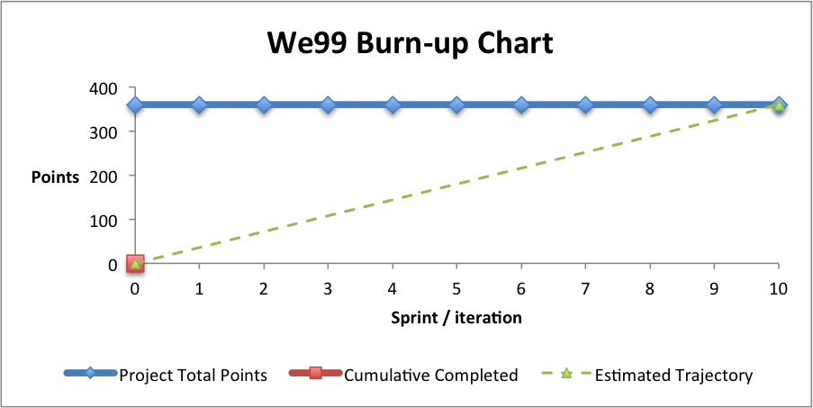
Project Planning
10 Iterations
360 Story Points (Project Estimate 720 Hours)
Burn-up Calculated weekly

Slide 24
Key Milestones
Milestone 2 Deliverables
Screen Process Flow
Domain Model
Web Service Interfaces
Plate Map Editor
Web Services for Plate Editor
Web Services for QC Results
Heat Maps
QC Plates / Experiments
Milestone 3 Deliverables
Interactive Analysis
Interactive Dose Response Analysis
Save or Publish

