Slide 1


Milestone 1
Harvard Extension School
CSCIE-99: Final Project
Biomedical Plate, Assay, and Results Management System
WE99: West-East Team
Sean Sinnott
Mark Ford
Alexander Zaman
Tim Stefanski
Alan Orcharton

Slide 2
WE99 Team Vision
The team focus is providing outstanding tools to assist in analyzing the dose response characteristics potential drugs.
We will provide beautiful interactive visualization tools that will assist the scientist in:
Creating and managing experimental plate sets for dose response experiments
Performing quality control checks on plate results and plate controls
Performing Interactive analysis of dose response results.
The team will store the experimental results and the analysis of the results so that the historic experimental analysis can be reviewed or reproduced at any time.
Scientists will be able to save the results for further analysis or publish their analysis, making it available to all other users.

Slide 3
Business Opportunity
High throughput screening tests millions of potential drugs.
Commercial software is expensive
Enable Scientists to be organized and efficient when screening potential drugs.
Dynamic analysis tools help reduce the number of experiments.
Eliminate compounds earlier in the discovery cycle.

Slide 4
Presentation Outline
Overview of Presentation
Plate Editing and Creation – Alex
Results Analysis – Sean
Architecture – Mark
Front End / Risks – Tim
Project Planning/Estimates - Alan

Slide 5
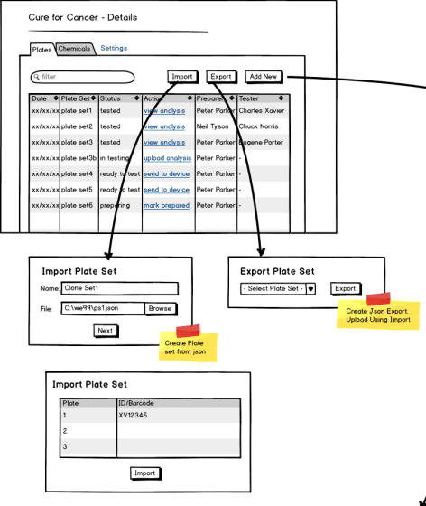
What “we99” are Delivering – Plate Map Editor
Plate Manager / Import – Export
Import to take data from json file.
Export to put details of the plate into a json file
Click actions to update status:
Mark prepared
Send to device
Upload analysis
View analysis

Slide 6
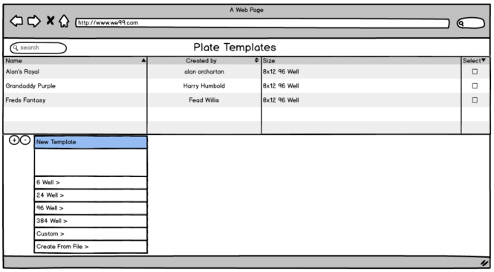
What “we99” are Delivering – Plate Map Editor
Plate Templates
Plate are created from plate templates

Slide 7
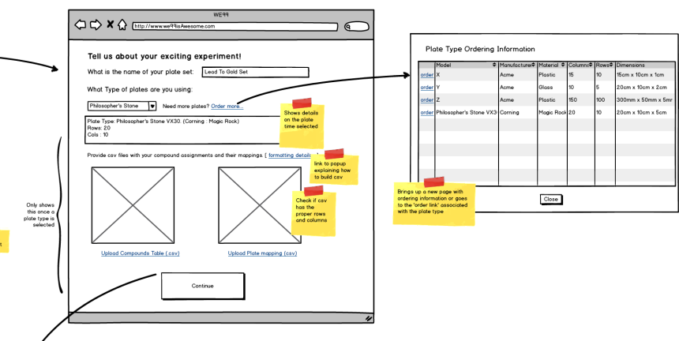
What “we99” are Delivering – Plate Map Editor
Add Plate Wizard – Part 1: Wells and Compounds

Slide 8
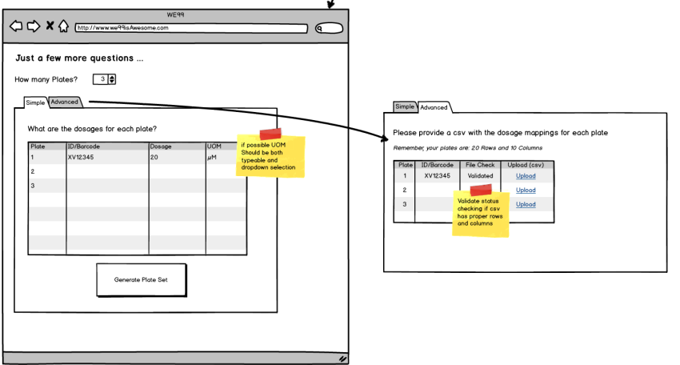
What “we99” are Delivering – Plate Map Editor
Add Plate Wizard – Part 2: Dosage

Slide 9
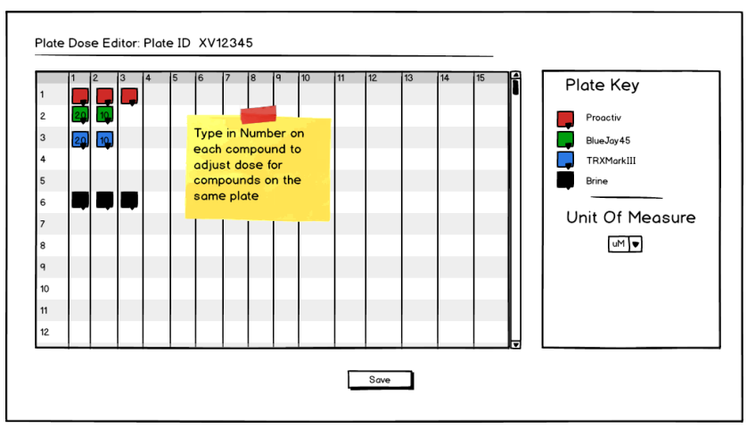
What “we99” are Delivering – Plate Map Editor
Add Plate Wizard – Plate Preview

Slide 10
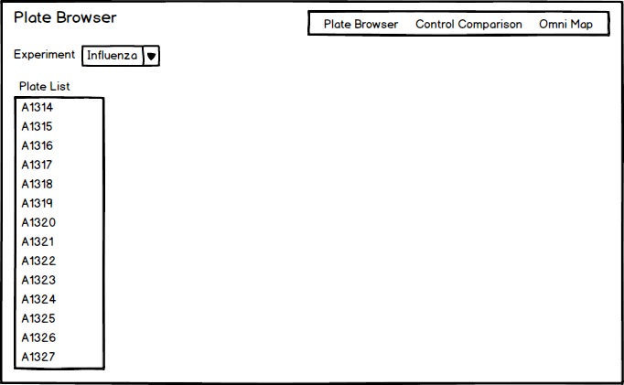
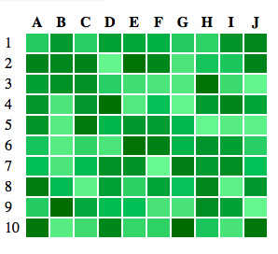
What “we99” are Delivering – Results Analysis

Slide 11
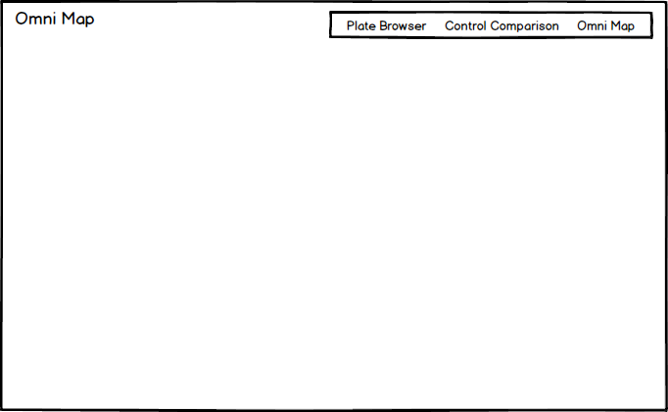
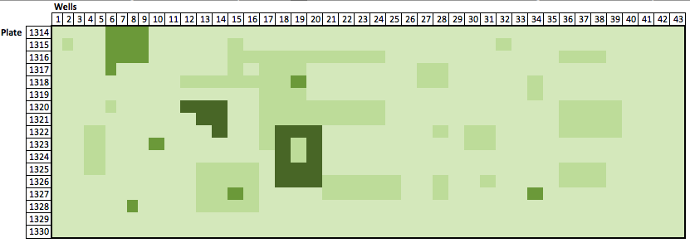
What we99” are Delivering – Results Analysis

Slide 12
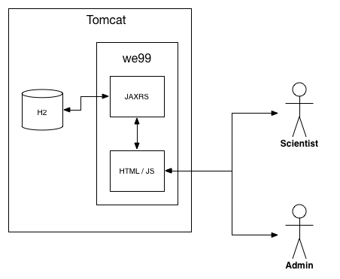
System Architecture

Slide 13
System Architecture
Model
The domain model uses the standard JPA annotations in order to be able to create a declarative persistence layer for the application
Controller
The controller portion of the application is implemented via REST services. The service classes are implemented using the JAXRS standard specification
View
The view component of the application is an application based on Angular JS.

Slide 14
Project Risks
Risks
Integration with other teams
Design meetings with other teams planned
Stories take longer that estimated
Keep a burn-up chart and prioritize stories
Getting of Good Test Data
Professor and TA may be able to get more
Testing Strategy
Test Driven Design

Slide 15
Project Planning – Team / Tools
Division of Labor
3 People specializing in Front End work
2 People specializing in Back End work
Collaborative Tools
Slack (messaging)
Git Hub Repository
JIRA

Slide 16
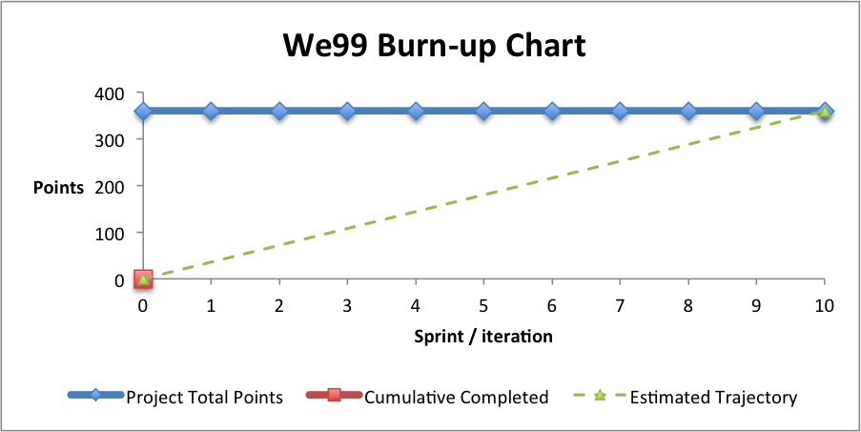
Project Planning
10 Iterations
360 Story Points (Project Estimate 720 Hours)
Burn-up Calculated weekly

Slide 17
Key Milestones
Milestone 2 Deliverables
Screen Process Flow
Domain Model
Web Service Interfaces
Plate Map Editor
Web Services for Plate Editor
Web Services for QC Results
Heat Maps
QC Plates / Experiments
Milestone 3 Deliverables
Interactive Analysis
Interactive Dose Response Analysis
Save or Publish

