Slide 1


Milestone 1
Harvard Extension School
CSCIE-99: Final Project
Biomedical Plate, Assay, and Results Management System
WE99: West-East Team
Sean Sinnott
Mark Ford
Alexander Zaman
Tim Stefanski
Alan Orcharton

Slide 2
WE99 Team Vision
Our overall vision is to create a centralized web application that will provide tools to assist scientists in managing experiment plate sets and with the analysis of experimental results.
The team focus is providing outstanding tools to assist in analyzing the dose response characteristics potential drugs.
We will provide beautiful interactive visualization tools that will assist the scientist in:
Creating and managing experimental plate sets for dose response experiments
Performing quality control checks on plate results and plate controls
Performing Interactive analysis of dose response results.
The team will store the experimental results and the analysis of the results so that the historic experimental analysis can be reviewed or reproduced at any time.
Scientists will be able to save the results for further analysis or publish their analysis, making it available to all other users.

Slide 3
Business Opportunity
New drug development is a time consuming and expensive process. In the early stages of drug discovery millions of compounds are screened and tested on the road to finding a few candidates for further exploratory development.
High throughput screening is a method scientists use in the early stages of drug discovery to test millions of potential drugs. The method allows scientist to quickly identify candidates. While the process is highly automated, a disparate selection software of software tools are often used to manage plate sets and analyze results. Commercial software to manage the process is often extremely expensive
The We99 team is proposing releasing an integrated suite of open source web based tools. The team believes that the tools will enable scientists to be more organized and efficient when screening and analyzing potential drugs. Time savings will allow scientist to more effectively eliminate compounds earlier in the discovery cycle potentially saving companies millions of dollars.

Slide 4
Presentation Outline
Outline of presentation and presenters

Slide 5
What “we99” are Delivering – Plate Map Editor

Slide 6
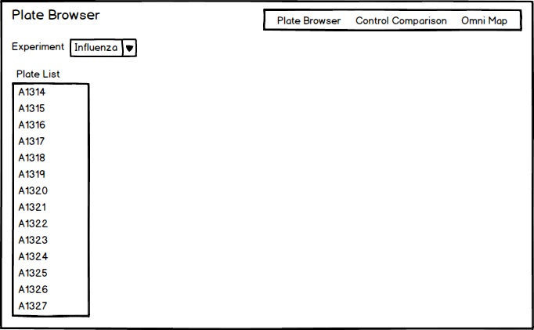
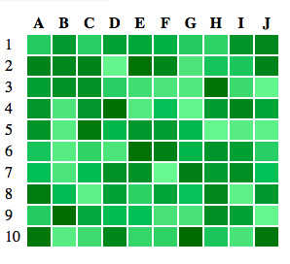
What “we99” are Delivering – Results Analysis

Slide 7
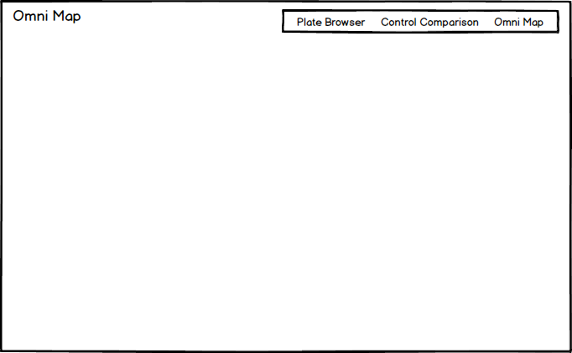
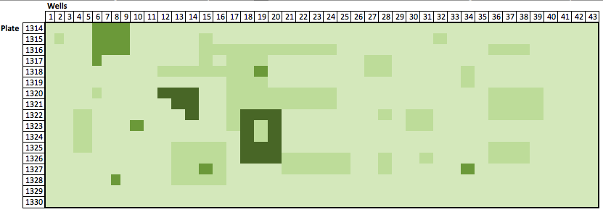
What we99” are Delivering – Results Analysis

Slide 8
System Architecture
Insert Hardware Requirements
Software Requirements / Databases
Diagrams / Design Ideas

Slide 9
Web Services

Slide 10
Front End

Slide 11
Project Planning
Iterations
Stories – division on labor
Estimates for Stories

Slide 12
Key Milestones
Milestone 2 Deliverables
Milestone 3 Deliverables

Slide 13
Project Risks
Strategy for mitigating risks
Requirements changes
Testing Strategy
Tools Git,Jira,Grunt, Metrics

