Slide 2
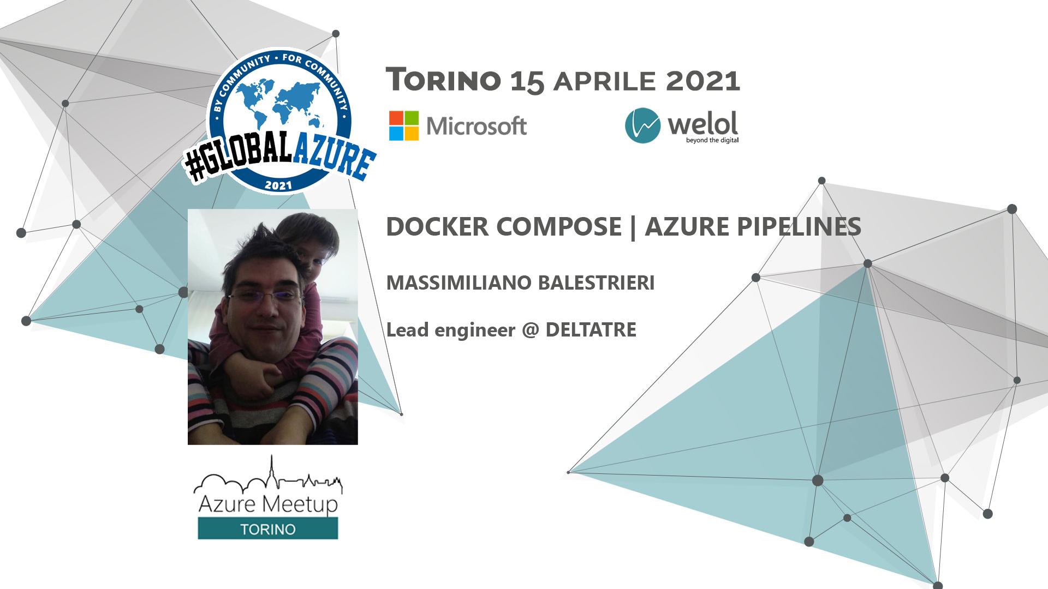

Slide 3
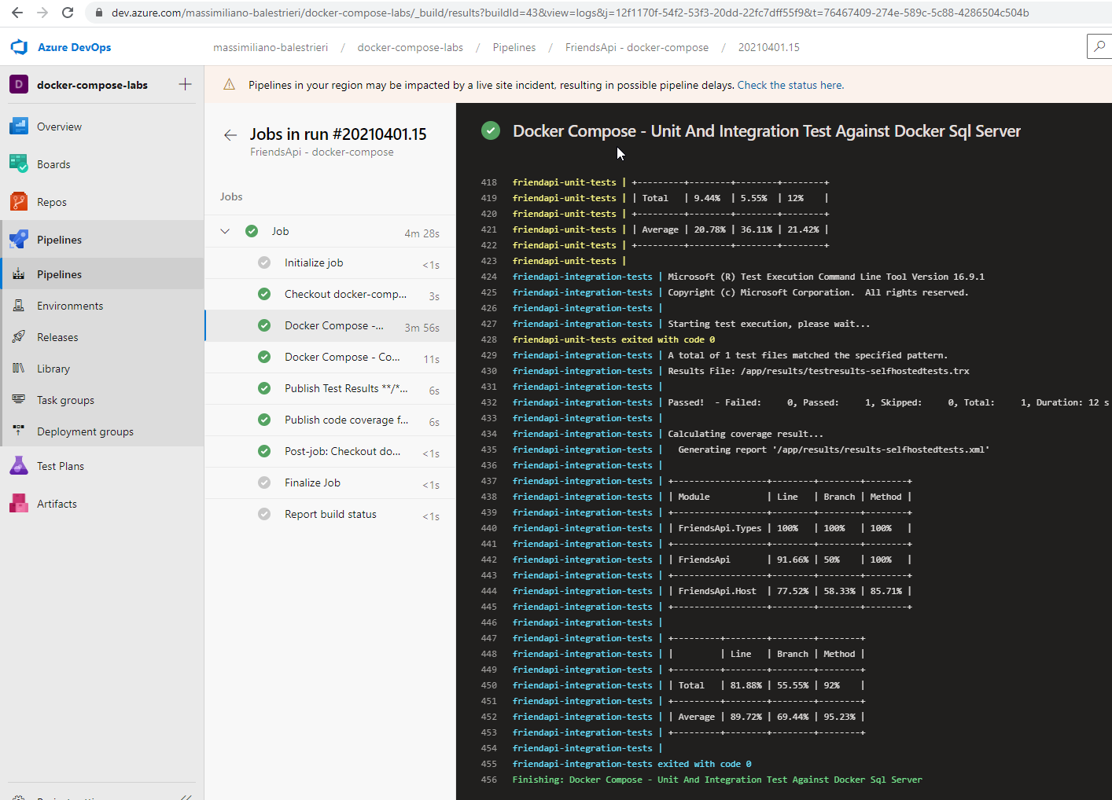

Docker compose | Azure Pipelines
https://dev.azure.com/massimiliano-balestrieri/docker-compose-labs

Slide 4
agenda
https://dev.azure.com/massimiliano-balestrieri/docker-compose-labs
Docker-compose + Azure-pipelines: cosa sono e perché insieme
Repository
Scenari
Integration tests: database server or memory database?
E2e tests project: la mia api e’ testata? Quanto?
Load tests + analisi memoria: esperimenti

Slide 5
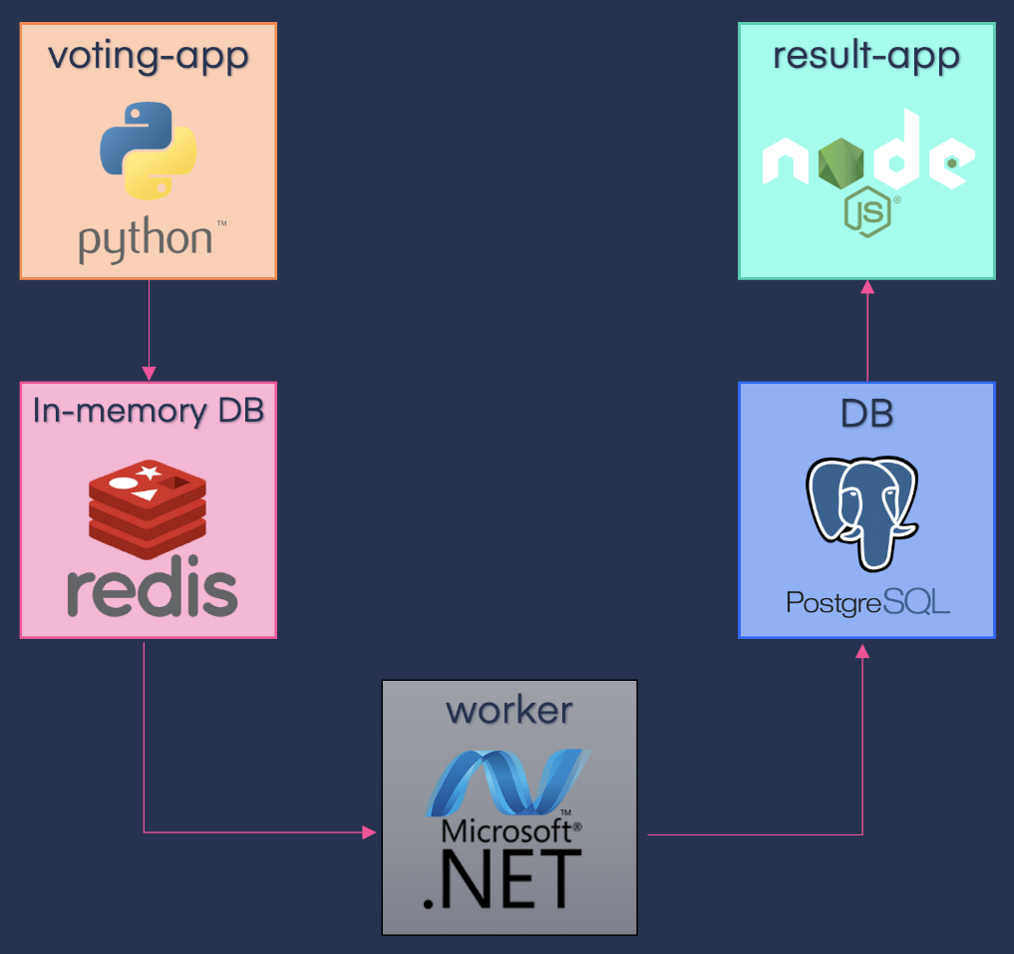
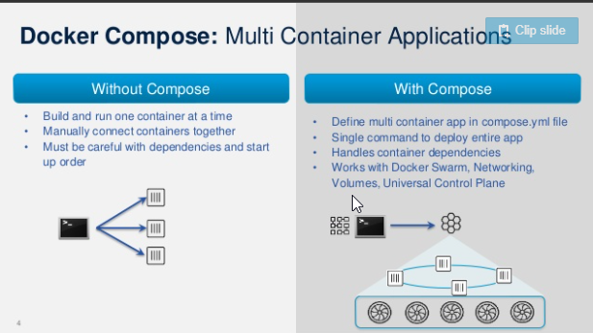
Cos’e’ docker-compose?
https://dev.azure.com/massimiliano-balestrieri/docker-compose-labs
- tool per per gestire applicazioni multi container

Slide 6
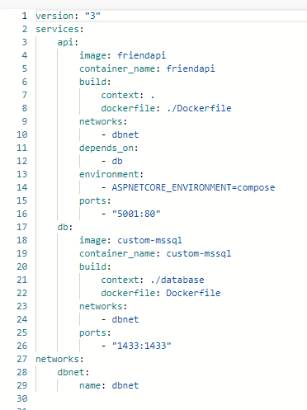
Cos’e’ docker-compose?
https://dev.azure.com/massimiliano-balestrieri/docker-compose-labs
- tool per per gestire applicazioni multi container
DOCKER: ☹
docker build -f ./Dockerfile -t friendapi .
docker run -p 5001:80 --env ASPNETCORE_ENVIRONMENT=development --network=dbnet friendapi
docker run -e 'ACCEPT_EULA=Y' -e 'SA_PASSWORD=yourStrong(!)Password' -p 1433:1433 -d mcr.microsoft.com/mssql/server:2017-latest
docker run -p 1433:1433 --network=dbnet custom-mssql
DOCKER-COMPOSE: ☺
docker-compose build
docker-compose up
docker-compose down

Slide 7
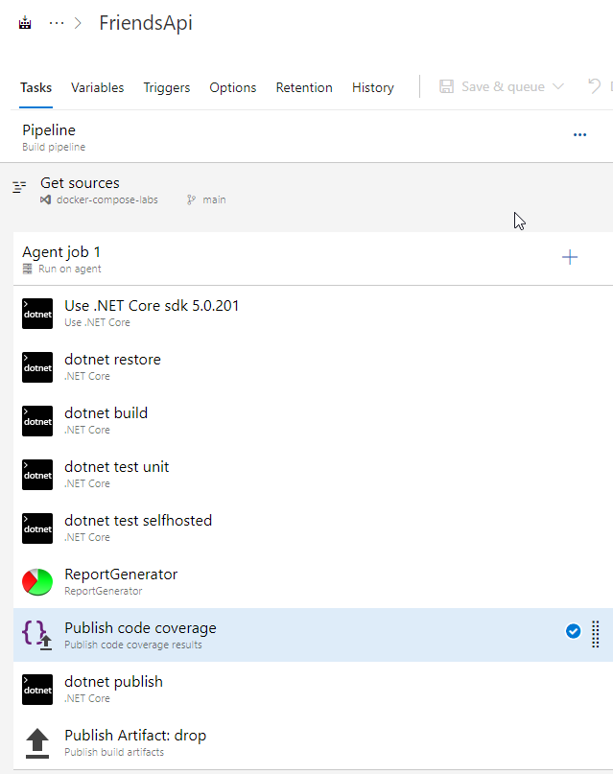
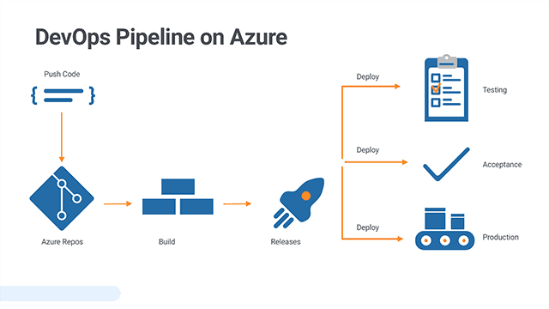
Cos’e’ azure pipelines?
https://dev.azure.com/massimiliano-balestrieri/docker-compose-labs
- servizio che consente di implementare una pipeline di compilazione, test e distribuzione di applicazioni

Slide 8
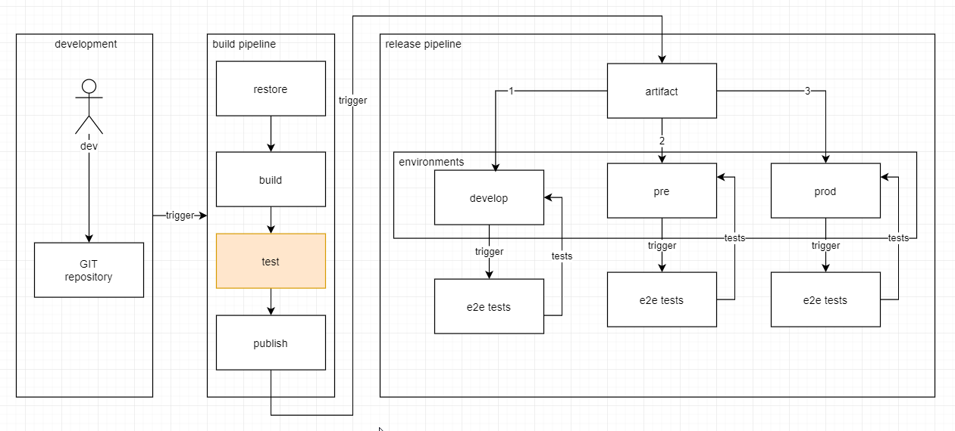
https://dev.azure.com/massimiliano-balestrieri/docker-compose-labs

Slide 9
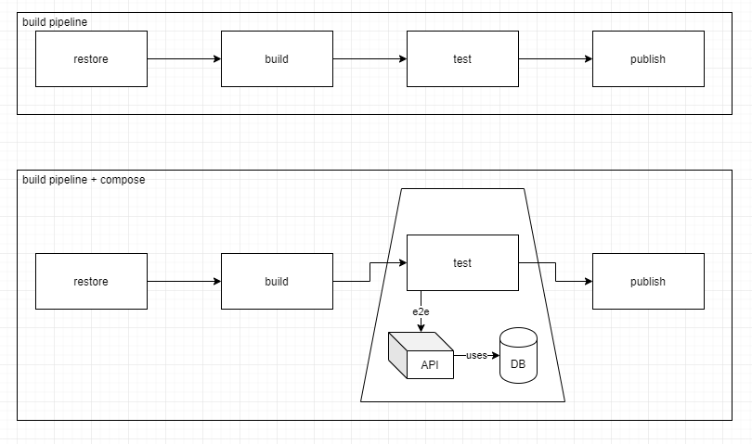
Azure pipelines + docker-compose: Ambienti di test automatizzati
https://docs.docker.com/compose/

Slide 10
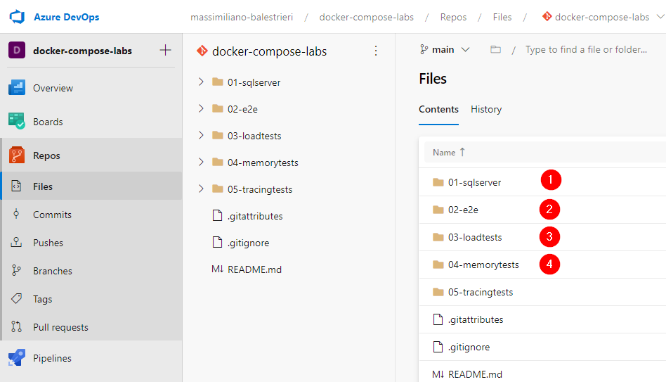
REPOSITORY
https://dev.azure.com/massimiliano-balestrieri/docker-compose-labs

Slide 11
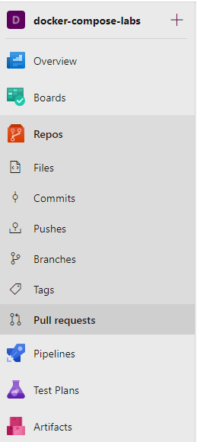
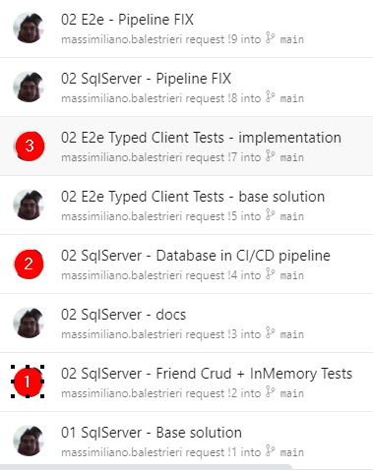
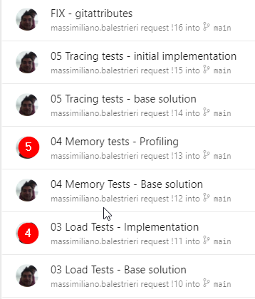
PULL REQUESTS
https://dev.azure.com/massimiliano-balestrieri/_git/docker-compose-labs/pullrequests?_a=completed

Slide 12
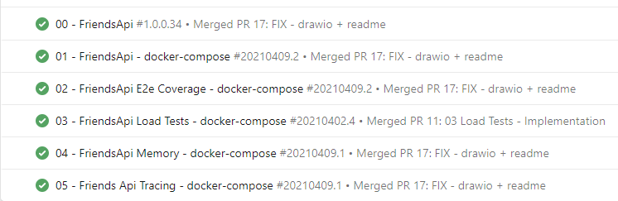
BUILD PIPELINES
https://dev.azure.com/massimiliano-balestrieri/docker-compose-labs/_build

Slide 13
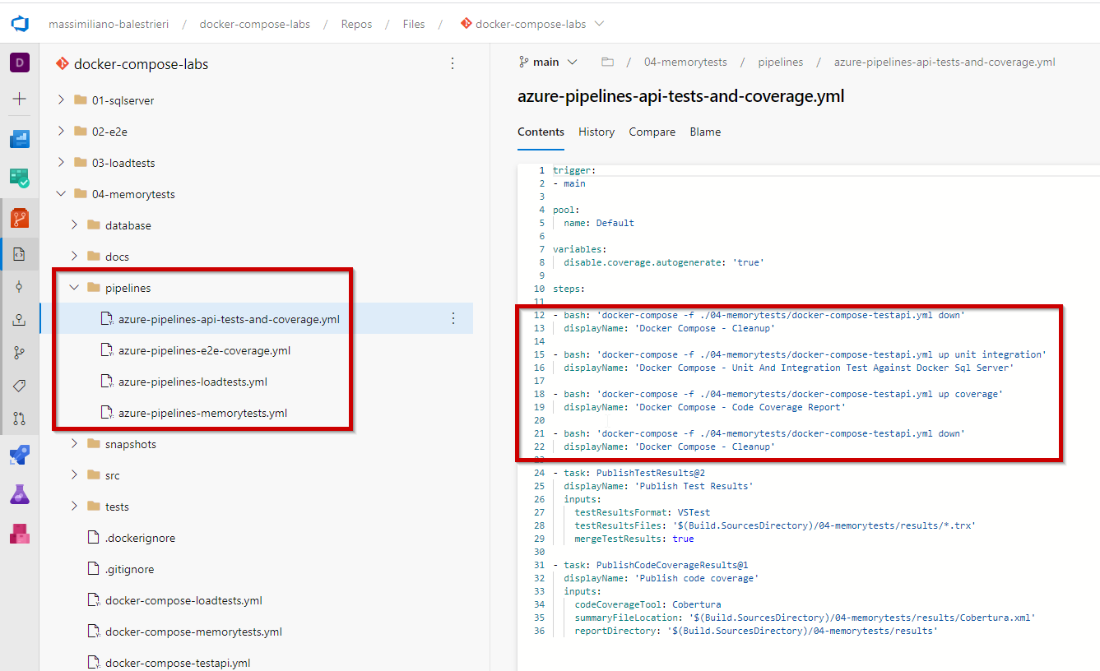
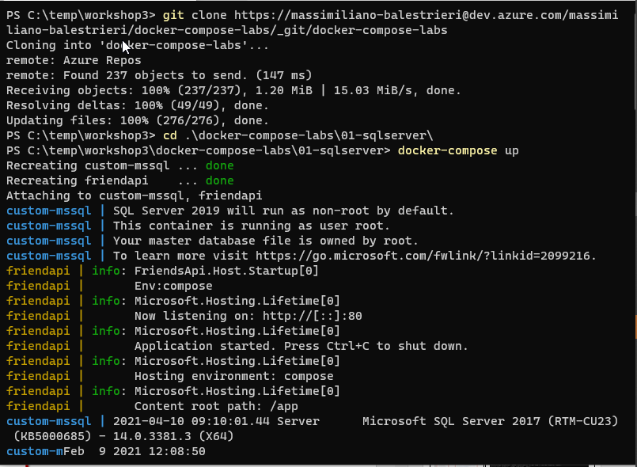

pipelines – 4 scenari – 4 Yaml definitions – come provarle

Slide 14
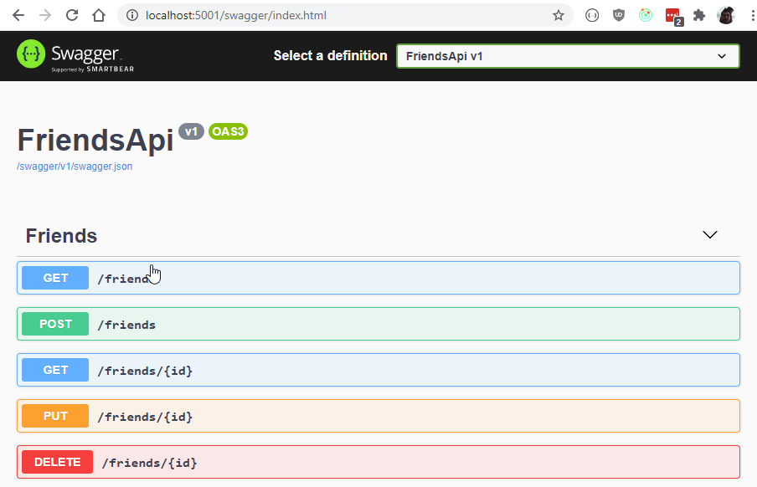
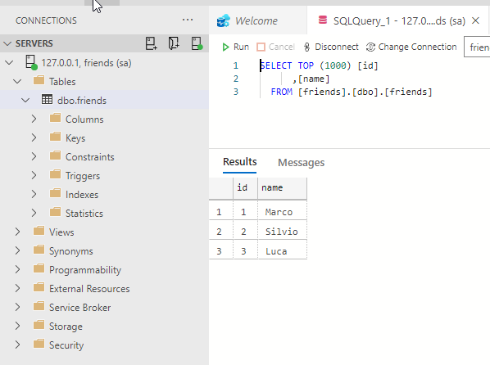
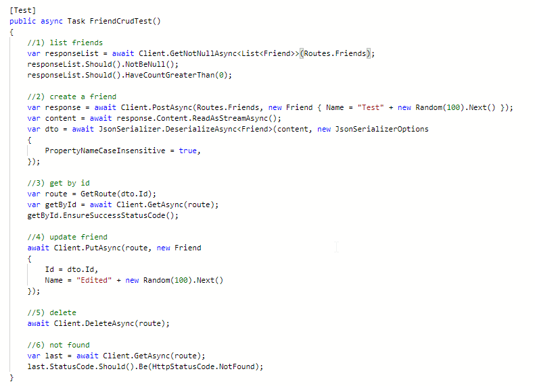
Perche’ DOCKER compose in build? sCENARIO 1 – integration tests – api + sqlserver + tests
https://dev.azure.com/massimiliano-balestrieri/docker-compose-labs
https://dev.azure.com/massimiliano-balestrieri/docker-compose-labs/_git/docker-compose-labs/pullrequest/2
L’ API
IL DATABASE
I TESTS

Slide 15
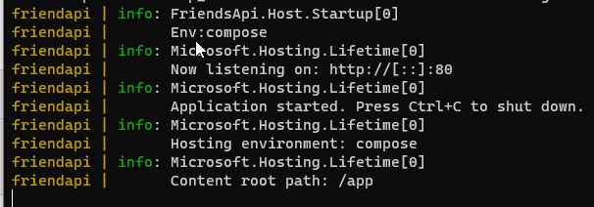
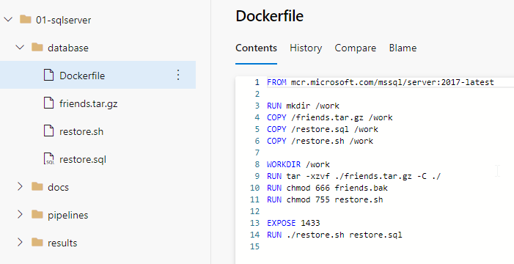
SCENARIO 1 – INTEGRATION TESTS – GIT + RUN DEMO
git clone https://massimiliano-balestrieri@dev.azure.com/massimiliano-balestrieri/docker-compose-labs/_git/docker-compose-labs
cd .\docker-compose-labs\01-sqlserver\
docker-compose up
http://localhost:5001/swagger

Slide 16
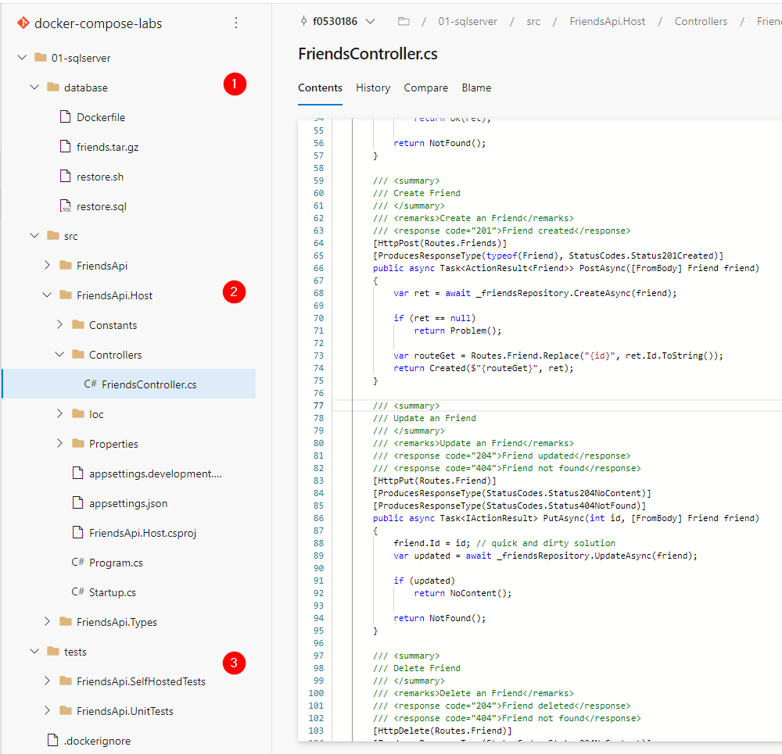
BASE SOLUTION

Slide 17
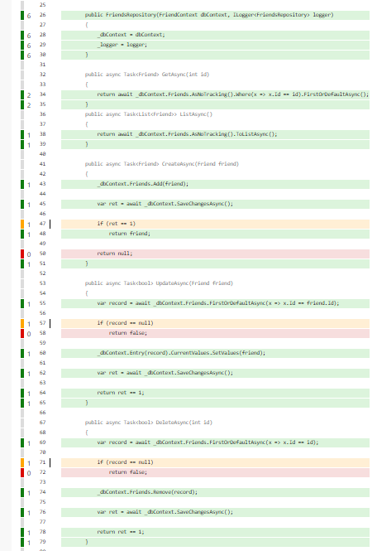
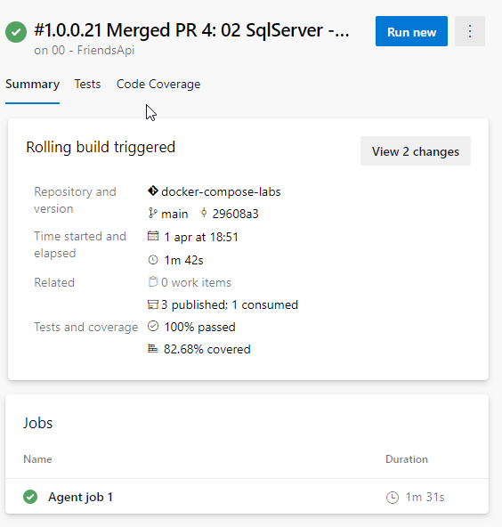
BASE BUILD PIPELINE
https://dev.azure.com/massimiliano-balestrieri/docker-compose-labs/_build/results?buildId=44&view=results

Slide 18
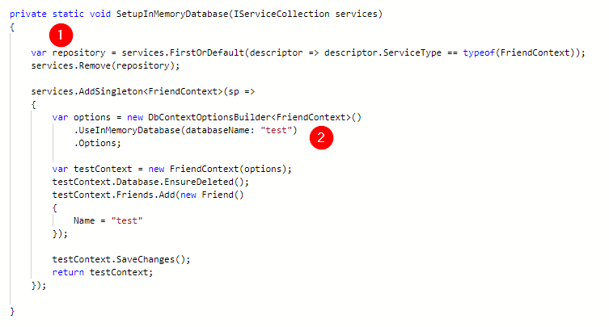

Scenario: DATABASE – COSA STIAMO TESTANDO? LIMITI?
SCENARIO 1 – INTEGRATION TESTS – IN MEMORY DATABASE

Slide 19
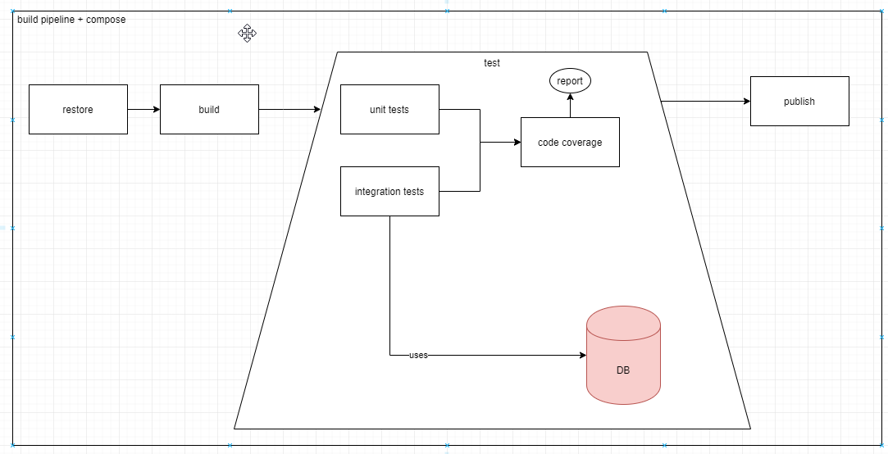
https://dev.azure.com/massimiliano-balestrieri/docker-compose-labs/_git/docker-compose-labs/pullrequest/4
SCENARIO 1 – INTEGRATION TESTS – ARCHITETTURA STEP

Slide 20
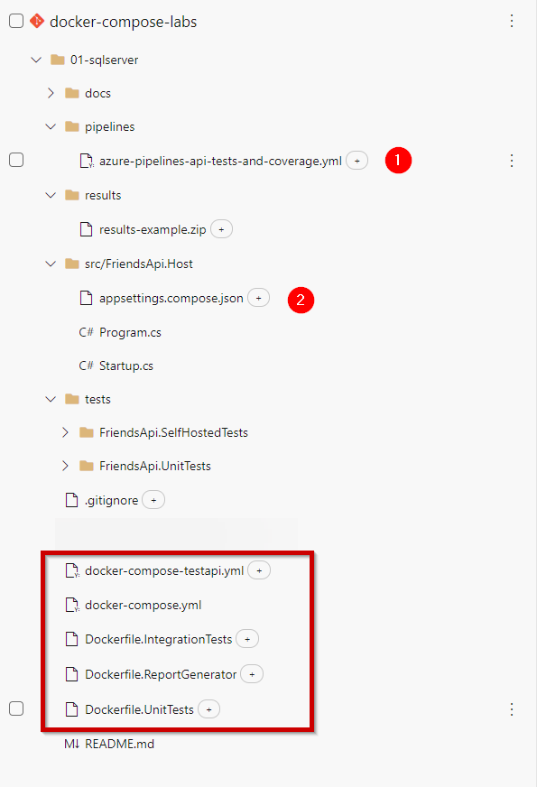
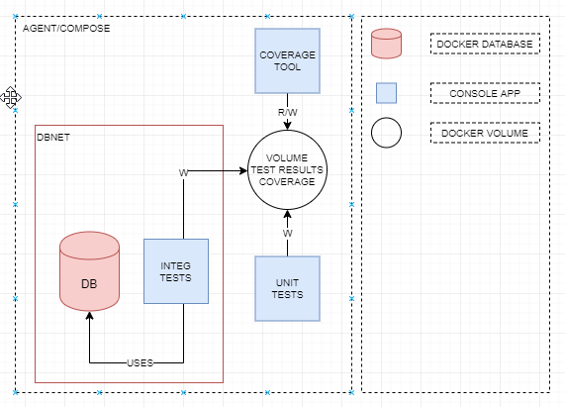
https://dev.azure.com/massimiliano-balestrieri/docker-compose-labs/_git/docker-compose-labs/pullrequest/4
SCENARIO 1 – INTEGRATION TESTS – ARCHITETTURA STEP

Slide 21
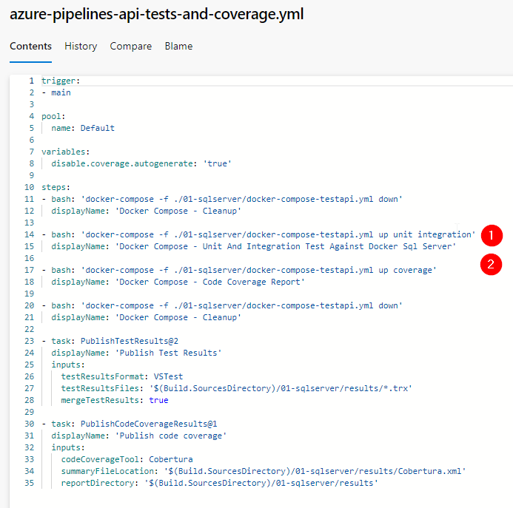
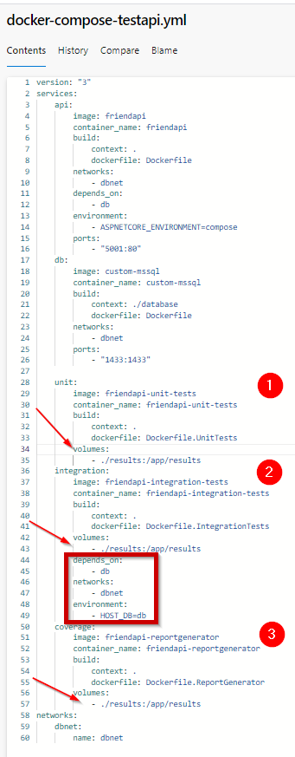
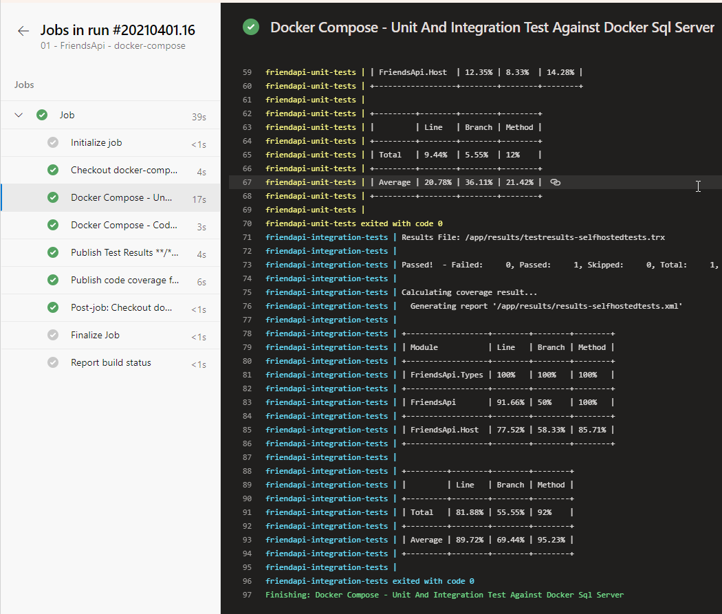
https://dev.azure.com/massimiliano-balestrieri/docker-compose-labs/_git/docker-compose-labs?path=%2F01-sqlserver%2Fpipelines%2Fazure-pipelines-api-tests-and-coverage.yml
https://dev.azure.com/massimiliano-balestrieri/docker-compose-labs/_build/results?buildId=45&view=logs&j=12f1170f-54f2-53f3-20dd-22fc7dff55f9&t=76467409-274e-589c-5c88-4286504c504b

Slide 22
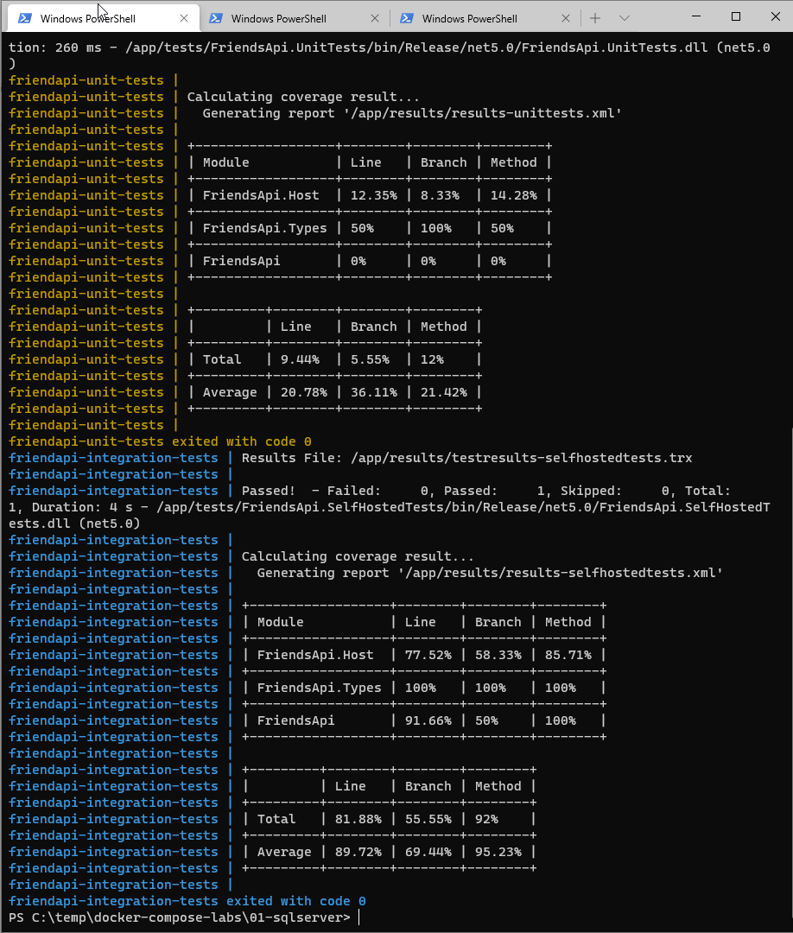
https://dev.azure.com/massimiliano-balestrieri/docker-compose-labs/_git/docker-compose-labs/pullrequest/4
DOCKER COMPOSE – SQL SERVER + TESTS
docker-compose -f .\docker-compose-testapi.yml up unit integration
docker-compose -f .\docker-compose-testapi.yml up coverage

Slide 23
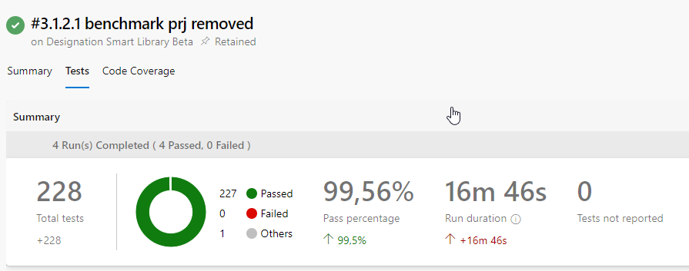
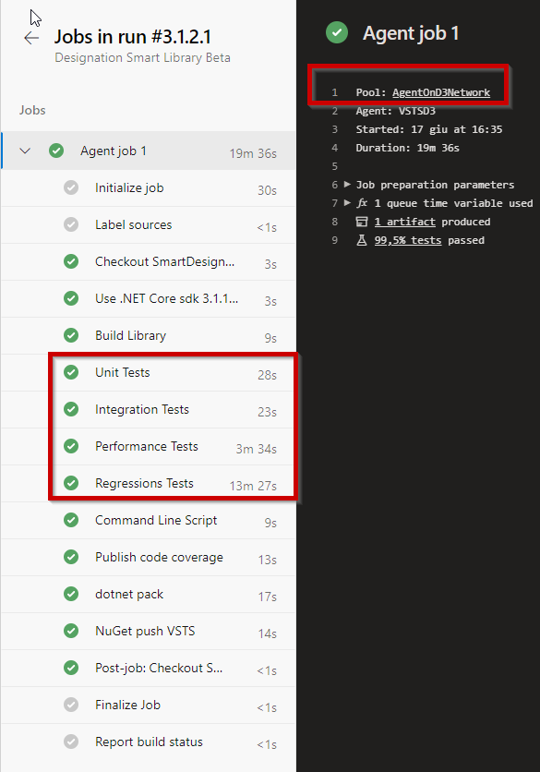
Perche’ DOCKER compose in build? sCENARIO 1B – ‘STRANGOLARE’ LEGACY STORED PROCEDURES – REGRESSION TESTS

Slide 24
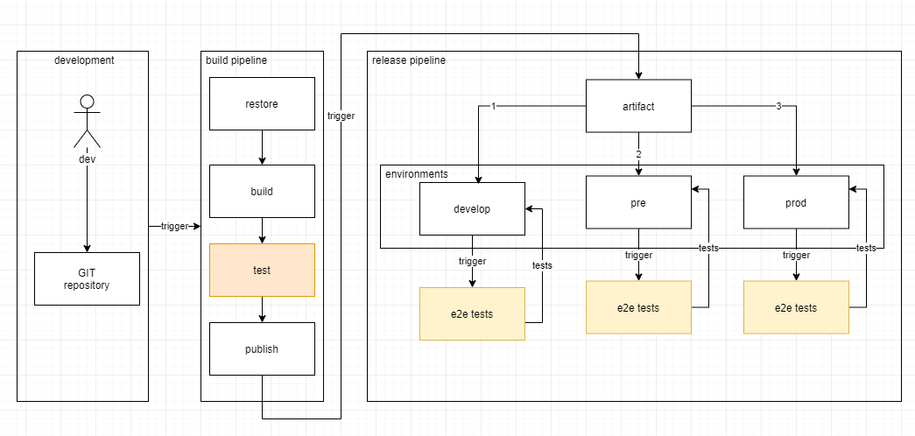
https://dev.azure.com/massimiliano-balestrieri/docker-compose-labs/_git/docker-compose-labs/pullrequest/7
SCENARIO 1 – INTEGRATION TESTS – ARCHITETTURA STEP

Slide 25
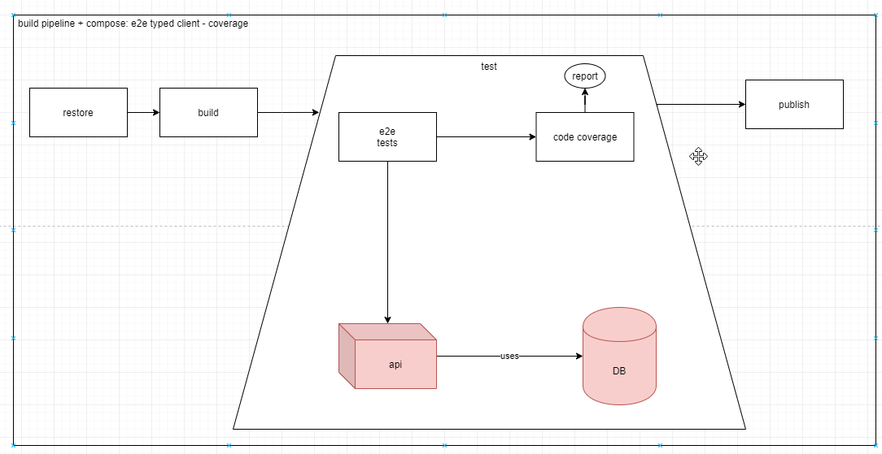
https://dev.azure.com/massimiliano-balestrieri/docker-compose-labs/_git/docker-compose-labs/pullrequest/7
SCENARIO 1 – INTEGRATION TESTS – ARCHITETTURA STEP

Slide 26
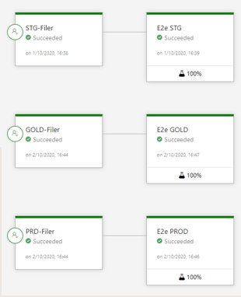
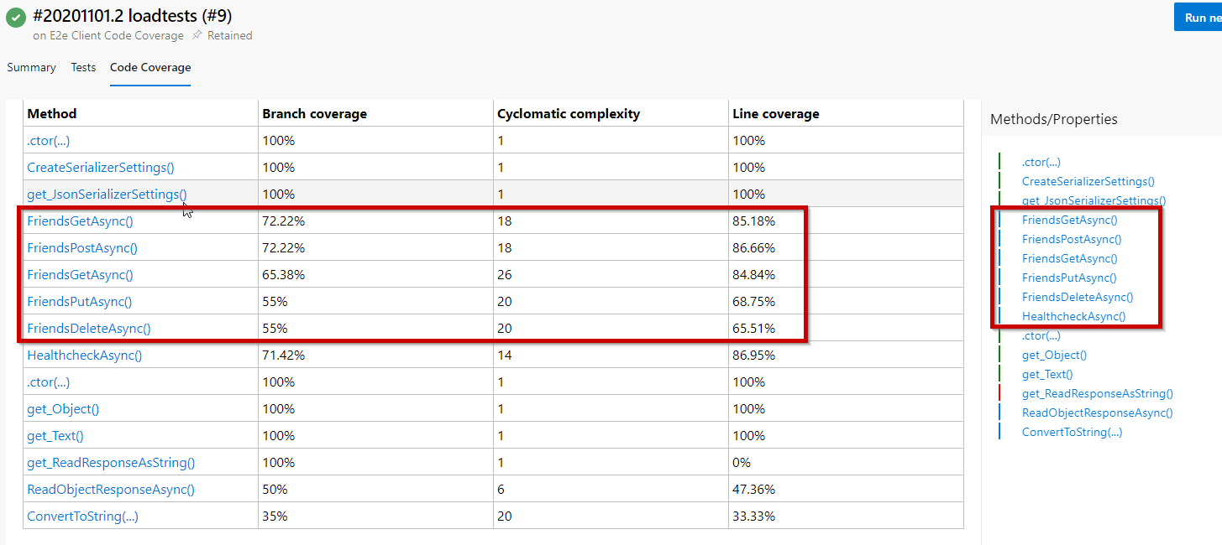
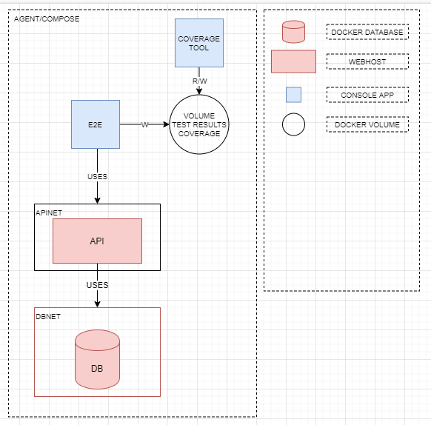
Perche’ DOCKER compose in build? sCENARIO 2 – E2E TESTS – METRICHE COPERTURA
https://dev.azure.com/massimiliano-balestrieri/docker-compose-labs/_git/docker-compose-labs/pullrequest/7

Slide 27
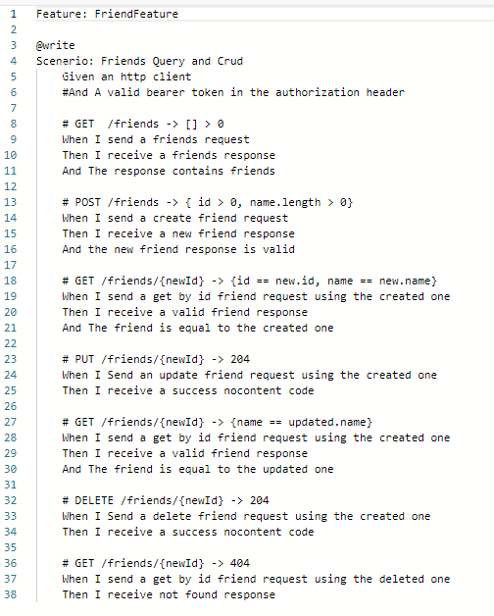
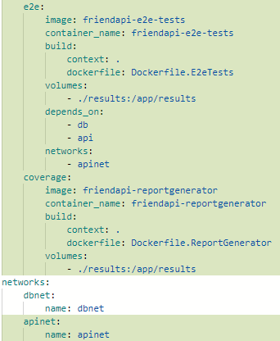
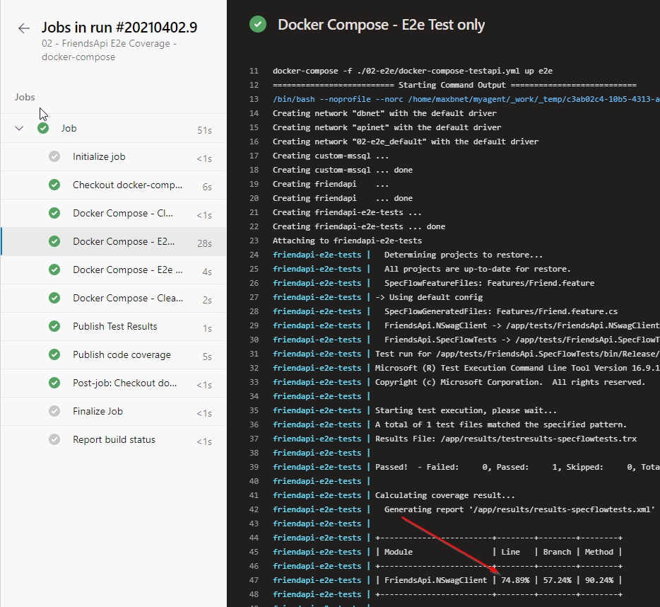
Perche’ DOCKER compose in build? sCENARIO 2 – E2E TESTS – BUILD PIPELINE – COVERAGE
https://dev.azure.com/massimiliano-balestrieri/docker-compose-labs/_build?definitionId=8

Slide 28
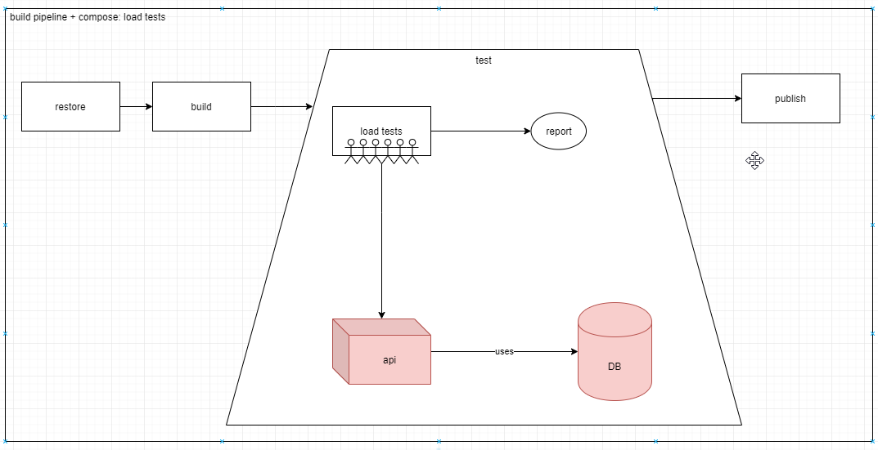
https://dev.azure.com/massimiliano-balestrieri/docker-compose-labs/_git/docker-compose-labs/pullrequest/11
SCENARIO 1 – INTEGRATION TESTS – ARCHITETTURA STEP

Slide 29
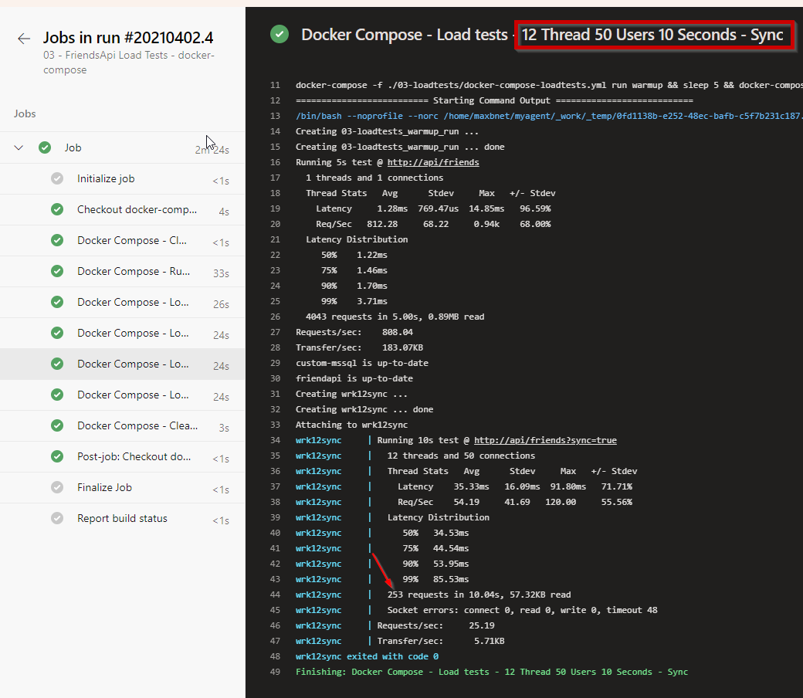
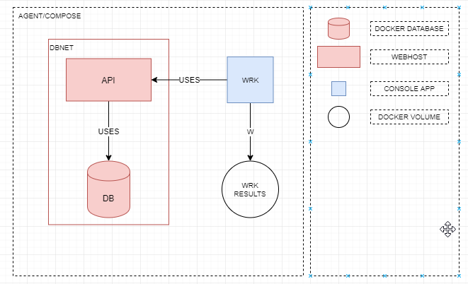
Perche’ DOCKER compose in build? sCENARIO 3 – LOAD TESTS – AUTOMAZIONE + BOTTLENECKS
https://dev.azure.com/massimiliano-balestrieri/docker-compose-labs/_git/docker-compose-labs/pullrequest/11

Slide 30
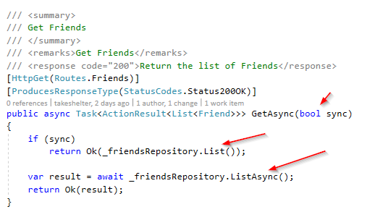
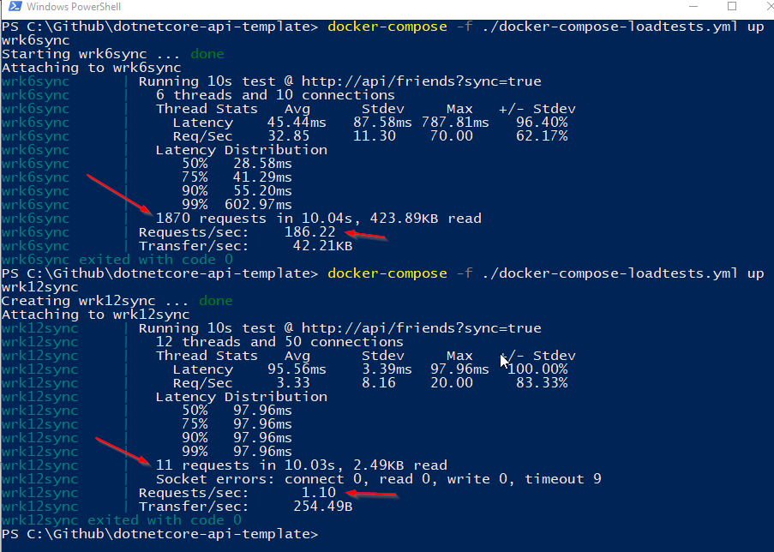
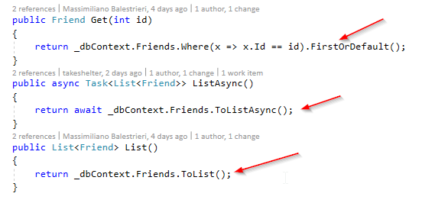
Perche’ DOCKER compose in build? sCENARIO 3 – LOAD TESTS – SYNC CODE BLOCK THREAD POOL
https://dev.azure.com/massimiliano-balestrieri/docker-compose-labs/_build?definitionId=9&_a=summary

Slide 31
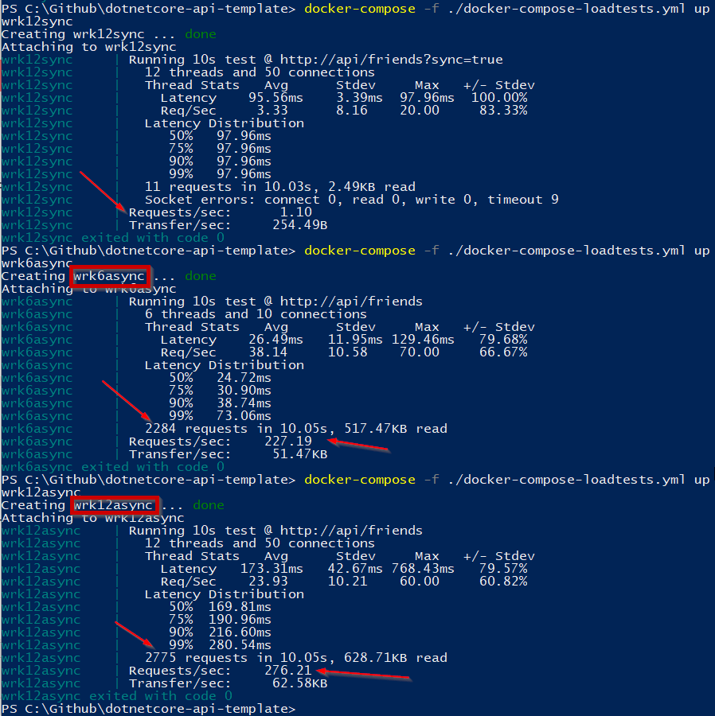
SCENARIO: load tests always async - THROUGHPUT
https://dev.azure.com/massimiliano-balestrieri/docker-compose-labs/_build/results?buildId=152

Slide 32
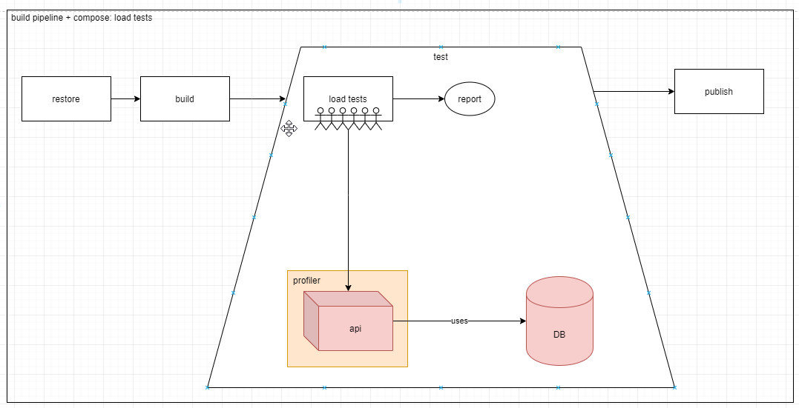
https://dev.azure.com/massimiliano-balestrieri/docker-compose-labs/_git/docker-compose-labs/pullrequest/13
SCENARIO 1 – INTEGRATION TESTS – ARCHITETTURA STEP

Slide 33



Perche’ DOCKER compose in build? sCENARIO 4 – MEMORY TRAFFIC PROFILING: JETBRAINS CLI TOOLS
https://dev.azure.com/massimiliano-balestrieri/docker-compose-labs/_git/docker-compose-labs/pullrequest/13

Slide 34




Perche’ DOCKER compose in build? sCENARIO 4 – MEMORY TRAFFIC PROFILING
https://dev.azure.com/massimiliano-balestrieri/docker-compose-labs/_build?definitionId=10

Slide 35

links
GIT REPO - https://dev.azure.com/massimiliano-balestrieri/_git/docker-compose-labs
ME - https://www.linkedin.com/in/massimilianobalestrieri/
OLD REPO - https://github.com/sheltertake/dotnetcore-api-template

