Slide 1


Slide 2
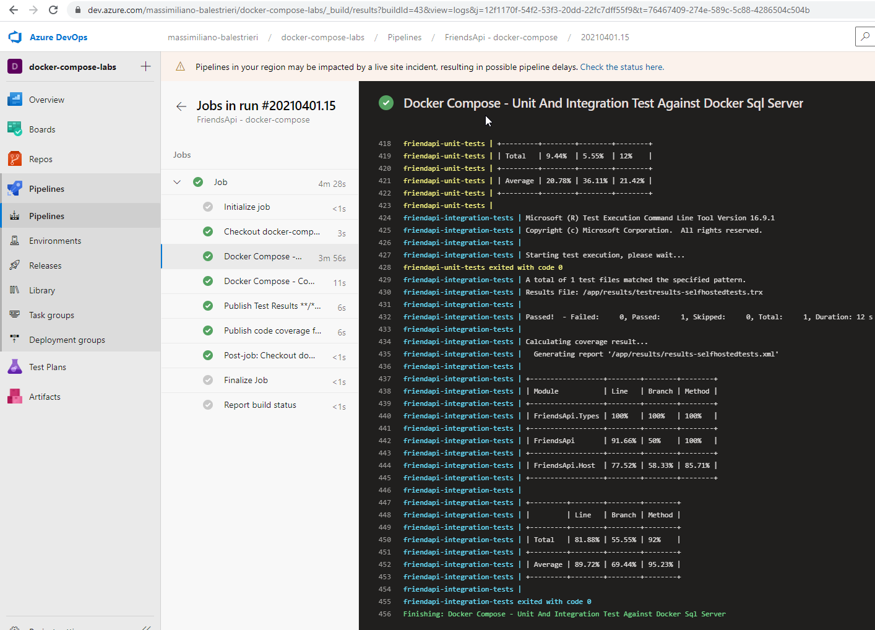

Docker compose | Azure Pipelines
https://dev.azure.com/massimiliano-balestrieri/docker-compose-labs

Slide 3
agenda
https://dev.azure.com/massimiliano-balestrieri/docker-compose-labs
Repository
Docker-compose + Azure-pipelines: cosa sono e perché insieme
Scenari
Integration tests: database server or memory database?
E2e tests project: la mia api e’ testata? Quanto?
Load tests + analisi memoria: esperimenti

Slide 4

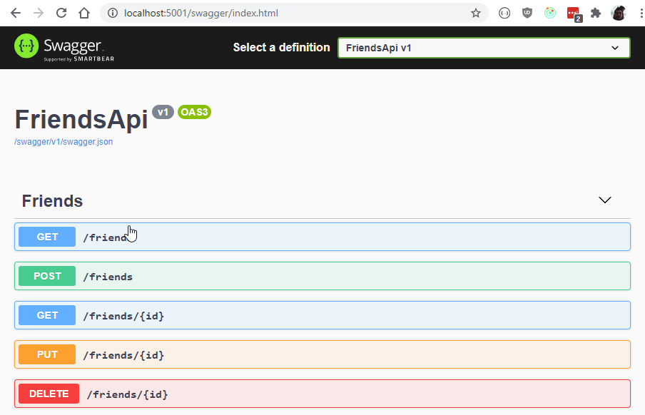
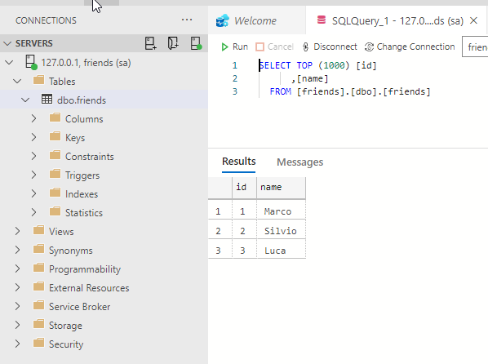
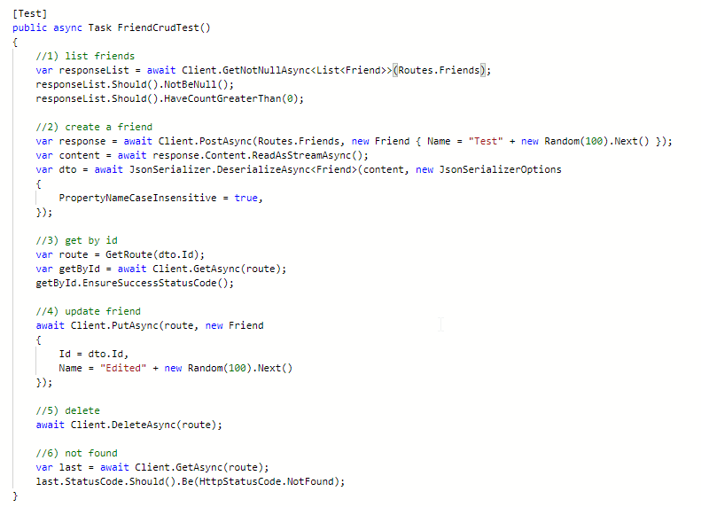
Perche’ DOCKER compose in build? sCENARIO 1 – integration tests – api + sqlserver + tests
https://dev.azure.com/massimiliano-balestrieri/docker-compose-labs
https://dev.azure.com/massimiliano-balestrieri/docker-compose-labs/_git/docker-compose-labs/pullrequest/2
L’ API
IL DATABASE
I TESTS

Slide 5
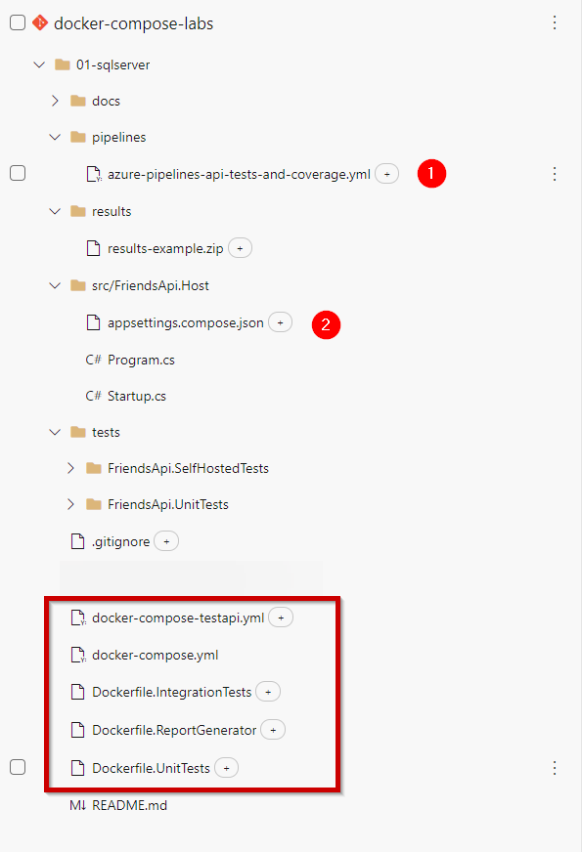
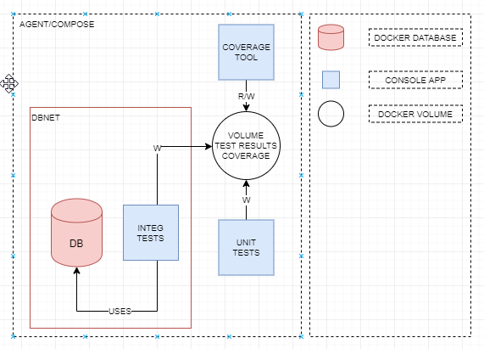
https://dev.azure.com/massimiliano-balestrieri/docker-compose-labs/_git/docker-compose-labs/pullrequest/4
SCENARIO 1 – INTEGRATION TESTS – ARCHITETTURA STEP

Slide 6
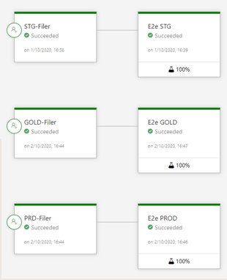
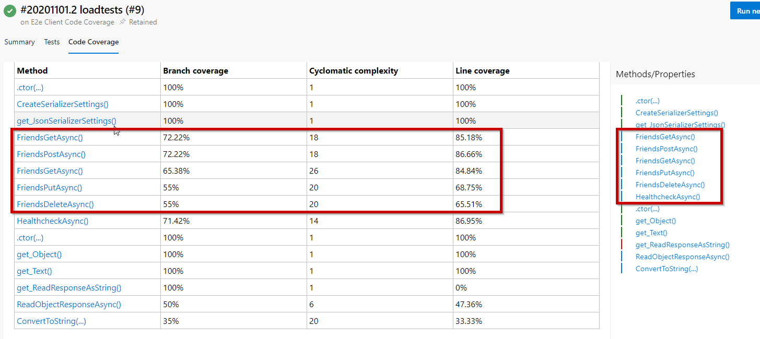
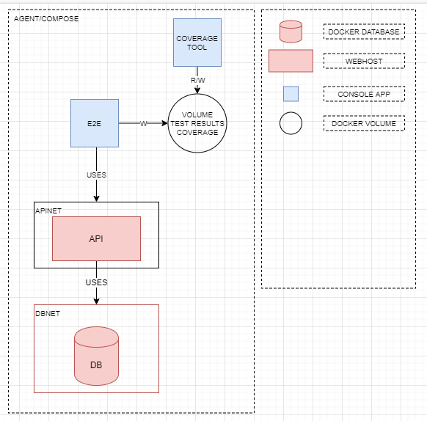
Perche’ DOCKER compose in build? sCENARIO 2 – E2E TESTS – METRICHE COPERTURA
https://dev.azure.com/massimiliano-balestrieri/docker-compose-labs/_git/docker-compose-labs/pullrequest/7

Slide 7
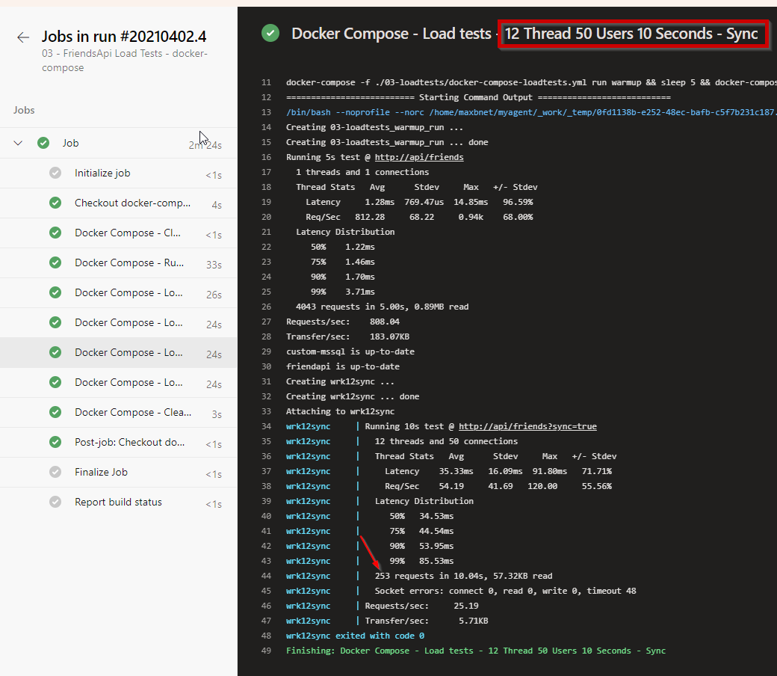
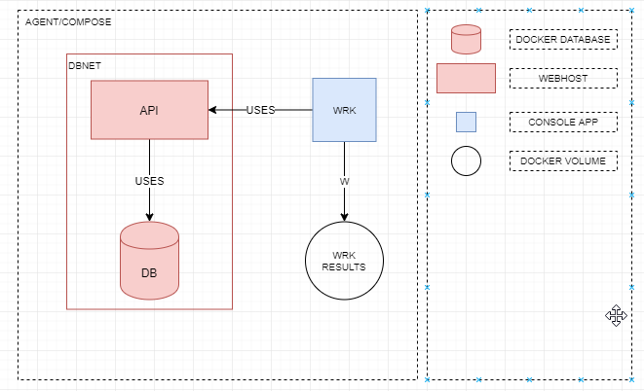
Perche’ DOCKER compose in build? sCENARIO 3 – LOAD TESTS – AUTOMAZIONE + BOTTLENECKS
https://dev.azure.com/massimiliano-balestrieri/docker-compose-labs/_git/docker-compose-labs/pullrequest/11

Slide 8
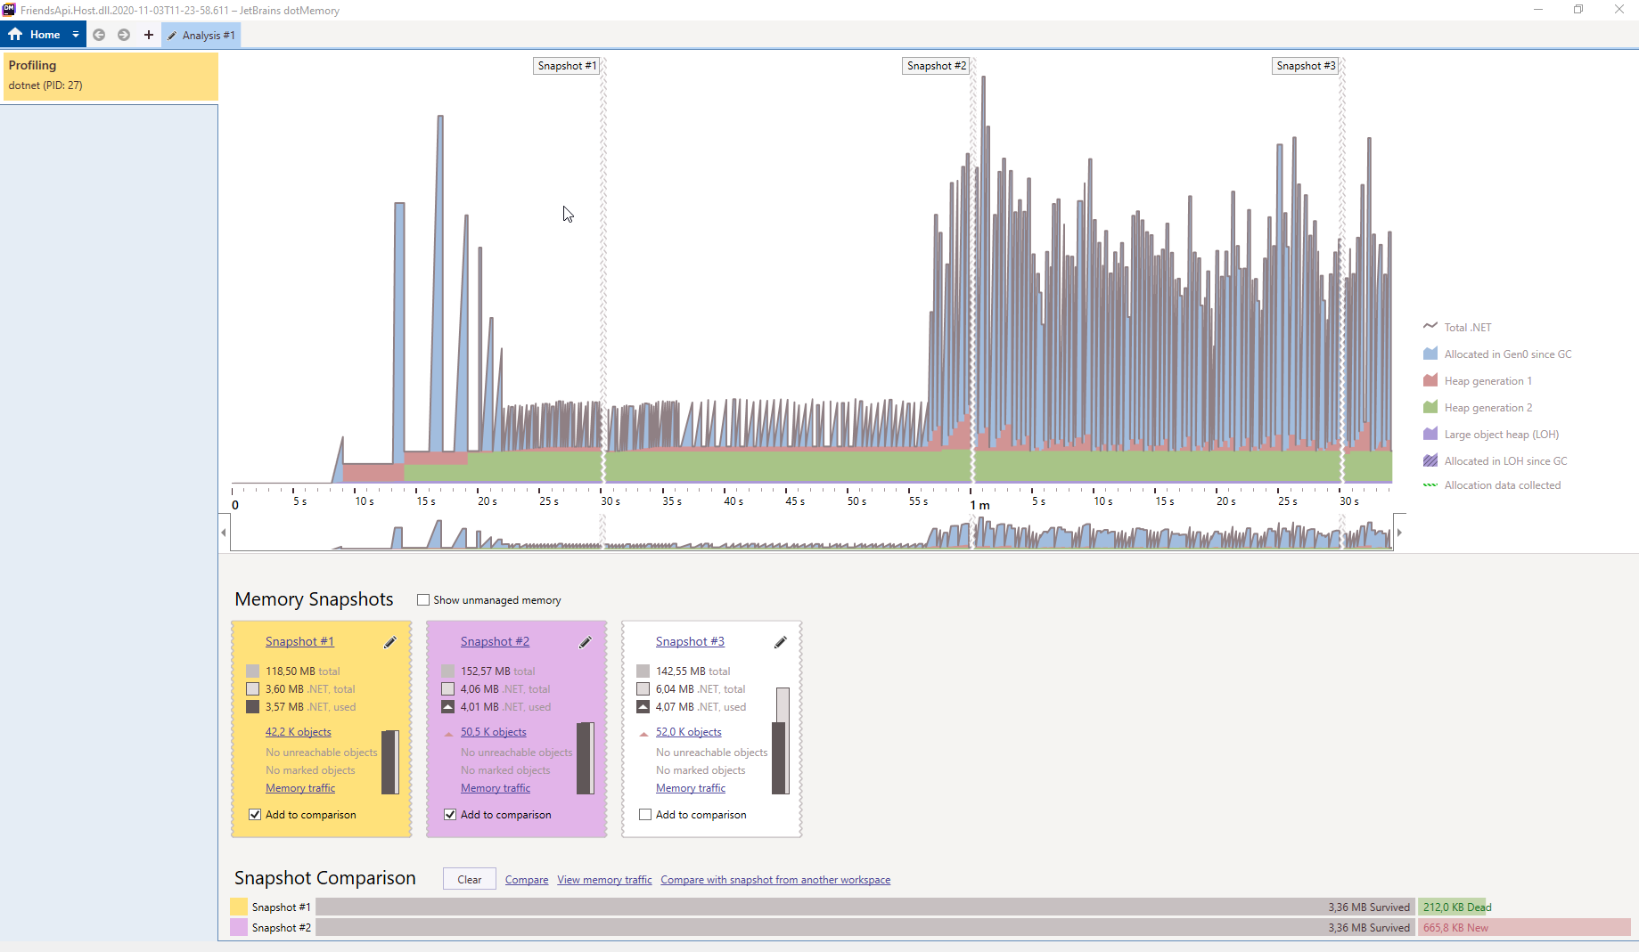
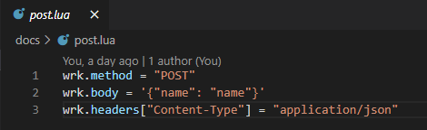
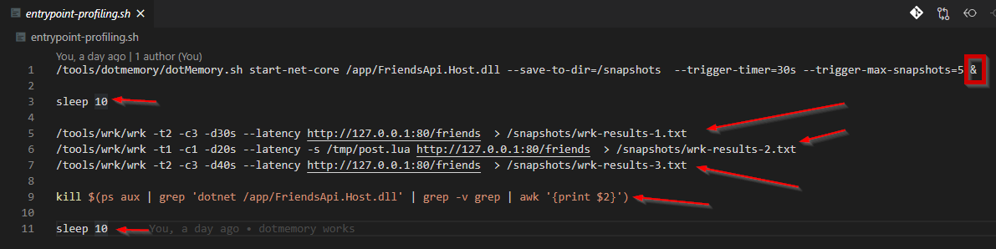
Perche’ DOCKER compose in build? sCENARIO 4 – MEMORY TRAFFIC PROFILING: JETBRAINS CLI TOOLS
https://dev.azure.com/massimiliano-balestrieri/docker-compose-labs/_git/docker-compose-labs/pullrequest/13

Slide 9

https://dev.azure.com/massimiliano-balestrieri/docker-compose-labs

