Slide 1
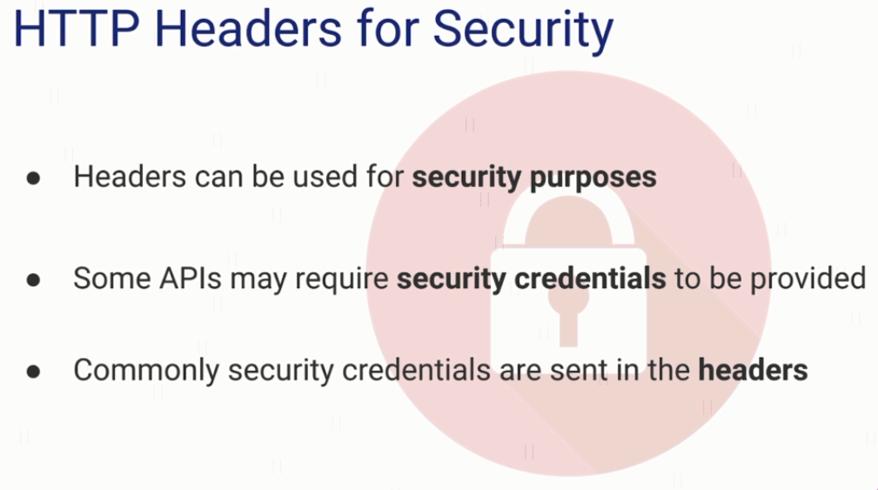
Authorization Header

Slide 2
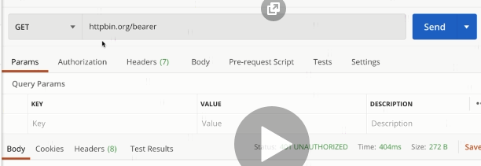
explain

Slide 3
HTTP Message Structure
https://www.udemy.com/course/introduction-to-apis-rest-api-graphql-soap-web-services-grpc/learn/lecture/19945722#overview

