Slide 1
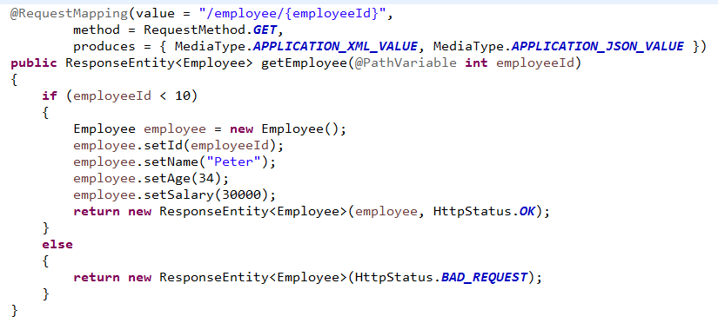
Spring Boot – Set Response Status Code

Slide 2
Spring Boot – Returning Object as JSON or XML Representation
https://www.udemy.com/course/restful-web-services-with-spring-framework-a-quick-start/learn/lecture/11780504#overview

