Slide 1
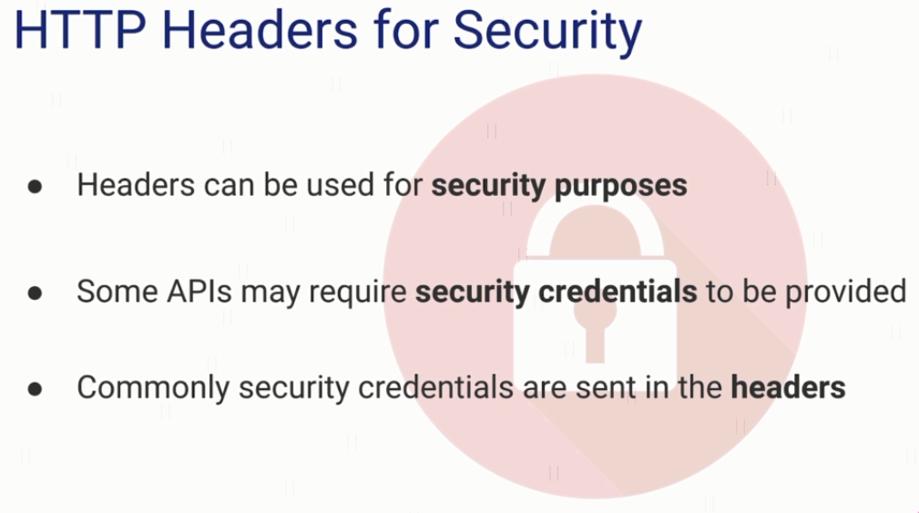
Authorization Header

Slide 2
Authorization Header
httpbin.org/bearer

