Slide 1
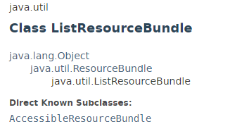
ListResourceBundle
ListResourceBundle is an abstract subclass of ResourceBundle that manages resources for a locale in a convenient and easy to use list

Slide 2
ListResourceBundle
https://docs.oracle.com/javase/8/docs/api/index.html?java/util/ListResourceBundle.html

