Slide 1
Data Visualizations and Maps with JavaScript
William Lim
Twitter: @wlwlz
Github: @wlwl2
wlwl2.com

Slide 2
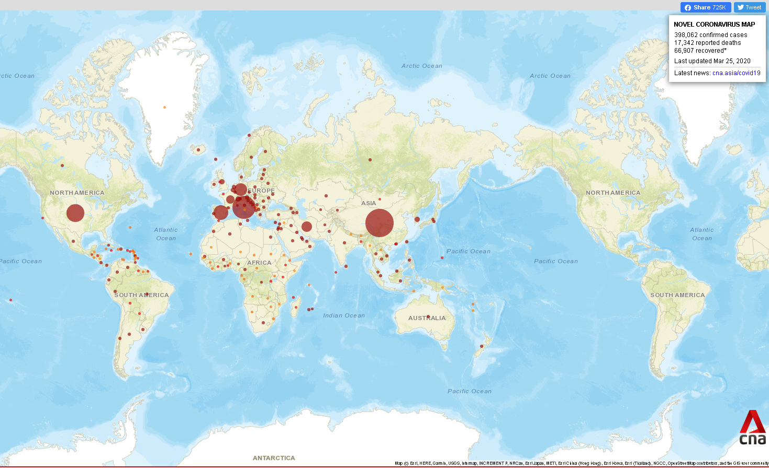
https://infographics.channelnewsasia.com/covid-19/map.html

Slide 3
- Today I am going to showcase something similar that I have built and also a bar chart
- Blurry, but I will show the real thing later and its problems (e.g. grey area)
- There are problems with mine (mapbox?)- e.g. “New Zealan”

Slide 4
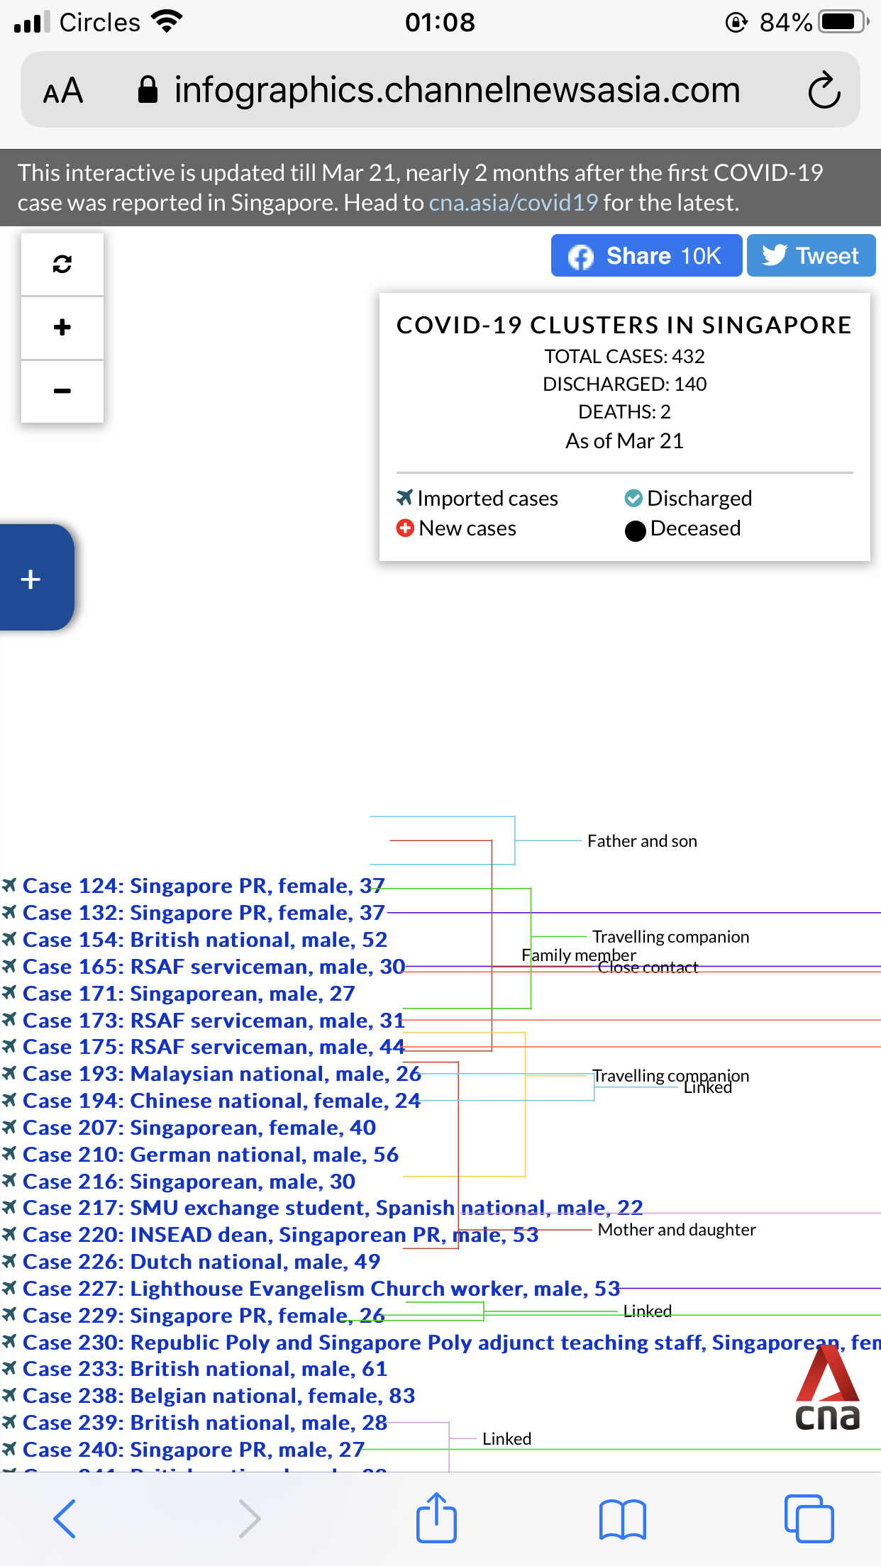
https://infographics.channelnewsasia.com/covid-19/coronavirus-singapore-clusters.html?cid=covid19_desktop-banner_19022020_cna

Slide 5
https://infographics.channelnewsasia.com/covid-19/coronavirus-singapore-clusters.html?cid=covid19_desktop-banner_19022020_cna

Slide 6
- Everybody makes mistakes
- I will talk about d3.js again later

Slide 7
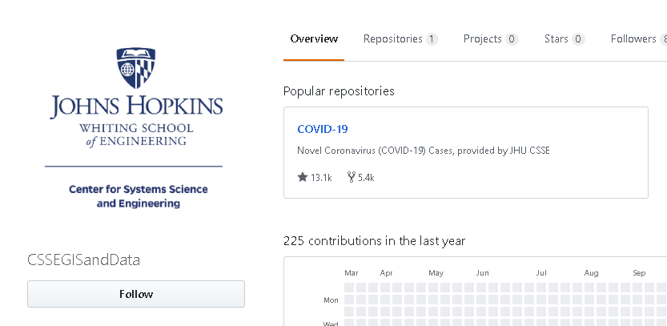
https://github.com/CSSEGISandData

Slide 8
- Notice only one repository
- Source of a lot of data that you see online, in the news and public APIs.
- I feel very grateful for this work.

Slide 9
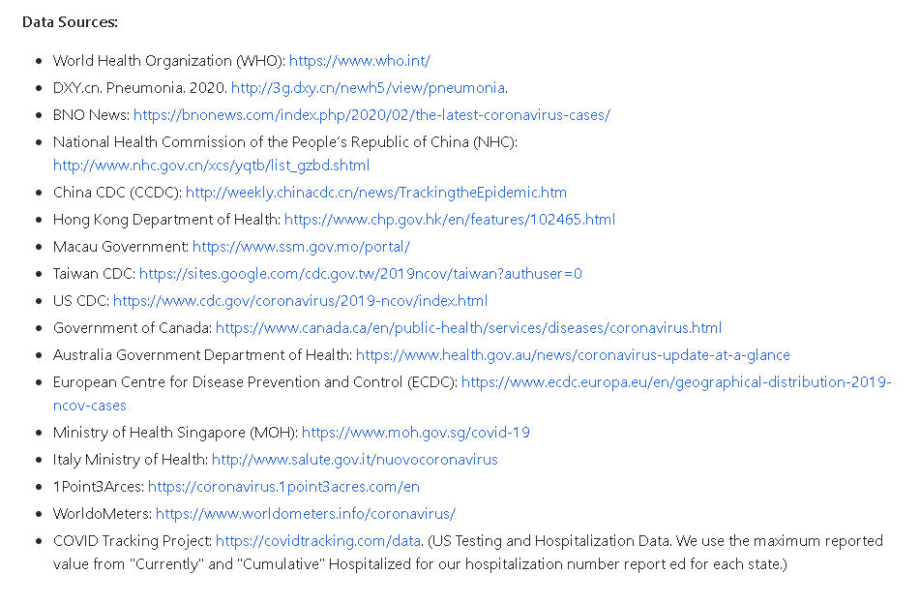
https://github.com/CSSEGISandData

Slide 10
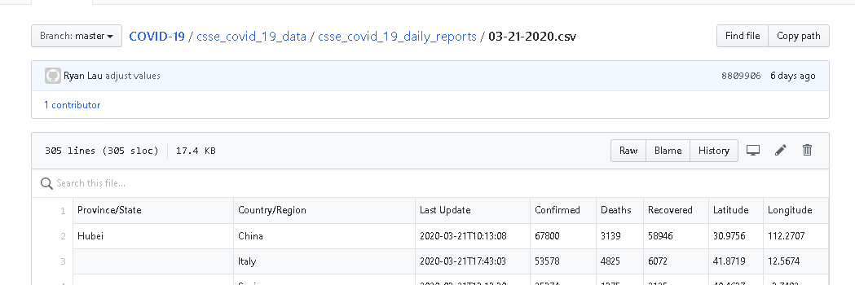
https://github.com/CSSEGISandData

Slide 11
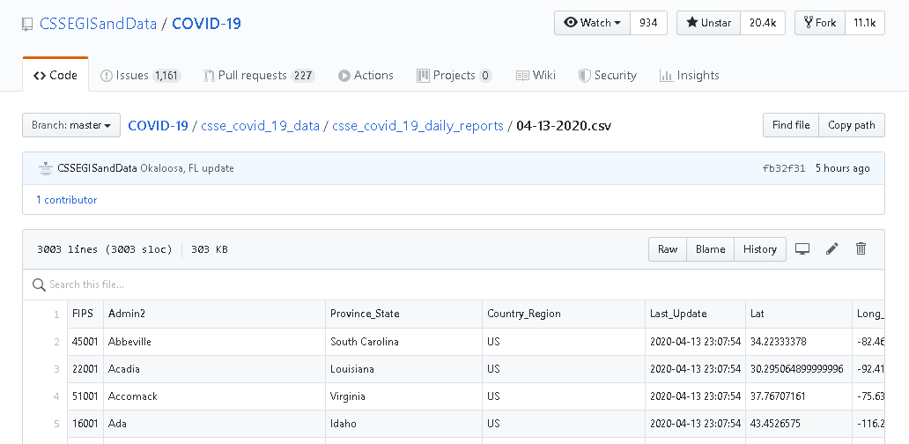
https://github.com/CSSEGISandData

Slide 12
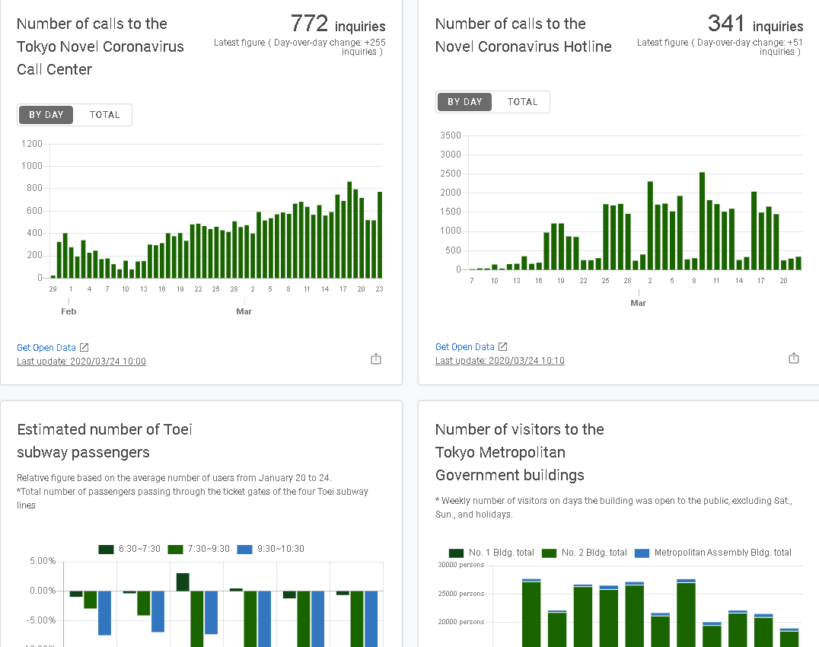
stopcovid19.metro.tokyo.lg.jp/en/

Slide 13
Some Commonly Used Map Libraries
- Leaflet
- OpenLayers

Slide 14
Considerations
- I’ll show the exact point at which I got stuck when using OpenLayers later.
- Ended up using leaflet for speed and it looks like the result I wanted to get.

Slide 15
Some Commonly Used Map APIs
- mapbox
- Google Maps Platform

Slide 16
Considerations
- Pricing
- Google Maps: You can also set daily quotas to protect against unexpected increases.
- Important to pick the right tool for the right job- don’t be like me if you can avoid it.
- Leaflet right now links nicely with mapbox
- Security (no comparison)

Slide 17
Considerations (Cont.)
- Plugins: L.GridLayer.GoogleMutant for linking leaflet to Google Maps
- From the plugins other Map APIs:
- Apple's MapkitJS
- Bing Maps
You can have a look at this and other plugins
- Other commonly compared features I’m not going to go through.
- If there is a plan that facilitates open-sourcing projects like this that would be best.

Slide 18
Before the demo
- If you take data from a repository or an API, be prepared for the data format to change and break your entire app.
- This will tend to happen if you automate pulling/fetching the data.

Slide 19
Before the demo (cont.)
- Not going to pull from a dynamic API because it is often not guaranteed to be accurate.
- It should also adapt to changes everyday or at shorter intervals. The shorter the interval, the better.
- If you intend to work at a news organization or a medical institution in the future this might be helpful for you.
- This is also helpful for data-viz in general.

Slide 20
Before the demo (cont.)
- Add choose primary location (for tables and bar charts). Save to localstorage.
- There are enough existing visualizations online on COVID-19 already. Please don't add more unless you can maintain it well. This repository is just a learning tool, it is not something to be deployed or put in production.

Slide 21
Demo
- Leaflet
- OpenLayers
- d3.js
- Chart.js
...

Slide 22
End of Talk
Twitter: @wlwlz
Github: @wlwl2
wlwl2.com

