Slide 1
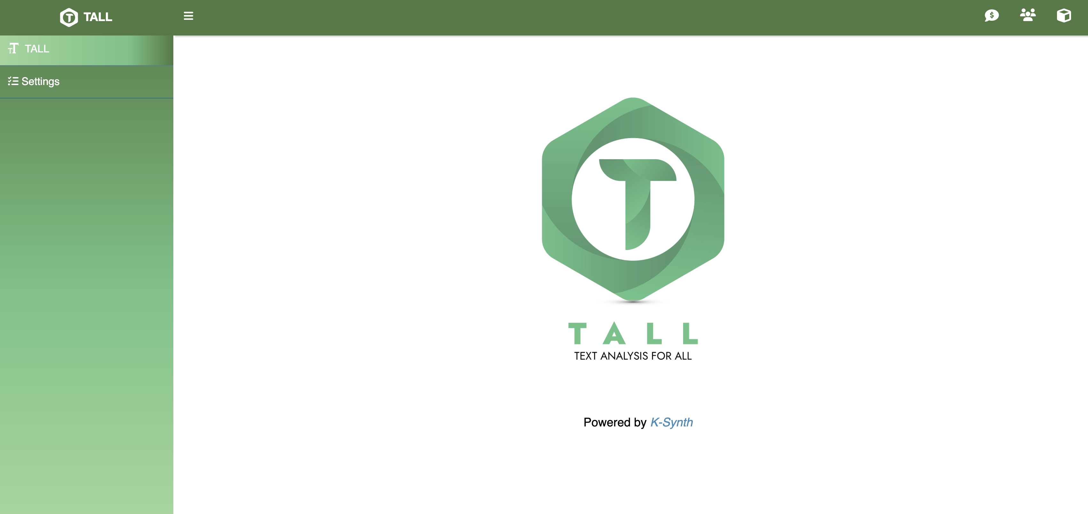
Interface overview
TALL menu
Donate
Credit
The rest of the TALL menu will be displayed after data are imported or loaded
Contributors
Notes:
The rest of TALL menu will be displayed after imported/loaded data

Slide 2
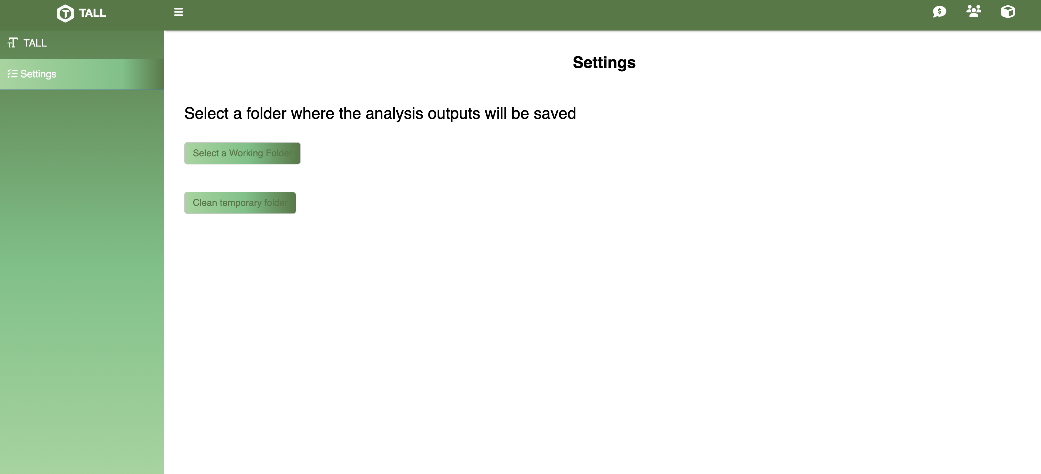

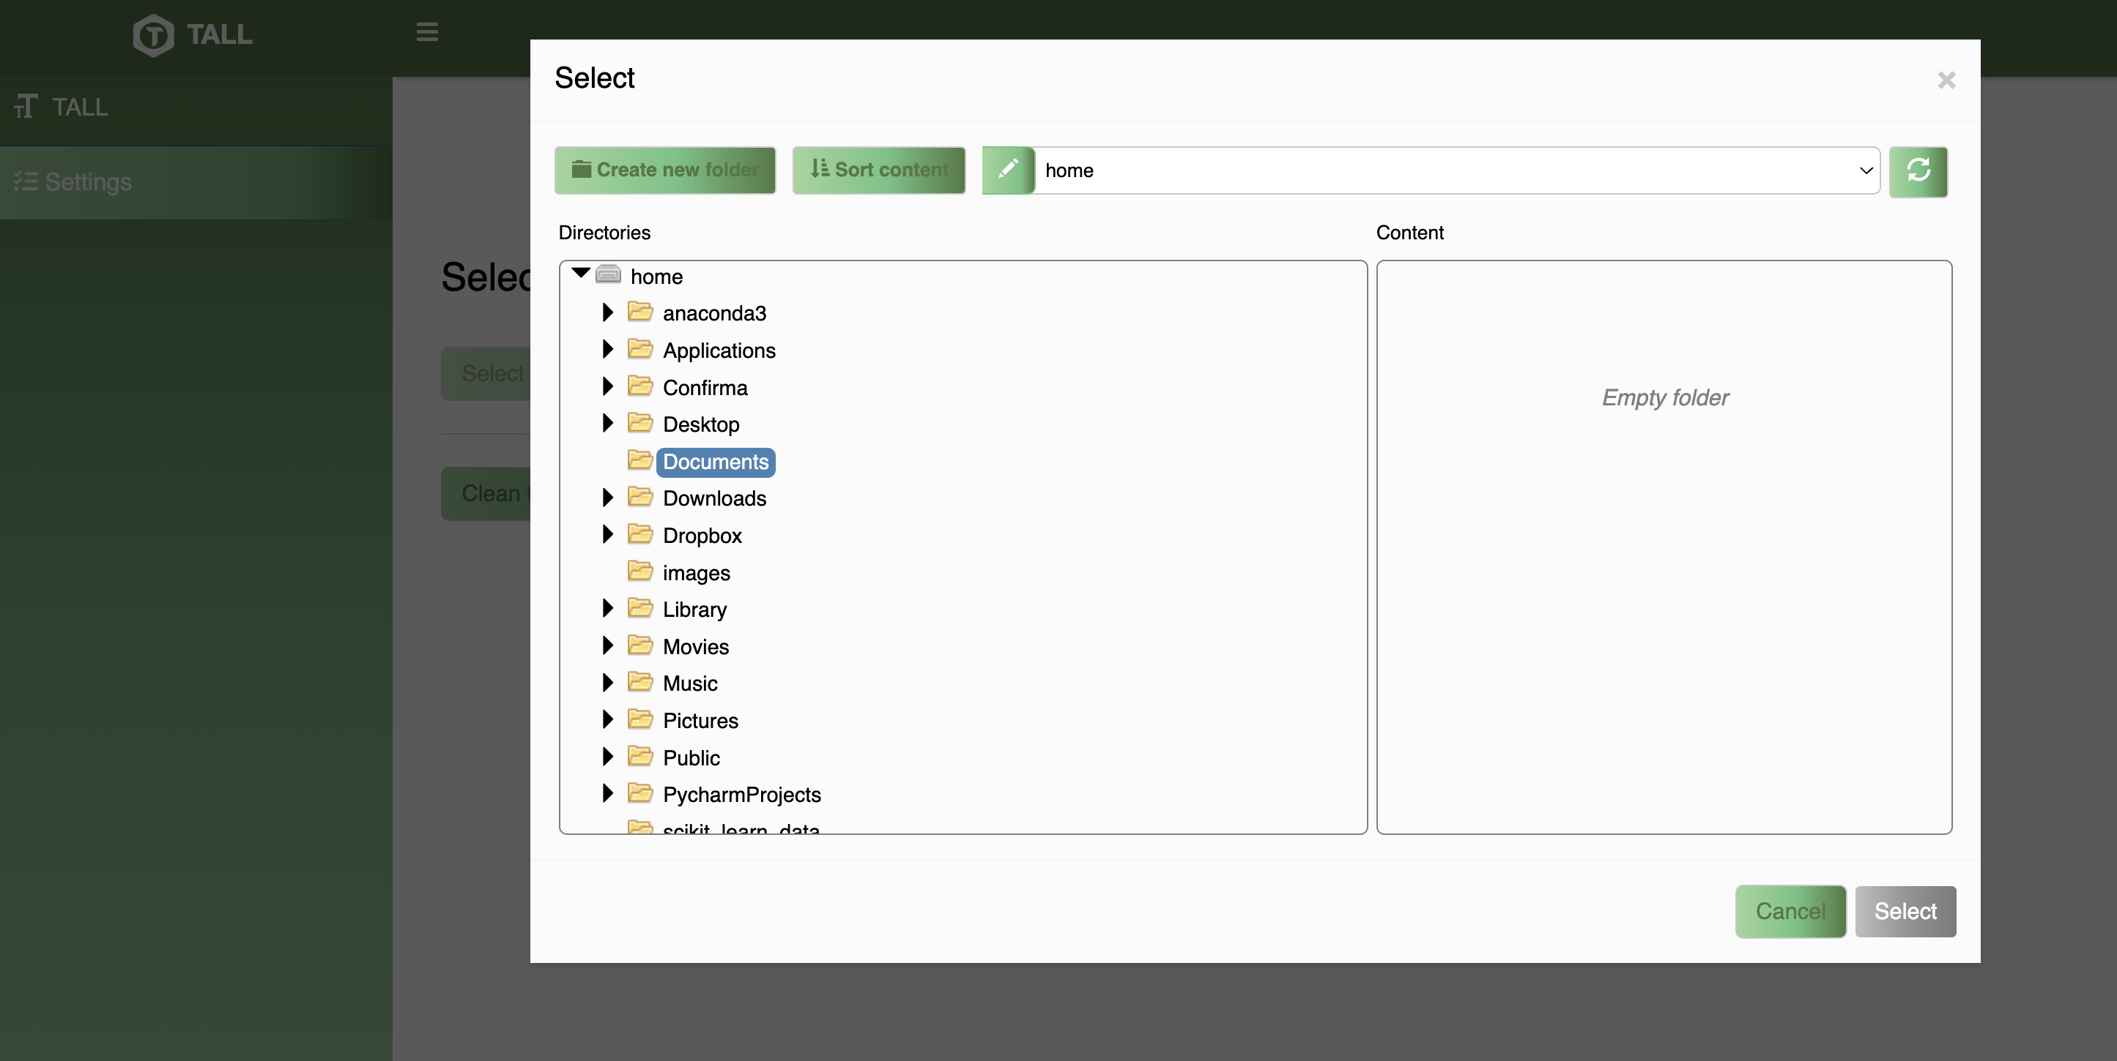
Settings: Configuring the Working Folder
All settings are saved and automatically applied in future sessions
The rest of the TALL menu will be displayed after data are imported or loaded
Upon the first launch, users must set a directory for storing outputs. This can be changed later in the settings
This ensures efficient file organization and easy access to results!
Notes:
The rest of TALL menu will be displayed after imported/loaded data

Slide 3






TALL buttons
Play
Start the process and execute the analyses
Download
Export analyzed data in TALL as a .tall file format
Settings
A list of options for setting analysis parameters
Add to Report
Save analysis results to a report
Export
Download the graphs or export data in Excel
Restore
Revert to the original data, restoring the initial object

