Slide 1
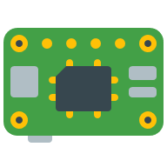

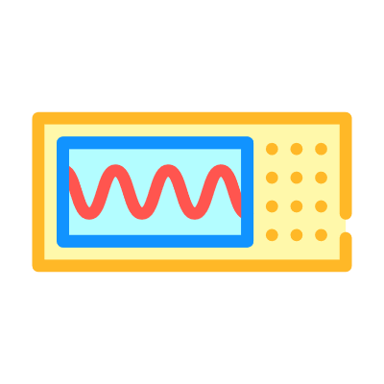

Devices
?
?
Telemetry Dispatcher
IoT Hub
Simulator
Telemetry Devices
Telemetry Dashboard

Slide 2




Storage Account
Telemetry Dispatcher
IoT Hub
Telemetry Entities
Telemetry Simulator
Telemetry Dashboard

