Slide 1

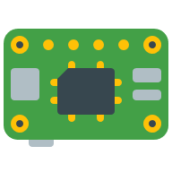





Storage Account
Telemetry Dispatcher
IoT Hub
Telemetry Entities
Telemetry Simulator
Telemetry Dashboard

