Slide 1
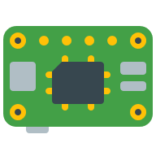



Devices
?
?
Telemetry Dispatcher
IoT Hub
Simulator
Telemetry Devices
Telemetry Dashboard

Slide 2




Storage Account
Telemetry Dispatcher
IoT Hub
Telemetry Entities
Telemetry Simulator
Telemetry Dashboard

Slide 3


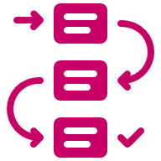
Storage Account
IoT Hub
Telemetry Dispatcher
Telemetry Simulator
Telemetry Dashboard
Telemetry Entities

Slide 4
Front-End Layer
Integration Layer
Stateful Data Layer
Telemetry Entities

