Slide 1
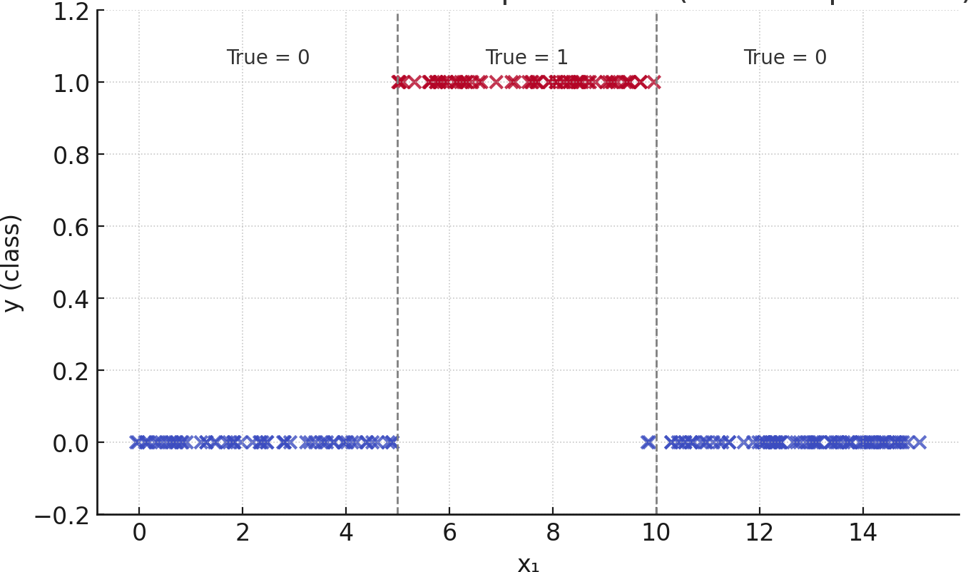
X < 5
Yes
No
Class 0
X < 10
Yes
No
Class 1
Class 0

Slide 2
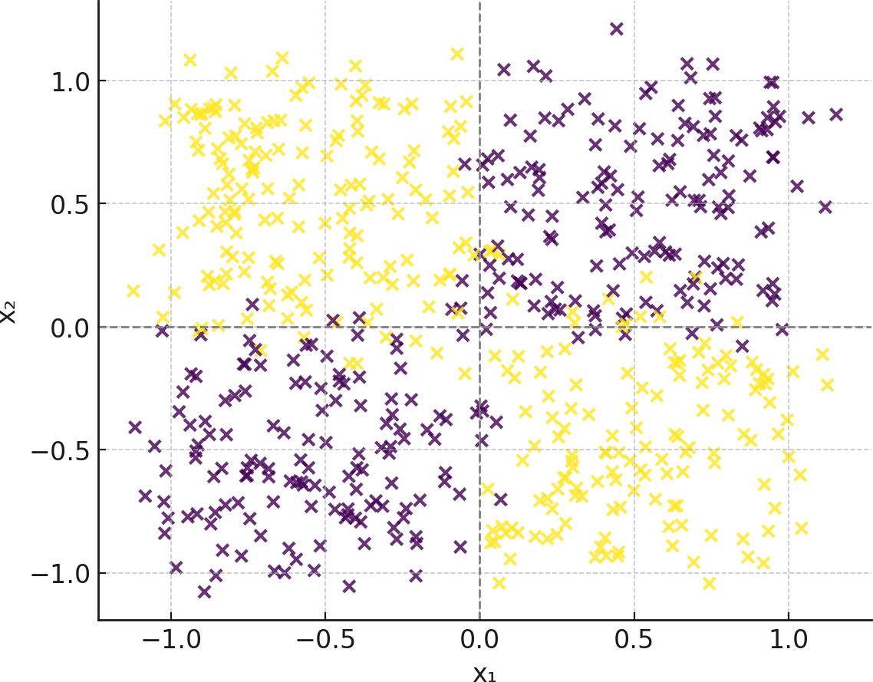
X1 < 0
Yes
No
X2<0
X2 > 0
Yes
No
Yes
No
Class 1
Class 0
Class 1
Class 0

