Slide 1
데이터마이닝특론 Advanced Data Mining COMP0771001
School of Computer Science and Engineering
Kyungpook National University
Chun-Hee Lee(이천희)

Slide 2
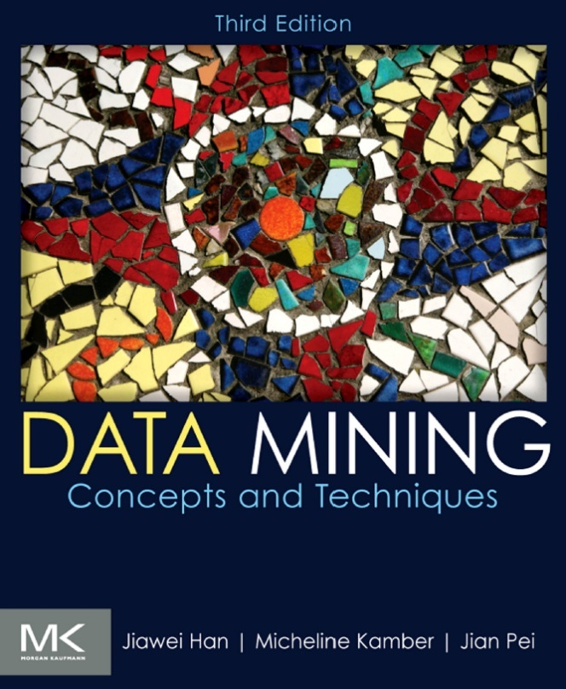
Intro
Textbook and Slides
Jiawei Han, Micheline Kamber and Jian Pei, Data Mining: Concepts and Techniques (Third Edition), Morgan Kaufmann, 2011
Book Homepage
https://hanj.cs.illinois.edu/bk3/
Slides
http://hanj.cs.illinois.edu/bk3/bk3_slidesindex.htm
Grading
Midterm/Final Exam: 40%/40%, Assignments: 10%, Attendance: 10%
Office Hour: 14:00 – 17:00 Mon
Class Homepage
https://github.com/massive-data-computing/ADM

Slide 3
Intro
Schedule
(Week 1) Chapter1. Introduction (Today)
(Week 2/Week 3) Chapter2. Getting to Know Your Data
(Week 4/Week 5) Chapter3. Data Preprocessing
(Week 6/Week 7) Chapter6. Mining Frequent Patterns, Associations, and Correlations: Basic Concepts and Methods
(Week 9/Week 10) Chapter7. Advanced Pattern Mining
(Week 11/Week 12) Chapter8. Classification: Basic Concepts
(Week 13/Week 14) Chapter10. Cluster Analysis: Basic Concepts and Methods
Advanced Topics (Locality Sensitive Hashing?)

Slide 4
Intro to Data Mining
Walmart case
Basket analysis
Difficulties in real problems
Data collection and privacy issues
Data preprocessing
Communication issues with domain experts

